Slide 1
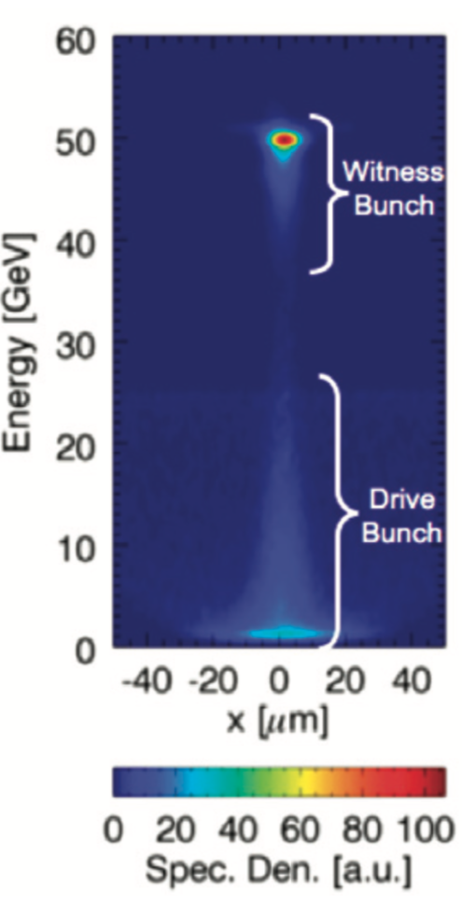
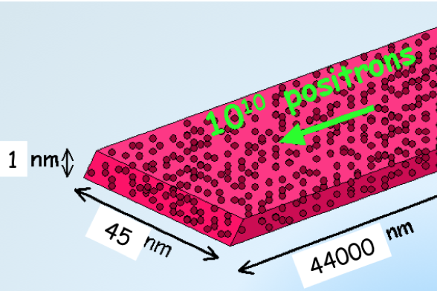
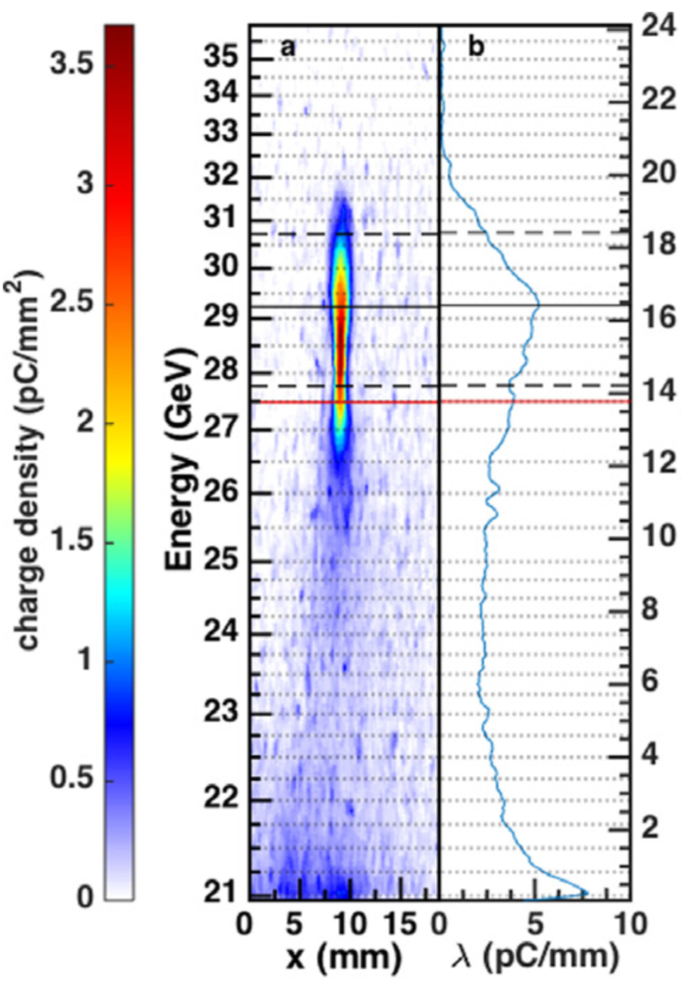
ALEGRO “Megatables”.
In order to progress towards a collider, I would suggest three columns for each technology Example here for e- e- acceleration:
Parallel effort:
What are interesting XX, ZZ?
Are the assumptions ZZ
the optimal ones?
Where can we go,
with experiments,
with the ideal test facility?
~
What can we do in simulation?
Where do we need to go,
for a collider with energy XX, luminosity
YY,
assuming overall layout/parameters ZZ?
Where are we,
with experiments?
Update
collider
layout
Define
ideal experiments and
test facilities
Requirements on :
efficiency
emittance
energy spread
and so on.
From 20 GeV to 29 GeV in 1.3 m.
Wake to beam efficiencey ~ 30 %.
M. Litos et al., PPCF, 58 034017 (2016)
25 GeV e- e- energy doubling in 1 m.
Total efficiencey >= 50 %.
M. Hogan et al., New J. Phys. 12 055030 (2010)
”Megatable” example: https://docs.google.com/spreadsheets/d/1ImxsiMtQUIo0Vrxub2WjyH-ZJqi_0vY3lZuFkjG9e9g/edit#gid=0

