Slide 1

J. Jason Ward
Principal Data Scientist
STFC Summer School in Artificial Intelligence and Machine Learning
Monday 23rd July 2018
Confidential. All rights reserved. Valtech Solutions, Inc.
Notes:
11 - Overview Deck / Cover

Slide 2



We are a global digital agency
focused on business transformation
Founded in 1993 Valtech now has 2,500+ people with diverse skill sets across 36 offices in 16 countries.
Argentina - Australia - Brazil
Canada - China - Denmark
France - Germany - India
Netherlands - Singapore
Sweden - Switzerland - Ukraine
United Kingdom - United States
Notes:
14 - Overview Deck / Countries

Slide 3


Slide 4
- Perspectives on Agile -
OBJECTIVE:
Continuously creating more value faster and cheaper in a complex fast changing environment. It is more than “just” running Scrum!
Explore
Test
Execute
Doing the right thing
What should we do that brings most business value?
Methodologies:
Design thinking:
Better concepts in an agile way
Lean Startup:
Quickly assess if there is a product/market fit?
Is it worth doing?
Doing the thing right
How can we do it in the most efficient way?
Methodologies:
Scrum
Iterative approach
Prioritized backlog
Continuous improvements
Keep learning
Keep optimizing
Keep Innovating
MVP
Notes:
29 - Example 11 / Perspectives on Agile

Slide 5
















Auto
Travel
Consumer
Goods
Retail
Luxury
Media
Notes:
41 - Clients per Vertical

Slide 6
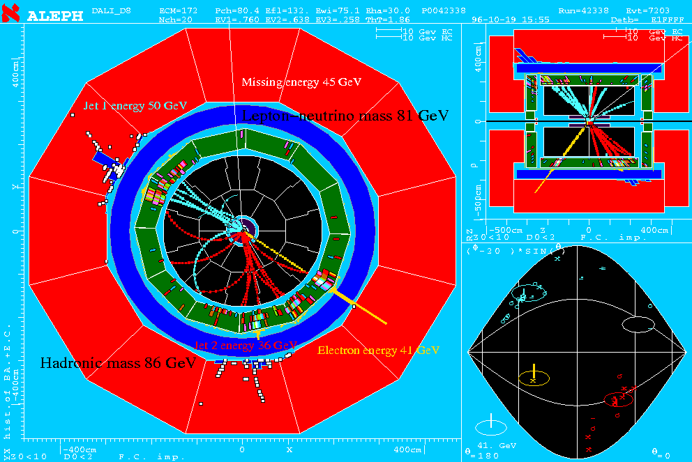
J. Jason Ward
http://www.linkedin.com/in/jjasonward
1
PhD UCL
(OPAL)
2
Postdoc University of Glasgow, CERN Fellow
(ALEPH, ATLAS)
3
Hedge Fund Quant
4
Principal Data Scientist
Valtech

Slide 7



Major data projects in Government
Data Platforms and Data Analytics

Slide 8

Valtech in the automotive sector
01
Re-imagining the supply chain for car construction
02
Click to configure and buy your dream car
03
Taking real-time car data and presenting it
on a global dashboard
Notes:
69 - Example 44 / 4 Icons with main icon

Slide 9
Example Data Science Topic Areas
A sample of things that I think about and do
01
MACHINE LEARNING ALGORITHMS
The other day I was exploring the Uniform Manifold Approximation and Projection (UMAP) dimension reduction technique.
02
SENSOR FUSION
Combining measurements from various sensors
Notes:
61 - Example 38 / Vertical Timeline 1 - Top

Slide 10
03
IMAGE ANALYSIS and OBJECT IDENTIFICATION
Location analytics; apparel identification
04
MATHS ON STREAMING DATA
In-session web analytics, ML near the front-end,
how it places demand on the data architecture and data engineering to do data science.
Time series analysis, e.g. smart meter data
05
SINGLE VIEW OF THE CUSTOMER
…and omni-channel experiences
Notes:
62 - Example 38b / Vertical Timeline 2 - Middle

Slide 11
06
INFORMATION THEORY
…and pathway analytics,
especially health pathways.
07
MEASUREMENT ERROR
As well as estimating error and optimizing timeliness and accuracy, also communicating error and uncertainty
https://www.valtech.co.uk/blog/know-thy-error/
08
DATA PRESENTATION, ETHICS, POLICY
Notes:
63 - Example 38c / Vertical Timeline 3 - Bottom

Slide 12
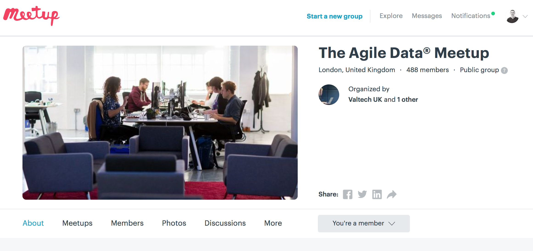

Slide 13
This is an exciting time to be alive – and rich in possibility for the curious, the inventive and the determined.
PM speech on science and modern Industrial Strategy:
21 May 2018, Jodrell Bank
Notes:
2 – Animations Quote

Slide 14
46 Colebrooke Row
London
N1 8AF
Dr. J. Jason Ward
Principal Data Scientist
Jason.Ward@valtech.co.uk

Slide 15
Notes:
103 - Thank you!

