Slide 1
Post-CWP perspectives for national R&D initiatives - CMS Italy
Tommaso Boccali - INFN Pisa

Slide 2
Small and incomplete list of efforts I know about
H2020 related efforts
INFN ongoing efforts
Other ...

Slide 3
H2020 projects
Building on the success of INDIGO-Datacloud, three projects were submitted + approved in the first half on 2017 - starting 2018; all with INFN as first or second biggest contributor
EOSC-Hub (PI: EGI.eu-NL)
  Main “connector” project for European Open Science Cloud
  DODAS thematic service (CMS is proponent and main target)
XDC: The eXtreme DataCloud (PI: INFN-IT)
  Develop scalable technologies for federating storage resources and managing data in highly distributed computing environments
Deep-HyperCloud (PI: CSIC-Spain)
  Work on intensive computing techniques on the analysis of very large datasets
  Also on specialized hardware components, like GPUs, low-latency interconnects

Slide 4
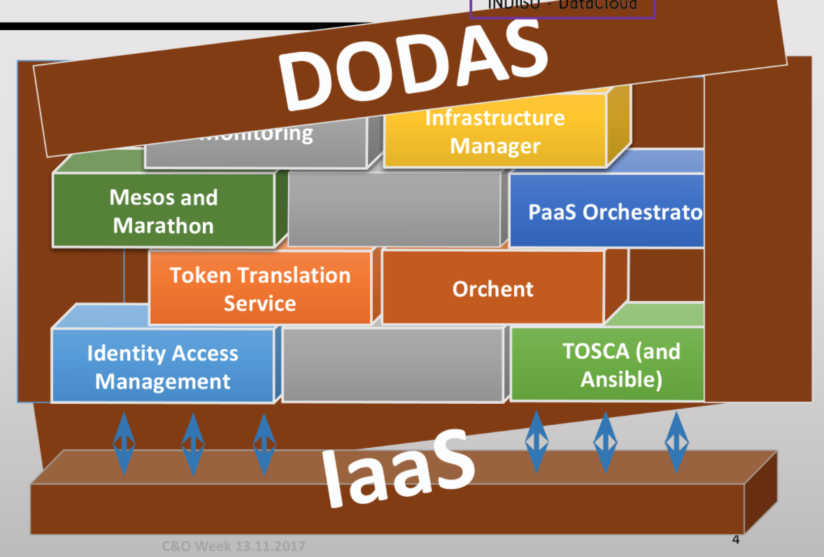
More in details - DODAS
DODAS: ideas are:
  Describe via TOSCA templates full data centers, with pets and cows, with all the interdependencies
  TOSCA translates seamlessly to all the major open/proprietary cloud implementations
  Already tests on Azure, Openstack.
  Implement full stat of authorization / authentication via IAM and TTS
  Next step: extend to storage, including virtual site proxies, caches, …
  Sinergies with XDC

Slide 5
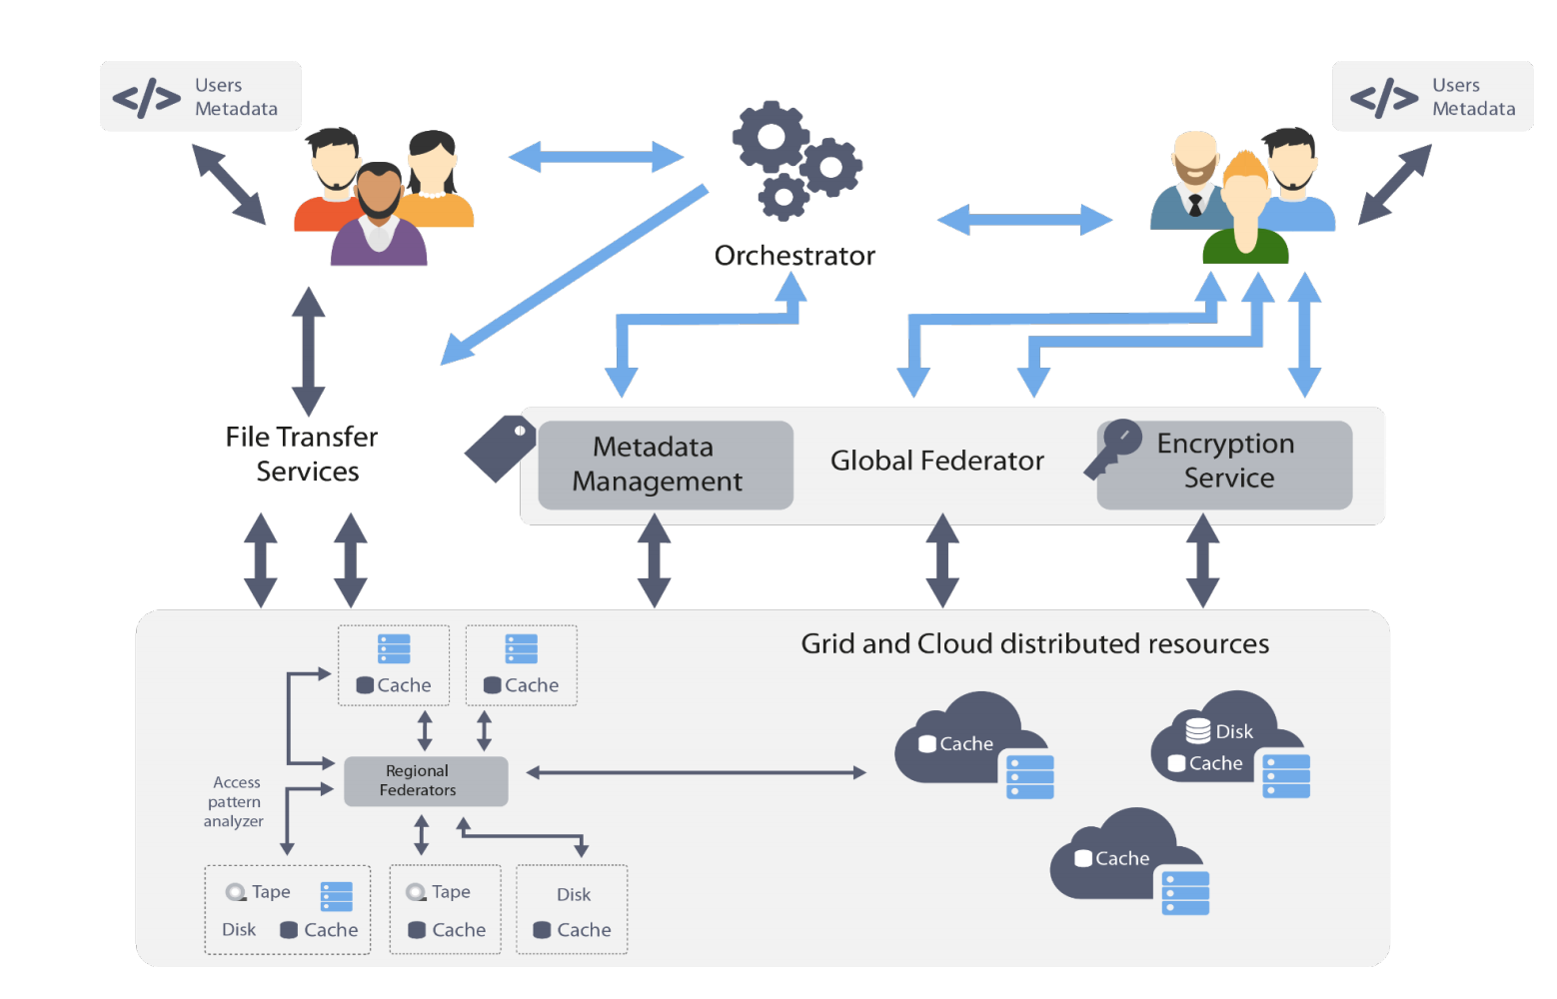
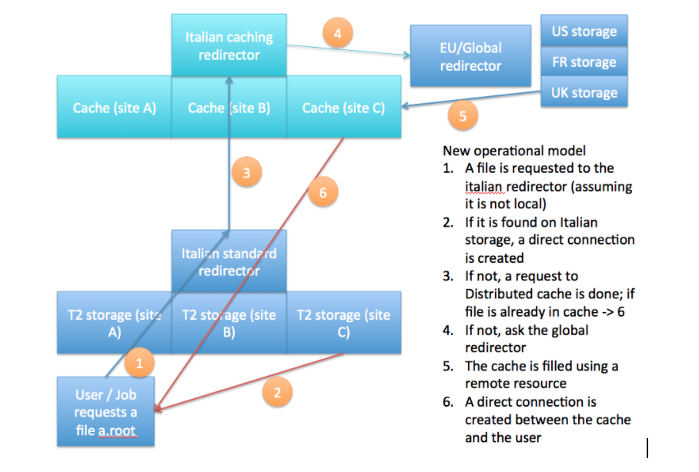
XDC
XDC: focus on data. Starting from existing software, integrate with added functionalities
In Italy, most interest in developing a global caching infrastructure supporting the following building blocks:
  Dynamic integration of satellite sites by existing data centres
  Creation of standalone caches modelled on existing web solutions
  Federation of the above to create a large scale caching infrastructure
In a sentence, distributed smart caching ...

Slide 6
(new)manpower
12 INFN positions for LHC SW/CMP R&D in early 2017 - contracts starting early 2018
CMS:
  2 positions (PI, BA) on Machine Learning development for analysis, DQM, …
  1 position (MIB) for Tracking with GPU
  1 position (PG) in data management, caches, DODAS
We would like these persons (usually senior postdocs) to participate actively / take leading role in the efforts
If successful, such contracts could become the norm in next years

Slide 7
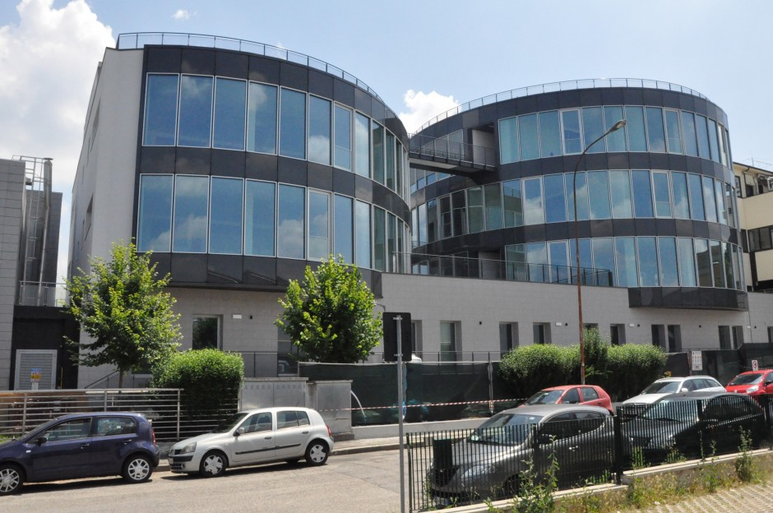
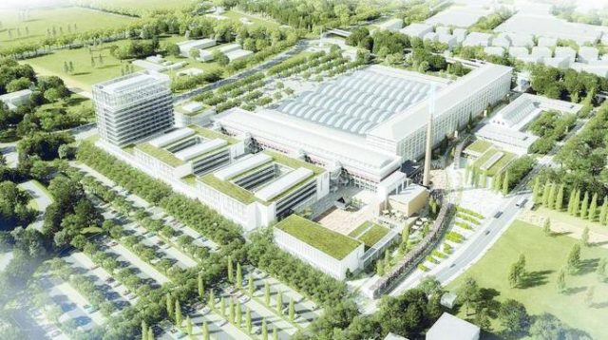
More on the Infrastructure side
As you know, CNAF is off since Nov 9th, due to a flood. It should start back in full shape for all the users by the end of Feb, but it was already planned moving to a separate site “in steps”:
  2018: most of the CPU moved to PRACE Tier-0 CINECA (10 km away) - storage at CNAF
    Interesting test for aggregatio of remote physical sites, dedicated network at 500 GBit/s (to be upgraded to 1200) available
  2019+: move the facility to the nearby ECWMF center, being built
Review of the existing 30+ INFN computing centers ongoing
  Expect a reduction to mostly the 10 in WLCG hierarchy

Slide 8
More standard activities (CMS mostly)
Deep Learning / Machine Learning for Physics
  Tau (PI), Btag (PI), Tracking/seeding (BA, PI)
  GPU tracking and analysis (BA, CNAF, MIB)
Data Management tests
  Rucio tests (PG)
ATLAS is following roughly the same path
  Trying to form links, not easy at the moment

Slide 9
Conclusions
More to come:
  Next round of national level funding for specific projects in the next months
  We see a large focus on ML/DL (even too much, sometimes just an attempt of using the buzzword?)
European Open Science Cloud (EOSC) going to get the largest share of EU funding in IT in the next years
  Not yet a well definite concept, but a clear focus for EU
EU also trying to push for HPC@EU
  1 BEur on the table
  Not yet defined through calls and grants
  INFN involved in previous projects (EuroExa, ExaNest)

