Slide 1
ALICE grows up
2001 - 2008
From Wonderland to Action in the Cavern
ALICE 25 years
C. W. Fabjan
21.3.2018

Slide 2
It all started in the CERN Cafeteria…
Few days before Christmas 2000, chance encounter with Lodovico Riccati, then chairperson of the Collaboration Board
We knew each other well from a fruitful collaboration in the SPS Heavy Ion Programme
Lodovico: Chris, would you be interested becoming the Alice Technical Co-ordinator?
CF: let me think about it
Following a series of discussions (W. Klempt, L. Leistam, J. Schukraft and others)
  Presented my views on the Technical Co-ordination to Collaboration Board on 22.2. 2001

Slide 3
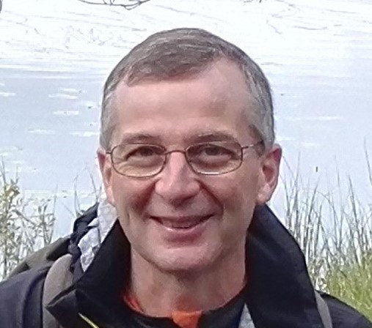
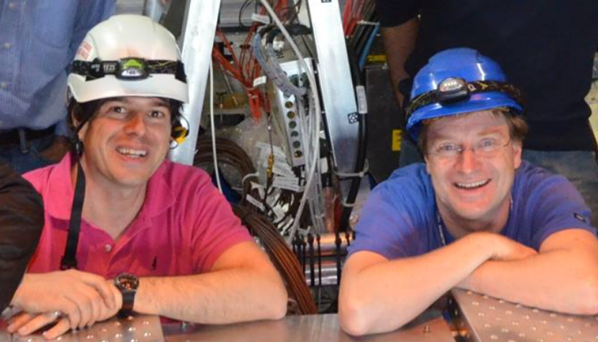
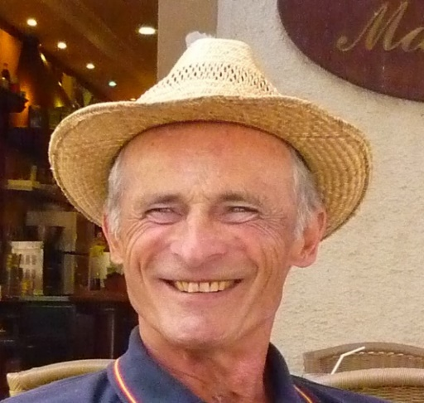
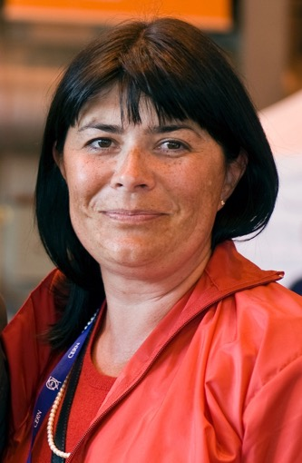
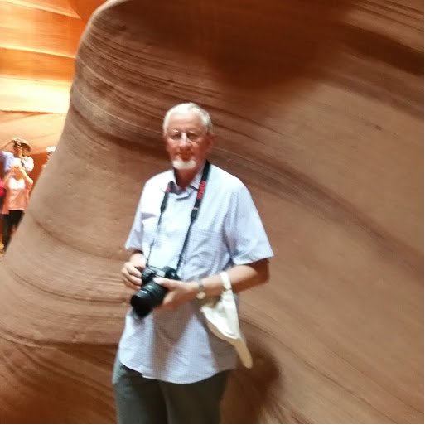
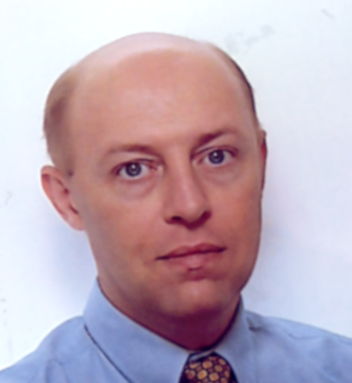
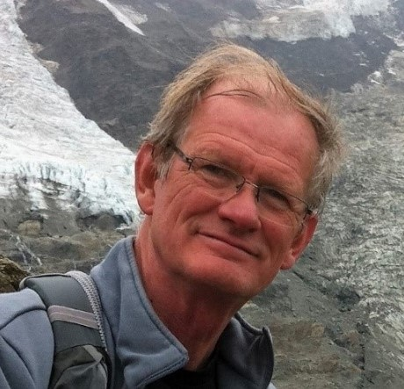
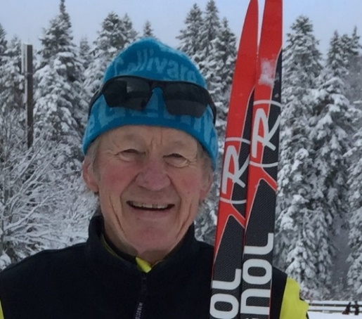
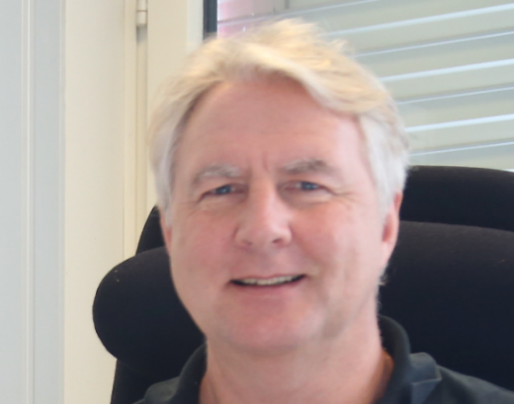
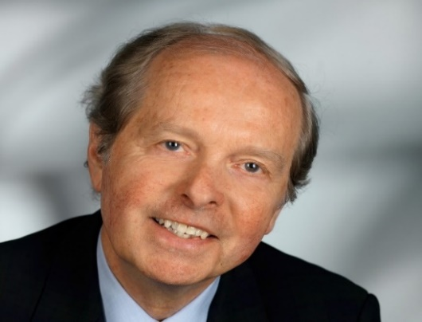
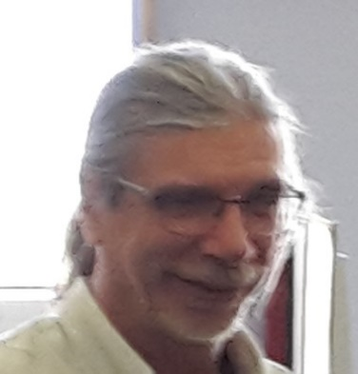
A remarkable team came together some of the key players
Hans Taureg
Reviews
Diego Perini: project engineer
Delef Swoboda
Muon Dipole
Catherine
Decosse Budget
Arturo Tauro Werner Riegler Planning; Services Integration; Specials
Andreas Morsch
Simulations
Fabio Formenti
Electronics
Lars Leistam
Point 2 Czar
CF: enjoy working with the team
Marc Tavlet
Safety Officer
Lennart Jirden
Detector Control

Slide 4
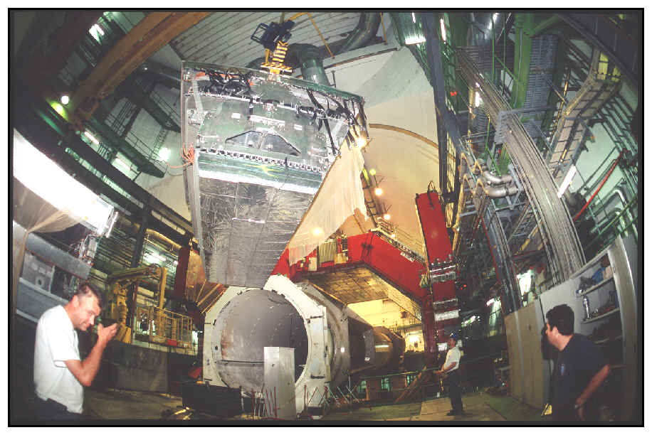
First job: House Cleaning and Maintenance
Removing the vestiges
of L3 legacy

Slide 5
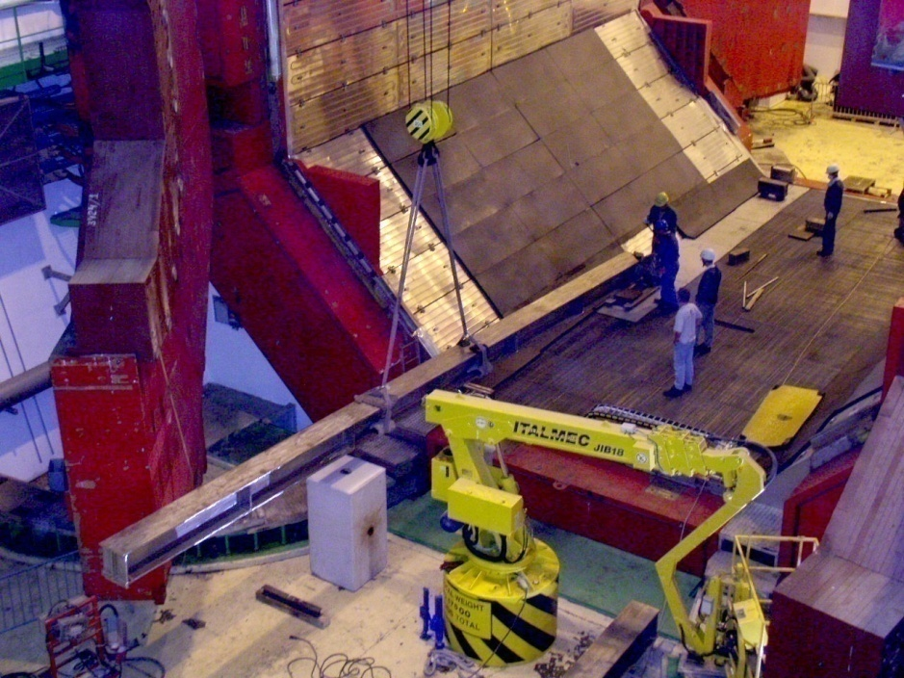
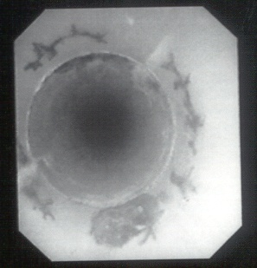
Crown Juwel L3 Magnet: world’s largest resistive solenoid
Major concerns: mechanical and functional integrity, field homogeneity, temperature gradients; access to detectors, cable routing…
Cracks and traces of corrosion from aluminium welding of the L3 magnet
cooling tubes
Extensive investigation with external experts participation.
Conclusion: better not to touch the cooling system
First powered in 1985…
still going strong after 33 years; 20 years to go…
Lars’ expertise was essential
Alice detector must be supported on rails fixed to “Crown”

Slide 6
Infrastructure: Welcoming Alice
Point 2 Mechanical Workshop
  Culturally divers staff and the envy of the other LHC experiments (and not fully appreciated by CERN management)
Assembly Hall:
  Clean Room, pre-assembly, testing, pre-installation
Space Frame
  Stabilizing motions (and emotions)
Muon Absorber (Ad)venture
  Ingenuity and pragmatism saves the day
Muon Dipole

Slide 7
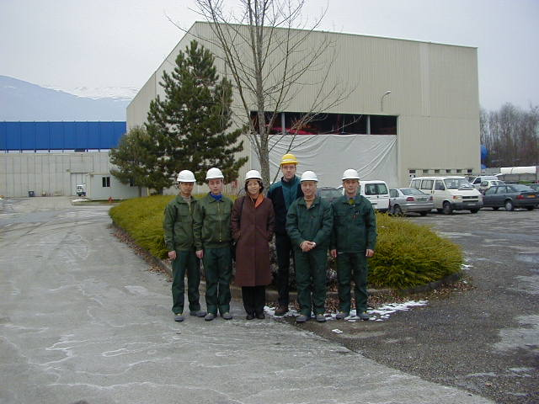
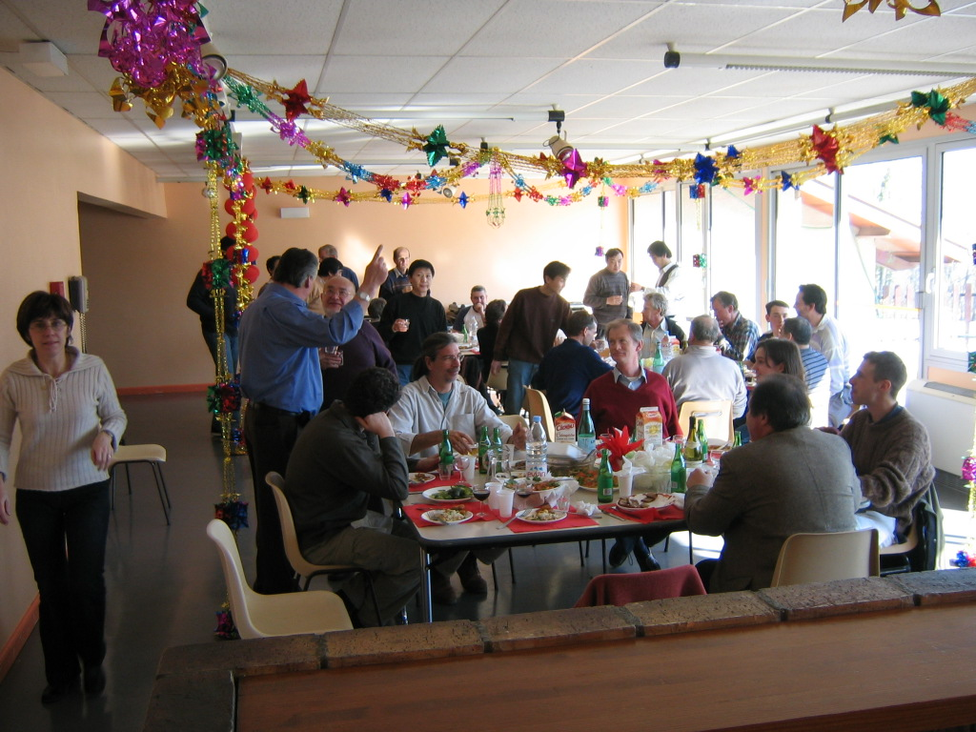
Workshop: in many ways a boon for Alice
Our Chinese team Chinese New Year Lunch Break
Led by lady engineer Lei Feng
Staff from Armenia, Pakistan, Russia

Slide 8
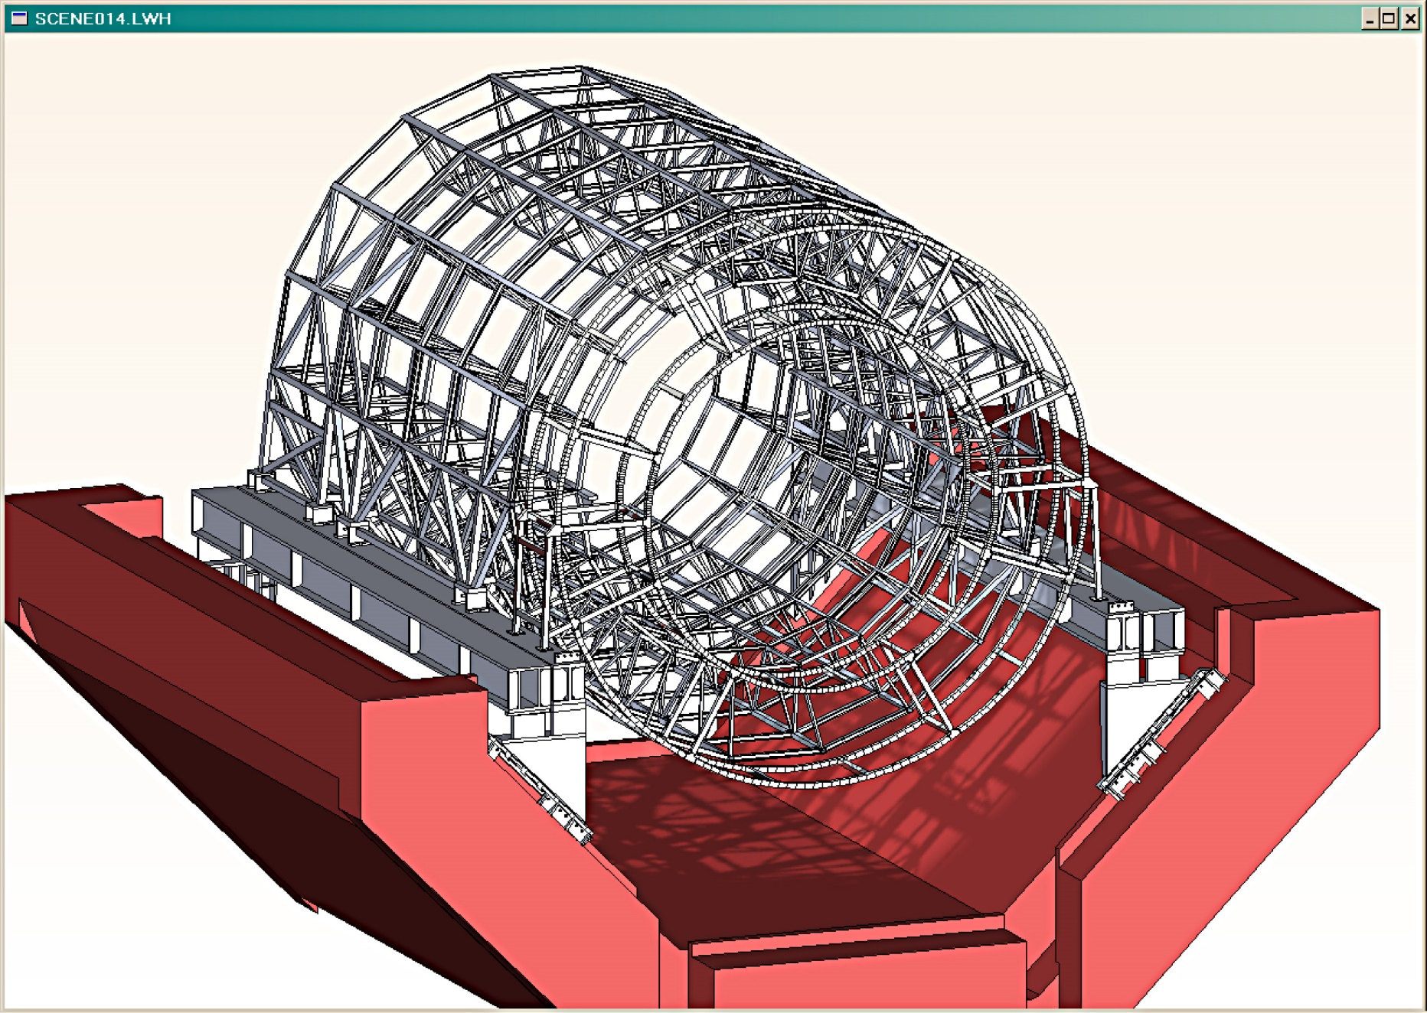


(Infra)Structures in L3: cylindrical drawers
Baby space frame
Space Frame
Elegant concept, complex in execution:
Sliding supports and detectors into position: large (~10 mm) displace- ments. Required monitoring and compen- sation with sub-mm accuracy.
Back frame
Rails
Supports
Joints
Diego Perini 12.05.03

Slide 9
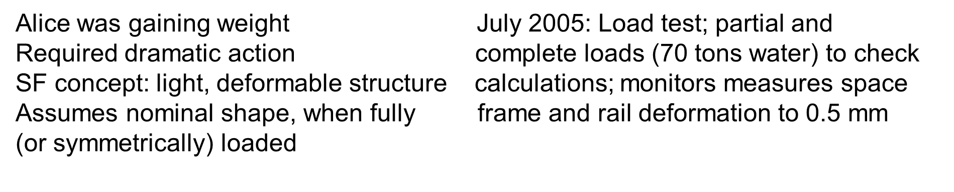
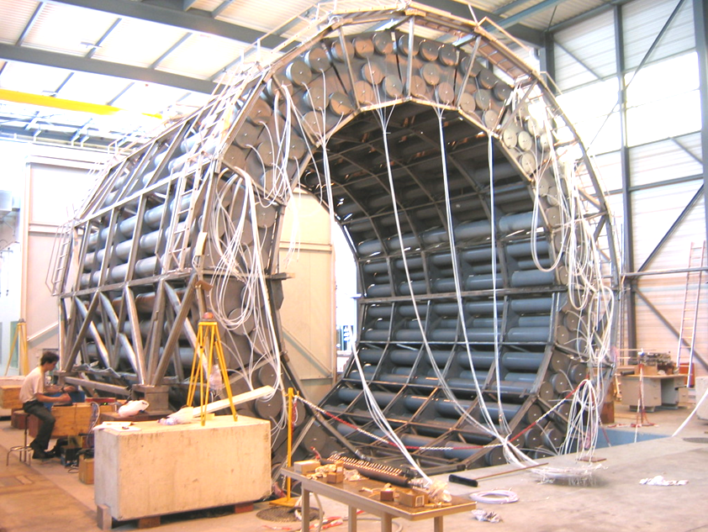
Space Frame (SF): supporting Alice’ ambitions

Slide 10
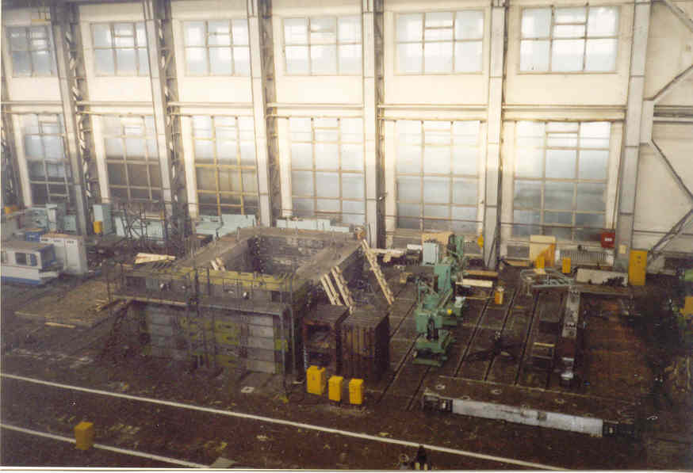
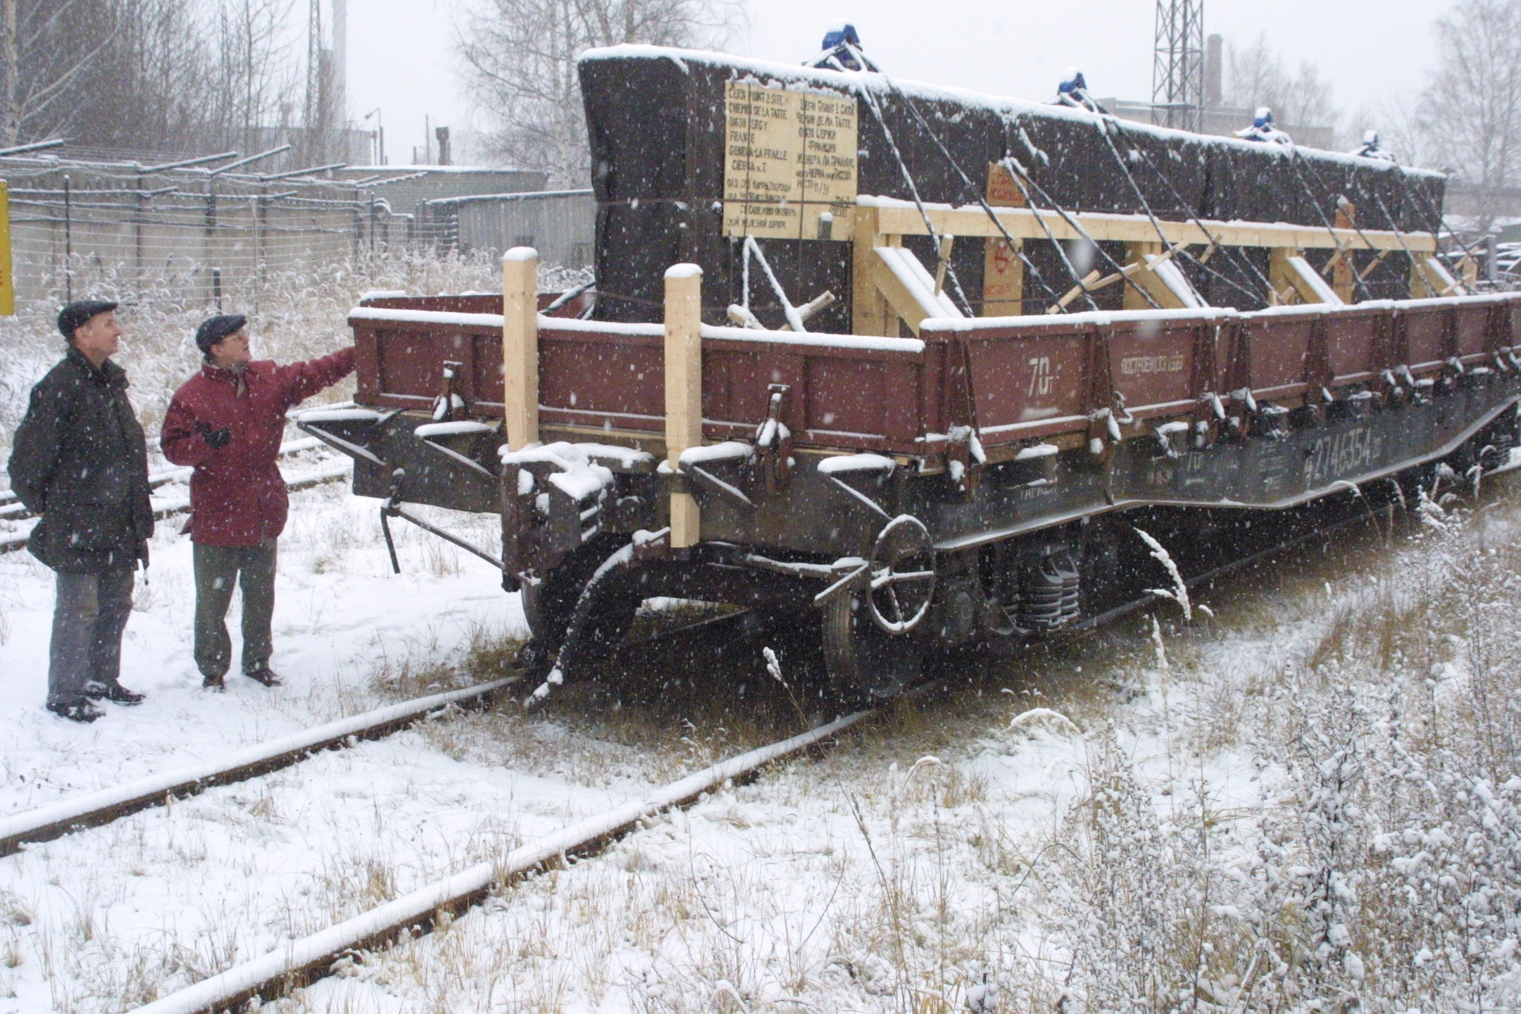
Muon magnet: From Russia (Dubna) (to CERN) with love
An (in)tense affair
Dipole status 17.12.2002
Yoke preassembled in Dubna ….horizontally
Non-optimal for verifying assembly tolerances
Transport delay: Putin had requisitioned freight wagons for a military project (???)
Stranded wagon at the Russian-Polish border

Slide 11
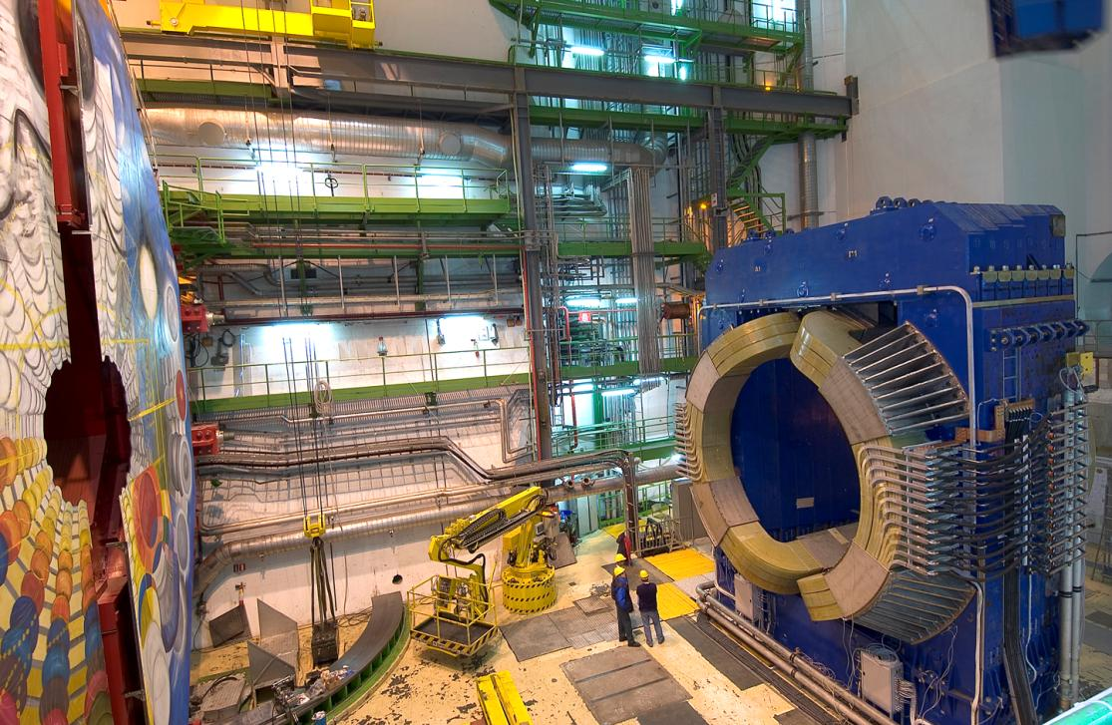
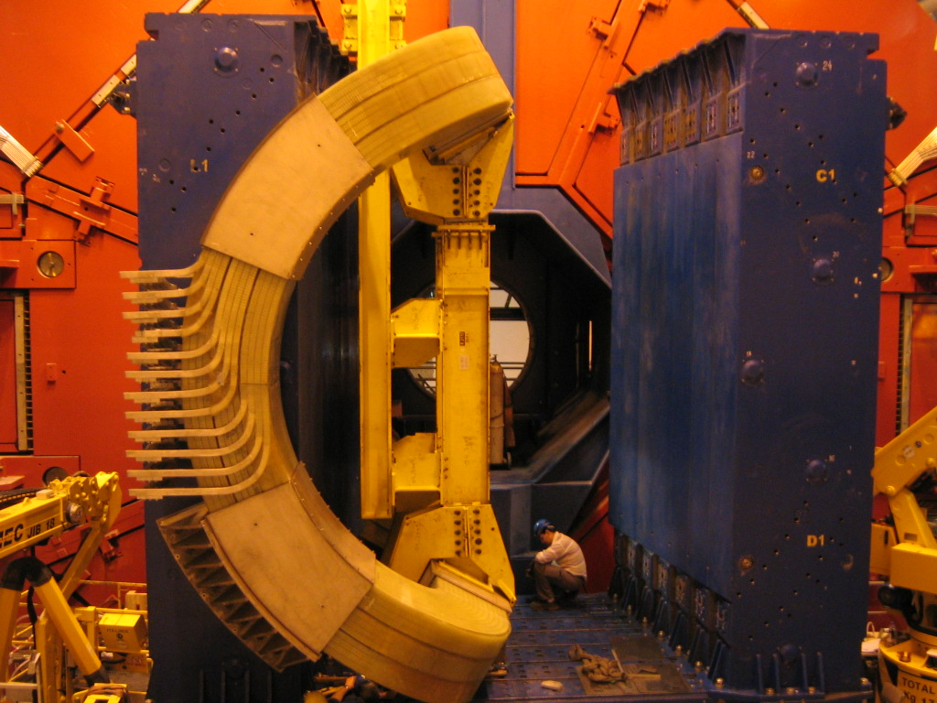
Muon Magnet: World’s largest resistive dipole
Artist-in-residence
Big Bang
Pre-assembly finished November 2004
Tricky coil installation during final assembly
Finished April 2005

Slide 12
The Front Absorber (Ad)Venture: Sarov - Cern
A finely tuned 40 ton instrument: gentle to muons, devastating to hadrons
Graphite
Austenitic steel cone
Tungsten front plate
Tungsten elements
Designed in Sarov
under ISTC contract
Engineering, construction, supervision at CERN to save 2 M €
Strategy: Selecting material and part manufacture from industry, world-wide and
build at home
Magnesium front plate
Austenitic steel plates
4797
Lead cone
Concrete
Borated polyethylene cone

Slide 13
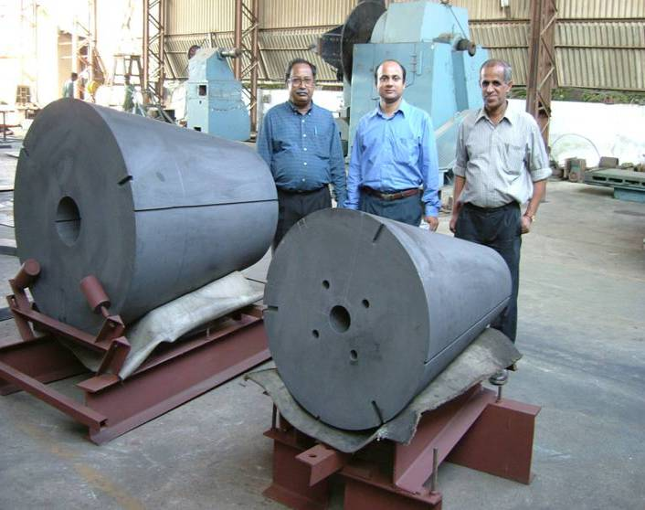
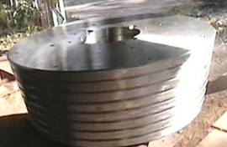
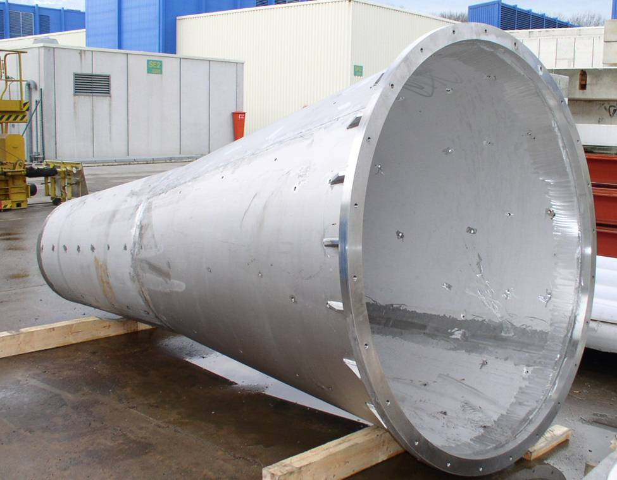
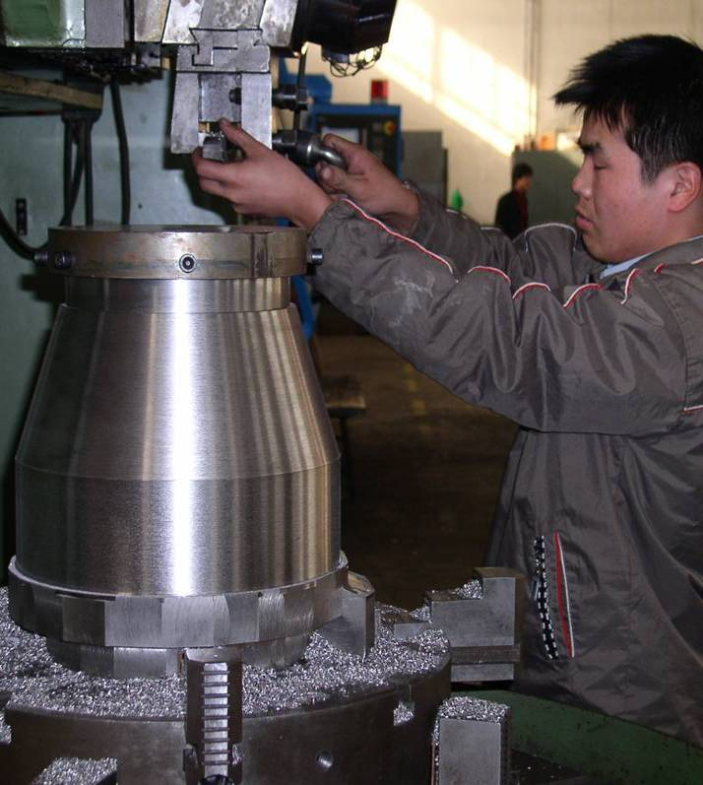
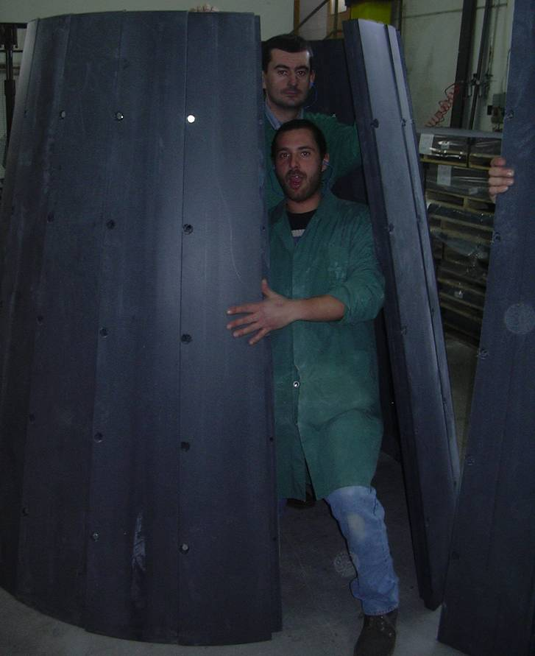
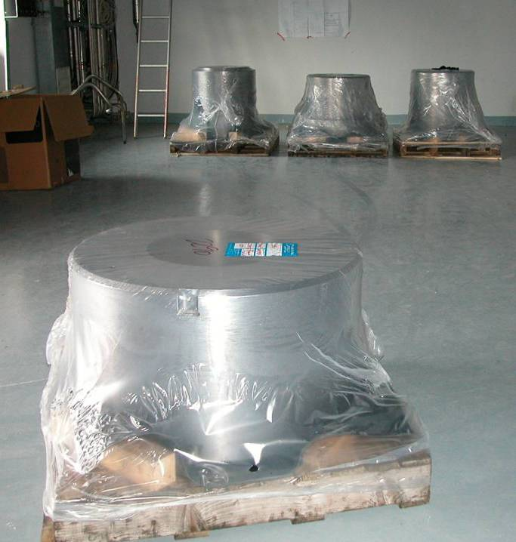
The Front Absorber: a global enterprise, IKEA Style
Steel cone from Finland
Steel from India
Graphite from India
Boronated
Polyethylene from
Switzerland
Lead from England
Tungsten from China

Slide 14
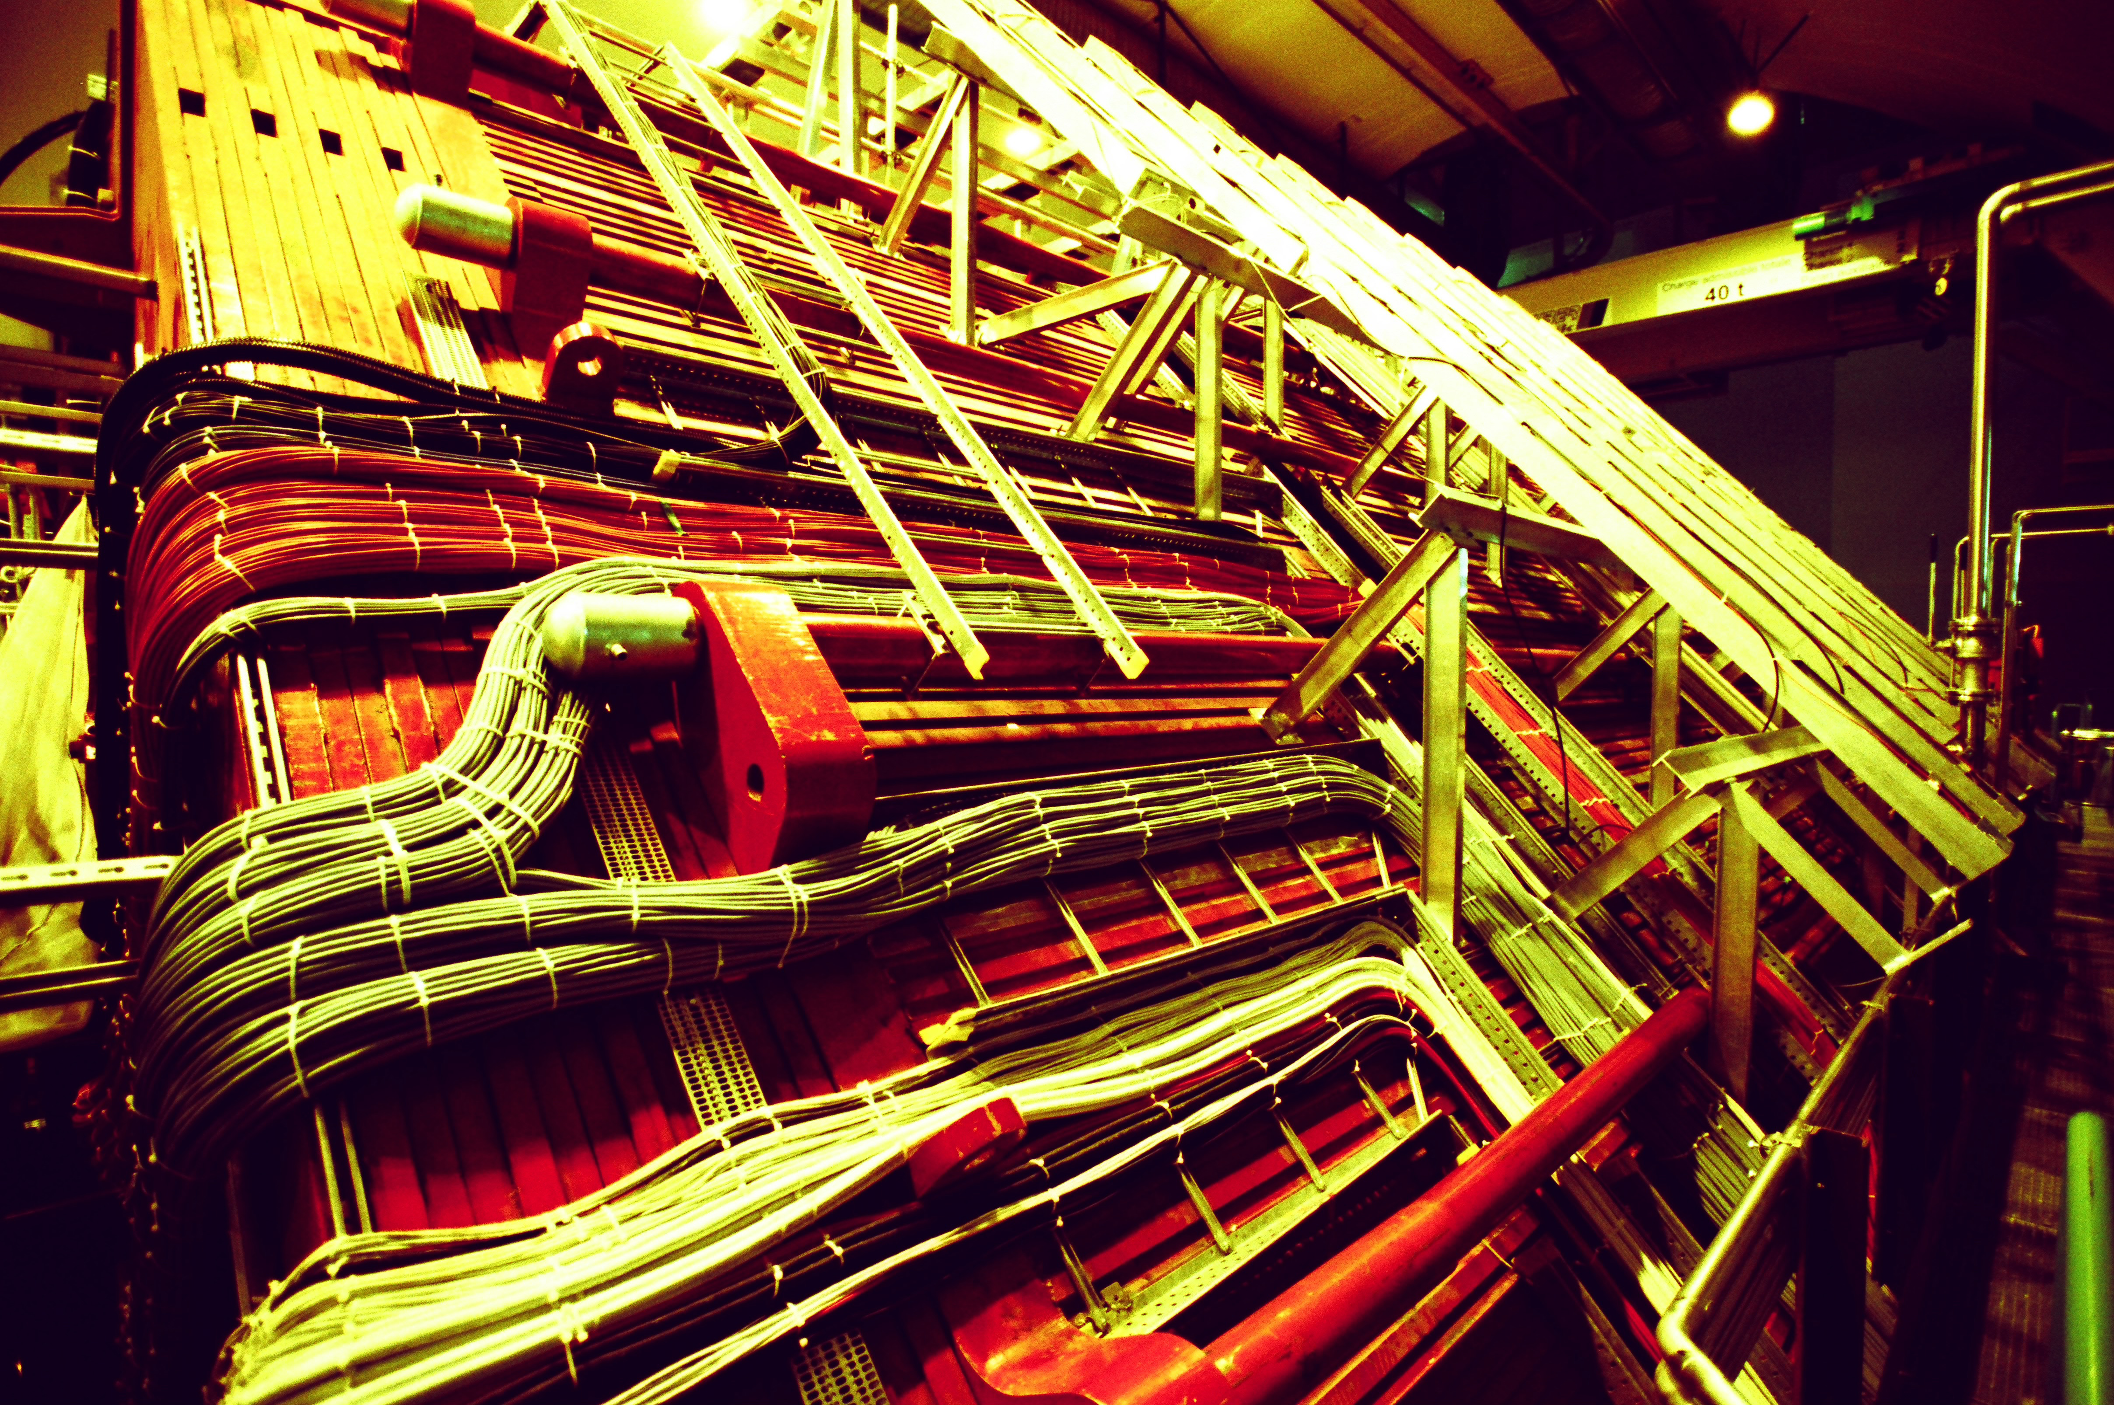
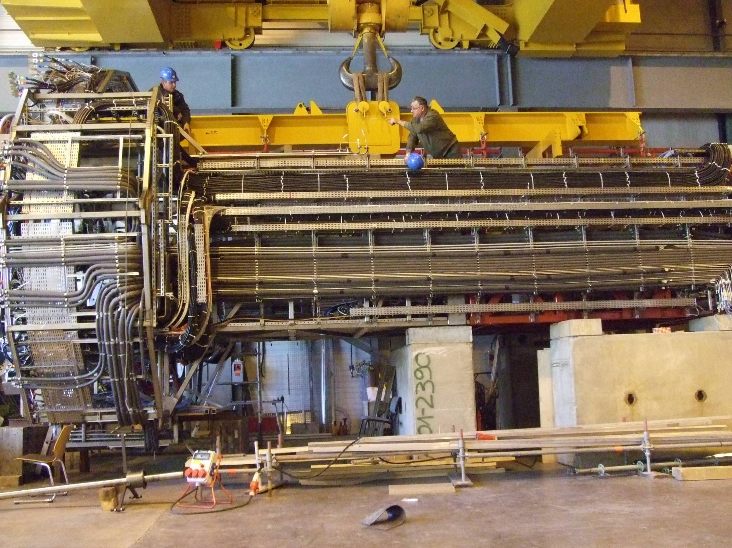
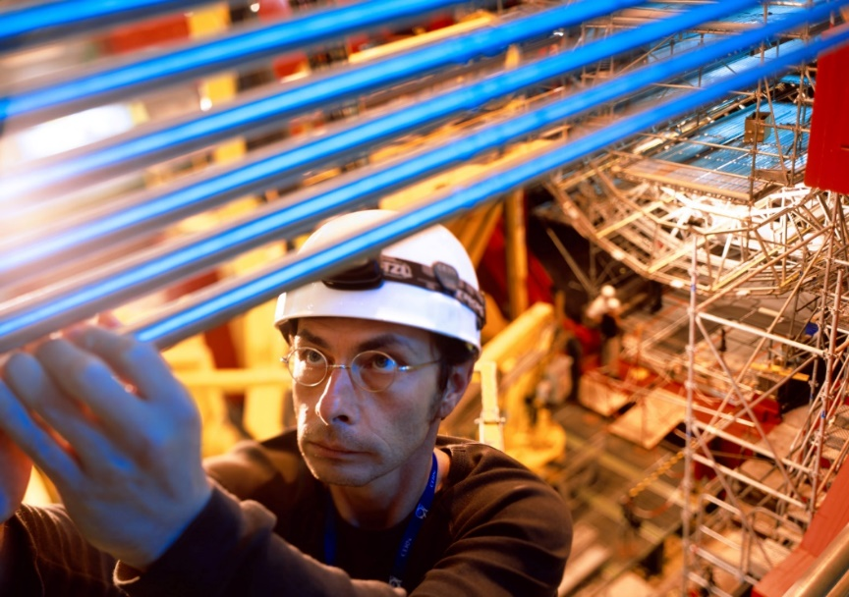
Alice’ umbilical links: treated with tender care
November 2007
500 km cables;
30 km gas pipes
15 km cooling pipes
Candidate for Guinness Book of Records: the world’s largest connector for TPC and ITS services connecting wall outlets to detectors

Slide 15
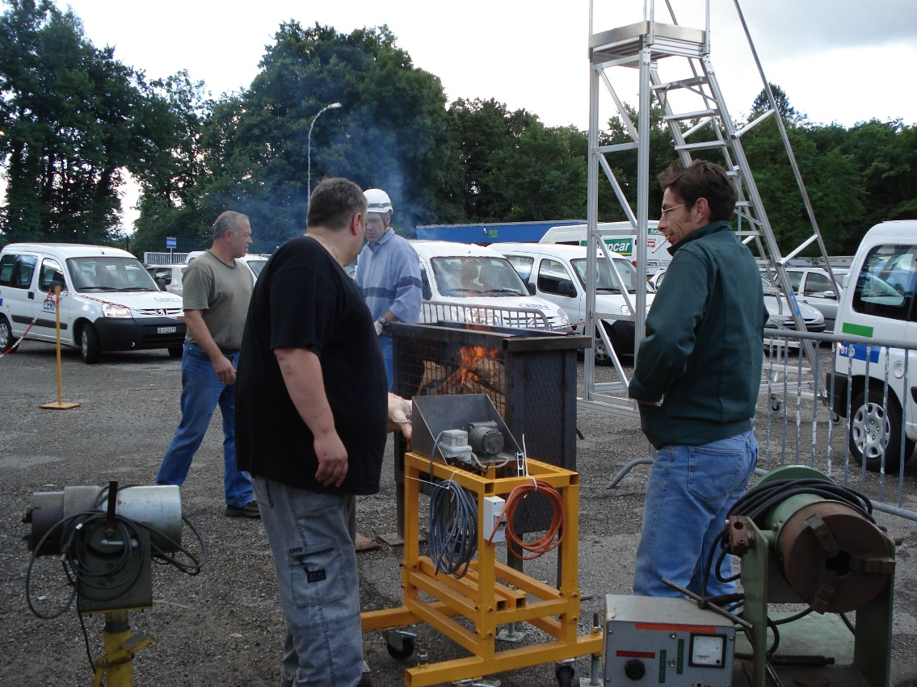
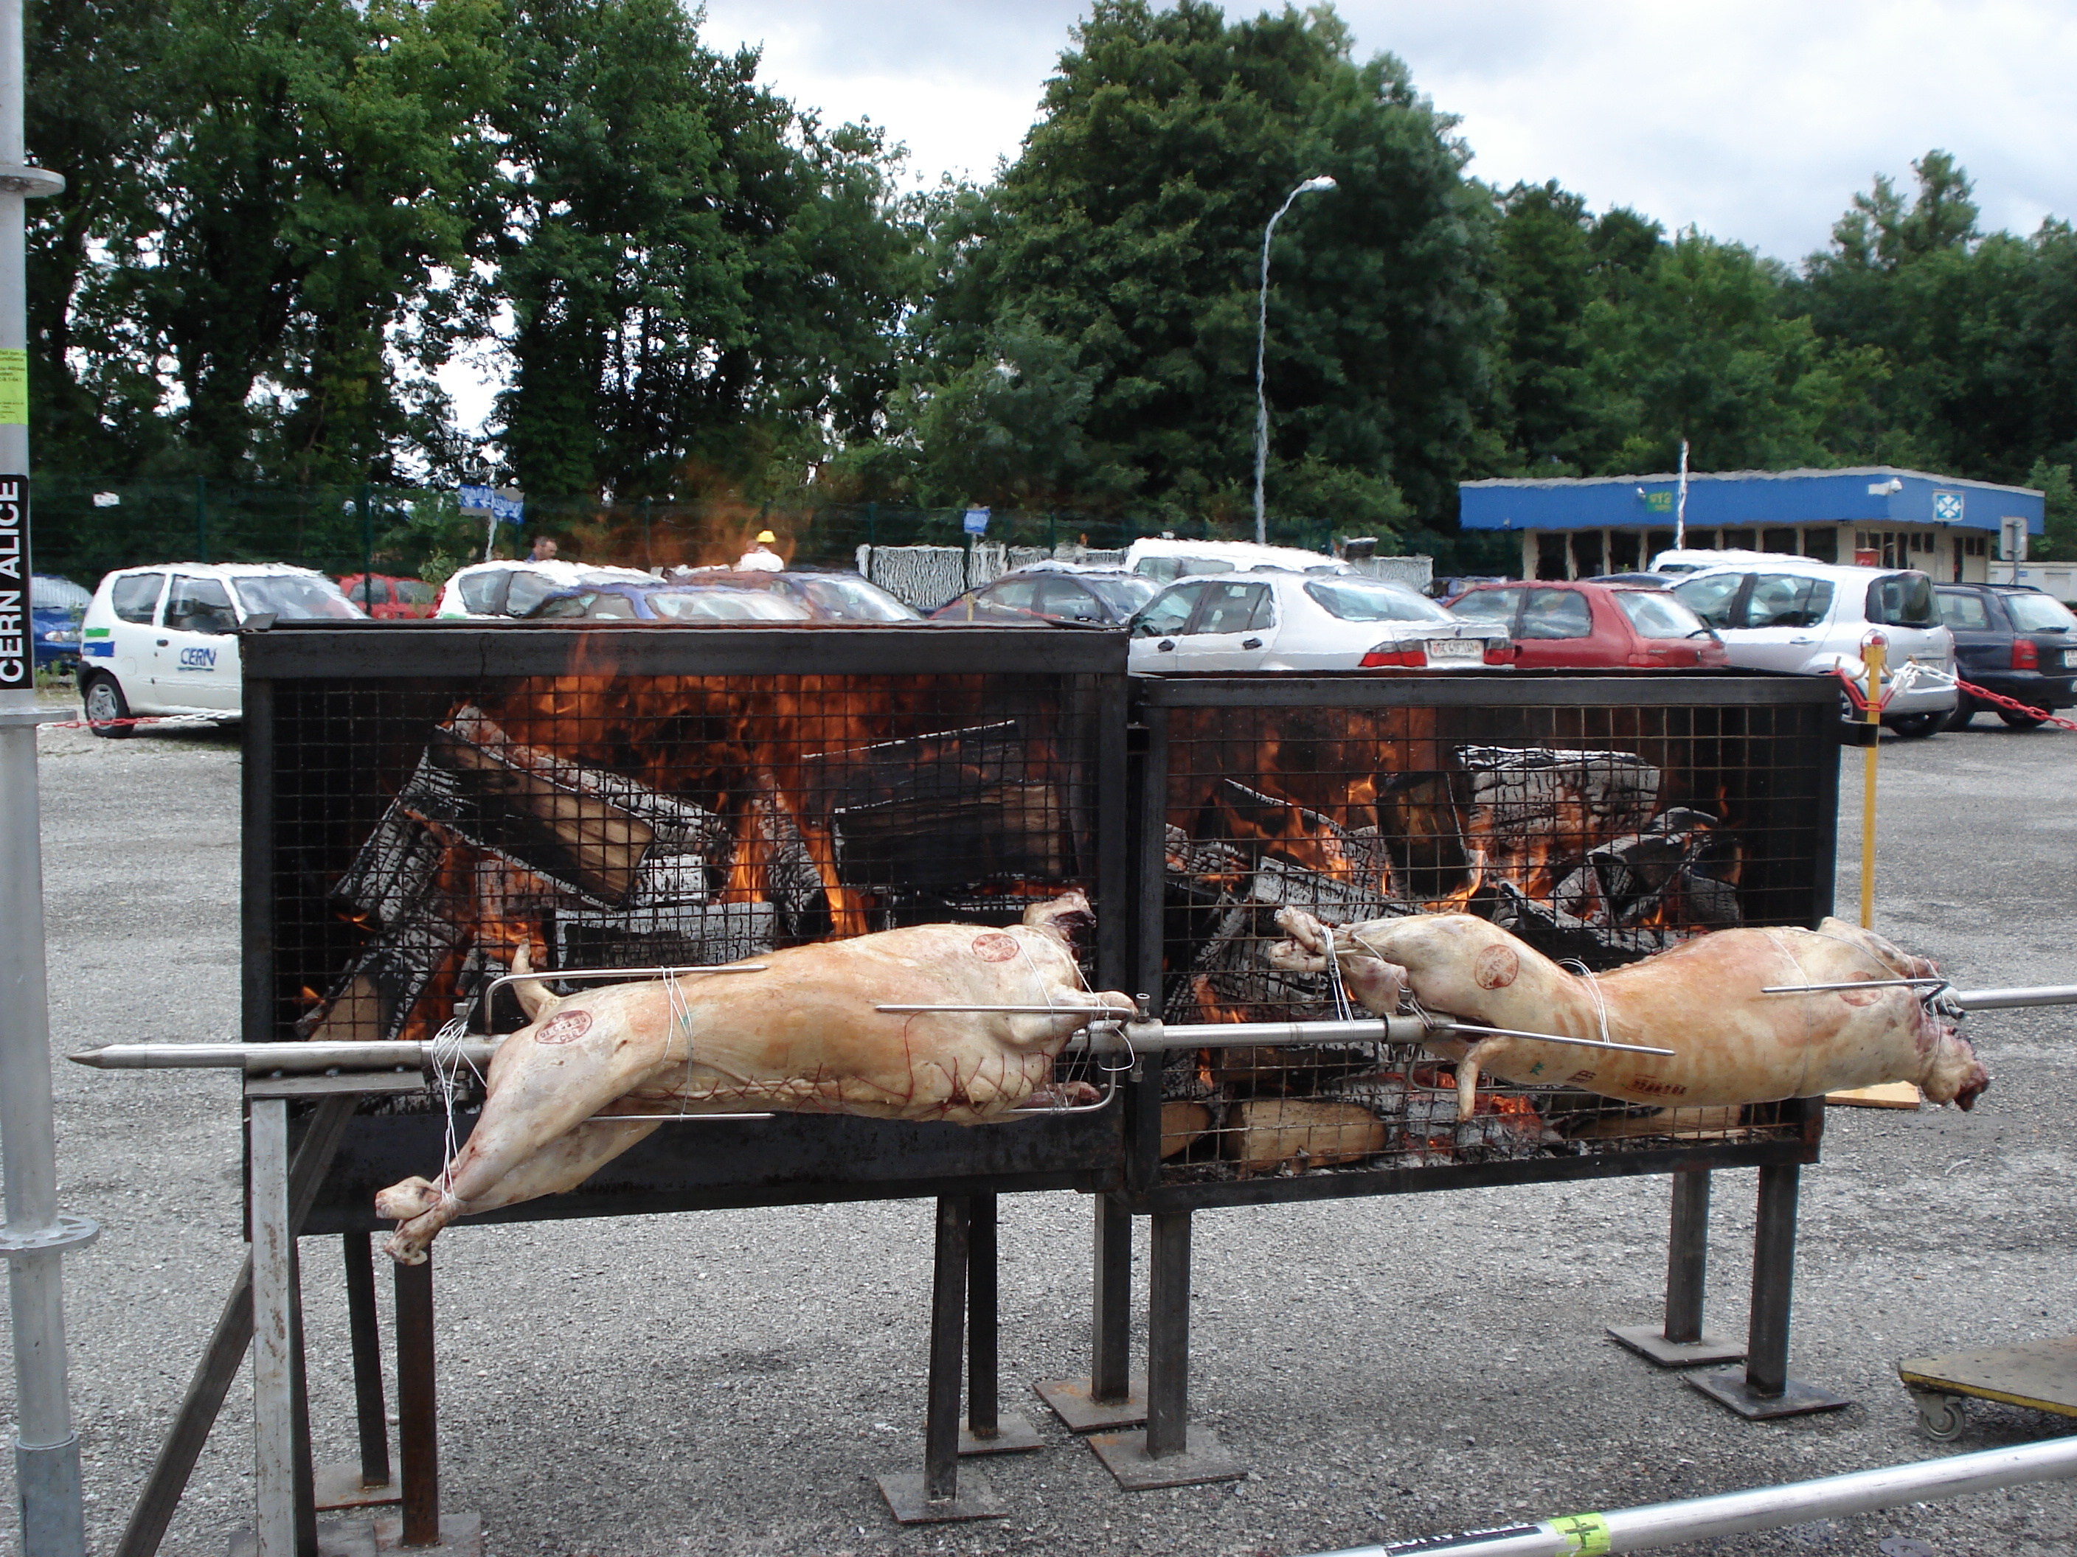
Proud achievement: developing the finest
DCS interfaced BBQ infrastructure
1st prototype
2nd generation; ongoing project

Slide 16
The Alice riches of detectors: selected flashbacks
Very large variety of detection techniques
Performance required at the front of detector physics and technology
  true also for all the other LHC detectors
Several unique techniques employed
Each detector system required international collaboration
“Technology transfer” to laboratories new to the field
Role of Technical Co-ordination
  Be supportive through site visits, reviews, documentation, extensive work on integration and installation
Apologies for not addressing major systems: DCS, DAQ, HTL …

Slide 17
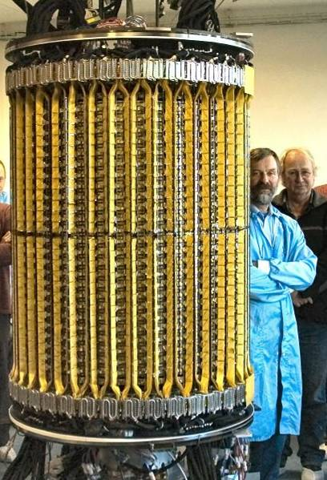
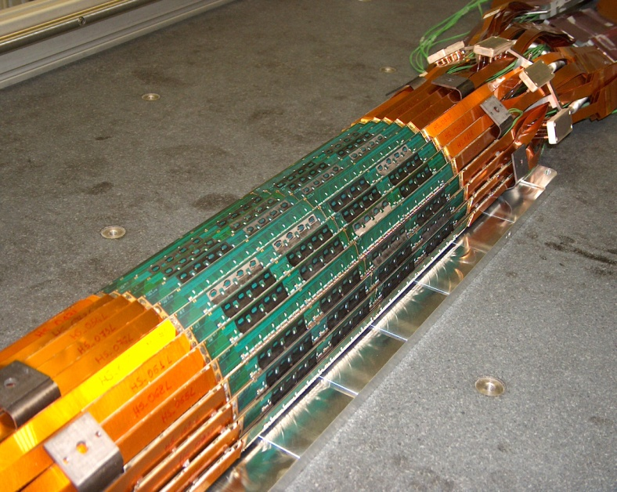
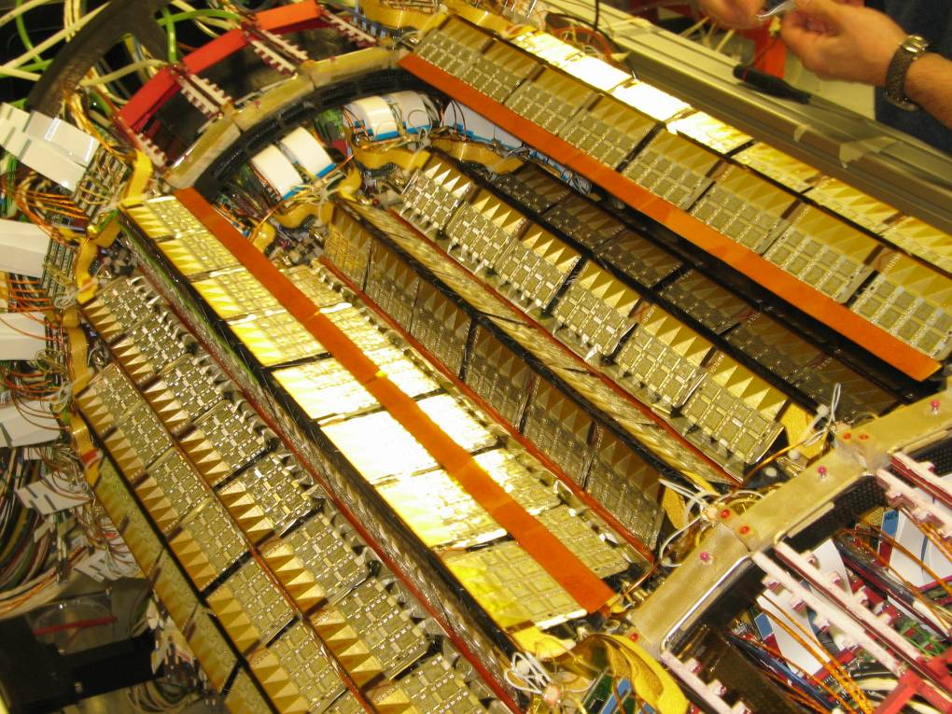
Inner Tracking System, ITS: silicon in many incarnations
Pixels, Drift and Strips
Pixels
SPD
Drift
SSD
Strips
SSD

Slide 18
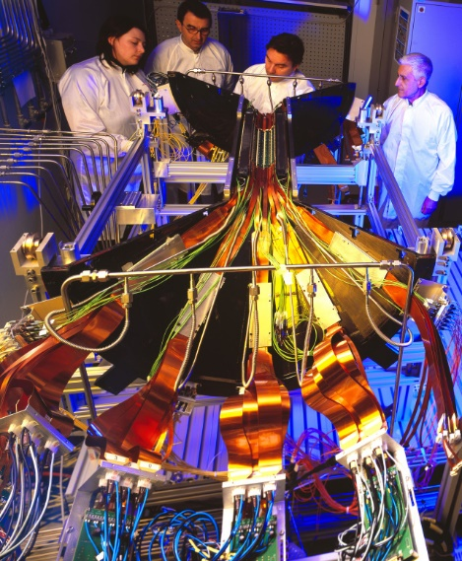
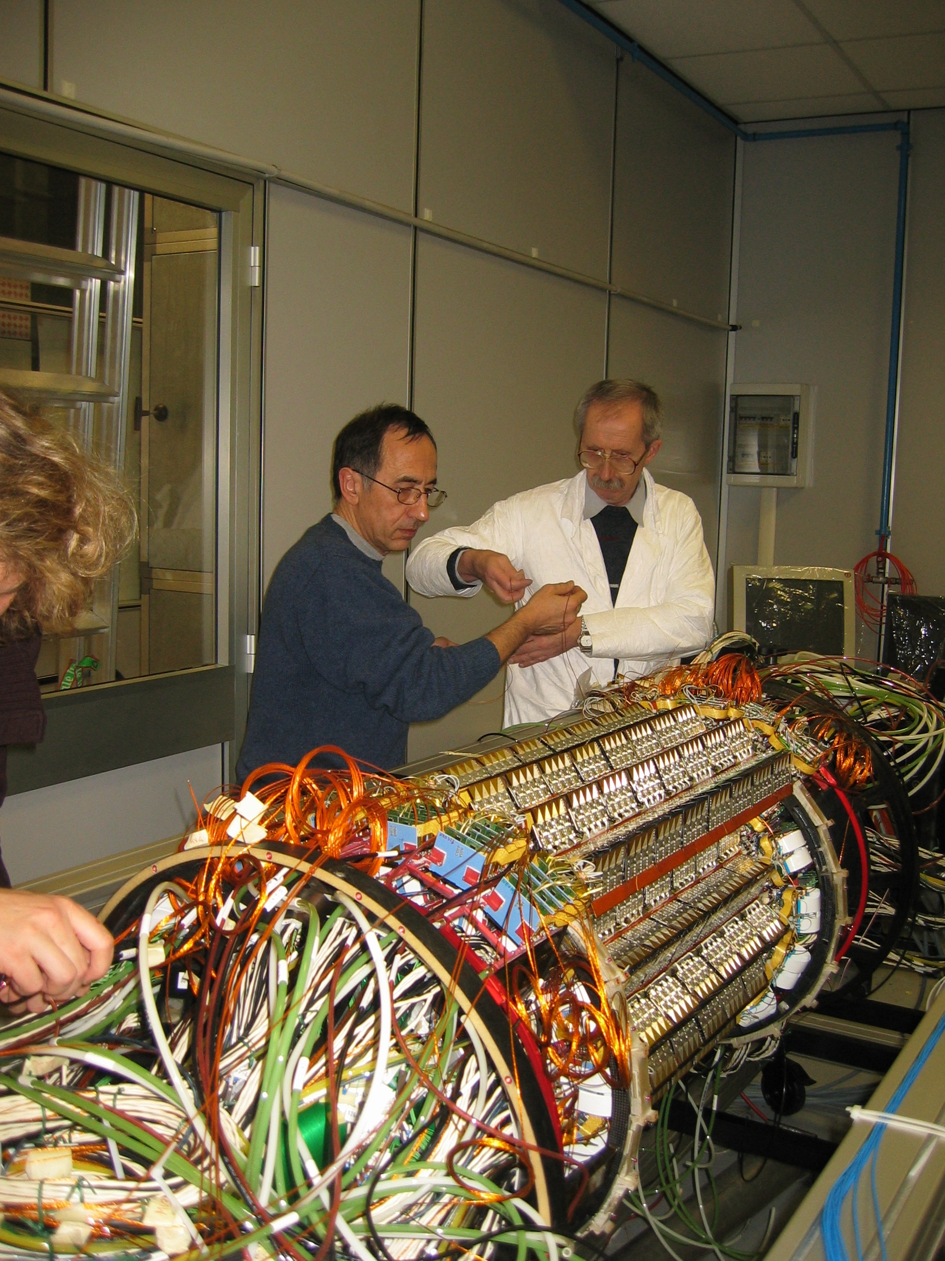
SPD: Preassembly SDD: largest employment of a challenging technology
Il Maestro…
SPD with lowest overall mass of all LHC Pixel detectors:
1.14 X0; inner radius: 39 mm

Slide 19
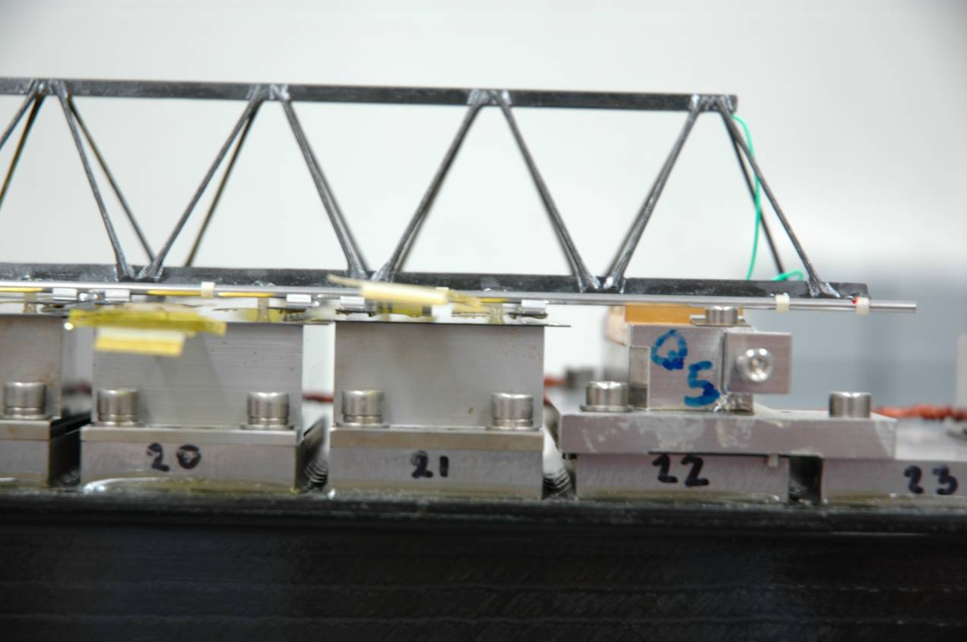
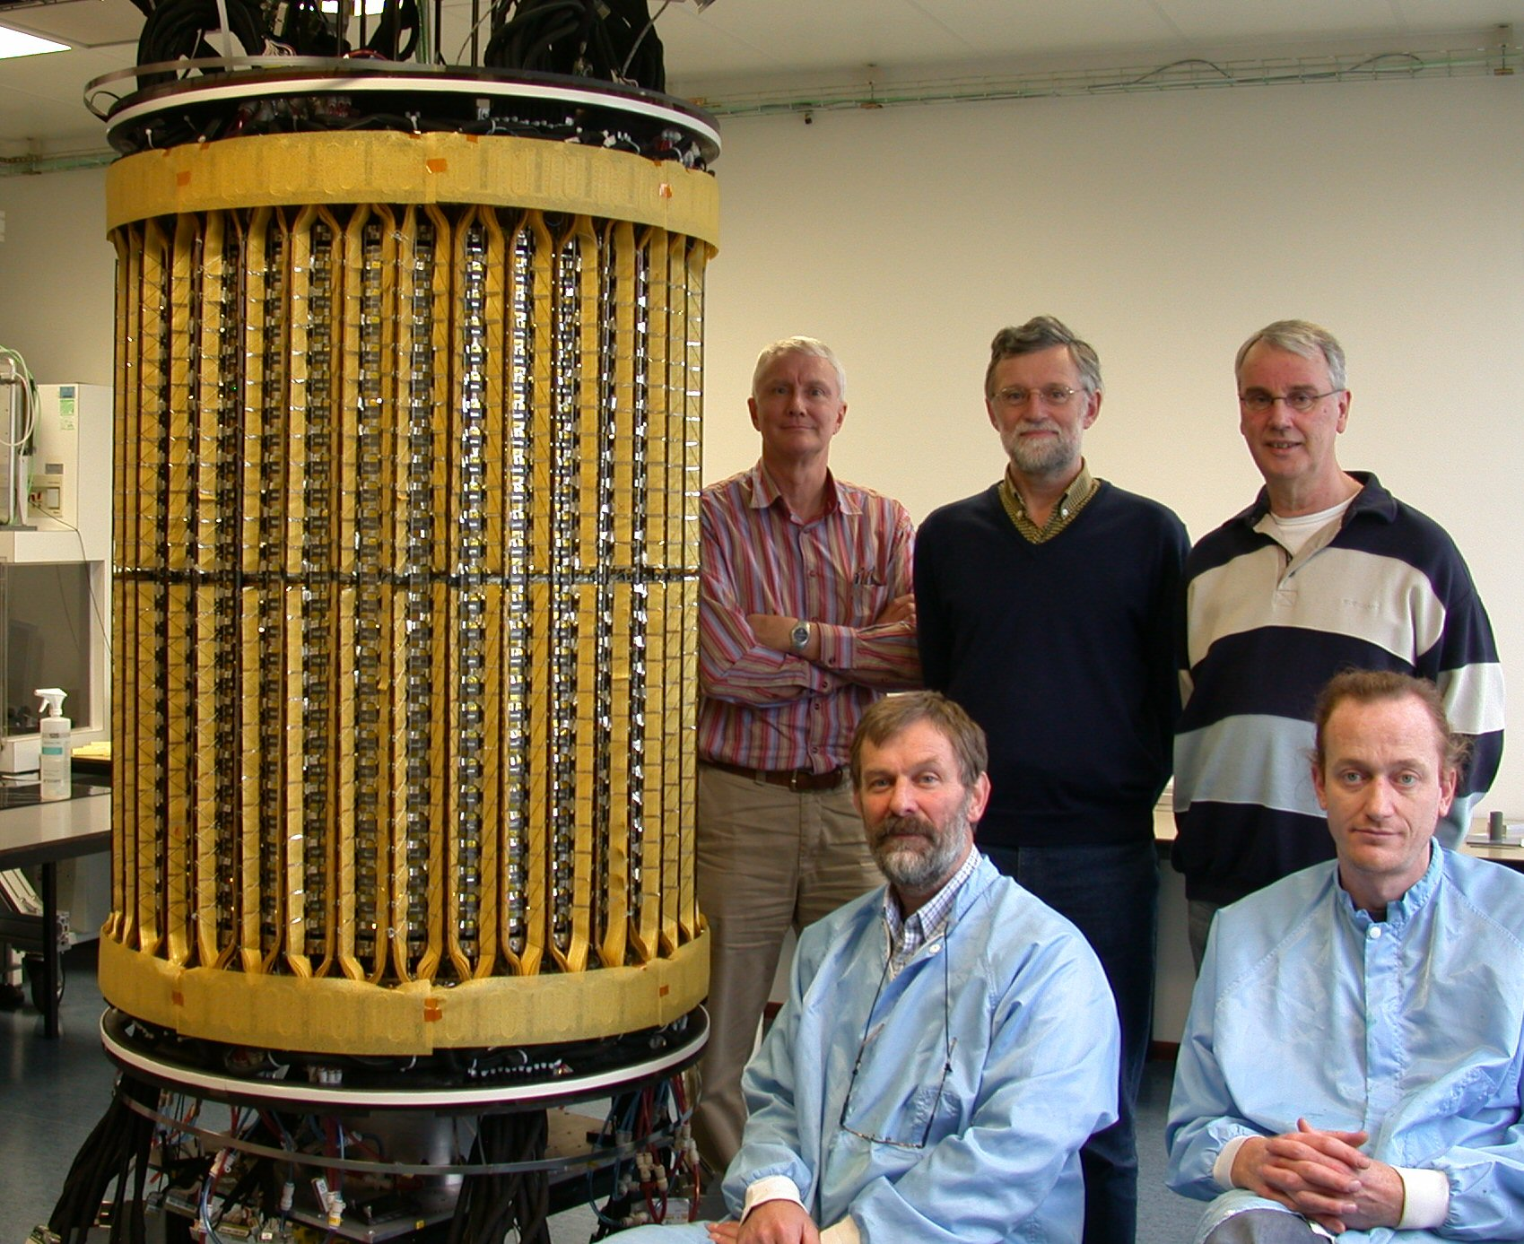
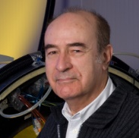
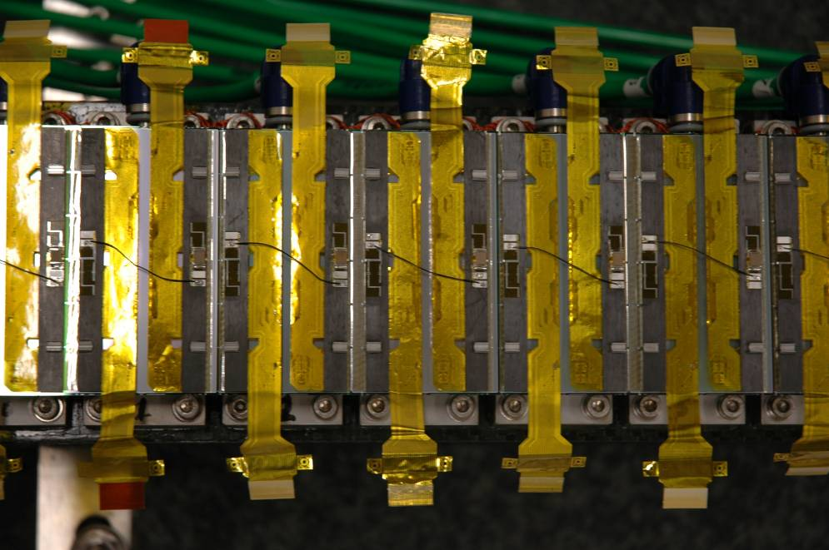
SSD: Dutch – French alliance with Russian Support(s)
Carbon fibre ladder construction at St. Petersburg
Module assembly

Slide 20
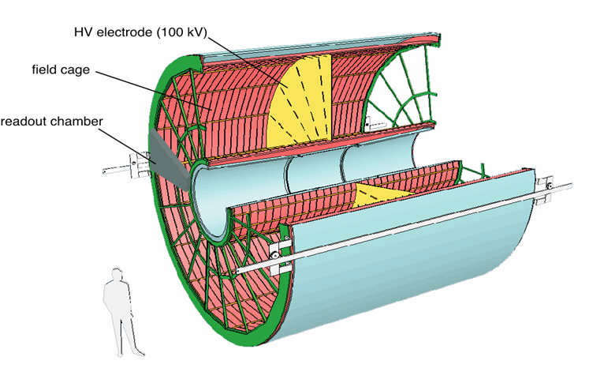
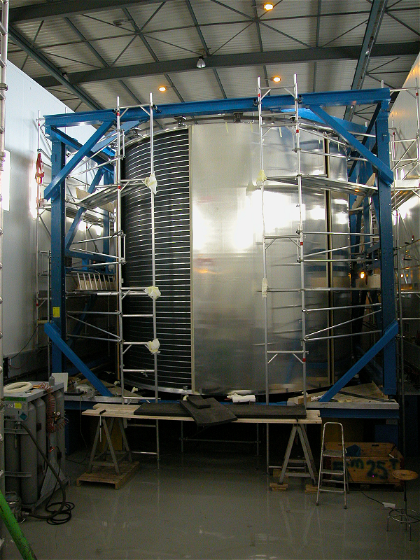
TPC: the world’s largest and a marvel of mechanical and electrical precision ….at the level of 10⁻⁴
From drawing to reality
E
E
E
E
88us
510 cm
Outer cylinder: longitudinal precision: 250 µm

Slide 21
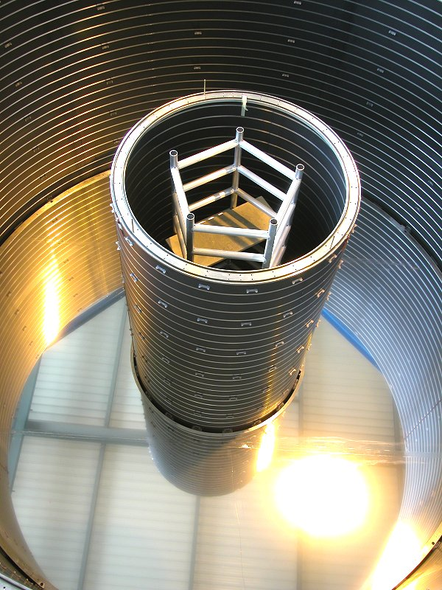
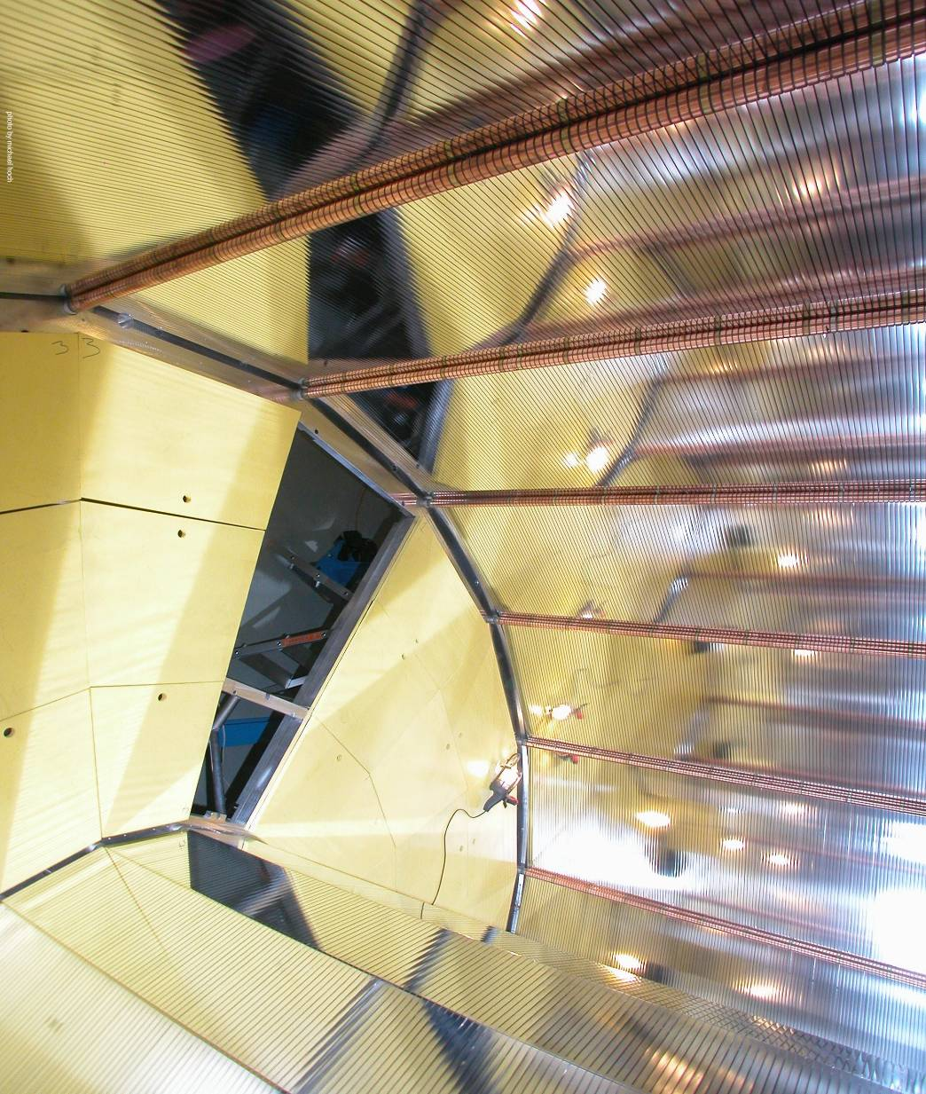
TPC: endplates with 250 µm precision
Central electrode with 10⁻⁴ parallelism
Inner Cylinder crisis:
Leak, faulty glue joint, repair. Considered too risky; decided with manufacturer on new fabrication
RODS
OROCs
ENDPLATE
IROCs

Slide 22
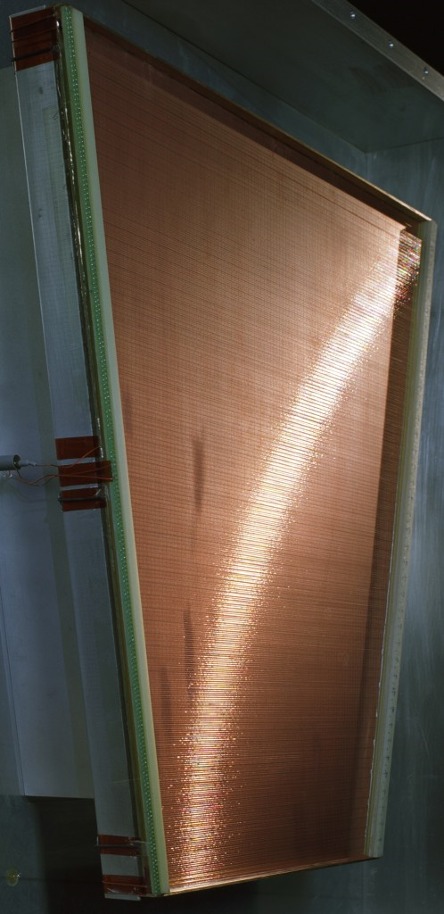
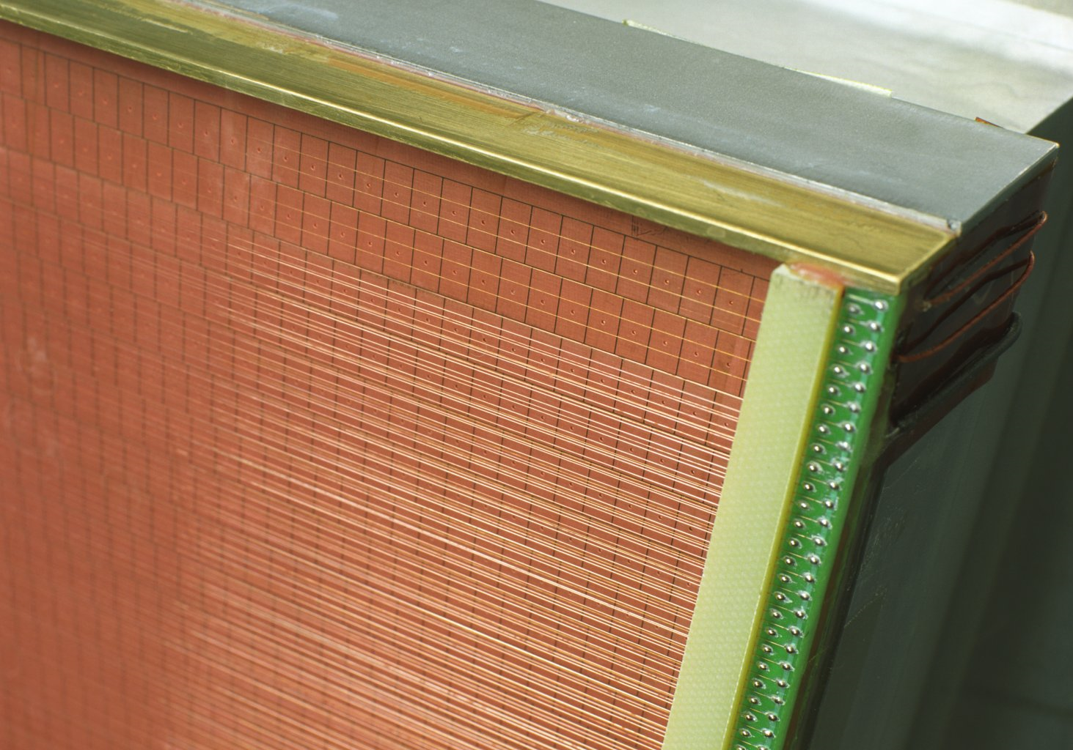
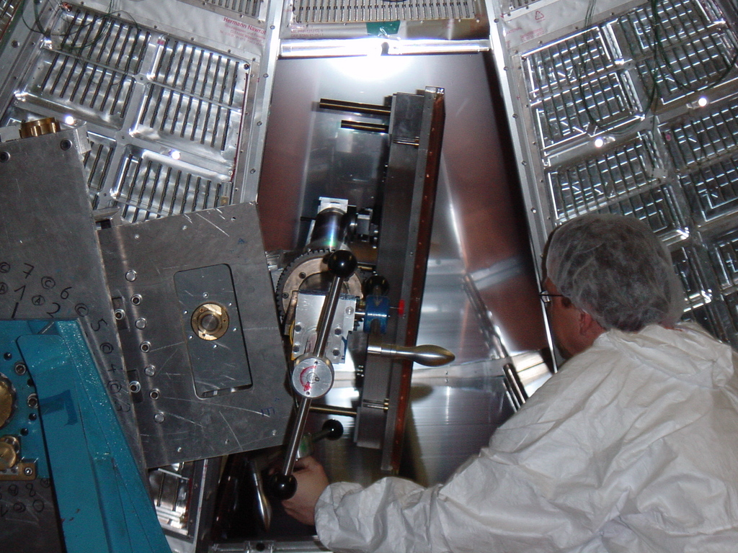
Readout chamber insertion: A nerve-wracking endeavor
Zero tolerance for failure
Close-up of the cathode
pad plane
72 (+ spares) readout chambers constructed in
Bratislava, GSI and Heidelberg
Chamber insertion with specially designed Insertion tool

Slide 23

TPC Signal Processing: A World Premiere
ad ALTRO
STM PRESS RELEASE
“STMicroelectronics Developes World’s Most Advanced Data Acquisition
System-on-Chip Jointly with the ALICE Experiment at CERN”
“Success in major scientific research project will benefit many aerospace,
Medical and industrial applications”
November 25, 2002

Slide 24



TRD: apogee of 30 years development
1.2 * 10⁶ channels; waveform analysis; e-trigger within 5 µsec
Heidelberg
Chamber
production
JINR Chamber Production Laboratory
1 of 18 supermodules
during assembly

Slide 25

TRD Signal processing: pushing state-of-the art

Slide 26


TOF: two time-honoured techniques revolutionized
From RPC to M(ulti)RPC: motivated deeper understanding of the RPC detector physics
TOF: from
sub-nsec timing to sub-100ps timing
The trick: use 10 detection gaps of
250 µm each
One of 18 Supermodules
8m long; 8000 TOF channels
Read out with NINO (the chip)

Slide 27


HMPID (High Momentum Particle Identification):
Every photon counts
CsI photocathodes; single-electron sensitivity: > 90 %
Proximity focusing
World’s largest CsI photocathode system: 11 m²
Photocathode efficiency: ~ 20%
uniformity: >5 %
Custom-built CsI evaporation plant for R&D, final cathode production

Slide 28

HMPID: assembled, ready for installation
Sept. 2006

Slide 29


Muon Tracking and Triggering: 1.3 * 10⁶ readout channels
50 µm sagitta resolution; France, India, Italy, Russia
Clean Room at Saha
Successful chamber construction technology transfer
Readout chip “MANAS” designed, fabricated in India
Partial view of Muon Spectrometer with tracking and triggering chambers

Slide 30

PHOS: photon and electron crystal calorimeter
A Russia-led collaboration with Norway and Japan and CERN involvement
Choice of PbWO₄ crystals to match LHC performance goal
  Energy resolution ~ 3% / √ E
  Dynamic range from ~ 100 MeV to ~ 100 GeV
  Timing resolution of ~ 1.5 ns / √ E
  Trigger capability at first level
Readout electronics
  Reuse of major parts of TPC electronics
First module: May 2006
First batch from Apati factory (near Murmansk)
with mastermind Slav Manko onlooking. It helped that Slav knew the minister of Atomic Energy …

Slide 31


First module: a very useful prototype
Entrance
face
Back side
Readout
electronics
Crystals need to be cooled to -20 degrees; required redesign of enclosure to exclude air leaks and thermal bridges

Slide 32


ACORDE: a new cultural and scientific contribution
Cosmic Ray Event triggered by ACORDE Oct. 9th, 2008
Happy collaborators: Was the easy part of the installation….

Slide 33




“Forward Detectors”: small, but important and with not so small challenges
From Finland and Russia:
30 ps timing resolution:
World record for scintillator
based detector
V0
Multiplicity
Detector:
Scintillator tiles with fibre readout
Denmark in charge of the Si pad detector
FMD
India led the Forward Photon Multiplicity
Detector project
Proton ZDC at
+- 116 m

Slide 34
Installation and integration
Started with service installation already in 2002
Extensive and very salutary pre-installation
Installation climax in 2007 with a few close calls

Slide 35
Evolution of personnel at Point 2

Slide 36

Integration test
Move of TPC into spaceframe

Slide 37

Integration test:
Delicately orchestrated movements of TPC/ITS/TRD/TOF/
Vacuum chamber/Front absorber
Aim: understand very complex installation sequence, deformations, lifting of detectors and…

Slide 38

TRD envelope crisis
Insertion test of dummy TRD Supermodule:
Result
Combined tolerances of SF and TRD insufficient
TC Pilgrimage to Heidelberg to discuss options
a) modify spaceframe
b) modify TRD
TRD collaboration accepted to modify TRD by shifting all modules radially
New module 1
Module 5 became modules 6
Consequences: TRD fits
Construction delay and 200 kCHF extra cost
Tense but constructive meeting in collaborative spirit

Slide 39


Getting serious: start of detector installation
Space frame
Jan. 2006
March 2006
Work on the front absorber.
The crane master of ceremony, Robert Porret, in command….

Slide 40


Jan. 8th, 2007, early morning: TPC moving into final habitat
It just stopped raining and snowing…
TPC levelled during transport to < 2 mrad
Lowering… it did fit…barely

Slide 41


Ready to install the first TRD supermodule
Installation tool (“Rotator”) recuperated from ALEPH
Demonstrating the value of the pre-installation: it fits
Supermodule being pulled into position

Slide 42


The ITS installation sequence required an unheard of level of dedication: celebrating Ferragosto 2007 working
SDD being unloaded
SDD insertion into SSD

Slide 43










Slide 44

Close call: movement of detectors around beam pipe
ALICE beam pipe is supported in 3 points
During installation: many movements, displacing these points independently
Strain gauges were installed to monitor forces on vacuum pipe and deformations
During displacements test in preparation of TPC installation:
Force on one gauge much higher than calculated
Explanation: the spring in one of the support points got blocked during bake-out
Without this system of gauges….???

Slide 45

EMCal support frame, installed Nov. 2007
In early 2001: decision to leave room in Alice for a possible later installation of a calorimeter
(CF never before participated in an experiment without a decent calorimeter…)
Responsibility of our American collaborators, who successfully applied for construction funds
However, for logistics reasons support frame had to be built before project approval…
No risk, no fun

Slide 46

July 23rd, 2008

Slide 47
Finally…
(CF Report to CB on April 4th, 2008)
It was a privilege and a pleasure to participate to Alice as Technical Coordinator and to work on our common goal to get Alice realized
I would like to acknowledge the most constructive and collaborative attitude I met in the collaboration
I enjoyed working again with colleagues from previous experiments and meeting many new colleagues
Lars Leistam will provide the desirable continuity, while Werner Riegler will bring some needed fresh ideas and a youthful style

Slide 48
ALICE
Many happy returns!

