Slide 1



Review of Jets in the vacuum and in the medium
Megan Connors
September 5, 2018

Slide 2
Review of
Jets
In the vacuum
In the medium
  What medium?
    Quark Gluon Plasma
    Cold nuclear matter

Slide 3

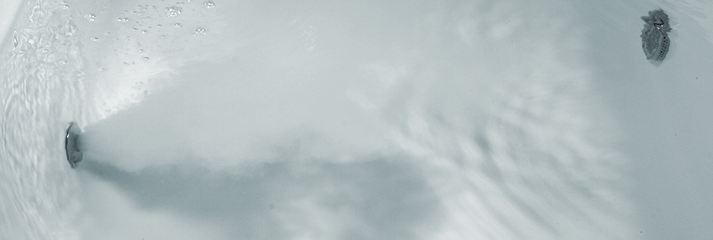
What is a jet?
In Vacuum
In Medium
A collimated spray of particles

Slide 4
In Vacuum
How many jets?
Which particles did you include?
What is a jet?

Slide 5
Jet Definition for QCD
Snowmass Accord: fermilab-conf-90-249
Must also be stable even if:
collinear splitting
soft gluon emission
Tevetron 1990

Slide 6
Jet Algorithms
Resolution parameter: R
For Anti-k_{T} R~radius

Slide 7
Jet Spectrum
After unfolding for detector effects:

Slide 8
pQCD Factorization
Δ
Δf_{a,b} = polarized quark and gluon distribution functions
Δ
D^{h}_{f} = fragmentation function for
Δ
Partonic cross section
from pQCD
Initial State
PDF
pQCD
Final State

Slide 9
To fully describe jets
Hadronization is important for properly describing jets reconstructed with different R

Slide 10
Fragmentation Functions
Photon triggered correlations in pp at RHIC match quark fragmentation functions measured in e+e- collisions
Fun with Fragmentation Variables

Slide 11
In medium
softer
broader
Partons lose energy

Slide 12
In medium
Heavy-Ion Collisions
softer
broader

Slide 13
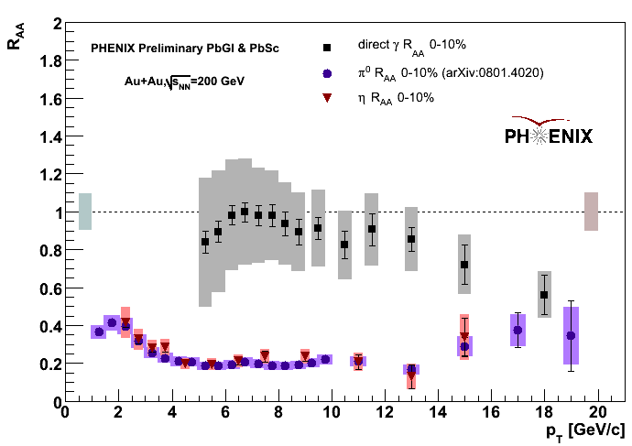
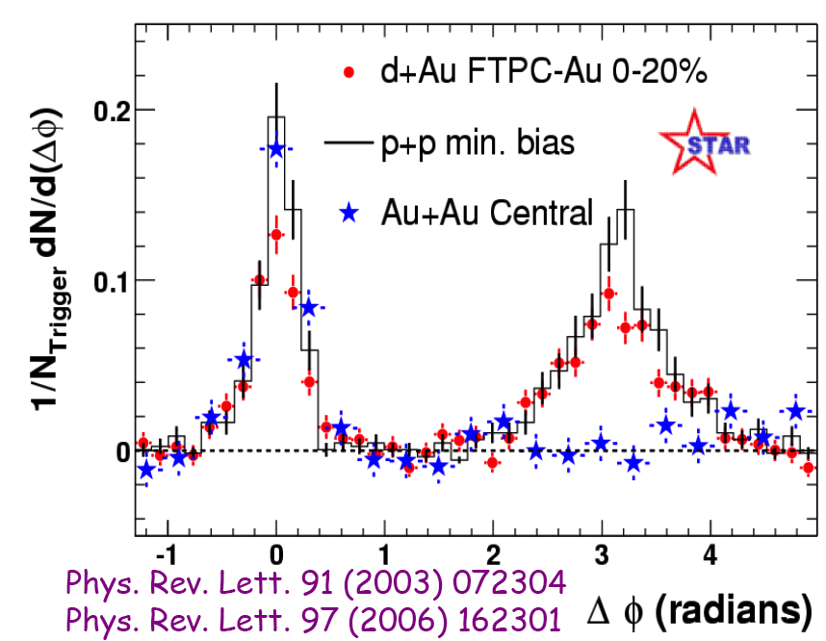
High p_{T} hadrons
A proxy for a jet (high p_{T} hadrons implies a hard scattering)
Jet quenching discovered at RHIC

Slide 14
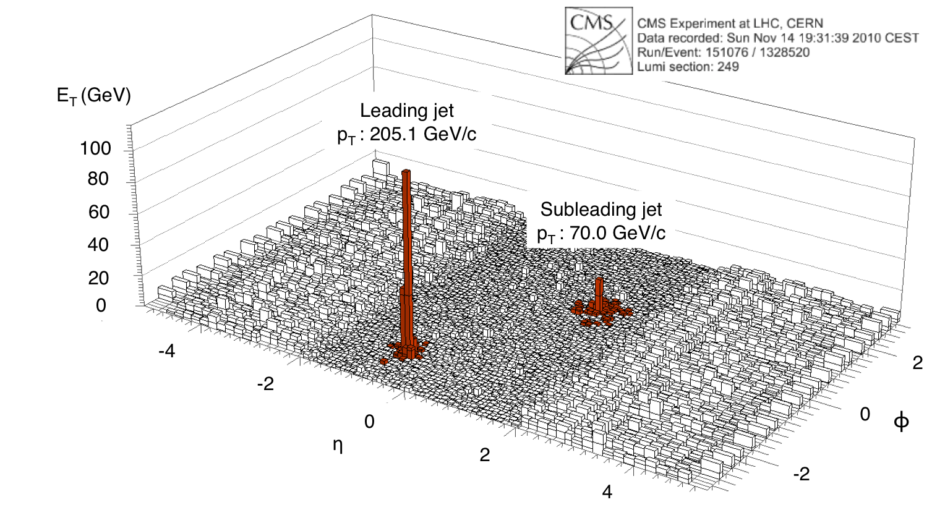
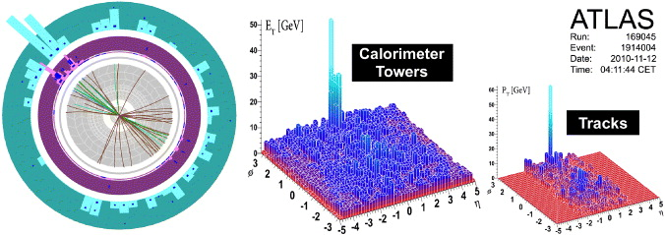
Fully Reconstructed Jets
1st Reconstructed jets from RHIC QM 2009
1st Reconstructed jets from LHC QM 2011

Slide 15
Jet R_{AA}
Demonstrates that jets are suppressed at LHC

Slide 16
Di-Jets
Dijet Asymmetry

Slide 17
pQCD Factorization in Medium
Δ
Δf_{a,b} = polarized quark and gluon distribution functions
Δ
D^{h}_{f} = fragmentation function for
Δ
Partonic cross section
from pQCD
Initial State
PDF
pQCD
Final State
n
ΔE

Slide 18
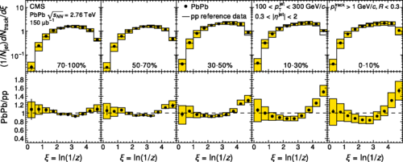
Jets at the LHC
Fragmentation functions with modified jets
z=p_{Th}/p_{Tjet}
CMS Phys. Rev. C 90, 024908

Slide 19


WARNINGS
Beware of fake jets
Biases inherent in the measurement
  Bias is not necessarily a bad word!

Slide 20
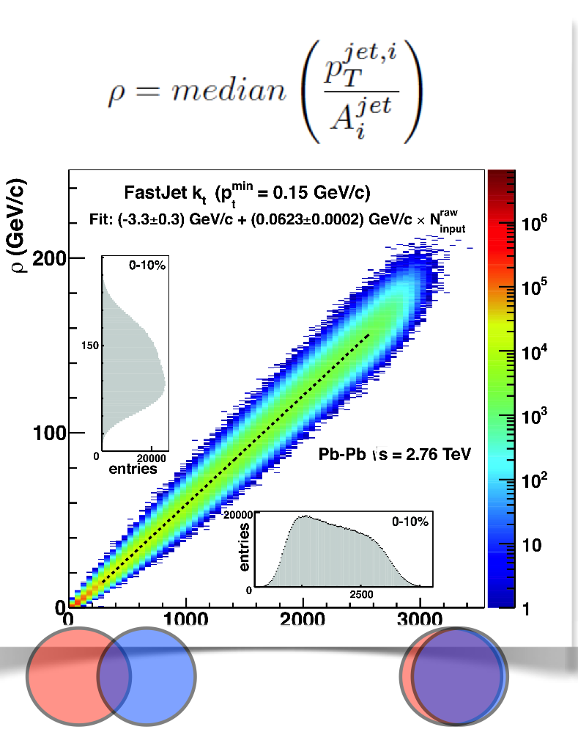
Removing the Background
Sometimes referred to as “fake jets” in PHENIX
ALICE & STAR median ρ subtraction
Iterative subtraction in η-rings
Need to account for fluctuating background!

Slide 21
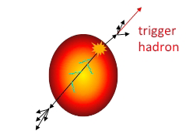
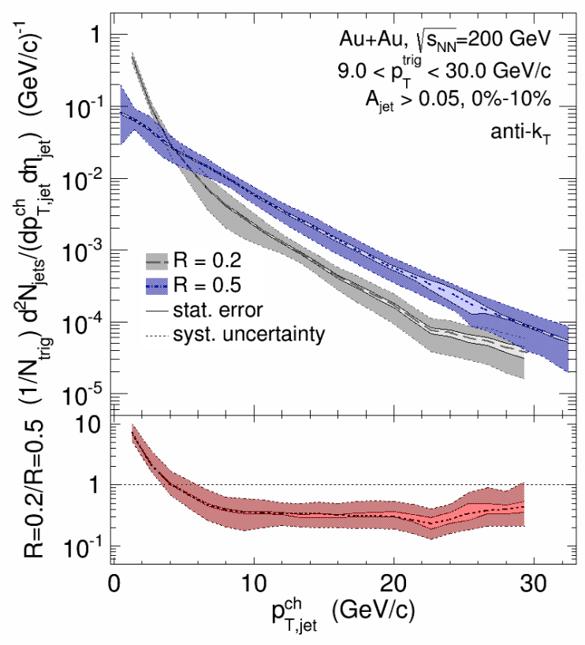
Hadron-Jet
An unbiased jet spectrum?
  No cuts on the reconstructed jet
  Trigger can bias pathlength
0-10%

Slide 22
Using Biases: Rapidity
More quarks at higher |y|
Quarks lose less energy than gluons so expect R_{AA} to increase with |y|
The steeper spectra at higher y cause the R_{AA} to decrease with |y|
No effect on the fragmentation functions

Slide 23
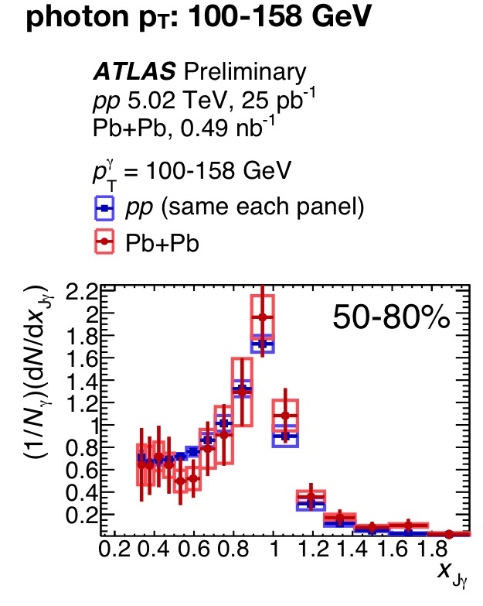
Photon Tagged Jets at LHC
Compare Fragmentation Function for Inclusive Jets and for photon tagged jets (quark dominant)
Centrality dependence to photon-jet imbalance

Slide 24
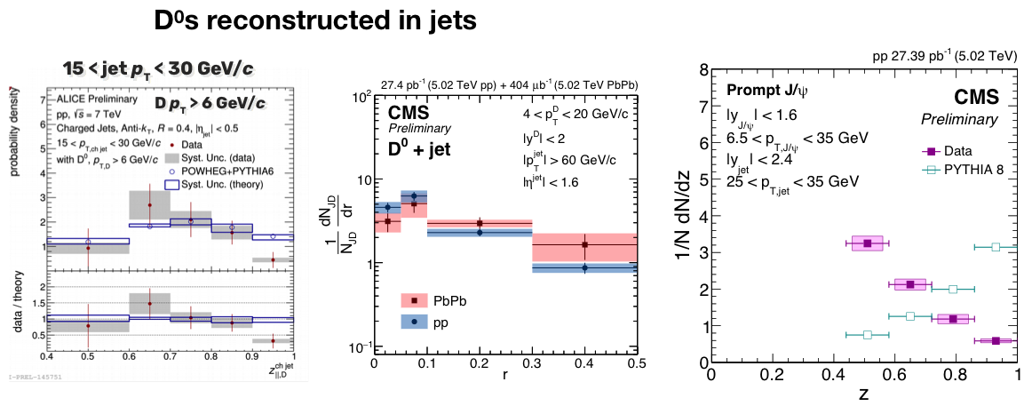
Heavy Flavor Tagged Jets
Now accessible thanks to increased luminosity and upgrades

Slide 25
Jets in Xe+Xe Collisions
Results shown at QM in May 2018!

Slide 26
Jet Substructure
Jet shape,
dispersion, girth
Mass
Grooming: soft drop

Slide 27

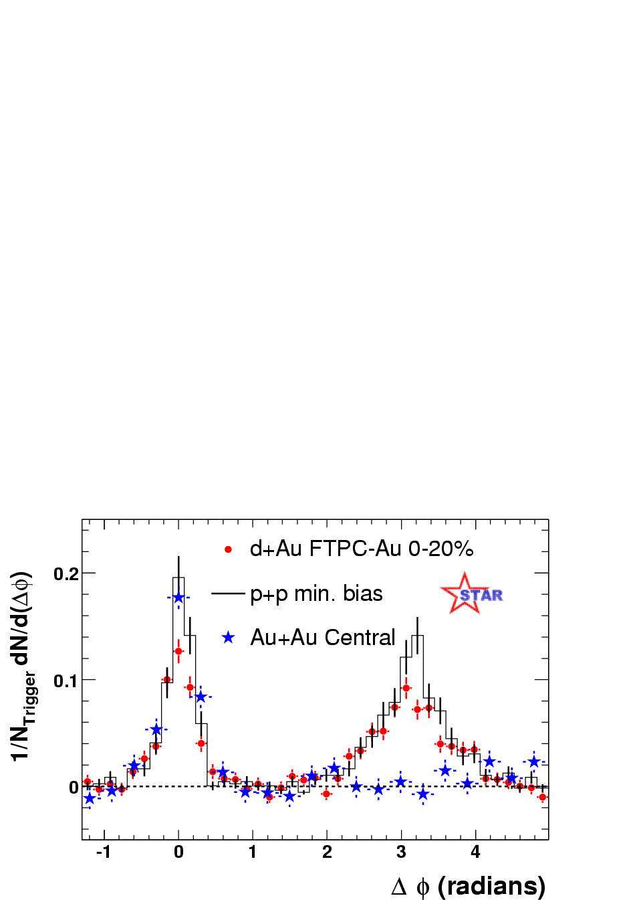
Quantifying Cold Nuclear Matter Effects
Suppression in Au+Au not observed in d+Au
Au+Au “Disappearance of the awayside jet” not in d+Au
Pedestal&flow subtracted

Slide 28
Cold Nuclear Matter
R_{pPb} for hadrons and jets are consistent with 1
Energy Loss?
No

Slide 29
Cold Nuclear Matter
Centrality dependence observed at PHENIX and ATLAS
Rapidity dependence studied at ATLAS
Other explanations besides energy loss include the Shrinking Proton
  partons with a higher momentum fraction probe a smaller cross-section of the nucleus
Energy Loss?
Interesting but Probably Not

Slide 30
Cold Nuclear Matter
Energy Loss?
Maybe but at what stage?
Broadening in p+A in two particle correlations
Broadening indicative of radiative energy loss

Slide 31
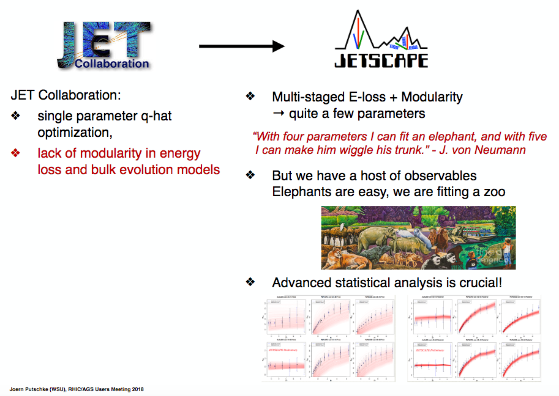
Theory Comparisons
Amount of experimental measurements with the dawn of the LHC is impressive and continually growing (Xe+Xe)
Models need to describe all stages of the collision to fully explain the increasingly precise data
Theory Collaborations
http://jet.lbl.gov/documents-1/
report-on-status-of-qhat

Slide 32
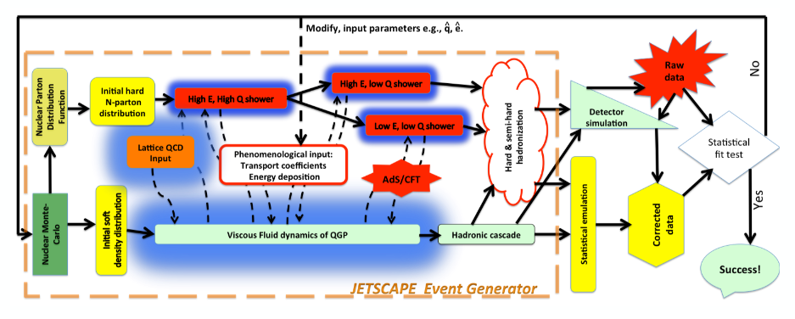
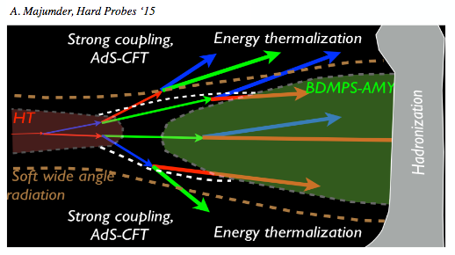
JETSCAPE

Slide 33
Interesting Jet Presentations
QM ’18
Definition of Jets in a Large Background, RBRC June 2018
Probing Quark-Gluon Matter with Jets July 23-25 at BNL
Hard Probes (next month)
Santa Fe Jets and Heavy Flavor Workshop January
High p_{T} Workshop, Knoxville TN, March 2019

Slide 34
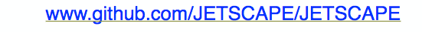

Tool Box
JETSCAPE
Jet finding algorithms: FastJet
Unfolding: RooUnfold
Review of Jet Measurements:
  Connors et al, arxiv:1705.01974

Slide 35
Future for Jets
Wealth of data is being analyzed and new observables are being explored
Major progress on theory side and with theory-experiment collaboration
sPHENIX will start data taking in 2023
Jets at the EIC (NAS Report Released in July)

Slide 36
Take home messages
Jets are a useful probes of the QGP
Reconstructed Jets are a robust observable
We have learned a lot about jets in the QGP without reconstructing jets
Reconstructed jets allow us to study modifications to the substructure of the jets
Photon tagged jets are a golden probe for studying energy loss in the QGP
RHIC and LHC are complimentary facilities
  Run 2 underway at LHC
  sPHENIX starts data taking in 2023
  Theory collaborations bridge gap in apples to apples comparisons

