Slide 1
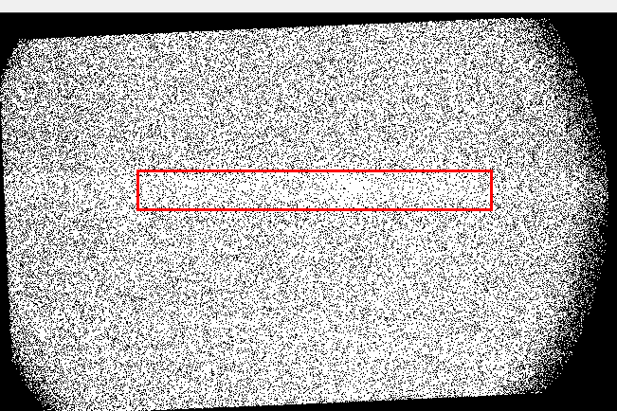
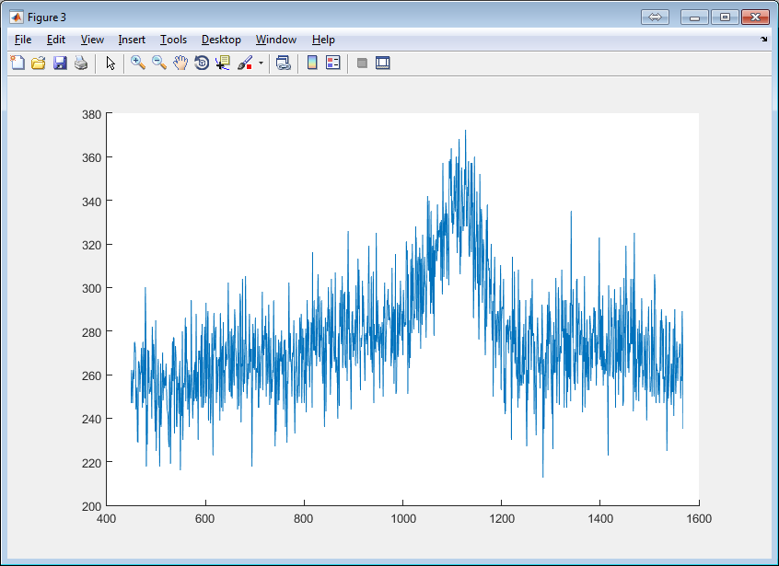
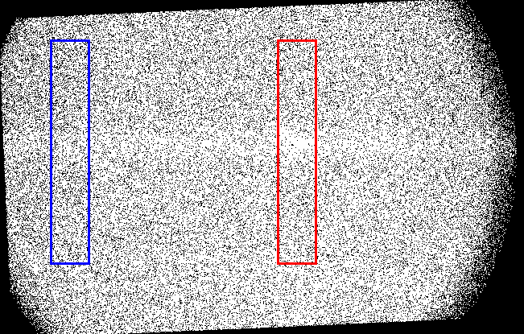
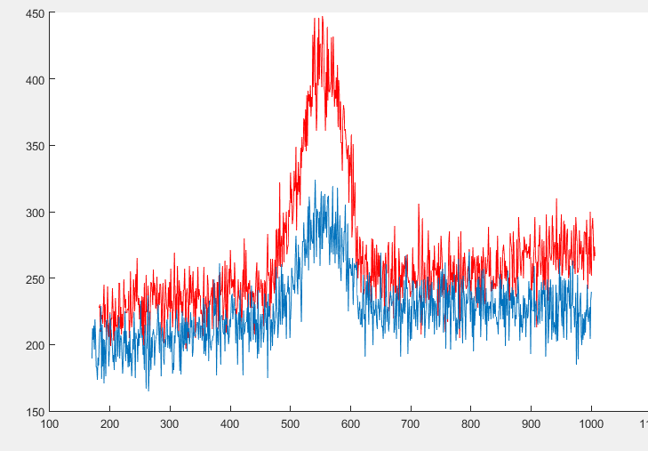
Electron beam
Energy: 5keV
Current: ~30uA
Pressure: ~6*10⁻⁸ mbar
4000 s integration time
Inlet pressure increased to 8 bar
111 pixel
88 pixel

Slide 2
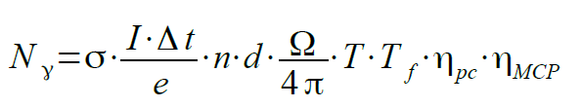
Density calculation
E = 5 keV
Sigma = 1.66e-18 cm⁻²
I = 30 uA
Delta_t = 4000 s
d = 2.8 mm
Omega = Pi*4e-4 sr
T = 0.7
T_f = 0.3
Mu_pc = 0.3 ???
Mu_MCP = 0.5
N ~ 5000
e = 1.6e-19 C
n ~ 4.56e15 m⁻³

