Slide 1

HP side simulations
DeLaval nozzle + first skimmer
(first results)
Przemysław Smakulski
2018-02-09

Slide 2
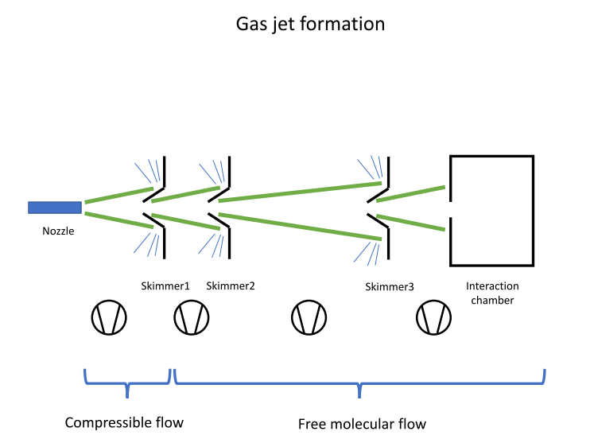

Slide 3
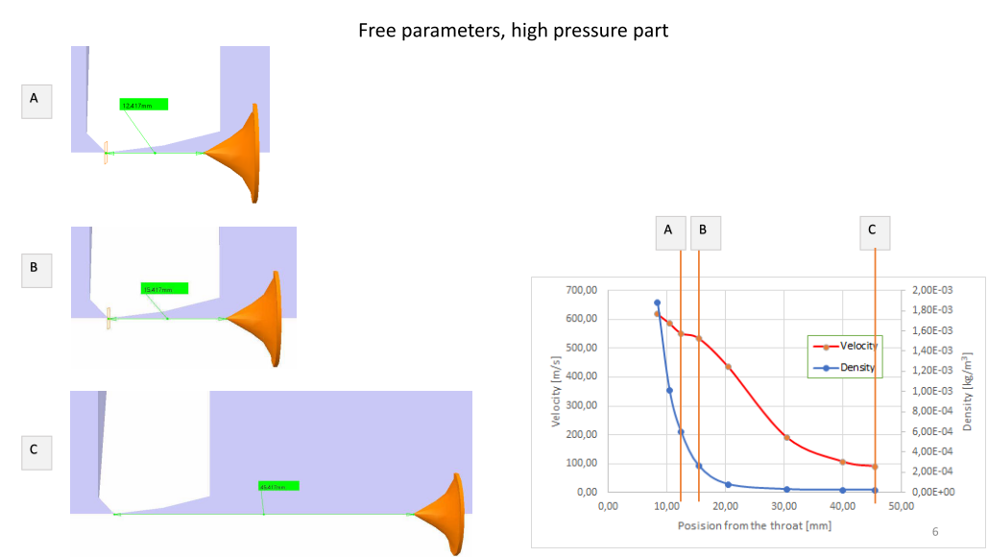
Data for nozzle inlet pressure 10 bar !

Slide 4
Bounadry conditions
Gas: Nitrogen
Zero thickness Skimmer inlet
Distance: position A (prev. Slide)
DeLaval nozzle 30μm throat; 3 bar Inlet pressure
Pressure 1 Pa (absolute)
Temperature 20ºC
!!!!
Pressure 0 Pa (absolute)
Temperature 20ºC

Slide 5
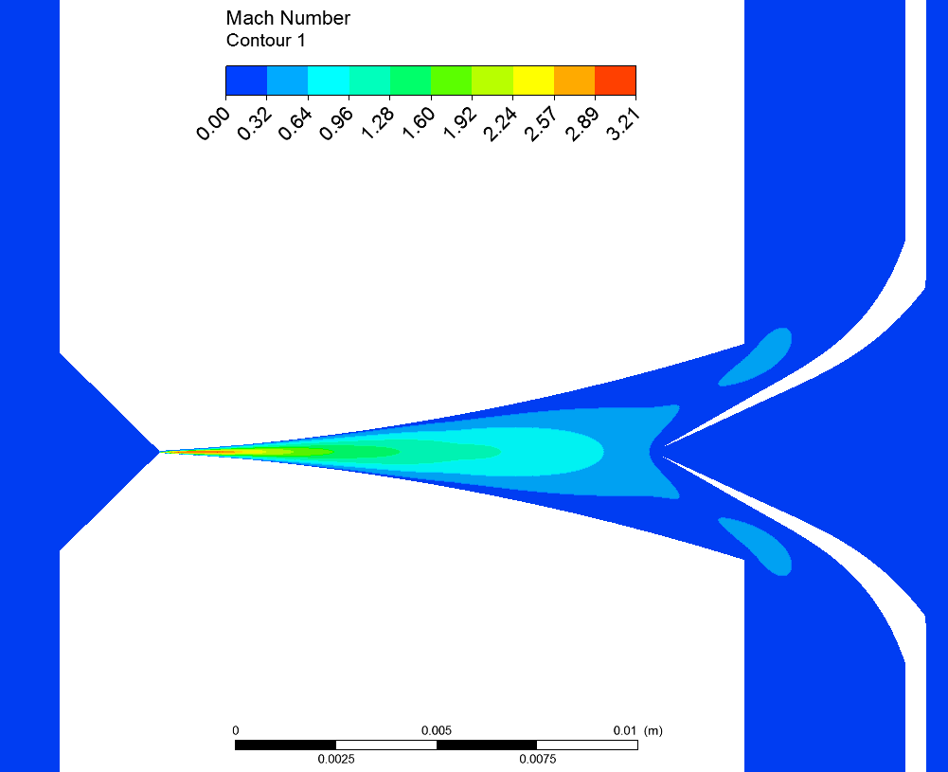
Results – Mach number
1st Skimmer geometry
De Laval nozzle

Slide 6
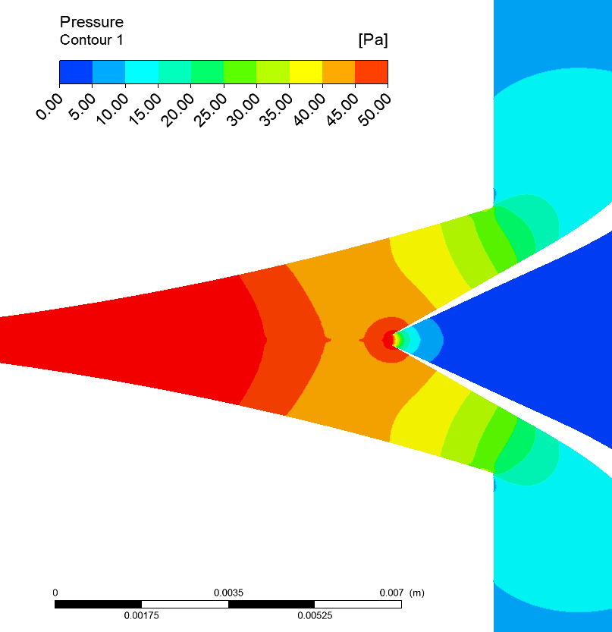
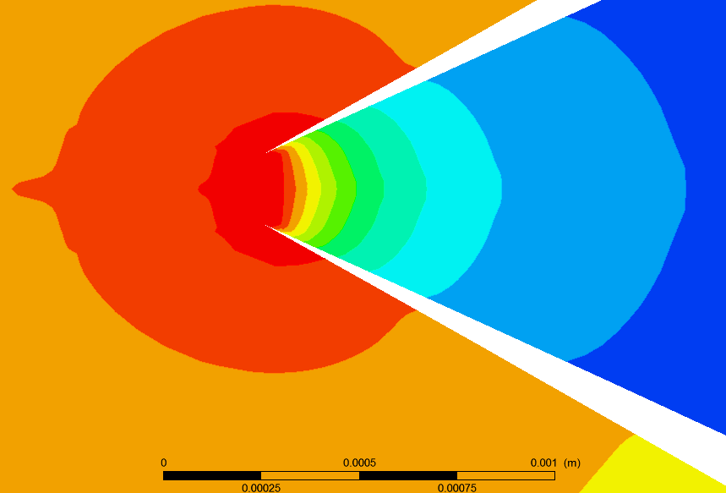
Results - pressure
Viscous flow region

Slide 7
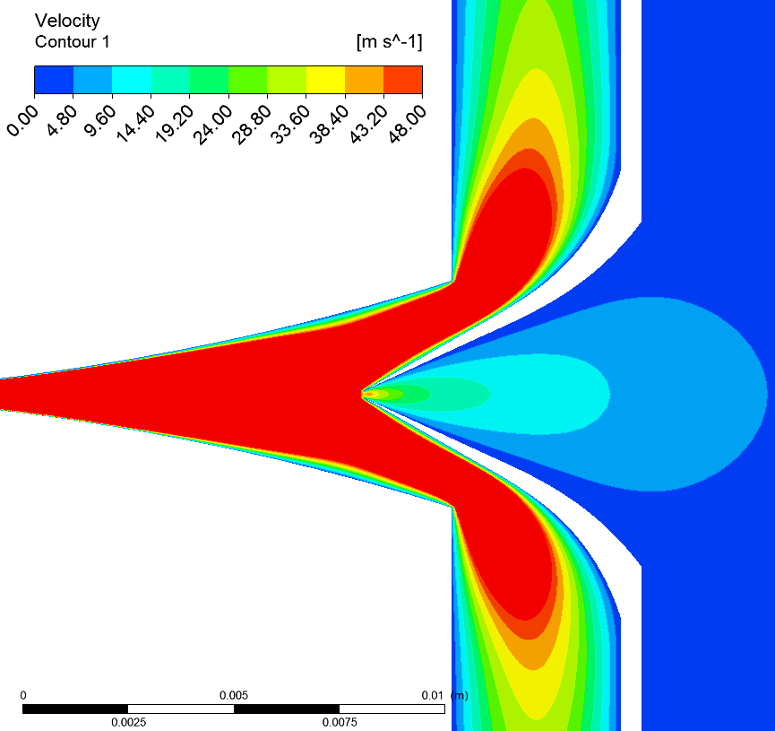
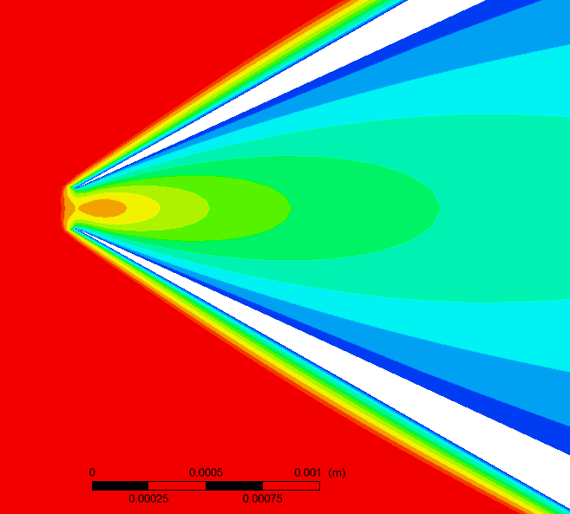
Results - velocity

Slide 8
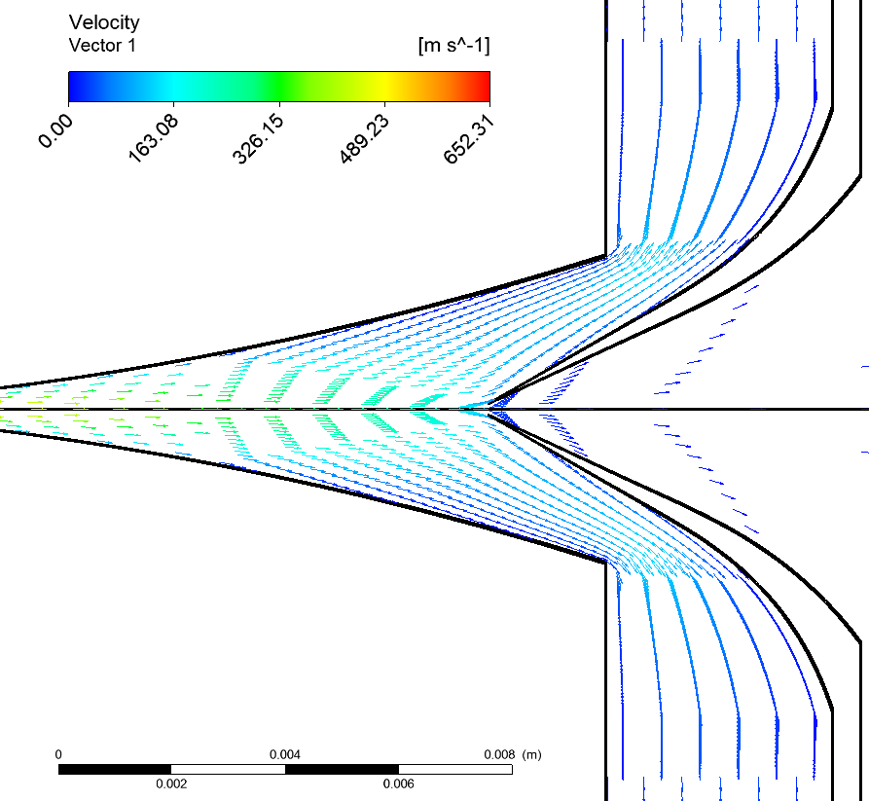
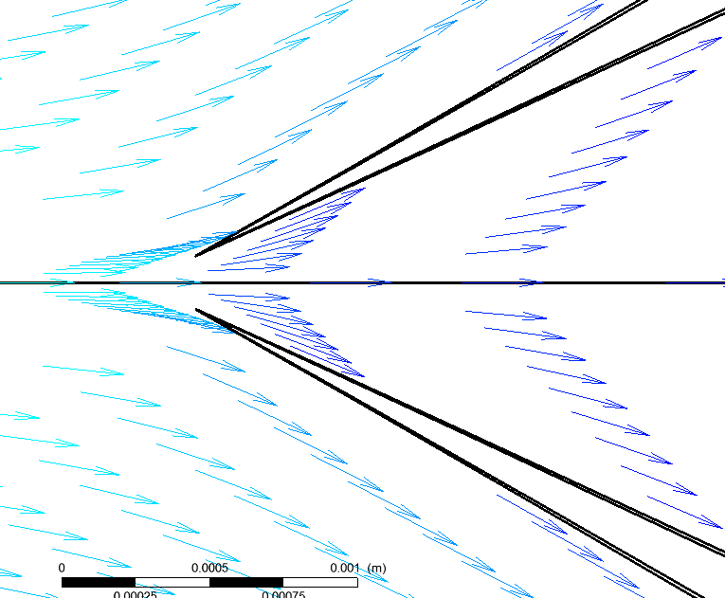
Results – velocity vectors

Slide 9
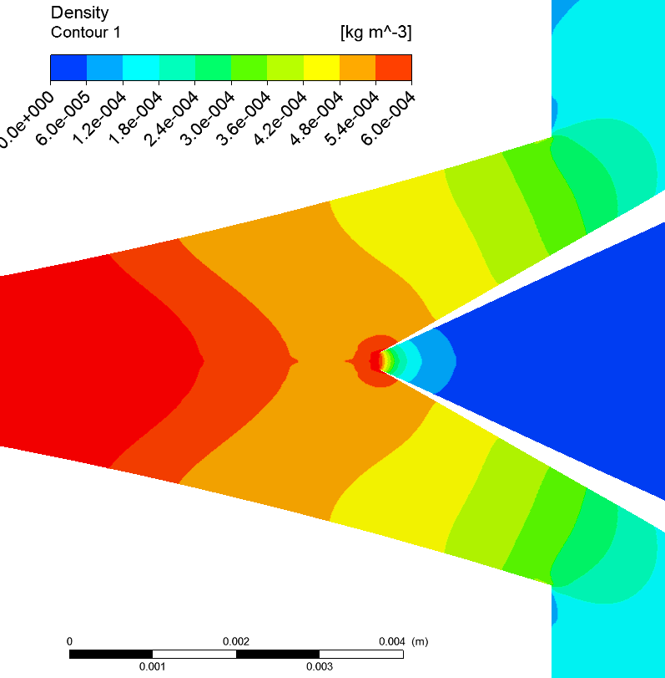
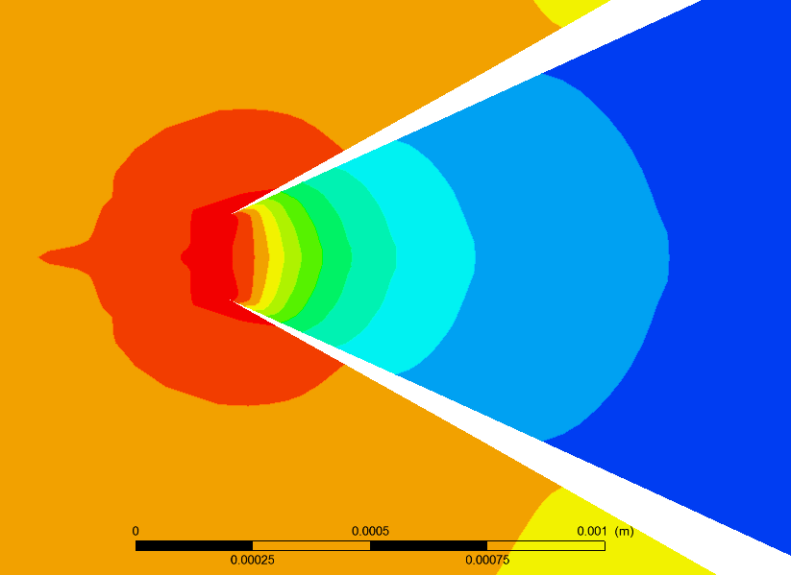
Results – Density
Density at the 1st Skimmer for
nozzle inlet pressure 3 bars is the same high as for the predicted density for
nozzle inlet pressure 10 bars.
(see slide 3)

Slide 10
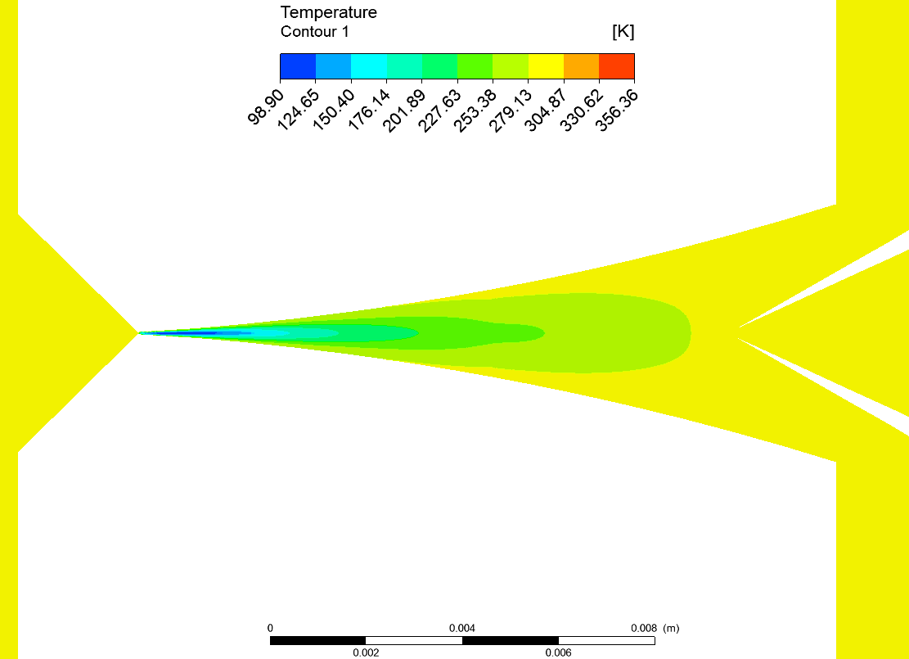
Results - Temperature
For specified boundary conditions, the temperature is above temperature of liquid nitrogen (77K @ 1 bar absolute pressure)
Potentially safe situation

Slide 11
Conclusions
The simulation shows high density of the Nitrogen gas @ Skimmer 1 for specified boundary conditions.
Due to viscous character of the flow at the Skimmer 1 is possible to shape Skimmer wall entrance to minimise back pressure generation (aerofoil like shape)

Slide 12
Still to consider in HP side …
Geometry shape of the Skimmer 1
Distance before Skimmer 1
Optimized shape of the nozzle / type of the nozzle
Pressure and temperature level before Skimmer 1 and between Skimmer 1 and Skimmer 2

Slide 13
Complementary numerical simulation information

Slide 14
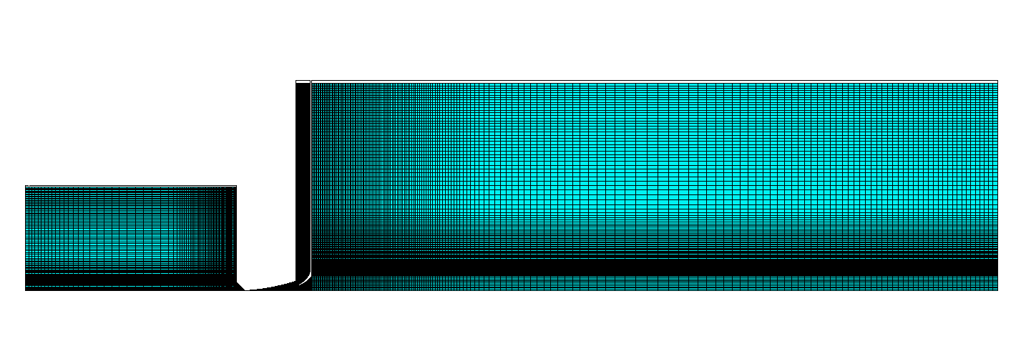
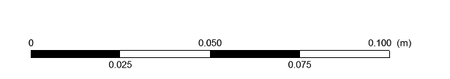
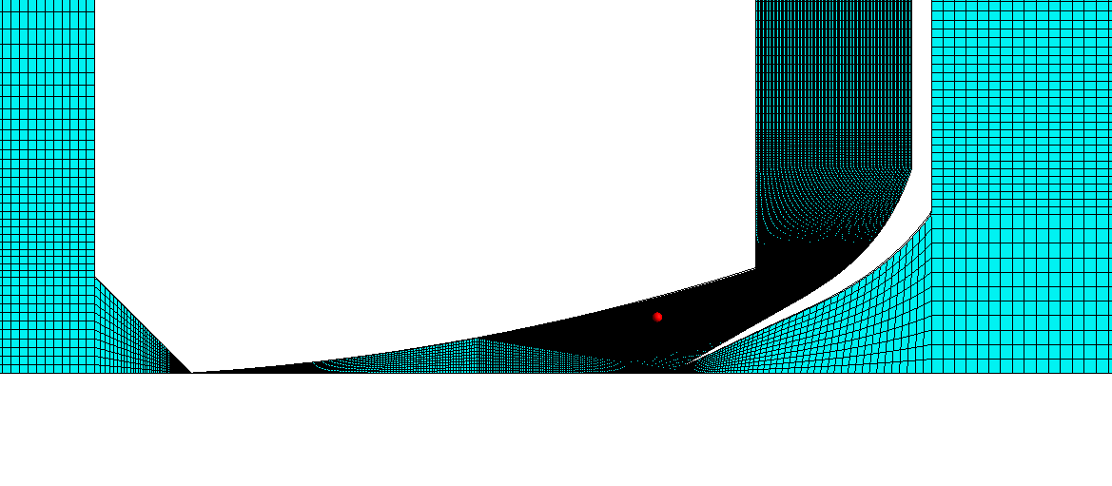
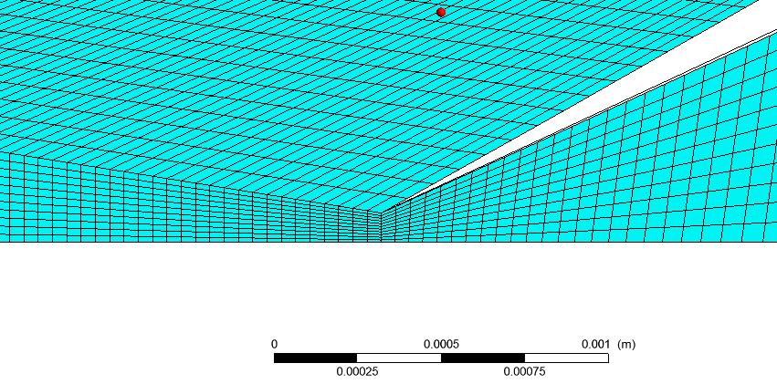
Numerical Mesh

Slide 15
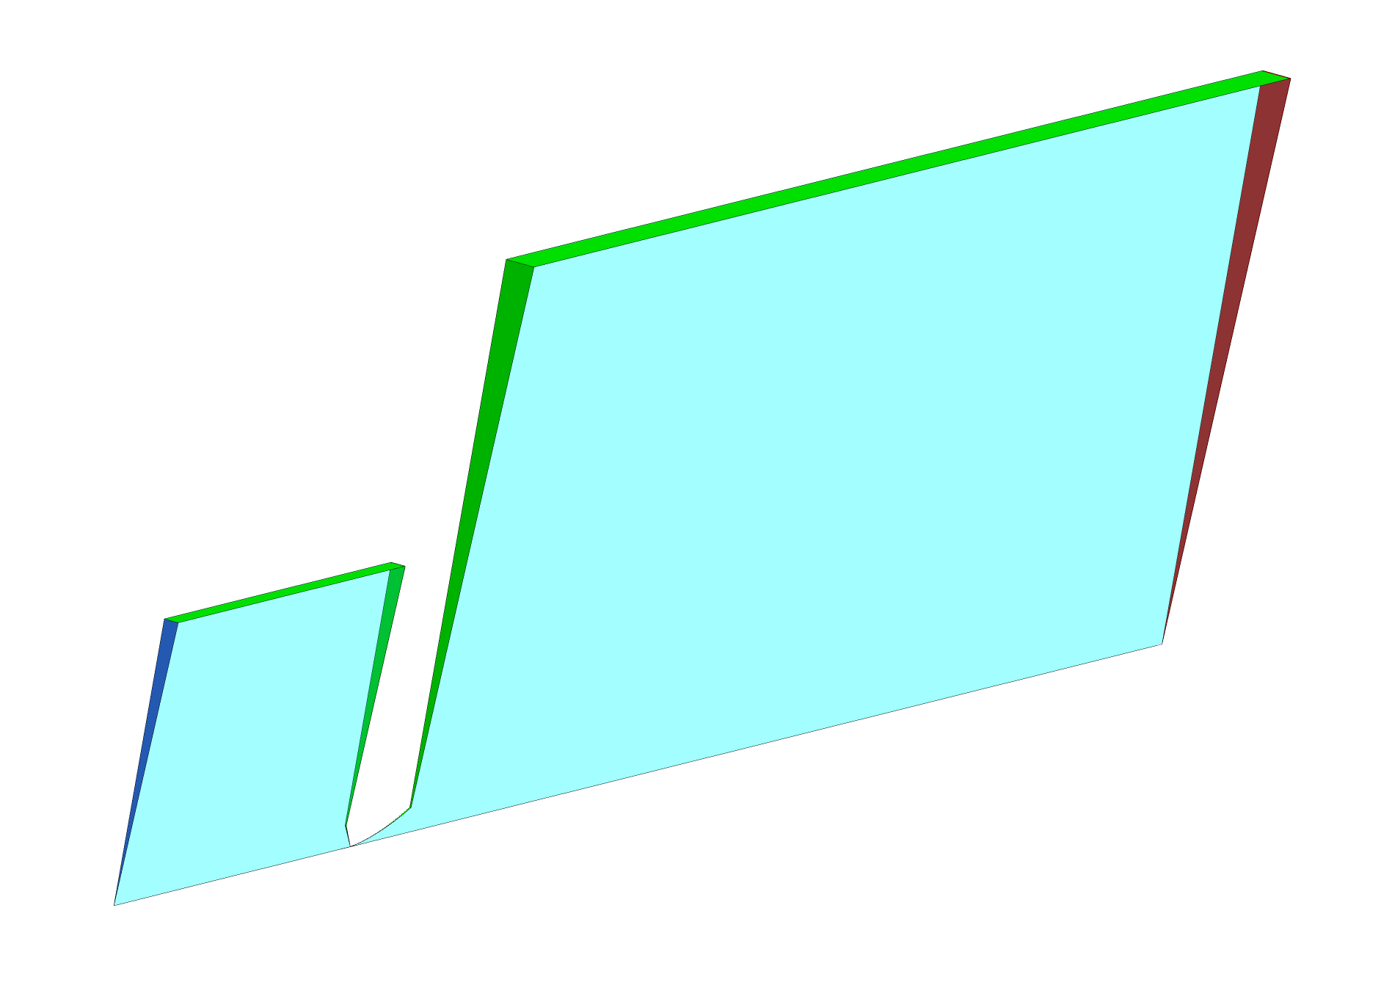
Numerical Domain: 2D simulation
Outlet
BC type: opening
Adiabatic wall
Inlet
BC type: opening
Rotational periodicity
Symmetry edge

Slide 16
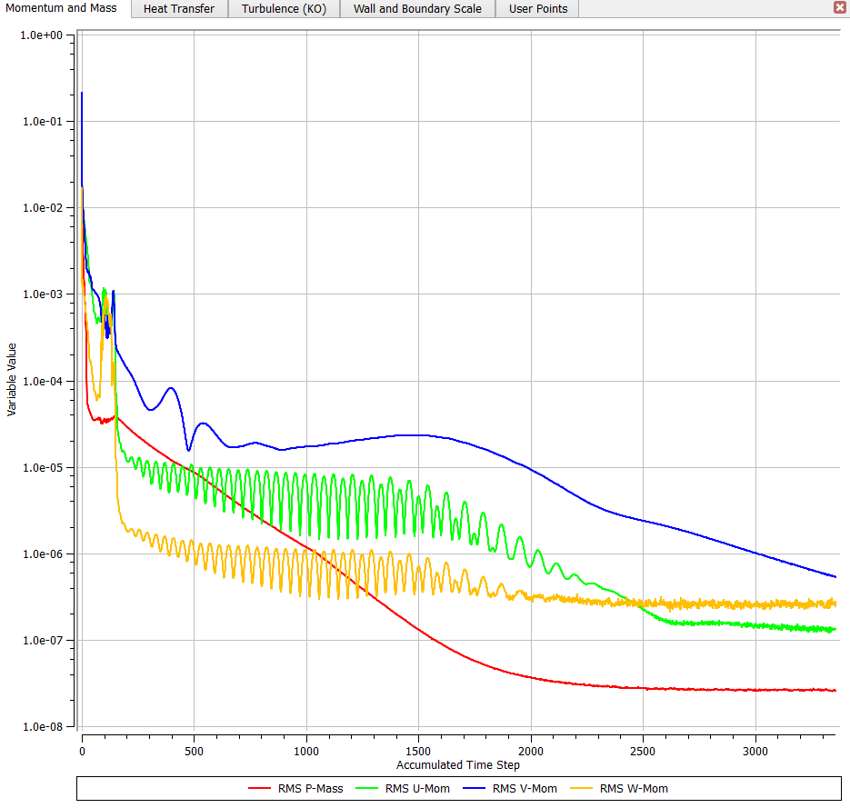
RMS numerical error
Below 10e-6

