Slide 1
MQXFS1d Welding Status
Antonios Vouris
Cold Mass Status Meeting
12 February 2018

Slide 2
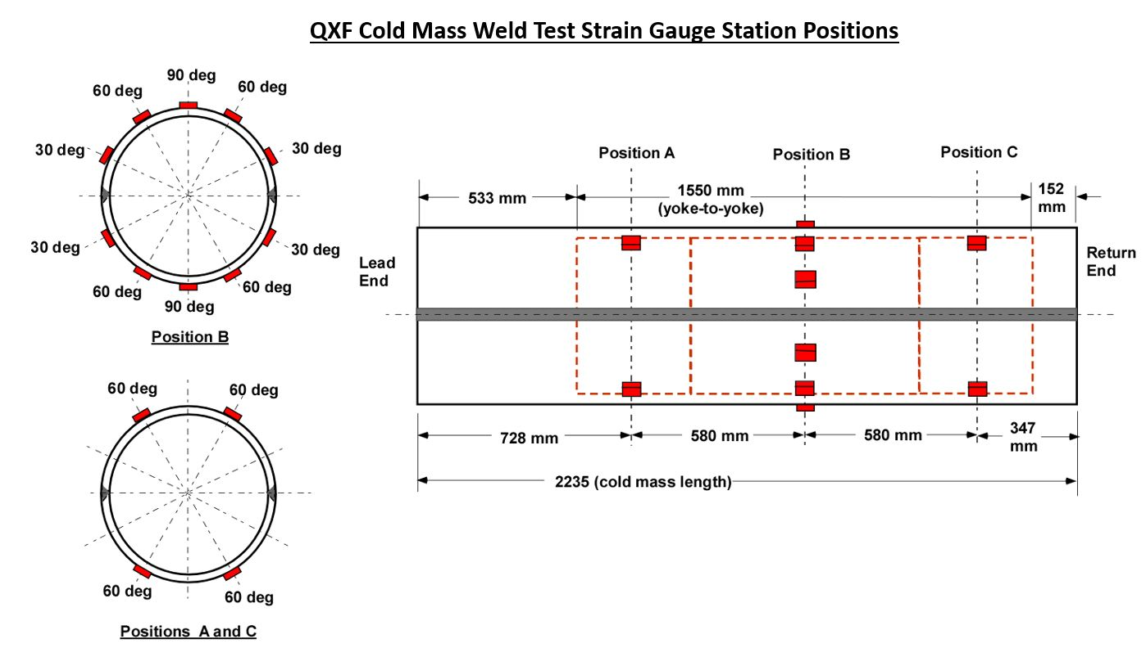
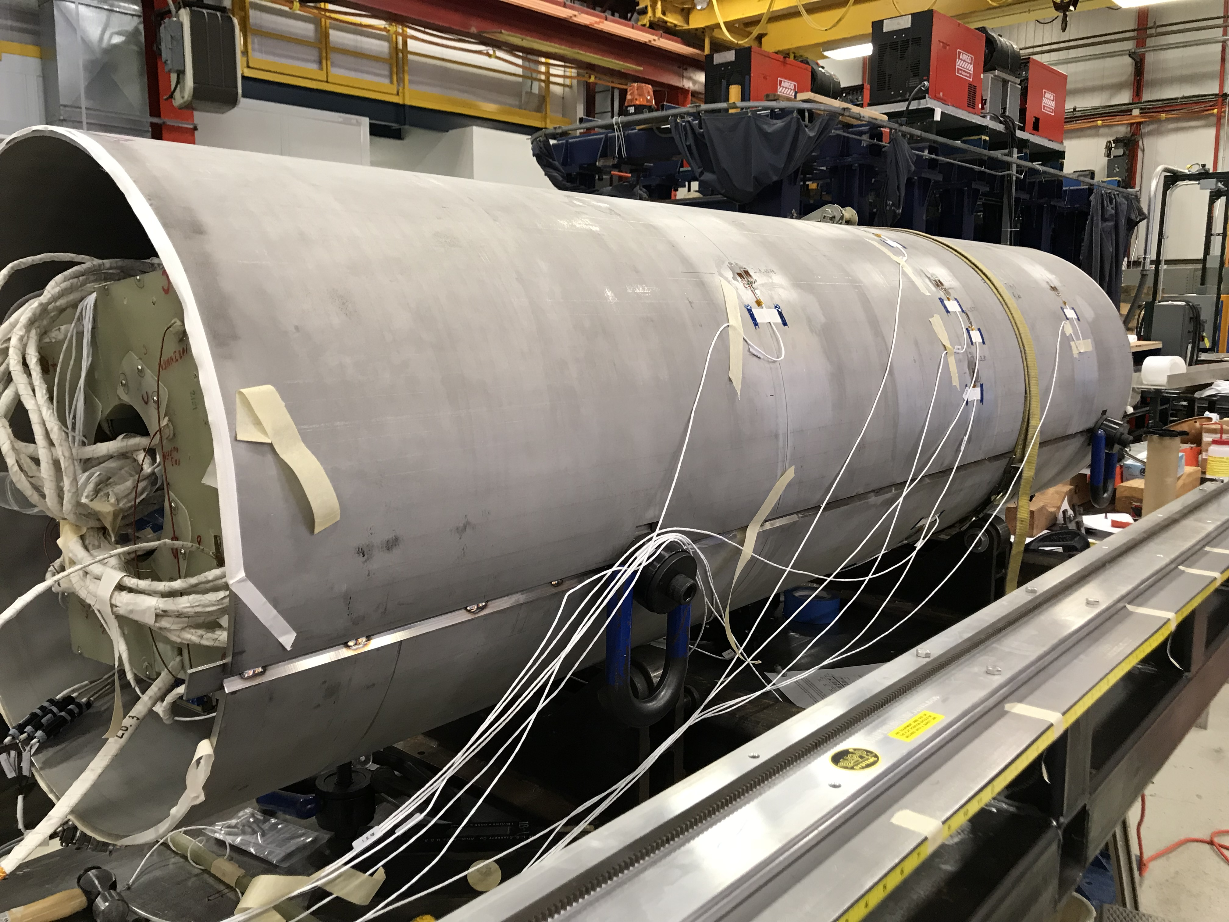
Gauges
Strain gauges and read out system is ready
RTD’s and read out system is working – 4K temp rise
during tack block – Backing plate welding.

Slide 3
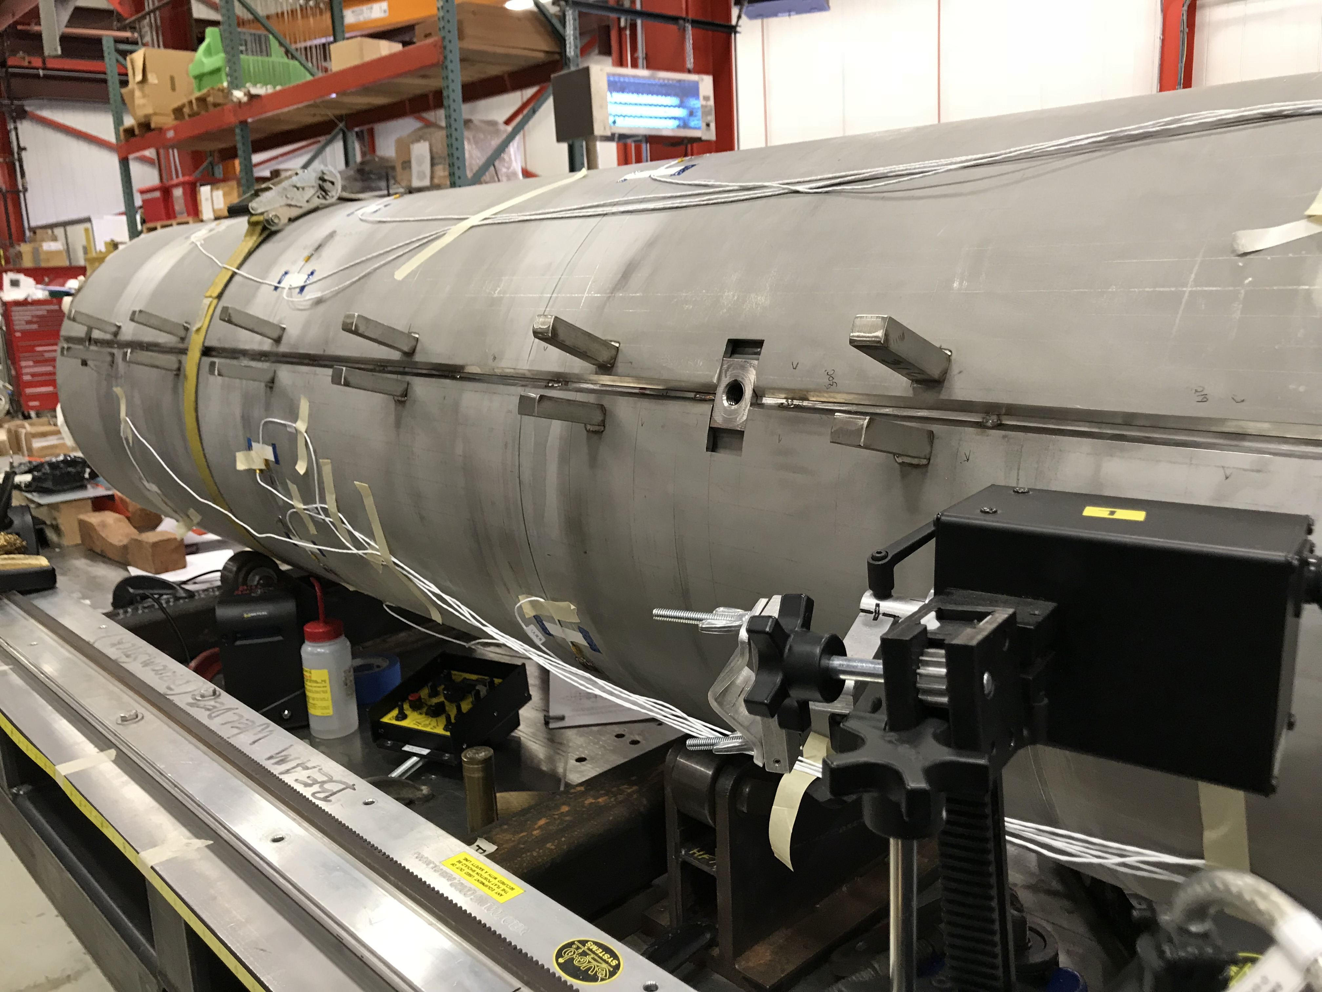
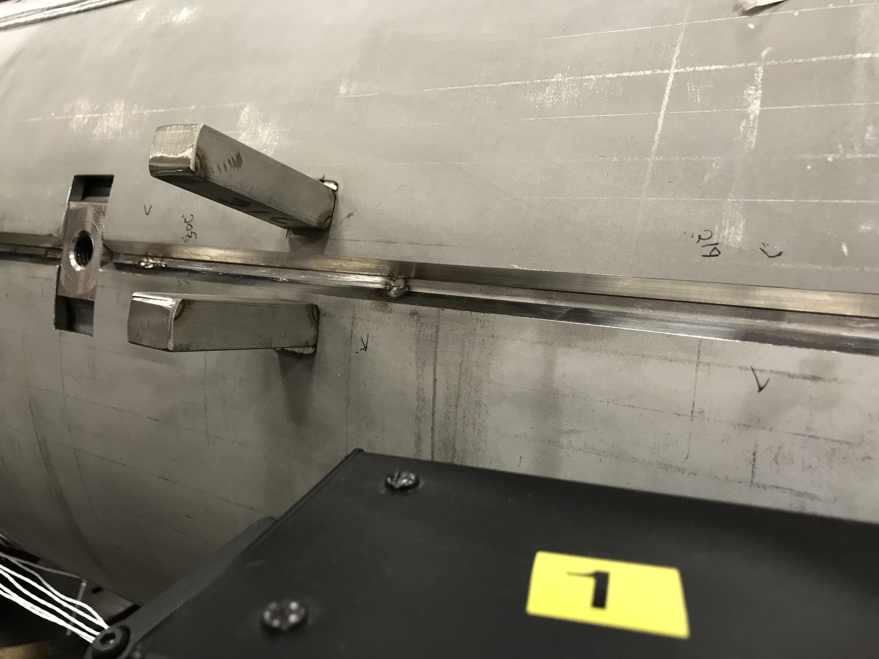
Shell Fit Up & Welding
Root Gap actual .18” (4.5 mm) – need .09” (2.2 mm)
Clamps welded to draw closed while reading gauges.
If all goes well, assume tack this week, welding to start next week.

