Slide 1
Status of Q1/3 cryostat interfaces
D. Ramos, H.Prin , 8/2/2018

Slide 2
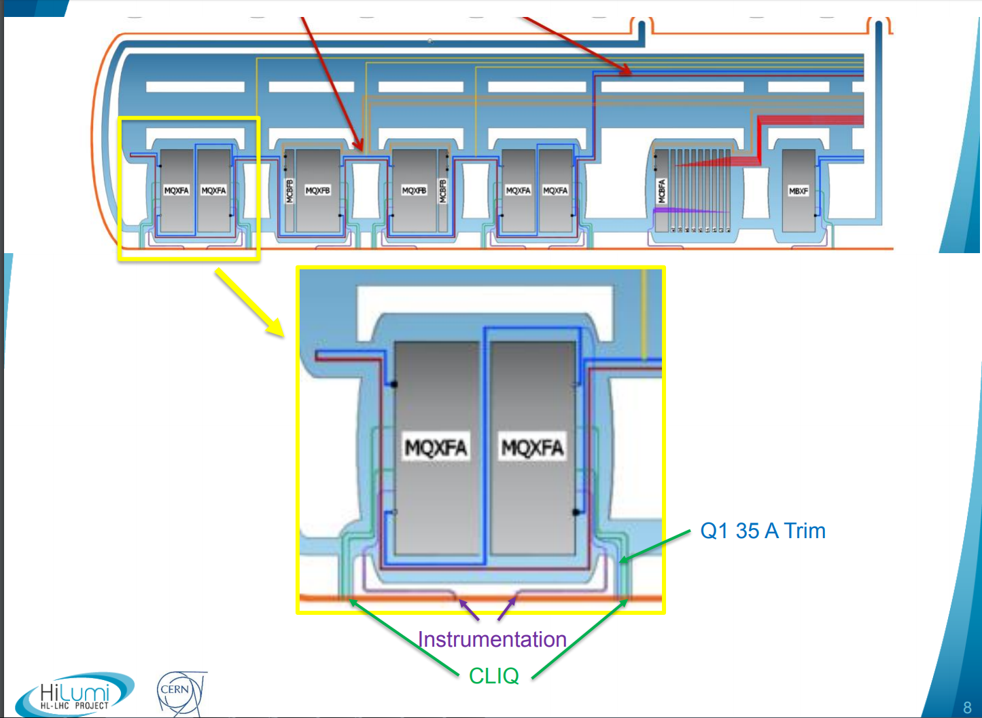

Slide 3
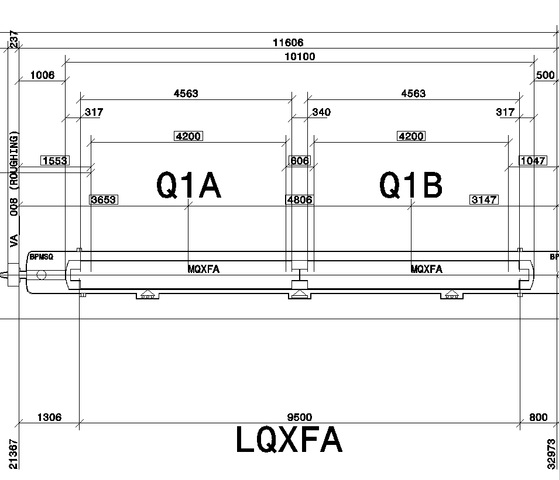
Instrumentation
Instrumentation
35 A trim
CLIQ
CLIQ

Slide 4
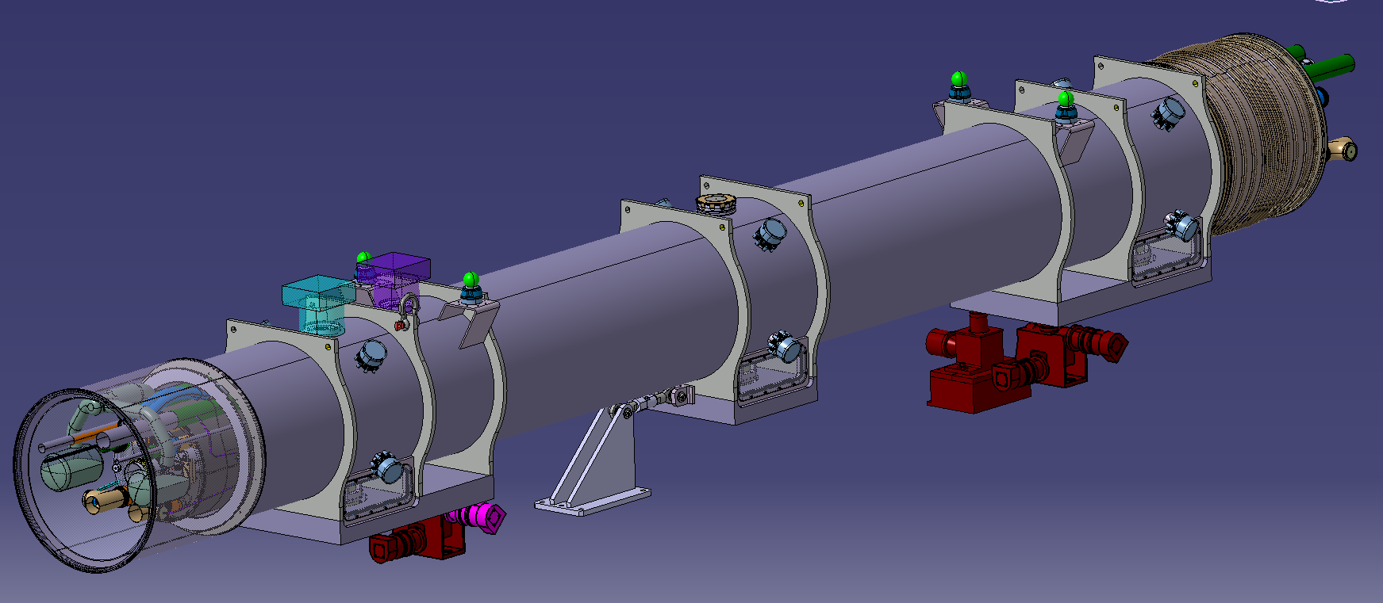


Straight pipes may be used as return lines during testing. Supplied with extra length (~100 mm on either side)
Not supplied
Not supplied
ISO clamped flange with elastomer seal for testing
Welded during service module assembly at CERN

Slide 5
Cryostat kit supplied by CERN
Supplied
  Vacuum vessel
  Themal shield
  MLI blankets
  Support posts
  Straight piping: pumping lines, themal shield line, quench line
  Supports for piping on cold mass
  Pressure relief valve for vacuum vessel
  IFS cover flange
Not Supplied
  Service module kit
  Manifolds/ phase separators
  Expansion joints
  Jacks
  Longitudinal anchor
  Vessel end covers
  Packing end covers, transport boxes and crates for shipping of the cryo-assembly to CERN
To be discussed
  FSI components
  Taylor Hobson survey supports

Slide 6
Cold mass kit supplied by CERN
Supplied
  Low cobalt plates for the shell (flat plates)
  End covers
  Cold bore tube
  Heat exchangers including expansion bellows
  Temperature sensors
  Auxiliary busbar tubes Busbar pipes
  Flexible hoses for busbar line
  Flat cables for busbars
  Instrumentation capillaries
  CLIQ leads and capillaries
  35 A leads
  Flanges and flares
Not Supplied
  Expansion joints
  Cold mass support saddles
To be discussed
  Flanges
  FSI components
  Busbars

Slide 7
3D model available soon
We are currently fine tuning the piping positions and selecting diameters and thicknesses for industrial availability

