Slide 1
Track ML
Adrian Alan Pol
Cesare Calabria
Valentin Volkl
Adriano Di Florio
May 25nd – Third Patatrack Hackaton – Final Scram

Slide 2
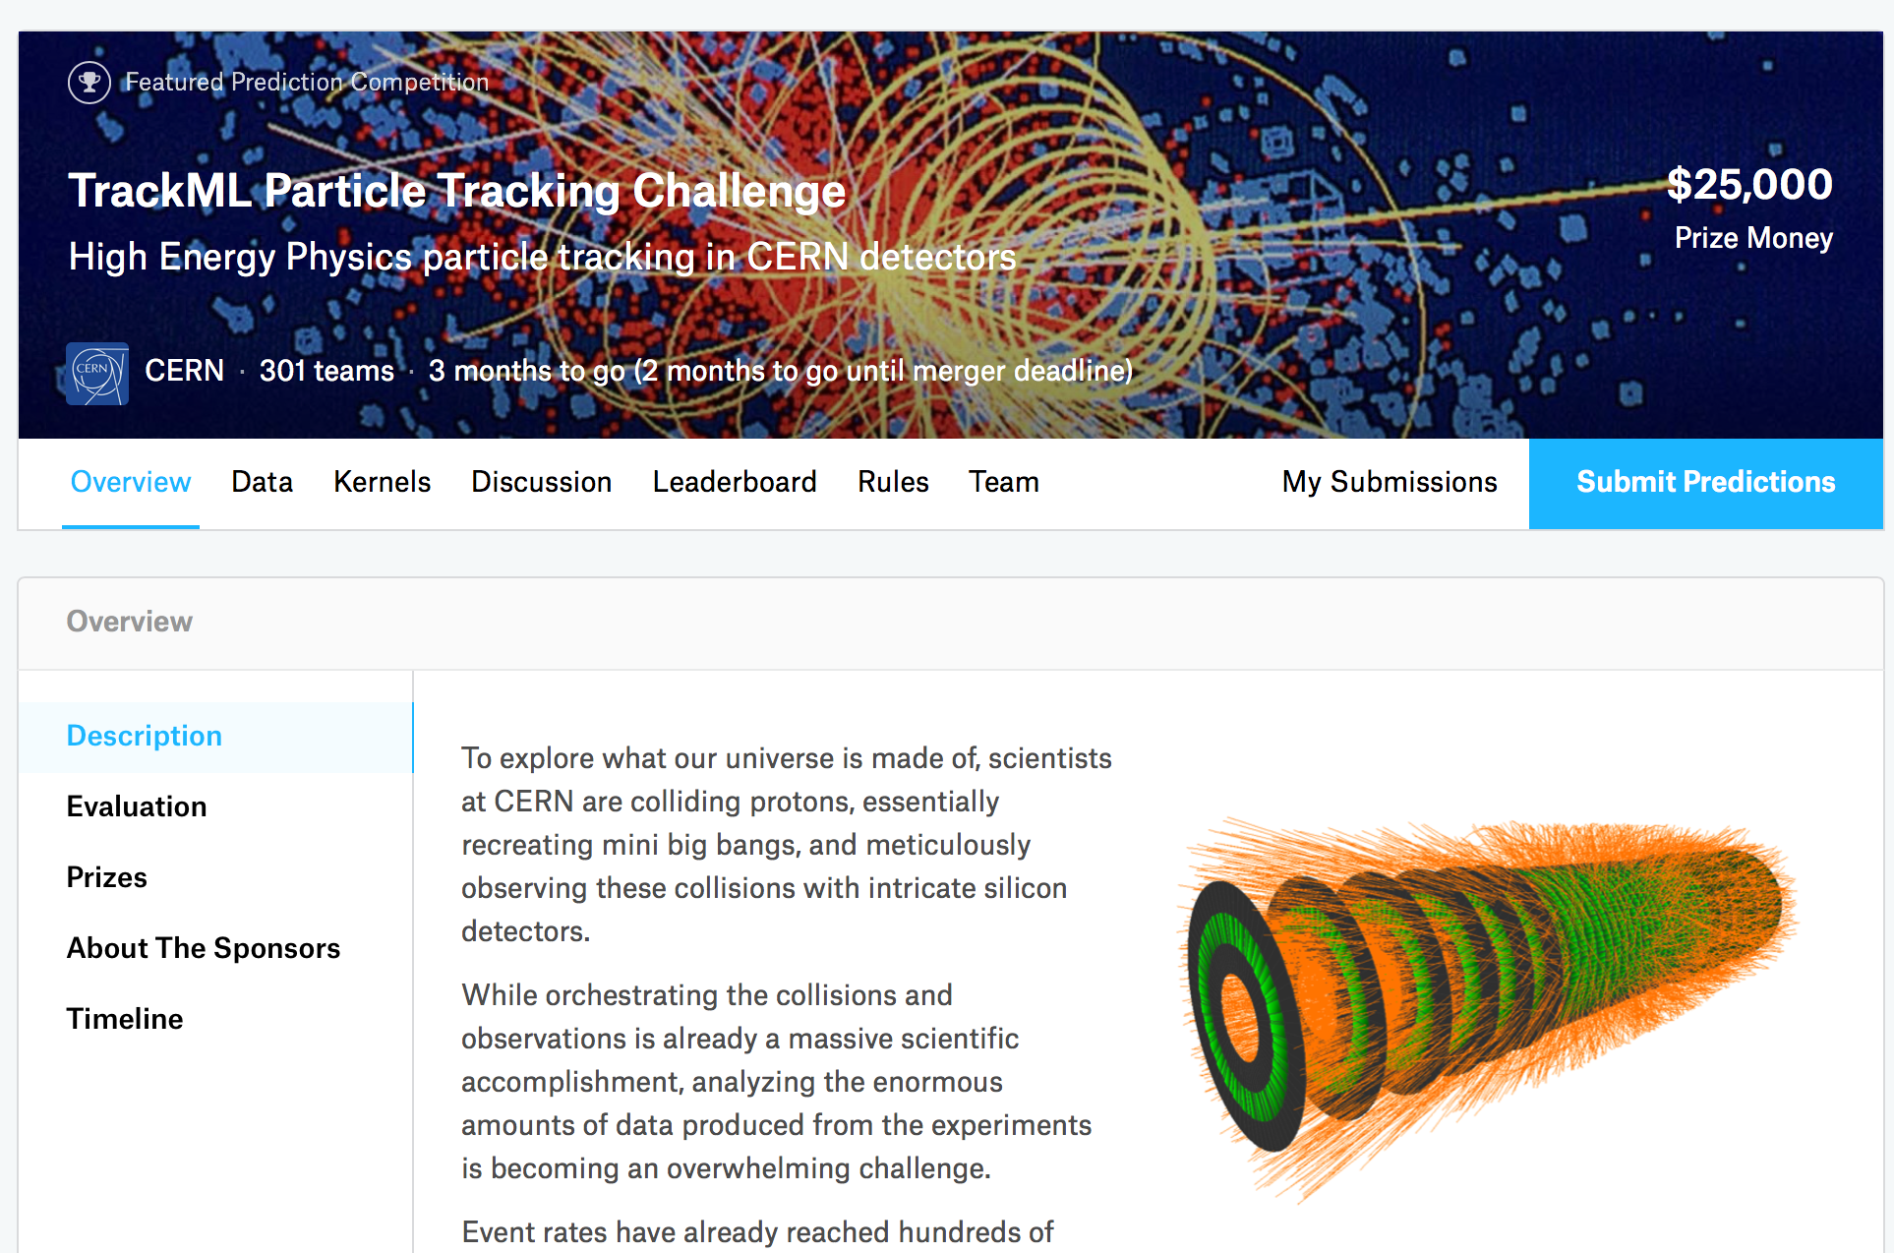
The aim – TrackML challenge
Start to work together on the challenge
https://www.kaggle.com/c/trackml-particle-identification
• O(10k) particles, O(100k) hits
• HL-LHC like environment (PU=200)
1

Slide 3
What has been done
Data exploration and visualization . . . like a lot of it
2

Slide 4
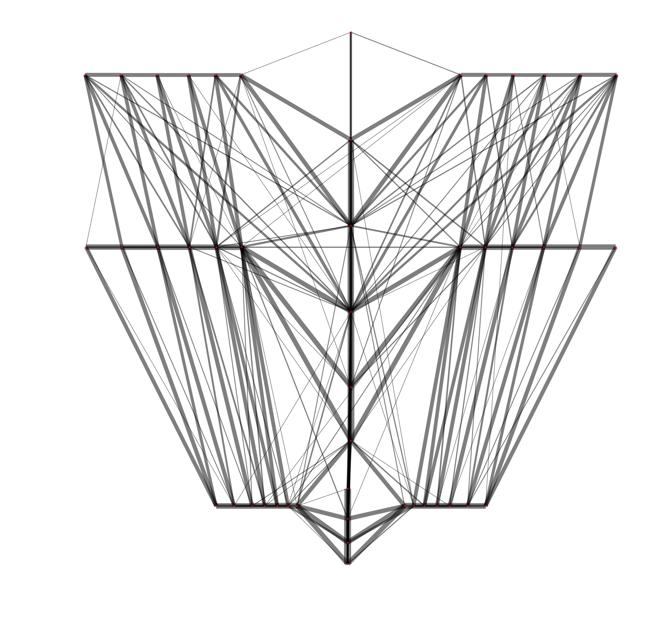
What has been done
Started to share resources and know-how
CA Graph
Set up a strategy and start building from that
“Tracking-like” NN based workflow
Building seeds (quadruplets)
From quadruplets predicting next hit position with a RNN
Taking all the hits in a fiducial region around the predicted position
Reiterate until no hit found in the fiducial region
Clean tracks (DNN-like model)
- TrikTrak CA for building triplets/quadruplets (running on c++ with pybindings) done
Interfaced directly with the pandas trackML dataset
- RNN for extending the seeds from 3rd or 4th to 4th or 5th hit done
Tuned, rethought and is working kind of neatly. Need to tune the fiducial region to get a proper efficiency/duplicates ratio
- Concatenation of RNNs to extend from nth hit to (n+1)th hit done
https://gitlab.cern.ch/adpol/trackml
3

Slide 5
What we learned and what’s next
Better to focus on a simpler version of the challenge by now ignoring small issues, of course (e.g. multiple hits on the same layer)
We got familiar with the dataset and the challenge
Continue to work on the challenge in the next months as a group
We understood that 20-30 people will finish all the pasta you prepare whatever the ammount (lowerlimit ~ 5kg)
What’s next
Tuning CA/TrikTrak parameters and cuts to get the best balance efficiency/fake rate rejection
How to properly propagate the RNNs
How to properly select of hits with a fiducial region
Train/test and submit
4

