Slide 1
Fermilab Education Update
Spencer Pasero
International Particle Physics Outreach Group
19 April 2018

Slide 2
Updating the vision for Fermilab outreach
Three-phase plan:
Phase I: Inventory
  The Office of Communication and the Office of Education and Public Outreach compiled an inventory of current outreach programs at Fermilab, including goals, audiences, recent impacts, and self-assessment.
Phase II: Independent Committee
  Director Lockyer convened a committee to review the inventory and draft a report describing a vision for the future of Fermilab’s outreach. That report is expected next month.
Phase III: Design and Transition
  A team of Fermilab outreach personnel will develop a long-term strategic outreach plan for the Lab informed by the committee’s report and our resources and expertise.

Slide 3
Scope
First task: define “public outreach.”
We took an expansive view, including five categories of programs:
  Formal education:
    Professional development for teachers and engagement with students as part of their school or university curriculum, or
    A Fermilab-organized educational program with its own rigorously defined units of study.
  Informal education: Raising awareness and appreciation of science, including Fermilab’s science areas, with in-person programs and activities outside the classroom.
  Internships & Fellowships
  Community relations: Building and maintaining supportive relationships with members of the local and regional communities.
  Online communication products: Raising awareness about particle physics and Fermilab among the local, national, international public.

Slide 4
Scope
What is not included?
  Educational programs aimed at postdocs, faculty members or staff scientists;
  Programs aimed primarily at Fermilab employees, facility users or the global particle physics community;
  Programs organized and carried out by Fermilab clubs or affiliated not-for-profit organizations (Fermilab Natural Areas or Fermilab Friends for Science Education);
  Programs other than community relations and online communication products that are part of Fermilab’s strategic communication program;
  Activities intended to recruit new industrial partners;
  Government relations activities.
Notes:
We do include programs that FFSE & FNA _support_, but not that they conduct on their own.

Slide 5
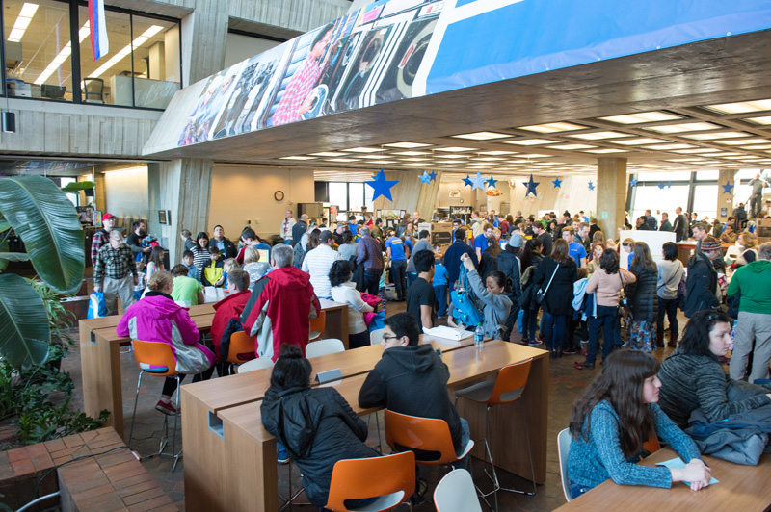
This inventory included 69 programs reaching a total of 93,509 people in FY2016.

Slide 6
Organization of outreach at Fermilab
Fermilab has a large, varied suite of programs and activities that reach the public.
They are led by people from all over the lab.
Most are led or supported by three organizations:
Office of Education and Public Outreach
Office of Communication
Office of Talent Acquisition, Diversity and Inclusion
Hundreds of employees and users support these programs.

Slide 7
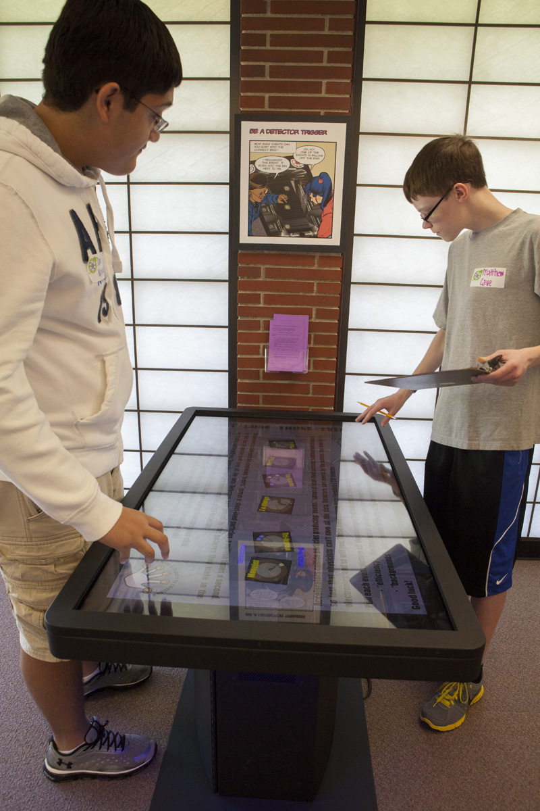
Formal education programs
Hallmark of the lab’s education program
Field trip programs
Teacher professional development
School district improvement
Summer schools for physicists
All formal education programs connect to
the lab’s physics mission or its National
Environmental Research Park; programs
served about 13,800 students and
teachers in FY16.

Slide 8
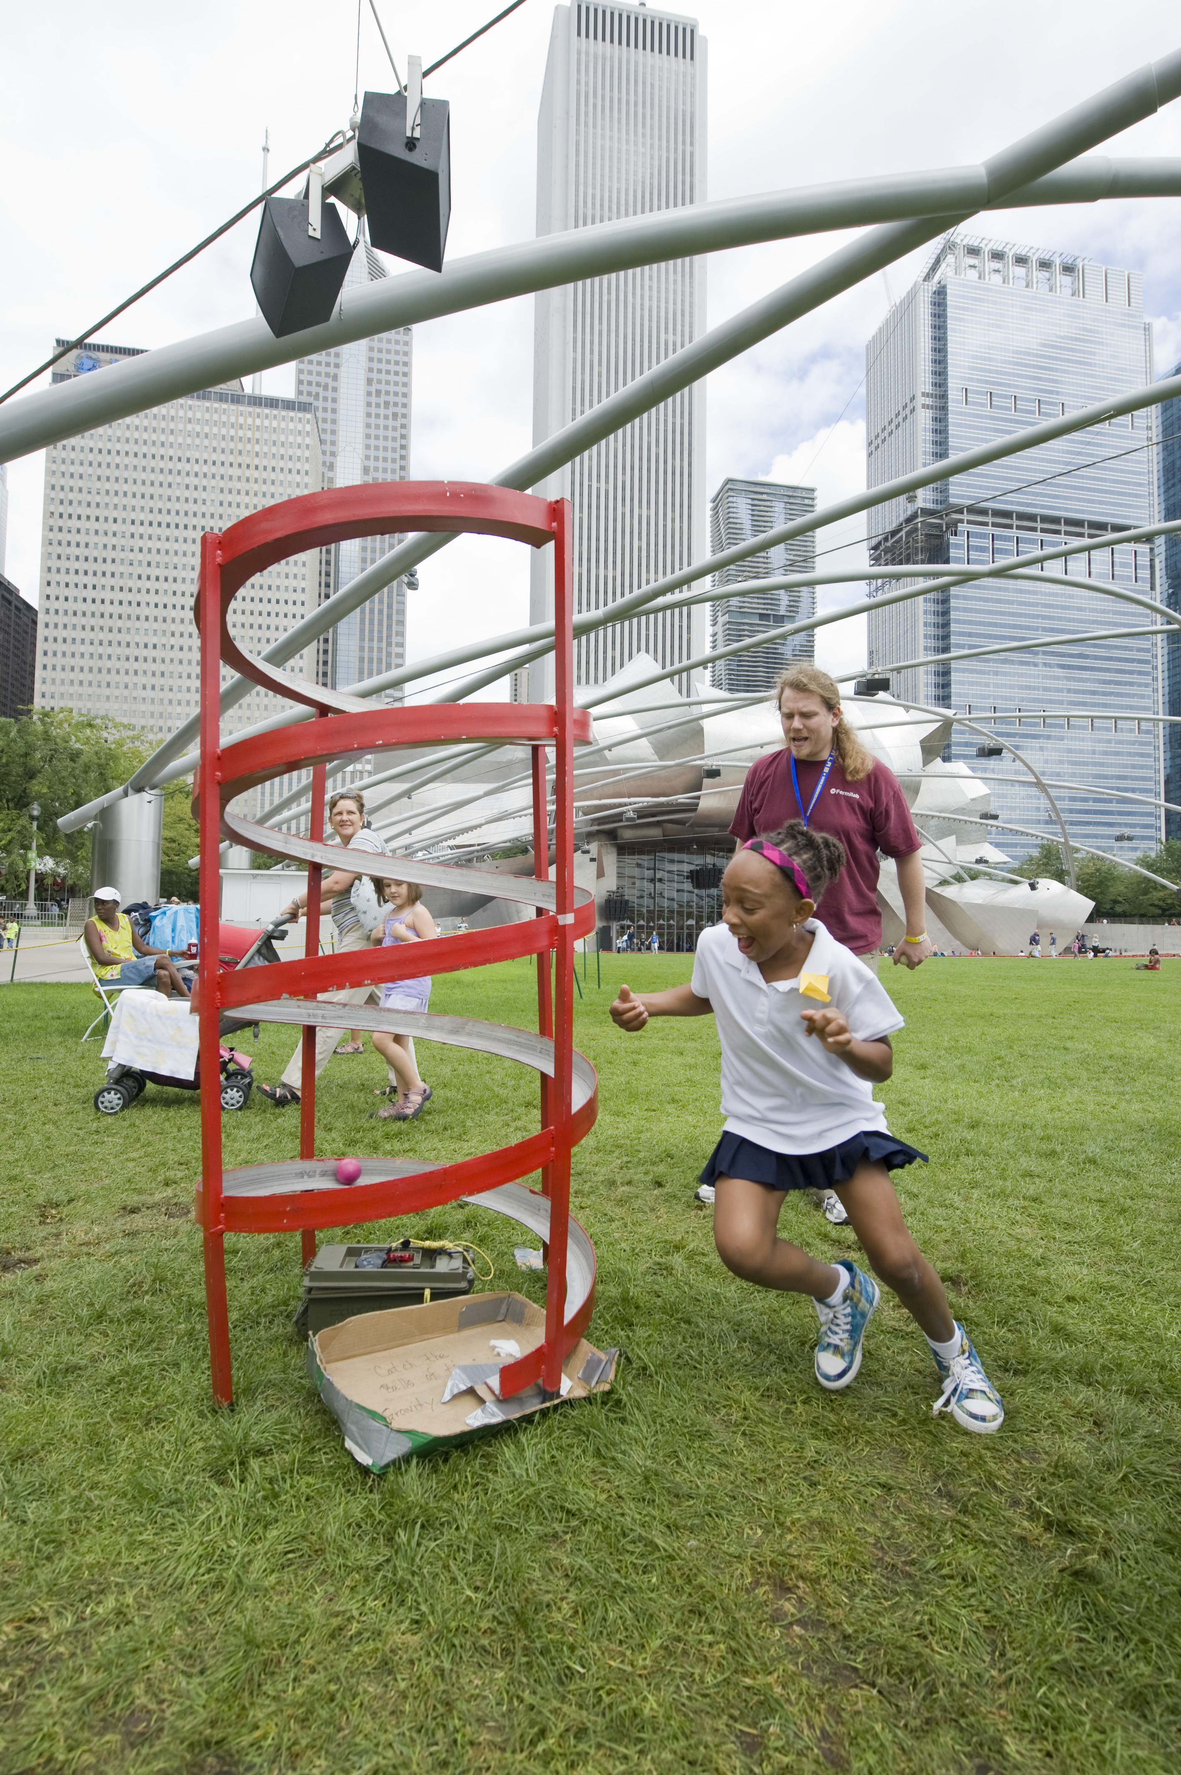
Informal education programs
Share goal of engaging young people and families in science
Classroom presentations (incl. Mr. Freeze) most popular
Three annual major public events
Informal pipeline programs
Ecology programs
Aim of these programs tends toward
inspiration; in FY16 all informal
programs together served more than
42,000 people.
Notes:
Three public events:
-Family Open House
-Wonders of Science
-Outdoor Family Fair
Informal pipeline programs:
-Saturday Morning Physics
-My Brother’s Keeper

Slide 9
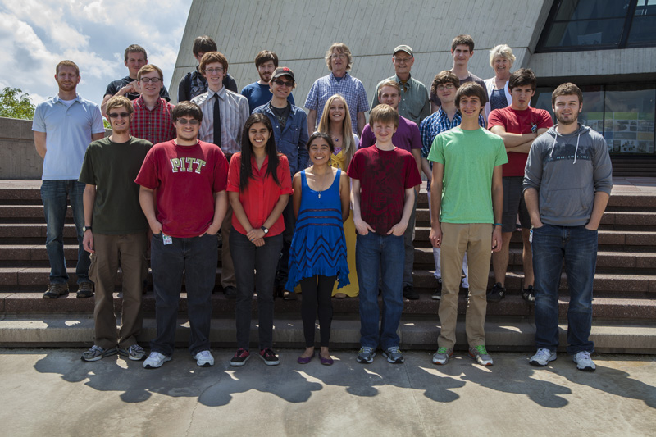
Internships and fellowships
Inventory includes programs through graduate school.
Pipeline:
  High school students
  and teachers
  Undergraduates
  Graduate students
Total of about 100 students served every year.

Slide 10
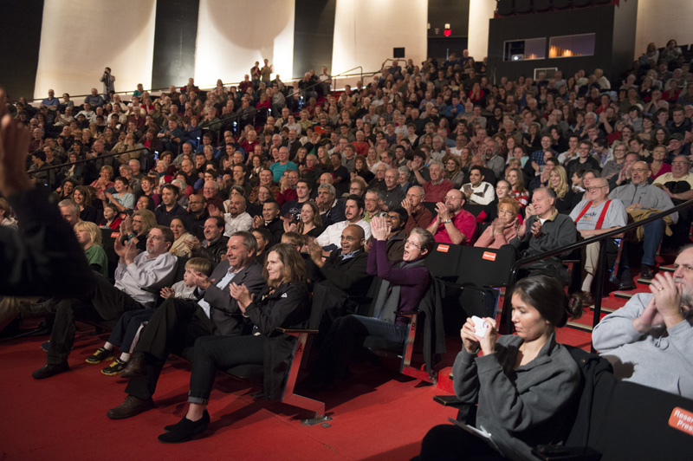
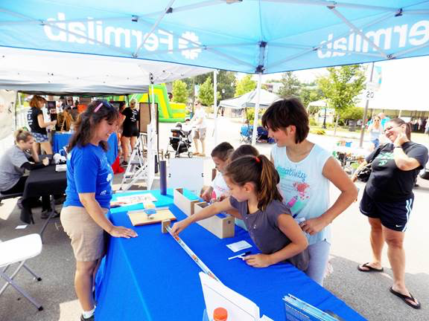
Community relations
Programs targeted at building a positive community relationship
Open site access, self-guided tours
Arts & Lecture Series, Art Gallery
Special events
Community Advisory Board
Community festivals, Ambassador Program
Plus all other programs that reach members of the local/regional community

Slide 11
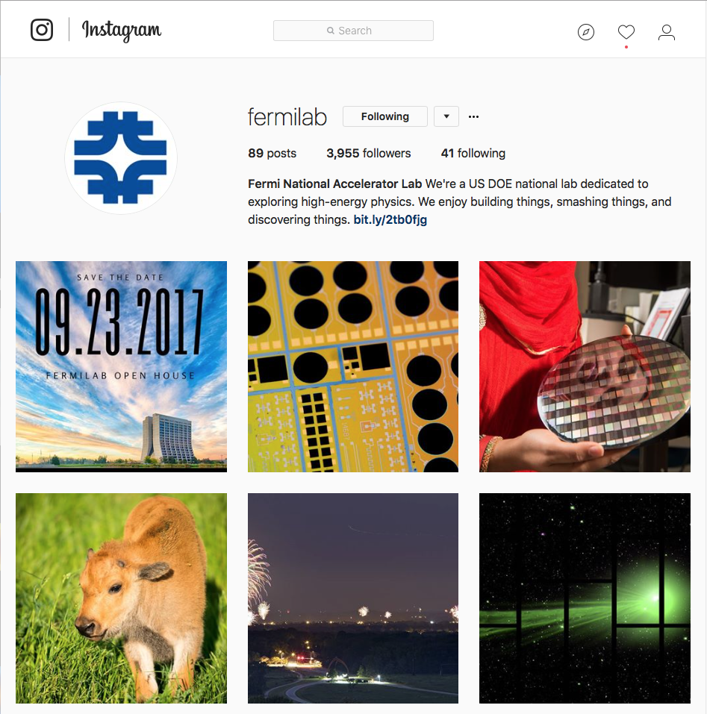
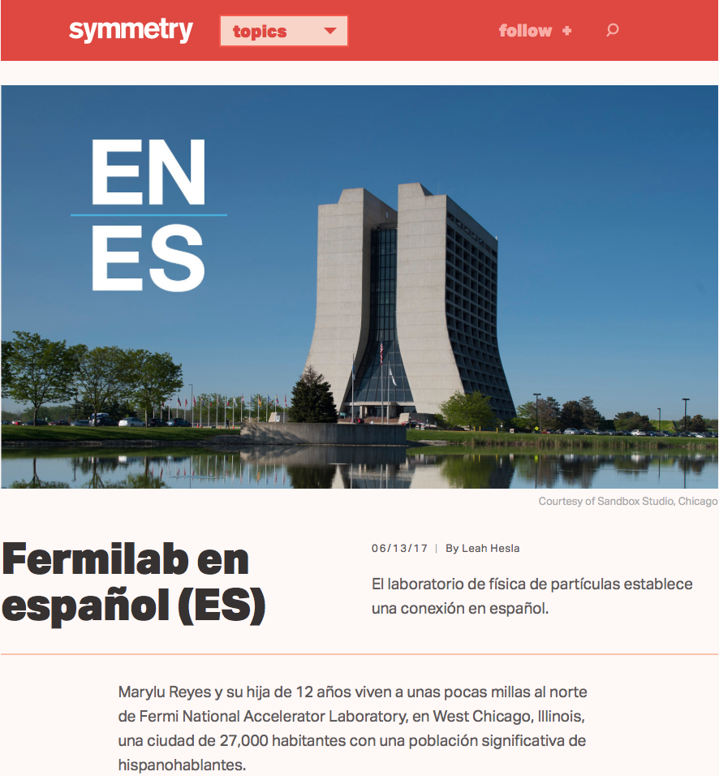
Online communication products
Driven by Fermilab’s communication strategy; convey information about research, people, accomplishments
Social media
Websites
Fermilab Frontiers
Symmetry
Together, these programs
represent an online public communication presence that reaches millions each year

Slide 12
Summary:
First complete inventory of all outreach programs.
Extensive program that reached nearly 100,000 people in FY16 through in-person programs.
Mark of the importance of outreach to Fermilab.
Provides many opportunities for employees, users to support and engage.
Still work to be done to improve diversity & inclusion, international reach/partnership.
As we look back on 50 years, it’s great to also be looking ahead.

