Slide 1
15th IPPOG Meeting – CERN
Panel on Communication
Platforms & Strategy

Slide 2
Communication Strategy
Goals & Priorities
  Highlight IPPOG Activities
  Promote best practices in particle physics outreach worldwide
Content
  Descriptions and Updates of IPPOG Activities
  Educational Content
  Curated High-Level Sources of Content and News
Target Audiences
  Teachers (and inquisitive Students)
    No restriction on age, but primarily high school (14-18yrs)
  Particle Physics Outreachers
Visual Identity
  Logo, Colour Palette, Font
    To be refined during web design

Slide 3
Communication Strategy
Internal & External Networks
  Internal Networks run by IPPOG reps
    Teacher Ambassadors, for example
  E-mail group with link to join or leave
    ippog-friends, perhaps social media groups
Need to define policies & procedures:
  Web content
  Social Media posting & sharing
Translation
  Need a reasonable policy and methods for translation

Slide 4
Public Pages & Resource DB
Development
  Steering Group
    S. Boutas (CERN Webmaster), M. Lapka, P. Watkins, B. Gulejova, H.P. Beck, S. Goldfarb (chair)
  Specifications
    Drupal 8
    Compliance with CERN Support
    Including Infrastructure for Resource Database, Global Cosmics, International Masterclasses
  Status
    Complete specifications based on CERN plans
    CERN Theme to be released this Spring
    Call for Tender Follows Completion of Specifications
    Developer Identified (Barbora)

Slide 5
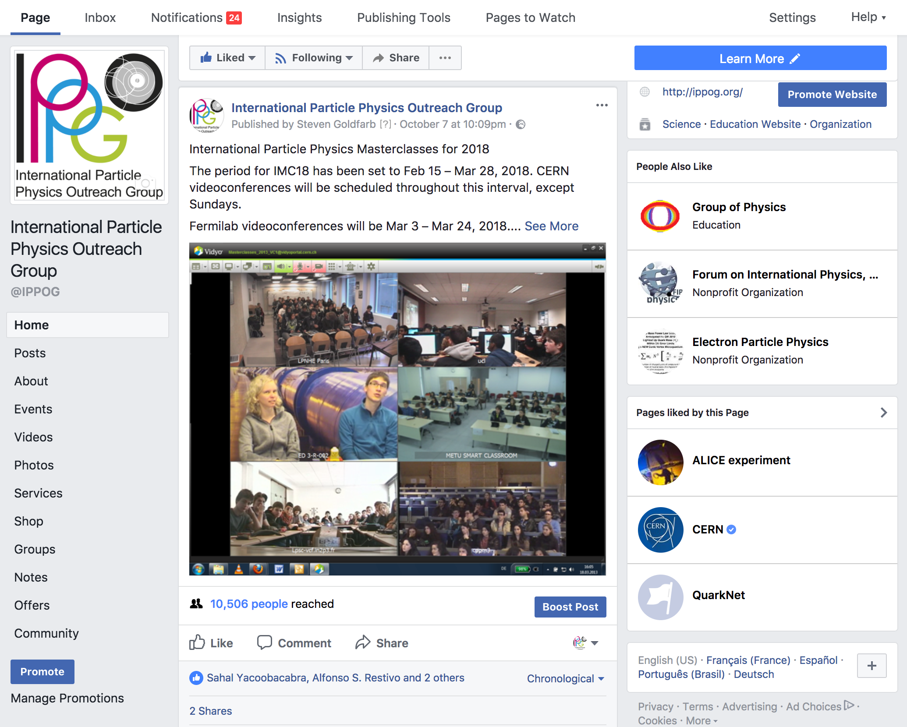
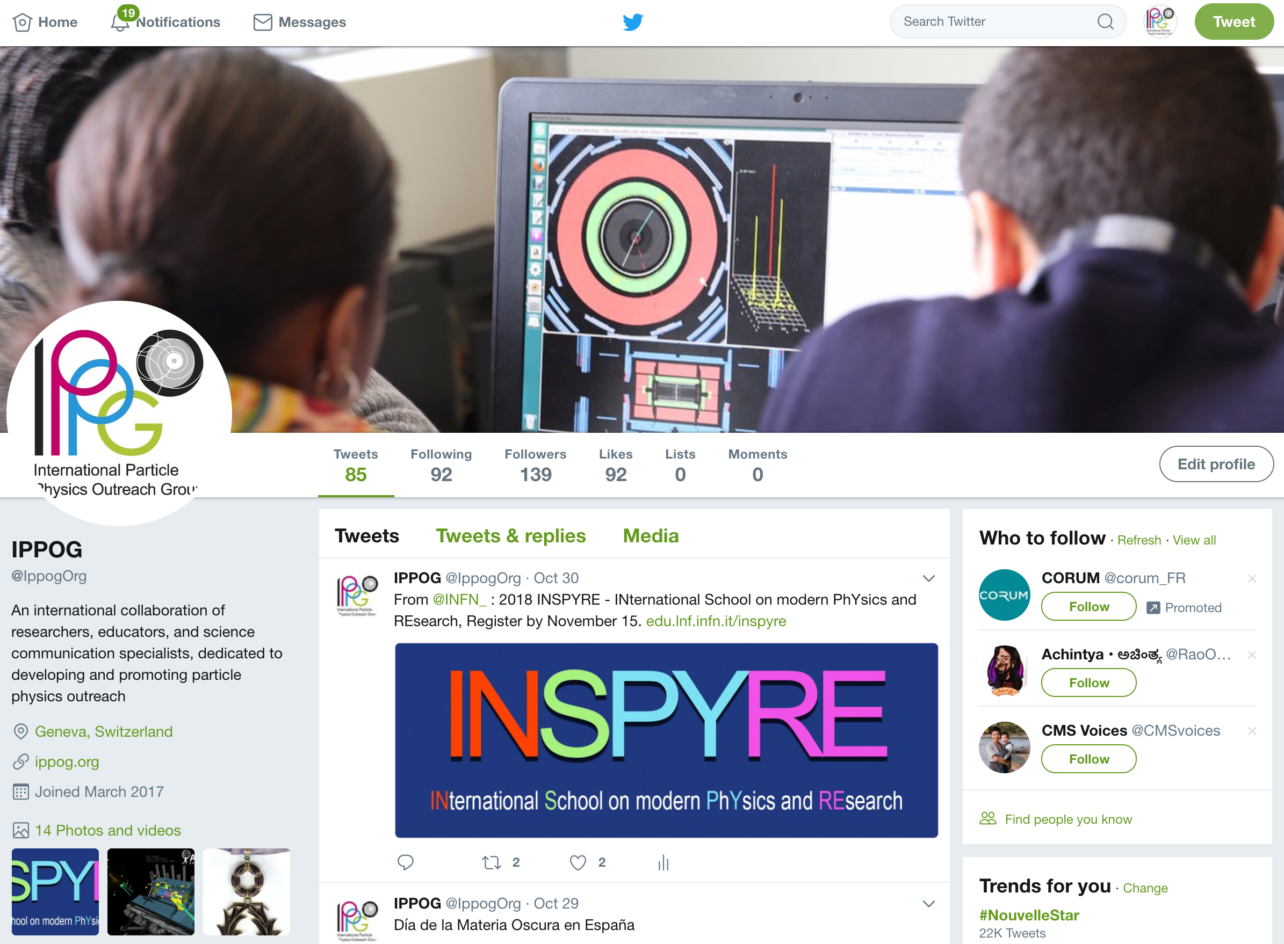
Social Media
Facebook: @IPPOG
Twitter: @ippogOrg

Slide 6
Leadership
Communication Coordinator
  Development of Communication Strategy
  Planning and Development of Content
  Maintenance and Development of Platforms
  Implementation of Communication Plan Based on Strategy
Social Media Coordinator
  Develop Strategy
  Establish Goals, Audiences, Messages, Policy
  Create Network of Contributors
  Coordinate Activities

