Slide 1
Calorimeter Upgrade:
Analog Electronics
D. Gascon, J. Mauricio, E. Picatoste
ICCUB//SiUB, University of Barcelona

Slide 2
Outline
Calorimeter upgrade: analog electronics
System design
Digital building blocks
Tests
Production

Slide 3
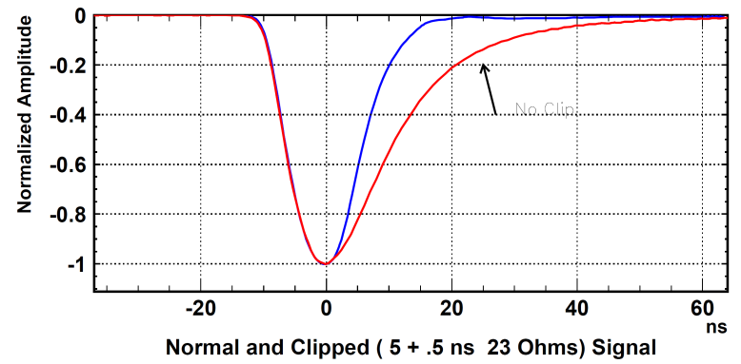
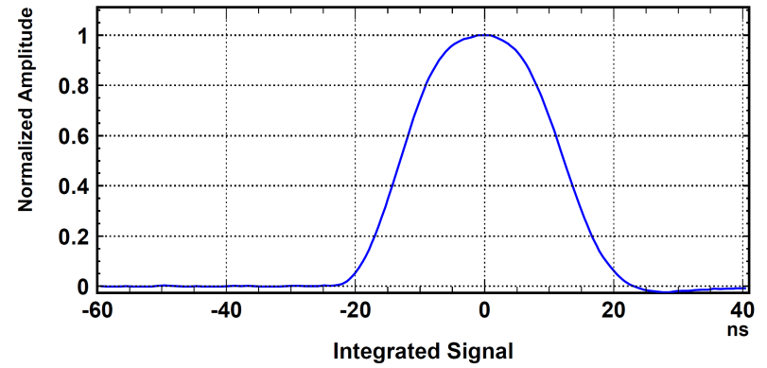
I. Current Analog Signal Processing
Analog Chip
Front End
Board
Before clip
R_{f} = 12MΩ
Detector cells
After clip
PMT
C_{f} = 4pF
50Ω
12m cable
100Ω
-
+
100nF
22nF
12b ADC
5ns 50Ω
25ns 100Ω
clip
BUFFER
INTEGRATOR
100Ω
BiCMOS 0.8um integrated circuit
8 channels per chip
  Specifications:
  Pulse shaping in 25ns
  Spill over (signal residue) < 1% after 25ns
  Integrator plateau: 4ns
  Linearity < 1%
  Rise time ~ 5 ns
  Clipping:
  Reduce signal tail
  Reduce spill over
  Integrator discharge:
  Clipped signal + delayed negative clipped signal
Before clip
After clip

Slide 4
I. Analog Electronics Upgrade Motivation
Analog Chip
Front End
Board
R_{f} = 12MΩ
Detector cells
PMT
C_{f} = 4pF
50Ω
12m cable
100Ω
-
+
100nF
22nF
12b ADC
5ns 50Ω
25ns 100Ω
clip
Delay lines
BUFFER
INTEGRATOR
100Ω
PMT current has to be reduced to increase lifetime
  FE electronics gain has to be increased correspondingly
  BUT FE noise should not be increased in the operation!
Radiation tolerance:
  Dose 100 rad per fb⁻¹
  Radiation qualification tests
  Design techniques on ASIC
    Enclosed transistors with guard rings
Proposed solution:
  New ASIC
    Increased gain
    Reduced noise
    Integration / shaping

Slide 5
Outline
Calorimeter upgrade: analog electronics
System design
Digital building blocks
Tests
Production

Slide 6
II. System design: channel architecture
Current
amplifier
Track-
and-Hold
Filter
Offset
Switched
Integrator
Multiplexer
PZ
ADC
driver
ʃ
TH
I
Drv
PZ
ʃ
TH
Very difficult to integrate HQ analog delay lines
2 switched alternated paths
Switching noise
Fully differential ASAP

Slide 7
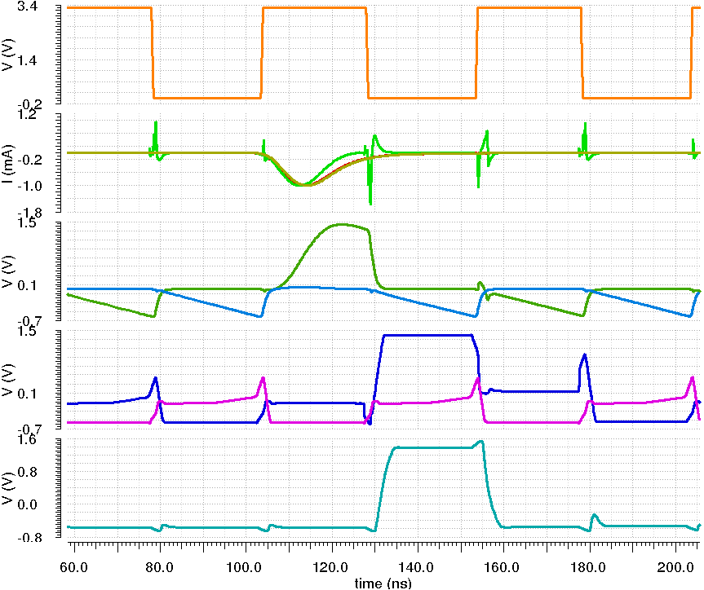
II. System design: channel architecture
Current
amplifier
Track-
and-Hold
Filter
Offset
Switched
Integrator
Multiplexer
PZ
ADC
driver
ʃ
TH
I
Drv
PZ
ʃ
TH
Clock input

Slide 8
II. System design: channel architecture
Current
amplifier
Track-
and-Hold
Filter
Offset
Switched
Integrator
Multiplexer
PZ
ADC
driver
ʃ
TH
I
Drv
PZ
ʃ
TH
Clock input
PMT signal
PZ
output
Input signal
Current Amplifier
output

Slide 9
II. System design: channel architecture
Current
amplifier
Track-
and-Hold
Filter
Offset
Switched
Integrator
Multiplexer
PZ
ADC
driver
ʃ
TH
I
Drv
PZ
ʃ
TH
Clock input
Integrator output
Main signal
Tail

Slide 10
II. System design: channel architecture
Current
amplifier
Track-
and-Hold
Filter
Offset
Switched
Integrator
Multiplexer
PZ
ADC
driver
ʃ
TH
I
Drv
PZ
ʃ
TH
Clock input
TH output
Main
signal
Tail

Slide 11
II. System design: channel architecture
Current
amplifier
Track-
and-Hold
Filter
Offset
Switched
Integrator
Multiplexer
PZ
ADC
driver
ʃ
TH
I
Drv
PZ
ʃ
TH
Clock input
Channel output
Main
signal
Tail

Slide 12
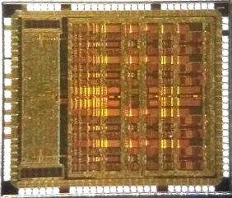
II. ICECAL ASIC
Complete 4 analog channels
Tunable parameters
4 DLL for synchronization
2 versions with gain:
  4.5 fC/LSB
  9.0 fC/LSB
Current
amplifier
Filter
Integrator
Track-
and-Hold
Multiplexer
PZ
ʃ
TH
ADC
driver
I
Drv
12b ADC
12b ADC
12b ADC
12b ADC
FPGA
PZ
ʃ
TH
MEM
x4
MEM
Bias
Phase detector charge pump
Ref clock
ADC clock
DLL + Slow Ctrl
CH0
SPI slave
25
x4
MISO, MOSI, !SS, SCLK
CH1
MEM
Regs+bias+DACs
Analog channel:
  Very difficult to integrate HQ analog delay lines
  2 switched alternated paths
  → no dead time between consecutive events
  Switching noise → fully differential ASAP
  Input impedance control by current feedback
    Low noise performance
CH2
CH3
SiGe BiCMOS 0.35um
AMS 10.5 mm²

Slide 13
Outline
Calorimeter upgrade: analog electronics
System design
Digital building blocks
Tests
Production

Slide 14
III. Digital building blocks: DLL
Clock management is internally done by the ICECAL Chip:
  Three clock phases are generated from an input reference (REF_CLK):
    Track & Hold clock phase (Φ_{TH}). F_{CLK} = 20 MHz.
    Integrator clock phase (Φ_{INT} = Φ_{TH} + ΔΦ_{INT}). F_{CLK} = 20 MHz.
    ADC clock phase (Φ_{ADC}). F_{CLK} = 40 MHz.
Vcoarse
ADC clock
T&H clock
INT clock
Legend
Phase detector charge pump
LVDS Clock
Vcontrol
Delay Lines
CMOS Clock
x4
Ref clock
Serial Reg. bus
5
Vcoarse
MEM
25
Vcontrol
Analog config.

Slide 15
III. Digital building blocks: slow and fast controls
Access to internal registers to configure the chip:
  Analog channel parameters
  DLL
  SPI Slave
Analog sub-channel reset circuit:
  FPGA needs to know the analog sub-channel source of the ADC reading Gain & Offset compensations.
  The first sub-channel is always the same for each configuration
SPI_Refresh
ICECAL
SlowCtl
FPGA
MOSI
SPI Slave
MISO
SCLK
!enableSpiRefresh
!SS
MEM
BXID_RST_SYN
FPGA clock
INT
T&H
SubCh Reset
Resynch
Delay Line channels
BXID_RST
Delay Line channels
FPGA
Delay Line channels
Delay Line channels
LHCb fast control
Detected
TFF
TFF
···
Ref clock
MEM
ICECAL

Slide 16
Outline
Calorimeter upgrade: analog electronics
System design
Digital building blocks
Tests
Production

Slide 17
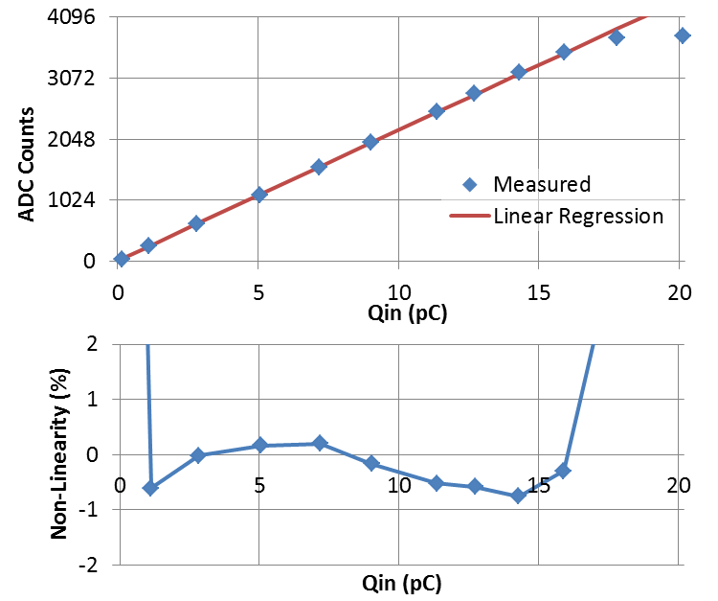
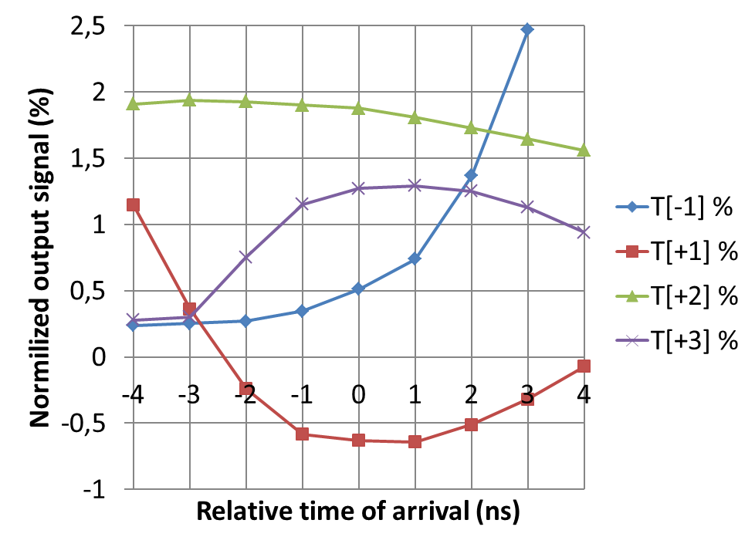
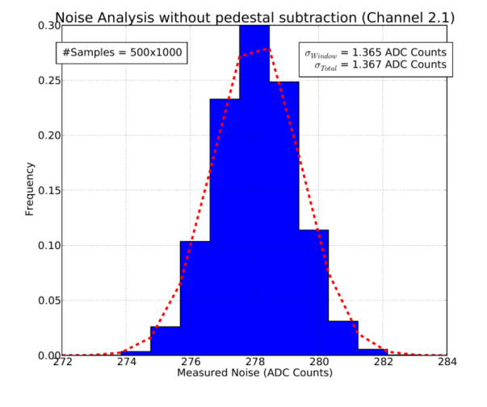
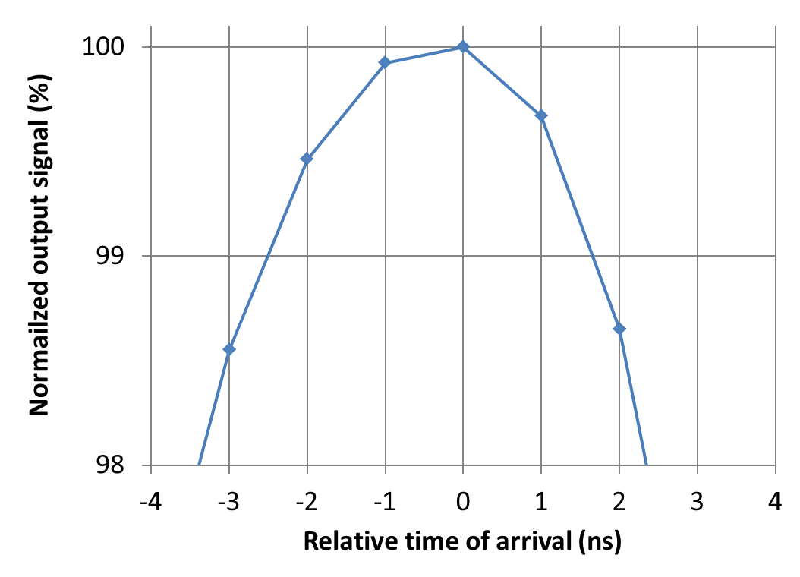
II. ICECAL ASIC: tests results
Tests at lab and test beams:
  Linearity
  Spill over
  Noise
  Plateau

Slide 18
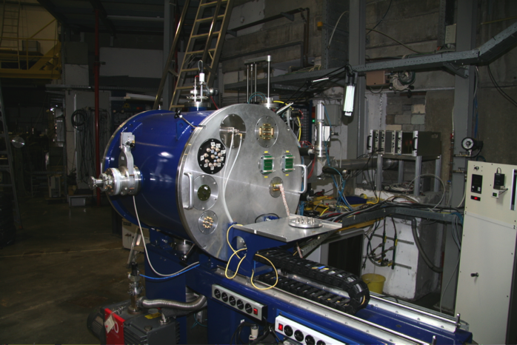
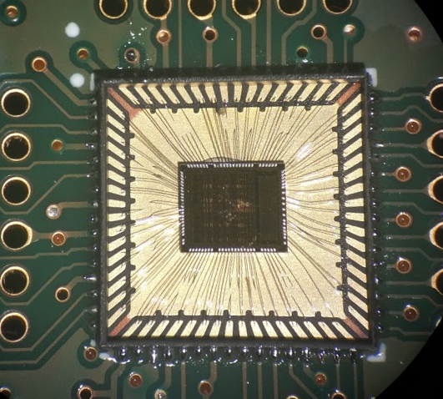
II. ICECAL ASIC: radiation hardness tests
At CRC (UCL) in Louvain-la-Neuve (Belgium)
TID tests:
Use beam of 61 MeV protons
Dose up to 55 krad on 4 chips
Results:
  No SEU or SEL was detected
  No relevant variation on the chips characteristics
SEE tests:
Irradiate with heavy ions: 58Ni+18
  LET = 20.4 MeV/mg/cm2
Two chips were irradiated:
  No SEU detected
Use refresh signal
Equivalent expected limits for all channels in detector lifetime:
  1.3 SEU
  0.9 SEL

Slide 19
Outline
Calorimeter upgrade: analog electronics
System design
Digital building blocks
Tests
Production

Slide 20
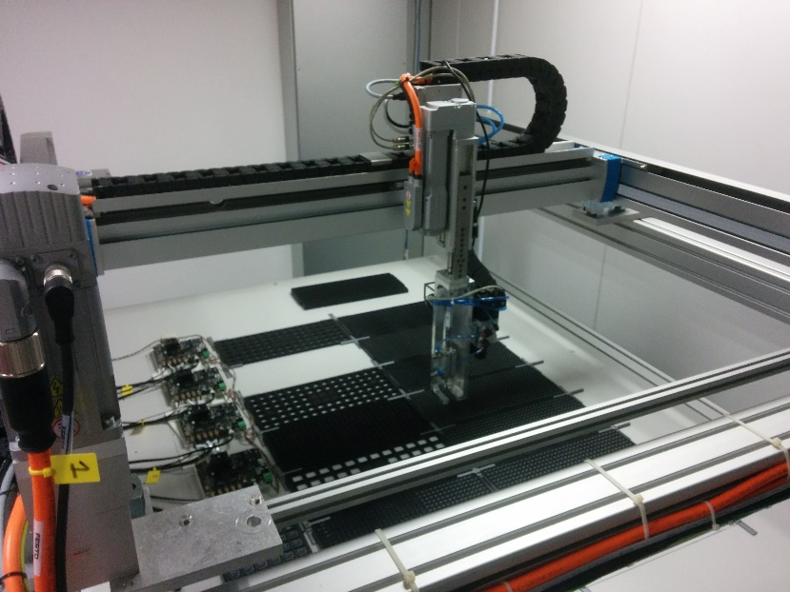
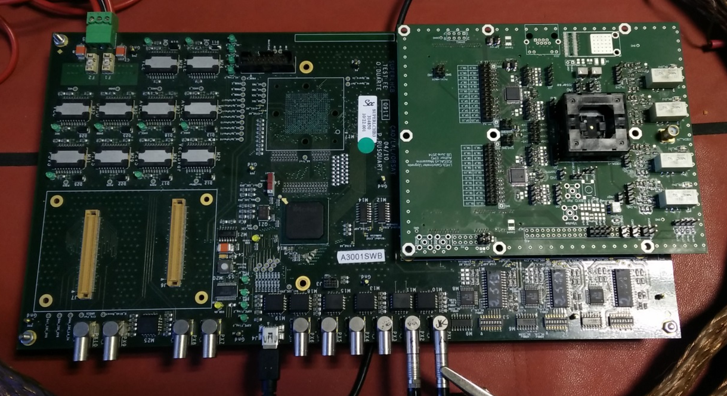
IV. Production
Robotic system
FEB prototype
(4 data channels)
Open top socket
Relays
IN
    Motorized horizontal gantry system to move the chips from tray to the test PCB and to final tray.
    Motorized stage in the vertical direction.
    Pneumatic suction.
    Pressure sensor.
Updated
mezzanine
    FPGA

Slide 21
V. Status
Production
  Standard version (v3.1): 3050 pieces
  Reduced gain (v3.2): 3050 pieces
Production test
  Mezzanine: ready
  SW:
    Test defined: rejection limits are being prepared
  Robotic setup ready in ~2 weeks
  Estimated total test time: 2-3 months

Slide 22
Backup

Slide 23
II. System design: Analog Electronics Specifications
PMT current has to be reduced by factor ~ 5 to increase their lifetime:
  FE electronics gain has to be increased correspondingly
  FE input equiv. noise should still be ~ 1 LSB
New ASIC:
  Increased gain
  Reduced noise
  Integration / shaping
New front end board is required:
  Low noise analog electronics
  Data transmission @ 40MHz
Energy range | 0-10 GeV/c (ECAL) Transverse energy
Calibration | 4.5 fC / 2.5 MeV / LSB
Dynamic Range | 4096-256 = 3840 : 12 bit
Noise | <≈ 1 LSB or ENC < 4 fC
Termination | 50 ± 5 Ω
Shaping | 25 ns (99% of the charge)
Baseline shift prevention | Dynamic pedestal subtraction (CDS) Pedestal is the smallest of 2 prev. Samples
Max. Peak current | 4 - 5 mA (clipped)
Spill-over residue level | ±1%
Linearity | < 1%
Crosstalk | < 0.5%
Timing | Individual (per channel)

Slide 24
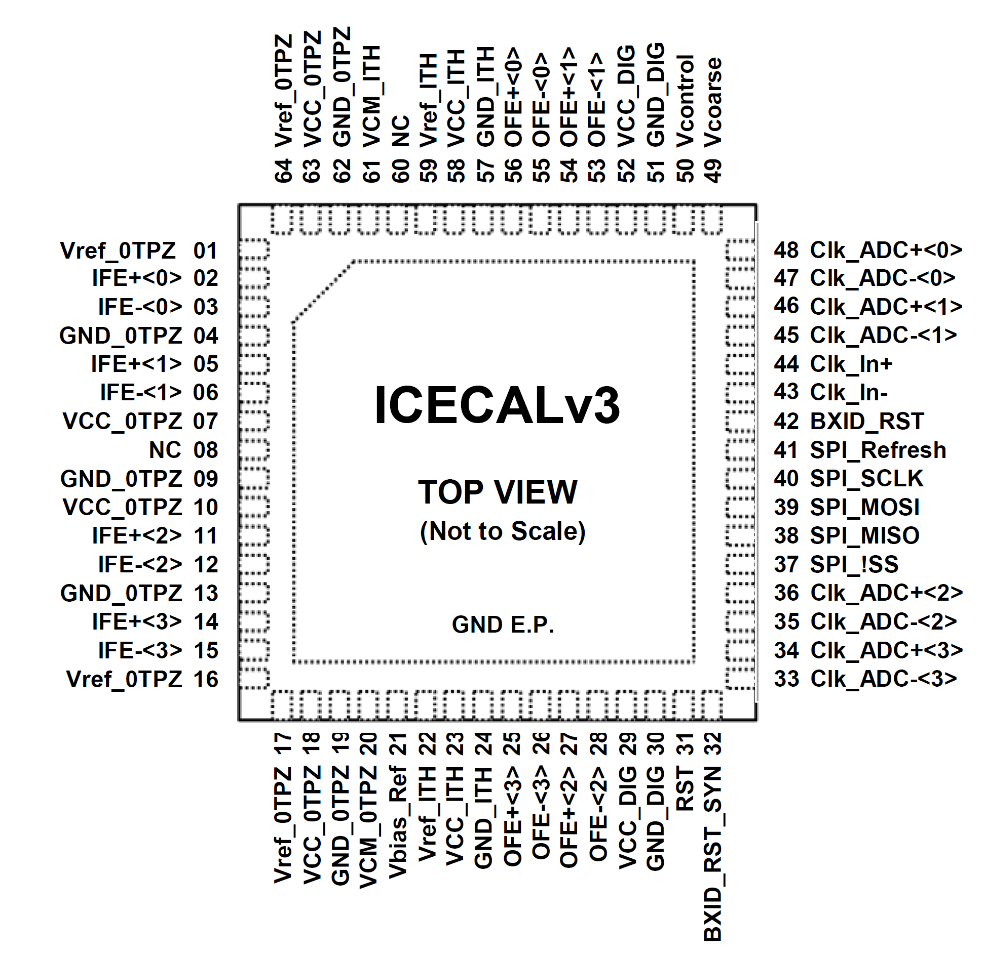
III. ICECAL pinout
DLL control
signals
Differential
inputs
LVDS ADC
clock outs
Input clock
Differential
outputs
BXID reset
Analog
Power/Ref
Digital
Power/Ref
SPI
Reset

Slide 25
III. SPI refresh
16-bit TMR registers:
  Each bit is stored in 3 flip-flops.
  Majority is computed.
  SEUs are automatically corrected.
    Problem: correction is done as long as SPI clock is active.
    Solution: SPI refresh signal.
SPI refresh signal:
  An auxiliary clock is provided.
  Only enabled when SPI slave is idle.
  Is optional: can be disabled by software.
PRESET
OUT
EN
d0
D
P
Q
D
P
R1
P
Q
D
FF
R2
3-V
Q
R3
0
CLK
FF
d0
FF
1
IN
SPI_Refresh
ICECAL
SlowCtl
FPGA
MOSI
SPI Slave
MISO
SCLK
!enableSpiRefresh
!SS
MEM

Slide 26
III. Fast control: BXID reset
Analog sub-channel reset circuit:
  An ASIC channel consists in two sub-channels.
  FPGA needs to know the analog sub-channel source of the ADC reading:
    Gain & Offset compensations.
How it works:
  FPGA generates 1-cycle width synchronous reset pulse.
  ICECAL resynchronizes this reset with its input clock.
    Metastable phases (FPGA→ASIC) are discarded.
    Debug signals:
      External pad: 32-BXID_RST_SYN
      Slow control bit (Detected)
  Integrator and T&H clocks levels are preset (clock phases remain unchanged).
  The first sub-channel is always the same for each configuration
(32) BXID_RST_SYN
FPGA clock
INT
T&H
SubCh Reset
Resynch
Delay Line channels
(42) BXID_RST
Delay Line channels
FPGA
Delay Line channels
Delay Line channels
LHCb fast control
Detected
TFF
TFF
···
Ref clock
MEM
ICECAL

Slide 27
III. Internal delay
Proposed circuits between ICECAL and GBT-SCA
DLL V_{control} out
DLL V_{COARSE} input generation
It is recommended to use a voltage divider to read the DLL V_{CONTROL} and adapt the voltage range to the ADC input.
The input VCOARSE voltage has to be controlled by a DAC.
  Its expected value is 1.2V
  Range: from 0.5V to 2V.

Slide 28
III. Time alignment
Synchronization method:
  Φ_{ICECAL_CLK_IN}: look for the most stable phase for which the sub-channel reset is performed (fixed for each PCB).
  Φ_{I_TH}: delay between the integration time and the Track-and-Hold clocks (internal delays of the chip, optimal = 1ns).
  Φ_{TH}: detector channel optimal integration time (particle time arrival, PM HV, signal cable length). Look for the maximum signal and minimum spill over.
  Φ_{ADC}: time at which the ADC performs the conversion (fixed for each PCB).
  Φ_{ADC_FPGA}: the ADC 12 bits of data have to be captured by the FPGA in parallel at the right phase or there will be data corruption. Use rising or falling edge of the FPGA clock (fixed for each PCB).
28

Slide 29
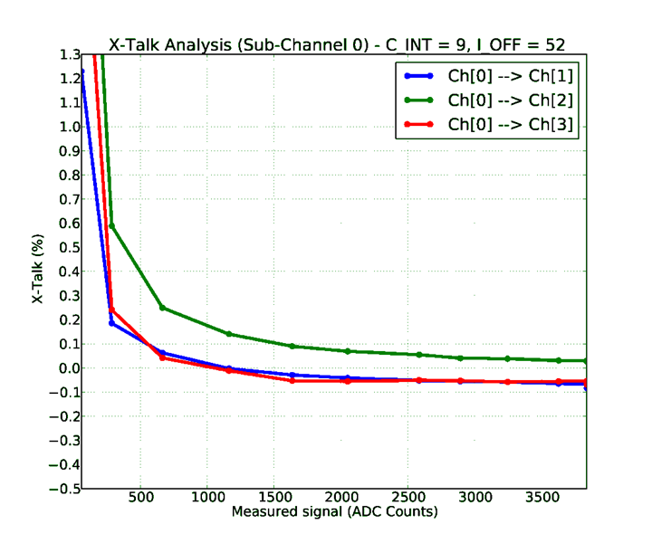
III. Calorimeter Upgrade: ICECALv3
FE PROTOTYPE
Tests at lab:
ANALOG MEZZANINE
  Input impedance
Inputs
ICECALv3
Outputs
AD9238
FILTER
12b ADC
ADC clock
12b ADC
FILTER
AD9238
FILTER
12b ADC
FILTER
12b ADC
Clock in
12 bits
SPI
(slow control)
Delay
Chip
FPGA
  Crosstalk
10 MHz
Trigger
USB to PC
Waveform
Generator

Slide 30
III. Calorimeter Upgrade: ICECALv3
Tests at lab:
  Linearity
  Spill over
  Noise
  Plateau

Slide 31
II. ICECAL ASIC: tests results
Check noise in different conditions:
 | Noise (LSB) | PS noise (LSB)
Laboratory | 1.4 | 1.7
Lab + cable | 1.6 | 1.8
Test beam | 12 | 2.7
Detector | < 7.1 | < 2.9
FEB prototype
Provisional GND
Spec: ~1 ADC count
The effects of Cockcroft-Walton HV sources and cables increase noise
Upgraded detector expected pile-up ~5 LSB
  Effect of electronics noise adds up to 5.8 LSB (vs. 5.1 LSB specified)

Slide 32
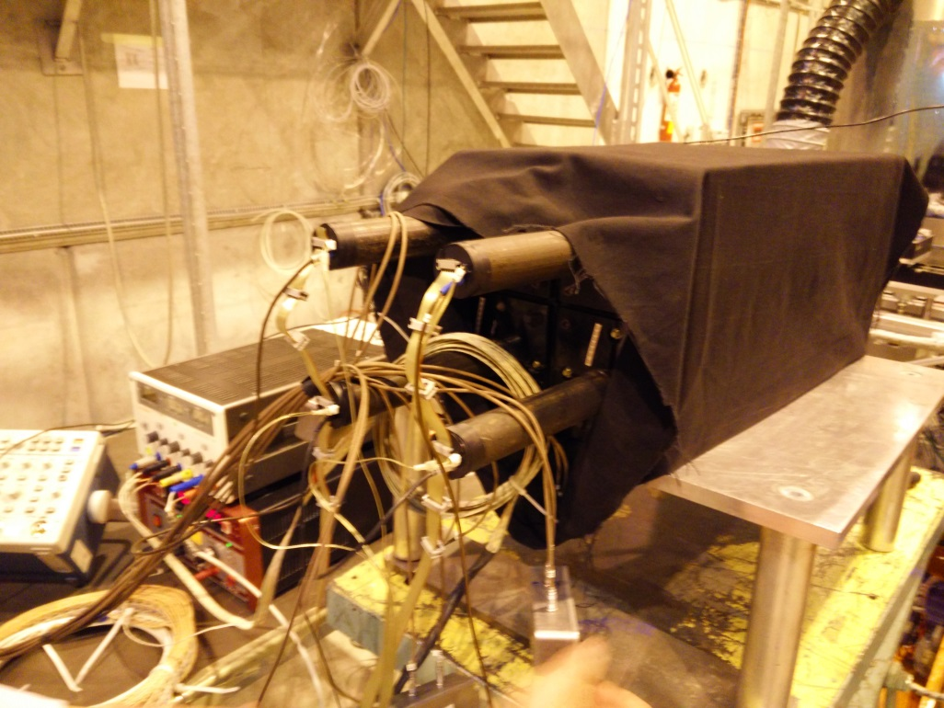
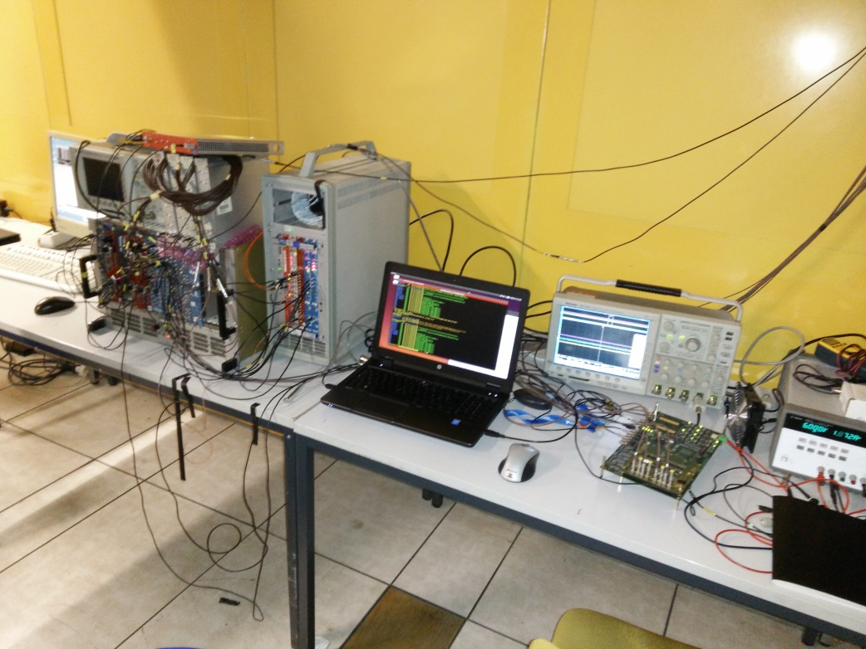
II. ICECAL ASIC: tests beams
ECAL channel
Beam line: T4-H8 at CERN Prevessin
Beam: e⁻ with energy ranging from 20 to 120 GeV
Elements used:
  4x(ECAL module+PMT+12m cable)
  FEB prototype
  Lecroy integrator
  Time-to-Digital Converter (TDC)
  ICECALv3 ASIC
Main tests:
  Plateau and spill-over
  Linearity
  Noise
PMT
Trigger (coincidence)
Lecroy integration
FEB
prototype
Measurements laptop

Slide 33
II. ICECAL ASIC: radiation hardness tests
At CRC (UCL) in Louvain-la-Neuve (Belgium)
TID tests:
Use beam of 61 MeV protons
Different irradiation steps. Dose:
  55 krad over 3 chips
  40 krad over 1 chip
Results:
  During irradiation no SEU or SEL was detected
  No relevant variation on the chips characteristics was observed
SEE tests:
Irradiate with heavy ions: 58Ni+18
  LET = 20.4 MeV/mg/cm2
Two chips were irradiated:
  No SEU detected after a fluence of 9,5·107 part/cm2
10 kHz refresh signal (SPIREFRESH)
Equivalent expected limits for all channels in detector lifetime:
  1.3 SEU
  0.9 SEL

Slide 34
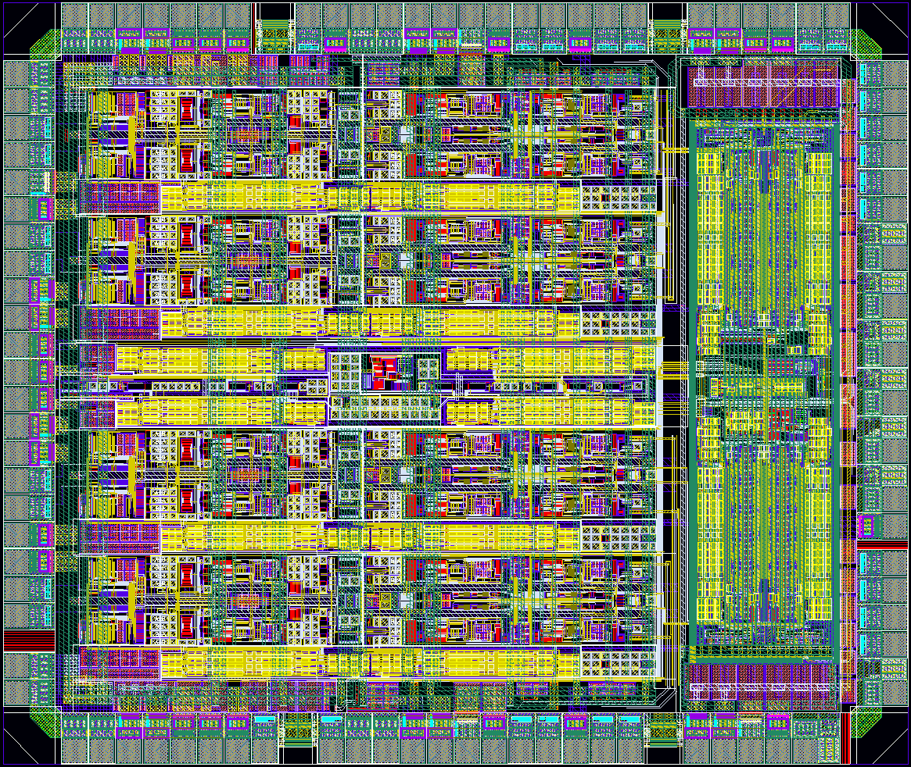
LHCb Upgrade Electronics
ICECALv3. A Full Custom design
IBias Block
Analog Ch
3-Voting FFs
3.0 mm
DLL + SPI
Die Area = 10.5 mm²
Submitted: March 2014
3.5 mm

Slide 35
Backup: ICECALv3 architecture
Front End Board
ICECALv3 ASIC
Current
amplifier
Track-
and-Hold
Detector cells
Filter
Integrator
Multiplexer
PZ
ʃ
TH
ADC
driver
PMT
50Ω
I
Drv
12b ADC
12b ADC
12b ADC
12m cable
12b ADC
FPGA
PZ
ʃ
TH
clip
MEM
x4
MEM
Bias
LVDS Clock
Phase detector charge pump
Ref clock
ADC clock
CMOS Clock
Serial Reg. bus
SPI slave
25
MISO, MOSI, !SS, SCLK
x4
MEM

Slide 36
Dynamic range and version decision (I)
 | v3.1 | v3.2
Sensitility (fC/LSB) | 4.54 | 9.05
Cint | 14 | 8
Pedestal | 311 | 311
Dynamic range (LSB) | 3784 | 3784
1 LSB (MeV) | 2.5 | 5
Dynamic range (GeV) | 9.5 | 19
Noise (LSB) | 1.21 | 1.06
Noise PS (LSB) | 1.66 | 1.26
Noise (MeV) | 3 | 5.3
Noise PS (MeV) | 4.2 | 6.3
Equivalent noise from detector (LSB) | 2.1 to 2.4 | 2.1 to 2.4
Noise PS+detector noise (LSB) | 2.7 to 2.9 | 2.4 to 2.7
Noise PS+detector noise (MeV) | 6.5 to 7.2 | 8.0 to 8.6
Which ASIC version?
  ICECALv3.1.
    Lower noise
  ICECALv3.2
    Increased dynamic range
  Mixed solution? For example:
    Inner FE with ICECALv3.2
    Outer FE with ICECALv3.1

Slide 37
Production quality control
Robotic system
FEB prototype
(4 data channels)
Open top socket
Relays
IN
    Motorized horizontal gantry system to move the chips from tray to the test PCB and to final tray.
    Motorized stage in the vertical direction.
    Pneumatic suction.
    Pressure sensor.
Updated
mezzanine
    FPGA
37

Slide 38
Production quality control
Automated procedure
Tray of accepted chips
Robot movement
Robot movement
Chip to test
Tested Chip
Tray of Chips
Chip Test: Socket open on top
Tray of rejected chips
    One set of parameters for all the chips
    The optimal parameter set of values is obtained from a statistically reasonable amount of chips.
    2 min < t < 5 min

Slide 39
Example: ASICs tested per robot run
Elements/Package | PACTA (Example) | ICECAL
Package | QFN32 | QFN64
Size | 6x6mm² | 9x9mm²
Num Chips/Tray | 490 | 260
Num Trays | 14 | 12
Num Chips/Robot | 6860 | 3120
Num Chips per test | 4 | 1
Robot Movement + photo per test | ~176s | ~44s
Test QC Time per test | ~65s | ~300s
Test Robot+QC iteration | ~240s | ~344s
Complete Run Test | 114h→~5 days | 298h→~12 days
Chips Tested per day | ~1440 chips/day | ~252 chips/day

