Slide 1



FEB Performance Tests
João Coelho
for the LAL team
13 February 2018

Slide 2
Outline
General tests performed on the FEB:
  Noise level and correlations
  Linearity of integrated response
  Cross-talk between channels
  Time stability of the acquisition

Slide 3
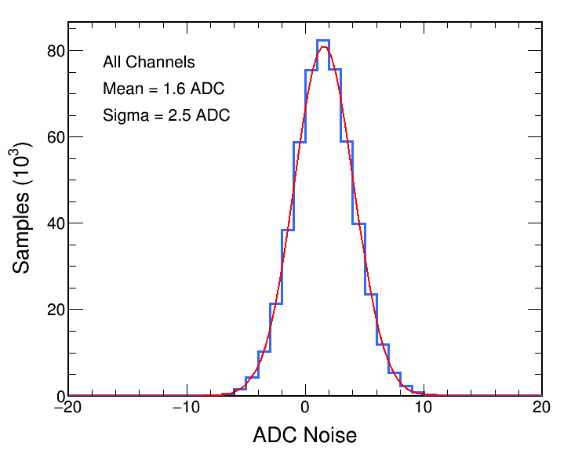
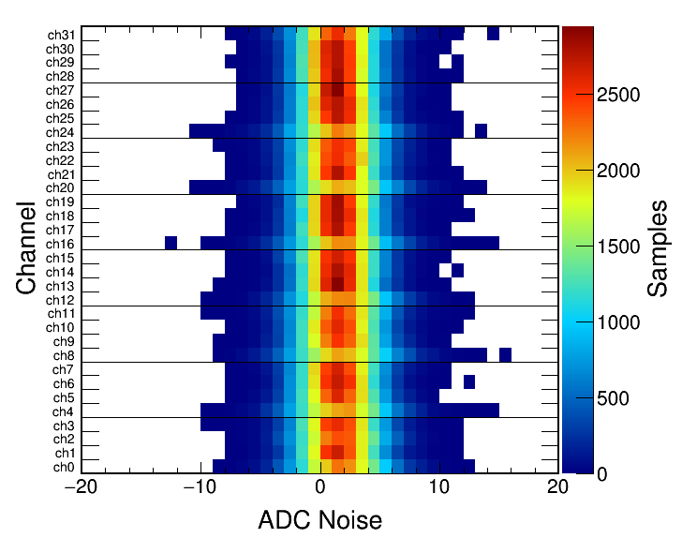
Noise Level
Acquisition was performed with no cables connected to the input signal
Integrators were synchronized to match between events
Bias due to pedestal subtraction: 1.6 ADC
Noise width: 2.5 ADC*
*1.8 ADC without pedestal subtraction

Slide 4
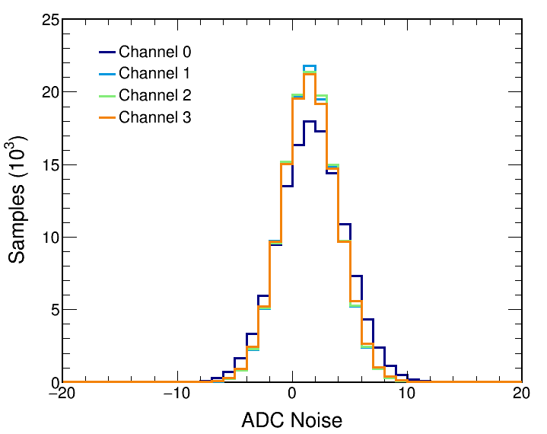
Noise Level
Acquisition was performed with no cables connected to the input signal
Integrators were synchronized to match between events
Not all channels are equal
Ch. 0 is noisier (2.9 ADC), while others are quieter (2.4 ADC)
*1.8 ADC without pedestal subtraction

Slide 5
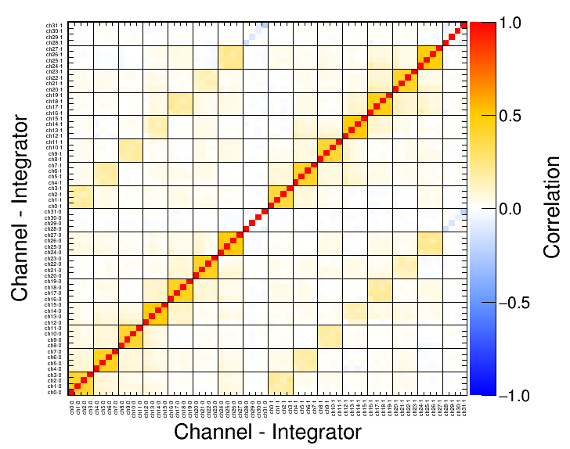
Correlations
Can also look at correlations between different channels and integrators
Observe 45% correlation between channels in same chip and integrator
Between integrators, correlation drops to 17%
Correlation between channels in different chips is 3.6%
Chip 7 has different behavior in this board

Slide 6
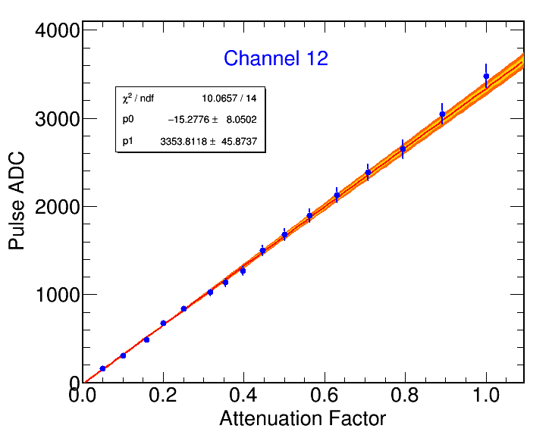
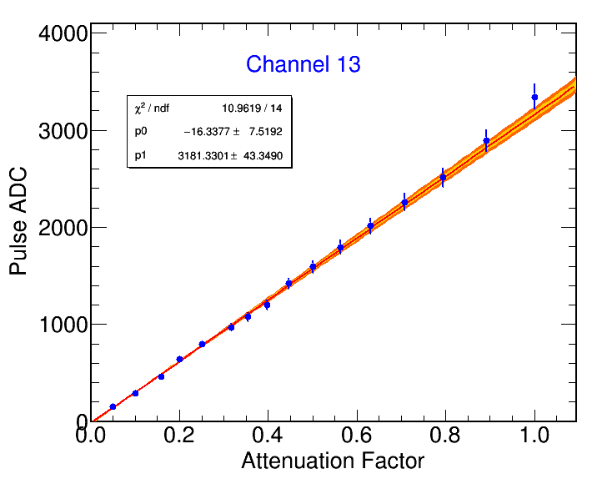
Linearity
Acquisition with pulses injected in channels 12 and 13 (chip 3)
Channels 13 and 14 were not connected
Used attenuators to control injected pulse size
Maximum amplitude tuned to generate ~18 pC (4.5 fC/LSB)
Measured attenuator precision to be at 4% level

Slide 7
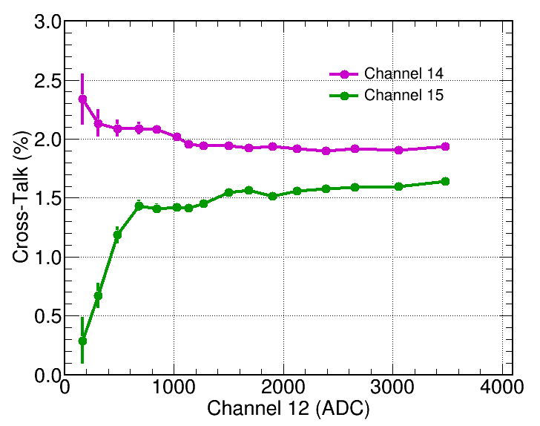
Cross-Talk
Using same acquisition from linearity test, measure cross-talk in adjacent channels 14 and 15
Setup is not ideal as cross-talk channels were not connected and pulses had been injected in two channels
Preliminary tests with improved setup:
Single channel injected with pulse
2 chs connected to 50Ω resistance
No significante cross-talk observed in those two channels
Unconnected channel sees cross-talk at ~1% level
Further tests needed with all channels connected and variable signal amplitude

Slide 8
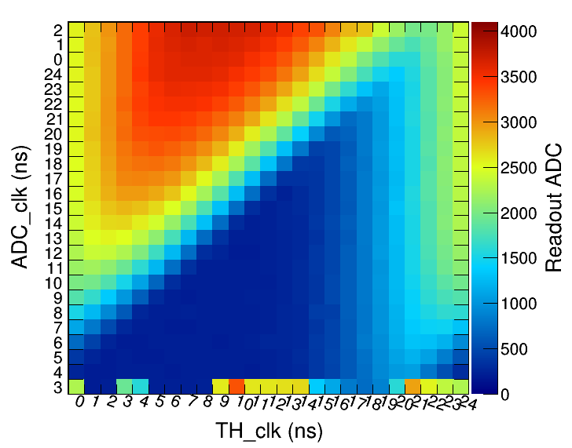
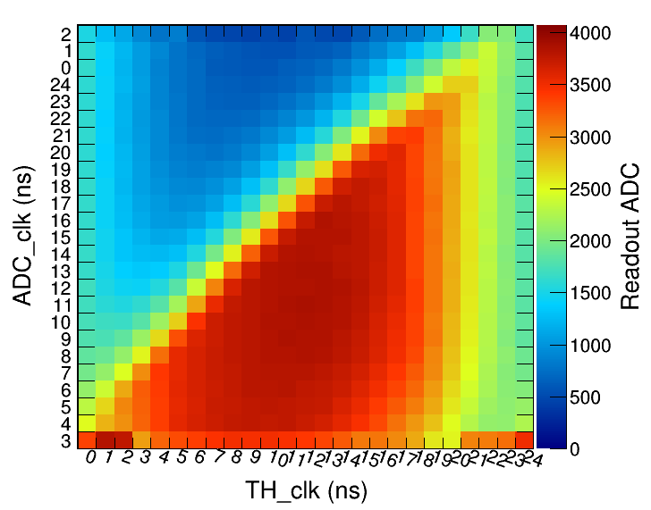
Time Stability
Testing for stable range of clock phases for acquisition
  Inject pulses at fixed amplitude
  Vary TH (start integration) and ADC phases
  Find range of phases within 1% of maximum readout
Sample 27
Sample 28
Stable
Region
Changed
Integrators

Slide 9
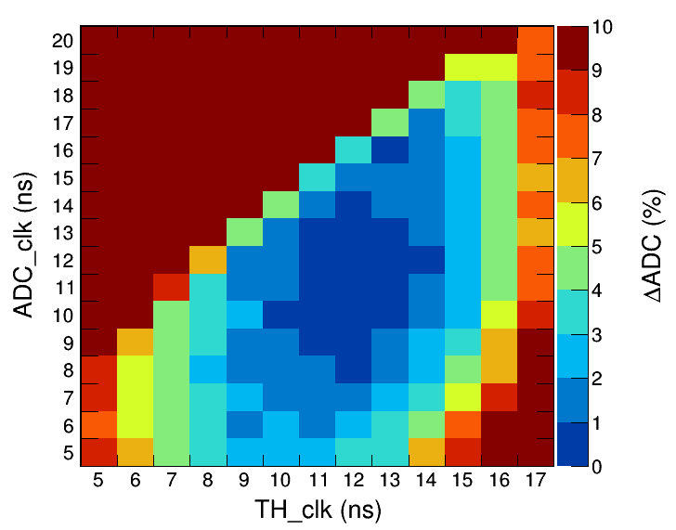
Time Stability
Testing for stable range of clock phases for acquisition
  Inject pulses at fixed amplitude
  Vary TH (start integration) and ADC phases
  Find range of phases within 1% of maximum readout
  About 7ns stability in ADC clock
Sample 28
Sample 28
Stable
Region

Slide 10
Conclusion
Initial performance tests of the FEB show promising results
Noise level a bit higher than expected, but reasonable
Correlations mostly within chip
Linearity demonstrated over full dynamic range
Cross-talk level still under investigation, but below 2%
Readout stable over 7ns in ADC clock

Slide 11
Backup Slides

