Slide 1


slow control and acquisition

Slide 2
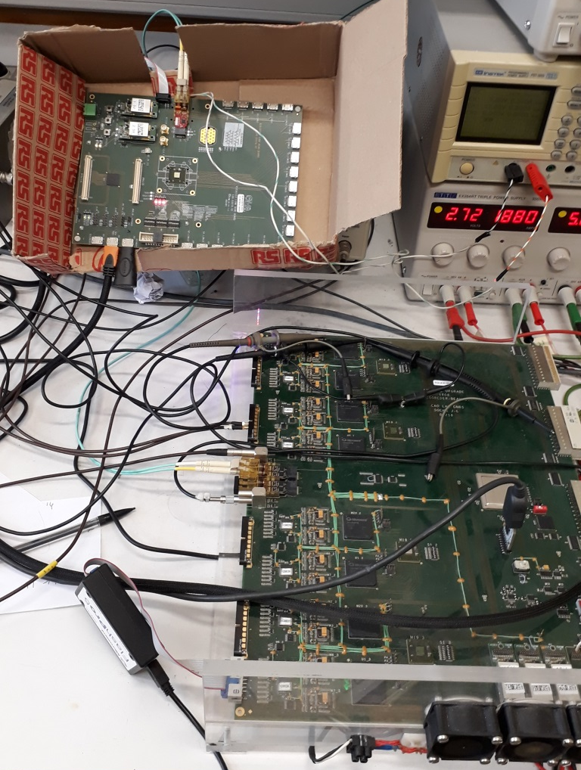
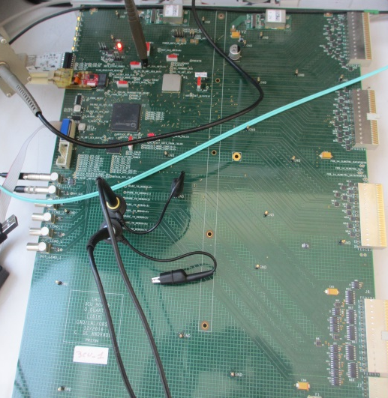
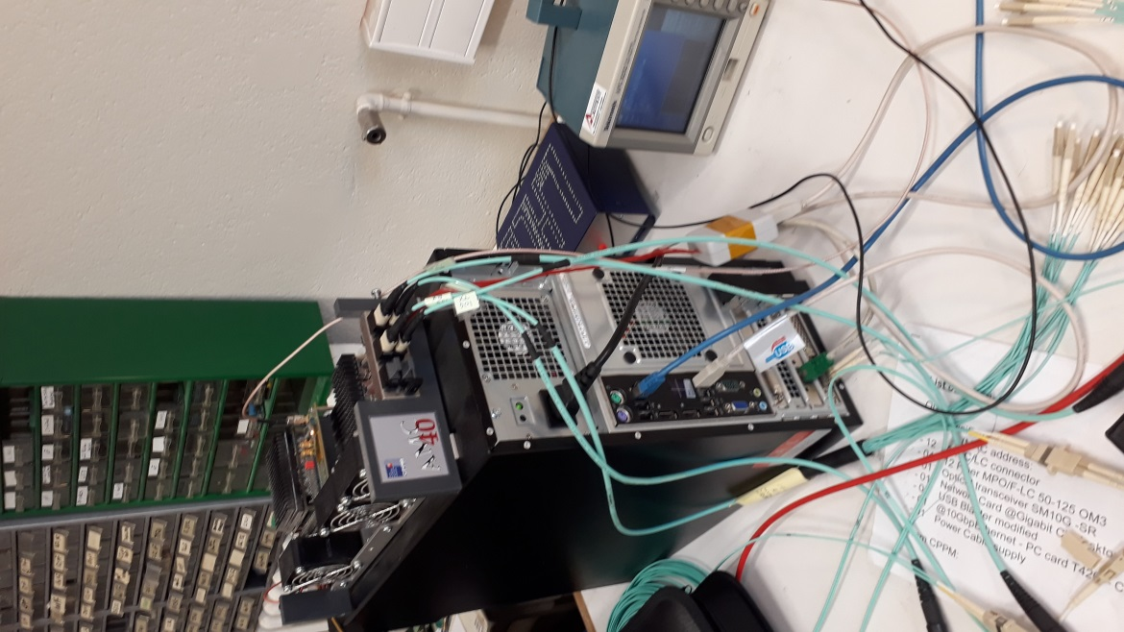
The MiniDAQ environment
MiniDAQ
3CU
20 meters
of fiber
FEB

Slide 3
Configuration of the FEB
The FEB is configured by the USB with program in python and C++ libraries
The board should be initialized , The different elements (ICECAL, FE-PGA,SEQ-PGA) are configured by the SPI, and I2C , through commands sent by the USB

Slide 4
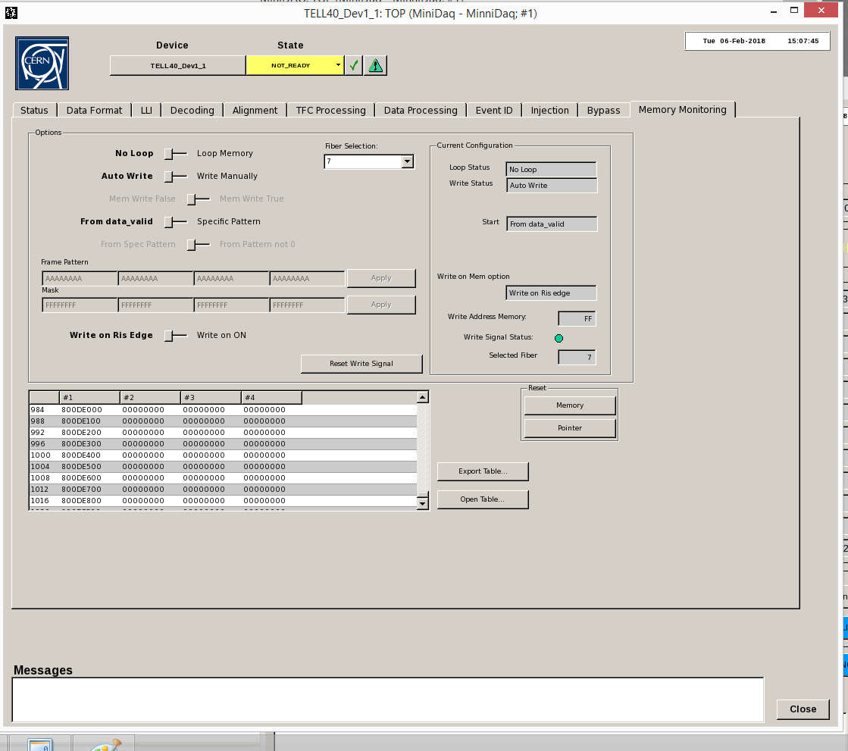
Test FE Data part
Test of the Data Frame received in the
Memory Management :
In fixed pattern mode (0xAA BB ..)
Random pattern mode
Test BCID is OK
easy to check from the Memory
Management panel
Data part more difficult to check
(see next slide)

Slide 5
In the Wide Bus frame
In the FEB
Chan 0
.
.
.
4 bits
Bit 95
Bit 91
96 bits
Bit 0
+
One Channel
= One Channel
1
2
3
4
5
6
7
8
9
10
11
Chan 7
How we test it :
Load FE injection Ram with specif pattern
Verification with a program to retrieve a specific pattern put in the data sent by the FEB in files written by the amc40_frgwriter of the miniDAQ
Specific data encoding of the FEB

Slide 6
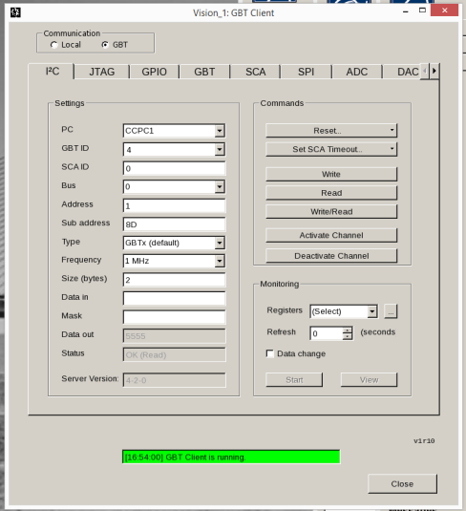
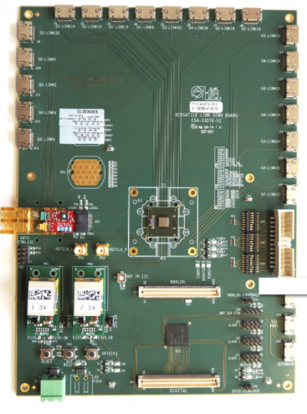
Test I2C communication with GBT-SCA of the FE
GBT Client
Read/write of some
Register of the different
Gbtx of the FEB
FEB
By optic fiber
By mini-HDMI to back end

Slide 7
Test SPI communication with GBT-SCA of the FE
CCP1 terminal
Spi_test line command used
Read/write of some
Register of SPI different
Slave (ICECAL OK),
firrmware adaptations for
Fe_pga and Tri_Seq_pga
FEB
By optic fiber
By mini-HDMI to back end

Slide 8
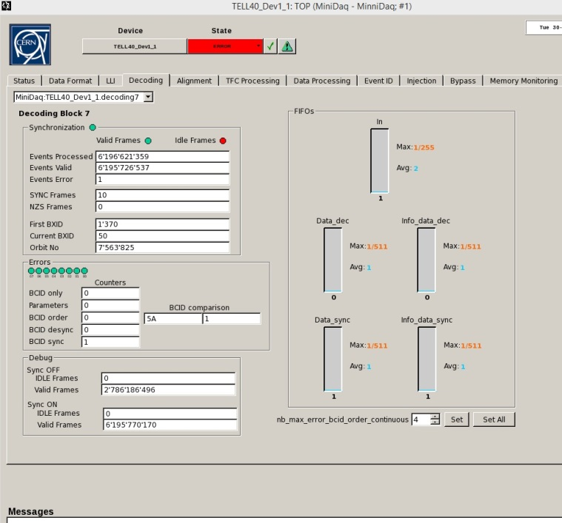
Test SyncFrame pattern to miniDAQ
a local command triggers 10 SyncFrames
SyncFrame = Configuration of the FEB to send the BCID under 12 bits with a fixed pattern after this.
Commutation to normal
datas with BCID under 8 bits after the 10 SyncFrames
The miniDAQ is synchronized !
But as we aren’t synchronous with a TFC cmd the miniDAQ is in Error
Green led synchronized
Datas
Optic fiber 7
FEB

