Slide 1


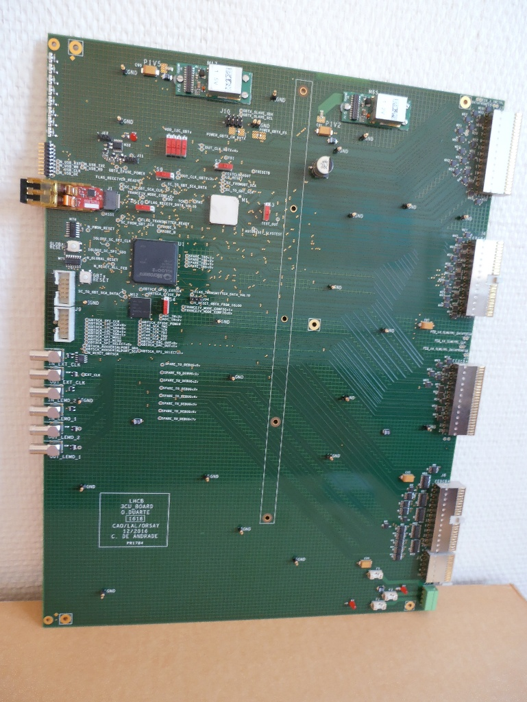
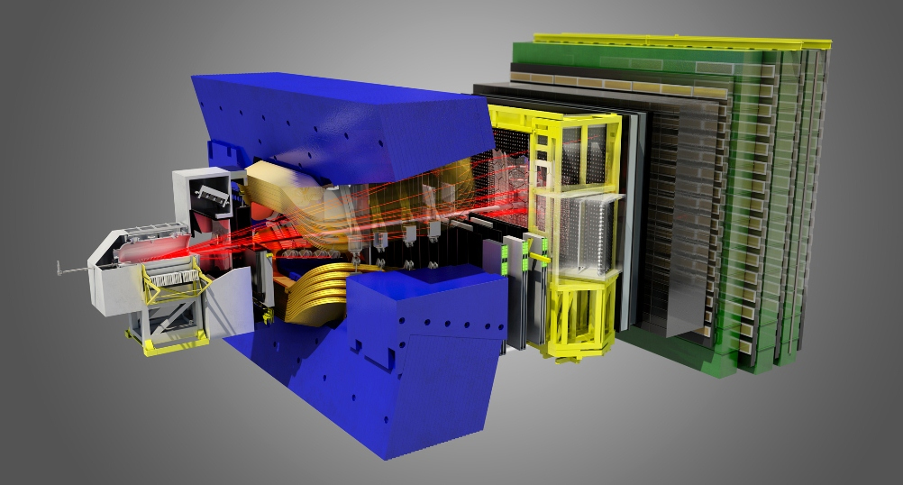
3CU (Calorimeter Crate Controller for the Upgrade)
Production Readiness Review
Introduction
➢ Short reminder (TFC system, Calorimeter crate)
General description
  ➢ Main role - main part of the board - overview
  Architecture
  ➢ Global architecture - clock tree - GBT frame format - Slow Control - Delatching control - IGLOO2 FPGA - Power supplies and power tree - Rear connections - Fimware architecture
Conclusion
On behalf of the Orsay group
1

Slide 2

PRR 3CU board
Introduction
➢ TFC system reminder
  ➢ Calorimeter crate reminder

Slide 3
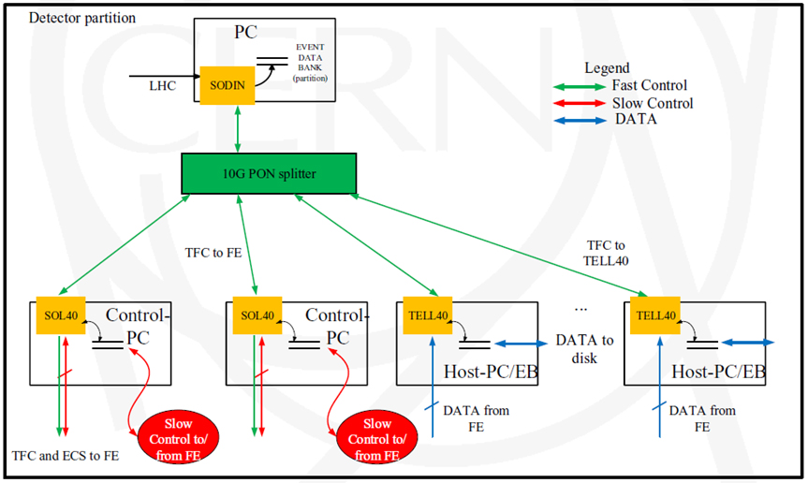
Introduction : TFC system reminder
S-ODIN receives directly Clk from the RF-system of the LHC.
S-ODIN card distributes the Clk and the Fast Control commands to the SOL40 ant TELL40 board.
3CU Boards
And SOL40 board distributes Clk and Fast Control command to the 3CU board.
F. Alessio Schematic
2

Slide 4
Introduction : Calorimeter crate reminder
Front-end crate with same backplanes and power supply
  3U ⇨ power supply, clock distribution, …
  6U ⇨ links between boards inside the same crate.
  New Front-end board with optical link DAQ and LLT.
  New Control Board (3CU).
  Remove TVB.
Calorimeter crate controller board (3CU)
Ensure signal distribution inside Front-end crate
  Clock distribution from the 3CU to all front-end board inside the same crate through 3U backplane.
  Slow control through 6U backplane
  Fast command (BxId Reset, FE Reset, …) through 3U backplane
Crate Power supply
  Reused Marathon equipment
3

Slide 5
PRR 3CU board
General description
➢ General description
  ➢ Global architecture
  ➢ Overview

Slide 6
3CU : General description
3CU main role:
  Receive the GBT frame through the optical link.
  Extract the information needed by the FEBs (inside the same crate)
    40 Mhz Clock
    Time Fast Control (TFC) commands
    Experiment Control System (ECS)
Main part of the board:
  A Versatile Transceiver (VTRx), a bi-directional module composed of both optical transmitter and receiver.
  A GBTx chip that can be used to implement multipurpose high speed bidirectional optical link.
  A GBT-SCA ASIC, part of GBT chip-set to distribute the Slow Control (SC) information on the board.
  A Microsemi FPGA (IGLOO2), in charge of the processing on the 3CU.
4

Slide 7
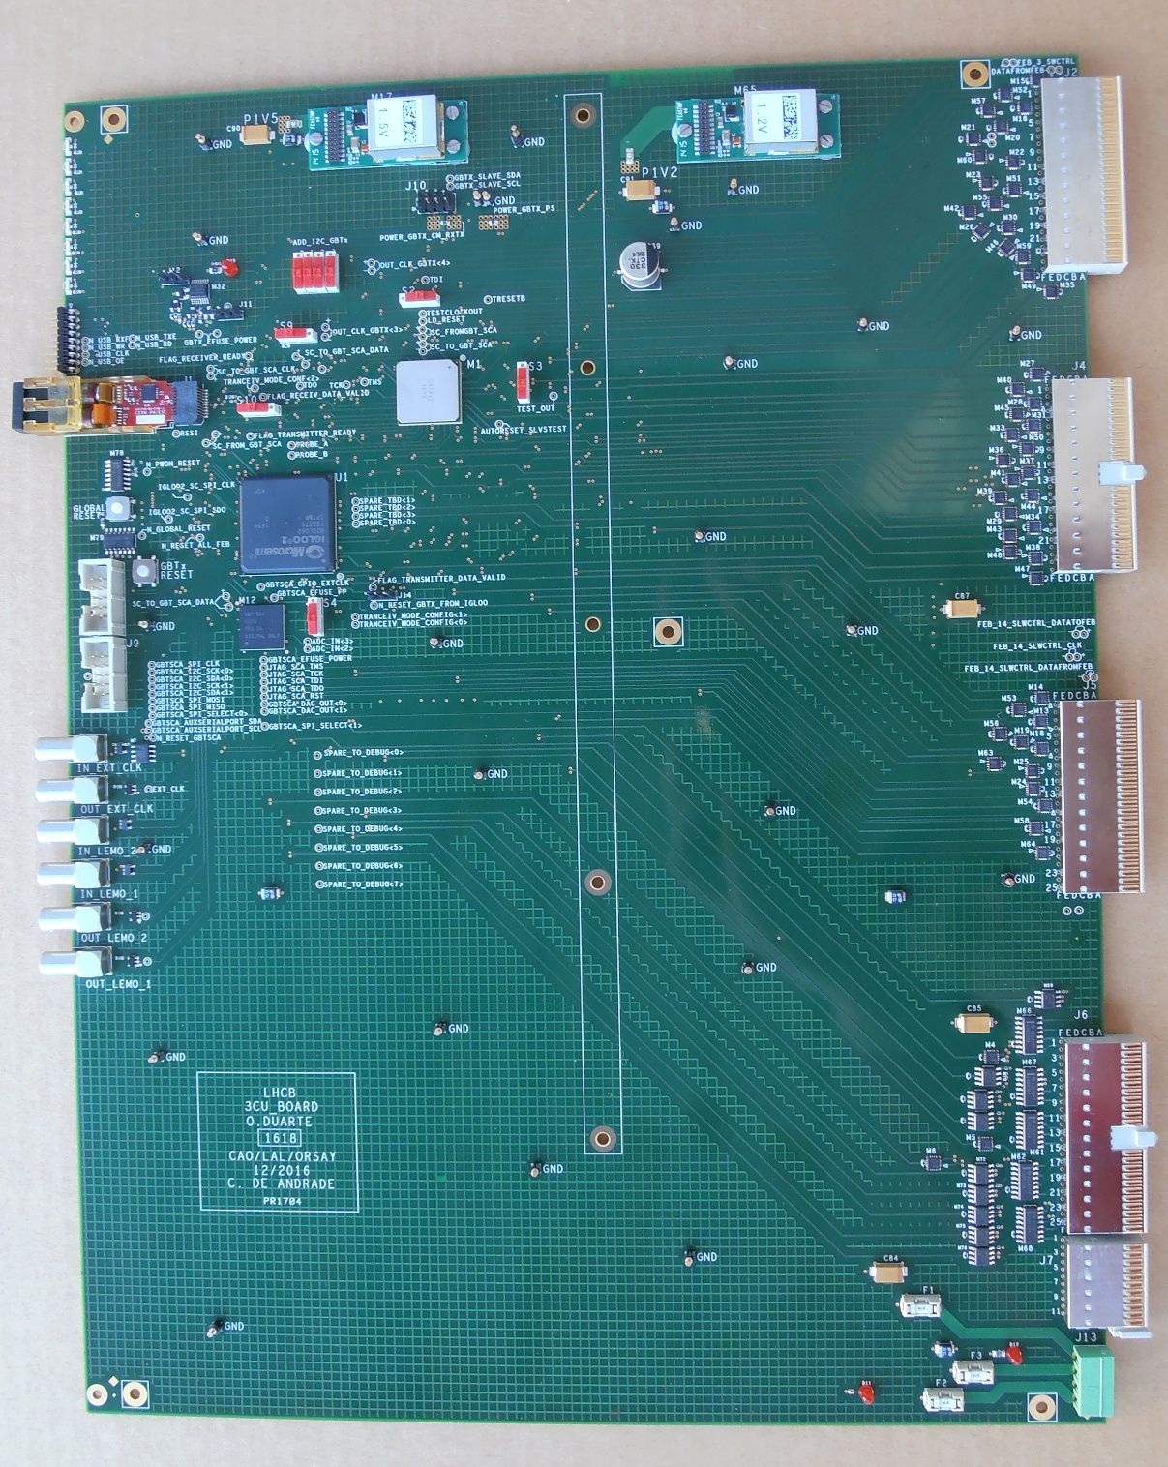
General description: overview
Front
Rear
DC-DC converter
GBTx
VTRx
6U backplane connections
IGLOO2
FEBs delach. Info
ECS distribution
GBT-SCA
3CU board:
  9U / 280 mm VME board
  Thickness 2.4 mm
  Components 999 / Connections 5115
  12 layers
  Routing very tight around IGLOO2 and GBTx and SCA
3U backplane connections
Clock
TFC command
5

Slide 8
3CU Board : Global architecture
Front
Rear
B25
AB25
Clk Ref / PLL
Phase Shift.
Clk Manager
GBTX
24 E-Port
(TFC cmd)
PS : 1V5
E-Port
(LVDS)
Uplink
E-Port
B25
Diff. Signal:
Clk, D_{OUT}, D_{IN}
Down-link
General Ctrl
……..
E-Port
Data
TTC cmd
Clock
SC
E-Port
I2C
Master
Slave
(LVDS)
VTRx
USB-I2C
AB25
1 Bi-directionnal link
TOSA
dongle
Laser Diode
GBLD
Edge-connector
I2C
PD +GBTIA
PCB
120b @ 40MSPS
ROSA
PS : 2V5 , 1V5
B77
6

Slide 9
3CU Board : Global architecture
Front
Rear
B25
Slow Control distribution to FEB through 6U_backplane
AB25
Clk Ref / PLL
Phase Shift.
Clk Manager
GBTX
24 E-Port
(TFC cmd)
Buffer
PS : 1V5
E-Port
(LVDS)
Uplink
E-Port
Slow control to FEB
B25
Diff. Signal:
Clk, D_{OUT}, D_{IN}
x (16)
(SLVS)
PS: 2V5
Down-link
General Ctrl
E-Port_SC_FEB
……..
E-Port
(SLVS)
Data
TTC cmd
Clock
SC
E-Port
I2C
Master
Slave
E-Port
E-Port_SCA
Prim. / Second.
(LVDS)
VTRx
USB-I2C
Network
Controller
AB25
1 Bi-directionnal link
TOSA
dongle
Laser Diode
GBLD
Edge-connector
User Buses :
I2C
{I2C, //, SPI,
JTAG, 12bADC,
…} – T°
I2C
PD +GBTIA
SPI
ROSA
PCB
GPIO
Protocol used on the board
120b @ 40MSPS
PS : 2V5, 1V5
GBT-SCA
…
B77
6

Slide 10
3CU Board : Global architecture
Front
Rear
FlashPro
connection
B25
JTAG
1V2
V_{CC} Core
1V5
USB
V_{CC} I/O_1
2V5
Slow Control distribution to FEB through 6U_backplane
Delatching
Ctrl.
V_{CC} I/O_2
E-Port (TFC_cmd)
AB25
24 b
SLVS / LVDS Translator
TFC command
Clk Ref / PLL
Phase Shift.
{Bidirectional !}
LVDS
Clk Manager
(SLVS)
TFC cmd
9 b
GBTX
24 E-Port
(TFC cmd)
Buffer
PS : 1V5
E-Port
Dedicated Clock IO
Clock Conditioning Circuit
(LVDS)
Uplink
LVDS
E-Port
Slow control to FEB
B25
Diff. Signal:
Clk, D_{OUT}, D_{IN}
x (16)
387 Max user I/Os – 10 I/O Banks
(SLVS)
PS: 2V5
Down-link
General Ctrl
E-Port_SC_FEB
M2GL060
……..
E-Port
(SLVS)
Data
TTC cmd
Clock
SC
E-Port
Interfaces
I2C
Master
Slave
In_1
E-Port
In_2
Out_2
Out_1
I2C
(LVDS)
SPI
E-Port_SCA
Prim. / Second.
GPIO
VTRx
USB-I2C
Network
Controller
Buffer
AB25
1 Bi-directionnal link
TOSA
dongle
TFC cmd distribution to FEB through 3U_backplane
Laser Diode
GBLD
Edge-connector
User Buses :
TFC command
I2C
{I2C, //, SPI,
JTAG, 12bADC,
…} – T°
I2C
(LVDS)
PD +GBTIA
SPI
PS: 3V3
ROSA
PCB
GPIO
Protocol used on the board
90LV001
120b @ 40MSPS
PS : 2V5 , 1V5
GBT-SCA
…
B77
6

Slide 11
3CU Board : Global architecture
Front
Rear
FlashPro
connection
B25
JTAG
1V2
V_{CC} Core
1V5
USB
V_{CC} I/O_1
2V5
Slow Control distribution to FEB through 6U_backplane
Delatching
Ctrl.
V_{CC} I/O_2
In_Ext_Clk
Ref_Clk[0:7]
AB25
E-Port (TFC_cmd)
SLVS / LVDS Translator
TFC command
24 b
Clk Ref / PLL
Phase Shift.
{Bidirectional !}
LVDS
Clk Manager
(SLVS)
TFC cmd
9 b
GBTX
24 E-Port
Ref_Clk[2]
(TFC cmd)
Buffer
PS : 1V5
E-Port
Ref_Clk[3]
Dedicated Clock IO
Clock Conditioning Circuit
(LVDS)
Uplink
LVDS
Out_Ext_Clk
E-Port
Out_Ext_Clk
Slow control to FEB
B25
LEMO
Out_1
Diff. Signal:
Clk, D_{OUT}, D_{IN}
x (16)
387 Max user I/Os – 10 I/O Banks
(SLVS)
PS: 2V5
Out_2
Down-link
General Ctrl
E-Port_SC_FEB
M2GL060
In_Ext_Clk
……..
E-Port
(SLVS)
Data
TTC cmd
Clock
SC
LEMO
In_1
E-Port
Interfaces
Buffer
In_2
I2C
Ref_Clk[1]
Left
Clock distribution to FEB through 3U_backplane
Master
Slave
In_1
Ref_Clk[2]
E-Port
In_2
Out_2
Out_1
I2C
(LVDS)
SPI
E-Port_SCA
Prim. / Second.
GPIO
(SLVS)
Network
Controller
PS: 3V3
Right
AB25
VTRx
USB-I2C
Buffer
TFC cmd distribution to FEB through 3U_backplane
1 Bi-directionnal link
TOSA
dongle
Laser Diode
GBLD
Edge-connector
User Buses :
TFC command
I2C
{I2C, //, SPI,
JTAG, 12bADC,
…} – T°
I2C
(LVDS)
PD +GBTIA
SPI
PS: 3V3
ROSA
PCB
GPIO
Protocol used on the board
90LV001
120b @ 40MSPS
PS : 2V5 , 1V5
GBT-SCA
…
B77
6

Slide 12
3CU Board : Global architecture
Front
Rear
DC-DC
Converter
5V -> 1V5
DC-DC
Converter
5V -> 1V2
Status Led
FlashPro
connection
B25
JTAG
1V2
USB
USB Interface Mezzanine
V_{CC} Core
1V5
(UM232H-B)
USB
V_{CC} I/O_1
2V5
Slow Control distribution to FEB through 6U_backplane
Delatching
Ctrl.
V_{CC} I/O_2
16 FEB Delatching Ctrl line
In_Ext_Clk
Ref_Clk[0:7]
{Bidirectional !}
AB25
E-Port (TFC_cmd)
SLVS / LVDS Translator
TFC command
Clk Ref / PLL
Phase Shift.
48 b/ 80 Mhz
LVDS
Clk Manager
(SLVS)
TFC cmd
9 b
GBTX
24 E-Port
Ref_Clk[2]
(TFC cmd)
Buffer
PS : 1V5
E-Port
Ref_Clk[3]
Dedicated Clock IO
Clock Conditioning Circuit
(LVDS)
Uplink
LVDS
Out_Ext_Clk
E-Port
Out_Ext_Clk
Slow control to FEB
B25
LEMO
Out_1
Diff. Signal:
Clk, D_{OUT}, D_{IN}
x (16)
387 Max user I/Os – 10 I/O Banks
(SLVS)
PS: 2V5
Out_2
Down-link
General Ctrl
E-Port_SC_FEB
M2GL060
In_Ext_Clk
……..
E-Port
(SLVS)
Data
TTC cmd
Clock
SC
LEMO
In_1
E-Port
Interfaces
Buffer
In_2
I2C
Ref_Clk[1]
Left
Clock distribution to FEB through 3U_backplane
Master
Slave
In_1
Ref_Clk[2]
E-Port
In_2
Out_2
Out_1
I2C
(LVDS)
SPI
E-Port_SCA
Prim. / Second.
GPIO
(SLVS)
Network
Controller
PS: 3V3
Right
AB25
VTRx
USB-I2C
Buffer
TFC cmd distribution to FEB through 3U_backplane
1 Bi-directionnal link
TOSA
dongle
Laser Diode
GBLD
Edge-connector
User Buses :
TFC command
I2C
{I2C, //, SPI,
JTAG, 12bADC,
…} – T°
I2C
(LVDS)
PD +GBTIA
SPI
PS: 3V3
Power Supply:
ROSA
PCB
GPIO
Protocol used on the board
90LV001
120b @ 40MSPS
PS : 2V5 , 1V5
GBT-SCA
…
B77
5V
3V3
2V5
6

Slide 13
PRR 3CU board
Architecture of the board
➢ Clock tree
  ➢ GBT frame
  ➢ Slow control
  ➢ Delatching control
  ➢ IGLOO2 FPGA
  ➢ Power supplies and power tree
  ➢ Rear connections
  ➢ Firmware architecture

Slide 14
3CU Board : Clock tree
Clk_Slot_0
65LVDS104
Clk_Slot_1
1 to 4
Clk_Slot_2
(LVDS)
Clk_Slot_3
Clk [0]
NB6L11S
(SLVS)
1 to 2
Clk_Slot_6
Clk to right FEBs
65LVDS104
Clk_Slot_7
1 to 4
Clk_Slot_8
Toward 3U Backplane for all FEB
Clk_Slot_9
OUT_Ext_Clk
GBTX : Clock manager
Clk_Slot_11
(Lemo)
NC7SZ125
Ext_Clk
Phase Shifter
Clk_Slot_12
65LVDS104
Clk_Slot_13
Clk [1]
(LVDS)
1 to 4
Clk_Slot_14
XPLL / XOSC
NB6L11S
Clock distribution on the old “Validation slot”
(SLVS)
1 to 2
Clk_Slot_17
XPLL
3 to 1
Clk [7:0]
Clk [7:0]
Clk to left FEBs
65LVDS104
Clk_Slot_18
1 to 4
Clk_Slot_19
IN_Ext_Clk
External clock source
Clk_Slot_20
(Lemo)
NC7SZ125
DS92LV010
(LVDS)
Clk_Slot_4 (Validation)
(Unipolar)
65LVDS104
Clk_Slot_5 (Validation)
1 to 4
Clk_Slot_15 (Validation)
Clk [2]
NB6L11S
(LVDS)
Clk_Slot_16 (Validation)
Clock distribution:
  8 output reference clocks available on the GBT (SLVS).
  The 8 reference clocks are programmable both in phase, 50 ps resolution and frequency 40, 80 160 and 320.
(SLVS)
1 to 2
Clk to Validation
3CU
FPGA
0 1 2 3
4 5
6 7 8 9
11 12 13 14
15 16
17 18 19 20
Clk [3]
Clock Conditioning Circuit
Ext_Clk
Clk [4]
(SLVS)
Global_Clk
  4 among 8 reference clocks on the GBTx used
NB6L11S (AnyLevel Input to LVDS Fanout Buffer / Translator): RMS Clock Jitter −0.5 ps, Typical
    Clk[0] : left FEBs on the crate through 3U backplane
    Clk[1] : right FEBs on the crate through 3U backplane
    Clk[2] : Spare (Old validation slot)
    Clk[3], Clk[4] : IGLOO2 Clock input (one should be enough ! )
SN65LVDS104 (1:4 LVDS Clock Fanout Buffer) : already used on the CROC for the clk distribution
7

Slide 15
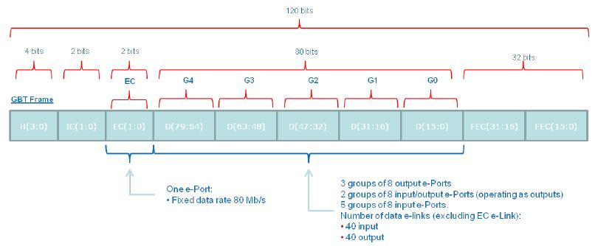
3CU Board : GBT frame
The 120-bit “GBT frame” is transmitted every 25 ns
GBT frame format:
  4 bits for the frame Header
  32 for the FEC (Forward Error Correction)
  This leaves 84 bit for data transmission
    4 bit for Slow Control information Internal Control (IC) and External Control (EC) field
    80 bit for user Data (D) transmission
    “D” and “EC” fields is not pre-assigned and can be used indistinctly for Data Acquisition (DAQ), Timing Trigger & Control (TTC) and Experiment Control (EC) application
3CU extract and process (if necessary) the TTC and EC to transmit them through backplane to the FEBs.
8

Slide 16
3CU Board : Slow Control (SC)
GBT encodes SC packets in the counting room
Transmit through optical fiber SC information interlaced with the rest of the traffic (DAQ, TTC, …)
Delivers the SCA packet unmodified to the GBT-SCA
GBT-SCA provides various user-configurable interfaces capable to perform simultaneous operations
  I2C (16 independent I2C master)
  SPI (with 8 individual slave select lines )
  GPIO (32 digital IO lines)
Clk Ref / PLL
Phase Shift.
Clk Manager
GBTX
24 E-Port
(TFC cmd)
PS : 1V5
E-Port
3CU board
  Transmit the SC to the 16 FEBs inside the same crate through the 6U backplane (translator SLVS – LVDS)
  Integrate a GBT-SCA to distribute control and monitoring signals on the 3CU
Uplink
E-Port
Buffer
Diff. Signal:
Clk, D_{OUT}, D_{IN}
x (16)
Slow Control distribution to FEB through 6U_backplane
Down-link
General Ctrl
E-Port_SC_FEB
……..
E-Port
(SLVS)
E-Port
PS: 2V5
(LVDS)
I2C
Master
Slave
E-Port
E-Port_SCA
Prim. / Second.
VTRx
USB-I2C
Network
Controller
1 Bi-directionnal link
TOSA
dongle
Laser Diode
GBLD
Edge-connector
User Buses :
I2C
{I2C, //, SPI,
JTAG, 12bADC,
…} – T°
I2C
PD +GBTIA
SPI
ROSA
PCB
GPIO
Protocol used on the board
120b @ 40MSPS
PS : 2V5 , 1V5
GBT-SCA
…
9

Slide 17
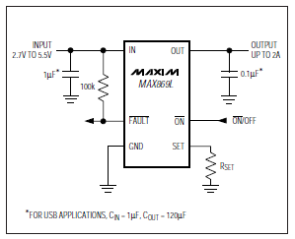
3CU Board : FEBs delatching control
Each FEBs inside the crate are protected by delatchers (2A, Current-Limited switch) of type MAX 869
  If Single Event Latchup (SEL ) occurs the MAX869 switch OFF (during few ms) the FEB and ON again
  The delatching is controlled by the 3CU one connection between each FEB and 3CU, 16 lines off the backplane)
On the 3CU
  Each delatching control line is connected to the IGLOO2 (status register)
  Status register regularly checked by the system, and if it necessary the FEB may be reloaded by ECS.
Reused the same system of the CROC board with the IGLOO2
10

Slide 18
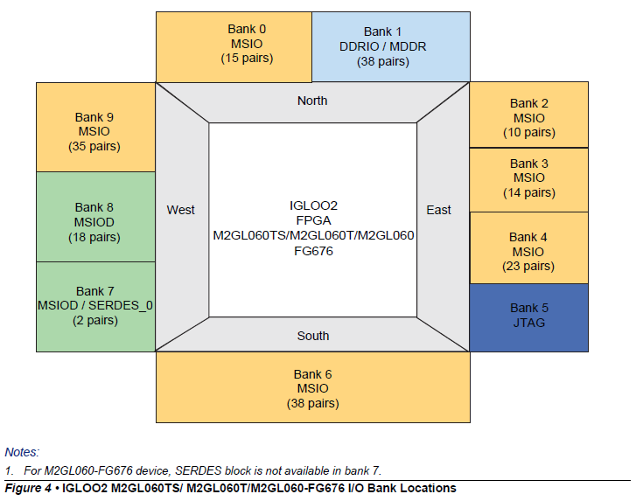
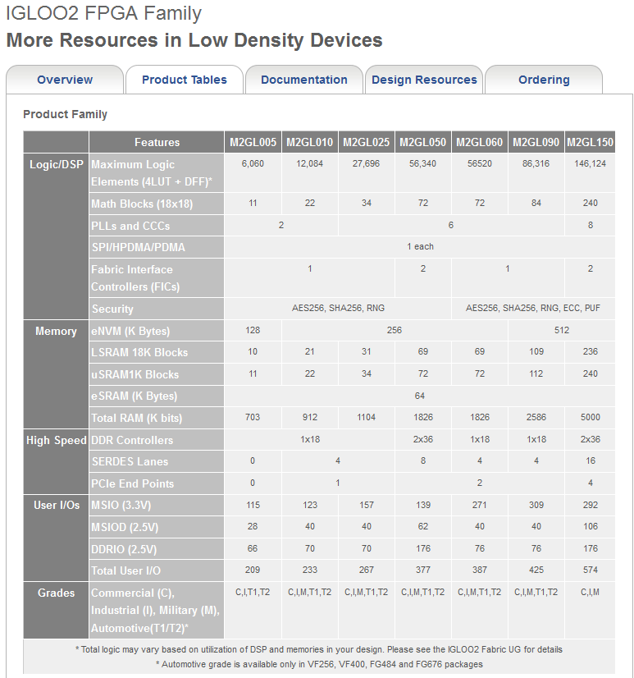
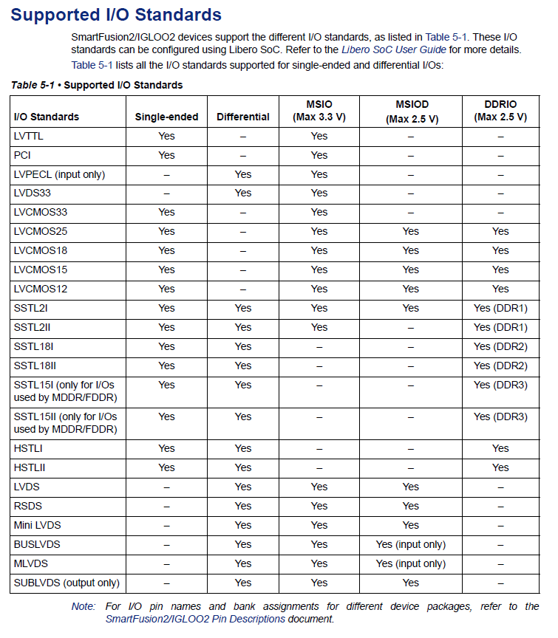
3CU Board : IGLOO2 FPGA
Flexible IOs structure
  Mixed voltages VCCIO_BANK (1.2, 1.5, 1.8, 2.5, 3.3V)
  Multistandard IOs
11

Slide 19
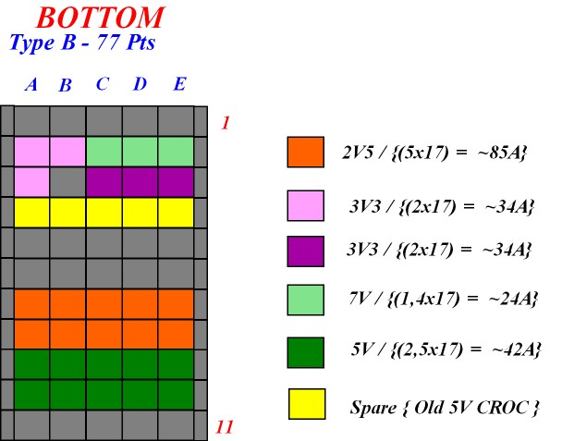
Power supplies and power tree
P7V unfused
Not used
3CU power supplies needed
P5V
5V
  Input DC-DC converter for 1V5 and 1V2
3V3
  Discret components,
2V5
  VTRx, FPGA IOs, …
1V5
  GBTx, GBT_SCA, VTRX, …
1V2
  FPGA Core
P5V unfused
FUSE
DC-DC
P1V5
( FEAST )
ON
ON BOARD CONNECTOR
DC-DC
P1V2
3U BACKPLANE
( FEAST )
ON
P3V3 unfused
FUSE
P3V3
P2V5 unfused
FUSE
P2V5
Crate power supplies available:
7V, 5V, 3,3V, and 2,5V
7V must be decrease at 6V
Modification to the compatibility with the LEDTSB design
Move the 2.5V to 3.3V and use diodes to generate the 2.5V.
12

Slide 20
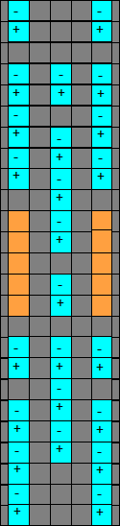
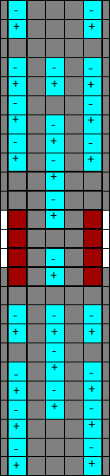
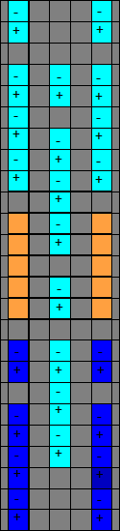
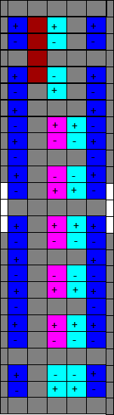

6U Backplane
Slow control to FEB through 6U backplane (3 differentials pairs between Control slot and each FEB)
3CU Board : rear connection with 3U and 6U Backplane
Rear
DC-DC
Converter
5V -> 1V5
DC-DC
Converter
5V -> 1V2
Delatching control (1point to point connection between each FEB and Control board)
B25
Connected to 6U backplane
Crate Id (8 bit DIP switch on 6U_backplane)
3CU Board
Valid to CROC link (Old – Not used to upgrade)
16 FEB Delatching Ctrl line
AB25
6U Backplane connections
  Transmit SC to all the FEBs
  Crate Id
  Delatching control line
Buffer
Slow control to FEB
B25
(SLVS)
PS: 3V3
3U Backplane connections
  Power supply distribution
  Clock distribution
  TFC command distribution
Buffer
Clock distribution from Control board to all slot of the same crate (20 differentials pairs between Control slot and each FEB)
Ref_Clk[1]
Left
Ref_Clk[2]
3U Backplane
(SLVS)
PS: 3V3
Right
AB25
TFC[8:0] Timing Fast Command (3U).
Buffer
TFC command
Slot ID (4 bit ….)
Connected to 3U backplane
7V (Not used on 3CU)
(LVDS)
PS: 3V3
5V
B77
3V3
3V3
NC
13

Slide 21
Firmware architecture (IGLOO 2)
LP Bus_Asyn
LP Bus _2
(USB to Users // bus)
16 bits Rd / Wr Registers
(Add 01h, 02h, 03h)
USB
We reused a lot of block implemented to the FEB
(thanks Jihane and Christophe !)



Add Map
(USB)
FIFO (16x1024)
(Add 05h, 06h, 07h)
CS


Verilog inside IGLOO2
SPI Master
(SPI Cmd register)

SPI Slave
SC
16 bits Rd / Wr Registers
Optical
Link
GBTX
GBT_SCA
SPI


I2C
Add Map
(SPI)
CS
RAM Pattern
(Emulation of TFC command)
//

Extract and process TTC Cmd
receive 21bit
transmit 9 to FEB
TFC cmd to FEB Through backplane
14

Slide 22
PRR 3CU board
Test of the board
➢ Test bench
  ➢ About clock
  ➢ About MiniDAQ
  ➢ About TTC commands
  ➢ Modification before production

Slide 23
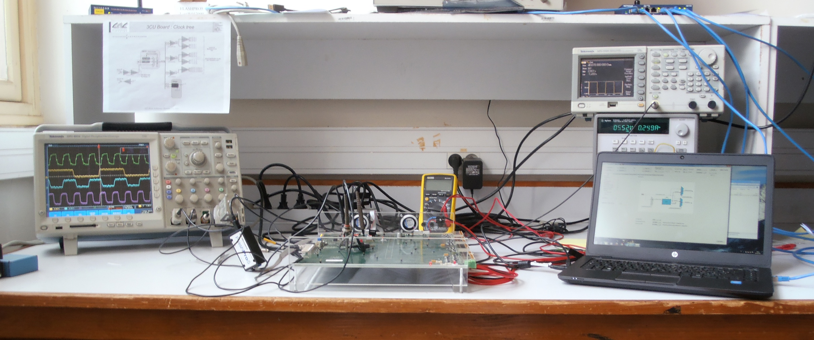
3CU Test Bench
Two 3CU board prototype available
  Optical link from MiniDAQ
  External clock generator
  USB interface
  Power supply, oscilloscope , …
15

Slide 24
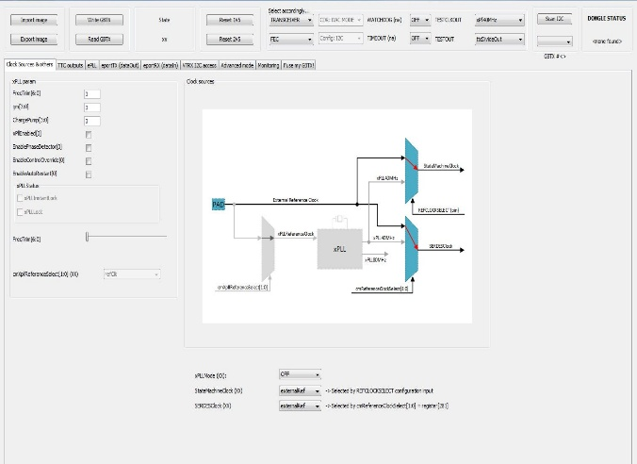
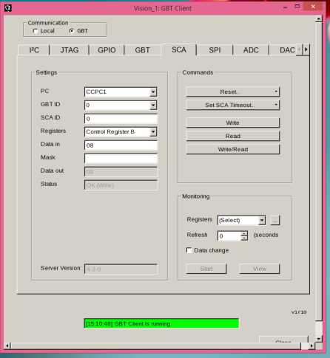
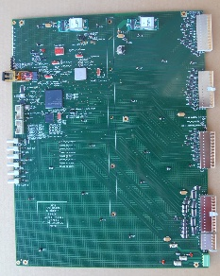
Test status about clock and MiniDAQ
About clock
  The 3CU board works in master Clock
    Without optical links and With GBTx configuration by dongle (I2C) from CERN
  The 3CU board works with the Clock locked on the optical fiber
  With optical links (from MiniDAQ) and with GBTx configuration by dongle (I2C) from CERN
  The test of the Clock distribution through backplane to FEB is to do.


To do
About MiniDAQ (Optical link between MiniDAQ and 3CU board only)
  The MiniDaq (GBT Client) read the fourth Ctrl register inside the GBT_SCA.

GBT Client
By optical link
16

Slide 25
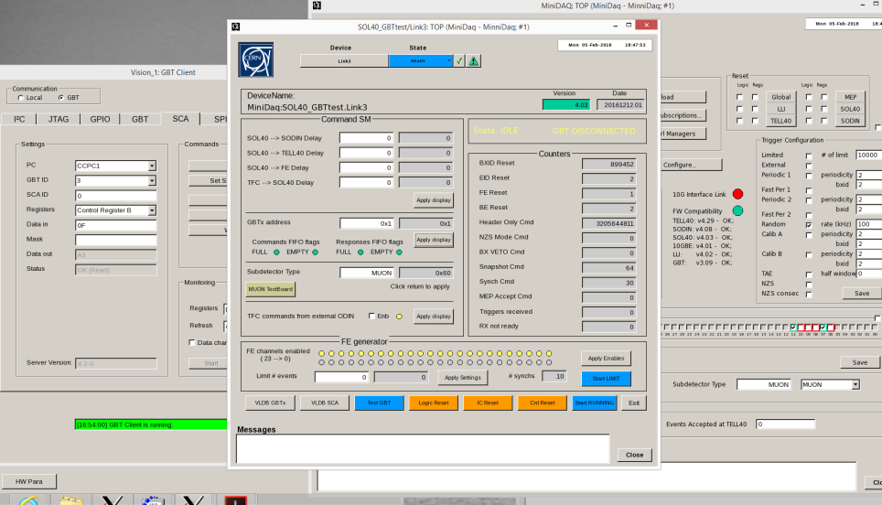
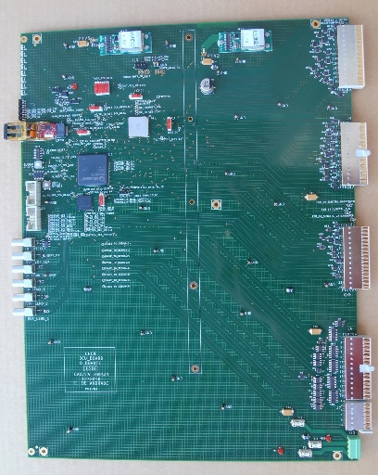
Test status about TTC command
MiniDAQ Ctrl Panel
By optical link
3CU
About MiniDAQ and TTC command
  The “Start_Run” command generate a Synch. Pulse in the frame
  Extract a Synch pulse from the frame (inside IGLOO2 FPGA)
  Transmit to FEB through backplane
In progress
17

Slide 26
Modifications and test before production
30 boards will be produced (including spares)
Wire modification
  Grounding of DC-DC converter (schematic mistake !)
  Add decoupling capacitor on several discret footprints
  Remove switch to command the GBTx configuration, the configuration will be from the FPGA (Triple Voting Rregister).
  Change the power supply : to move the 2.5V to 3.3V and use diodes to generate the 2.5 V. 2 Amps diode available
Standalone tests
  Extract the TTC command from a frame
  Transmit Rd/Wr from the GBTx (3CU) to GBT_SCA (3CU)
In progress
3CU board in the crate with FEB
  Transmit the Clock through backplane to all FEBs inside the same crate (At the moment the clock is present on the rear connector of the 3CU board)
  Transmit the TTC command through backplane to all FEBs inside the same crate
  Transmit Rd/Wr from the GBTx (3CU) to GBT_SCA (FEB) through backplane
18

Slide 27
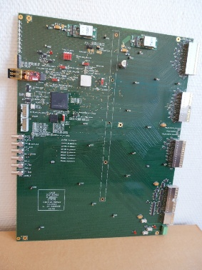

Conclusion
Two 3CU prototype boards available and under test
No major corrections for the final version
There are still some tests to do before production (test with FEB inside the same crate)
  The 3CU documentation is available and up to date
19

Slide 28
Thank you

Slide 29
SPARES

Slide 30
Production Schedule
2018
Q1
Q2
Q3
Q4
Q1
End of tests of prototype
Final version CAD
Final version Production
Tests of 3CU Final version

Slide 31
3CU Board : Reset tree
Push button GBTx reset
Schmitt-trigger
N_Reset_GBTx
FPGA
Push button on board reset
Schmitt-trigger
Reset Manager
N_Reset_GBT_SCA
Power On reset
Schmitt-trigger
N_Reset_All_FEB_Through_3U_Backplane
USB Interface Mezzanine
USB
(UM232H-B)
M2GL050

Slide 32
3CU Delatching
Same as the CROC …
3CU
Delatcher
Scrutinize mode
  Scrutinize the state (ON or OFF) off all board inside crate
  Storage delatching of FEB or Validation board (FEBn = OFF).
Drive mode
  Switching ON or OFF of FEB or Validation (FEBn= ON or OFF).

Slide 33
SLVS standard
SLVS (Scalable Low Voltage Standard)
  JEDEC standard: JESD8-13
  Differential voltage based signaling protocol.
    Voltage levels compatible with deep submicron processes.
    Typical link length runs of 30cm over PCB at 1Gbps.
    Low Power, Low EMI
  Application in data links for Flat Panel displays in mobile devices.
    Mobile Pixel Link, MPL-2 (National semi.)
LVDS
400mV
SLVS specifications brief
2 mA Differential max
Line impedance: 100 Ohm
Signal: +- 200 mV
Common mode ref voltage: 0.2V
1.2V
SLVS
0.2V
200mV

