Slide 1


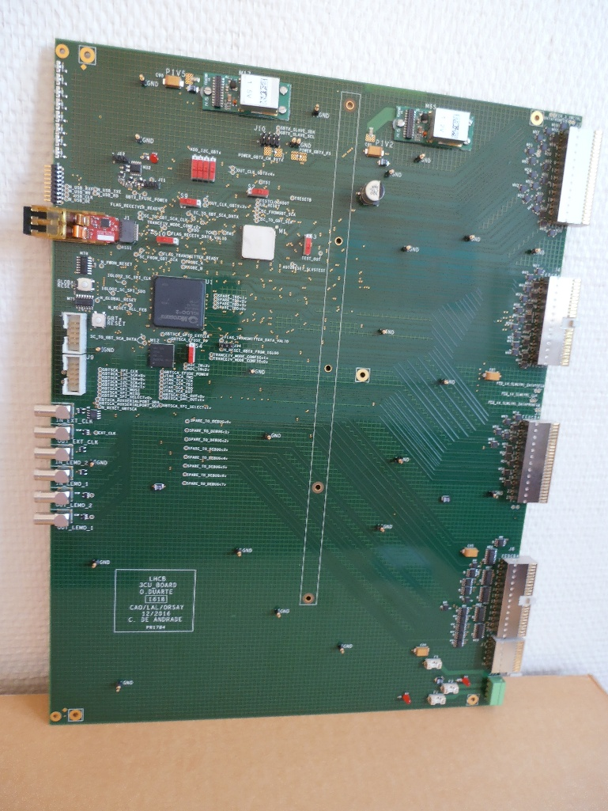
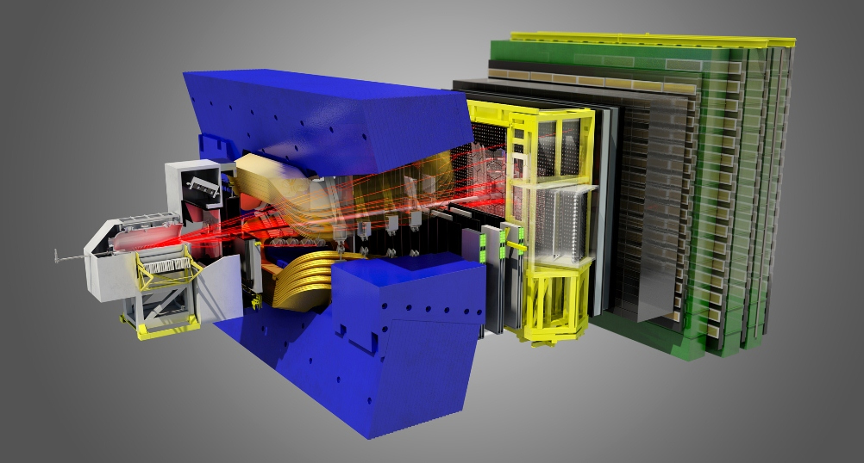
3CU (Calorimeter Crate Controller for the Upgrade)
Production Readiness Review
Test of the production
➢ Manufacturer
➢ Production flow
➢ Production test
AOI (Automated Optical Inspection), Rx, Takaya
➢ Aging
On behalf of the Orsay group
1

Slide 2
3CU Production : Manufacturer
30x3CU board will be product
  Price for about 30xPCB ( ~500x30) = 15 000 €
  Price for cabling about 30x3CU board ( ~1000x30) = 30 000€
  According to the CNRS rules, only a PUMA for each will be necessary.
Criteria for choice of the manufacturer
  Rx tests for all BGA on all board
  We prefer different manufacturer than FEB (production in the same time)
  Takaya test
  Aging
Production of the current CROC board
  It was made by ALTREL
  Renewal ?
1

Slide 3
3CU : Production flow
All the PCBs and components are checked upon reception at the factory.
SMC components are mounted first.
Right after the SMC oven, there is a visual control of each side of the board plus a BGA Xray test for all BGA on boards.
AOI (Automated Optical Inspection). Validation of components polarity, solder quality, no short circuit
The other components are mounted and soldered
The press-fit connectors are mounted with a dedicated tool.
Then the boards undergo the flying probe test (Takaya)
There is a final visual control before powering the boards and checking the power consumption.
If this is OK, the boards are sent to the aging oven.
The power consumptions are tested again at the exit of the oven to look for potential component failure.
If everything is OK, the boards are sent to LAL.
All the former step results are noticed in a report file.
The production boards will be produced by lots of 10-10-8 boards every week.
2

Slide 4
Production Test AOI
(Automated Optical Inspection)
Automated optimal Inspection
  Control presence and quality of components weld
  Control the polarity of components
  Control the placement (X-Y) of all components by laser
  Detection of the raised leg
3

Slide 5
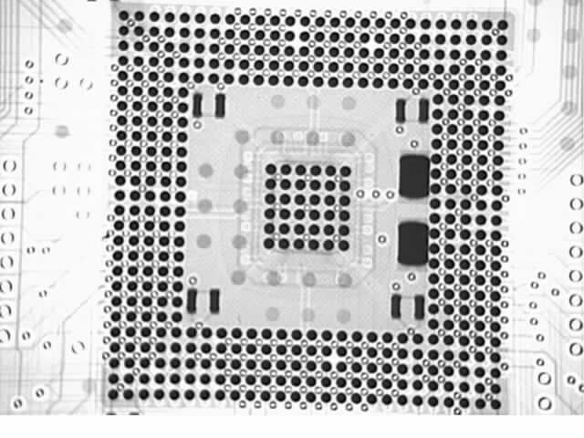
Production Test Rx
RX
  All BGA on the 3CU
  All board
  Validation solder of all Ball of BGA, no short circuit between ball no void
4

Slide 6
Production Tests : Takaya
Takaya : flying prob test
  Measures the impedance values of nets and components and check the interconnections
  Valid interconnection and passive components
5

Slide 7
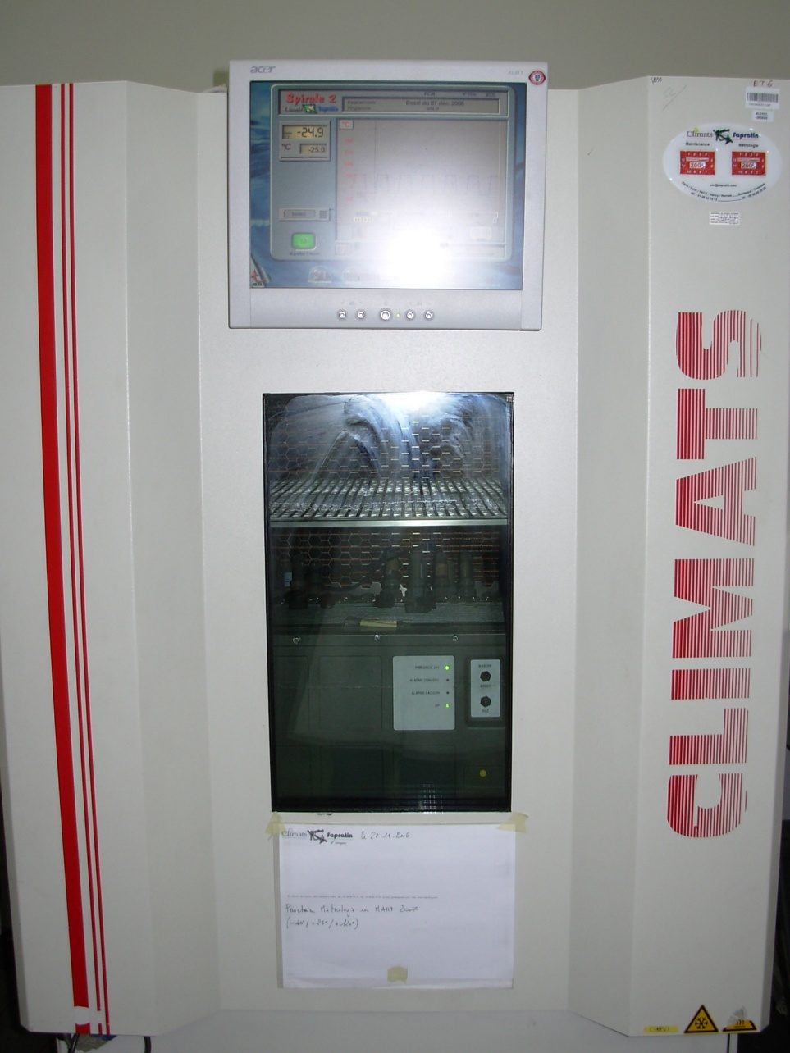
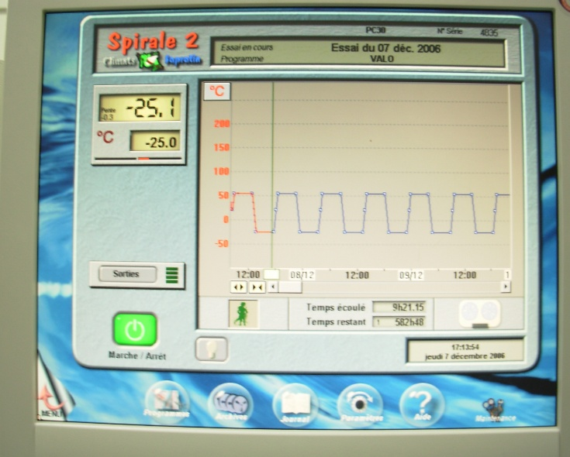
Aging
For this test we will used the same crate as CROC aging test
Goals :
  Detection of bad soldered components
  Infant mortality
Power consumption is controlled before and after the aging
6

Slide 8
Aging cycle
8 cycles of 9 hours between 0 and 60 degrees.
The upper temperature was fixed after measurements made on the hottest component on the board: its package was at 90 degrees when air was at 60.
7

Slide 9
Conclusion
The choice of the manufacturer is not fixed, we have several possibility (ALTREL, OUESTRONIC, …)
Legal obligation PUMA (rules of the public service !)
Production will be start for summer
  30 PCB
  2 x 3CU boards cabling
  Then 8, 10, 10.
14

Slide 10
Thank you

Slide 11
SPARES

