Slide 1
YETS 2017-18 AD RING
AD Technical Coordination Meeting #5
2018-02-08
Aymeric BOUVARD
EN-EA-EC

Slide 2
YETS 2017-2018
From 18 dec 2017 to 23 march 2018
Beginning of the Hardware Tests : 12 March 2018
The access point will be in "general" mode during the entire shutdown with free access by the emergency exits.
An exception will be made at dangerous interventions requiring limited access to persons qualified for this work. During these periods, access control through impact will be awarded based.
All material out of the Ring will be stored in Buffer Zone and a TREC Request will be done for control, by the owner.
Each owner of equipment will be in charge of performing the EDH transport and handling referring to their equipment.
The visits will be subject to restrictions under the current work.

Slide 3
YETS AD Ring
Work Request
MSC
  Refurbishment of 3 Magnets: BHS52, QDN55, QFN56.
  Storage of the shielding blocs in AD Hall.
    BHS52:
      18 blocks 24168
      2 ventilation modules
      Cutting of the vacuum chamber in AD Hall before transfer to the b.867. This intervention will be supervised by RP and EN-EA.
    QDN55
      4 shielding blocks 24168
    QFN56
      6 concrete beams
    The exhibition magnets, near ELENA should be removed in another place in the AD Hall. Probably on the shielding in front of ASCUSA and ALPHA experimental areas.
  BCCC
  Installation of new controlled flow valve and insulation vacuum valve

Slide 4
YETS AD Ring
Work Request
BI
  General maintenance of the E.Cooler.
  General maintenance BTV
  Kickers:
  General maintenance + Test
CV:
  Removal of ventilation modules (BHS52)
  Maintenance of demineralized water.
  Water maintenance
  RP:
  Source Test:
    PMIA604
    PAXA604
    PAXT113
  EL:
  AUG Test
VSC
  Disconnection and reconnection: BHS52, QDN55, QFN56
  Works and Maintenance:
    Sector 1A
    Sector 1B
    Sector 2A
    Sector 2B
    Sector 3
    Sector 4
    DE Experimental Lines
  Bakeout Sector 1 (BHS52, QDN55, QFN56)
  Bakeout Sector 2A (SHV1305)
  SU
  Alignment: BHS52, QDN55, QFN56
  STI
  Replacement of the scraper SHV1305 (sector2)
  RF
  Maintenance + Test ADC02 and ADC10

Slide 5
Works from W03 to W06
MSC:
  Refurbishment BHS52, QDN55 and QFN56. In progress
  Return of QDN55 and QFN56 in AD Ring (W06) Postponed W07-> Preparation area + opening of shielding, end of W05 (EA+HE) Finished
BCCC
  Pump Insulation Vacuum. In Progress
STI:
  Maintenance BTV
RP:
  Source test. Postponed W08
SU:
  Alignment QDN55 and QFN56. Postponed W07
EA:
  Cleaning of cables line 8000. Postponed W08
VSC:
  AD Ring:
    Sector 2A and 2B. In progress
    Magnets group sector 1A. In progress
    Sector 1B. Postponed
    Sector 3. Postponed
    Sector 4. In Porgress
  ELENA:
    LNR30-40-50: Bakeout. In progress
    LNE50: In progress
    LNI-LNE: In progress
EL:
  Installation of cables for Scraper Done
RF:
  Maintenance ADC02/ADC10

Slide 6
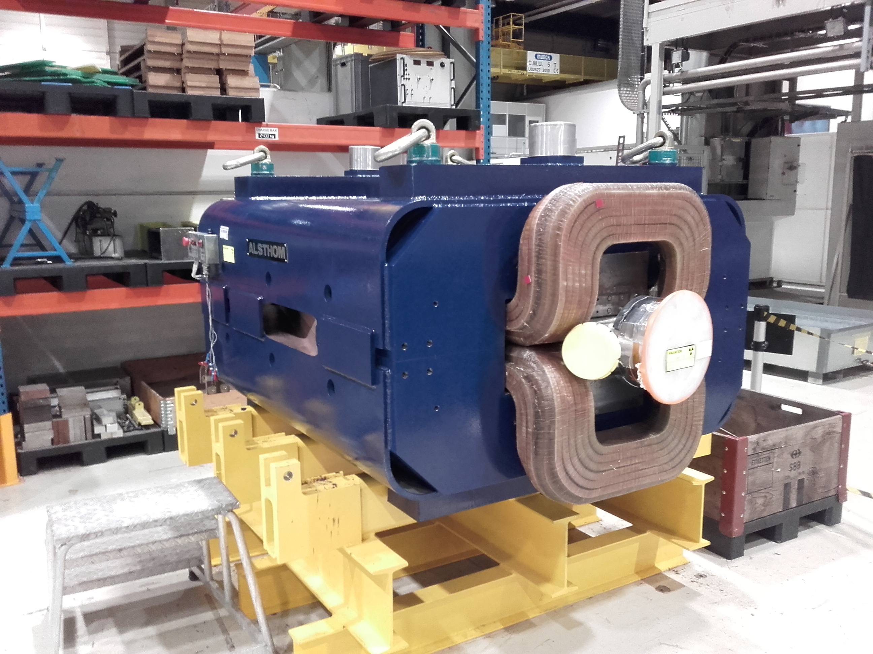
Magnets
The return of the magnets are scheduled from end week 06 to week 07.
The opening of the shielding was finished on Tuesday 06 February.
BHS52: Arrival Friday 09 February -> reassembling of the Y vacuum chamber -> Installation in the Ring
QDN55 and QFN56: Arrival during w06 with installation directly in the ring
BHS52

Slide 7
Works from W07 to W10
  MSC:
    Installation BHS52 + QDN55 + QFN56
  SU:
    Alignment of magnets
  CV:
    Maintenance of demineralized water
  RF:
    Power Test ADC02 and ADC1
  BI:
    Checking E-cooler + BIPM
  ICS:
    Maintenance of Acces point
  RP:
    Source Test
  EA:
    Cleaning of cables line 8000.
  BCCC:
    Pump Insulation vacuum
    Cool-down and refill
  VSC:
    AD Ring:
      Connection of Magnets
      Line 6000
      Magnets group sector 1A.
      Sector 1A.
      Sector 1B.
      Sector 2B
      Sector 3
      Sector 4
    ELENA:
      LNR30-40-50
      LNE50
      LNI-LNE

Slide 8
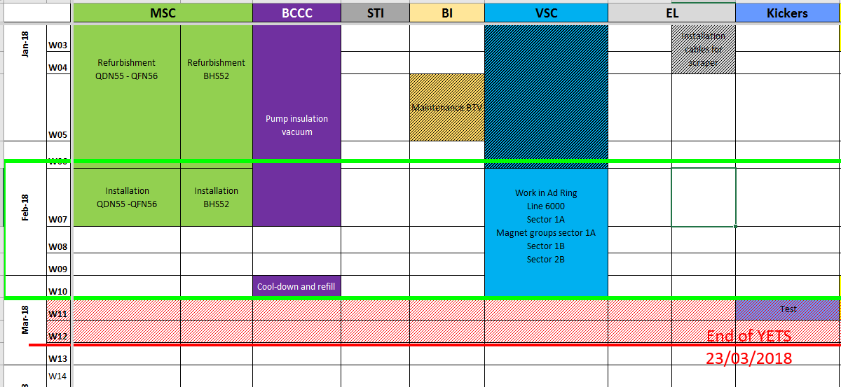
Planning

Slide 9
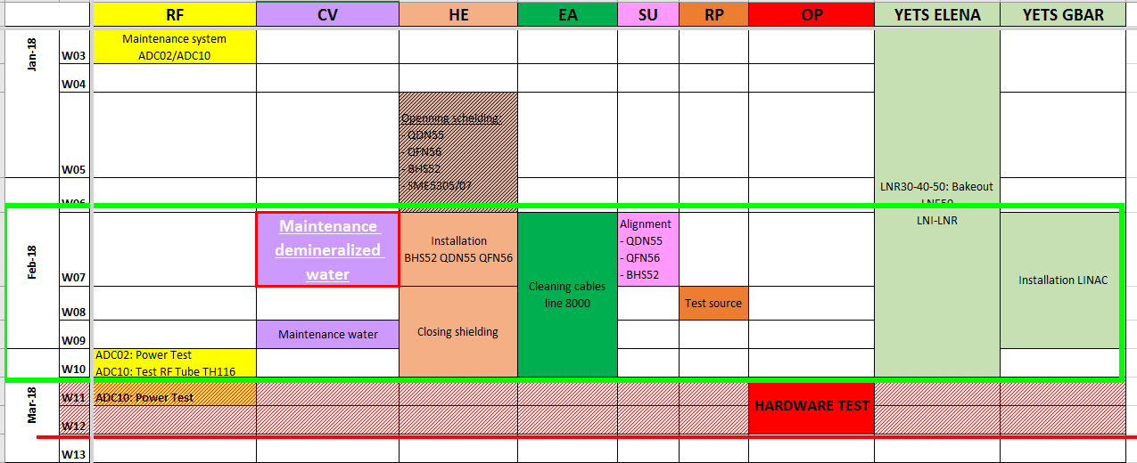
Planning

Slide 10
Thank You

