Slide 1


ELENA Project
TRANFER LINES INSTALLATION LS2

Slide 2
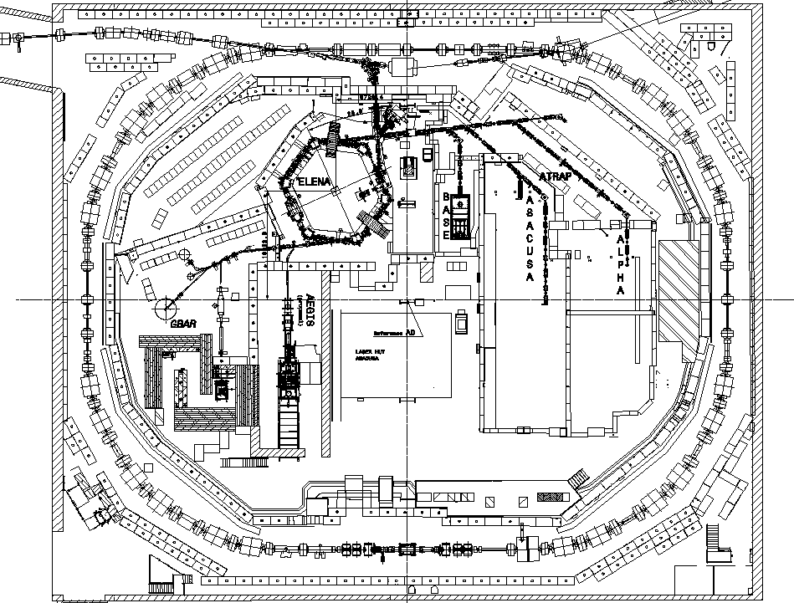
ELENA in AD hall
AEGIS
ELENA
ATRAP
BASE
ASACUSA
ALPHA
GBAR
AEGIS 2
AD machine

Slide 3
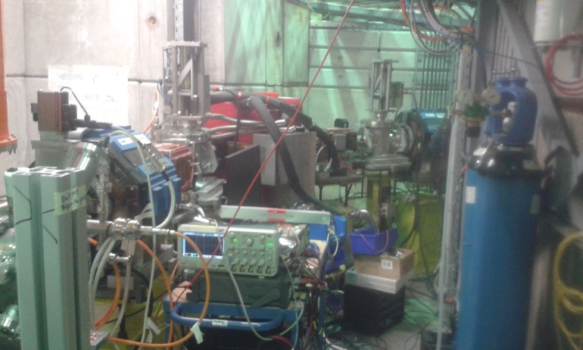
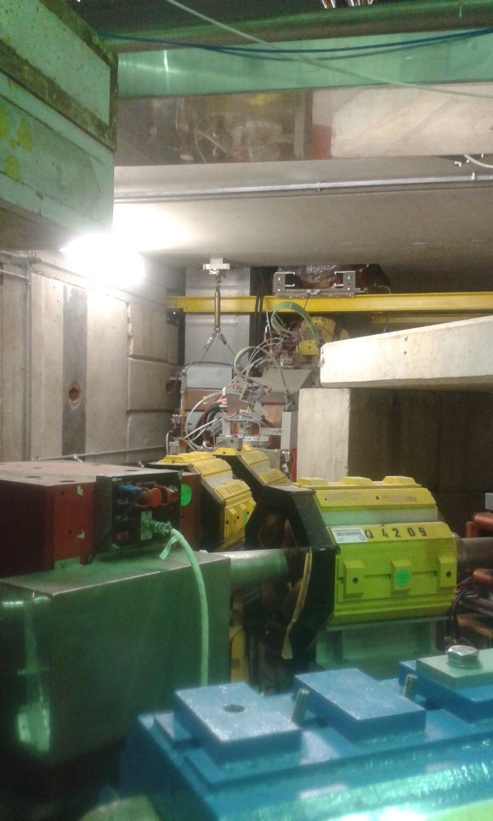
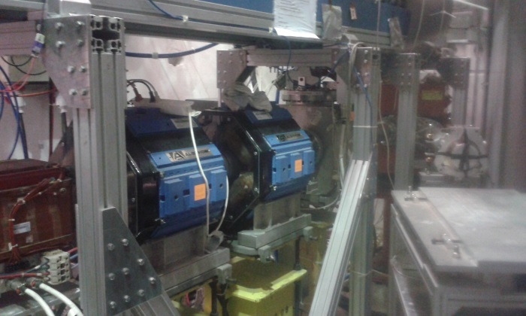
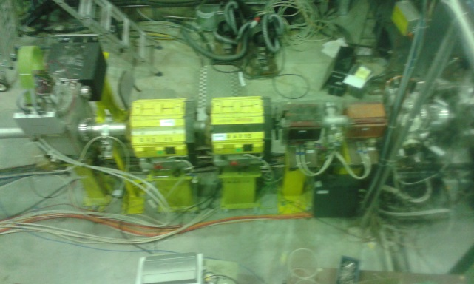
LS2 : 12 Nov 2018 – Jan 2021
Beam lines to be replaced by electrostatic TL

Slide 4
Transfer lines works
Remove all magnetic transfer lines plus corresponding supports and services
Re-organize part of the shielding walls
Re-route cable trays and water pipes
Install electrostatic transfer lines and services
Commission new transfer lines

Slide 5
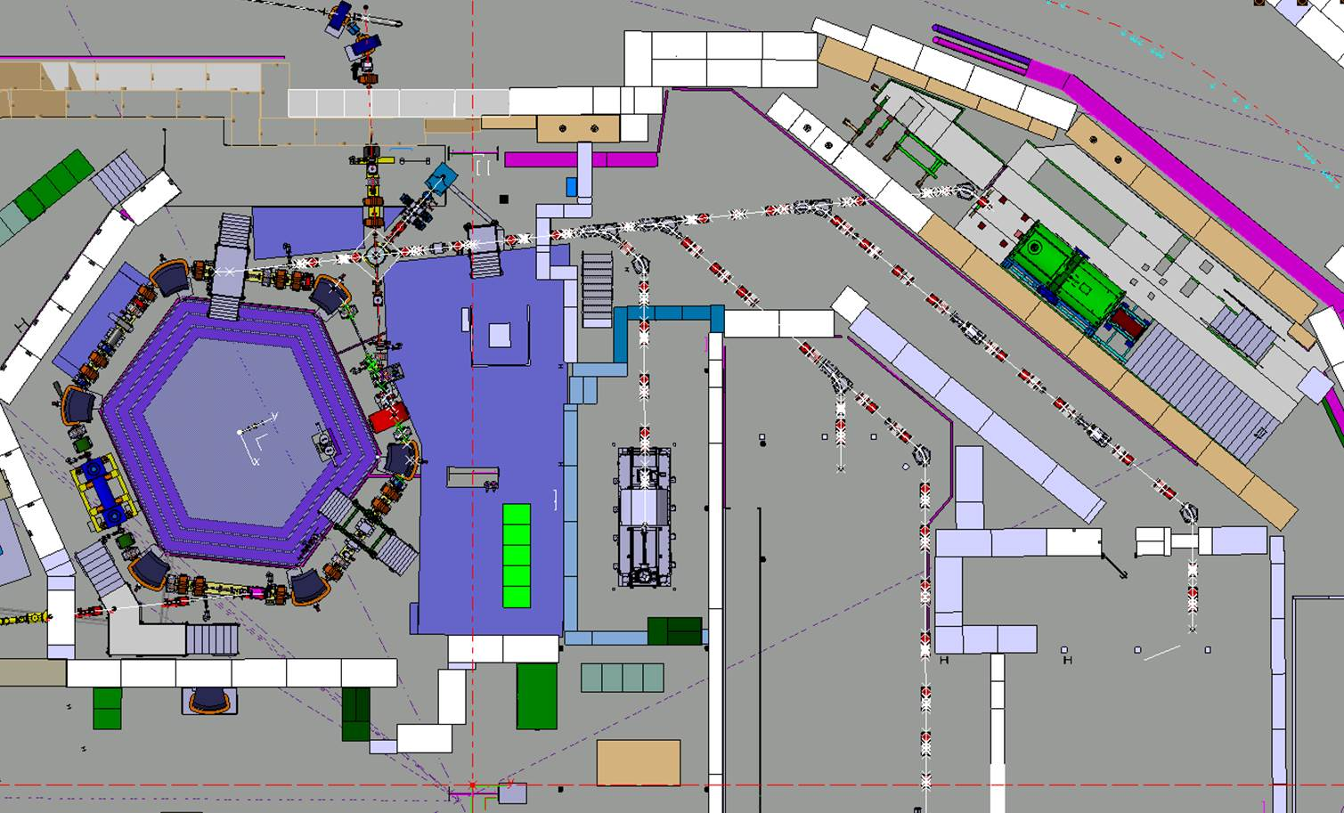
Electrostatic lines to be installed
LNE02
LNE00
LNE01
LNE03
LNE07
LNE06
LNE04
LNE50
LNE05
LNE51

Slide 6
Existing lines dismantling strategy
Disconnect cables/pipes from equipment
Remove Equipment accessible with crane (Vac, GEM, Magnets)
Remove Supports accessible with crane
TIME
Remove Cables
Remove remaining equipment (Vac, GEM, Magnets)
Remove remaining supports
Infrastructure works (shielding, piping)

Slide 7
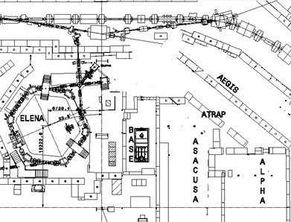
Installation of the new lines
Survey Marking
Floor drilling
Atrap 1
Install mechanical supports
Atrap 2
LNE00
LNE01
LNE02
Install new cables (signal, AC, optical fibres)
LNE07
LNE06
LNE03
LNE04
LNE05
Install Equipment (Electrostatic + vacuum + SEM)
TIME
Survey /Align Equipment
Connect equipment
Vacuum connections
Pump and bake-out

Slide 8
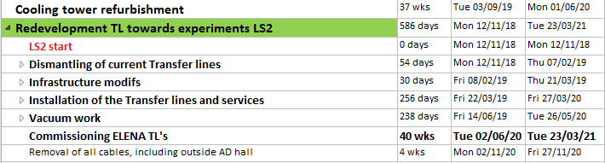
Master schedule

Slide 9
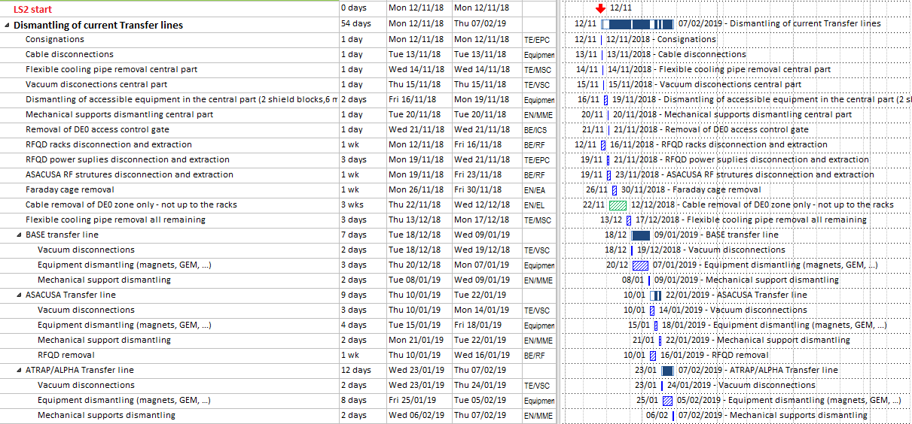
1st stage: Dismantling

Slide 10
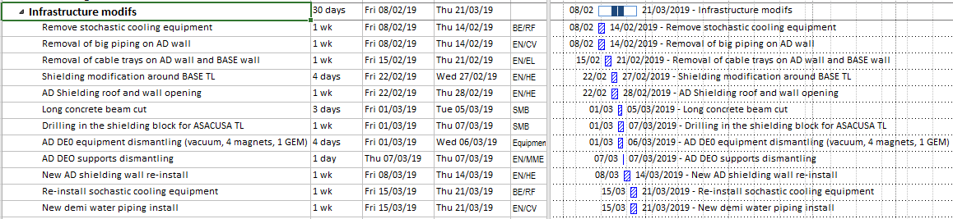
2nd stage: Infrastructure modifs

Slide 11
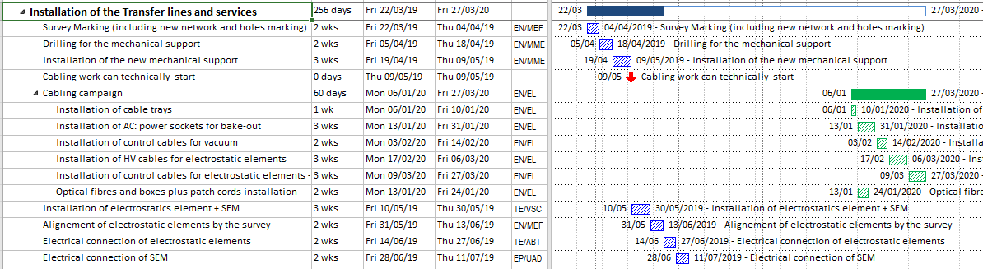
3rd stage: TL’s installation

Slide 12
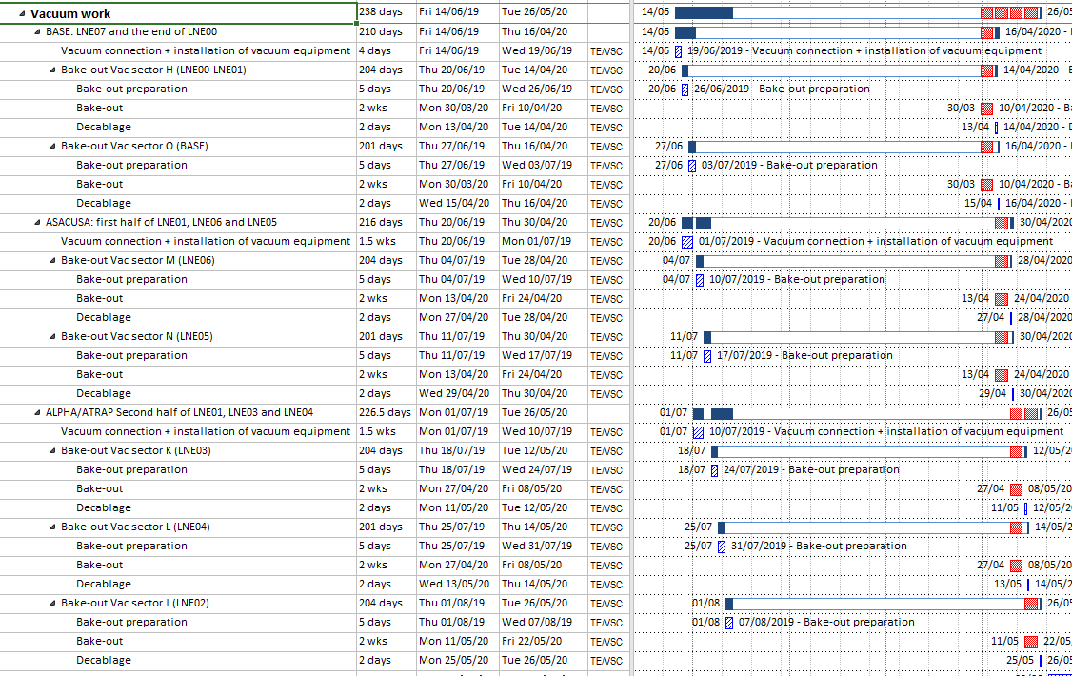
4th Stage: vacuum work

Slide 13
Conclusion
About 18 months of intense activity for ELENA
To be done in parallel with AD machine consolidation / AD hall infrastructure works / BASE exp area extension / AD target renovation / potentially AEGIS relocation…
Will organize discussions with individual groups to check details, planning etc.

