Slide 1

Qualification of CLICpix2 assemblies with planar sensors
Morag Williams, CERN and University of Glasgow
CLIC Detector and Physics Collaboration Meeting
28-29th August 2018
0

Slide 2
Contents:
Bump-bonding in hybrid pixel detectors
CLICpix2 + planar sensor assemblies
Results of lab measurements of CLICpix2 assemblies:
1) X-ray images
2) Test pulse measurements
3) Sr90 source measurements
Outlook – new assemblies, and test beam results
Summary
1

Slide 3
Bump-bonding in hybrid pixel detectors
Hybrid pixel detectors consist of a sensor layer and readout chip.
Solder can be used to connect the chips both electrically and mechanically.
Advantage: Sensor and readout can be optimised separately.
Disadvantage: Connecting the layers is complicated.
Bumps: typically tin or copper
2

Slide 4
Issues that can arise:
Solder placement: misalignment or missing bumps
Solder size: bump=~pitch/2
Levelling problems: uneven pressure
Thin chips: temperature dependent bending
Contamination/defects/splinters
Testing only one chip on a large support wafer: pixel misalignment
3

Slide 5
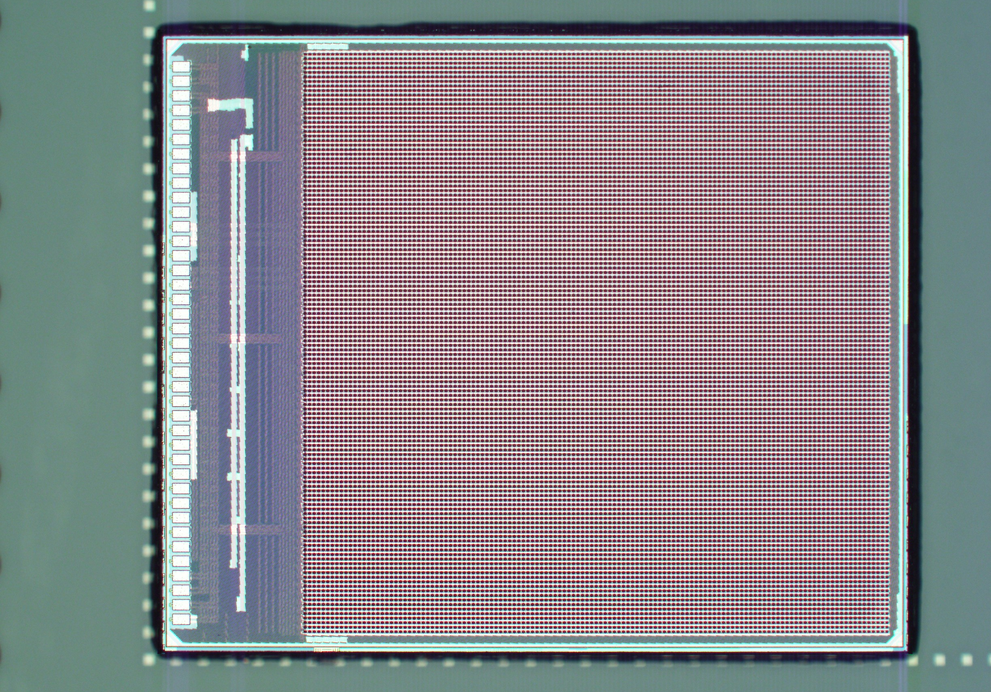
CLICpix2 + planar sensor assemblies
CLICpix2: pixelated readout chip, 128x128 pixels of pitch 25μm
8 bit ToT and 5 bit ToA precision
65nm feature size of the CMOS process
Two CLICpix2 devices tested in our lab
FBK produced sensor of 130μm, active-edge, UBM (under-bump metallization) processing and bonding at IZM
Image of a bumped CLICpix2 ASIC from IZM.
IZM project aims to deliver 10 assemblies bump-bonded to planar sensors
4 have been received so far
4

Slide 6
Results of lab measurements
Aims of laboratory testing:
Identify:
Missing bumps
Unconnected pixels
‘Dead’ pixels on the ASIC
Shorts between pixels
Feedback:
for optimization of processing
Interpret:
Contamination
Mechanical stresses
Chemical effects
5

Slide 7
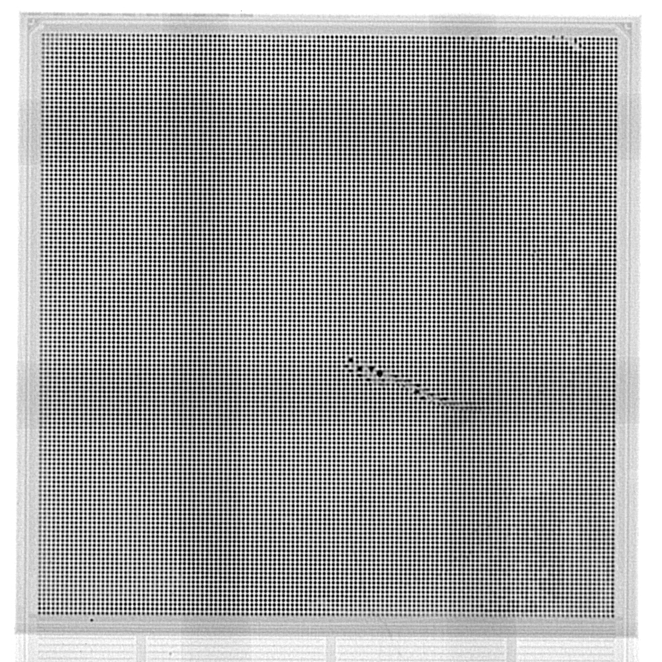
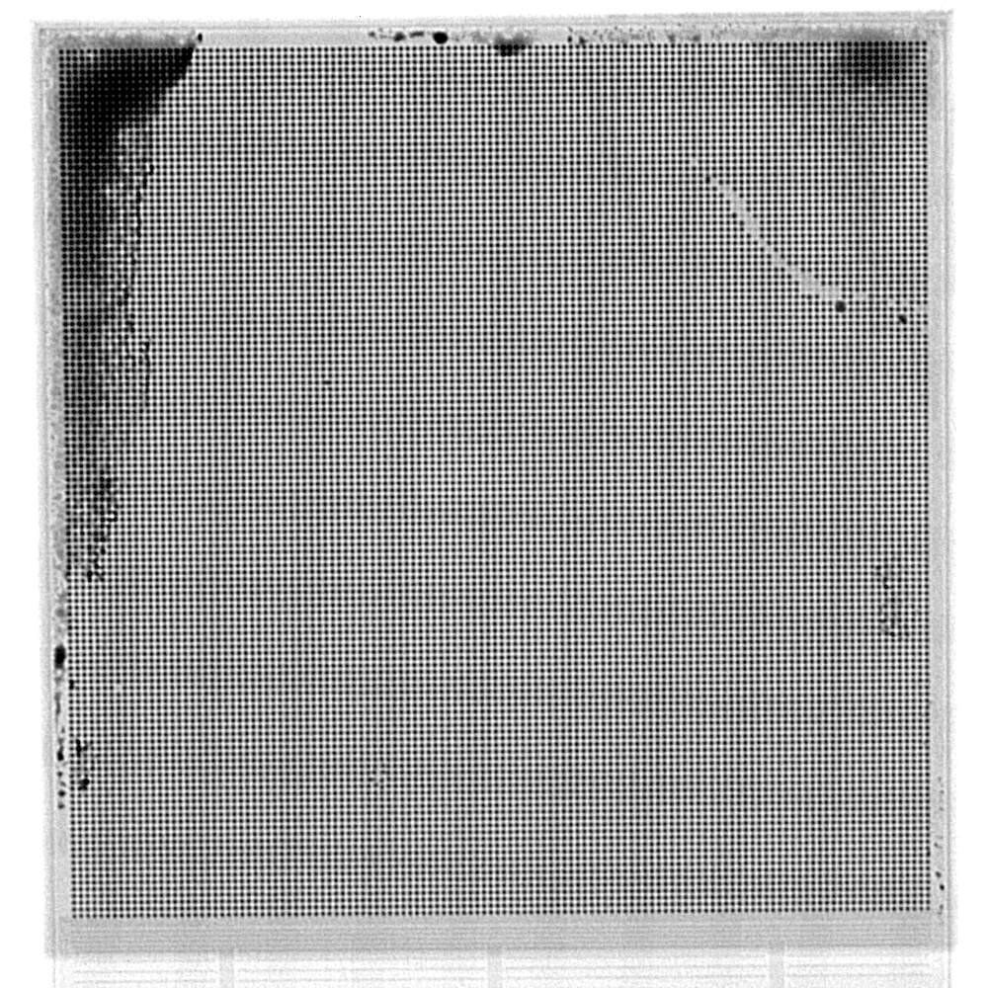
1) X-ray images
X-ray images show any missing bumps, mechanical defects, and/or contamination.
Assembly 14
Assembly 16
6
Notes:
Pattern=gel packet for transport can be seen
Black regions 16= unknown substance / issue in imaging
14= looks like mechanical impact -> see if this is the case with further results

Slide 8
1) X-ray images
Pattern from gel packet for transport
Black regions due to unknown substance or issue in imaging
Pattern from gel packet for transport
Possible mechanical defect
Missing bumps due to handling issue
Assembly 14
Assembly 16
7
Notes:
Pattern=gel packet for transport can be seen
Black regions 16= unknown substance / issue in imaging
14= looks like mechanical impact -> see if this is the case with further results

Slide 9
2) Test pulse measurements
Shows the number of ‘dead’ or masked pixels on the ASIC and shows possible shorts.
CLICpix2 ASIC can generate an automatic series of test pulses -> independent of bonding
Pulse strength = difference in value between two capacitors.
Test pulses are performed in 16 steps: one pixel in each super pixel is pulsed at a time (1024 pixels pulsed per step).
16 | 15
13 | 14
12 | 11
9 | 10
8 | 7
5 | 6
4 | 3
1 | 2
Test pulsing order of a CLICpix2 superpixel (2 columns and 8 rows of pixels).
8

Slide 10
Test pulsing: All pixel hits, 16 files combined
Combined pixel hits from all 16 steps gives the test pulse performance of every pixel. Shows which pixels never fire and which fire at a lower/higher rate.
0
0
0
Assembly 14
# dead/masked pixels = 62
# masked pixels = 59
Assembly 16
# dead/masked pixels = 19
# masked pixels = 18
9

Slide 11
Test pulsing: Unexpected hits, 16 files combined
Combined unexpected pixel hits from all 16 steps; unexpected = pixel hits recorded from unpulsed pixels.
0
0
0
0
Assembly 14
# unexpected pixels = 29
Assembly 16
# unexpected pixels = 22
10

Slide 12
Test pulsing: Unexpected hits, 16 files combined
Other pixels are not masked during test pulsing, hence this measurement shows areas with electrical shorts. Have to distinguish noise from shorts -> look at individual files.
0
0
0
0
Assembly 14
Small amount of shorts in defect region
Assembly 16
No shorts observed, all noise hits
11

Slide 13
3) Sr90 source measurements
Shows number unresponsive pixels: particle passes through the sensor layer but there is no signal recorded.
Either ‘dead’ on the readout ASIC, have been masked, or have bonding problems.
Combined with the test pulse measurements, you can determine which pixels have bonding issues.
Sr90 source (beta minus), 20us shutters, -60V bias voltage.
12

Slide 14
Source measurements: Hitmaps
Assembly 14:
THL = 1250 ADC -> ~700e-
# unresponsive pixels = 10,141
# dead/masked pixels = 62
Assembly 16:
THL = 1189 ADC -> ~540e-
# unresponsive pixels = 62
# dead/masked pixels = 19
Possible cause for assembly 14: a) contamination causing gap between layers, b) bow in sensor, c) combination of the previous and too low a bonding force.
13

Slide 15
Outlook
Short term:
Analyse test beam data taken for these assemblies.
Calibration measurements.
Longer term:
Obtain new assemblies using improved processing.
Test these new assemblies in the lab and in a test beam to see improvements.
16

Slide 16
Summary
Presented laboratory measurements of two CLICpix2 + planar sensor assemblies.
Discussed possible problems that can arise while bump-bonding.
Showed results of X-ray, test pulsing, and source measurements.
Assemblies show promising results so far.
Feedback has been given to IZM.
17

Slide 17

Thank you for your attention
Morag Williams, University of Glasgow and CERN
morag.williams@cern.ch
18

Slide 19
Source measurements: ToT pixel 10,10
Assembly 14:
Assembly 16:
These show that ToT circuit works correctly (previous plots were counts only). Calibration can/will be carried out to have a conversion to electrons taking into account the pixel-by-pixel variations.
15

Slide 20
Source measurements: ToT pixel 76,10
Assembly 14:
Assembly 16:
These show that ToT circuit works correctly (previous plots were counts only). Calibration can/will be carried out to have a conversion to electrons taking into account the pixel-by-pixel variations.
14

Slide 21
Source measurements: Hitrates
Assembly 14:
Assembly 16:

Slide 22
Source measurements: ToT 2D
Assembly 14:
Assembly 16:

Slide 23
Test pulsing: file 0
Assembly 16
Assembly 14

Slide 24
To do: Calibration
Part 1:
Test pulse measurements with varying pulse strength.
Measure counts and ToT per pixel.
Part 2:
Source measurement with an iron source to measure spectrum peaks.
Combine results to create a plot for each pixel of ToT vs. test pulse strength.

Slide 25
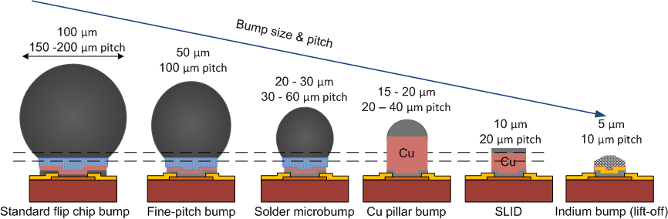
Bump-bonding options

Slide 26
IZM processing for assemblies
Bump-bonding project with IZM that targets to deliver 10 assemblies with planar active-edge sensors, 4 of which we have received and tested (in the lab and/or in test beam).
1) Preparation of carrier wafers with mask alignment marks and bonding layer
2) die-bonding of single chips on carrier wafer
3) bumping: sputtering of plating base, resist lithography, Cu+SnAg galvanic, resist removal, etching of plating base outside the bumps, reflow of bumps
4) removal of chips from carrier wafers
5) flip-chip assembly on sensors
6) x-ray inspection

Slide 27
Talk slide from Barcelona Techno Week 2018: Sensors and Interconnects (Sami VAHANEN)

