Slide 1
ATLASpix status and development of a version for CLIC
Ivan Peric

Slide 2
ATLASPIX is a HVCMOS large area prototype for ATLAS
Produced by AMS in 180nm HVCMOS process
Submitted as engineering run
Different substrates: standard, high resistivity
1. MuPix8 (area 1cm x 2cm)
2. ATLASPixM2 (area 3.5mm x 2cm)
3. ATLASPixSimple/ATLASPixIsoSimple (both: area 3mm x 2cm)
The chips have been implemented on 4 different substrates: 10 Ωcm (standard substrate), 50-100Ωcm, 200-400Ωcm and 0.7-2kΩcm.

Slide 3
HVCMOS sensors are monolithic depleted active pixel sensors in standard HVCMOS technologies
Smart diode concept
Pixel electronic placed inside the collection electrode
Properties:
Monolithic
Fast signal generation and charge collection
High radiation tolerance
Cost effective production (no need for bumps)
NMOS
PMOS
HV
p-well
n-well
Deep n-well
Depleted zone
P-type substrate

Slide 4
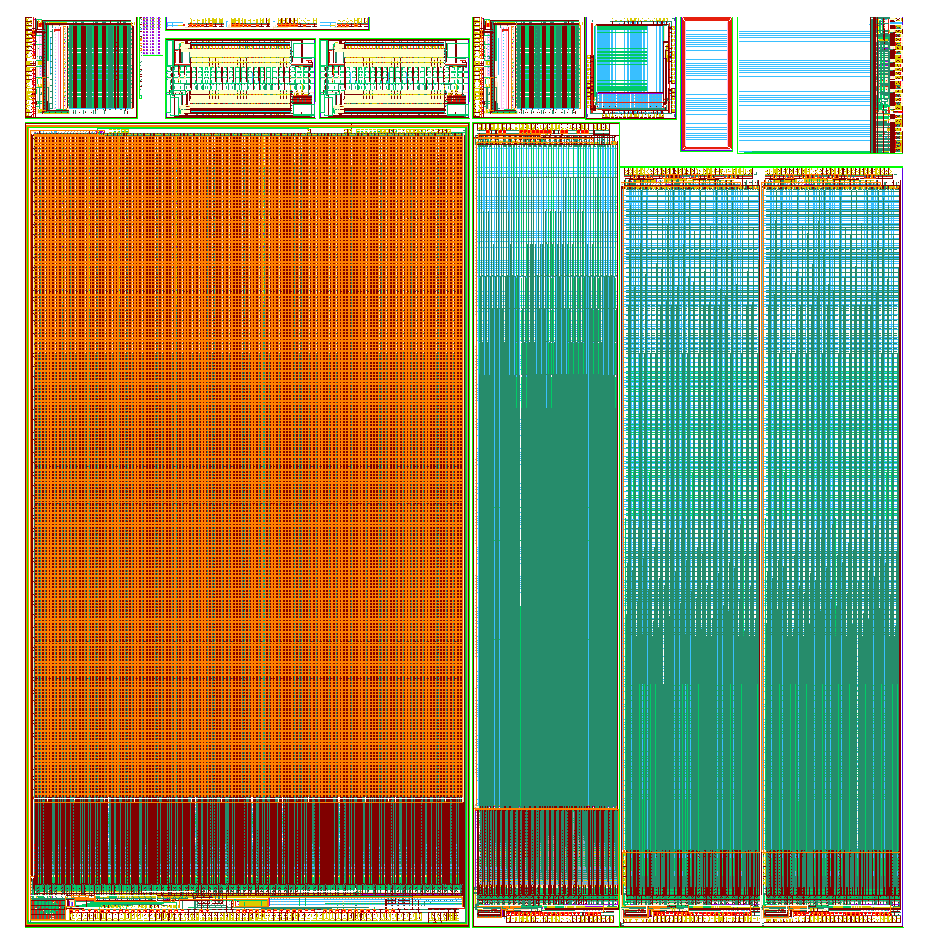
Reticle
…
CCPD_1stGen
Belle II Switcher
CCPD_2ndGen
C3PD
MuPix8
ATLASPix
Main type
Simple
Simple
PMOS
IsoPMOS
Trigger readout
Triggerless readout
MuPix, ATLASPIX

Slide 5
Reticle
…
CCPD_1stGen
Belle II Switcher
CCPD_2ndGen
C3PD
MuPix8
ATLASPix
Main type
Simple
Simple
PMOS
IsoPMOS
Trigger readout
Triggerless readout
MuPix, ATLASPIX

Slide 6
ATLASPIX simple
ATLASPIX simple with triggerless (hit driven) readout

Slide 7
Architecture
Architecture of the chip
Pixel matrix: 24 x 400 pixels of 40µm x 130µm size.
Matrix control shift register (MSR) used to select pixels for injection, enable analogue output and hitbus (hitbus not implemented in M2) and write the pixel RAM
Hit buffers that receive pixel signals and enable priority based readout
EoC buffer to allow horizontal multiplexing
Digital control unit (DCU), PLL
Current-mode and voltage-mode DACs – they use shift register for configuration
The DAC-SR, VDAC-SR, matrix-SR and a configuration-SR form a chain
Pads
MSR
Matrix
MSR
Trigger buffers
EOC
Dcu
cdac
vdac
pads

Slide 8
Column 0
Column 24
Row control
Pixel 399
Pixel 399
Pixel 201
Pixel 201
Pixel 200
Pixel 200
Pixel 199
Pixel 199
Pixel 1
Pixel 1
Pixel 0
Pixel 0
Col. control
Col. control
Bias block
0
0
0
0
RO cell 0
Left
RO
Block
Right
RO
Block
Left
RO
Block
Right
RO
Block
1
1
1
1
ScanOut
Hit data
ScanIn
160MHz
PLL and oscillator
RO cell 199
CU
ScanOut
199
199
ScanIn
ScanOut
199
199
EoC
Data (1.6 Gbps)
EoC
EoC
EoC
EoC
LDPIX, LDCOL, RDCOL
Hit data

Slide 9
Pixel
Pixel contains sensor diode, charge sensitive amplifier, comparator, threshold tune DAC, RAM for tune bits (3) and disable bit and output driver
The outputs of the pixels are transmitted to the column periphery (long metal lines)
Pixel
1.8V
BL
Bias resistance
disable
Tout
Amplifier
Comparator
Sensor
AnalogOut
Th
C_{inj}
disable
Offset
-HV
Row
control
RAM
3
TDAC
Data transfer line
Injection
TDAC write
Injection enable
4
TDAC in
column control
readout cell or trigger buffer

Slide 10
RO-Cell
Every pixel has its RO cell at the periphery
Readout cell contains hit flag latch, timestamp memory (for leading edge time stamp and time over threshold), address generator, priority logic, bus driver
ScanIn
10 bit TS
Sync
Receiver
Hit
x
Hit
RdScan
x
6 bit TS
Address
ScanOut
LdPix
RdPix
TS
Data

Slide 11
EoC cell
By issuing read, the hits are transferred to EoC buffers. These EoC buffers are forming an active bus, they don’t change the data received by triggered buffer they just add the column address to the hit data. The hits are transferred from EoC buffers by RdCol signal in a priority way – the same as used for hit buffers
Wr
PrioOut (from buffers)
Rd
D-latch
Col
Add
S
R
In
Data (from buffers)
PrioOut (not empty)
LdCol
RdCol
Data

Slide 12
DCU
Digital control unit generate the signals for the buffer readout: time stamps, Wr, trigger, RdBuf, LdBuf and RdCol. It receives and formats hit data and sends them using a fast link (1.6gbps).
Digital control unit has the inputs: RefCk (160Mhz), for debug FastCk (800MHz), SyncReset, Trigger and fast output. There are many parameter bits (e.g. for changing of time stamp speed) that are stored in the configuration shift register.
Data
LdBuf, RdBuf, RdCol
PrioOut
TS
RoSM
Ld pix
Time stamp cnt
40Mhz
160Mhz
Ck gen
800MHz
Osc
PLL
200Mhz
Ld col
RefCk
Rd col
SyRes
Debug
Comma
Global register (matrix, DACs and configuration)
Data Mux
40Mhz
Lat
SOut
SR
Sin,Ck1,Ck2,Ld,Rb
k
8
k
8
k
8
k
8
8b10b encoder
160Mhz
40
200Mhz
S
400Mhz
1.6gbps
800Mhz

Slide 13
DCU
Digital control unit contains following blocks:
Clock generator that includes PLL and oscillator
Time stamp counter
Data
LdBuf, RdBuf, RdCol
PrioOut
TS
RoSM
Ld pix
Time stamp cnt
40Mhz
160Mhz
Ck gen
800MHz
Osc
PLL
200Mhz
Ld col
RefCk
Rd col
SyRes
Debug
Comma
Global register (matrix, DACs and configuration)
Data Mux
40Mhz
Lat
SOut
SR
Sin,Ck1,Ck2,Ld,Rb
k
8
k
8
k
8
k
8
8b10b encoder
160Mhz
40
200Mhz
S
400Mhz
1.6gbps
800Mhz

Slide 14
DCU
Readout state machine. It receives the priority output from EoC cells (empty signal) and generate a sequence of LdBuf, RdBuf and then if EoCs are not empty, RdCol. The state machine also controls the data multiplexer and sends either the hit data, debug data or the comma words to the 8b10b encoder. The data are sent in RdCol states and in other states debug data or comma words.
Data
LdBuf, RdBuf, RdCol
PrioOut
TS
RoSM
Ld pix
Time stamp cnt
40Mhz
160Mhz
Ck gen
800MHz
Osc
PLL
200Mhz
Ld col
RefCk
Rd col
SyRes
Debug
Comma
Global register (matrix, DACs and configuration)
Data Mux
40Mhz
Lat
SOut
SR
Sin,Ck1,Ck2,Ld,Rb
k
8
k
8
k
8
k
8
8b10b encoder
160Mhz
40
200Mhz
S
400Mhz
1.6gbps
800Mhz

Slide 15
DCU
Encoder: Custom made pipelined 8b10b encoder is used
Serializer: Novel 8to1 serializer (S) based on binary tree is used to produce bit stream. Blocks of 4 words (40 bits) are sent to the serializer
Data
LdBuf, RdBuf, RdCol
PrioOut
TS
RoSM
Ld pix
Time stamp cnt
40Mhz
160Mhz
Ck gen
800MHz
Osc
PLL
200Mhz
Ld col
RefCk
Rd col
SyRes
Debug
Comma
Global register (matrix, DACs and configuration)
Data Mux
40Mhz
Lat
SOut
SR
Sin,Ck1,Ck2,Ld,Rb
k
8
k
8
k
8
k
8
8b10b encoder
160Mhz
40
200Mhz
S
400Mhz
1.6gbps
800Mhz

Slide 16
Readout
Hit driven, trigerless, readout (MuPix8, Simple ATLASPix)
Time:
Amplitude:
Time:
Amplitude:
Time:
Amplitude:
Time:
Amplitude:
Time:
Amplitude:
Address:

Slide 17
Readout
Hit driven, trigerless, readout
Time: 0
Amplitude: 5
Time:
Amplitude:
Time:
Amplitude:
Time:
Amplitude:
Time:
Amplitude:
Address:

Slide 18
…
Hit driven, trigerless, readout
Time:
Amplitude:
Time: 0
Amplitude: 5
Time:
Amplitude:
Time:
Amplitude:
Time:
Amplitude:
Time:
Amplitude:
Address:

Slide 19
…
Hit driven, trigerless, readout
Time:
Amplitude:
Time: 0
Amplitude: 5
Time:
Amplitude:
Time:
Amplitude:
Time: 3
Amplitude: 10
Time:
Amplitude:
Address:

Slide 20
…
Hit driven, trigerless, readout
Time:
Amplitude:
Time: 0
Amplitude: 5
Time:
Amplitude:
Time:
Amplitude:
Time: 3
Amplitude: 10
Time:
Amplitude:
Address:

Slide 21
…
Hit driven, trigerless, readout
Time:
Amplitude:
Time:
Amplitude:
Time:
Amplitude:
Time:
Amplitude:
Time: 3
Amplitude: 10
Time: 0
Amplitude: 5
Address: 1

Slide 22
…
Hit driven, trigerless, readout
Time:
Amplitude:
Time:
Amplitude:
Time:
Amplitude:
Time:
Amplitude:
Time:
Amplitude:
Time: 3
Amplitude: 10
Address: 4

Slide 23
Measurement results
ATLASPix efficiency measured at CERN SpS – CLIC telescope > 99%
Spatial resolution: RMS = 12.6µm
Efficiency
Dominik Dannheim, Andreas Nürnberg
Threshold voltage

Slide 24
Measurement results
Figure shows the measurement performed with ATLASPixSimple at 200 Ωcm substrate
Fast readout has been used, TS period was 25ns (800mbps)
Sr-90 spectrum has been measured with ToT. (ToT has 6 bits)
The spectrum peak is 7000e. (Calibrated with x-rays)
Figure right shows signal (MPW – Sr-90) vs depletion voltage

Slide 25
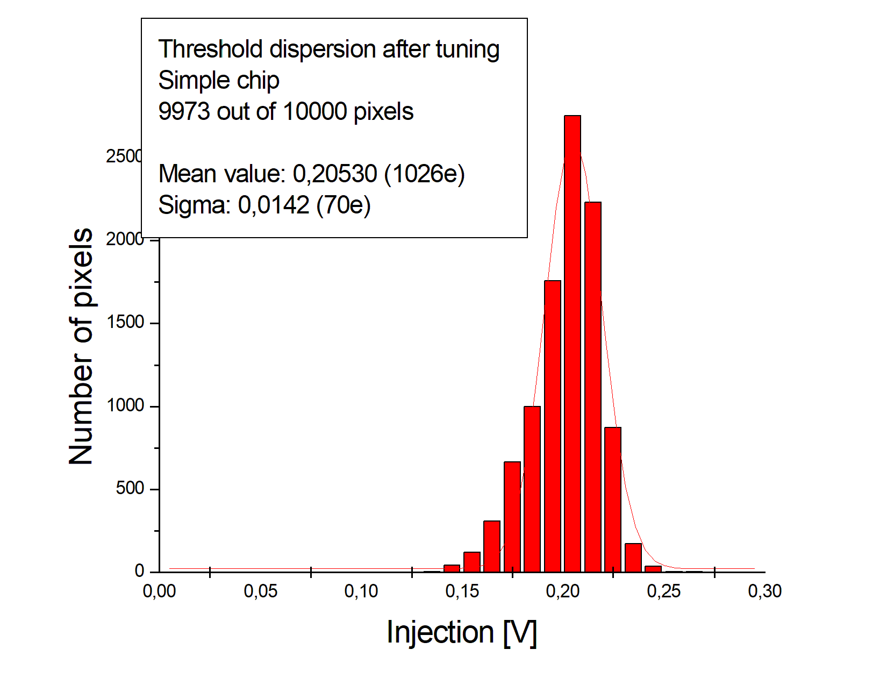
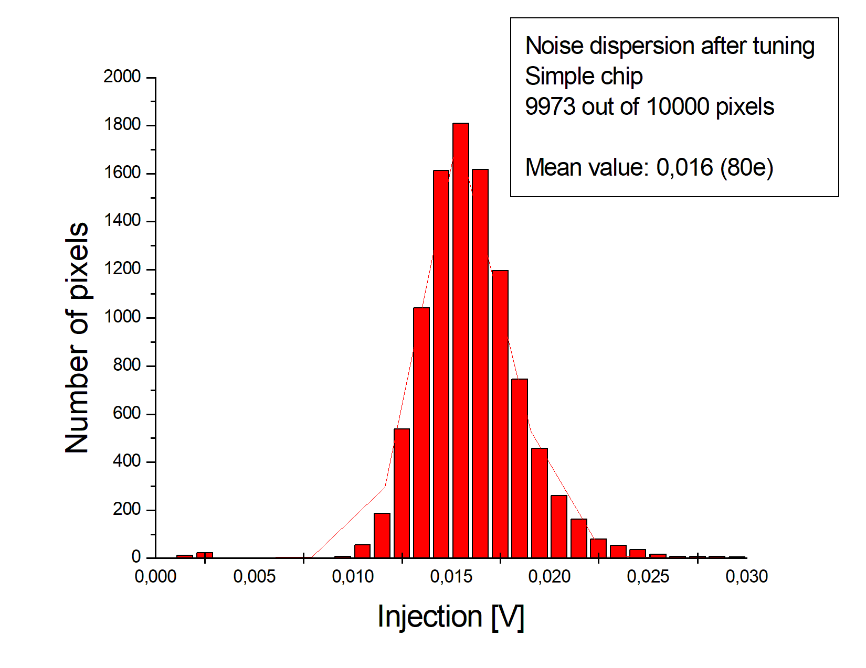
Measurement results
Result of the threshold scan for ATLASPIxSimple. Matrix has been tuned
Average threshold is ~1026e and the threshold dispersion 70e.
The noise dispersion is shown in the figure right. Average noise is 80e.
Signal to noise ratio of ATLASPIxSimple is about 80. There is enough signal. It would work also at standard substrate

Slide 26
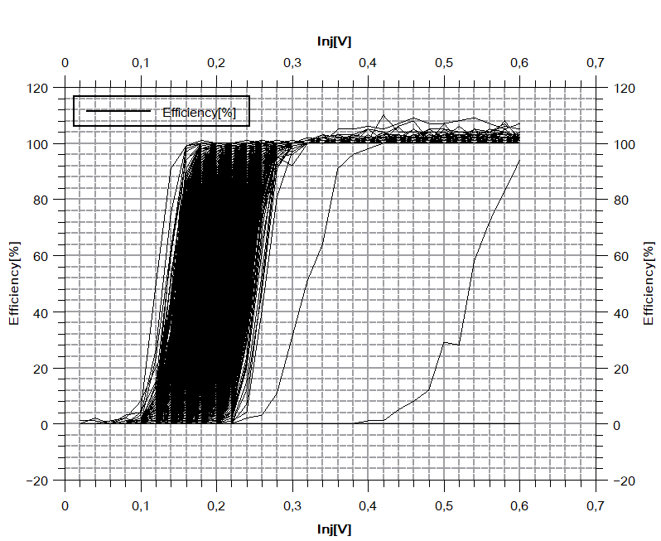
Measurement results
All s-curves are shown as well. Signals > 0.3V (1700e) can be detected with 99% efficiency

Slide 27
Design for CLIC
Pixel 399
Pixel 399
Pixel 201
Pixel 201
Pixel 200
Pixel 200
Pixel 199
Pixel 199
Pixel 1
Pixel 1
Pixel 0
Pixel 0
Col. control
Col. control
0
0
0
0
Left
RO
Block
Right
RO
Block
Left
RO
Block
Right
RO
Block
1
1
1
1
199
199
199
199
EoC
EoC
EoC
EoC

Slide 28
Design for CLIC
Pixel 799
Pixel 798
601
600
Pixel 199
Pixel 1
Pixel 0
Col. control
Col. control
0
0
0
0
Left
RO
Block
Right
RO
Block
Left
RO
Block
Right
RO
Block
1
1
1
1
199
199
199
199
EoC
EoC
EoC
EoC

Slide 29
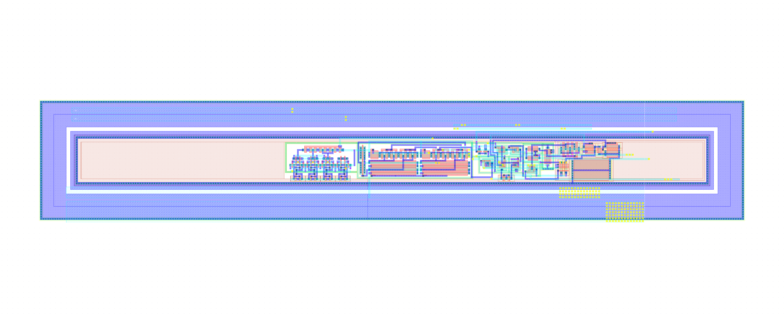
Layout of the CLIC pixel
22 – 25µm

Slide 30
ATLASPIX is a HVCMOS large area prototype for ATLAS
Produced by AMS in 180nm HVCMOS process
Submitted as engineering run
Different substrates: standard, high resistivity
Features:
Pixel matrix: 24 x 400 pixels of 40µm x 130µm size
6.5 bit time over threshold
10 bit time stamp
Time stamp resolution up to 12.5ns
1.6 Gbps data transfer with 8b10b conversion
Efficiency measured in beam > 99%
SNR ~ 80
Power consumption < 200mW/cm²
Time resolution: sigma ~ 12ns (pixel to pixel variation corrected, preliminary)
Spatial resolution: 12.6µm
Design for CLIC ongoing

