Slide 1
WP2 et al. - Beam Physics studies
Results and next steps
Nov 2017- Nov 2018
Phu Anh Phi NGHIEM (CEA) et al.
EuPRAXIA Yearly Meeting
& 4th Collaboration Week
Frascati, November 19-23, 2018

Slide 2
The analysis of the high energy 5 GeV beam is not yet finished and the general impression is that this WP is exploring a field that has not yet reached its final maturity.
Rec5. SAC recommends to define a time-line for starting this down selection process that should lead to a CDR with identified solutions for the low energy case (1 GeV) and the high-energy case (5 GeV) in one year from now.
OUTLINE
1. Results obtained at each plasma stage
and selection of the schemes
2. Start-to-End simulations
Issues
Results
3. Next step
Study of errors and tolerances
Rec6. SAC recommends reinforcing the coordination with the above WP [3, 4, 5, 6, 7] and considering opening up the design space if showstoppers are identified by any of the WPs …
SAC learns from the WP2 leader that the different codes used were benchmarked one another on similar physical situations leading to compatible results. Despite this, it was pointed out a poor stability of the solutions analysed leading to a high sensitivity to the input parameters.
Rec7. SAC recommends carrying on an analysis of the stability of the solutions under investigation and including the stability parameter as an element in the down selection process; deepening the analysis of the effects associated to non-ideal conditions, such as density fluctuations in the plasma target, quality of transverse laser mode, and, ….

Slide 3
EuPRAXIA acceleration schemes
1 GeV
5 GeV
5 GeV
LPI
LPAS
LPI
1A
1B
L
W
F
A
500 MeV
1 GeV
5 GeV
500 MeV
5 GeV
RFI
LPAS
LPAS
RFI
LPAS
2A
2B
150 MeV
1 GeV
5 GeV
150 MeV
5 GeV
LPI
LPAS
LPAS
LPI
LPAS
3A
3B
PWFA
500 MeV
1 GeV
500 MeV
5 GeV
RFI
PPAS
RFI
PPAS
4A
4B

Slide 4
Restricted acceleration schemes
CEA
HETL
5 GeV
(1 GeV)
LPI
At Yearly meeting in Lisbone (2017)
Scheme 1
CNR
L
W
F
A
STRATEGIC Objective:
- Providing beam at 5 GeV meeting 'perfectly'
FEL and HEPO requirements
- Providing as well beam at 1 GeV 'usable'
for FEL and HEPO, as a 'commissioning' step
LNF DESY
CEA
500 MeV
HETL
5 GeV
(1 GeV)
RFI
LPAS
Scheme 2
DESY
INFN
CEA LETL
CEA
150 MeV
HETL
5 GeV
(1 GeV)
Scheme 3
LPI
LPAS
IST, LLR
LPGP, CNR
CEA
PWFA
LNF LNF
CEA
500 MeV
HETL
5 GeV
(1 GeV)
RFI
PPAS
Scheme 4
LNF

Slide 5
Restricted acceleration schemes
CEA
HETL
5 GeV
(1 GeV)
LPI
At Yearly meeting in Lisbone (2017)
Scheme 1
CNR
L
W
F
A
STRATEGIC Objective:
- Providing beam at 5 GeV meeting 'perfectly'
FEL and HEPO requirements
- Providing as well beam at 1 GeV 'usable'
for FEL and HEPO, as a 'commissioning' step
LNF DESY
CEA
500 MeV
HETL
5 GeV
(1 GeV)
RFI
LPAS
Scheme 2
DESY
INFN
CEA LETL
CEA
150 MeV
HETL
5 GeV
(1 GeV)
Scheme 3
LPI
LPAS
IST, LLR
LPGP, CNR
CEA
PWFA
LNF LNF
CEA
500 MeV
HETL
5 GeV
(1 GeV)
RFI
PPAS
Scheme 4
LNF
HYBRID
HETL
5 GeV
(1 GeV)
Additionally : Scheme 2A and Hybrid schemes
Scheme 5
LPAS
PPAS
Strathclyde, DESY

Slide 6
EuPRAXIA requirements
Critical parameters of the electron beam
required at Injection or Acceleration stages

Slide 7
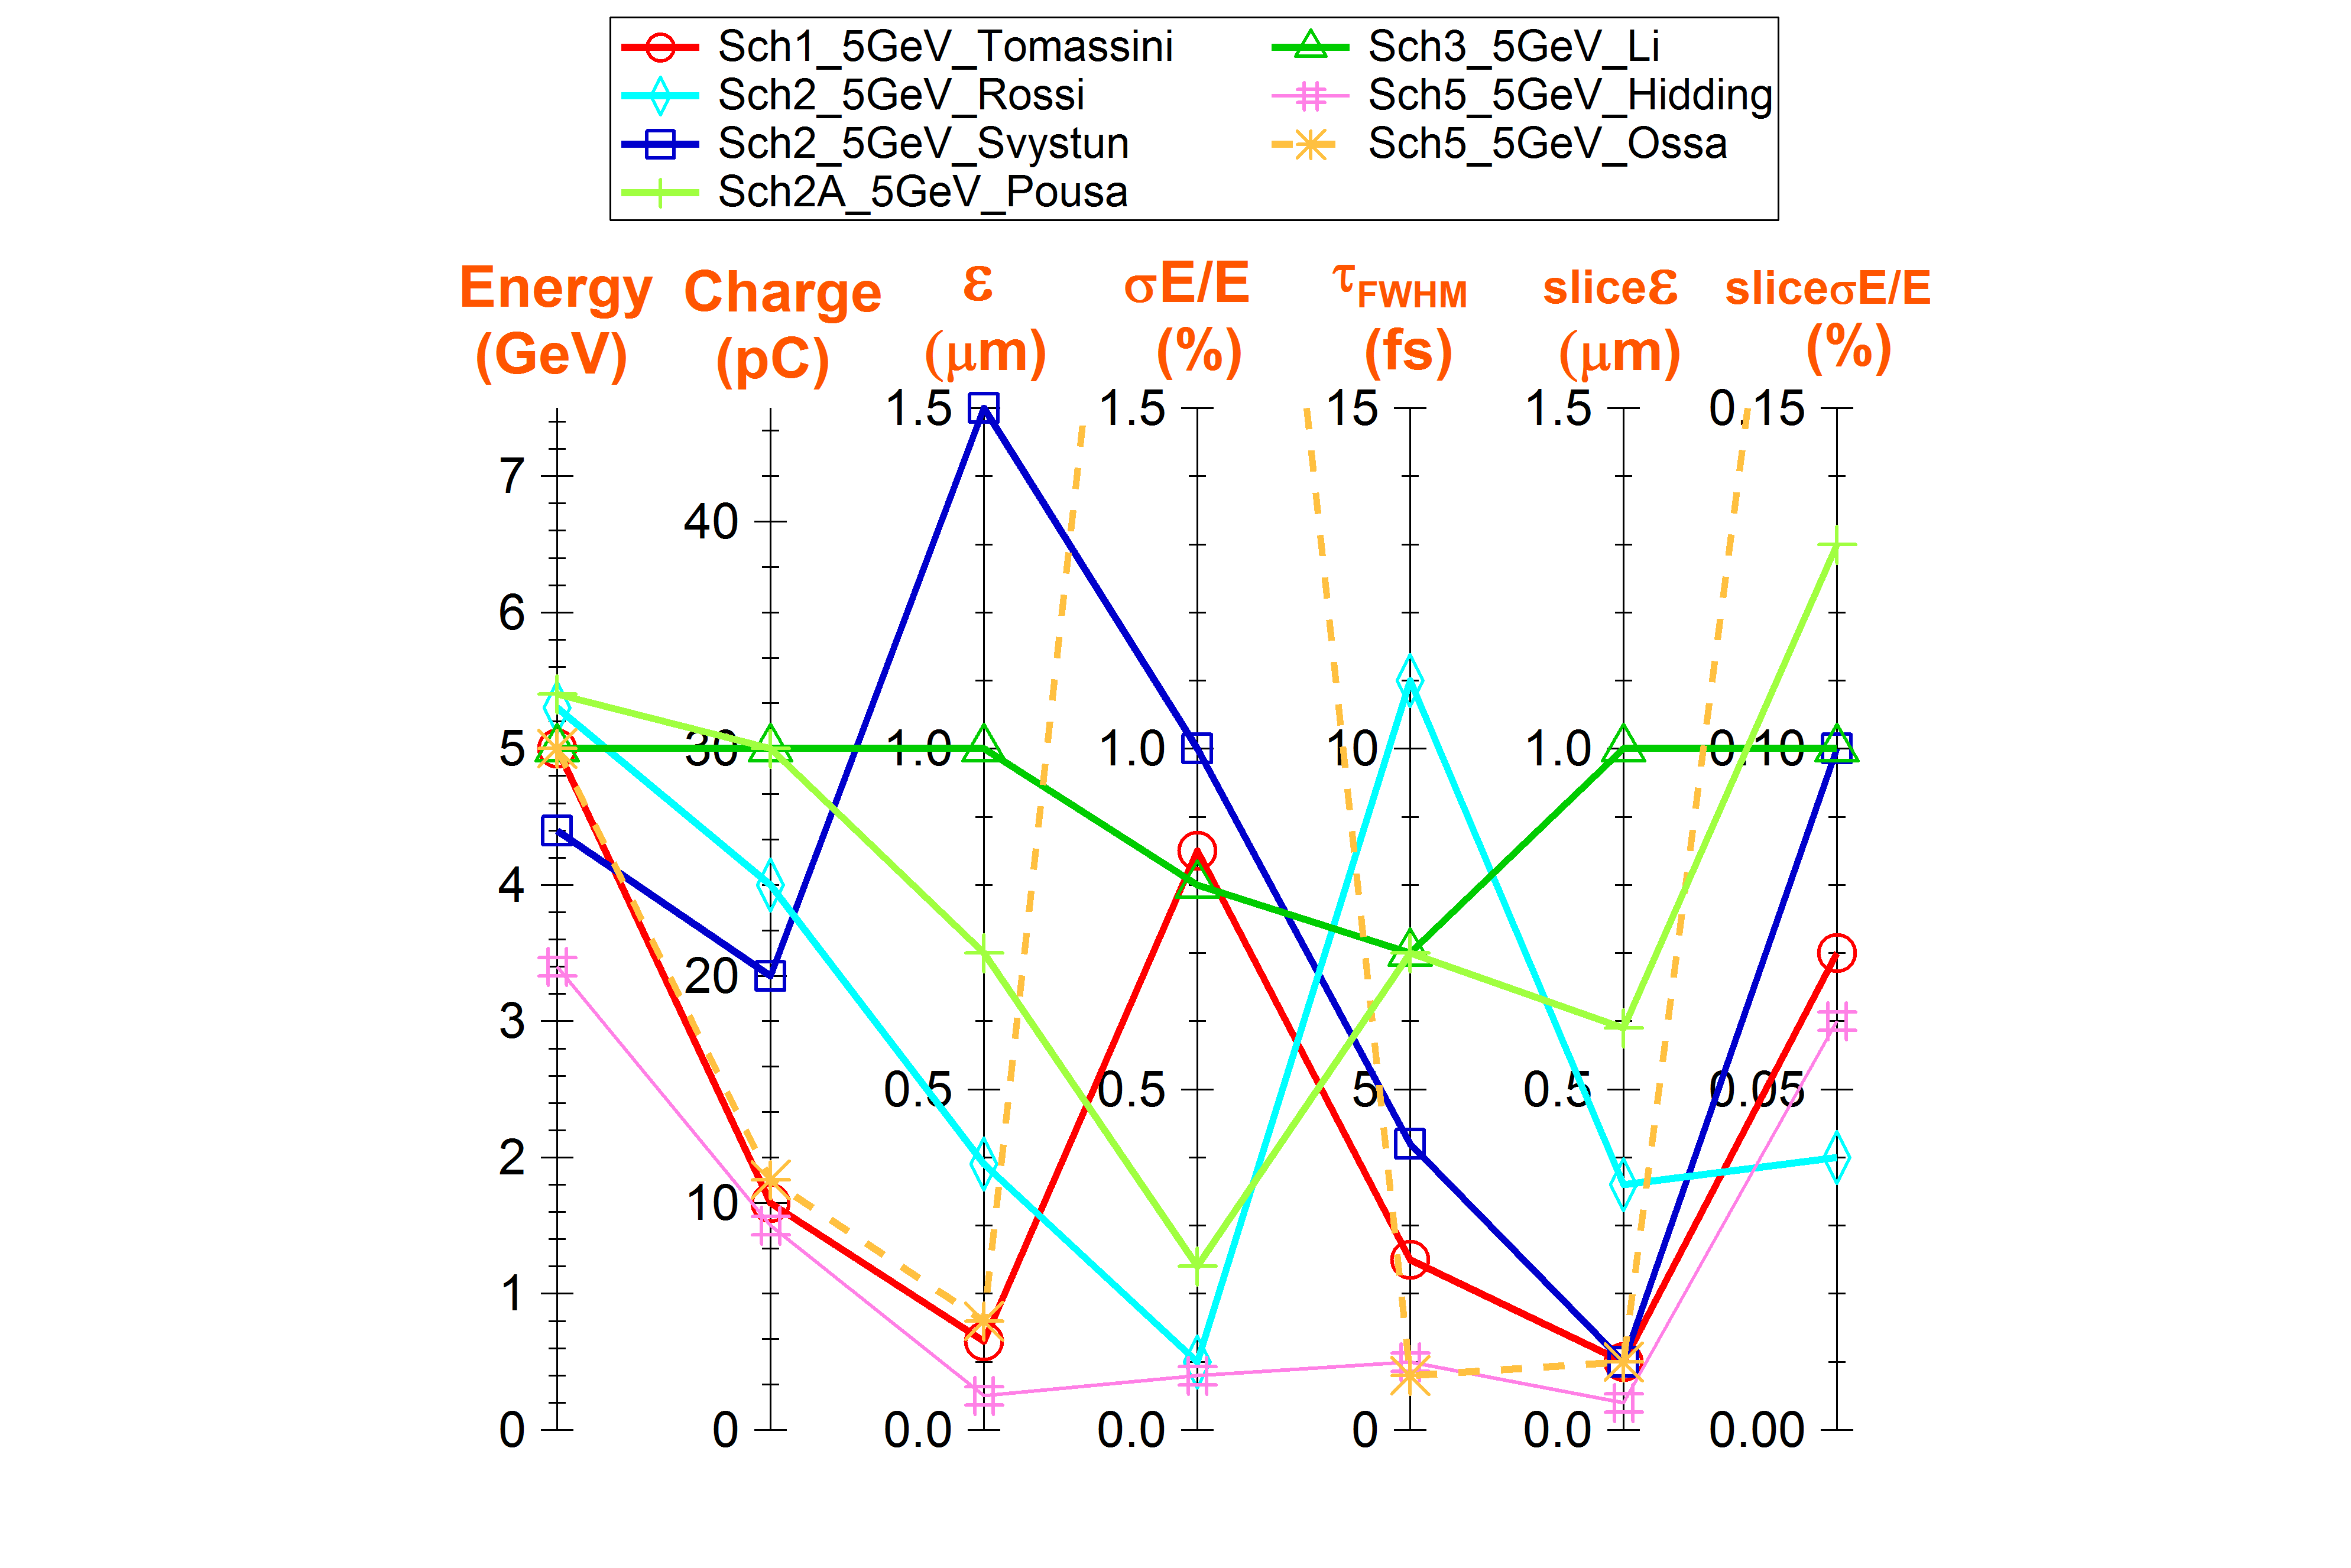
Beam parameters obtained at 5 GeV
All the schemes
Required value

Slide 8
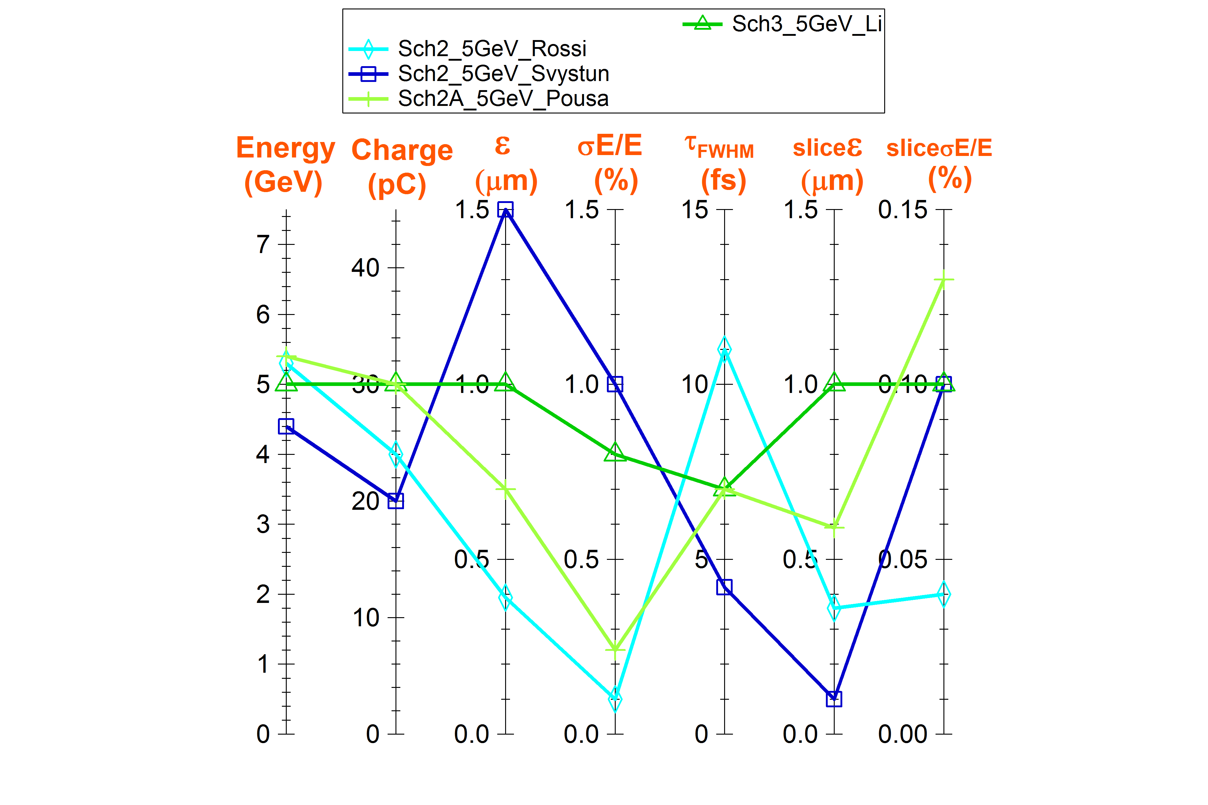
Beam parameters obtained at 5 GeV
Schemes the closest to the requirements
Four experts
Three institutes
Three codes used:
- Warp 3D
- QFluid ~3D
- FBPIC 3D
Three injectors:
LPI 150 MeV
RFI 240 MeV
RFI 540 MeV
Close plasma,
laser parameters
Quasi linear regime
⇒
Close results
Robustness of the results !!!
Required value

Slide 9
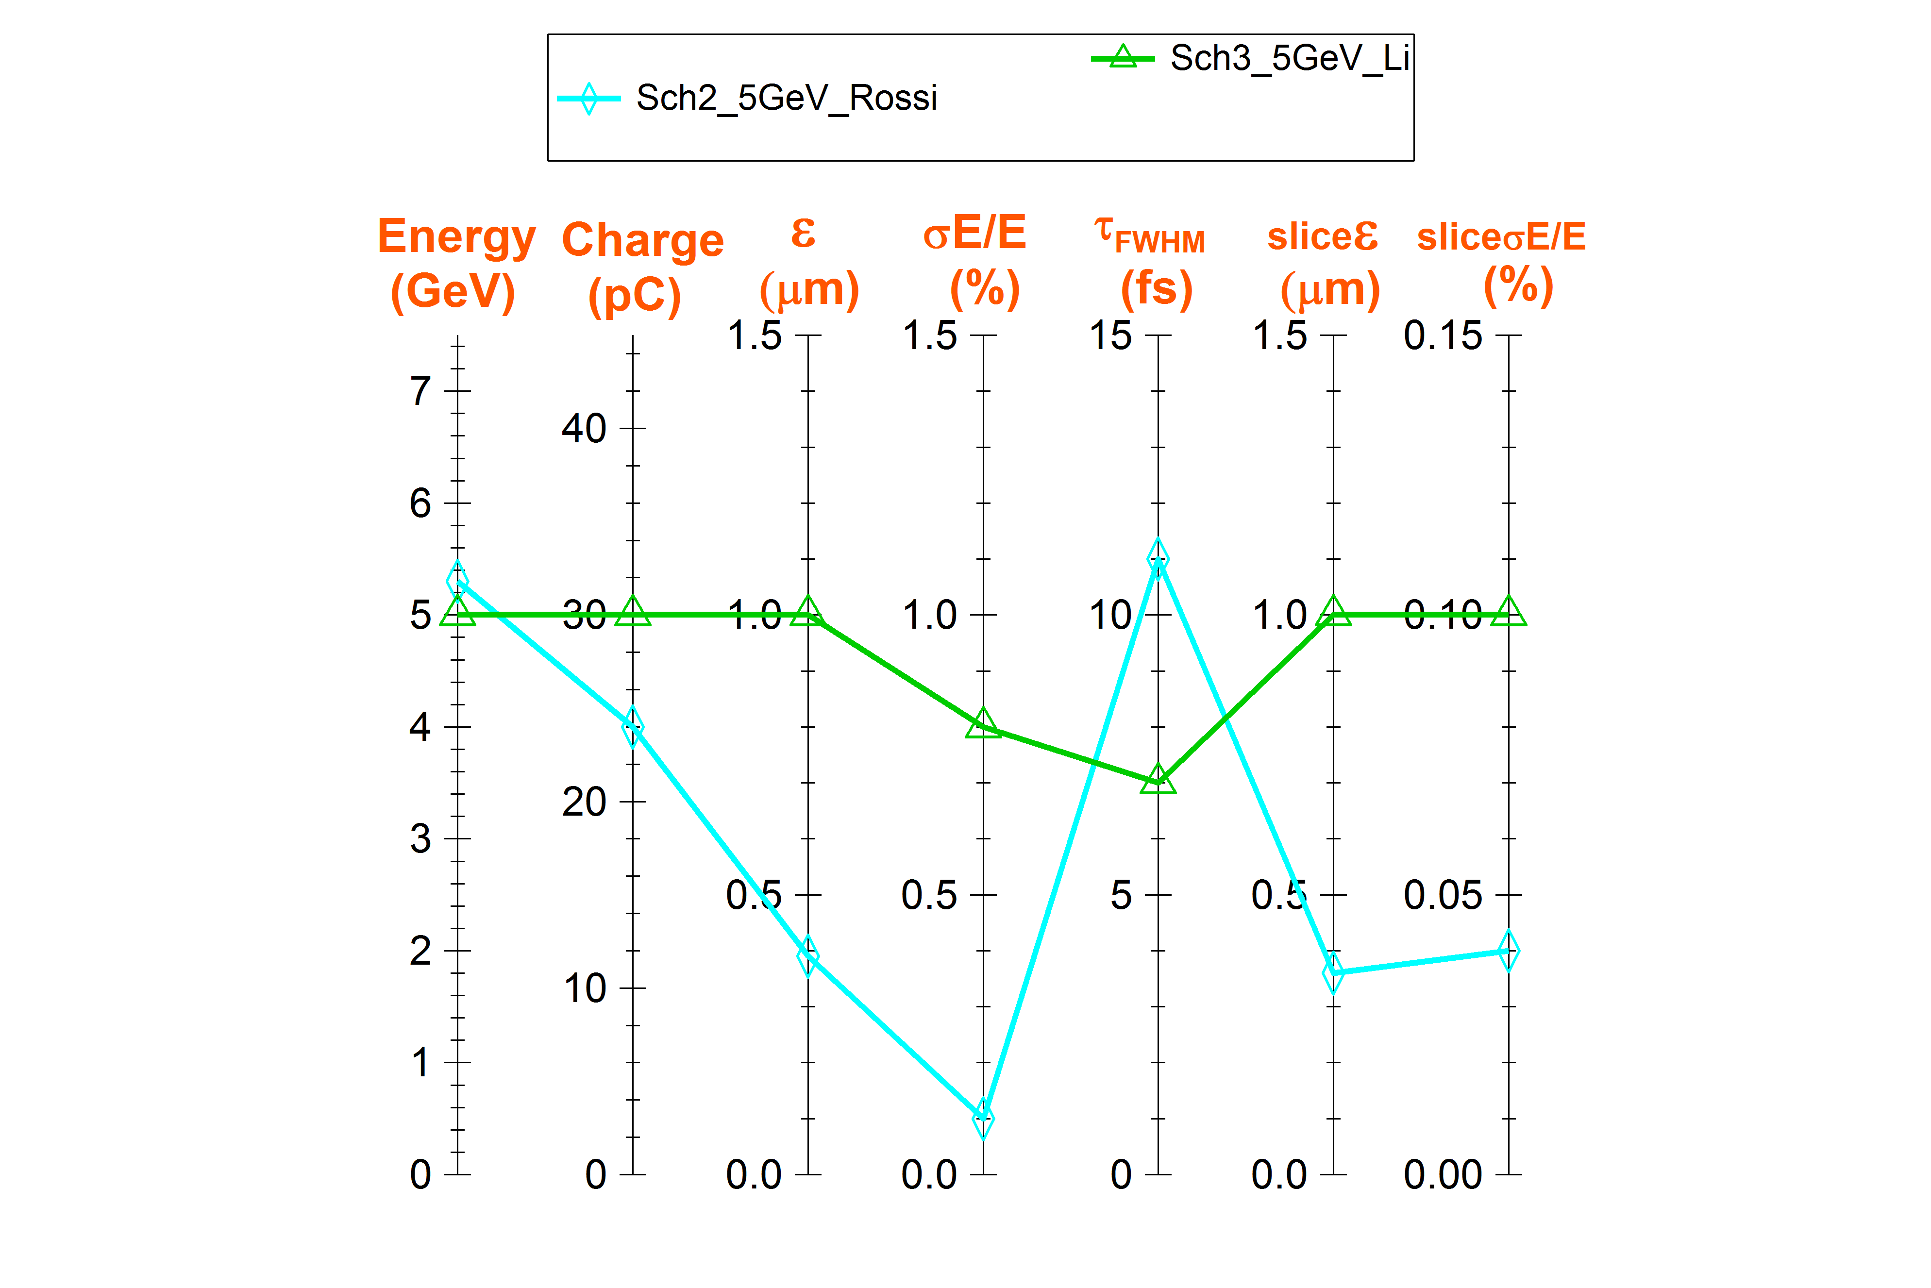
Beam parameters obtained at 5 GeV
Schemes selected for Start-to-End simulations
Required value
LPI 150 MeV
RFI 540 MeV
Quasi linear regime

Slide 10
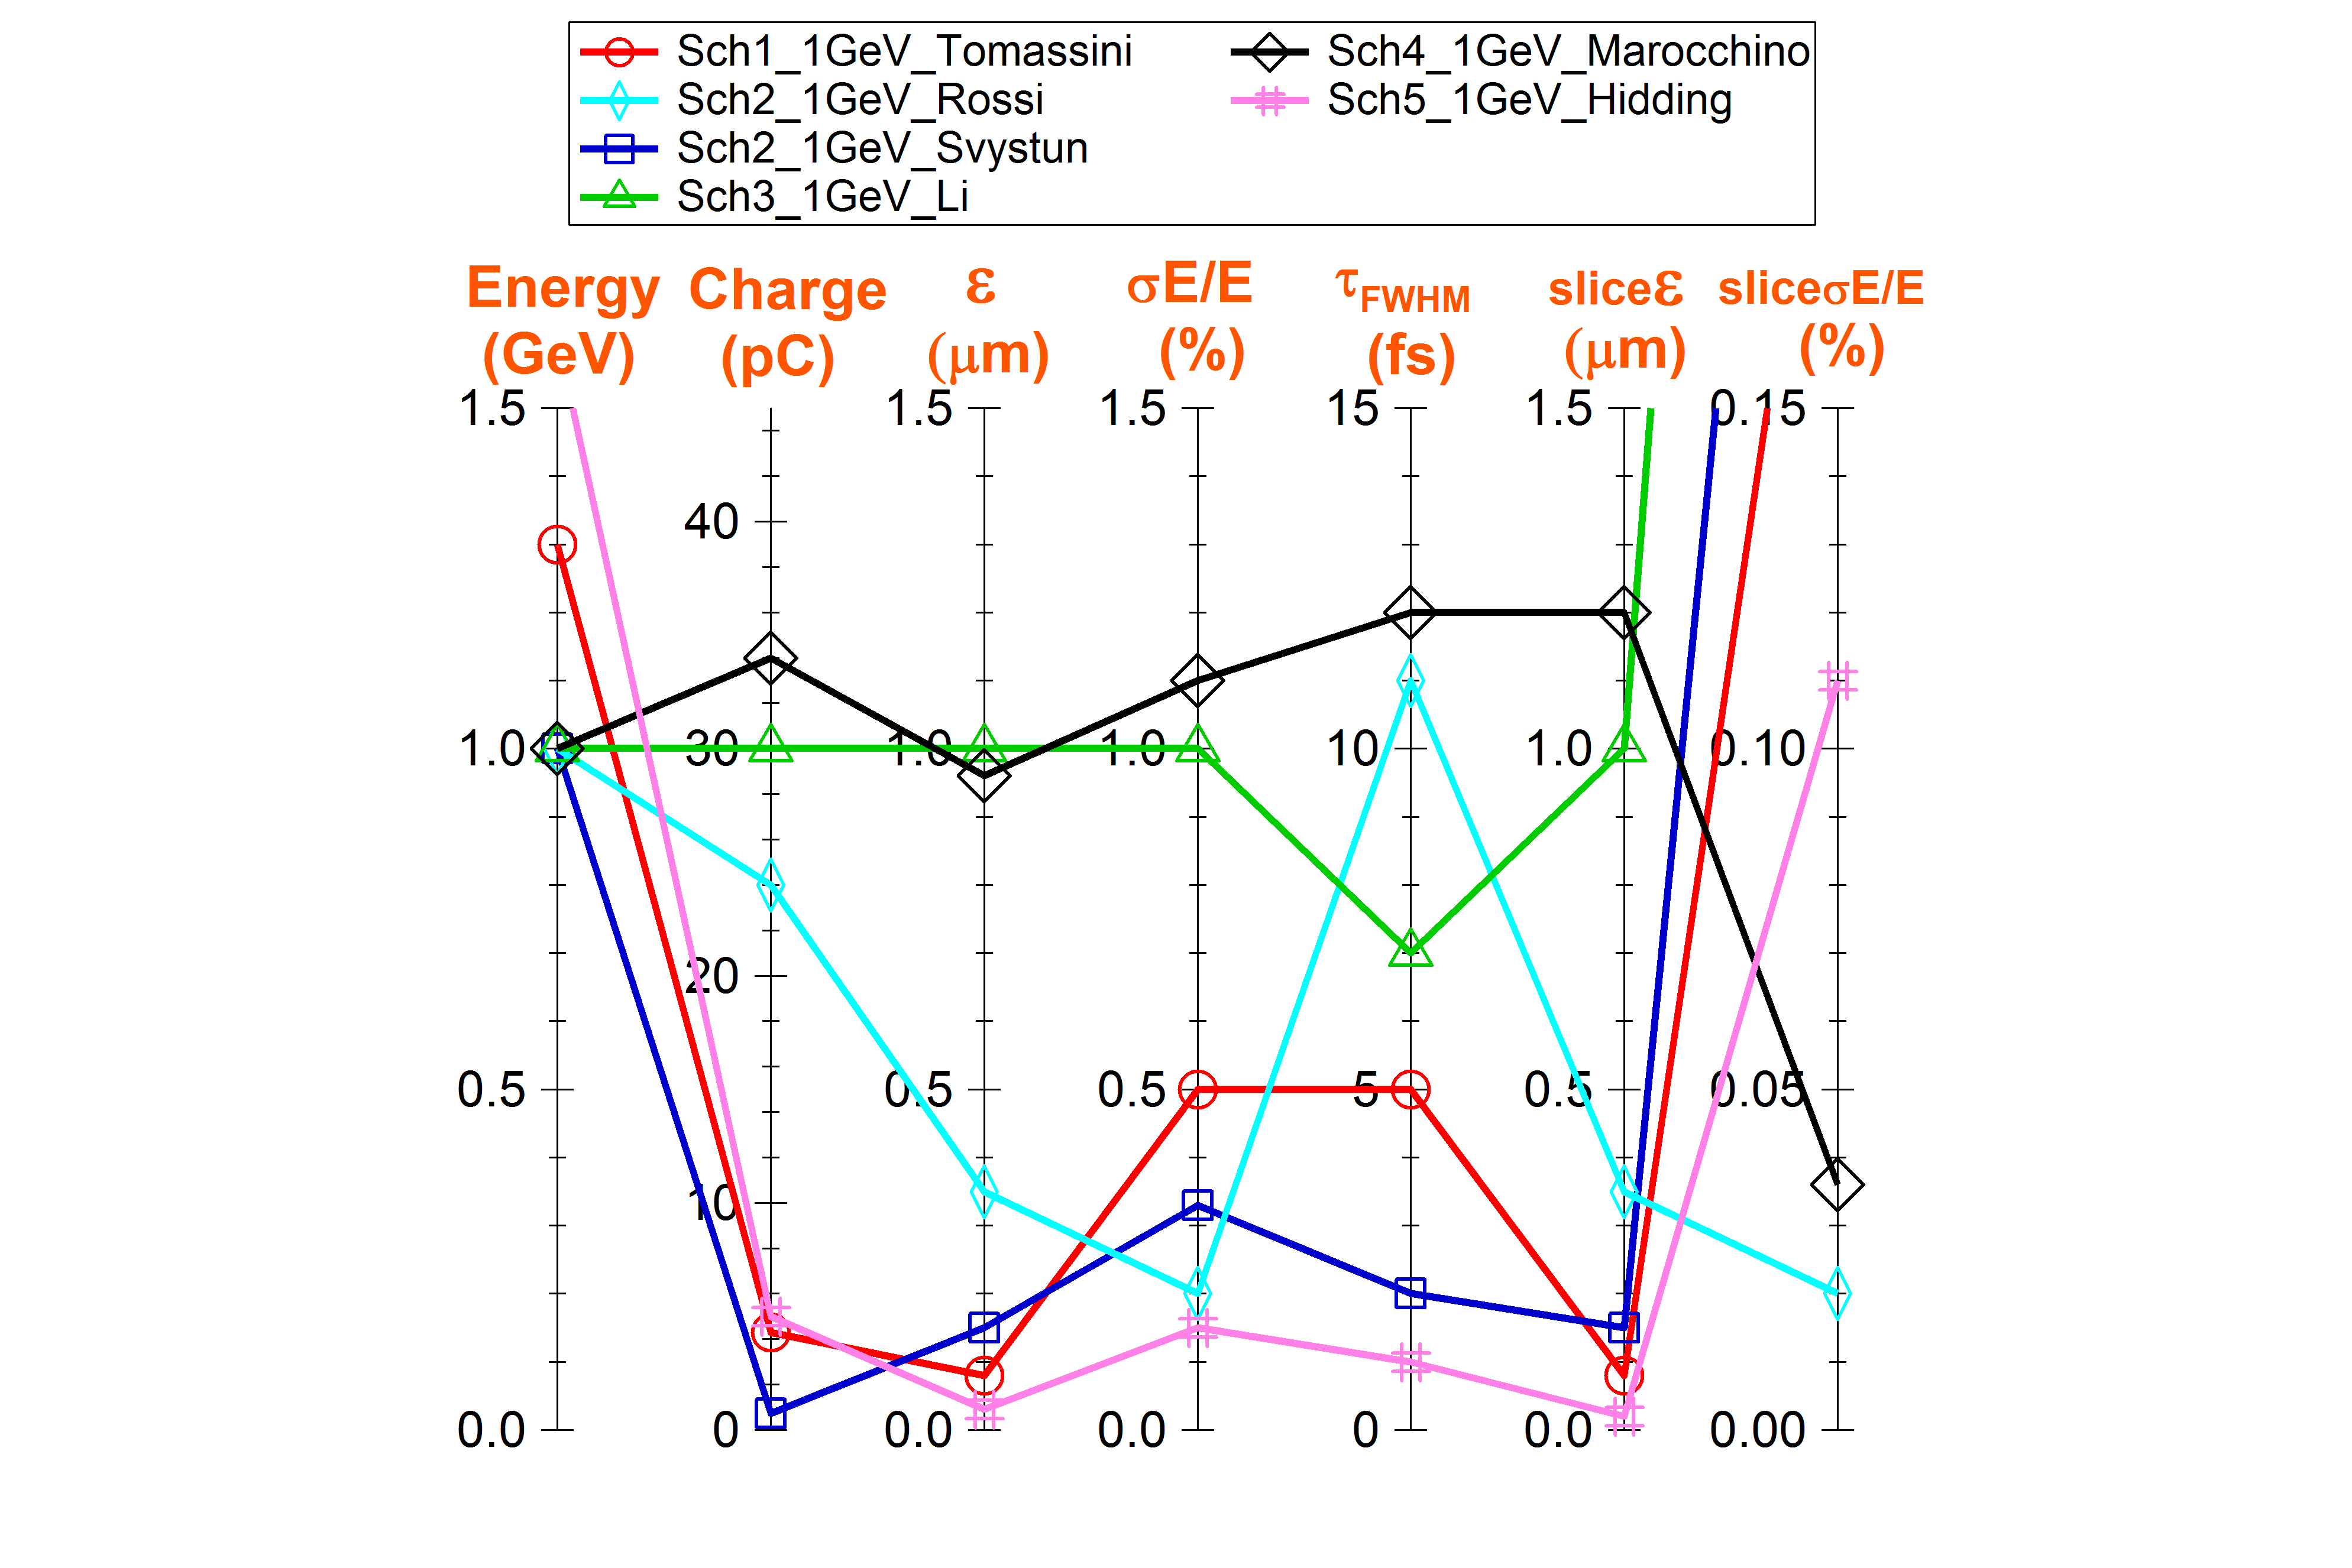
Beam parameters obtained at 1 GeV
All the schemes
Required value

Slide 11
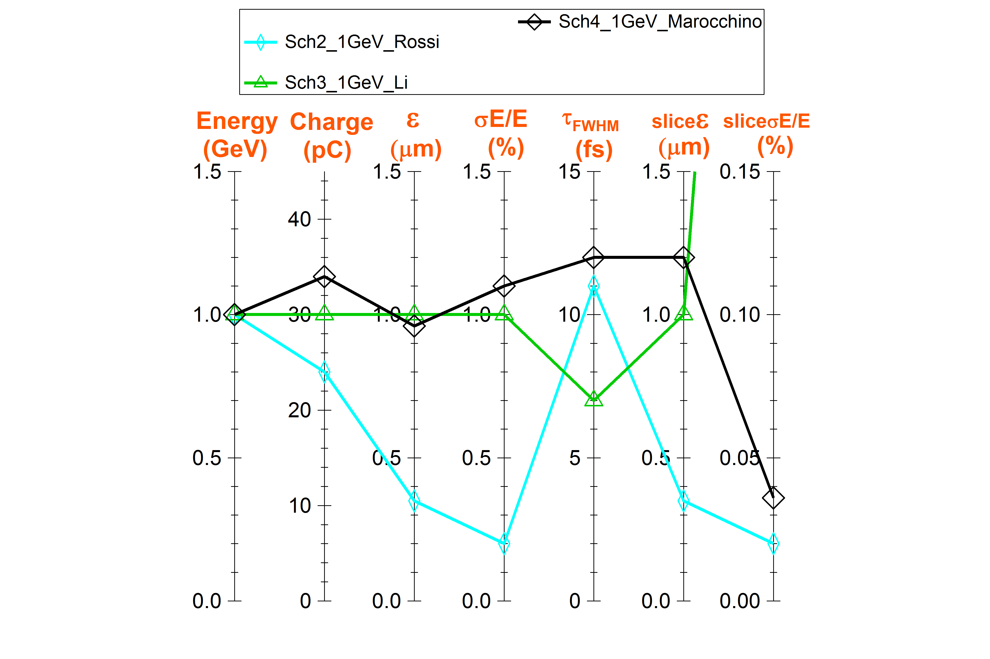
Beam parameters obtained at 1 GeV
Schemes the closest to the requirements
Required value

Slide 12
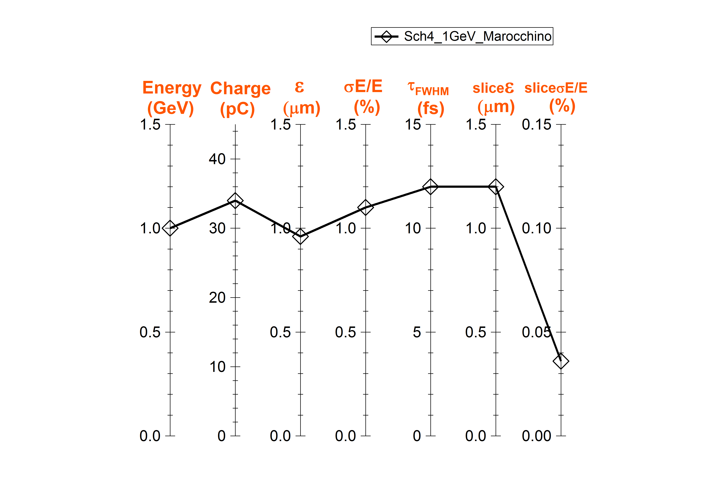
Beam parameters obtained at 1 GeV
Scheme Selected for Start-to-End simulations
Required value

Slide 13
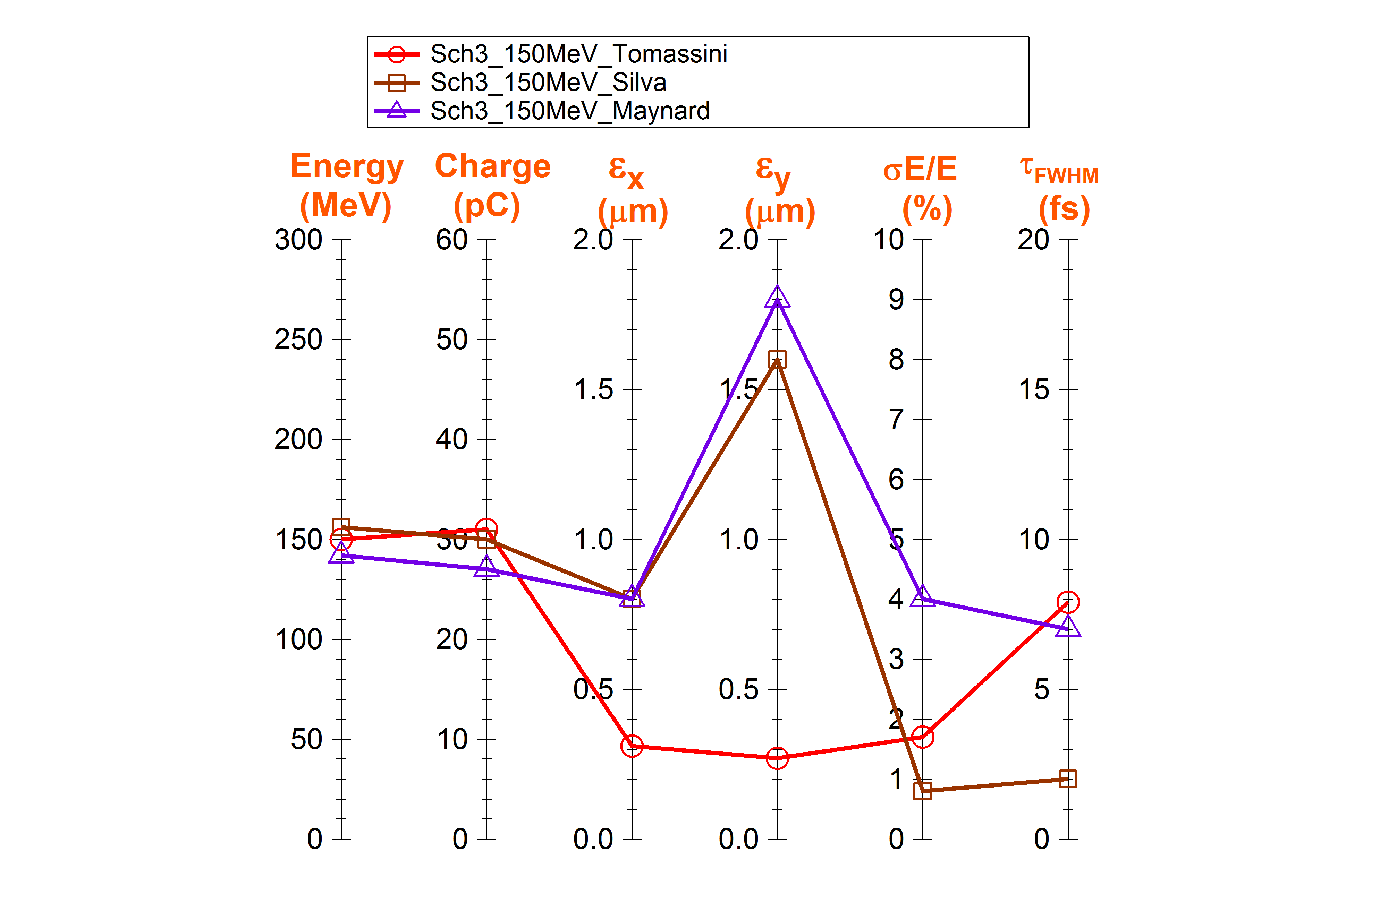
Beam parameters obtained at 150 MeV
Scheme selected for start-to-end simulations
Required value

Slide 14
Schemes selected for S2E simulations
Scheme 2 : RFI + LPAS (quasilinear regime)
Scheme 3: LPI (REMPI) + LPAS (quasilinear regime)
Scheme 4: RFI + PPAS (bubble regime)
500 MeV
HETL
RFI
LPAS
5 GeV
(1 GeV)
Scheme 2
LETL
150 MeV
HETL
5 GeV
(1 GeV)
Scheme 3
LPI
LPAS
500 MeV
HETL
1 GeV
RFI
PPAS
Scheme 4
LNF
Note: This is only the present snapshot. Not definitive
Other schemes and other regimes remain to be very precious alternatives !!!
They may be found to be equally or even more appropriate later on

Slide 15
Plasma configurations used in simulations
Interactions with WP3
Brigitte Cros, T. Audet
- Plasma H, Ar, N⁵⁺, N2 impurity, …
- Longitudinal: uniform plateau
with ramps at entrance and exit
Radial: parabolic
- Longitudinal: downramp for auto injection
- Gas jet, or capillary, or cell
- Length and density:
LPAS 5 GeV: 17-28 cm, 0.1-2.5 10¹⁷ cm⁻³
LPAS 1 GeV: 3-7 cm, 1-5 cm⁻³
LPI 150 MeV: 0.6-4 mm, 7-80 10¹⁷ cm⁻³
Scheme ID | Realistic? | How to achieve | Imperfections | Alternative
Scheme1B P. Tomassini | No (revised) | ? more details on requirements are necessary | Described gradient at entrance too sharp | are smoother gradient and transitions acceptable for the scheme?
Scheme 2B E Svystun et al | Yes | Capillary, ramps given by fluid simuls | Low density challenging for parabolic profile, reproducibility to be tested | Gas cell also an option for parabolic profile (OFI plasma) and length smaller than 20 cm
Scheme 2B A Rossi | No | ? details on requirements are necessary | Uniformity over 50cm to be determined for a discharge | Promising option: laser created plasma
Scheme 3B T Silva et al | No | Upramp gradient too sharp; Shock for downramp gradient | Gradient fluctuations | Shock injection with a smooth gradient at entrance
Scheme 3B A Beck | No | ? beyond state-of-the-art gas jet | Gradients are linear and too sharp | Gas jets with longer, exponential ramps
Scheme 3B G Maynard | yes | Gas cell | Density controlled better than 10% | Double gas jet
Scheme 3B P Tomassini A | Yes | Gas jet far from the nozzle, smooth gradients | Pure nitrogen may induce non uniform distribution: ionization level? | Gas cell, required profile needs to be specified
Scheme 3B P Tomassini B | No (revised) | Separation of areas with “pure” gas difficult inside gas jets | Ramps need to be determined | Two-stage gas cell
Scheme 3B X Li | Yes | Low density channel may be achieved with OFI in gas capillary | Plasma uniformity needs to be specified Delta n is of the order of fluctuations, 10% | Promising option: laser created plasma
Scheme 4B A Marocchino | ? yes if uniform plasma | Depends on transverse profile, uniform ok in capillary tube with OFI | Plasma uniformity needs to be specified | -
A first estimate is given:
- Realism level
- How to achieve
- Potential imperfections
- Suggestion of alternative

Slide 16
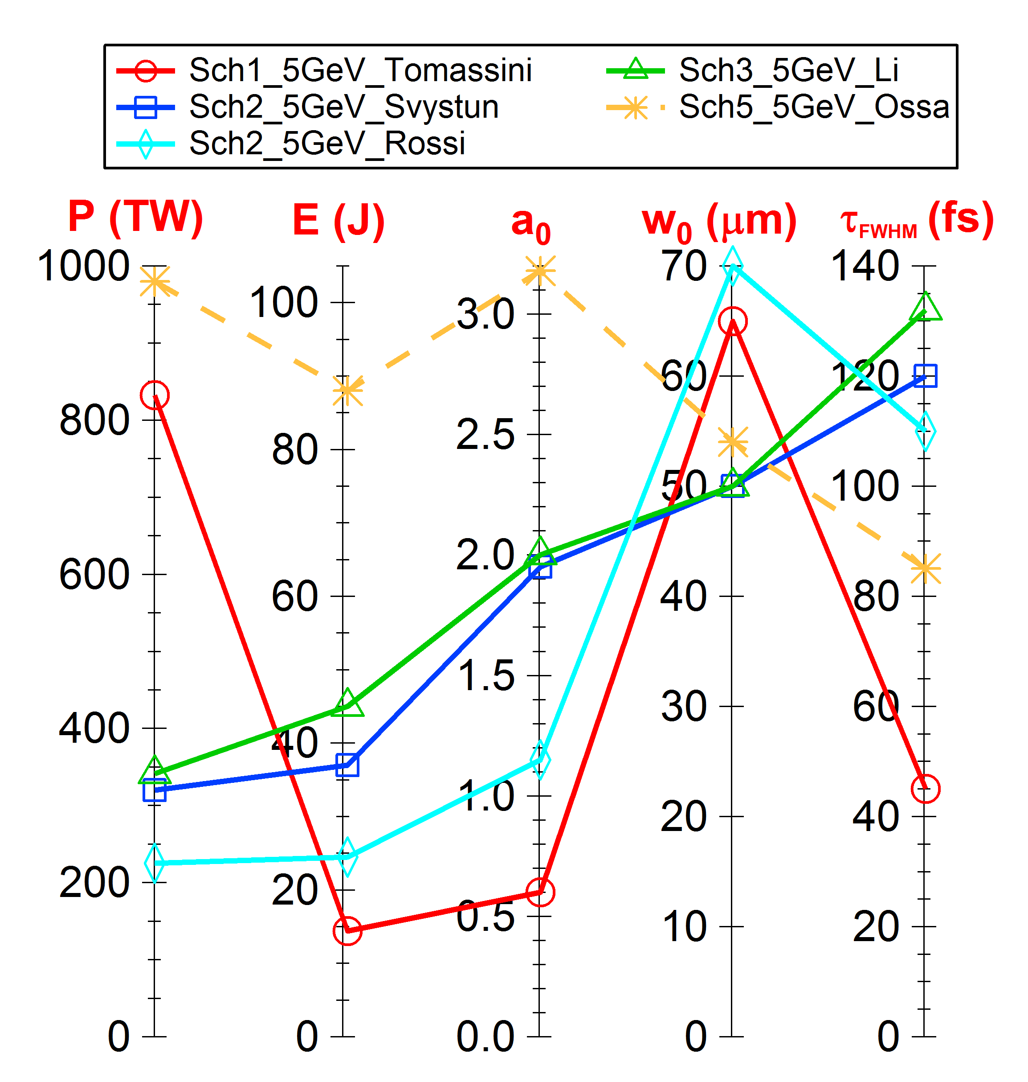
Laser parameters used in beam simulations
for 5 GeV
Interactions with WP4
Bi-Gaussian pulse
λ = 800 nm
Required laser parameters: P = 400 TW, E = 60 J, w₀ = 45 μm ( a₀ = 2.42, τ_{FWHM} = 141 fs)

Slide 17
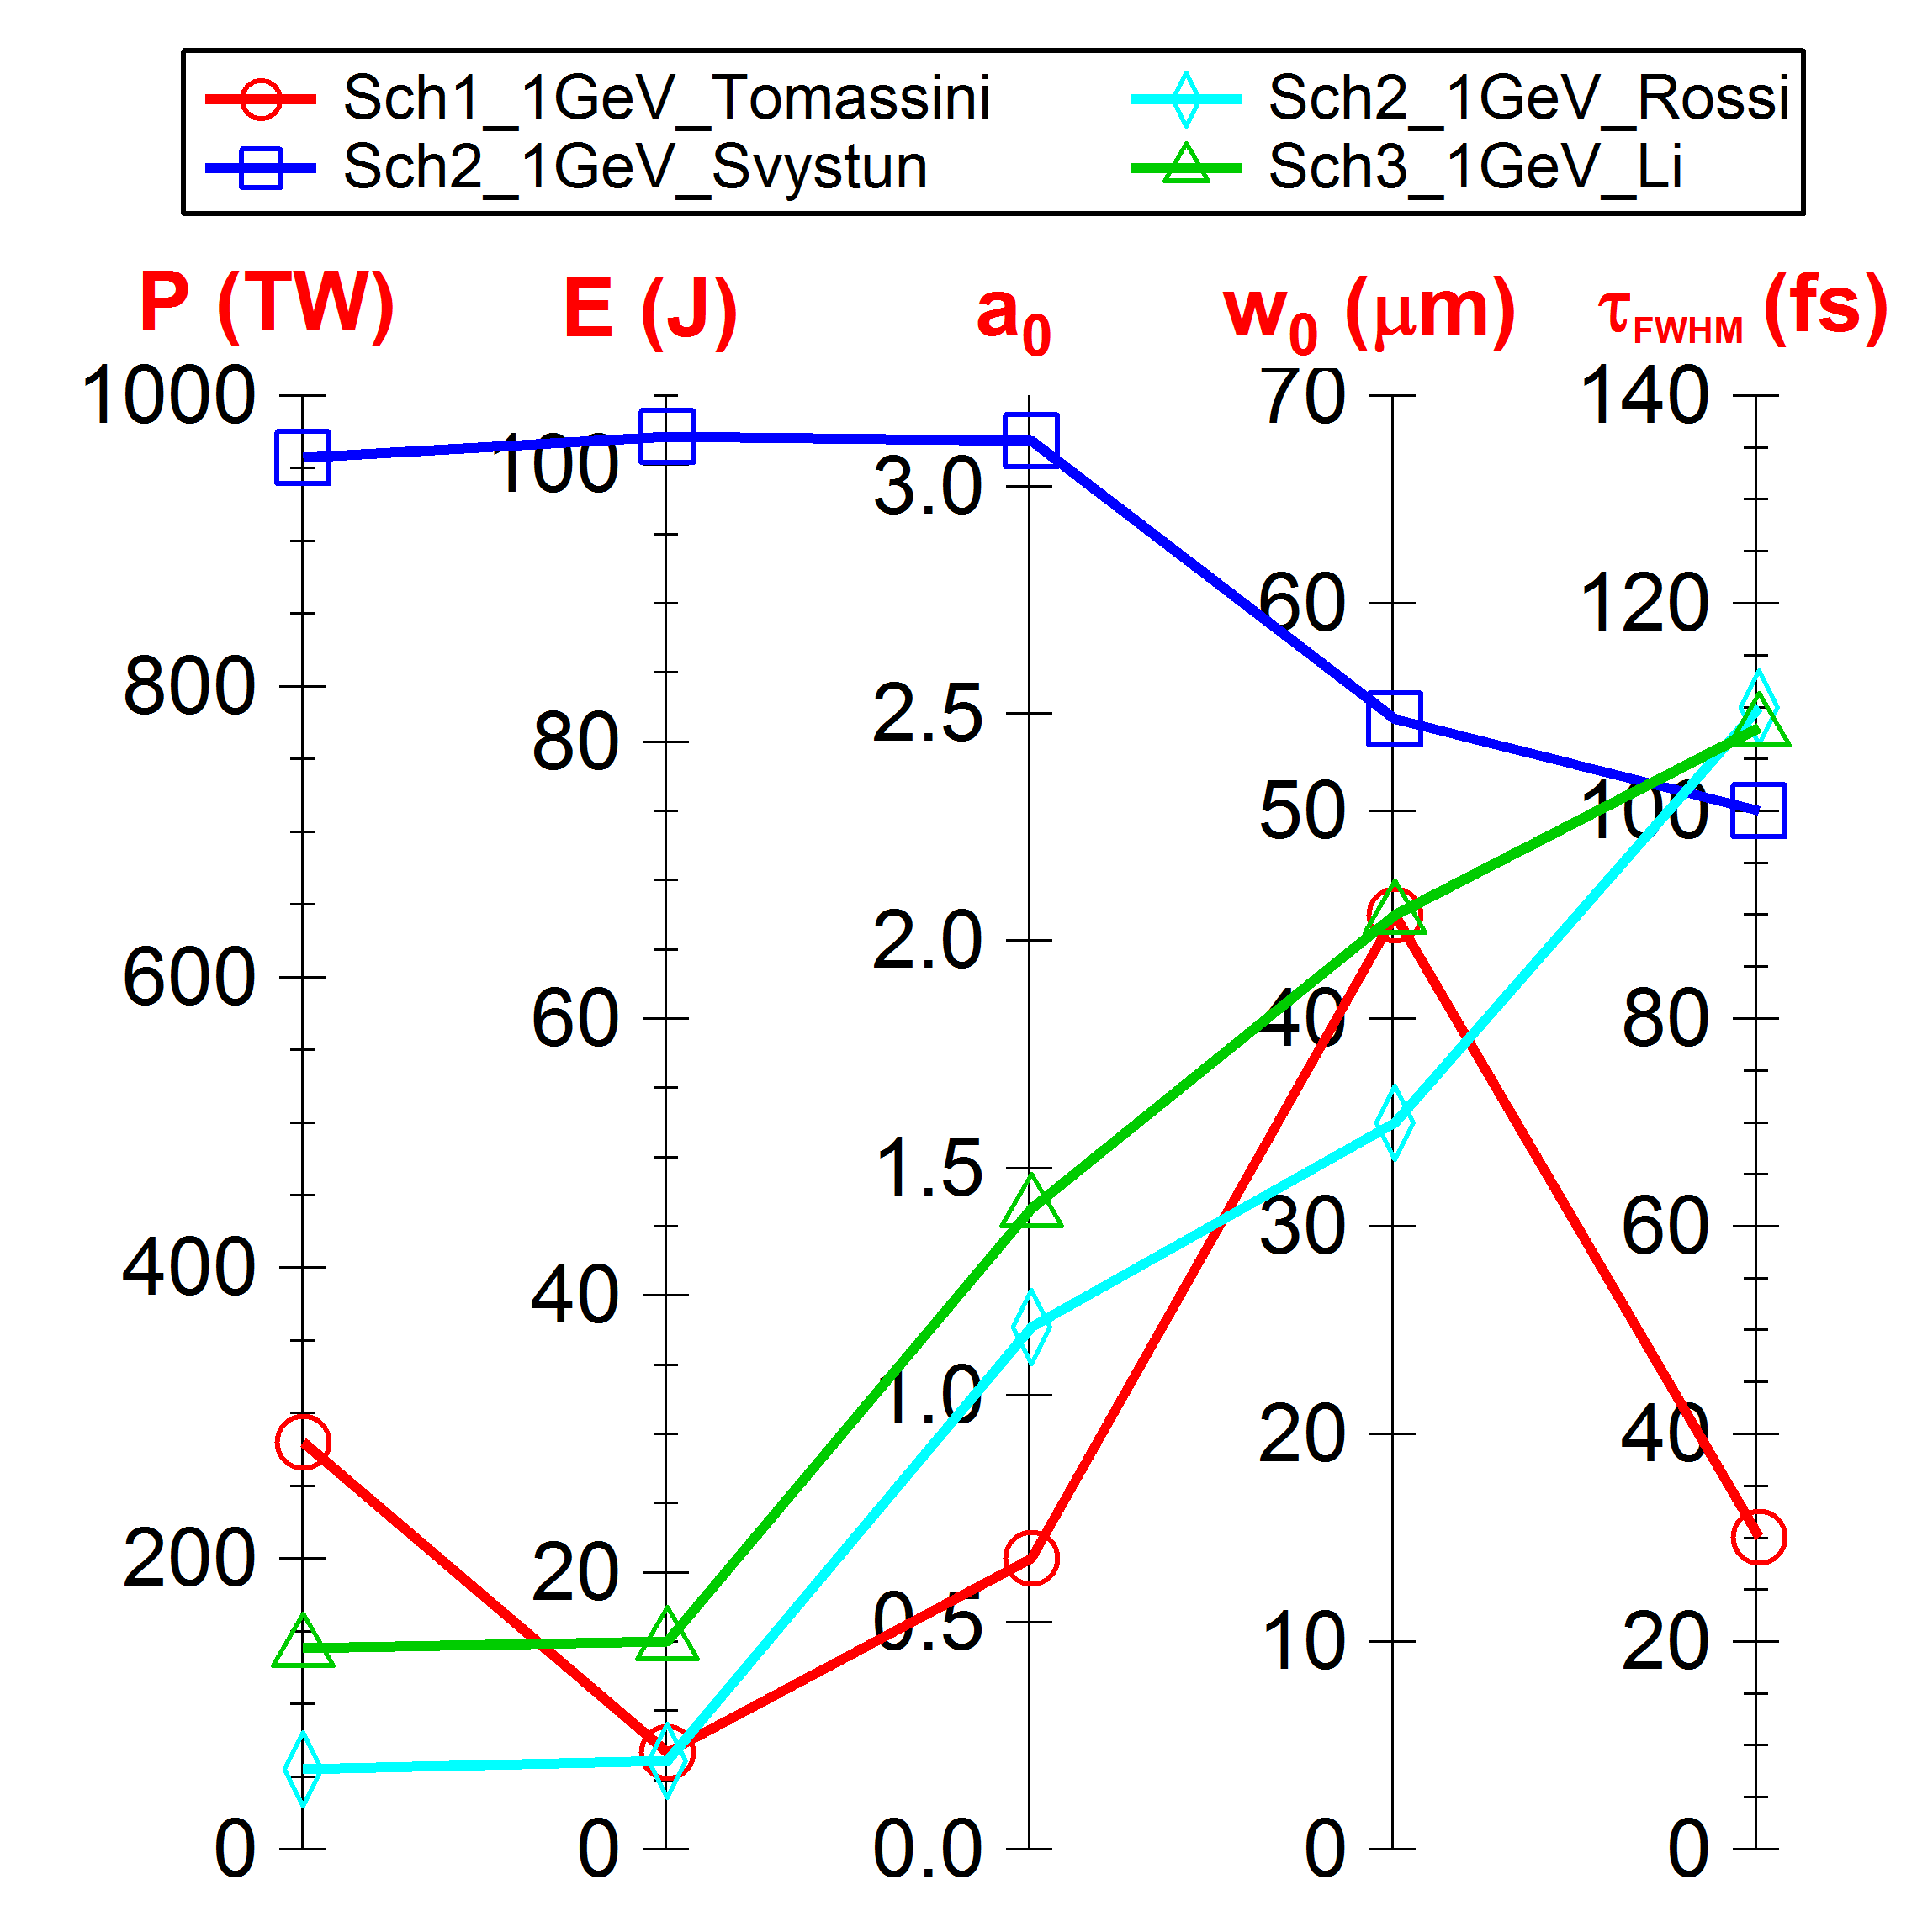
Laser parameters used in beam simulations
for 1 GeV
Interactions with WP4
Bi-Gaussian pulse
λ = 800 nm
(cosine squared in longitudinal
for Sch2_1 GeV_Rossi)
Required laser parameters: P = 200 TW, E = 30 J, w₀ = 30 μm ( a₀ = 2.57, τ_{FWHM} = 141 fs)

Slide 18
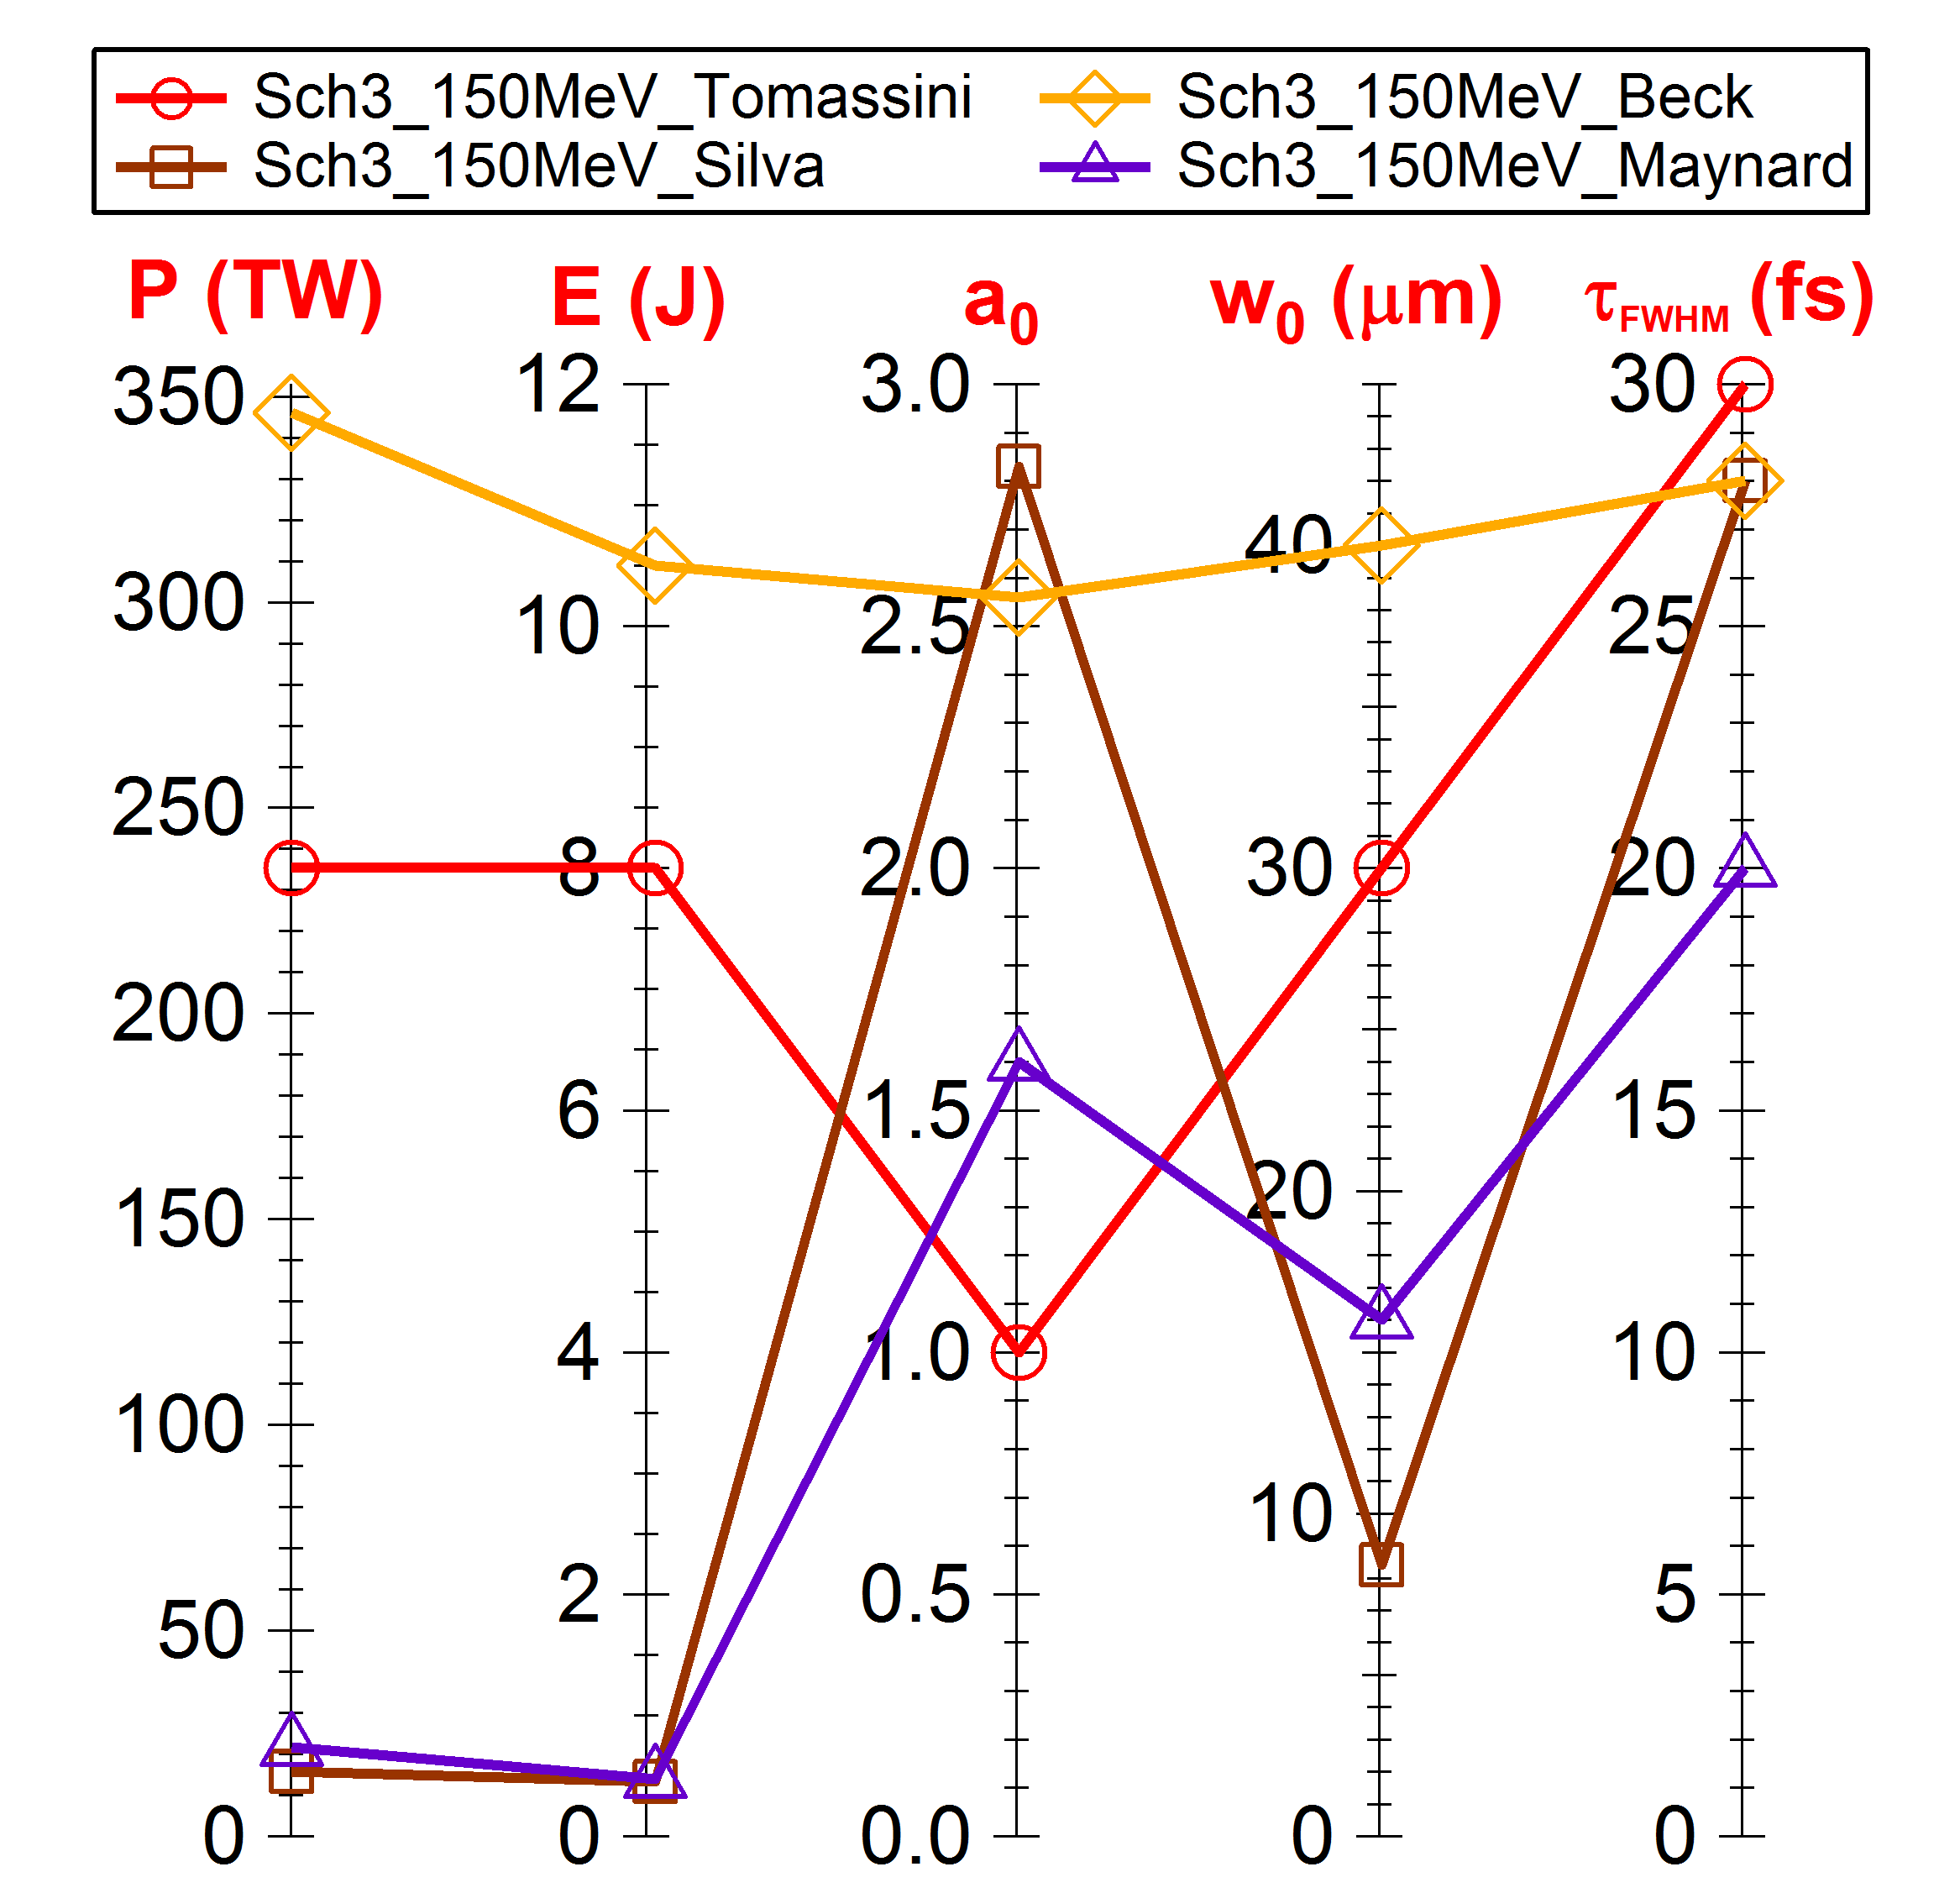
Laser parameters used in beam simulations
for 150 MeV
Interactions with WP4
Bi-Gaussian pulse
λ = 800 nm
Required laser parameters: P = 250 TW, E = 10 J, w₀ = 30 μm ( a₀ = 2.87, τ_{FWHM} = 38 fs)

Slide 19
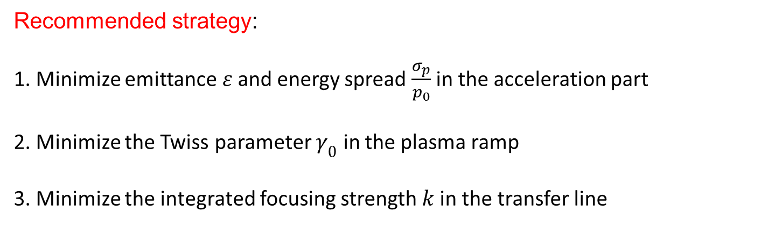
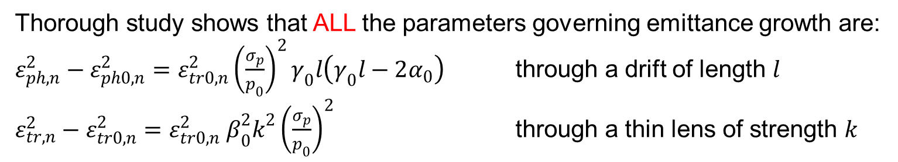
Start-to-End simulations
Issue: preserving emittance
when extracting the beam from the plasma and transporting it
- Parameters governing emittance growth not clear
- No solution for avoiding emittance growth in case of high charge beam
Thorough study shows that ALL the parameters governing emittance growth are:
$ε_{ph,n}^{2}−ε_{ph0,n}^{2}=ε_{tr0,n}^{2}{\left(\frac{σ_{p}}{p_{0}}\right)}^{2}γ_{0}l\left(γ_{0}l−2α_{0}\right)$ through a drift of length $l$
$ε_{tr,n}^{2}−ε_{tr0,n}^{2}=ε_{tr0,n}^{2} β_{0}^{2}k^{2}{\left(\frac{σ_{p}}{p_{0}}\right)}^{2}$ through a thin lens of strength $k$
Recommended strategy:
1. Minimize emittance $ε$and energy spread $\frac{σ_{p}}{p_{0}}$ in the acceleration part
2. Minimize the Twiss parameter $γ_{0}$ in the plasma ramp
3. Minimize the integrated focusing strength $k$in the transfer line

Slide 20
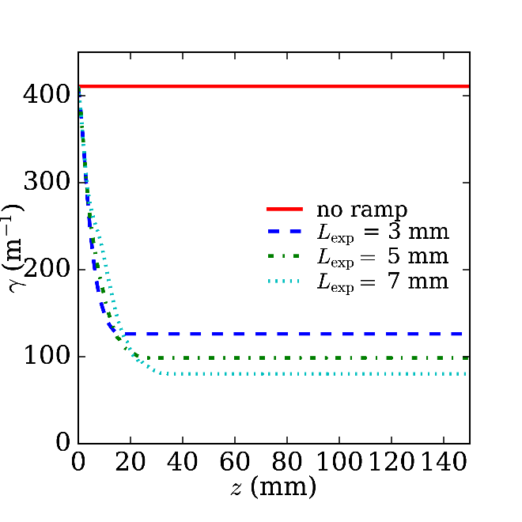
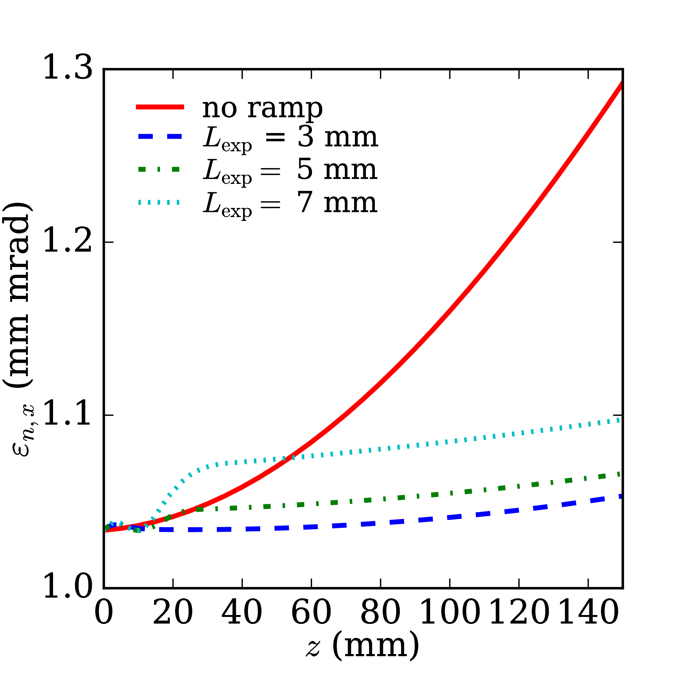
Start-to-End simulations
1
Up- and Downramp with Linear or Exponential density profiles have been checked
Optimized length → Minimum emittance growth
Efficient and easy to implement
2
Transfer line: number of quadrupoles = number of constraints
6 quadrupoles → emittance growth of only 10% at FEL entrance

Slide 21
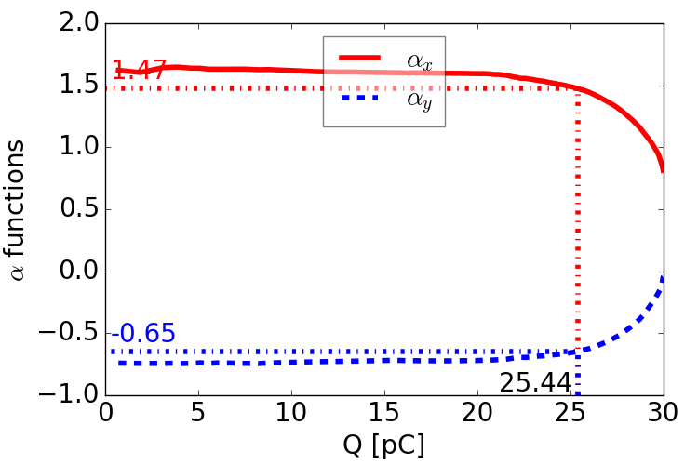
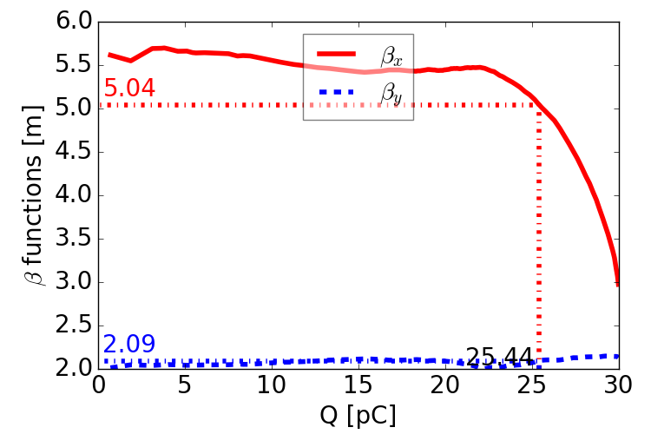
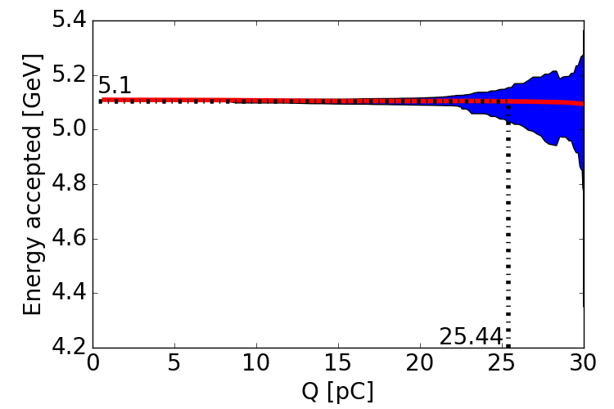
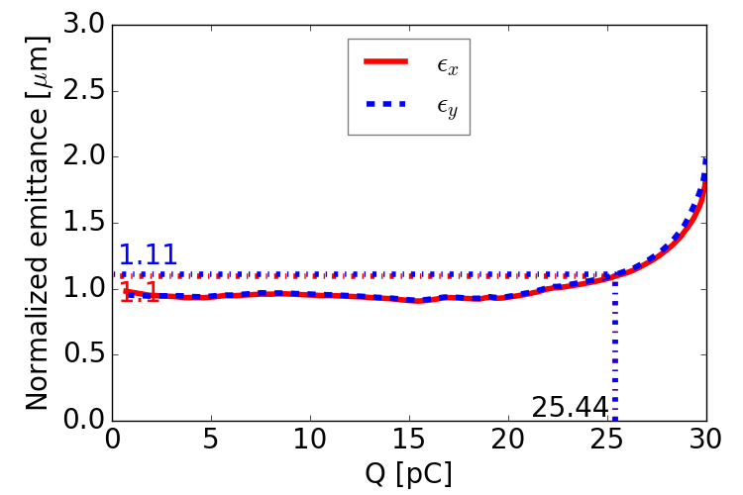
Start-to-End simulations
At the entrance of user's applications,
when keeping only the "core" part where rms values are in the "plateau"

Slide 22
Start-to-End simulations
At the entrance of user's applications,
when keeping only the "core" part where rms values are in the "plateau"
Scheme 2 : RFI + LPAS (quasilinear regime)
Q = 24 pC, ε_{tr,n} = 0.32 mm mrad
Scheme 3: LPI (REMPI) + LPAS (quasilinear regime)
Q = 25 pC, ε_{tr,n} = 1.1 mm mrad
(actual beam distribution from LPI to LPA remaining to be done)
Scheme 4: RFI + PPAS (bubble regime)
Q = 28 pC, ε_{tr,n} = 1.8 mm mrad
(γ₀ can be furthermore decrased)
500 MeV
HETL
RFI
LPAS
5 GeV
(1 GeV)
Scheme 2
LETL
150 MeV
HETL
5 GeV
(1 GeV)
Scheme 3
LPI
LPAS
500 MeV
HETL
1 GeV
RFI
PPAS
Scheme 4
LNF
every other beam parameters remaining unchanged by the transfer lines
Further progress are still possible…

Slide 23
Next step: Error and Tolerance studies
Deliverable Report in Spring 2019: "Final tolerance analysis"
Issue: very time consuming simulations
→ Strategy of error studies to be defined
→ Sharing of works to be coordinated
→ Prerequisite: Top Level Tolerances to be defined
At this meeting!
For the moment:
- Pre-discussions on these subjects have been launched
- A preliminary list of Errors/Requirements is circulating for collecting comments

Slide 24
Preliminary list of Errors/Requirements
Tolerance on Requirements
Emittance
Twiss α, β
Slice emittance
Energy spread
Slice energy spread
Bunch length
Energy
Charge
Alignment, position
Alignment, angle
Errors on Plasma
Errors on Laser
Errors on Transfer Line
Plasma density
Plateau long. profile
Plateau trans. profile
Ramp long. profile
Input beam energy
Input beam position
Input beam angle
Input beam emittance
Input beam Twiss α, β
…
Power
Energy
w0
Transv. profile
Longit. profile
Focal plane position
Alignment, angle
Time shift
…
Quadrupole position
Quadrupole strength
Input beam energy
Input beam position
Input beam angle
Input beam emittance
Input beam Twiss α, β
...

Slide 25
Conclusions
Tremendous simulations and optimizations have been performed by many contributors
→ Many results obtained on different injection/acceleration schemes and techniques
→ First down selection performed for S2E simulations
→ Issues of S2E simulations studied and solved
→ Beam parameters at user's door very close to requirements
Other schemes or techniques remain very promising
Further progress still possible
Robust results (see also presentation tomorrow afternoon)
Next step: Errors and Tolerances studies

