Slide 1



BNL Magnet Test Facility Updates
Joseph F Muratore
Superconducting Magnet Division
Brookhaven National Laboratory
Upton NY 11973 USA
2nd International Workshop on Magnet Test Facilities
BNL, May 8-9, 2018

Slide 2
BNL Magnet Test Facility
Test Facility overview/refresher
Test results since last workshop
Cryogenics system updates
Power supply updates
Quench detection and protection updates
DAQ updates
2nd International Workshop on Magnet Test Facilities BNL May 8-9 2018

Slide 3
BNL Magnet Test Facility
Since the last workshop at CERN in 2016, the following events, milestones, and upgrades have occurred:
Operation at 1.9 K and lower, at 1 bar (nom)
Powering of magnet to 19.4 kA (24 kA in power supply tests)
Training of first long coil (mirror) and first long magnet (prototype), showing similar performance to the short versions of each
Successful implementation of CLIQ at 500 V and 40 mF
Operation of quench protection heaters satisfy LHC requirements or better
Independent operations of EE, QPH, and CLIQ, with independent delays if needed
Redundant quench detector systems
Improvements to power supply and EE systems
Upgrades to cryogenics quench He return system to mitigate loss of He gas due to high quench pressures
Addition of second He liquefier after next test to meet 3 quench per day test rate.
2nd International Workshop on Magnet Test Facilities BNL May 8-9 2018

Slide 4
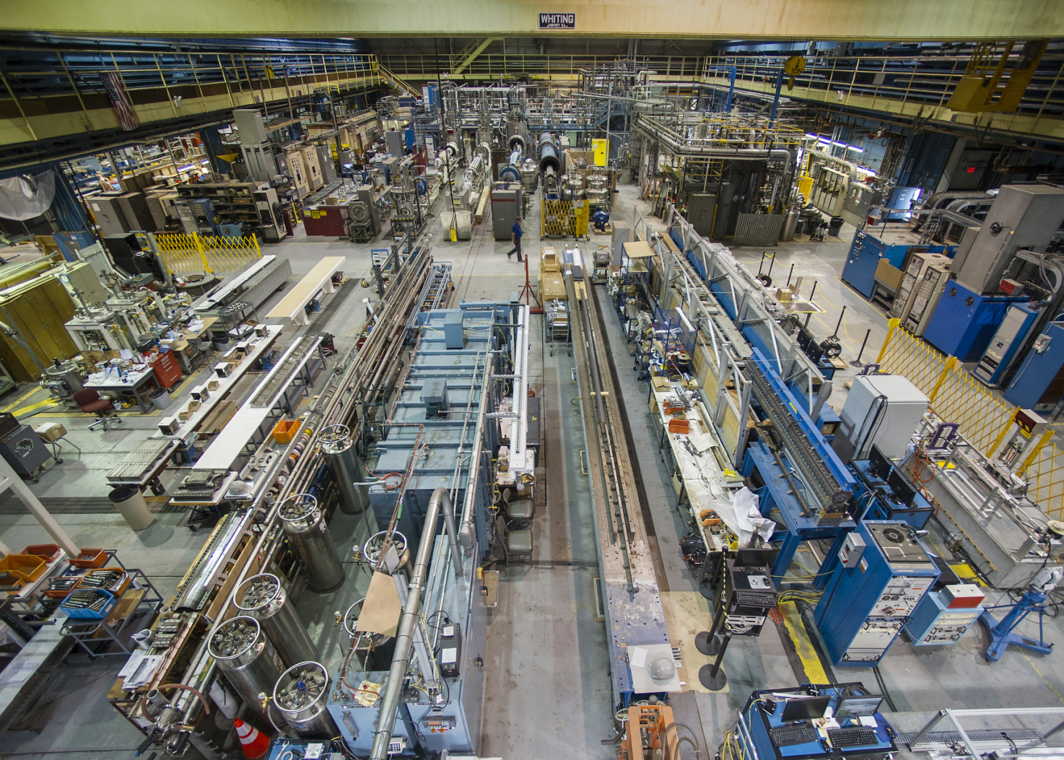
BNL Magnet Test Facility
BNL Facility North (High) Bay Area (30 ton crane)
Test Facility in Background
2nd International Workshop on Magnet Test Facilities BNL May 8-9 2018

Slide 5
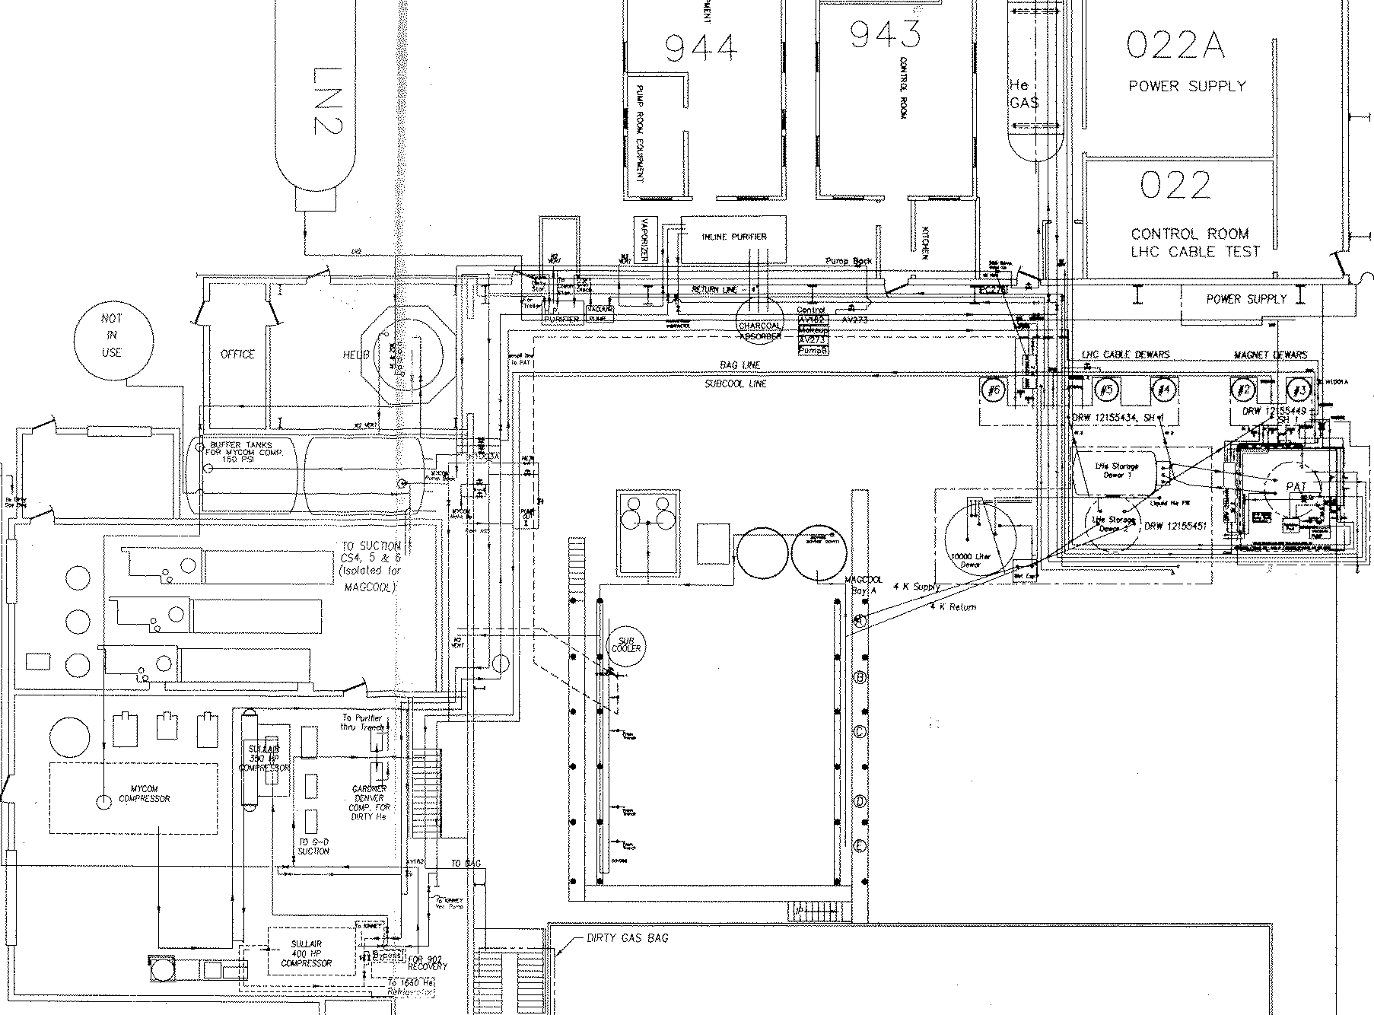
BNL Magnet Test Facility
Nash “high capacity” vacuum Pump (1.9K)
Building 902 Test Facility Floor Plan and Overview
30 kA Power Supply
MQXF
CTI 4000 He Refrigerator
CONTROL ROOM
2.7 m Deep Test Dewars
6.1 m Magnet Deep Test Dewars
Vertical Test Dewars 2-6
2nd International Workshop on Magnet Test Facilities BNL May 8-9 2018

Slide 6
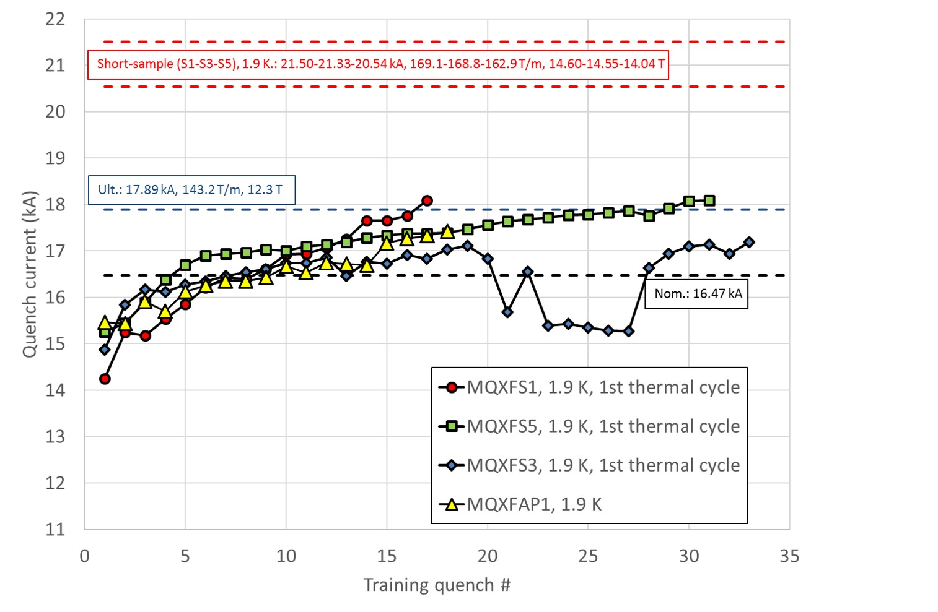
Test Results – MQXFAP1 (1st Long Magnet)
All quench tests were at 1.9 K (nom) and 20 A/s.
Quench training results were similar to the short prototypes.
Testing was ended because Coil 5 developed a short to ground and to outer layer quench heaters. This is still being investigated.
From G. Ambrosio
2nd International Workshop on Magnet Test Facilities BNL May 8-9 2018

Slide 7
Cryogenic System Upgrades
Newly designed relief valve assembly – to mitigate burst disc problem and decrease loss of He gas at quench
Use of Test Cryostat 3 as a cold buffer tank next to Test Cryostat 2 under test – all parts (including newly designed transfer line) ready for use in next test (July 2018)
Future addition of two more buffer tanks (29874 L each) if needed
Linde Model 1610 He Liquefier is being shipped to BNL from PNNL at minimal Project cost – to increase liquid He rate by 80-100 L/hr (in addition to CTI 4000 246 L/hr), and allow for 3 quenches/day and more efficient operation between tests
Increased number of pressure transducers and thermometers to provide better diagnostics and control of valves
Total energy at quench - up to 6 MJ at 19kA (training quenches) with 33mH inductance – Need to be ready for this
2nd International Workshop on Magnet Test Facilities BNL May 8-9 2018

Slide 8
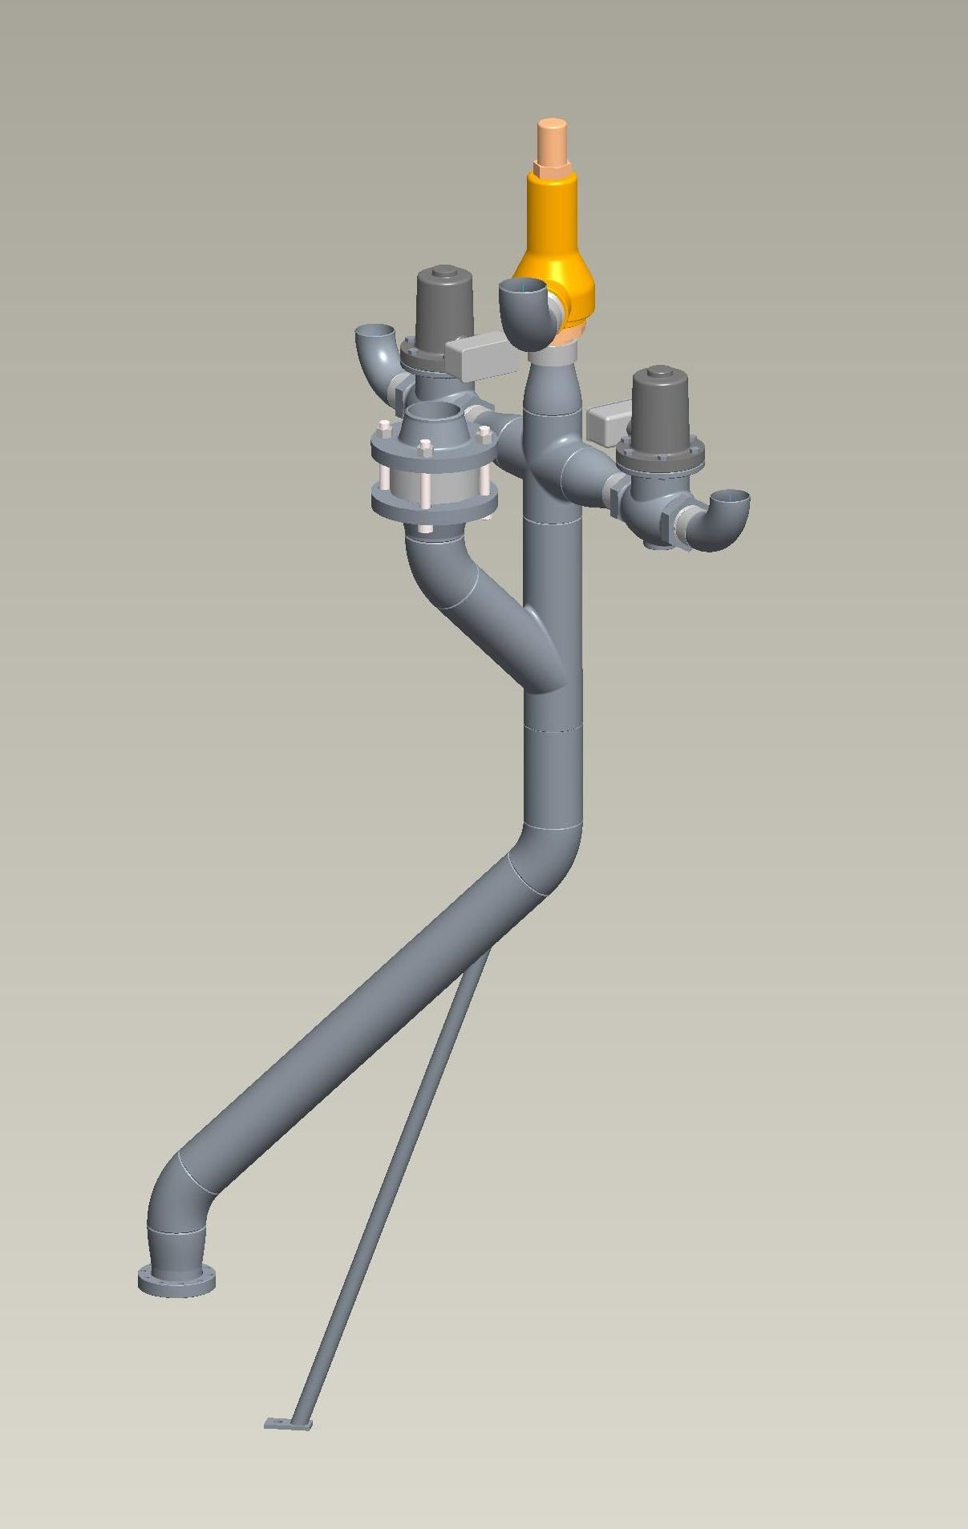
Dewar Relief Systems
Cryogenic System Upgrades
Test Dewar Relief Stack (Unchanged)
  Cash Relief Valve (1380g/s @ 30 PSIG)
  3” Burst Disk (40 PSIG)
  2” Solenoid Valve (1400 g/s @ 30 PSIG)
  3” Solenoid Valve (2700 g/s @ 30 PSIG)
Buffer Dewar relief stack is identical except that it does not have the 3” solenoid valve.
Solenoid valve activation time is approx. 1 s after signal.
Cash relief valve full open @ 33 PSIG.
This slide courtesy of A. Marone
2nd International Workshop on Magnet Test Facilities BNL May 8-9 2018

Slide 9
Helium Flow Schematic Using 2nd Test Cryostat as Cold Buffer
Cryogenic System Upgrades
This slide courtesy of A. Marone
2nd International Workshop on Magnet Test Facilities BNL May 8-9 2018

Slide 10
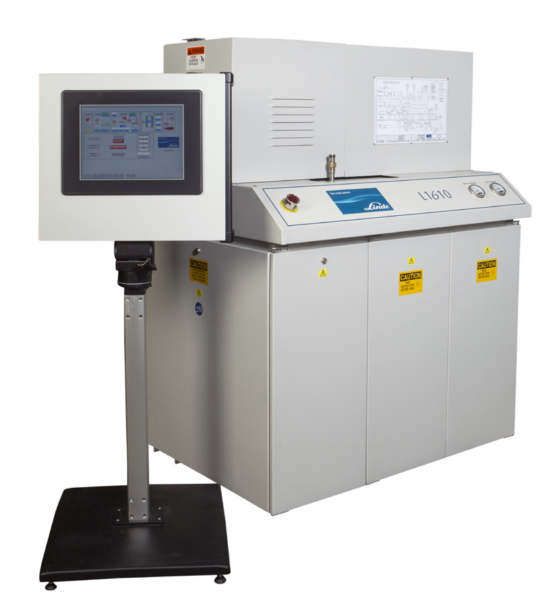
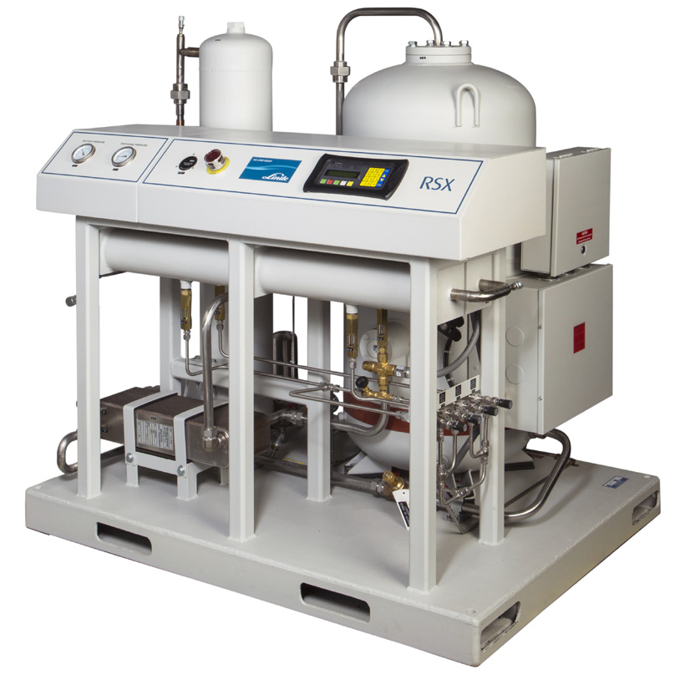
Cryogenic System Upgrades
Linde Model 1610 He Liquefier
Based on modified Claude cycle with two gas piston expanders
In-line purifier
80 – 100 L/hr
With main refrigerator CTI 4000, will allow liquefaction rate for 3 quenches / day
2nd International Workshop on Magnet Test Facilities BNL May 8-9 2018

Slide 11
Power Supply System
2nd International Workshop on Magnet Test Facilities BNL May 8-9 2018

Slide 12
Power Supply and Quench Protection Upgrades
Ceramic non-inductive dump resistors have replaced the stainless steel resistors used during the mirror test – now have more options -
R_{D} = 30, 37.5, 50, 75, 150 mΩ
Upgrade of IGBT switches on PS#2 to 1700 V rating - allows for use of higher EE resistance at training quench currents
Replacement of main 480 V switches for both power supplies to meet safety requirements
Addition of FPGA-based quench detector for main quench signals – total coil, total coil-L(dI/dt), ½ coil difference, ¼ coil differences, SC leads
PXIe quench detector also still being operated – as backup to FPGA-based QD and for signals which can trigger slow discharge, such as gas-cooled leads and LHe level, etc. (see following drawing)
2nd International Workshop on Magnet Test Facilities BNL May 8-9 2018

Slide 13
Quench Protection Upgrades
P. Joshi
2nd International Workshop on Magnet Test Facilities BNL May 8-9 2018

Slide 14
Quench Protection Upgrades
12 independent Quench Protection Heater firing units (8 600 V, 12 mF; 4 900 V 13 mF) with four charging systems
Each QPH can be charged and time-delayed independently of each other and the EE and CLIQ triggers
CLIQ has been implemented successfully and used during MQXFAP1 training
CLIQ was operated at 500 V and 40 mF, with and without inner layer heaters
2nd International Workshop on Magnet Test Facilities BNL May 8-9 2018

Slide 15
Instrumentation Upgrades
HBM equipment to control and read 40 CERN-style strain gauges has been ordered and will be ready for next test
Vishay/LARP-style gauges will now be divided among five current sources to minimize loss of data due to a gauge failure
Quench fast data logger file has been expanded to include more coil signals with different gains
All voltage tap, coil and layer main voltage, quench antenna, CLIQ, and protection heater signals are included in one data file, along with cryostat and buffer pressures, power supply voltages and currents, and other signals
Strain gauge reads, FPGA detector, and power supply monitoring parameters are each written into separate data files
All data files are generated using LabVIEW programs
Magnetic field measuring transporter is being readied for next test in July.
2nd International Workshop on Magnet Test Facilities BNL May 8-9 2018

Slide 16
BNL Magnet Test Facility
CONCLUSION
Upgrades to the BNL test facility cryogenics, power supply, energy extraction, quench detection, and quench protection systems have been made or are in progress at this time.
Next test is scheduled for July and will be the 2nd prototype MQXFAP2.
2nd International Workshop on Magnet Test Facilities BNL May 8-9 2018

Slide 17
Thank you for your attention.
2nd International Workshop on Magnet Test Facilities BNL May 8-9 2018

Slide 18
Back-Up Slides
2nd International Workshop on Magnet Test Facilities BNL May 8-9 2018

Slide 19
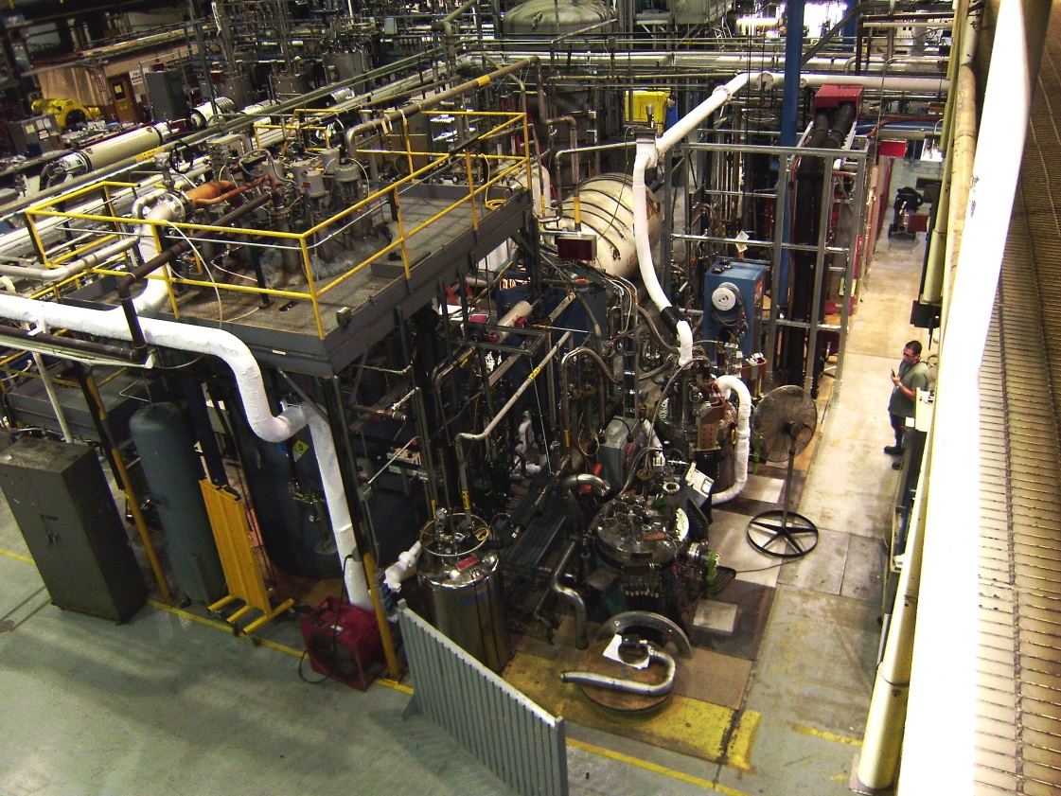
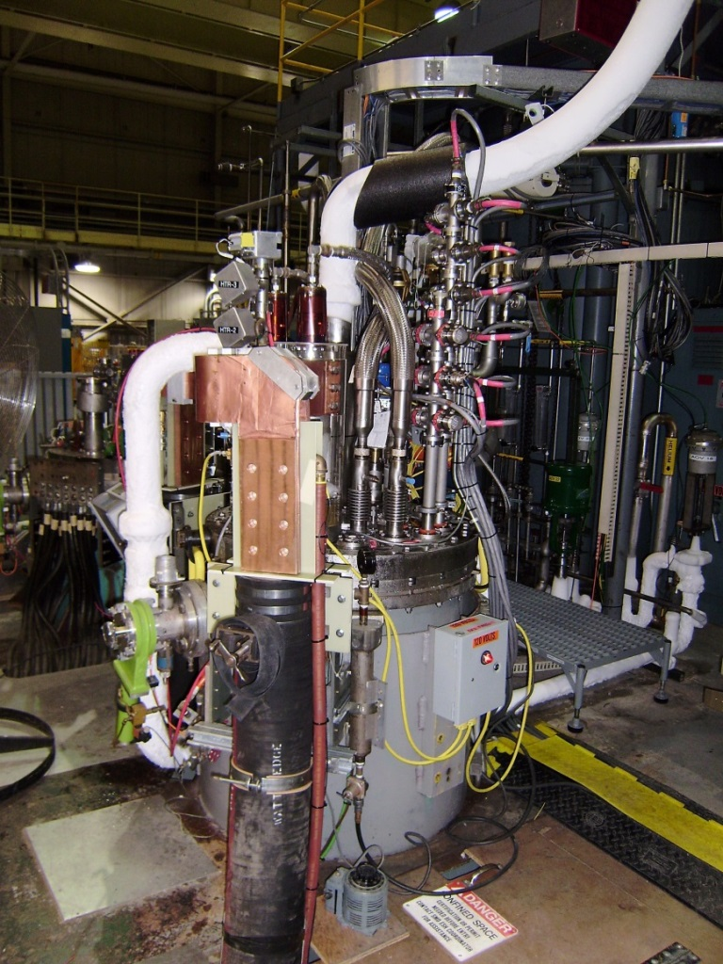
BNL Magnet Test Facility
Vertical Test Facility at BNL, showing two of the five test cryostats and the backup refrigerator. Long arrow points to Vertical Test Cryostat 2 (1.9K and 24kA).
Short arrow points to Test Cryostat 3, which will be used as cold buffer for the He return during quenches on future MQXFA tests.
Vertical Test Cryostat 2, upgraded to provide 1.9 K at 1 bar (nom) and 24 kA, for testing of the 4.2 m-long MQXFA quadrupoles. The picture shows the test stand with the mirror MQXFPM1 under test.
2nd International Workshop on Magnet Test Facilities BNL May 8-9 2018

Slide 20
Test Results – Mirror (1st Long Coil)
Thermal Cycles
Magnet was still training by end of test – locations of quenches varied and highest current quench at end was at 4.4 K. A quench at 300 A/s showed no change in quench current.
2nd International Workshop on Magnet Test Facilities BNL May 8-9 2018

Slide 21
Test Results – Mirror (1st Long Coil)
Training of long mirror and short mirror are similar. No degradation in longer coil.
2nd International Workshop on Magnet Test Facilities BNL May 8-9 2018

Slide 22
2nd International Workshop on Magnet Test Facilities BNL May 8-9 2018

