Slide 1
FREIA Laboratory
Facility for Research Instrumentation and Accelerator Development
News from FREIA
Status of the “Gersemi” Test Stand
Roger Ruber for the FREIA Team
2nd International Magnet Test Stand Workshop
BNL, 8-9 May 2018

Slide 2
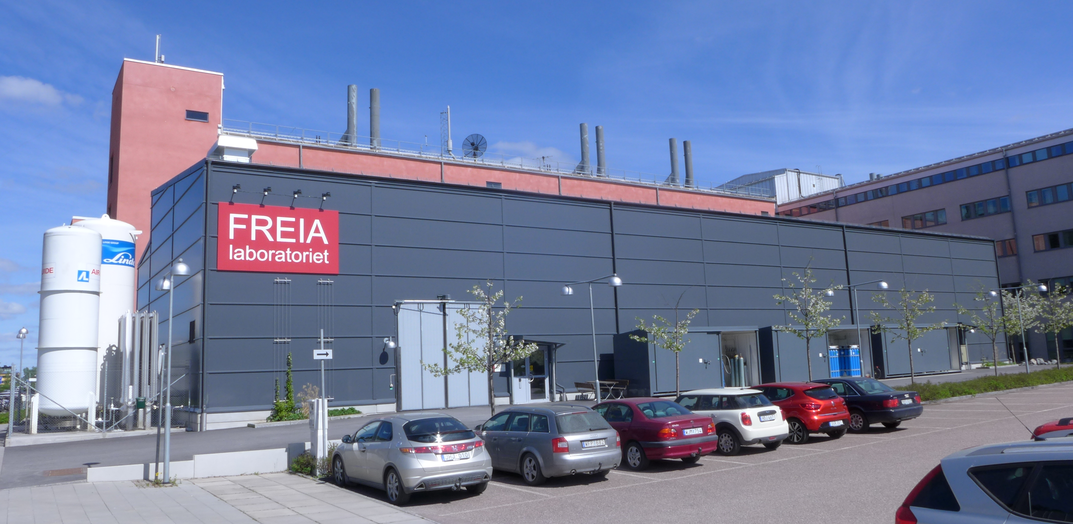
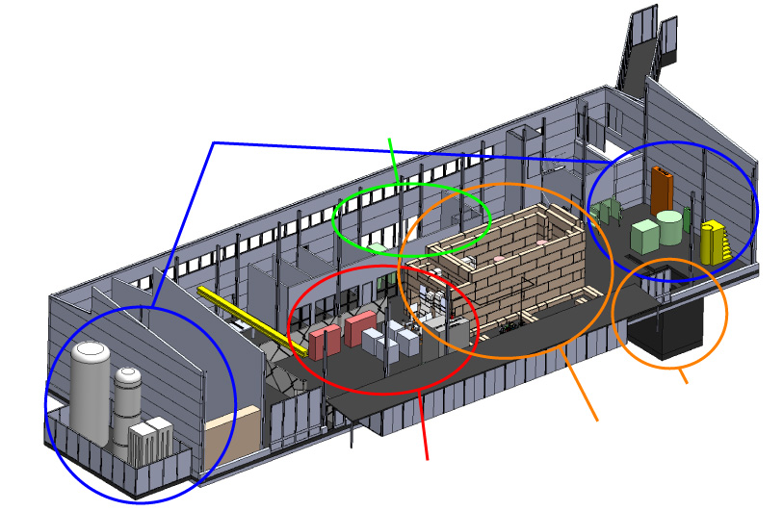
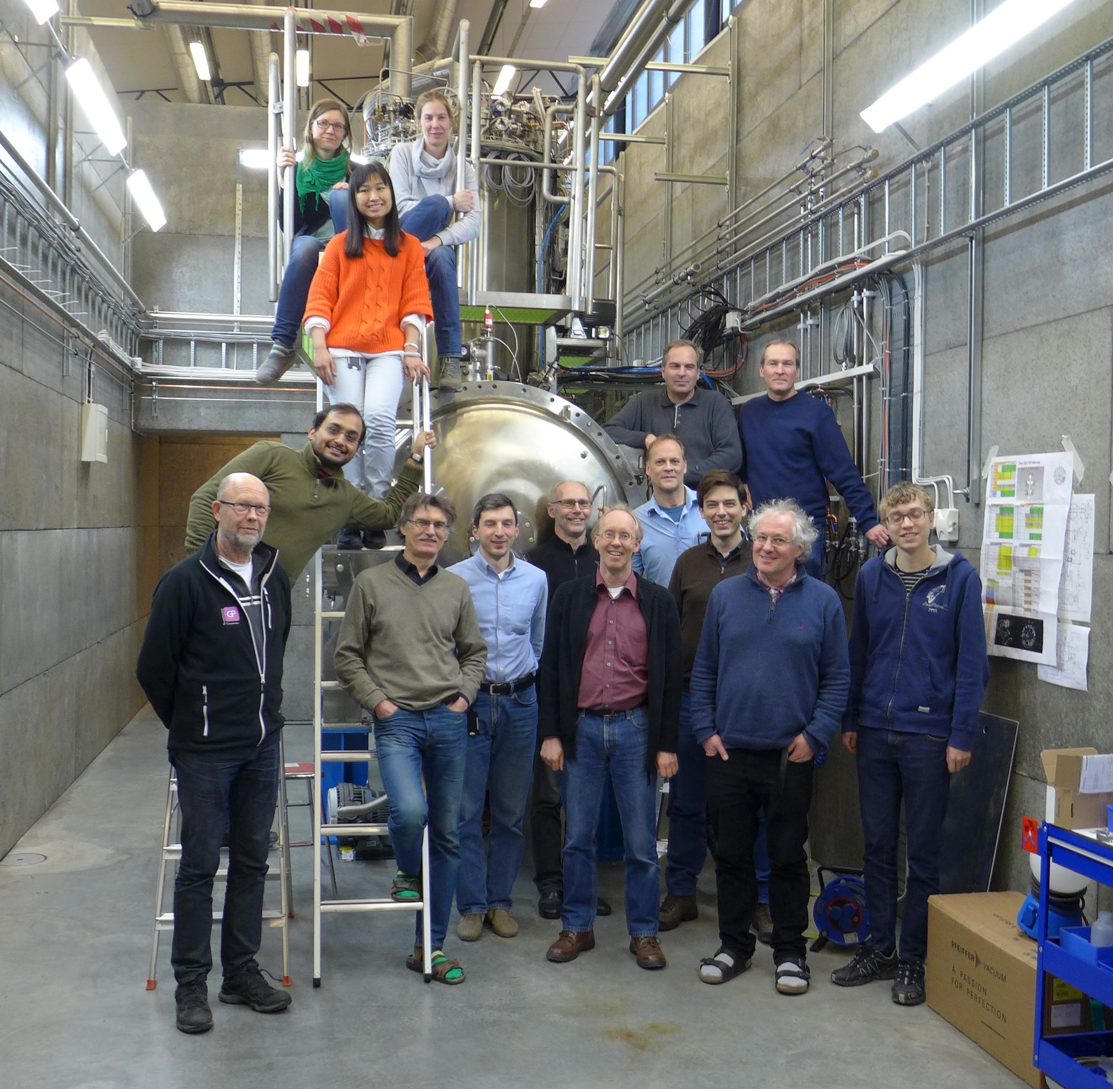
FREIA Laboratory at Uppsala University
Facility for Research Instrumentation and Accelerator Development
Funded by
KAWS, Government, Uppsala Univ.
State-of-the-art Equipment
cryogenics
- liquid helium
- liquid nitrogen
control room
- equipment controls
- data acquisition
Competent and motivated staff
collaboration of physics (IFA)
and engineering (Teknikum).
vertical cryostat
3 bunkers
with test stands
horizontal cryostat
radio-frequency (RF) power sources

Slide 3
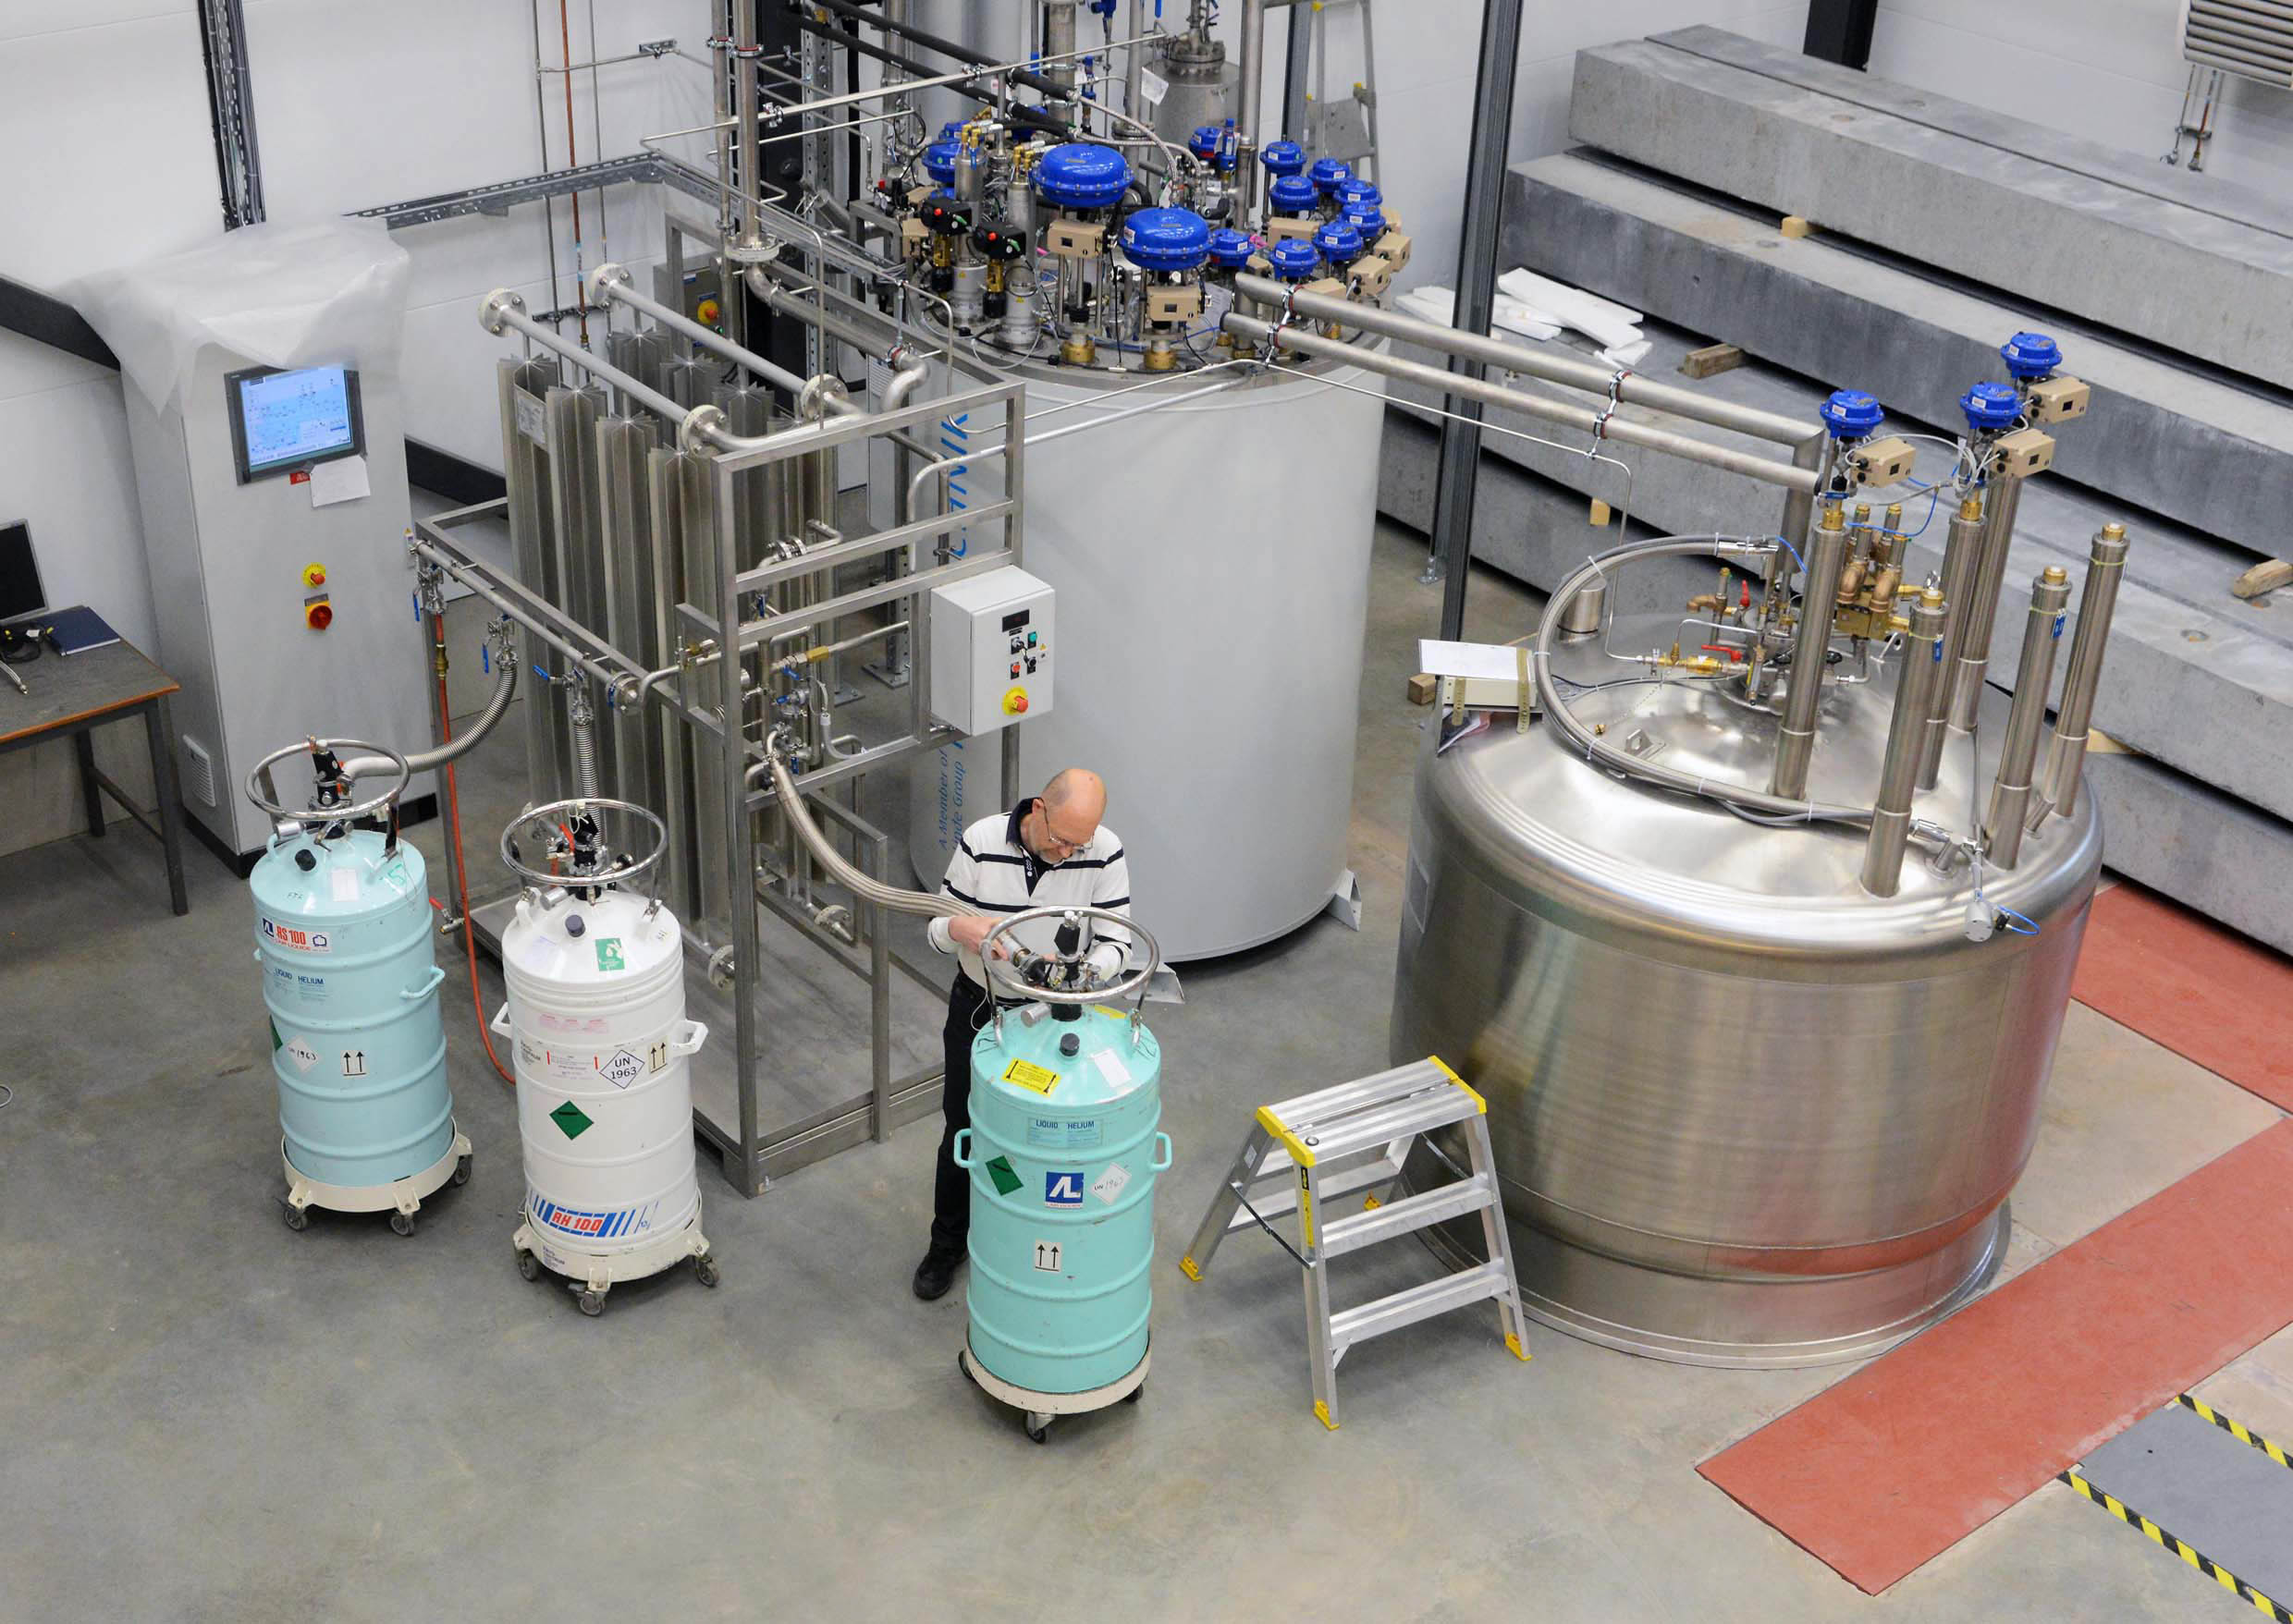
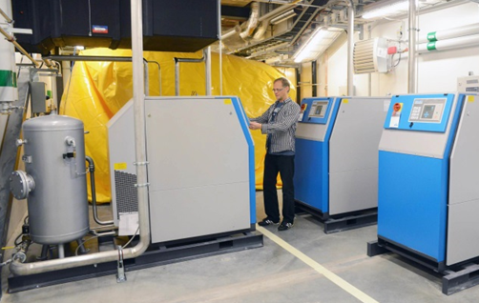
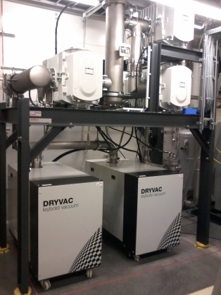
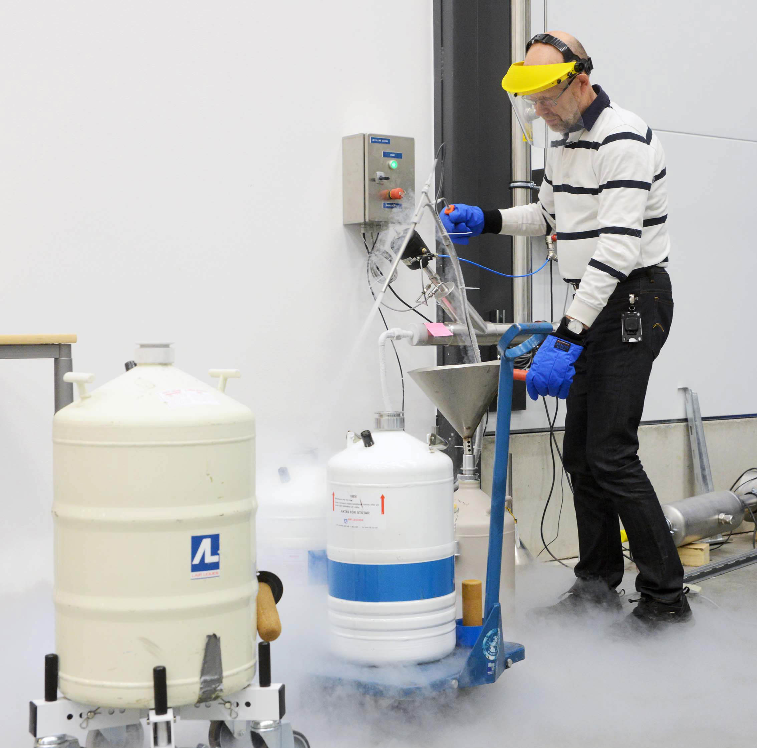
Cryogenics
Helium liquefaction
  150 l/h at 4.5K (LN2 pre-cooling)
  2000 l LHe dewar/buffer, 3+1 outlets
  cryostats connected in closed loop
Gas recovery
  100 m³ gasbag
  3x 25 m³/h compressor
  10 m³ 200 bar storage
2K Pumping
  ~3.2 g/s at 10 mbar
  ~4.3 g/s at 15 mbar
  90 W at 1.8 K
  110 W at 2.0 K
Liquid nitrogen
  20 m³ LN2 tank
Helium gas recovery system
Sub-atmospheric pumping station

Slide 4

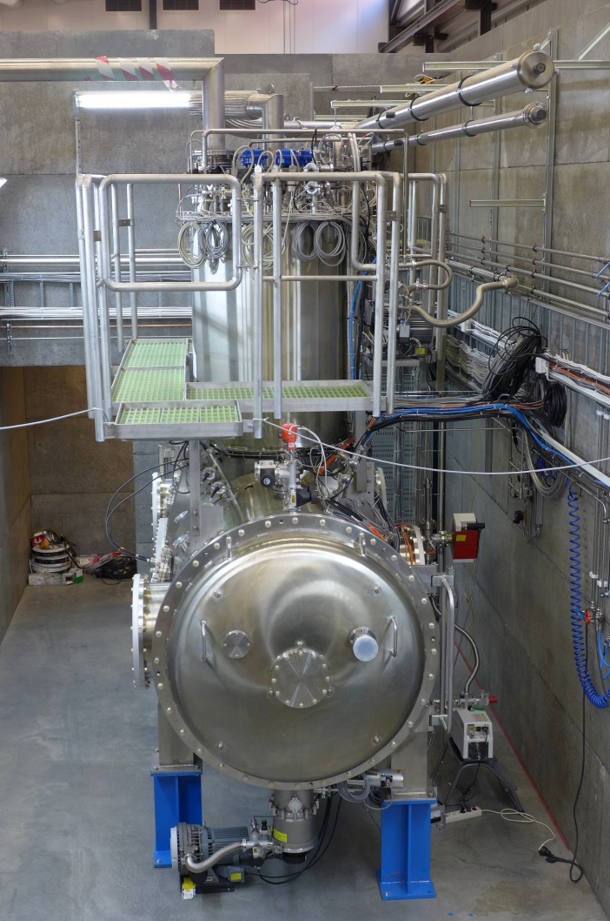
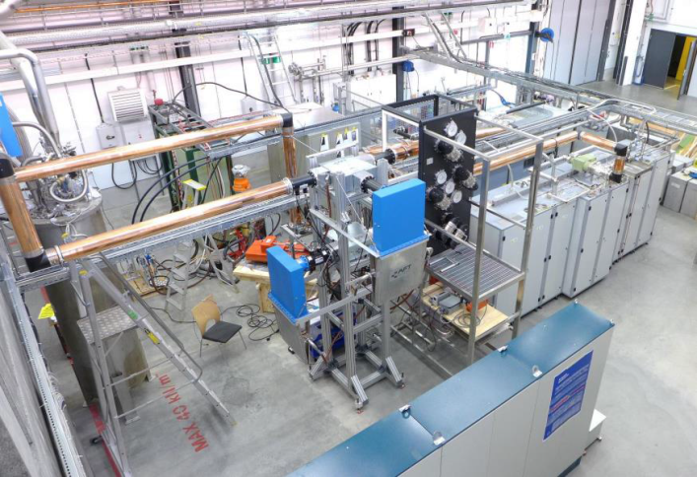
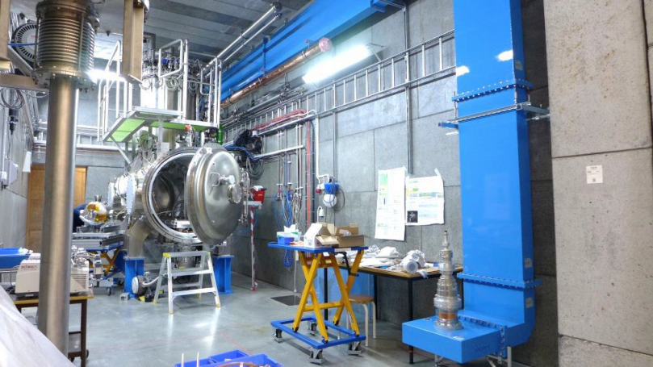
“HNOSS” Horizontal Cryostat
HNOSS = Horizontal Nugget for Operation of Superconducting Systems
Test of superconducting cavities/devices
  3240 x ø1200mm inner volume
  up to two cavities simultaneously,
  each equipped with helium tank,
Low or High power RF testing
  fundamental power coupler (top, bottom, side)
  self excited loop or frequency generator driven
Operation in the range 1.8 to 4.5K.
Available as ARIES
Trans National Access Facility

Slide 5
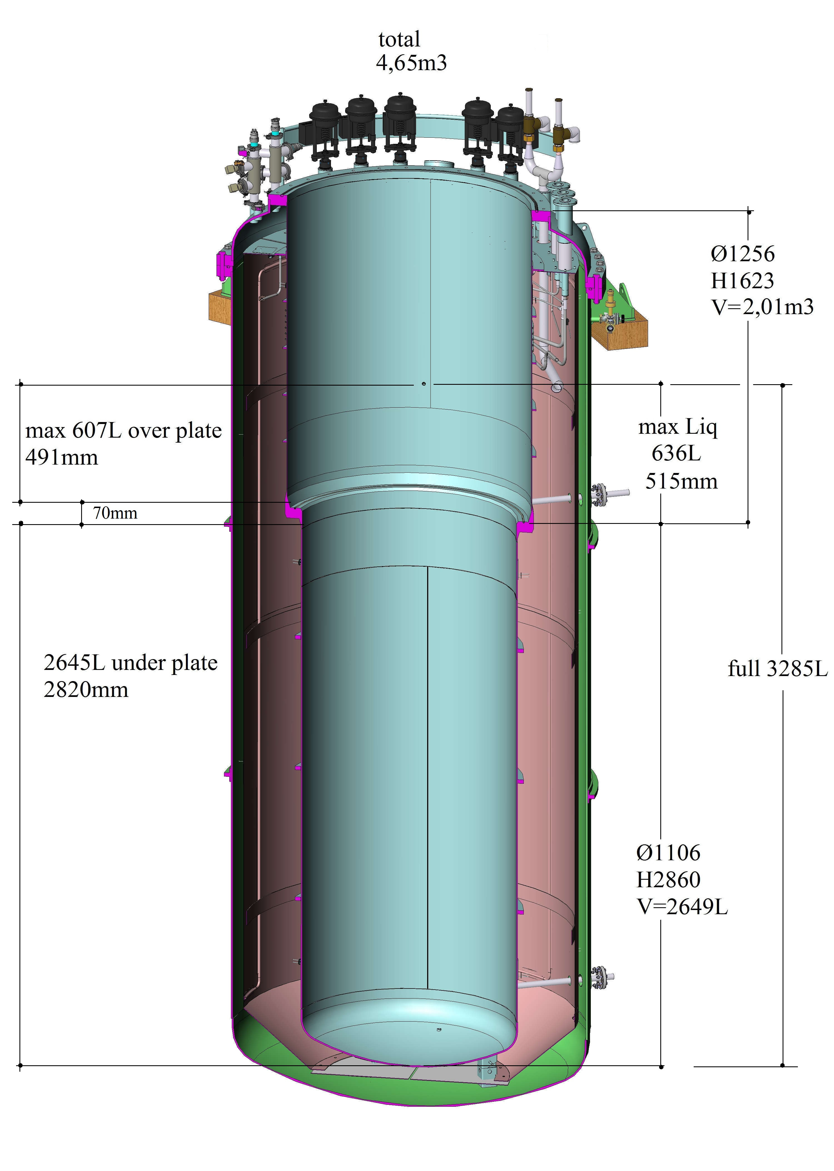
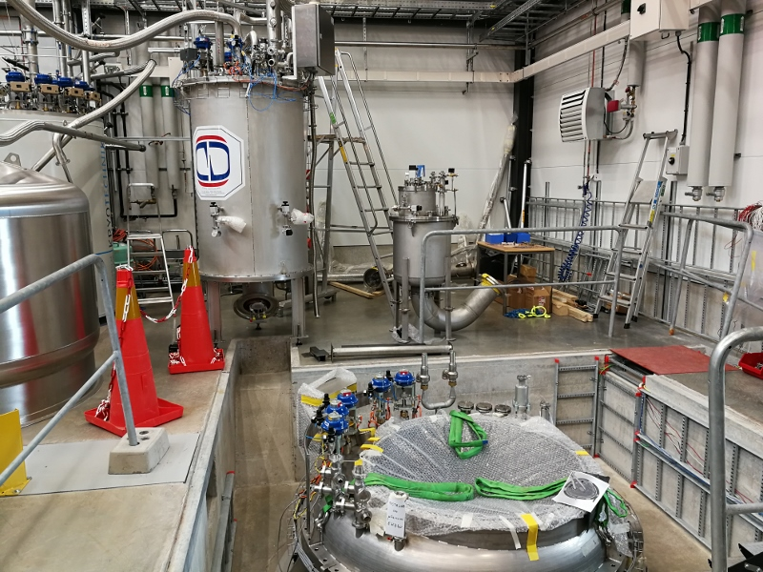
“Gersemi” Vertical Cryostat
Under construction
  May ➔ installation
  June ➔ start commissioning with simulator
  September/October ➔ commissioning with inserts
Test of SC cavities & magnets
  3.2m x ø1.1m total volume
  2.65m x ø1.1m below lambda plate
    design includes joint for lambda plate
Three operation modes
  vacuum
  liquid (saturated) bath
  pressurized bath
  with 2K heat exchanger
Available as ARIES
Trans National Access Facility

Slide 6
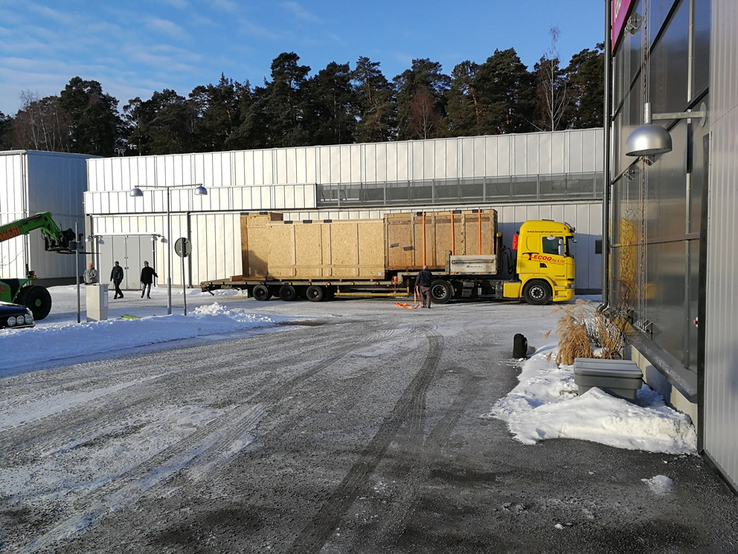
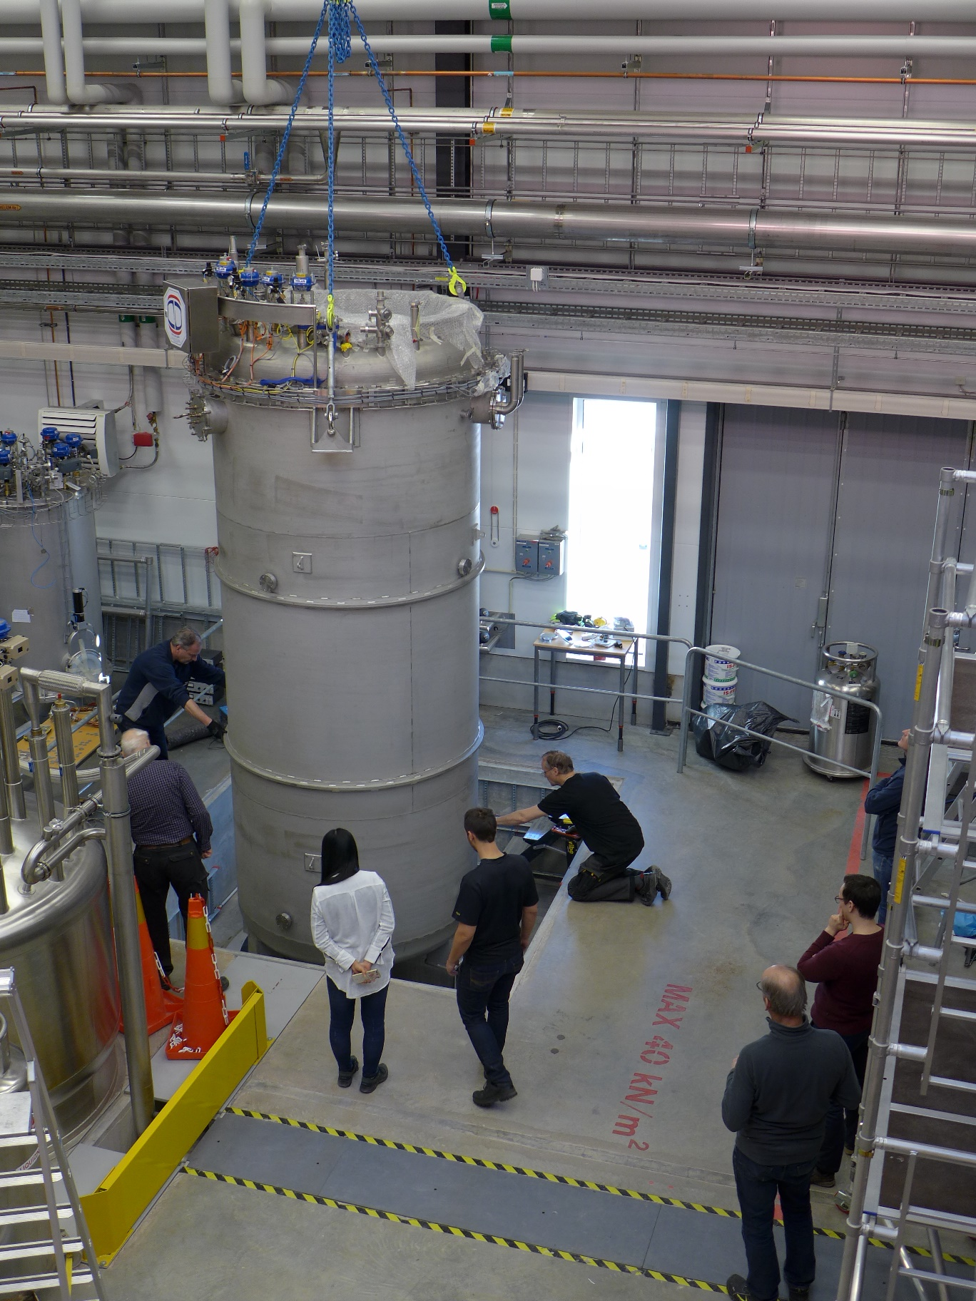
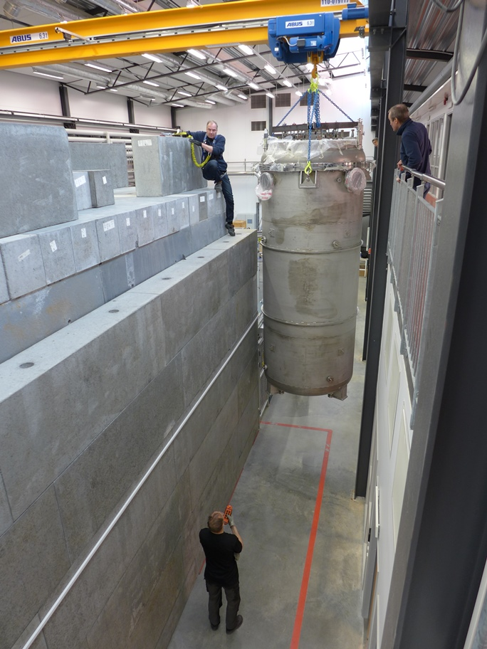
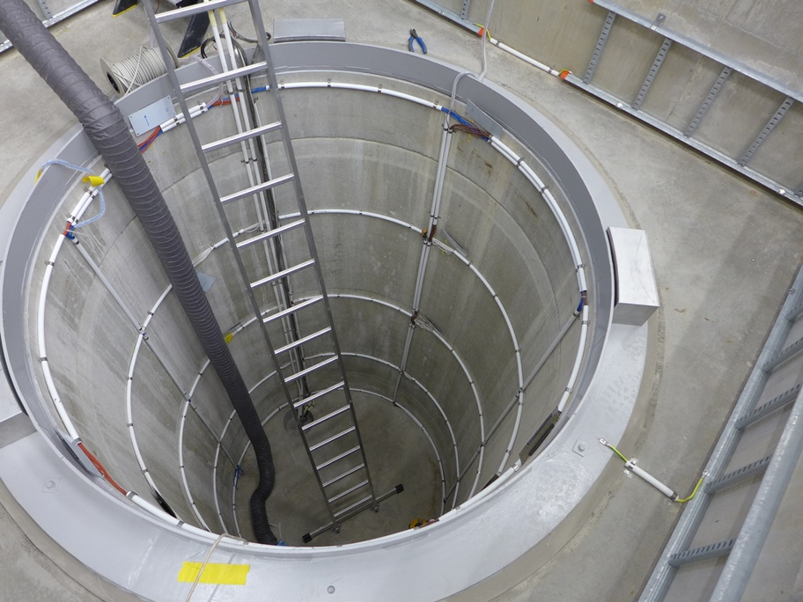
“Gersemi” Arrival & Positioning
05-Mar-2018 (081030)
Gersemi arrival at FREIA
15-Mar-2018 (P1040500)
13-Mar-2018 (P1040470)
16-Mar-2018 (P1040527)

Slide 7
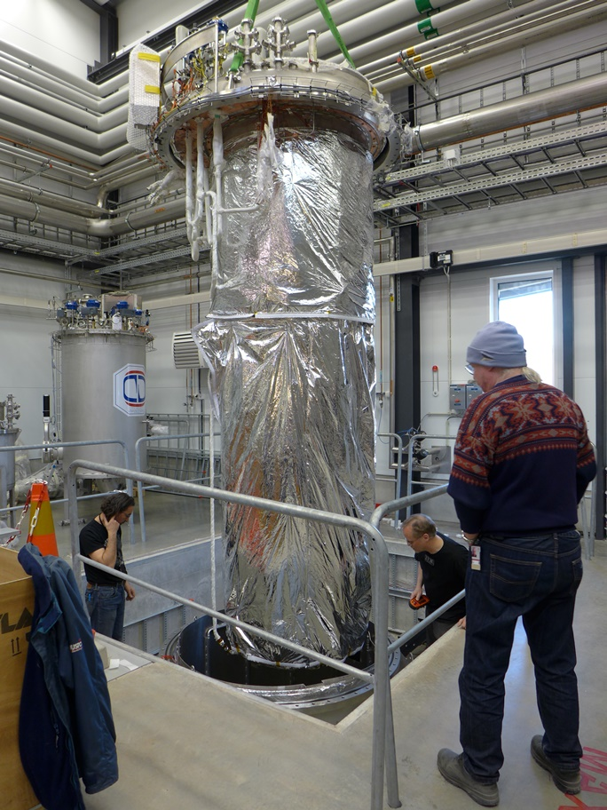
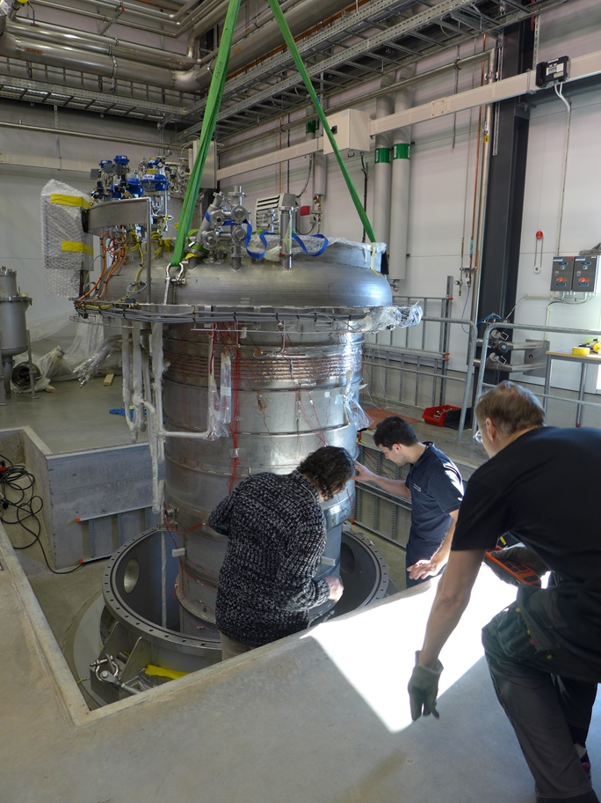
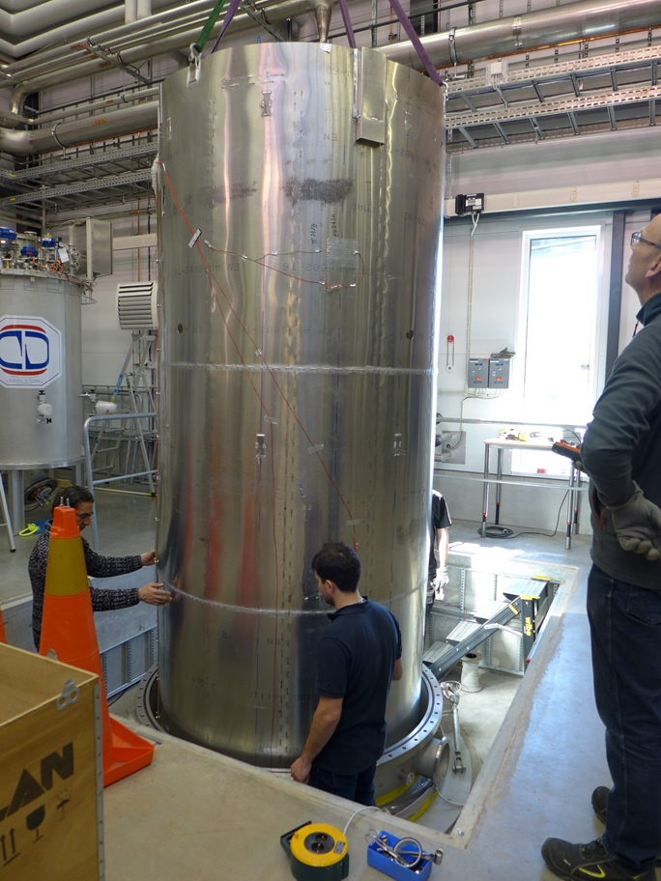
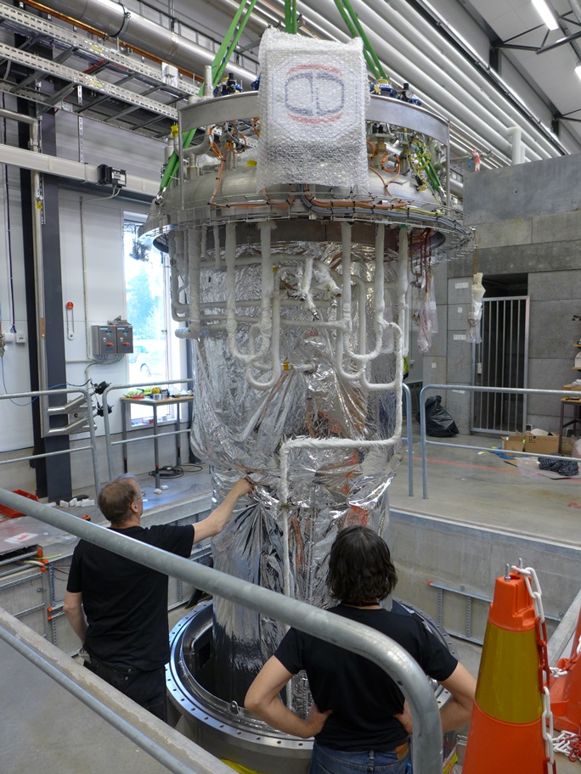
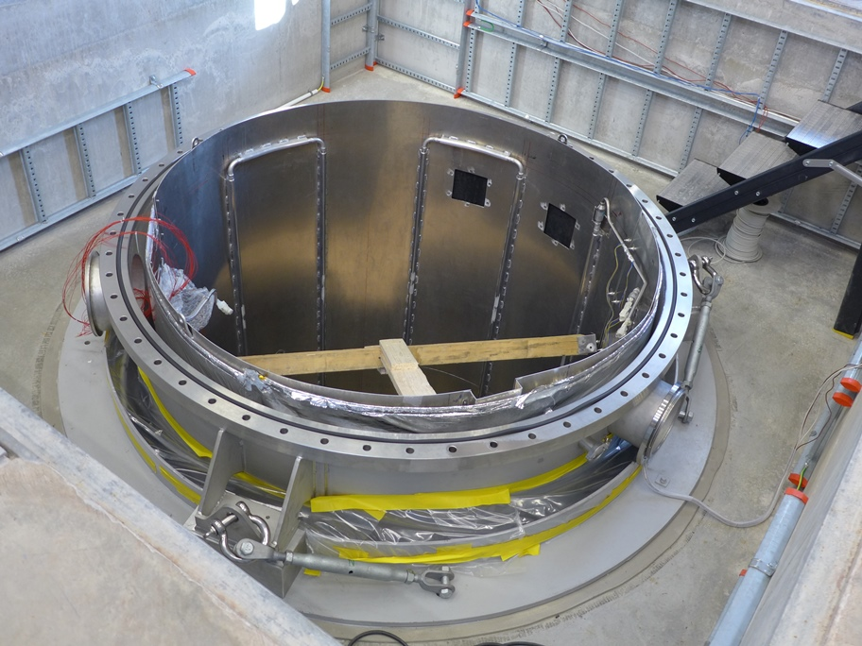
“Gersemi” Cryostat Re-assembly
28-Mar-2018
(P1040611)
21-Mar-2018 (P1040559)
22-Mar-2018
(P1040588)
27-Mar-2018 (P1040592)
28-Mar-2018 (P1040616)

Slide 8
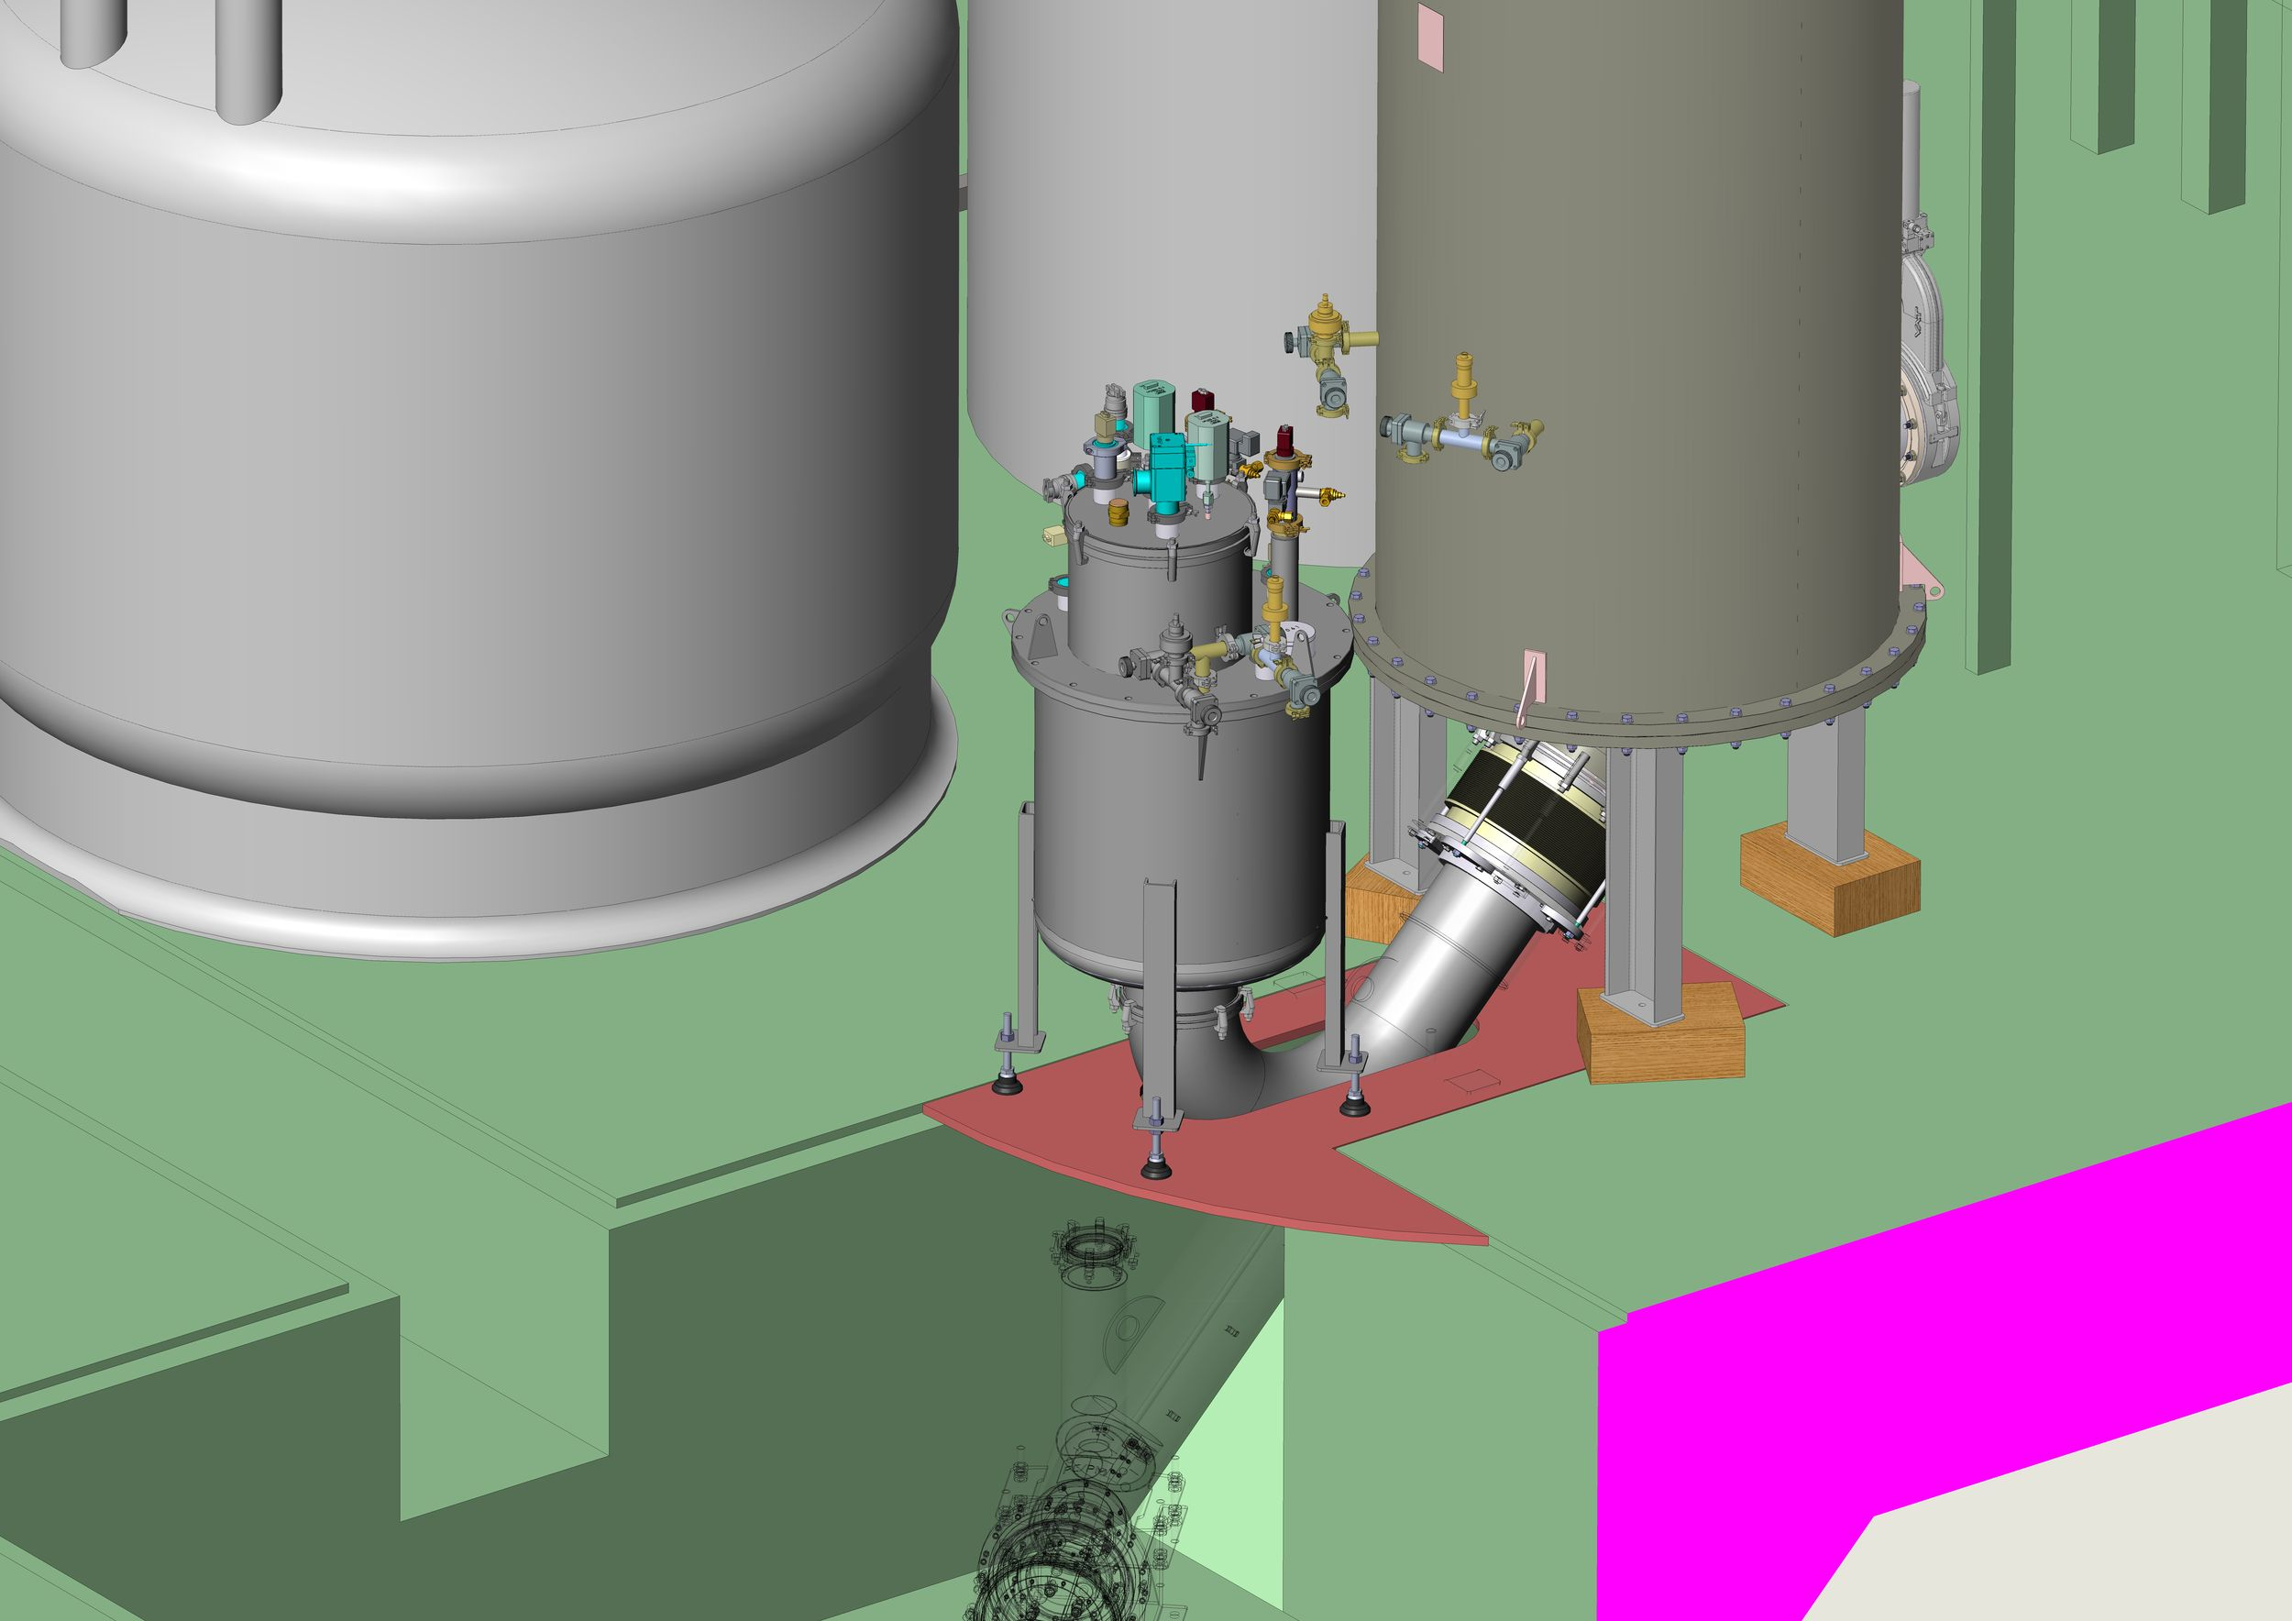
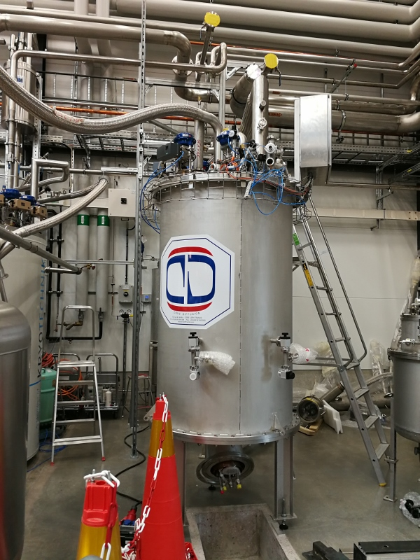
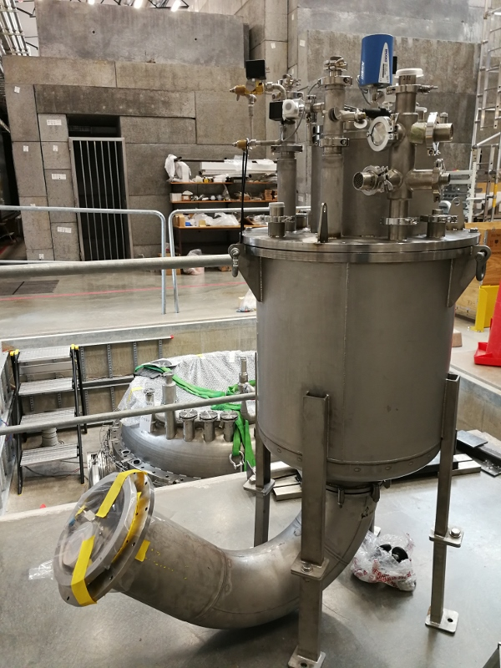
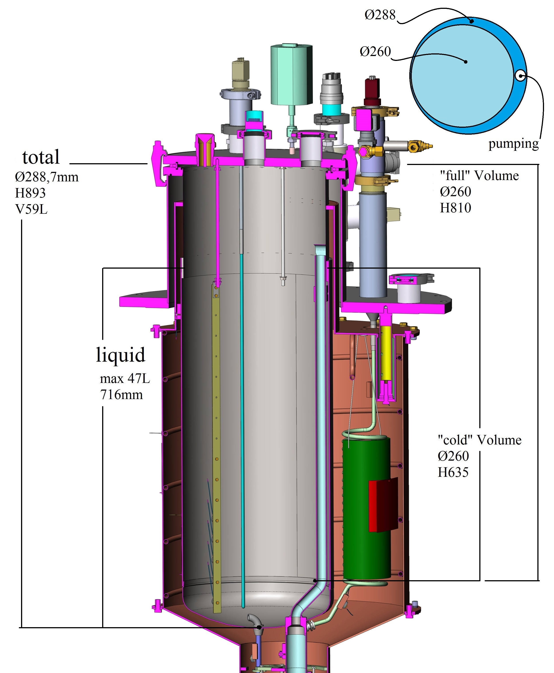
“µGersemi” Simulator & Valve Box
“µGersemi” simulator
60 l cryostat for system test
“µGersemi” simulator
2-May-2018 (100425)
helium distribution
cold box
2-May-2018 (100442)

Slide 9
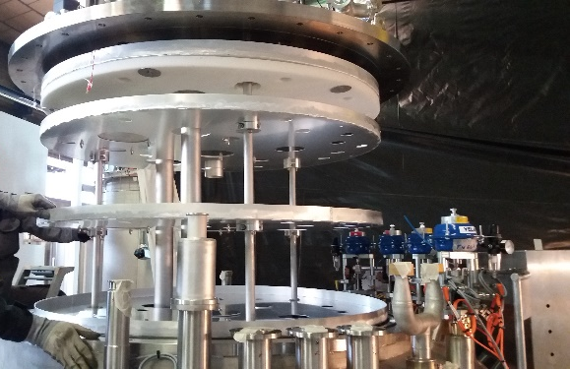
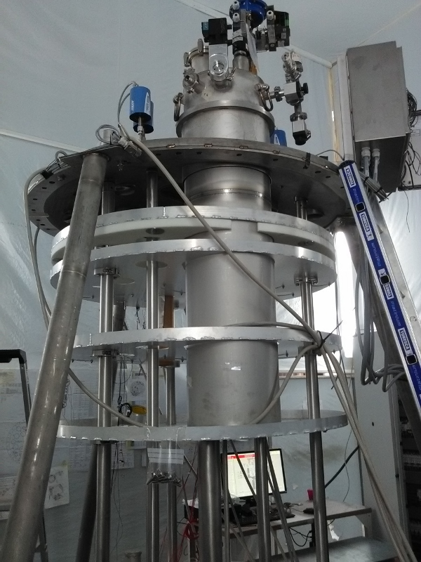
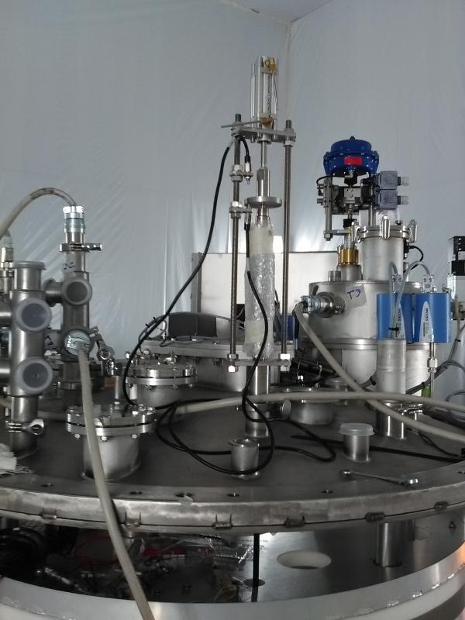
“Gersemi” Inserts
Liquid (Saturated) Bath Insert
Pressurized Bath Insert
(sub-)atmospheric liquid bath
mainly for SRF cavities
pressurized liquid bath
  2K heat exchanger
mainly for (small) SC magnets
  magnet + insert max 6 ton
  nominal operation 4 barG max.
    max. stored energy ~500 kJ
  ports for current leads
    4x 2kA current leads (ordered)
  central oval port for field measurement
    field measurement system itself not yet foreseen
Liquid Bath Insert
Delivery by end May
2-May-2018
Magnet Insert
No vacuum insert (yet) → use HNOSS

Slide 10
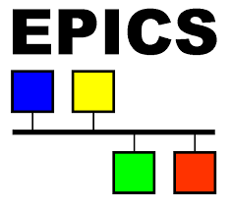
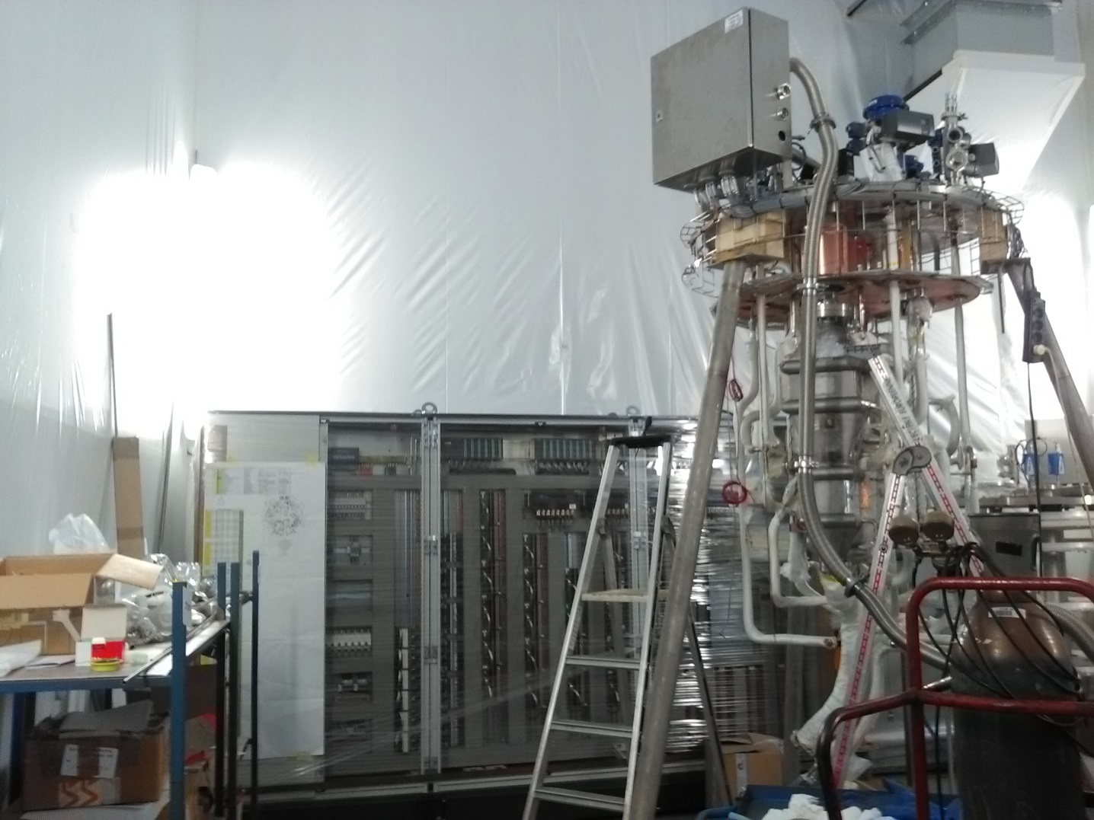
Controls, Powering, Safety
Controls & Monitoring System
Magnet Powering System
cryostat/valve box
  Siemens PLC
  NI cRIO (safety interlocks)
  EPICS interface with data archiver
  connecting different sub-systems:
  cryogenics, cryostats, ...
factory tests
  with valve box & simulator box performed during end 2017-begin 2018
magnet
  CERN type
2x 2kA
  CERN type power converters
switch and power extraction unit
  CERN type
Opened valve box & electrical cabinet
26-Oct-2017
Talk by Kevin Pepitone
Tue. 5-May 17:05

Slide 11
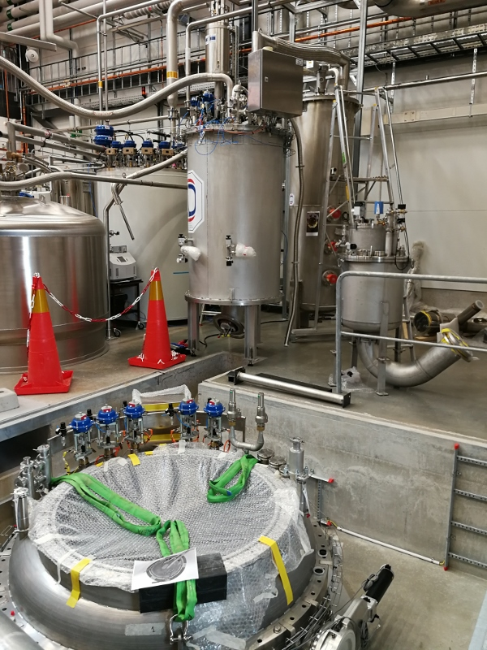
Summary
“Gersemi” at FREIA
commissioning after summer,
builds on a long tradition,
is a young player in magnet testing,
but working hard to contribute to
the community.

Slide 13
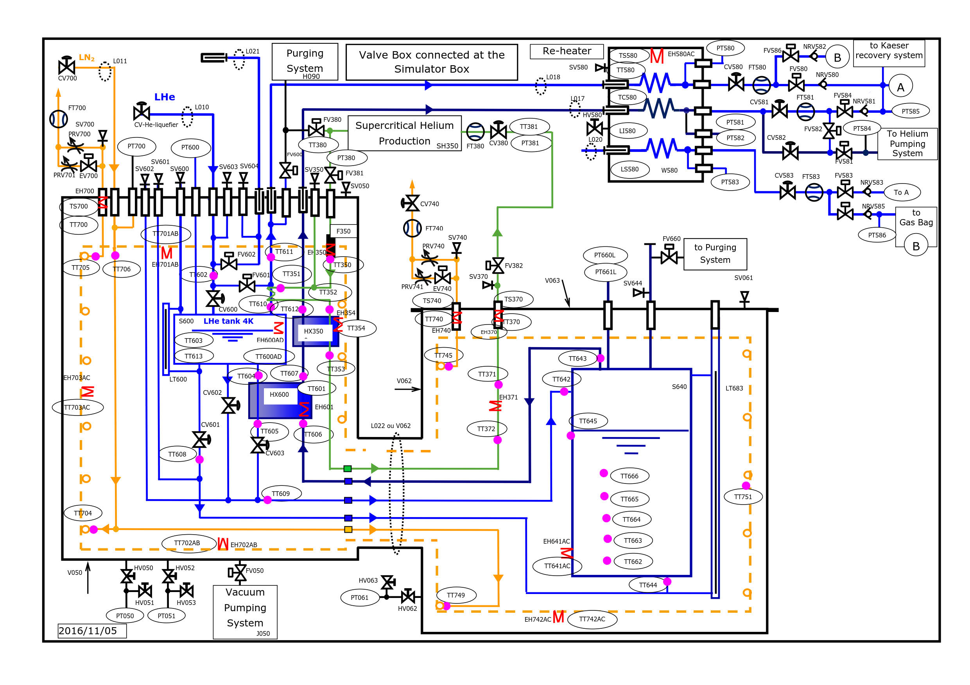
“Gersemi” Operation - “µGersemi”
LHe System
Valve Box
Vertical Cryostat

Slide 14
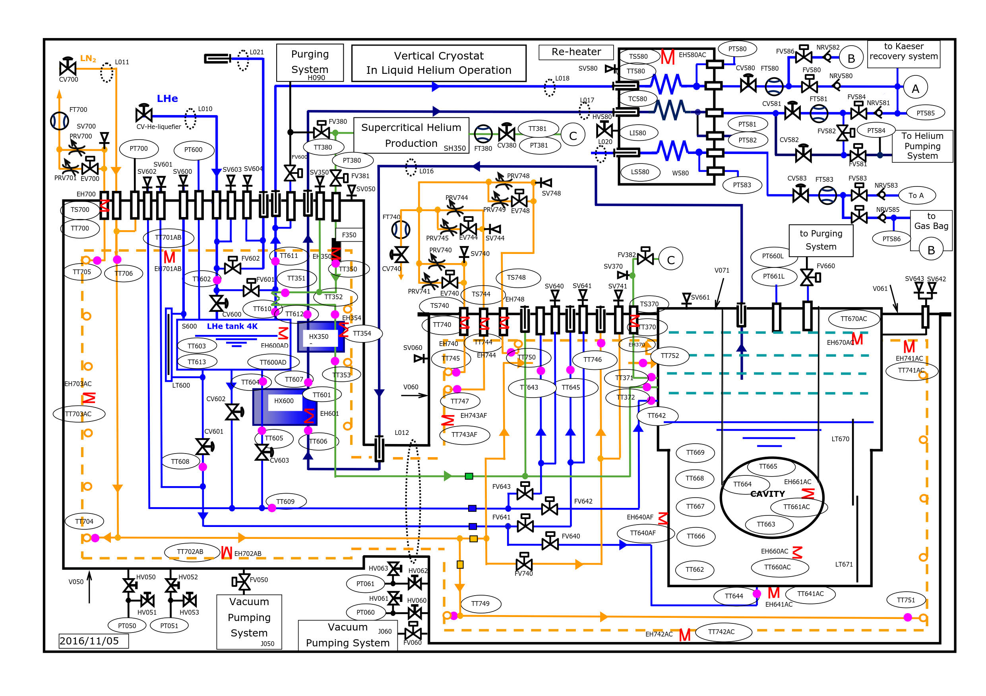
“Gersemi” Operation – Saturated Bath
LHe System
Valve Box
Vertical Cryostat

Slide 15
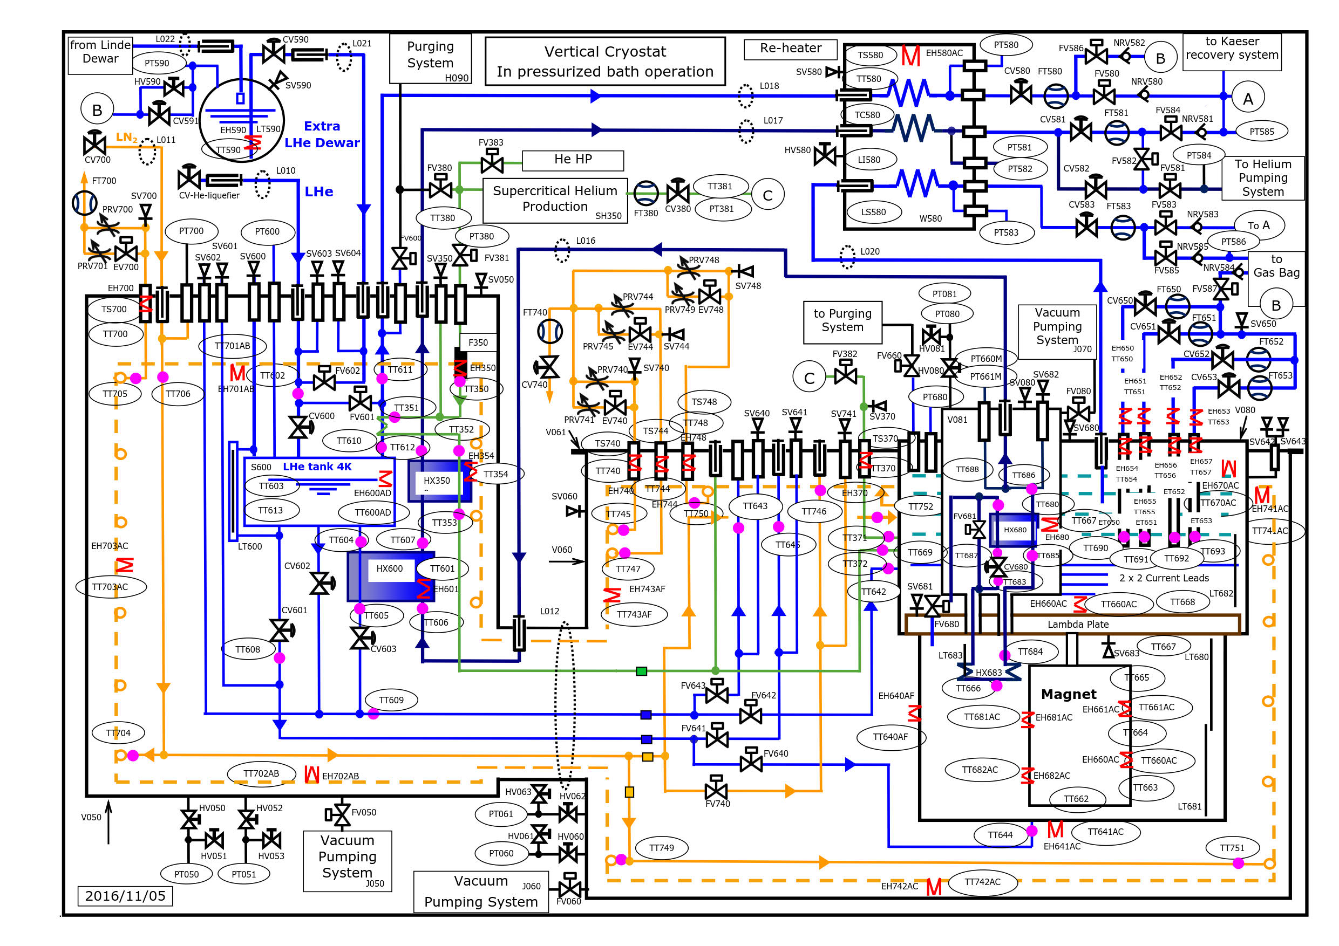
“Gersemi” Operation – Pressurized Bath
LHe System
Valve Box
Vertical Cryostat

Slide 16
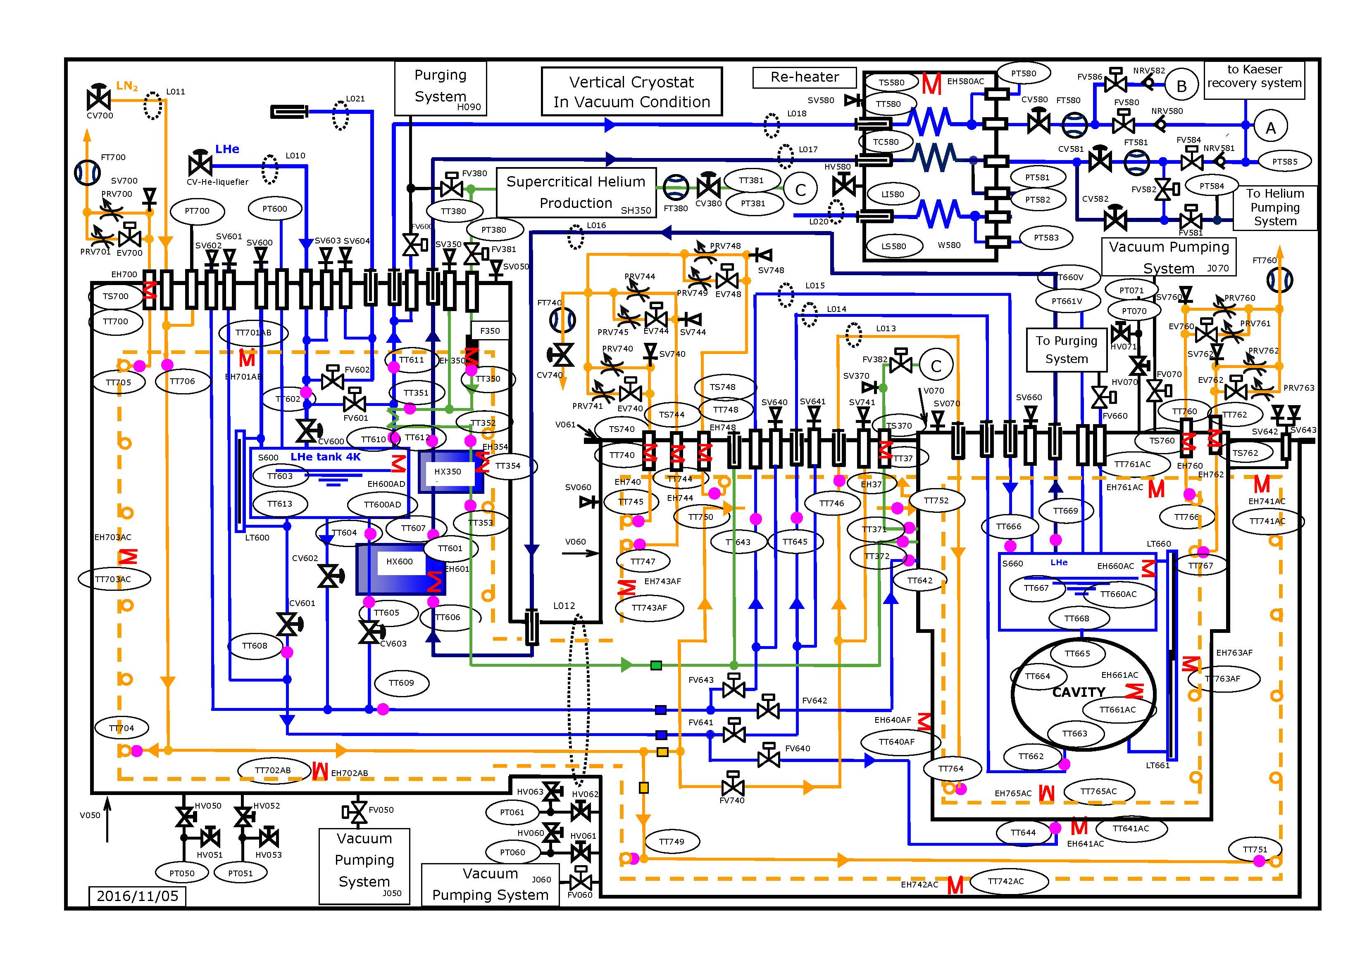
“Gersemi” Operation – Vacuum
LHe System
Valve Box
Vertical Cryostat

