Slide 1
Quench protection:
CLIQ and Quench heaters
Vittorio Marinozzi
2nd International Magnet Test Stand Workshop
8-9 May, 2018

Slide 2
Outline
Quench protection of high-energy magnets
Quench heaters: working mechanism
CLIQ: working mechanism
Quench heaters vs CLIQ
Conclusions

Slide 3
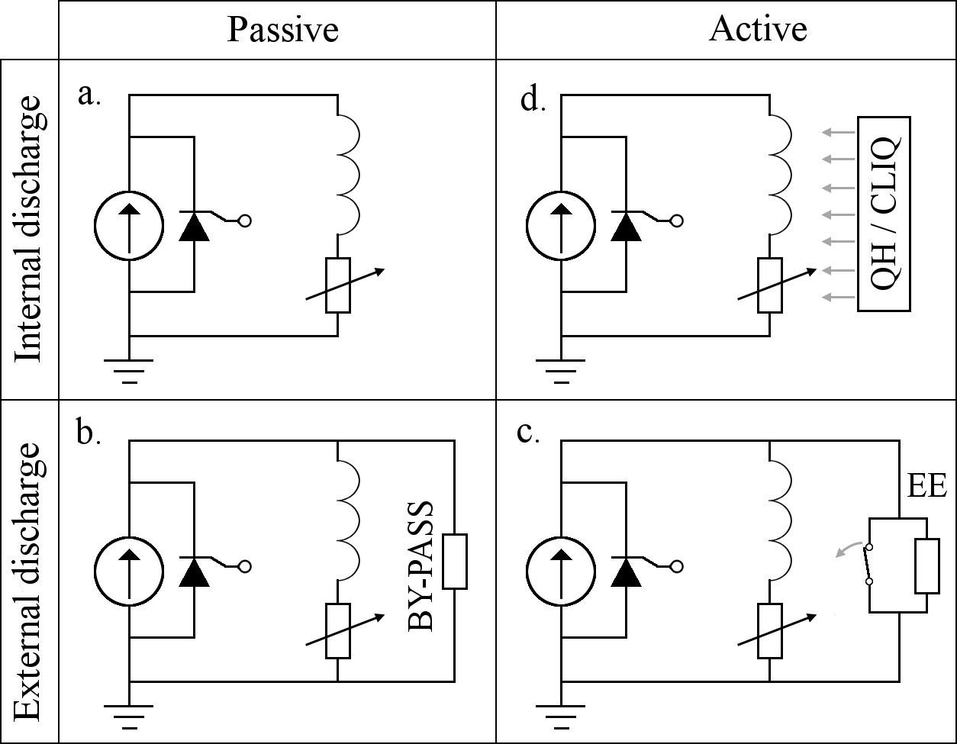
Quench protection of high-energy magnets
During a quench, the electromagnetic energy stored into the magnet is dissipated into the normal zone (usually, small volume)
First approach: extract the energy
EE is limited by the voltage (~ 1 kV)
For high-energy magnets, this method is generally not sufficient to ensure protection
Need of active methods: CLIQ and quench heaters
Courtesy of E. Ravaioli

Slide 4
Quench protection of high-energy magnets
CLIQ and quench heaters are active methods to protect the magnet
Main goal: induce a quench in the largest volume as possible
Energy is not extracted, but it is dissipated inside the magnet
Average temperature is increased, but hot spot temperature is reduced

Slide 5
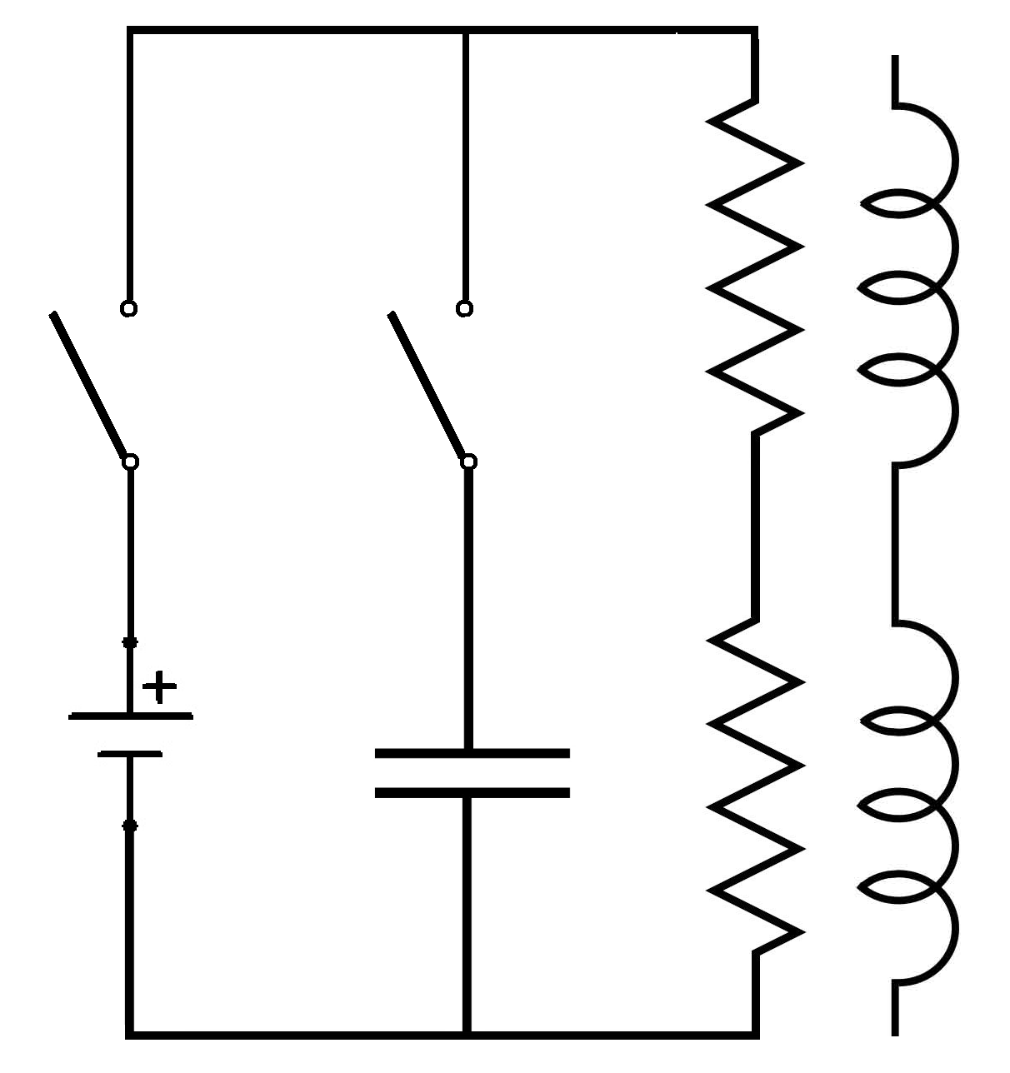
Quench Heaters: working mechanism
Quench heater is basically an RC circuit
I ≈ 100-500 A
τ ≈ 100 ms
R1
Heater Firing Unit
(HFU)
Test station
S1
S2
Coil
Magnet
C
V₀
R2

Slide 6
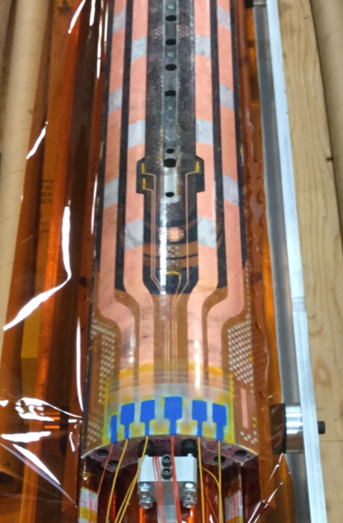
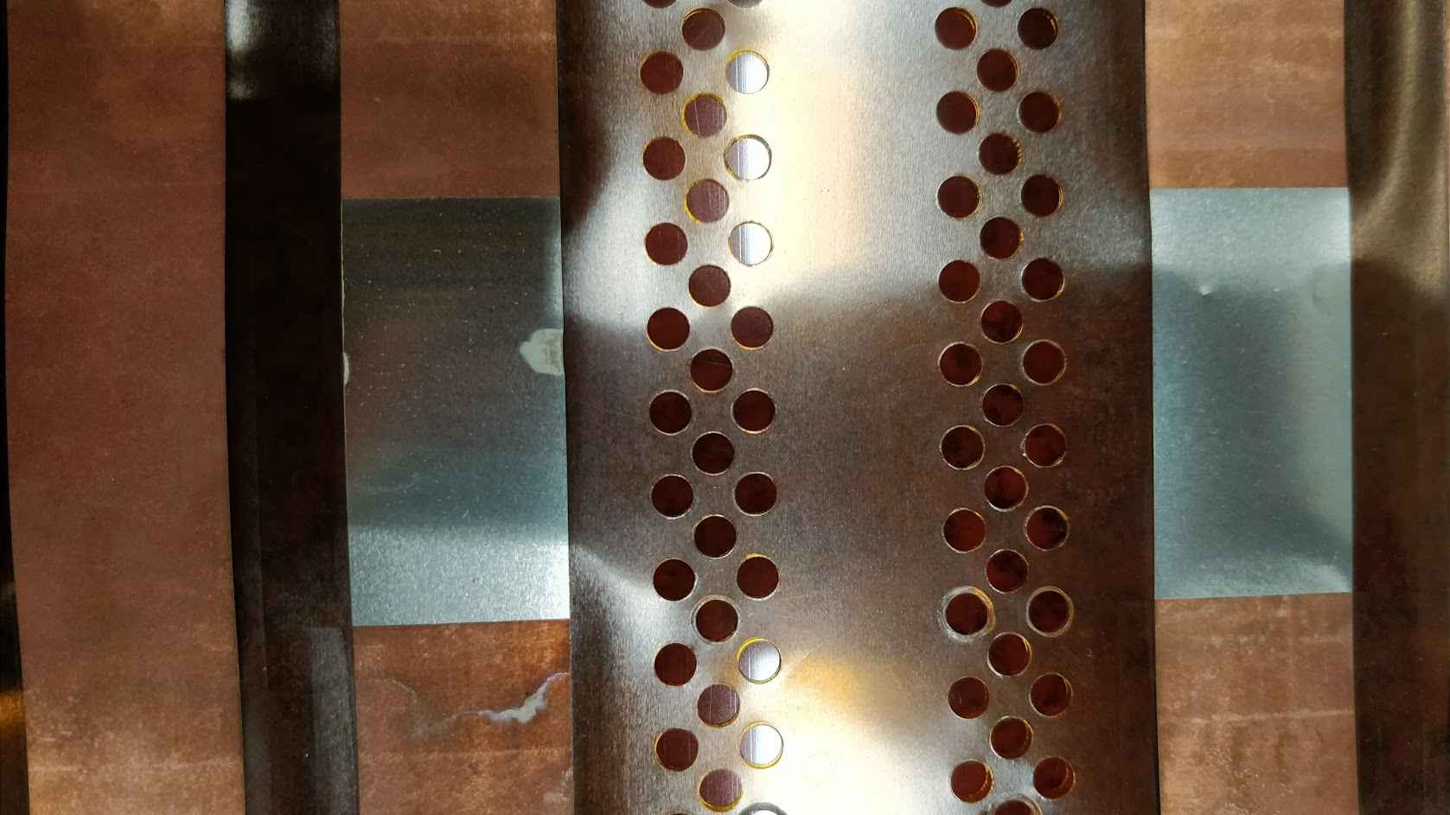
Quench Heaters: working mechanism

Slide 7
Quench Heaters: working mechanism
The quench heater efficiency depends on:
  HFU capacitance
  Voltage
  Number of HFUs
  Heater-coil insulation thickness
  Heater strips resistance
  Heater strips design and position
  Heater strips degradation
  Conductor properties
Combination of test stand availabilities and magnet design

Slide 8
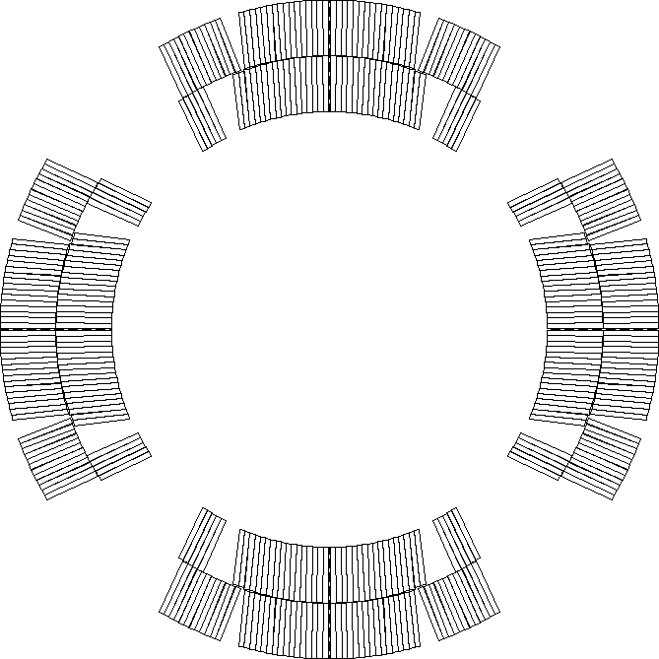
Quench Heaters: working mechanism
Example: MQXFAP1 at BNL
24 heater strips
12 HFUs
HFU voltage: 600 V (± 300 V)
HFU capacitance : 12.4-14 mF
Heater strip resistance: 1.7-1.1 Ω (10 K)
Peak power density: 100 - 210 W/cm²
Time constant: 50-30 ms
Insulation thickness: 50 µm
Quenching time: 7 - 30 ms

Slide 9
CLIQ: working mechanism
CLIQ: Coupling Loss Induced Quench
CLIQ exploits the coupling currents between filaments and strands, in order to induce a spread quench in the whole magnet
Main advantage: more effective heat deposition with more robust electrical circuit

Slide 10

Current change
Patent EP13174323.9
CLIQ – Coupling-Loss Induced Quench system
Courtesy of E. Ravaioli
Magnetic field change
Transitory losses (Heat)
Temperature rise
QUENCH

Slide 11
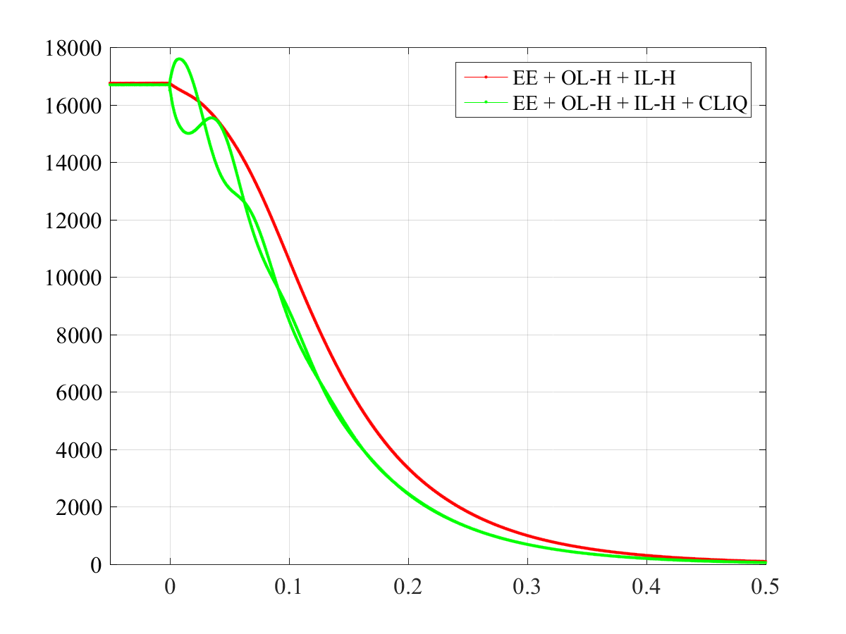
CLIQ: working mechanism
I ≈ 1-2 kA
τ ≈ 100 ms

Slide 12
CLIQ: working mechanism
The CLIQ efficiency depends on:
  CLIQ capacitance
  CLIQ charging voltage
  Number of CLIQ units
  Number and position of the CLIQ connections on the magnet
  Magnet size
  Magnet geometry
Combination of test stand availabilities and magnet design

Slide 13
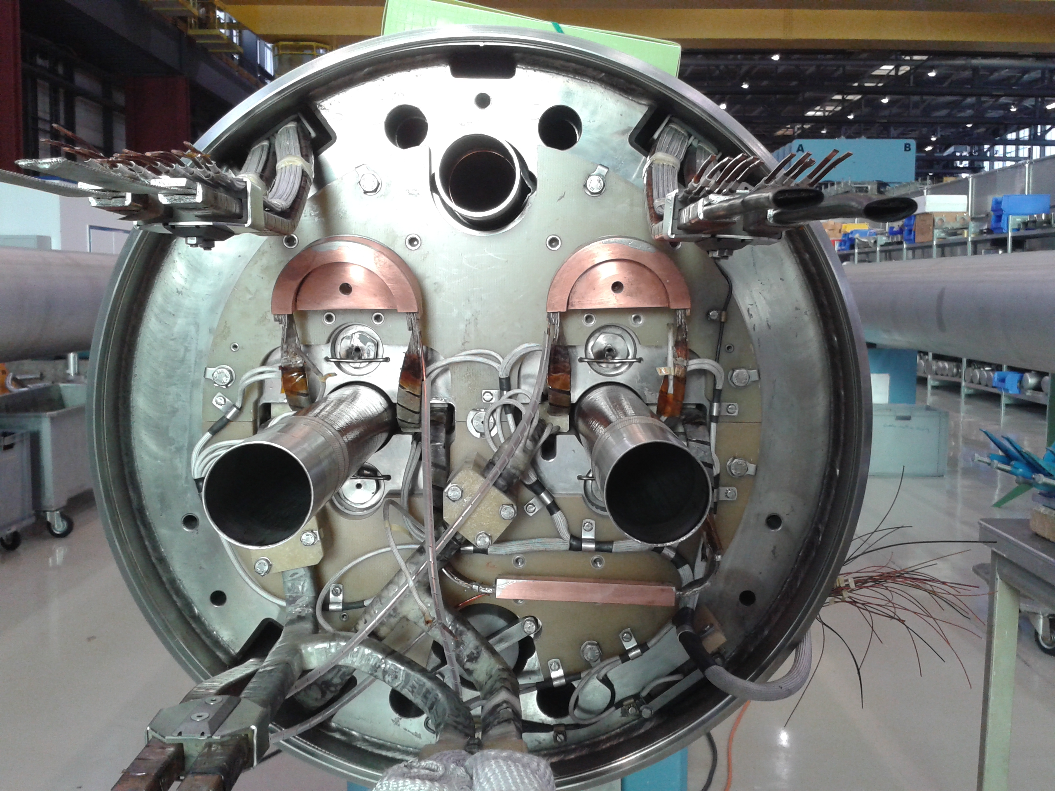
CLIQ: working mechanism
CLIQ UNIT
LHC full size main dipole

Slide 14
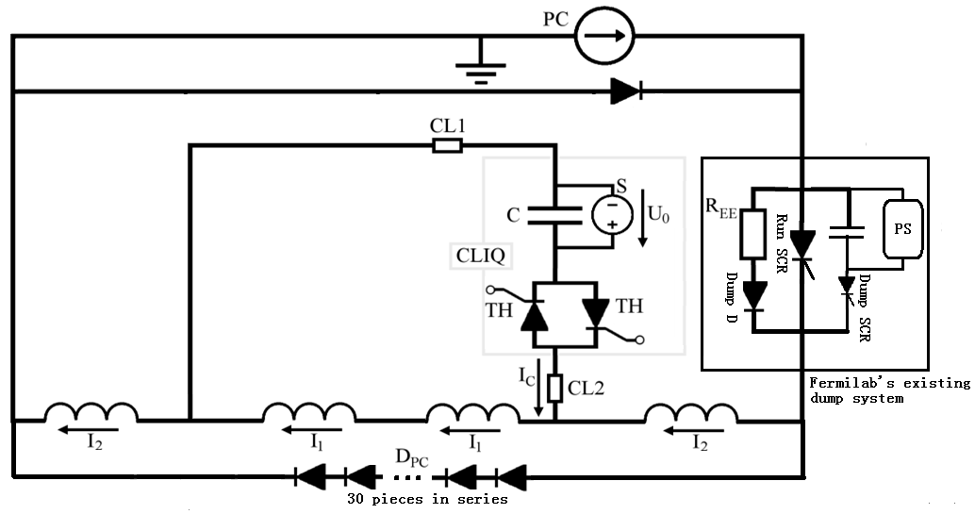
CLIQ: working mechanism
Example: commissioning at FNAL for MQXFS
CLIQ unit
Diodes to avoid reverse current in PS during CLIQ test

Slide 15
CLIQ: working mechanism
Cliq has been successfully tested on several magnets:
MB (spare LHC main dipole)
MQY (spare LHC individually powered quadrupole)
MQXC
HQ02
MQXFS1, MQXFS3, MQXFS5
MQXFAP1
11 T dipole
Small-scale solenoid
Small-scale HTS coil

Slide 16
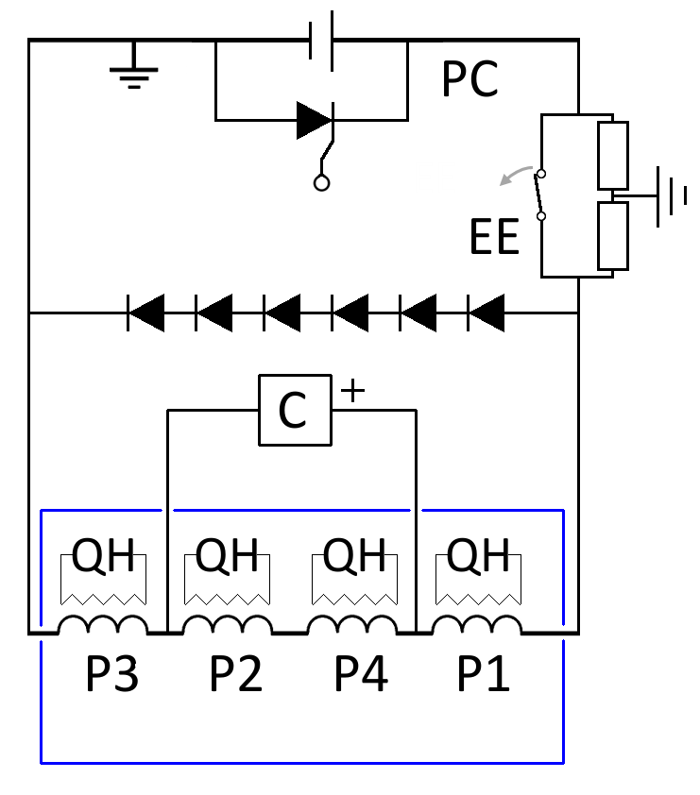
CLIQ: working mechanism
Example: MQXFAP1 at BNL
  1 CLIQ unit
  CLIQ capacitance: 40 mF
  CLIQ charging voltage: 500 V
  MIITs reduction respect to QH: ~15 %

Slide 17
Quench Heaters vs CLIQ
Simple implementation in the test station
Quench heater circuit independent on the magnet circuit
Redundant
Independent on length
Damaged strips cannot be repaired
High voltage components very close to coils
Risk of shorts with coils
Bubbles when in contact with helium
QUENCH HEATERS
More efficient to induce quench
Electrically robust
External to the magnet
Easy to repair
Slightly dependent on conductor properties
Need to implement parallel components in the test station
Implementation in the circuit not trivial (especially with EE)
1 unit is fully not redundant
Effectiveness reduced with magnet length (short models do not fully demonstrate protection)
CLIQ

Slide 18
Conclusions
CLIQ and Quench Heaters are active protection systems, needed to protect high energy magnets
Quench Heaters implementation in a test station is relatively simple, but probability of electrical issues is larger
CLIQ is more robust and efficient, but the implementation in the test station circuit is not trivial
Just one CLIQ is not completely redundant, so it should be implemented together with a quench heaters system, or with other CLIQ units (complexity of circuit/connections)
  “Third generation” CLIQ units will ensure redundancy of all internal components
Presence of HFUs in a test station today is mandatory to test large magnets. Adding a CLIQ unit ensures more efficiency and redundancy, and possibility to test more performing magnets in the future.

