Slide 1


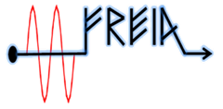

Quench detection and DAQ systems
Kévin PEPITONE
2nd International Magnet Test Stand Workshop
Brookhaven National Laboratory, 8-9 May 2018

Slide 2




Outline
FREIA
  Presentation of Gersemi
  Magnets to be tested at FREIA
Equipment connected to the magnets
  General layout
Magnets protections
  Magnet protection
  Detailed layout, PotAim cards, Safety matrix
Acquisition systems
  DAQ
  DDM
  Software

Slide 3


FREIA
Gersemi

Slide 4
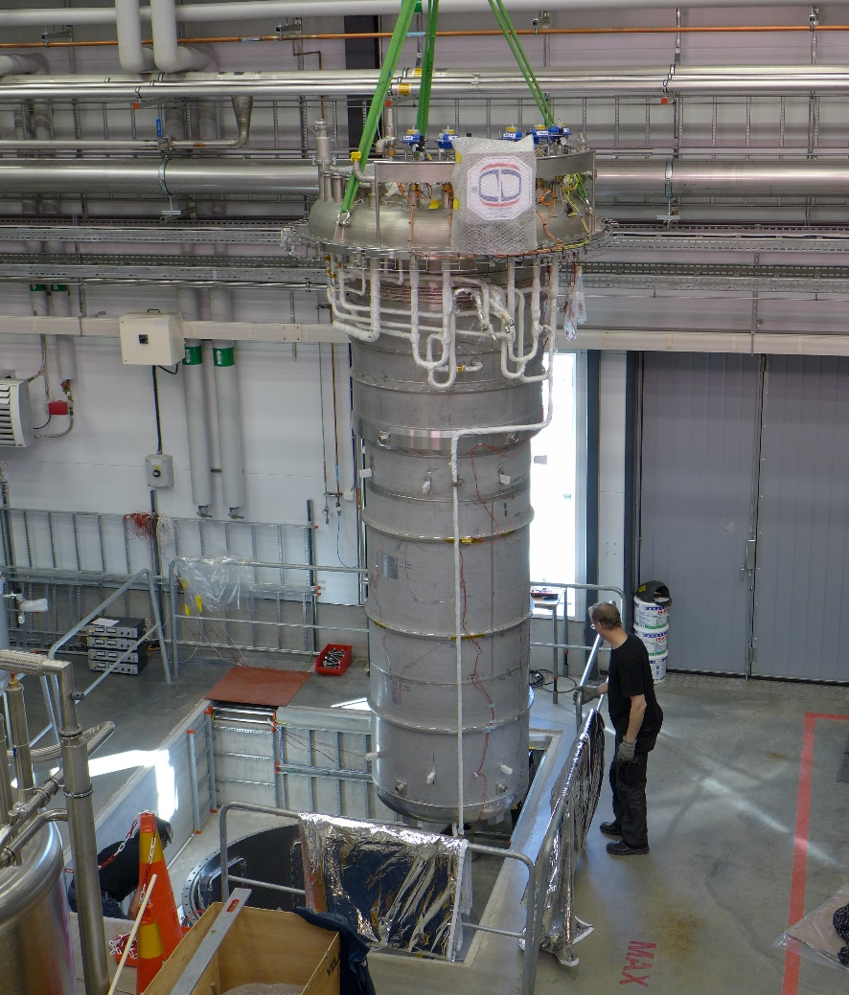
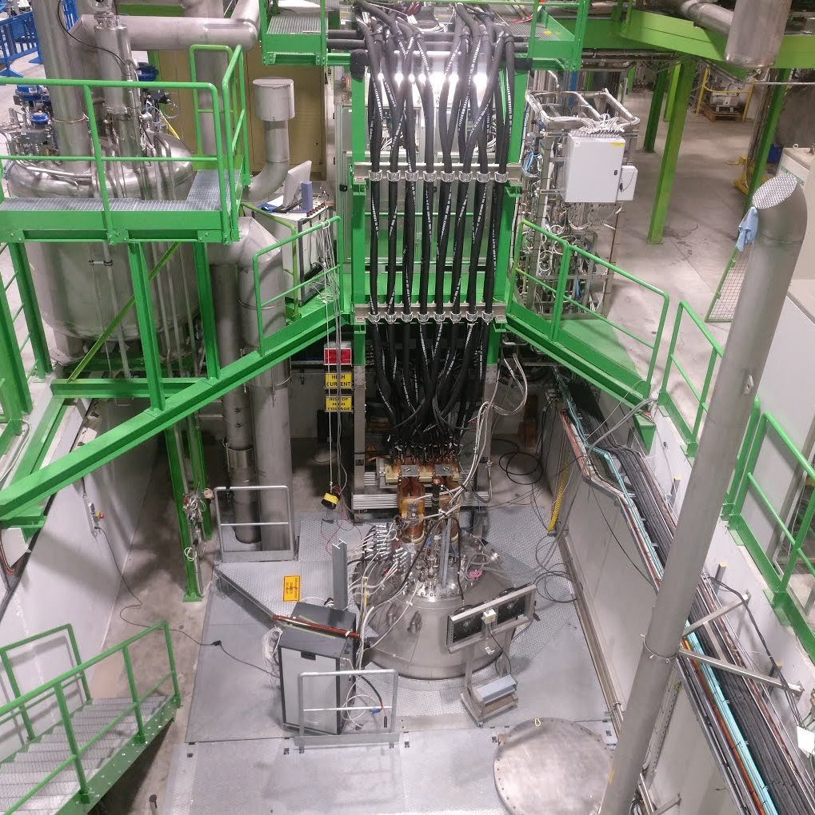
FREIA – Gersemi
What we have
What we want
Gersemi - FREIA
Cluster D - CERN

Slide 5
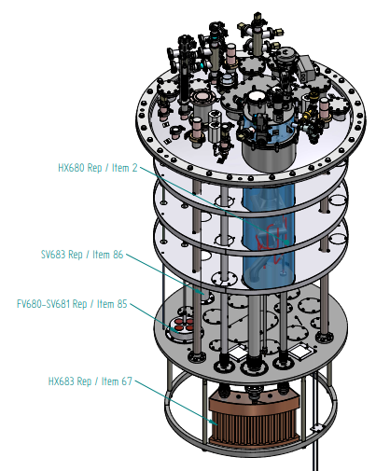
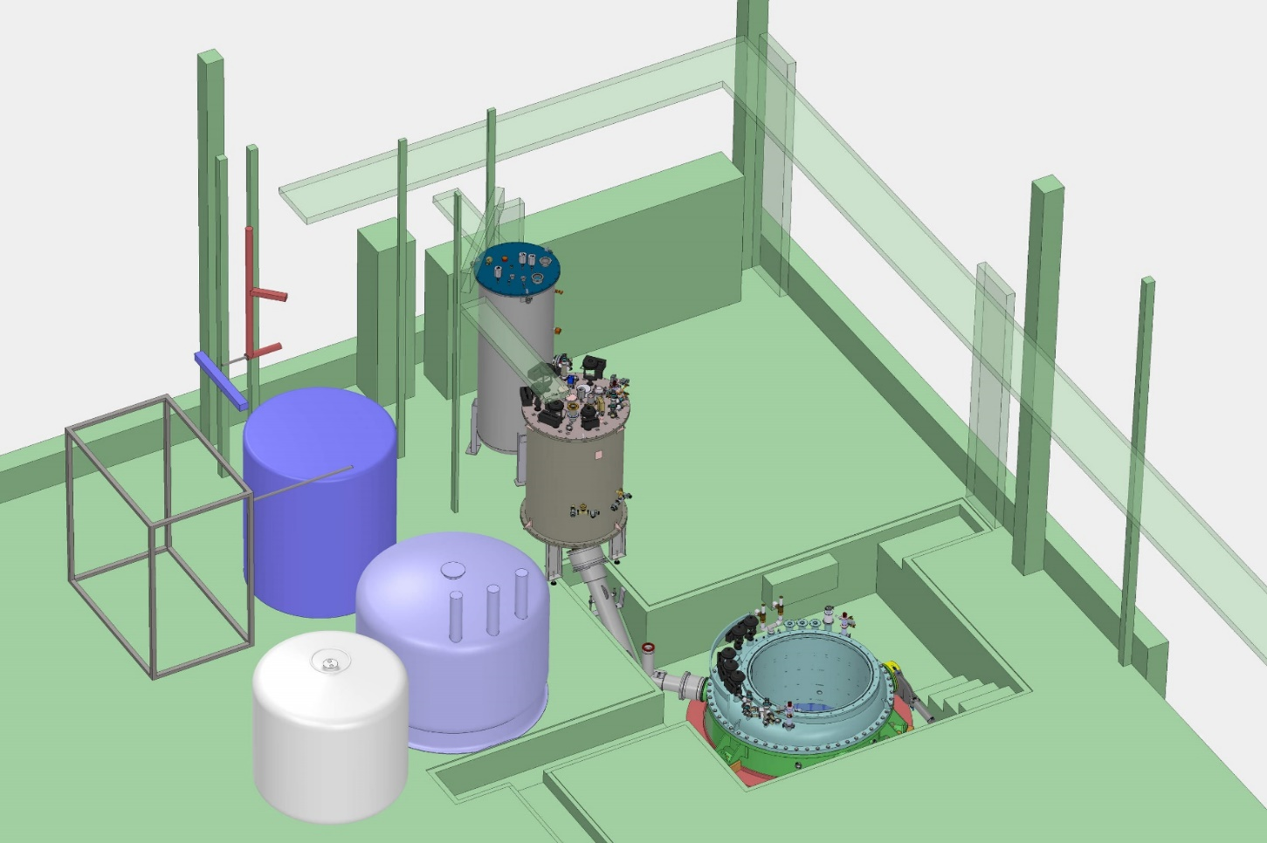
FREIA – Gersemi
Delivered later this month
Gersemi is a cryogenic test station, using a vertical cryostat and a powering circuit up to 2x2 kA, with EE based on fast switches and dump resistor
Delivered
Reheater
Liquifier
ValveBox
Dewar
Cryostat
Bottle
Diameter: 1.1 m
Total length: 3.2 m
Length below the lambda plate: 2.65 m

Slide 6
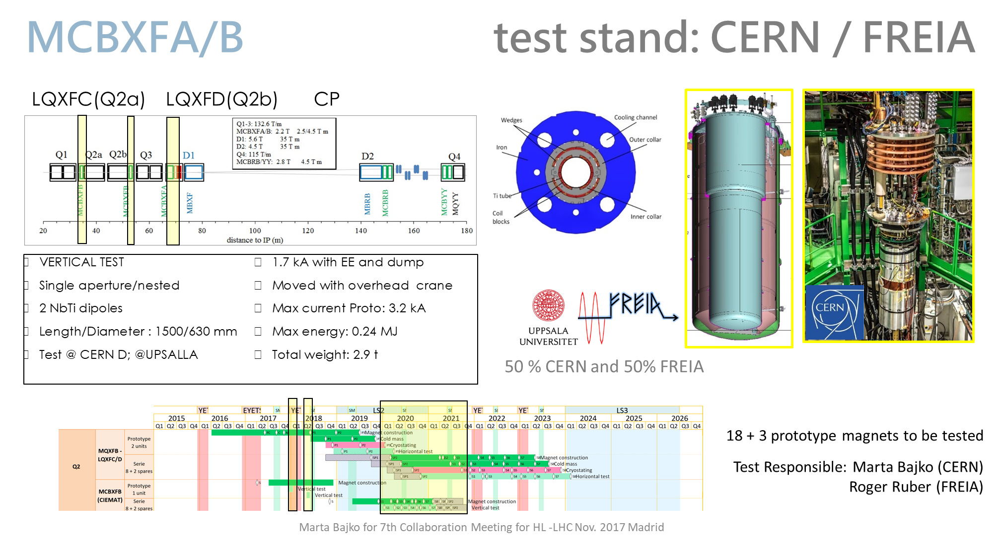
FREIA – Magnets to test
Kevin Pepitone (FREIA)

Slide 7
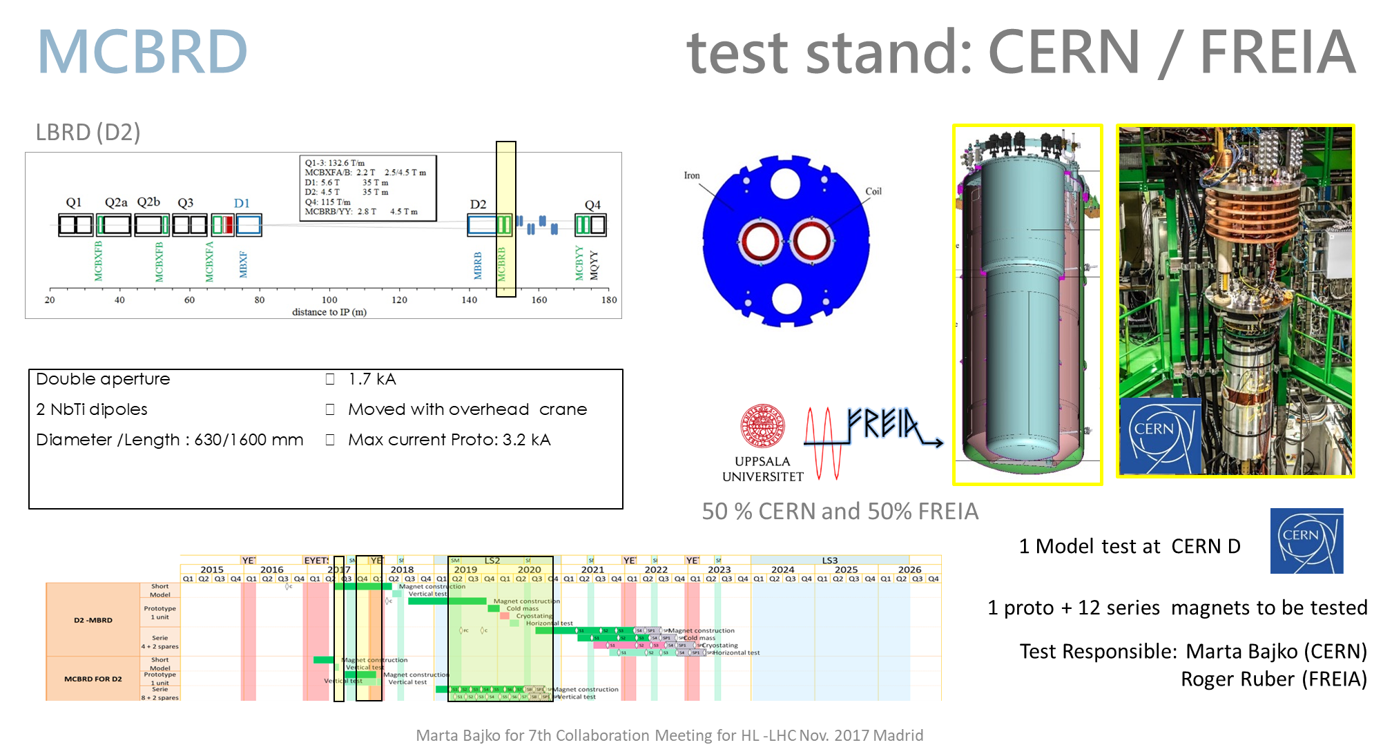
FREIA – Magnets to test
Kevin Pepitone (FREIA)

Slide 8
Equipment connected to the magnets

Slide 9
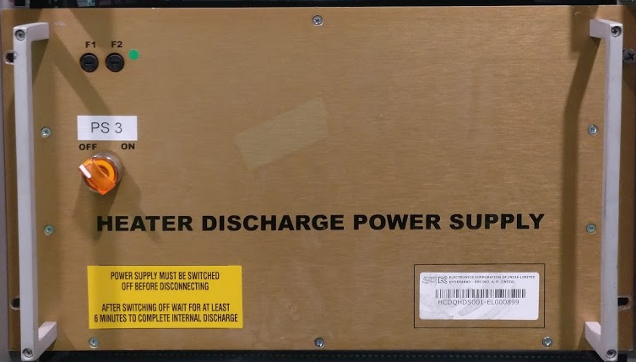
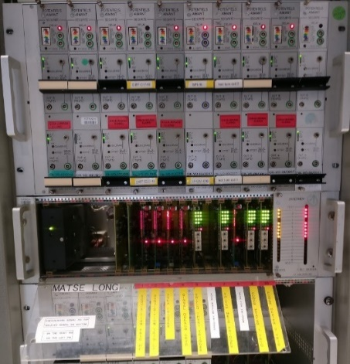
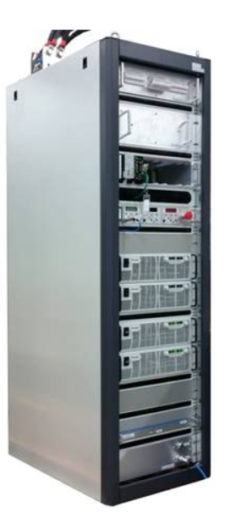
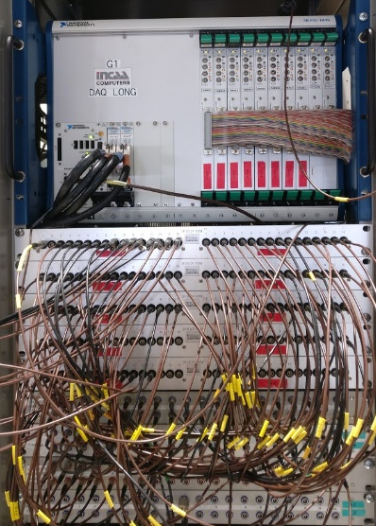
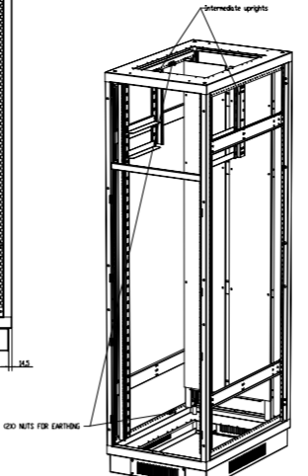
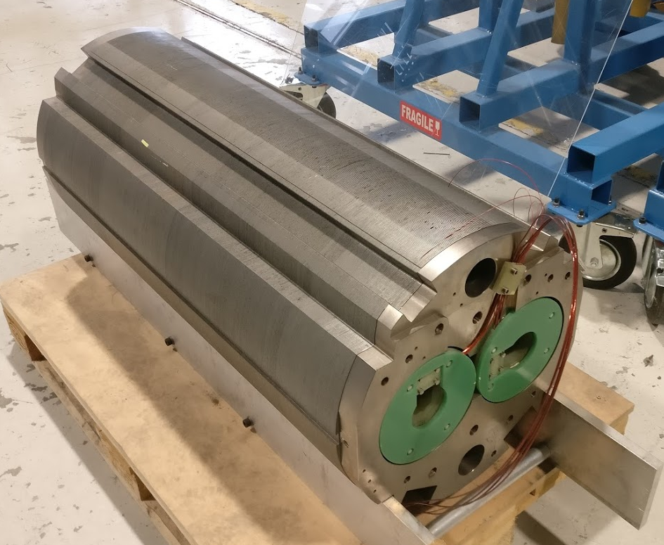
Equipment – Layout

Slide 10
Magnet protection

Slide 11
Magnet protection – Introduction
A quench happens when the superconductor goes from superconductive state to resistive state
To detect a quench, we use Vtaps on the magnets and electronics to trigger the power converters, energy extraction, quench heaters and acquisition systems
Direct voltage:
V_{sum} = (V₁ + V₂ + V₃ + V₄)
Differential voltage:
V_{diff(1-2)} = (V₁- V₂ )
V_{diff(3-4)} = (V₃- V₄ )
V_{diff(1,2-3,4)} = (V₁+ V₂ )-(V₃+ V₄ )
Current derivative:
V_{res} = V₁+ V₂-(L₁+L₂)dI/dt
V_{diff(1-2)} = (V₁- V₂ )
Fixed
delay
Adjustable
delay
t_{Validation}
V_{threshold}
Notes:
Vtaps are symmetrically installed on the magnet, the signal used to protect the magnet is the difference of two voltages.
By measuring differentially, the common mode signal (e.g. inductive voltage during current injection) is mostly suppressed so that only resistive voltage remains in the resulting signal.
In case of a differential protection method, a non-symmetric quench is characterized by a continuous rise (or fall) of the voltage. In case of symmetric quench the resistance may grow in both voltages and never reach the threshold. This symmetric case is typically protected for a magnet with four identical parts by measuring multiple differential coils (i.e. (1+2)-(3+4)).
In case a magnet has only two identical parts or even only one single coil, the current derivative method may be needed. If a symmetric quench occur as shown in Figure 4 we’ll be able to detect this by subtracting the inductive voltage to the total voltage of the magnet but not with the Vdiff.

Slide 12
Equipment – Detailed layout
A double aperture quadrupole
Signal higher than the threshold for a time longer than the validation time
The total number of signals is 12

Slide 13
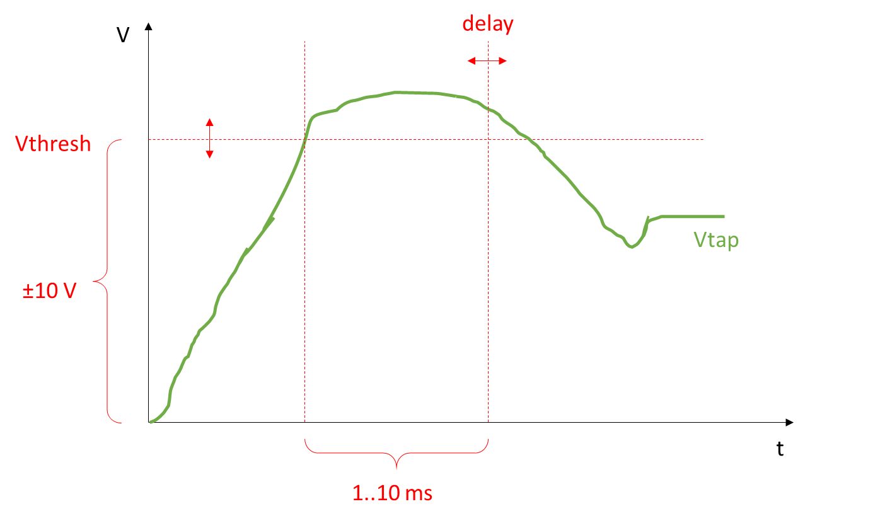
Equipment – PotAim cards
PotAim v3
PotAim VT
Notes:
When a current ramp is applied to superconducting magnets made of Nb₃Sn, voltage spikes of hundreds of millivolts called flux jumps appear at relatively low currents. To avoid tripping the protection during magnet tests, an adaptive voltage threshold in function of the magnet current will be required
If the absolute value of the voltage surpasses the detection threshold and remains above threshold during the validation time, a quench is detected and a Quench Detection Signal is issued

Slide 14
Acquisition systems

Slide 15
Acquisition systems - Settings

Slide 16
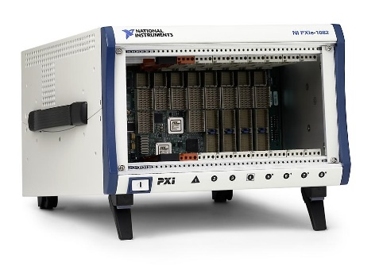
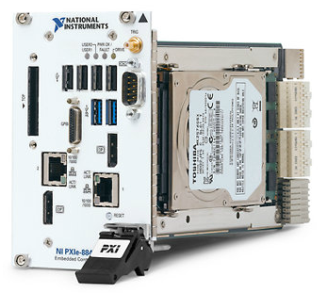
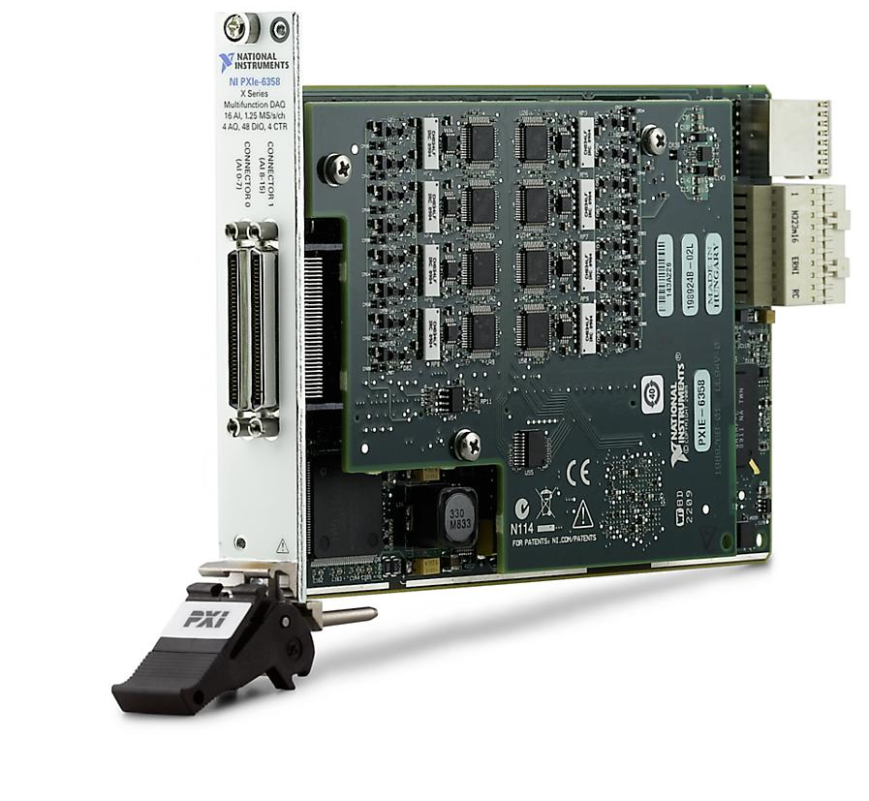
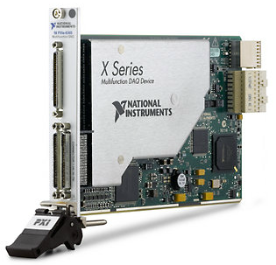
Acquisition systems - NI DAQ
PXIe-1082: Chassis
4 hybrid slots, 2 PXI Express slots, 1 PXI Express system timing slot
High performance - up to 2 GB/s per slot dedicated bandwidth and 8 GB/s system bandwidth
Compatibility with PXI, PXI Express, CompactPCI, and CompactPCI Express modules
PXIe-6358: I/O card
16 simultaneous analog inputs at 1.25 MS/s/ch with 16-bit resolution; 20 MS/s total AI throughput
Four analog outputs, 3.33 MS/s, 16-bit resolution, ±10 V
48 digital I/O lines (32 hardware-timed up to 10 MHz)
Four 32-bit counter/timers for PWM, encoder, frequency, event counting, and more
Analog and digital triggering and advanced timing with NI-STC3 technology
PXIe-6365: I/O card
144 analog inputs, 2 MS/s 1-channel, 1 MS/s multichannel; 16-bit resolution, ±10 V
2 analog outputs, 2.86 MS/s, 16-bit resolution, ±10 V
24 digital I/O lines (8 hardware-timed up to 10 MHz)
Four 32-bit counter/timers for PWM, encoder, frequency, event counting, and more
Analog and digital triggering and advanced timing with NI-STC3 technology
PXI-8840: CPU
2.6 GHz quad-core Intel i7-5700EQ or 2.7 GHz dual-core Intel i5-4400E
4 GB (1 x 4 GB DIMM) single-channel 1600 MHz DDR3 RAM standard, 8 GB maximum
2 Gigabit Ethernet, 2 USB 3.0, 4 USB 2.0, ExpressCard (optional), and other peripherals

Slide 17
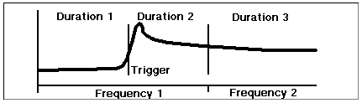
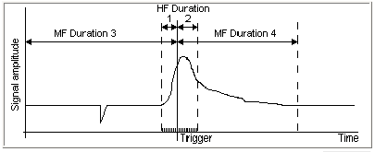
Acquisition system - Gersemi acquisition system
DAQ (16 bits) | HF | MF | LF
Maximum number of channels to be recorded | 16 | 16 | 72
Maximum differential input voltage | 1 kVdc | 1 kVdc | 1 kVdc
Acquisition frequency | 5 - 200 kHz | 1 - 5 kHz | 1 kHz
Bandwidth of the system | 600 Hz
Noise (Ripple) | 100 µVrms
Range of selectable gain per signal | 0.01 - 40
Range of selectable thresholds per signal | 0 – 9990 mV
Range of selectable delays per signal | 0 – 999 ms
Data through LF individual channels are recorded in archiving mode, every 10 minutes synchronised or not, or every second on threshold exceeding.
The trigger defines the zero time reference (for data synchronisation).
For standard tests, duration 1 & 2 (HF) are for few hundreds of milliseconds whereas duration 3 & 4 can be few tens of seconds in total.

Slide 18
Acquisition systems - Settings
 |  |  |  |  |  | Nominal |  | Gain | Daq |  | Voltage |  | Securite |  | DAQ
 |  |  |  |  |  | channel |  |  | Setting |  | Span |  | Seuil | Del. | Analysis Group
 |  |  |  |  |  | attribution |  |  |  |  |  |  | [mV] | [mS]
 |  |  |  |  |  | External Trigger |  | - |  | 1 | 20 V |  | - | - | 1
 |  |  |  |  |  |  | Daq name | Real Gain | Daq | HF
 |  |  |  |  |  |  |  |  | Setting
 |  |  |  |  |  |  |  |  | ( x 10⁻³ )
Crate | Card | Chan. | Woertz entrée
No | No | No | n1 | n2 | n3 |  |  |  | ¹ / _{Gain}
1 | 1 | A | 1 | 3 | 2 | Diff-total | Dif_tot | 5 | 0.200 | 26 | 20 V | 2000 | 400 | 50 | 6
1 |  | B | 4 | 6 | 5 | Vsum low gain | Vtotal | 0.012 | 83.333 | 27 | 20 V |  |  | 50 | 3
1 | 2 | A | 7 | 9 | 8 | VGas LA | VGLA | 40 | 0.025 | 28 | 20 V | 3200 | 80 | 500 | 32
1 |  | B | 10 | 12 | 11 | VGas LB | VGLB | 40 | 0.025 | 29 | 20 V | 3200 | 80 | 500 | 32
1 | 3 | A | 13 | 15 | 14 | Diff-lg | Dif_lg | 0.6 | 1.667 | 30 | 20 V |  |  | 10 | 6
1 |  | B | 16 | 18 | 17 | Vsum | Vsum | 1.2 | 0.833 | 31 | 20 V | 7200 | 6000 | 10 | 3
1 | 4 | A | 19 | 21 | 20 | VConn LA | VCONLA | 40 | 0.025 | 32 | 20 V | 400 | 10 | 8 | 32
1 |  | B | 22 | 24 | 23 | VConn LB | VCONLB | 40 | 0.025 | 33 | 20 V | 400 | 10 | 8 | 32
1 | 5 | A | 25 | 27 | 26 | Vcable LA | VCABLA | 40 | 0.025 | 34 | 20 V | 400 | 10 | 8 | 32
1 |  | B | 28 | 30 | 29 | Vcable LB | VCABLB | 40 | 0.025 | 35 | 20 V | 400 | 10 | 8 | 32
1 | 6 | A | 31 | 33 | 32 | Diff CR3403-CR1202 | Diff_CR3403_CR1202 | 5 | 0.200 | 36 | 20 V | 750 | 150 | 50 | 6
1 |  | B | 34 | 36 | 35 | Diff CR1201-CR3402 | Diff_CR1201_CR3402 | 5 | 0.200 | 37 | 20 V | 750 | 150 | 50 | 6
1 | 7 | A | 37 | 39 | 38 | CR3403 Splice Upper | CR3403_Sp_Up | 40 | 0.025 | 38 | 20 V | 200 | 5 | 8 | 32
1 |  | B | 40 | 42 | 41 | CR3403 Splice Lower | CR3403_Sp_Low | 40 | 0.025 | 39 | 20 V | 200 | 5 | 8 | 32
1 | 8 | A | 43 | 45 | 44 | CR1202 Splice Upper | CR1202_Sp_Up | 40 | 0.025 | 40 | 20 V | 200 | 5 | 8 | 32
1 |  | B | 46 | 48 | 47 | CR1202 Splice Lower | CR1202_Sp_Low | 40 | 0.025 | 41 | 20 V | 200 | 5 | 8 | 32
1 | 9 | A | 49 | 51 | 50 | CR1201 Splice Upper | CR1201_Sp_Low | 40 | 0.025 | 42 | 20 V | 200 | 5 | 8 | 32
1 |  | B | 52 | 54 | 53 | CR1201 Splice Lower | CR1201_Sp_Up | 40 | 0.025 | 43 | 20 V | 200 | 5 | 8 | 32
1 | 10 | A | 55 | 57 | 56 | CR3402 Splice Upper | CR3402_Sp_Low | 40 | 0.025 | 44 | 20 V | 200 | 5 | 8 | 32
1 |  | B | 58 | 60 | 59 | CR3402 Splice Lower | CR3402_Sp_Up | 40 | 0.025 | 45 | 20 V | 200 | 5 | 8 | 32
DAQ Analysis Group
Trigger | 1
Current | 2
Voltage sum | 3
Quench Detection | 4
Safety | 5
Voltage Diff | 6
Direct Voltage (horizontal benches) | 7
Quench Antena | 8
Cold Mass Temp | 9
Pressure Sensor | 10
Quench Heater Voltage | 11
Quench Heater Current | 12
Instrum Temp | 13
Voltage Diff Aux Magnet (horizontal benches) | 14
Direct Voltage Aux Magnet (horizontal benches) | 15
T Coil | 16
IAP and diode voltage (horizontal benches) | 17
Direct Voltage Aux Magnet (horizontal benches CD) | 18
Direct Voltage Aux Magnet (horizontal benches EF) | 19
Coil 1 Direct voltage | 20
Coil 2 Direct voltage | 21
Coil 3 Direct voltage | 22
Coil 4 Direct voltage | 23
Coil 5 Direct voltage | 24
Coil 6 Direct voltage | 25
Coil 7 Direct voltage | 26
Coil 8 Direct voltage | 27
Coil 9 Direct voltage | 28
Coil 10 Direct voltage | 29
Spot Heater | 30
Cliq | 31
Connection | 32
Magnetic Measurment | 33

Slide 19
Acquisition systems - Results
Look at the differential voltages to find where is the quench
Find the segment(s) where the quench occurs
Quench detected by the matrix
=> Triggers fired

Slide 20
Acquisition systems - Settings

Slide 21
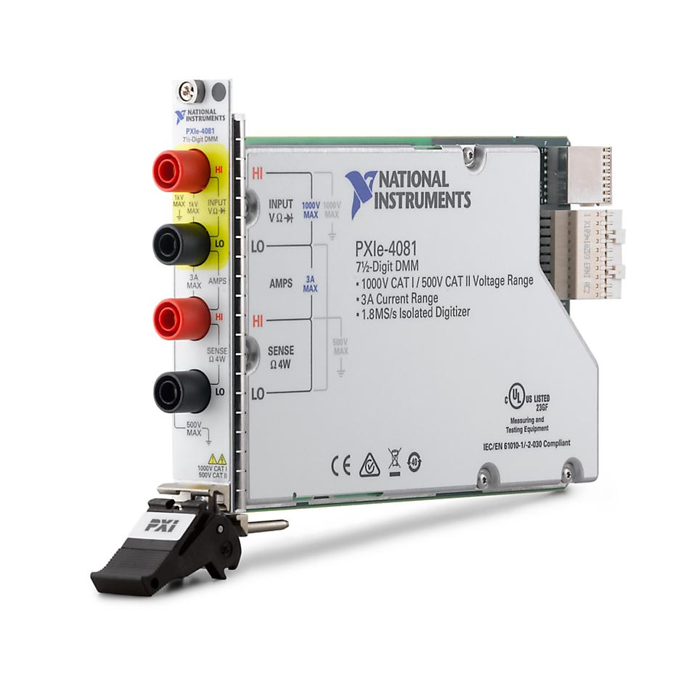
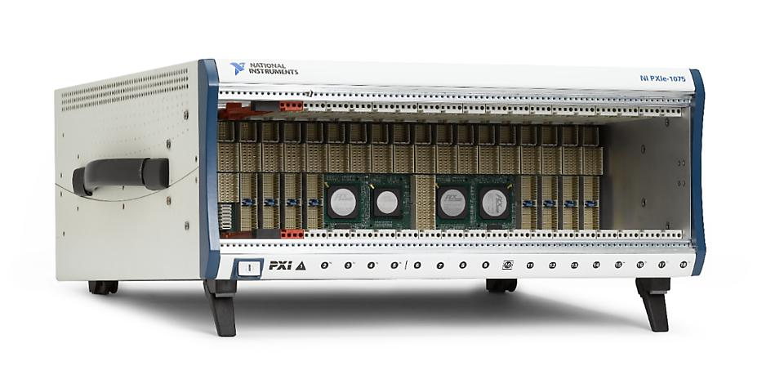
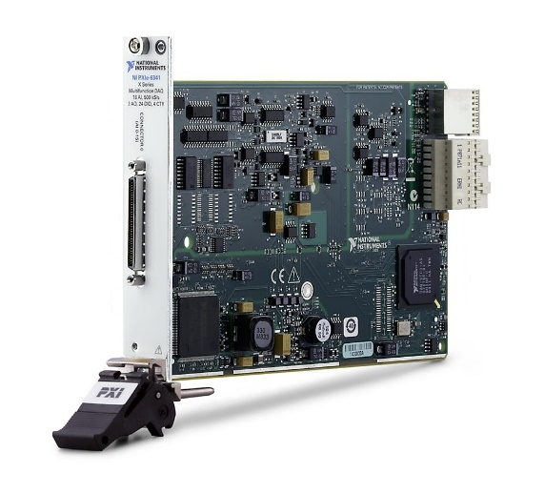
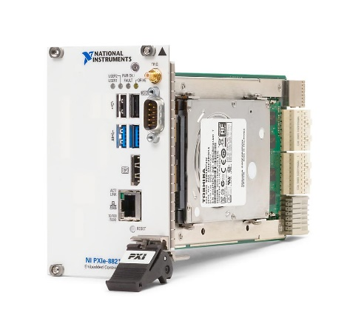
Acquisition systems - NI DMM
Delivered later this year
PXIe-1075: Chassis
8 hybrid slots, 8 PXI Express slots, 1 PXI Express system timing slot
791 W total power
Compatibility with PXI, PXI Express, CompactPCI, and CompactPCI Express modules
High performance - up to 1 GB/s per-slot dedicated bandwidth and 4 GB/s system bandwidth
PXIe-4081: ADC
The most accurate 7½-digit DMM
Voltage measurements from ±10 nV to 1000 VDC (700 VAC)
8 DC current ranges with sensitivity down to 1 pA
Resistance measurements from 10 µΩ to 5 GΩ
±500 VDC/Vrms common-mode isolation
1.8 MS/s isolated, 1000 V waveform acquisition
PXIe-6341: I/O card
16 analog inputs, 500 kS/s, 16-bit resolution, ±10 V
Two analog outputs, 900 kS/s, 16-bit resolution, ±10 V
24 digital I/O lines (8 hardware-timed up to 1 MHz)
Four 32-bit counter/timers for PWM, encoder, frequency, event counting, and more
Advanced timing and triggering with NI-STC3 timing and synchronization technology
PXIe-8821: CPU
2.6 GHz Intel Core i3-4110E dual-core processor
Up to 2 GB/s system bandwidth and 500 MB/s slot bandwidth (four Gen2 x1 PCI Express links)
2 GB 1600 MHz DDR3L RAM standard, 8 GB maximum
1x DP v1.2, 1x GbE, 2x USB 2.0, 2x USB 3.0, 1 RS-232 ports

Slide 22
Acquisition systems - Results
“Plateau” -> Splices measurements
Ramp Rate -> Inductances measurements
Quench

Slide 23
Conclusions

Slide 24
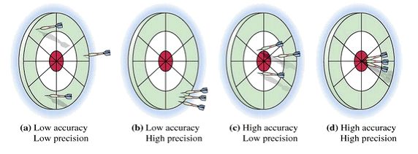
Conclusions
Magnet protection
  Define the needs:
  How many Vtaps ?
  How many PotAim cards ?
  Energy extraction ?
  Quench Heaters ?
  Dump resistor / IGBTs ?
  Connect the magnet:
  Differential voltage
  Current derivative
  Adjust the PotAim cards and Matrix parameters:
  Threshold
  Validation time
  Delay
Acquisition system
  Define the needs:
  How many Vtaps ?
  How many HF, MF, LF channels ?
  DAQ and DMM:
  Chassis
  CPU
  Cards
  Software:
  Data analysis

Slide 25

Thank you for your attention
Thank you to my colleagues at Uppsala University and at CERN helping me to learn more about the SC magnets
Special thanks to D. Turi and J. Villena for the pictures
Questions

