Slide 1
AC losses quantification in Nb₃Sn magnets
H. Bajas
2nd International Workshop on Superconducting Magnet Tests Stands

Slide 2
Outline
Origin of the AC loss
Measurement technique
Experimental result
Simulation result

Slide 3
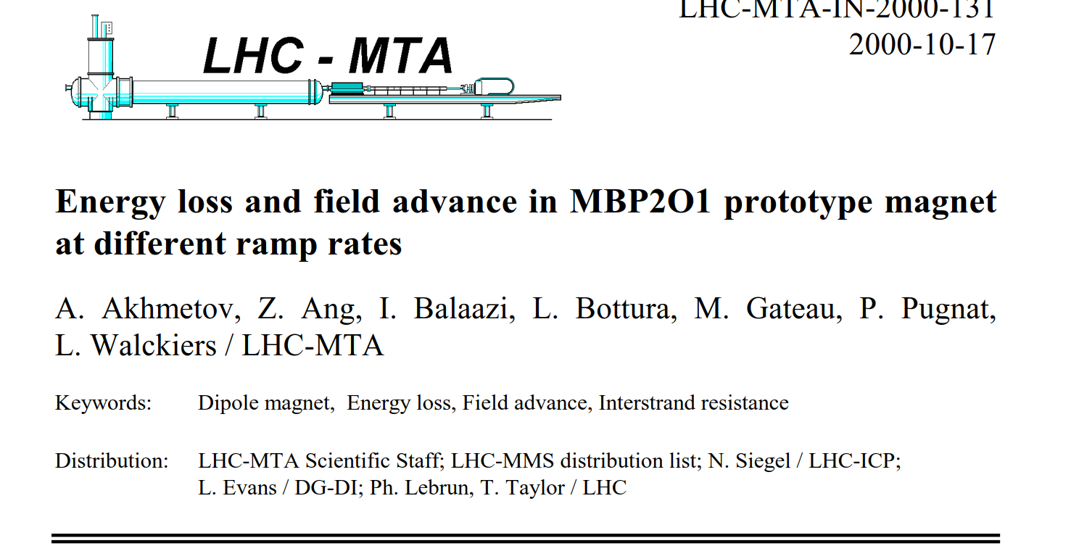
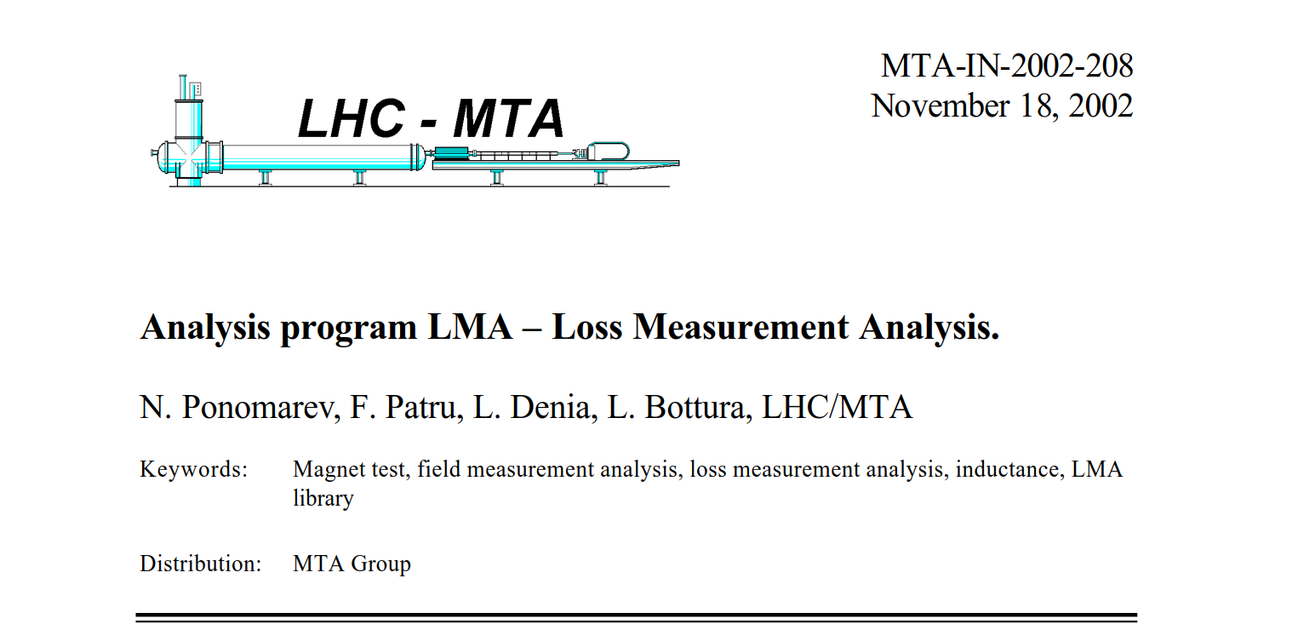
References

Slide 4
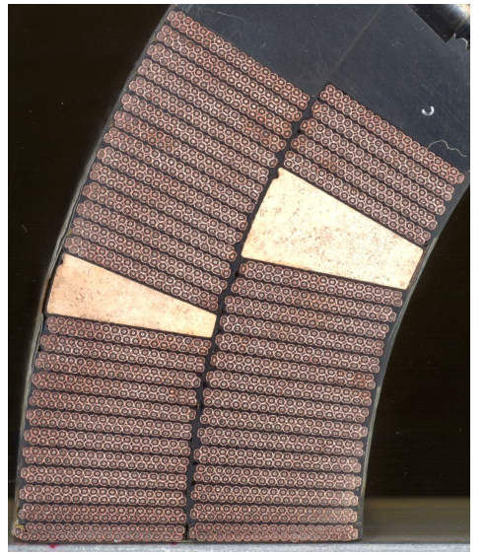
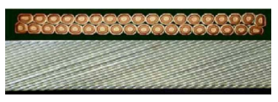
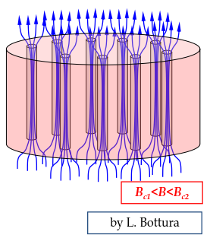
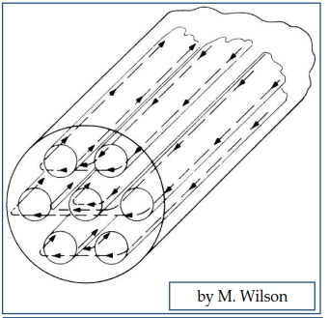
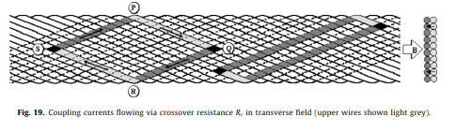
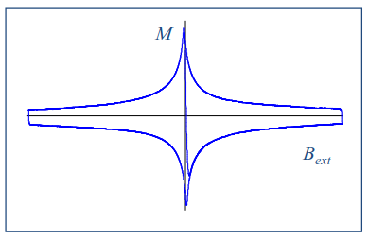
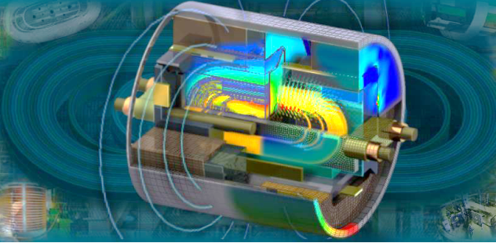
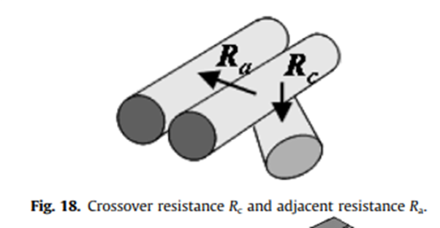
Origin of AC losses
There are 3 main sources of loss when a transport current is ramped in a superconducting magnet.
  Hysteretic magnetization loss (i.e. flux flow combined with flux pinning, results in a net energy loss when subjected to a field cycle)
    Proportional to the superconductor Jc and filament size (Deff)
  Inter-strand coupling loss (ISCC) and Inter-filament coupling losses (IFCC)
    Combination of individual superconducting filaments and a separating normal-metal matrix results in a coupling Joule loss
    Low thanks to the use of cored cable
    Low at the typical ramp-rate of an accelerator as LHC/FCC (10 A/s)
  Eddy currents in normal-metal
    Iron yoke and saturation effect
Notes:
When a filament is in a varying Bext,
its inner part is shielded by currents
distribution in the filament periphery
They do not decay when Bex is held
constant -> persistent currents

Slide 5
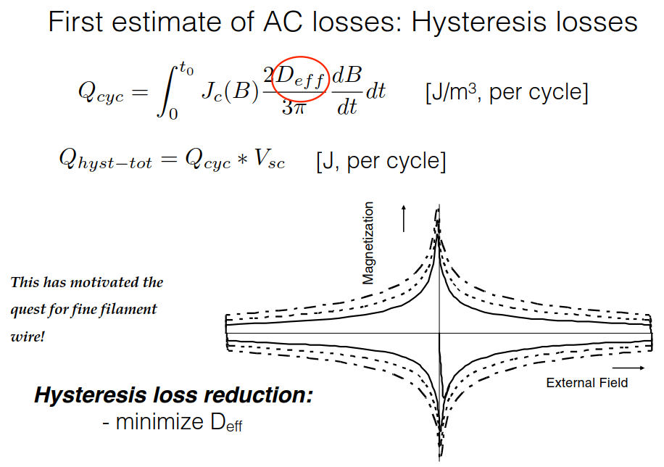
Origin of AC loss

Slide 6
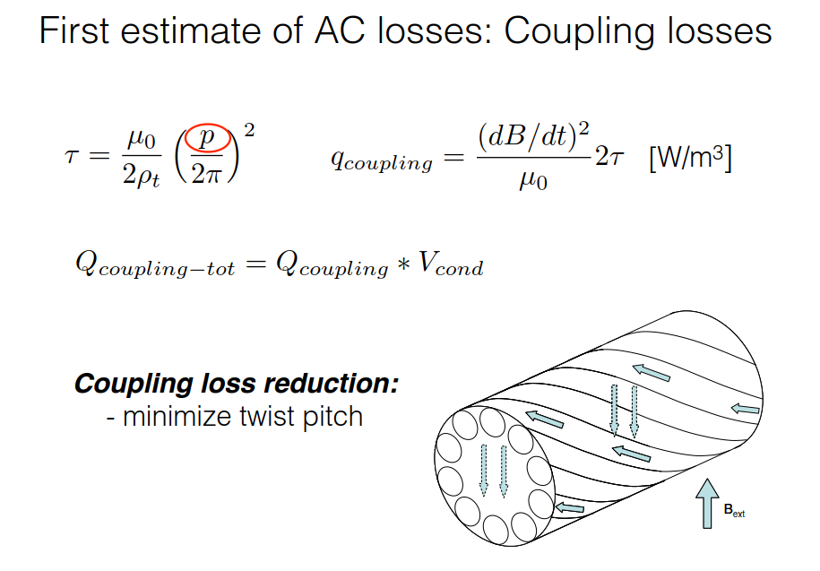
Origin of AC loss

Slide 7
AC losses measurement
Measurement issues in superconducting magnet
  The AC losses are delicate measurements as one has to detect Joules (resistive)
  over hundreds of kJ (inductive voltage).
  It requires High Resolution/precision Digital MultiMeters (DMM 1 uV ± 0.01%).
  Measurement requires to perform a great number of cycles at different ramp rate and level of current.
  Those are time-consuming measurements that are not systematically done.
  Need a performant framework for automatic analysis over 10th of file, 100th of cycle, 10th of voltages.

Slide 8
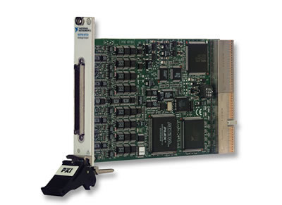
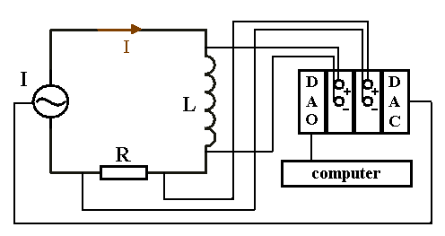
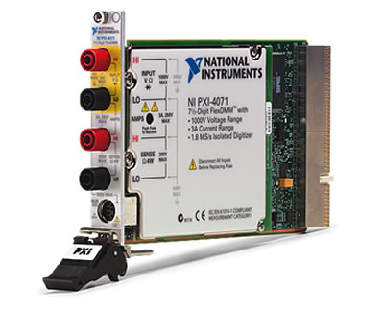
Measurement Procedure (hardware)
Measurement of the voltage across the coil using the voltage taps signals acquired with high precision high resolution DMM
Measurement of the the transport current using DCCT signals
Numerical integration of the power over current ramp cycle.
Digital analog output
W – energy loss
I – current,
U – voltage,
t - time
Digital to analog converter
Digital multimeter

Slide 9
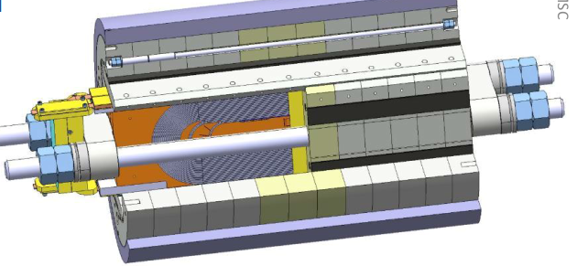
Measurement Procedure (example on SMC11T)

Slide 10
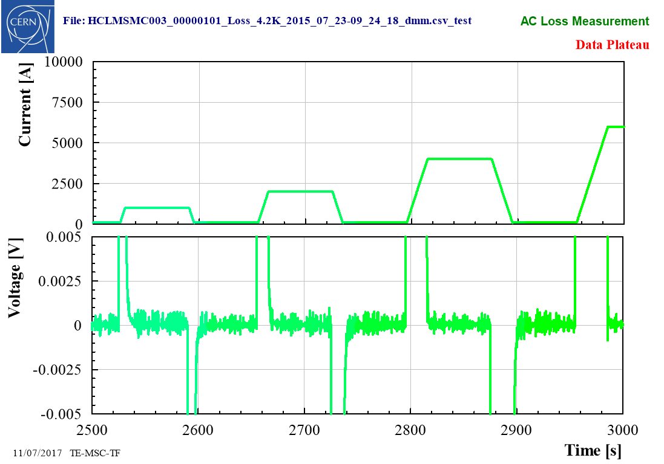
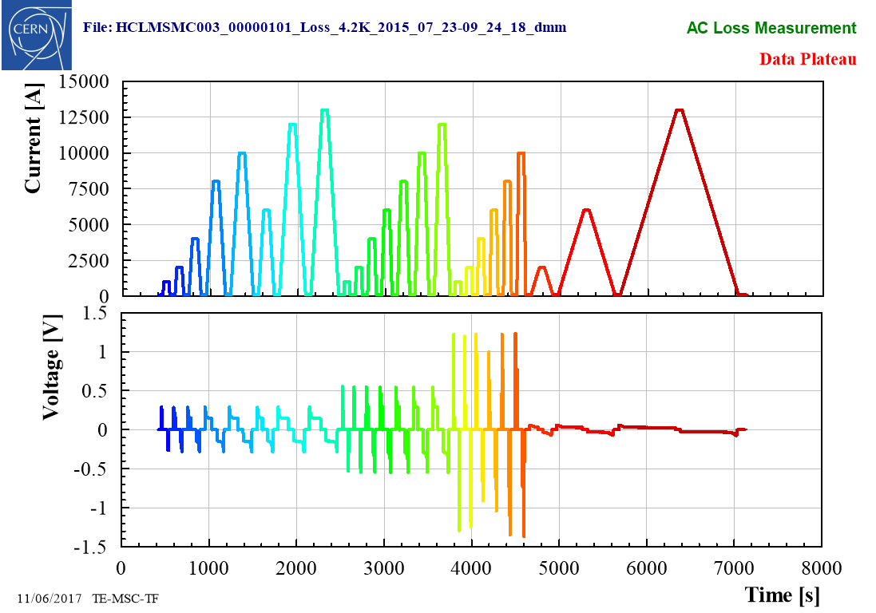
Measurement Procedure (example on SMC11T)
Current cycle between two level of current
@ different ramp rates

Slide 11
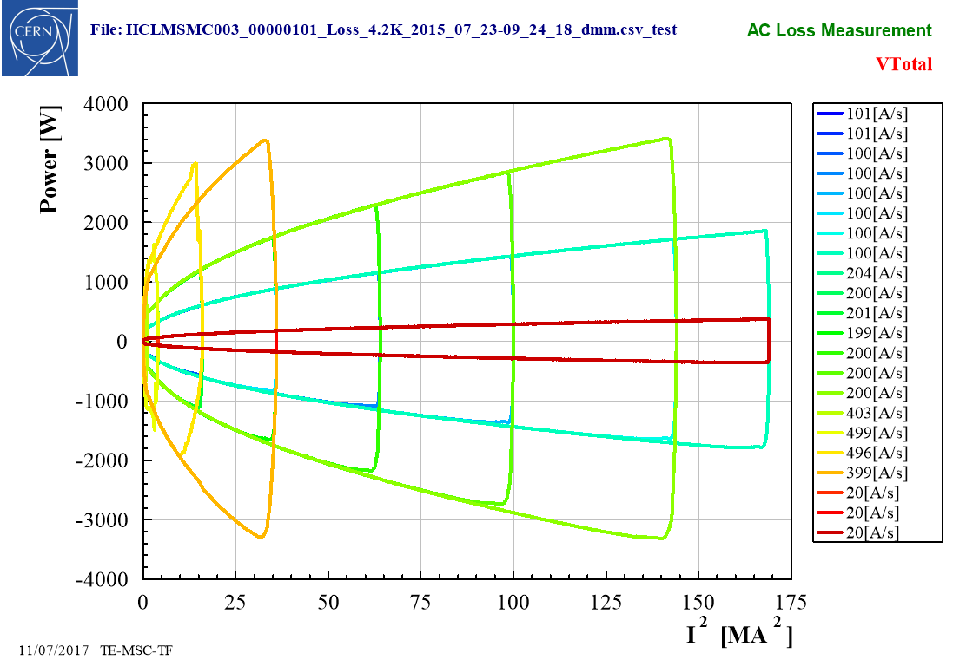

Measurement Procedure (example on SMC11T)
Current cycle between two level of current
@ different ramp rates
$$P=U.I$$
Importance of the cycle and offset definition!!

Slide 12

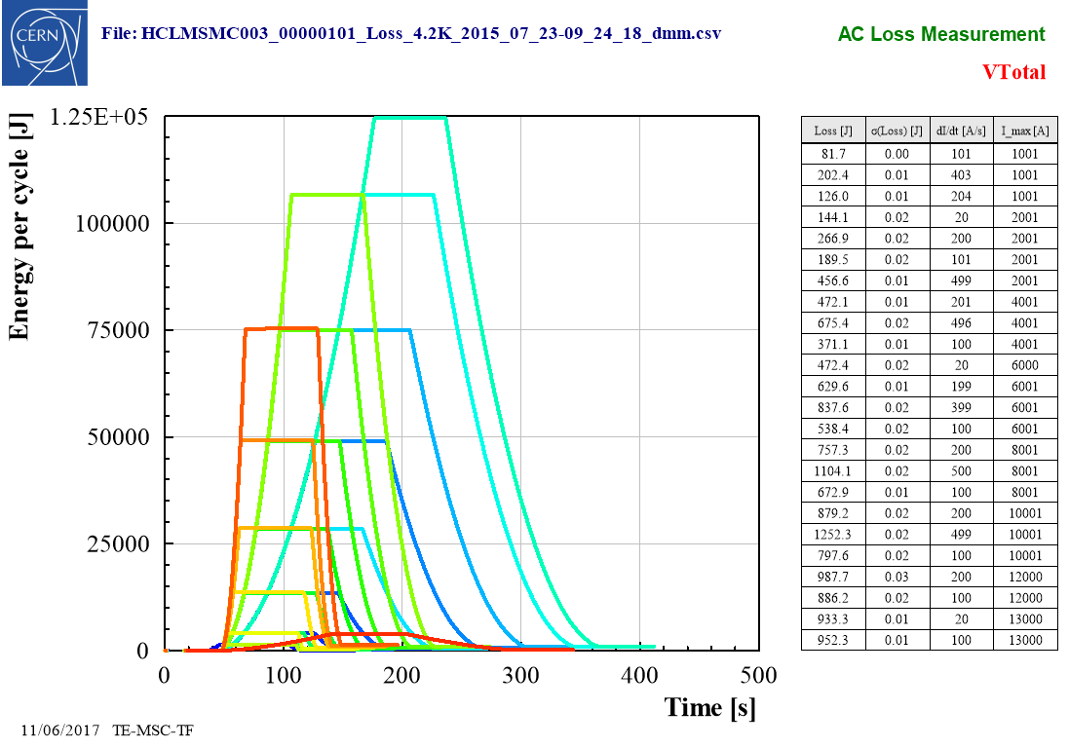
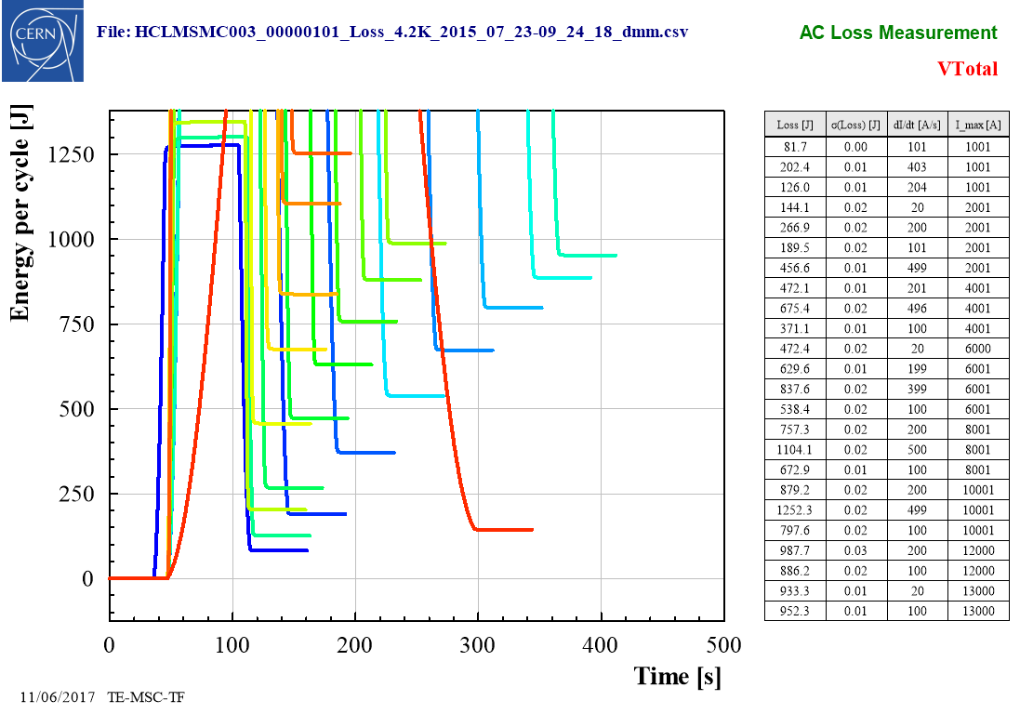
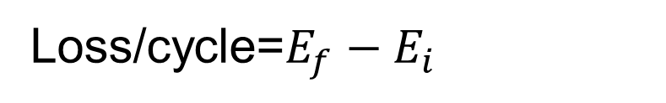
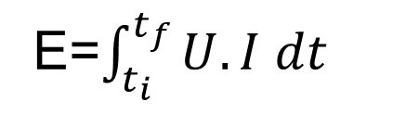
Measurement Procedure (example on SMC11T)
E=$\int_{t_{i}}^{t_{f}}{U.I dt}$
Loss/cycle=$E_{f}−E_{i}$

Slide 13
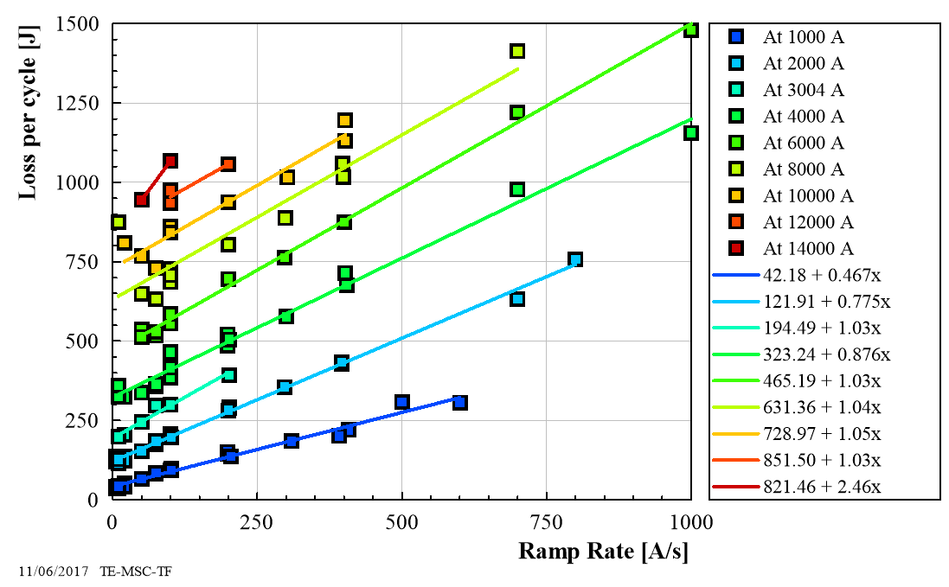
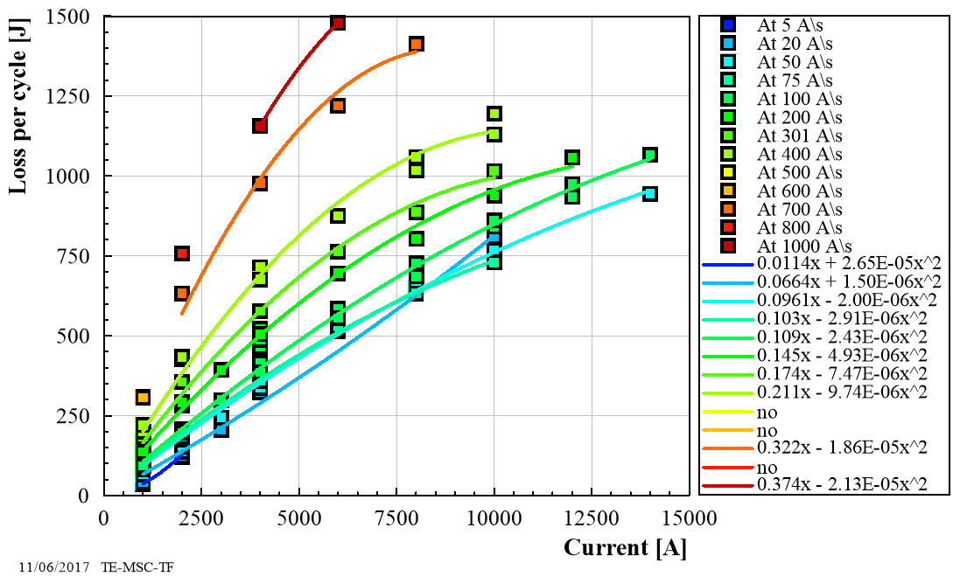
Measurement final result (example on SMC11T - RRP)
AC loss as function of the ramp rate (linear fit)
AC loss as function of the current (quadratic fit)

Slide 14
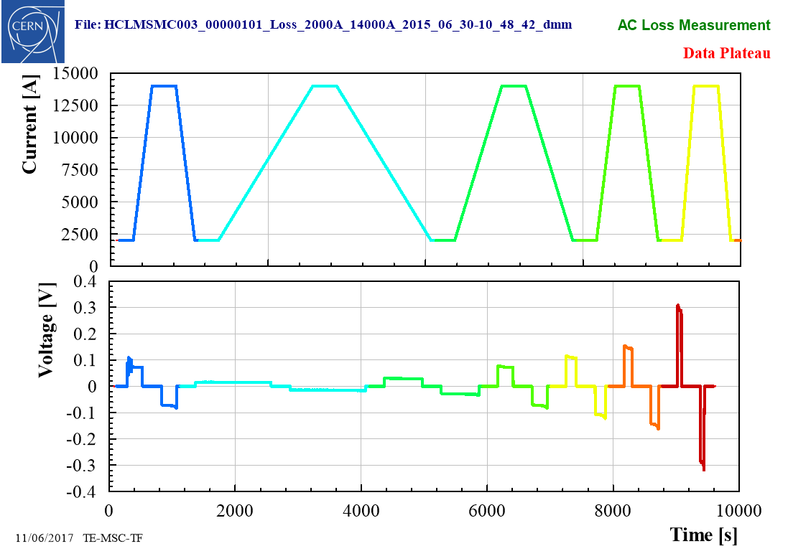
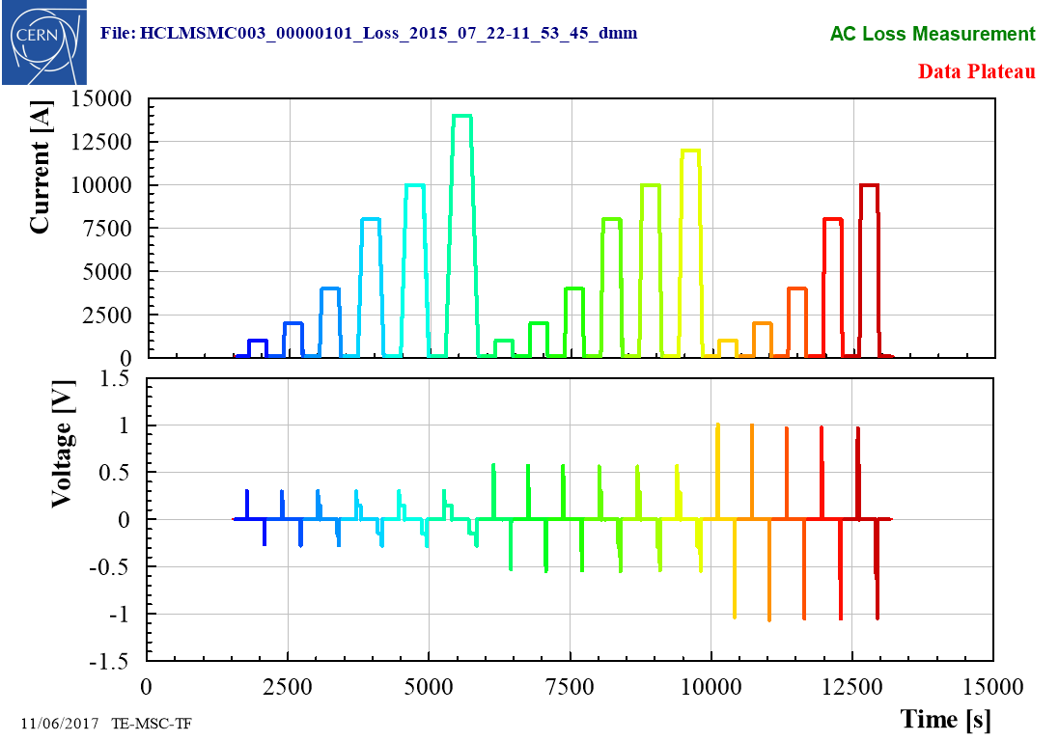
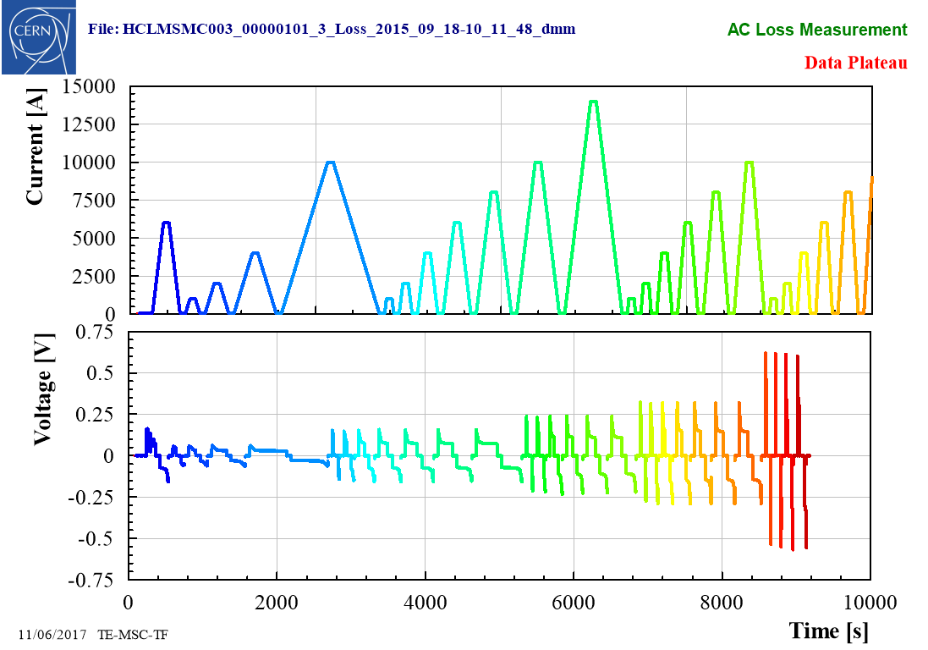
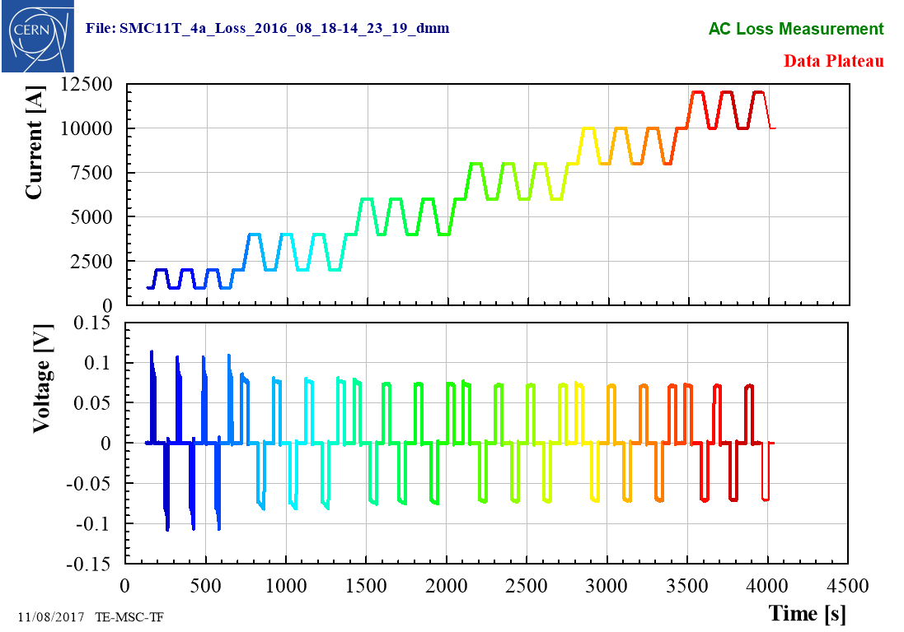
Measurement Procedure (example on SMC11T)
Algorithm to automatically process large number of:
magnets / files / cycles / signals

Slide 15
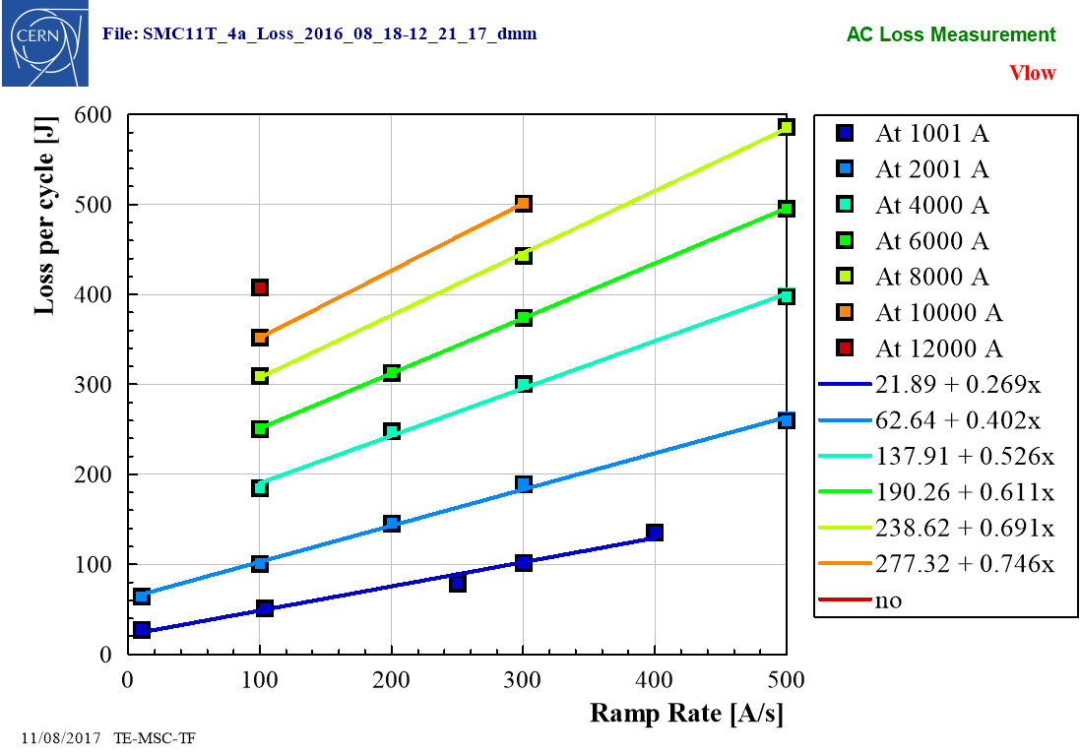
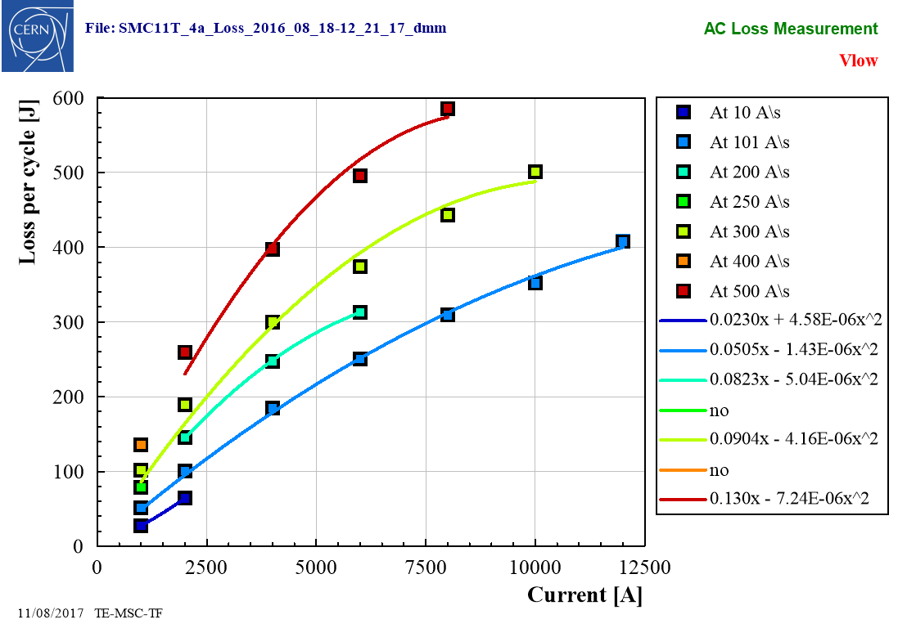
Measurement final result (example on SMC11T4 - PIT)

Slide 16
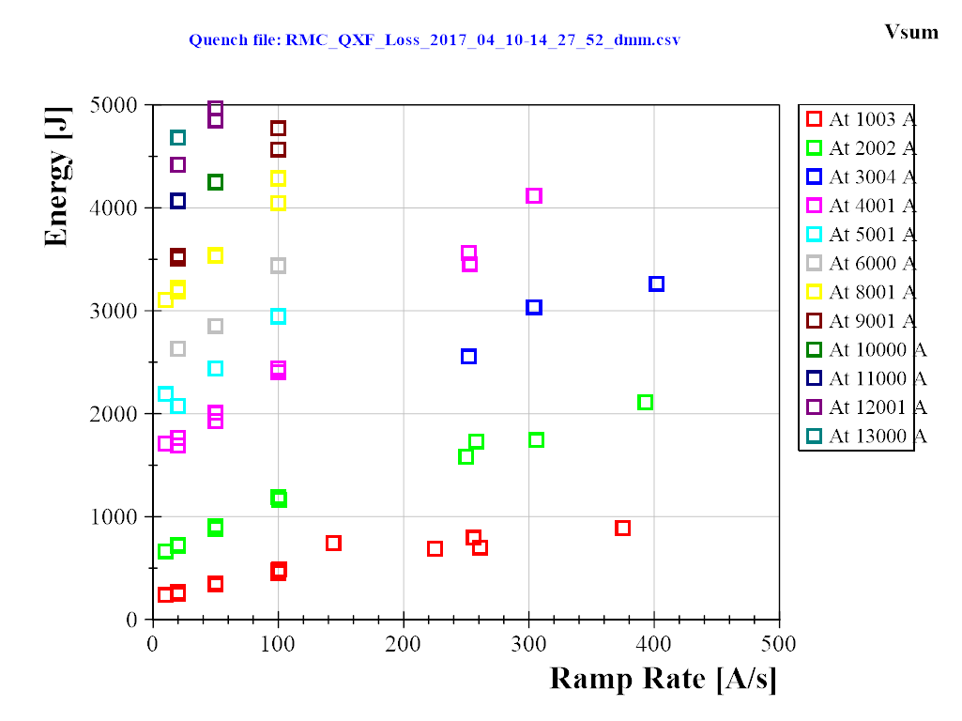
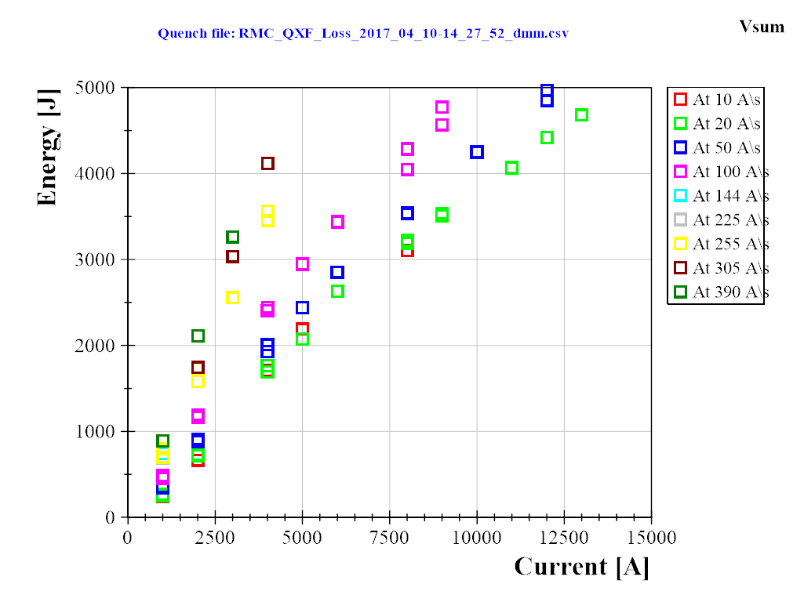
Another example of RMC…
Result for RMC_QXF

Slide 17
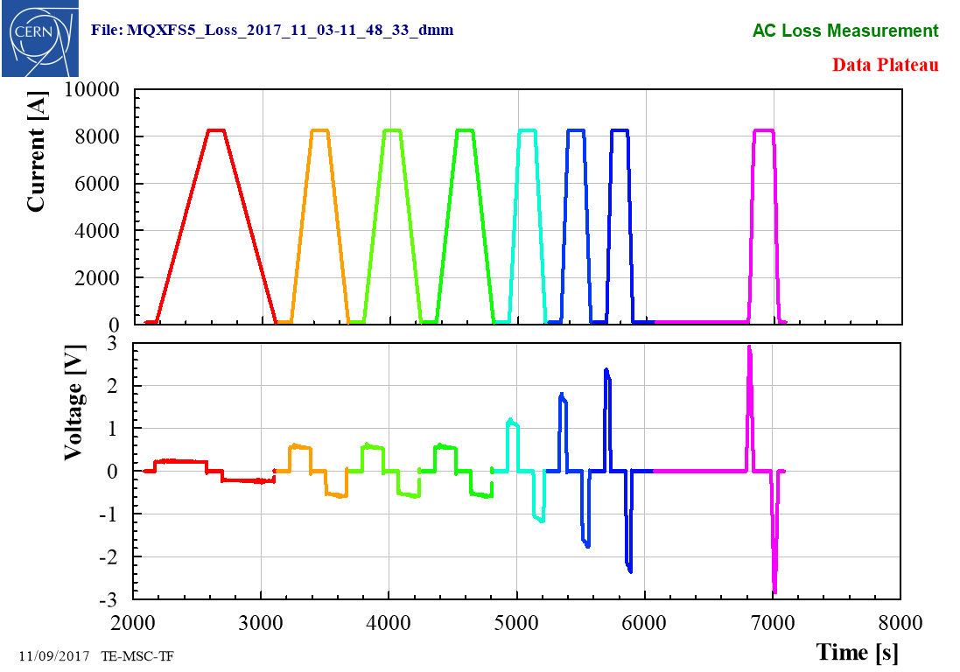
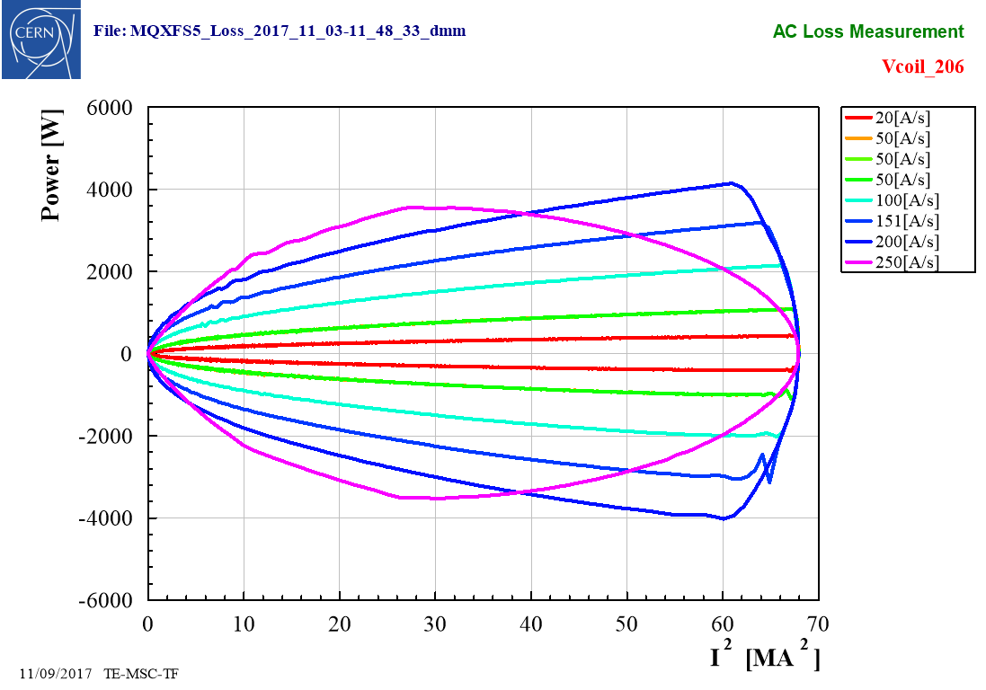
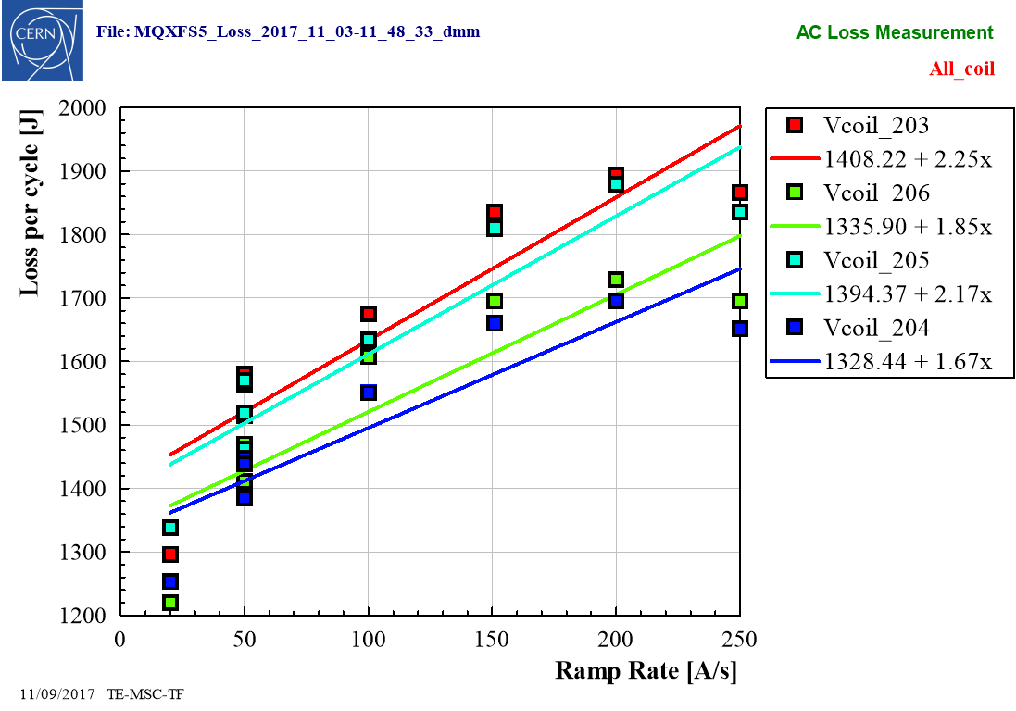
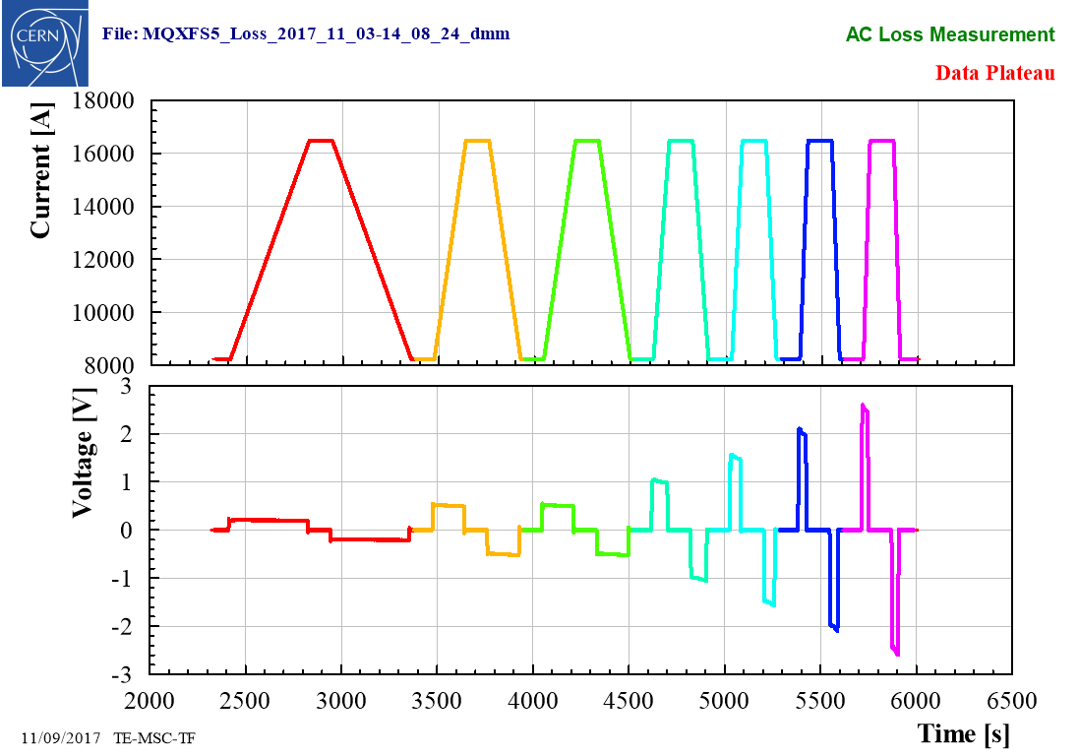
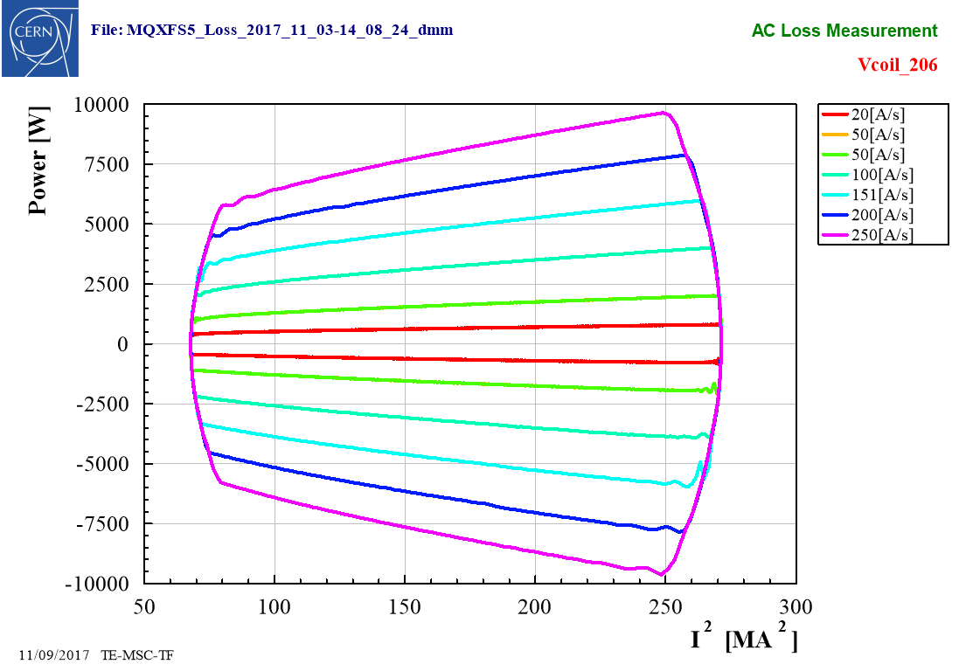
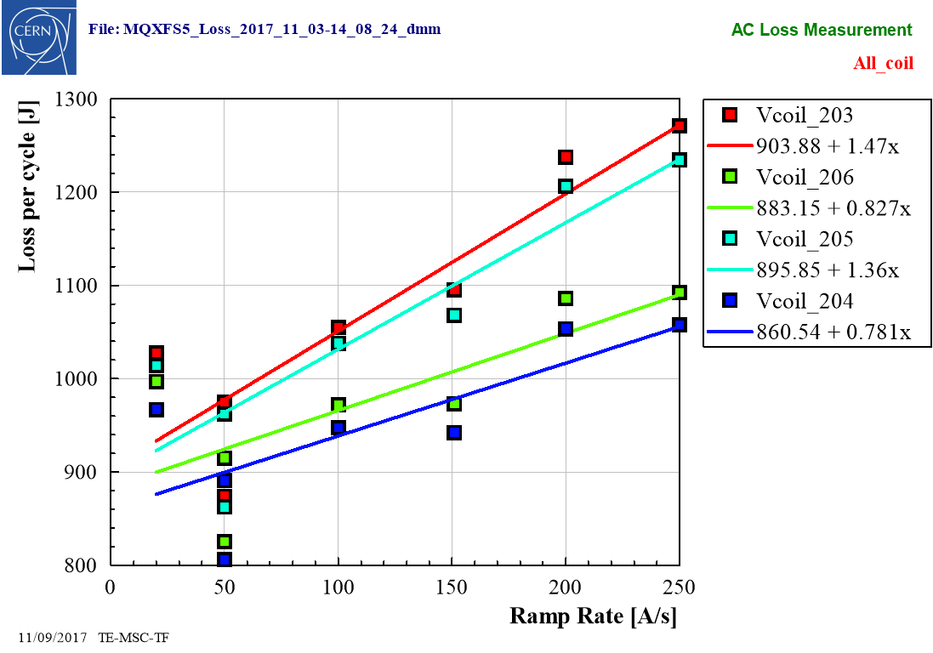
Example of analysis on MQXFS5
Current/voltage
(0-50 % Inom & 50 -100 % I nom)
Loss per cycle function of ramp rate (4 coils)
Power over cycle (1 coil)

Slide 18
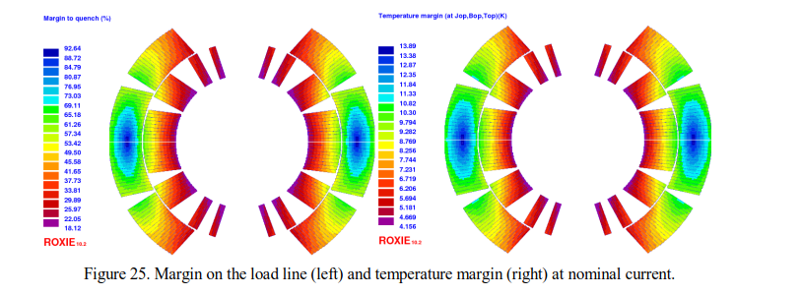
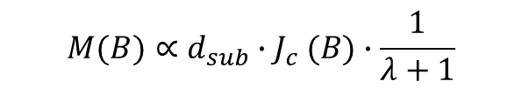
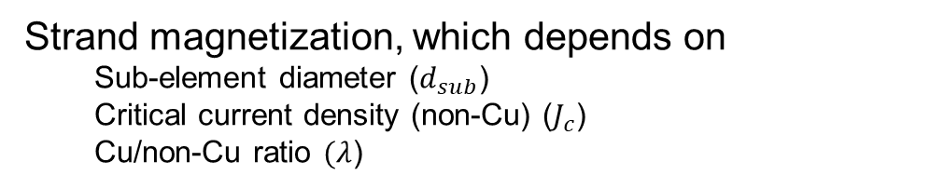
Simulation with Roxie (11T dipole)
11 T (2 apertures) loss per cycle (up+down) ≈ 7 kJ/m
Low field: from 0.1 to 6 kA
High field: From 6 kA to 11.85 kA
Courtesy of S.I. Bermudez and G. Willering
  dB_{p}/dI (11T) ~ 1 T/kA
Margin on the loadline
Our assumption: ISCC and IFCC are negligible, only strand magnetization losses are considered
Strand magnetization, which depends on
  Sub-element diameter ($d_{sub}$)
  Critical current density (non-Cu) ($J_{c}$)
  Cu/non-Cu ratio $(λ$)
$$M(B)∝d_{sub}{∙J}_{c}(B)∙\frac{1}{λ+1}$$

Slide 19
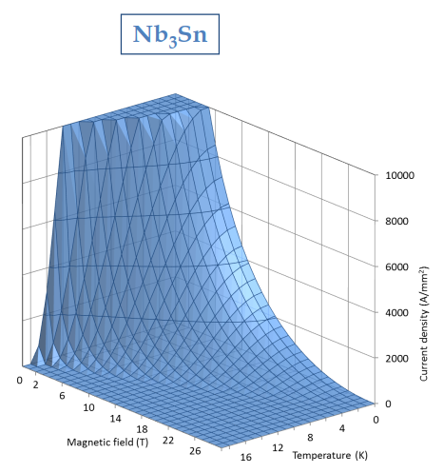

Roxie Model Input
Superconductor current density as specified for HiLumi
  T_{c0} = 16 K
  B_{c20} =29.38 T
  α = 0.96
  C₀ = 188870 A/mm² T
  3 % cabling degradation
Reference: D_{eff} = 50 µm, no reduction due to flux jumps
Sensitivity analysis to:
  Effective filament size D_{eff} = 20 µm, D_{eff} = 50 µm
  Reduction of strand magnetization at low field due to flux jumps χ= 0.5-1
$$B_{c2}\left(T\right)=B_{c20}∙\left(1−t^{1.52}\right)$$
$$J_{C}=\frac{C(t)}{B_{p}}∙b^{0.5}∙{(1−b)}^{2}$$
$$C\left(t\right)=C_{0}∙{(1−t^{1.52})}^{α}∙{(1−t^{2})}^{α}$$
Courtesy of P. Ferracin

Slide 20
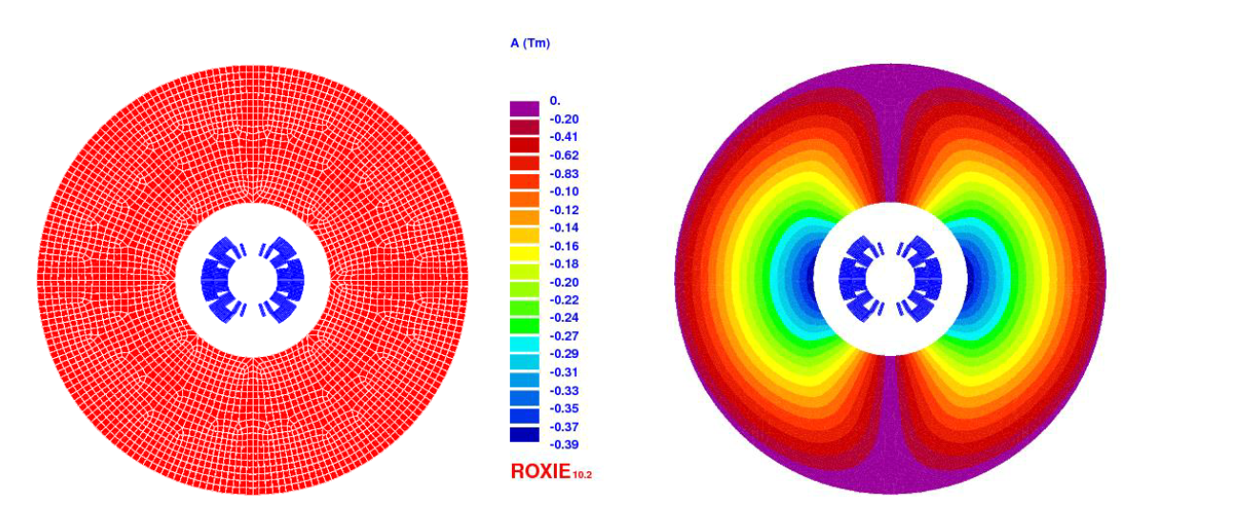
Roxie Model Input
Margin on the loadline
Temperature margin at nominal current
Courtesy of S.I. Bermudez
and F. Murgia
Iron mesh and vector potential

Slide 21
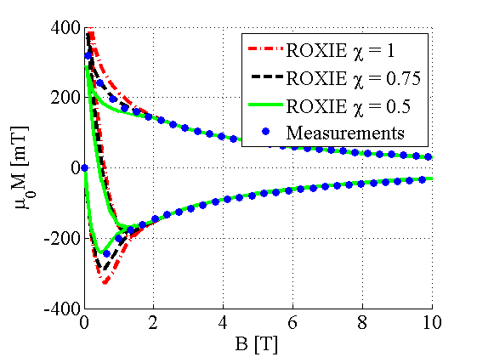
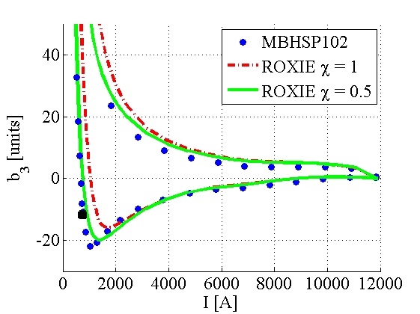
Modelling SC magnetization
Semi-analytical hysteresis model for the superconductor, developed in [1], and implemented in ROXIE [1].
Limited accuracy at low field, partially due the reduction on magnetization observed in Nb₃Sn due to flux jumps [2], which can be overcome by introducing a reduction on the strand magnetization below a given field level.
Model has been validated in 11 T [2] and MQXF [3] magnets
Courtesy of S.I. Bermudez
[1] C. Vollinger, Superconductor magnetization modelling for the numerical calculation of field errors in accelerator magnets. PhD thesis, 202
[2] S. Izquierdo Bermudez, et.al, Persistent Current Magnetization effects in High-Field Superconducting Accelerator magnets, IEEE 2016
[3] S. Izquierdo Bermudez, et.al, Magnetic Analysis of the Nb3Sn low-beta Quadrupole for the High Luminosity LHC, IEEE 2017

Slide 22
ROXIE vs AC loss measurement: 11T
Measured ramp up + ramp down around 6 kJ, 6/1.7= 3.6 kJ/m for a single aperture (ROXIE gives 4 kJ/m, a bit conservative, but good enough for a first approximation).
11 T - Magnetization loss per aperture (Deff = 0.046 mm, RRP 108/127) | ROXIE
 | J/m | J/m3
Pre-Cycle (0- 11.85 kA-0.1 kA) | 4133 | 8.139E+05
Ramp up (0.1 kA -11.85 kA) | 1853 | 3.650E+05
Ramp down (11.85 kA - 0.1 kA) | 2207 | 4.346E+05
Ramp down + Ramp up (11.85 kA-0.1 kA-11.85 kA) | 4060 | 7.996E+05

Slide 23
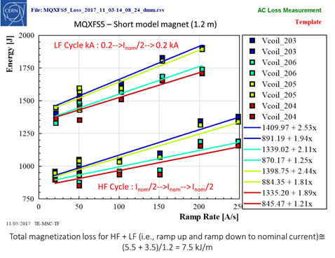
ROXIE vs AC loss measurement: MQXFS
Measurements: 7.5 kJ/m, so reasonably close to the 8.3 kJ/m predicted by ROXIE (actually Jc is 5 % lower than the spec in MQXFS5, so the difference is explained with that)
MQXF - Magnetization loss (Deff = 0.039 mm, PIT bundle) | ROXIE
 | J/m | J/m3
Pre-Cycle (0-16.47 kA-0.1 kA) | 8474 | 5.994E+05
Ramp up (0.1 kA -16.47 kA) | 3782 | 2.675E+05
Ramp down (16.47 kA -0.1 kA) | 4503 | 3.186E+05
Ramp down + Ramp up (16.47 kA-0.1 kA-16.47 kA) | 8286 | 5.861E+05

Slide 24
Conclusion
If the theory behind AC loss is well understood, the literature about Nb₃Sn magnet is rather limited and mainly referring to ITER magnet (central solenoid pulse mode).
Experimental results on recent Nb₃Sn magnet shows values one order of magnitude higher
than NbTi (0.5 kJ/m vs. 8 kJ/m)
A large amount of experimental data is now available from (SMC, RMC, 11T, MQXF) with a defined procedure for AC loss quantification.
A new framework of analysis has been developed following literature procedure to process a large number of files (including old file with different format) can now be treated massively.
So far only electrical method has been used. Next would be to perform calorimetric method.
Simulation work is just recently started at CERN…
Subsidiary goal… can we simulate quench current versus ramp rate using AC loss measurement?

Slide 25
