Slide 1
WP4-Task5: Integration
Markus Aicheler
Helsinki Institute of Physics
15.03.2018

Slide 2
Recap: What we would like to do for XLS
Help establishing alignment and stability requirements for each component in the linac
Develop design for support structure of components for the entire length of the accelerator
Use lessons learned from CLIC module for high quality and affordable realization of support design
Use synergy in prototyping for CLIC module to improve XLS support design if necessary

Slide 3
Task 5: Integration
Description:
Providing a framework for condensing/bringing together mechanical designs and related systems designs
Translating stability requirements of components in concrete mechanical designs for supports
Ensuring proper interfacing with adjacent injector and undulator
Establish lists of components for costing exercise
Issue space allocations?

Slide 4
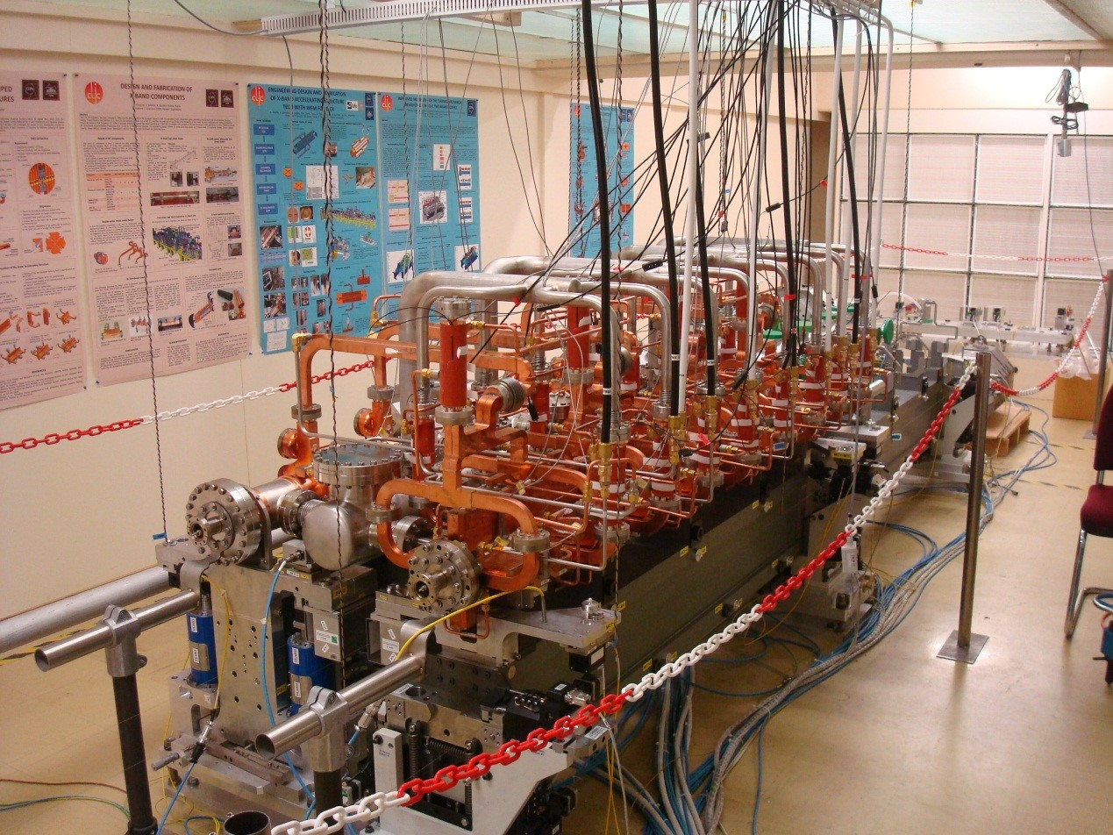
Examples CLIC-module
CLIC CDR baseline design from 2013 test-mockup
Running thermal tests combined with numerical simulations in order to predict individual deformations and compensate for
Testing individual components for installation and alignment methods
Powering and cooling of individual components for establishing heat dissipation to air and cooling optimisation

Slide 5
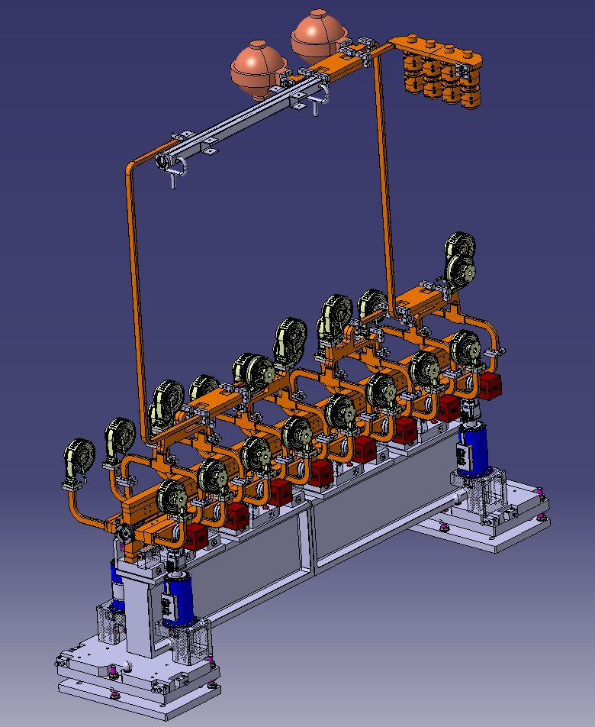
CLIC 380 GeV klystron
Infrastructure/tools available at CERN:
Catia V5
Dassault Smarteam data management software
Extensive database of RF components for CLIC
Smarteam allows for online publishing for feeding back to your designers
We can start as soon as we agreed on some basic parameters:
AS length
Module layout
Powering scheme

