Slide 1
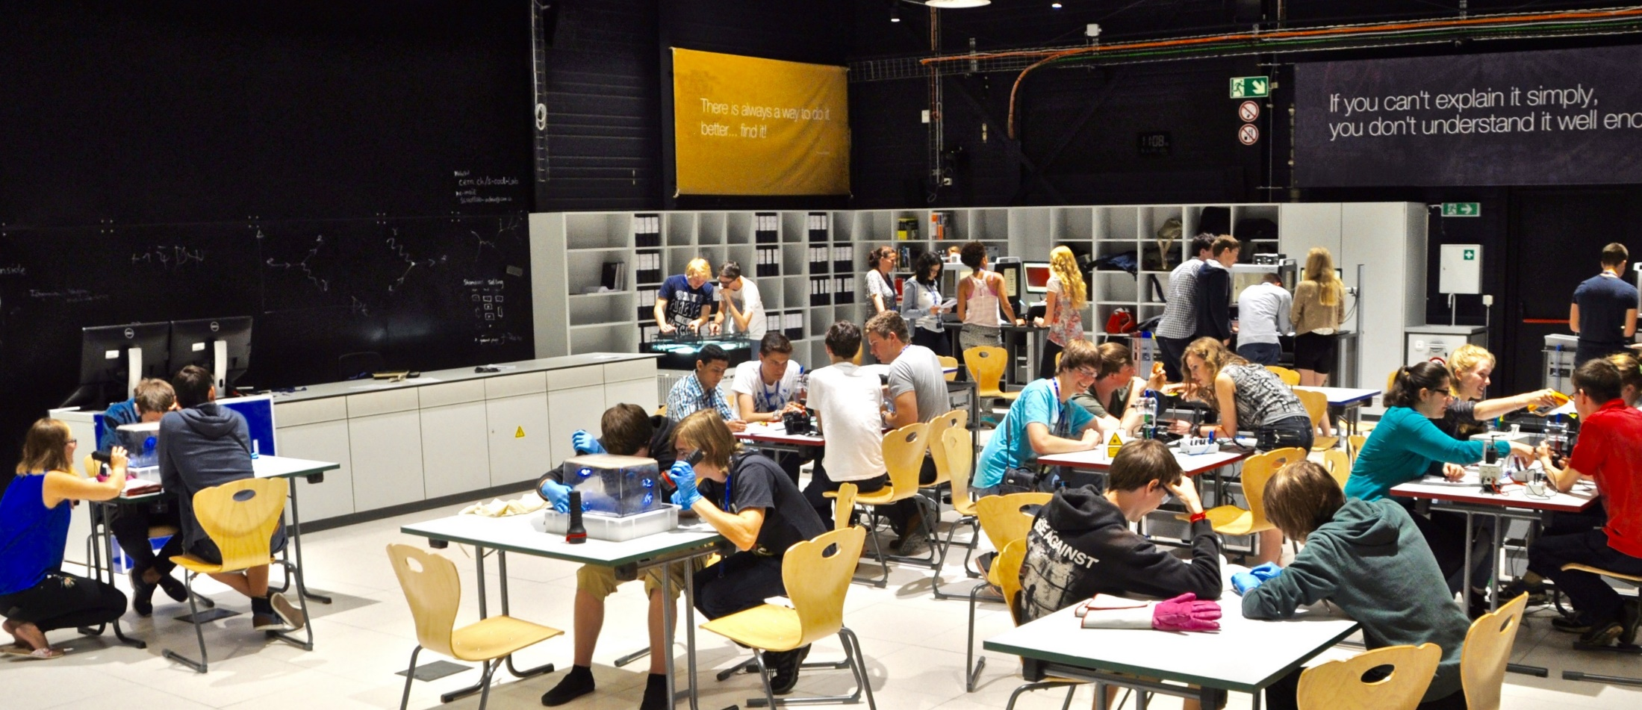

AAPT Winter Meeting, San Diego, 9 Jan 2018
3D-Printable Things in Particle Physics Education
Julia Woithe, Alexandra Jansky, Oliver Keller, Sascha Schmeling

Slide 2
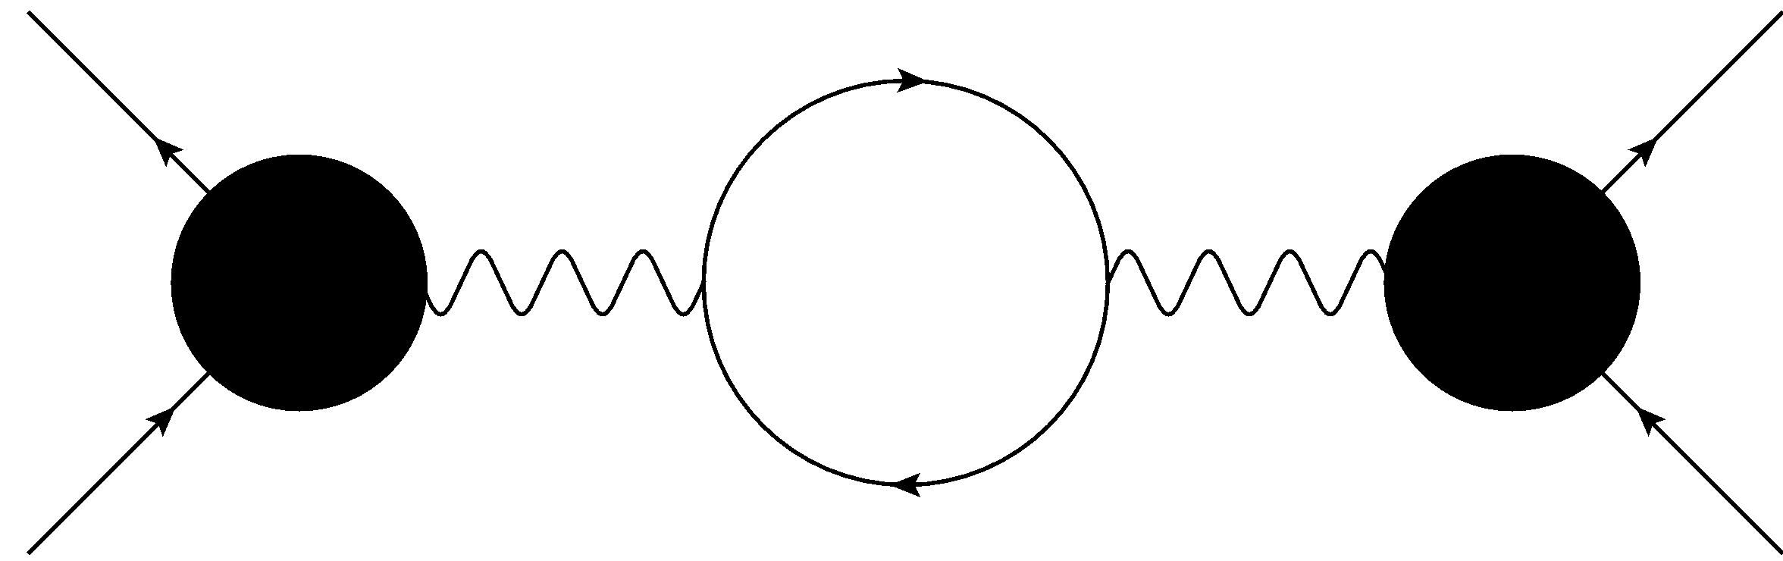
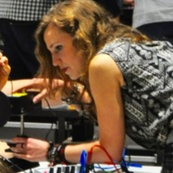
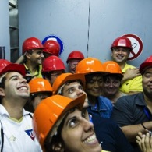
CERN S‘Cool LAB a hands-on particle physics learning laboratory
particle physics experiments
► hands-on & minds-on
Physics Education Research
high school students
high school teachers

Slide 3
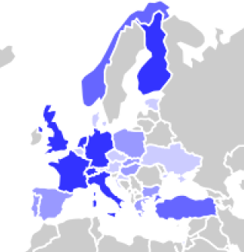
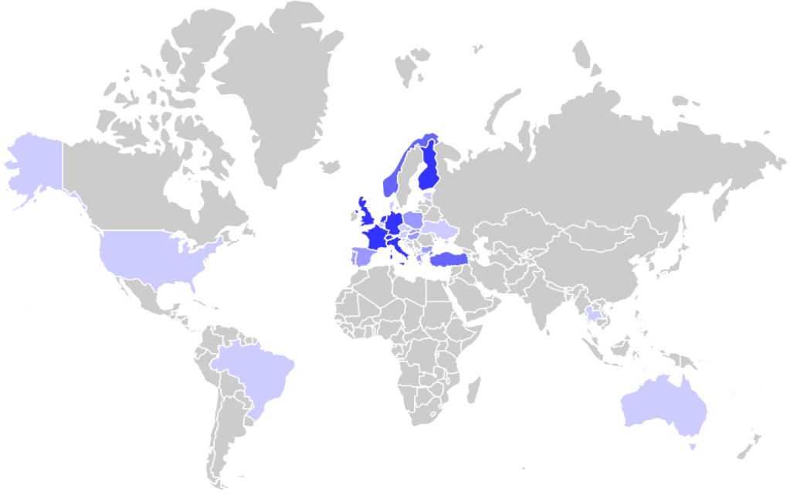

6000 students from all around the world
Origin of S‘Cool LAB student groups 2017

Slide 4
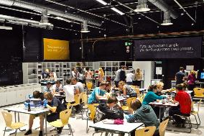

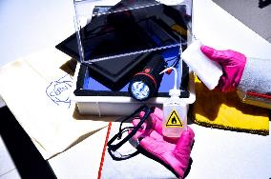
Current opportunities
S’Cool LAB Days
Summer CAMP
Cloud Chamber WS
A full-day programme of hands-on experiments & CERN tours for high school students aged 16-19 participating in
S’Cool LAB’s PER projects.
1030 participants in 2017
A two-week residential particle physics summer camp for 30 high school students aged 16-19 from all around the world.
2nd camp in 2018 (24/07 – 04/08)
A 90-minute hands-on particle physics workshop for high school students (aged 14 and above)
and high-school teachers.
5780 participants in 2017
(4830 students & 950 teachers)

Slide 5
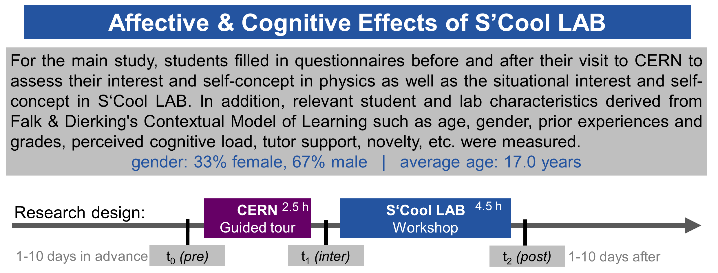

Slide 6
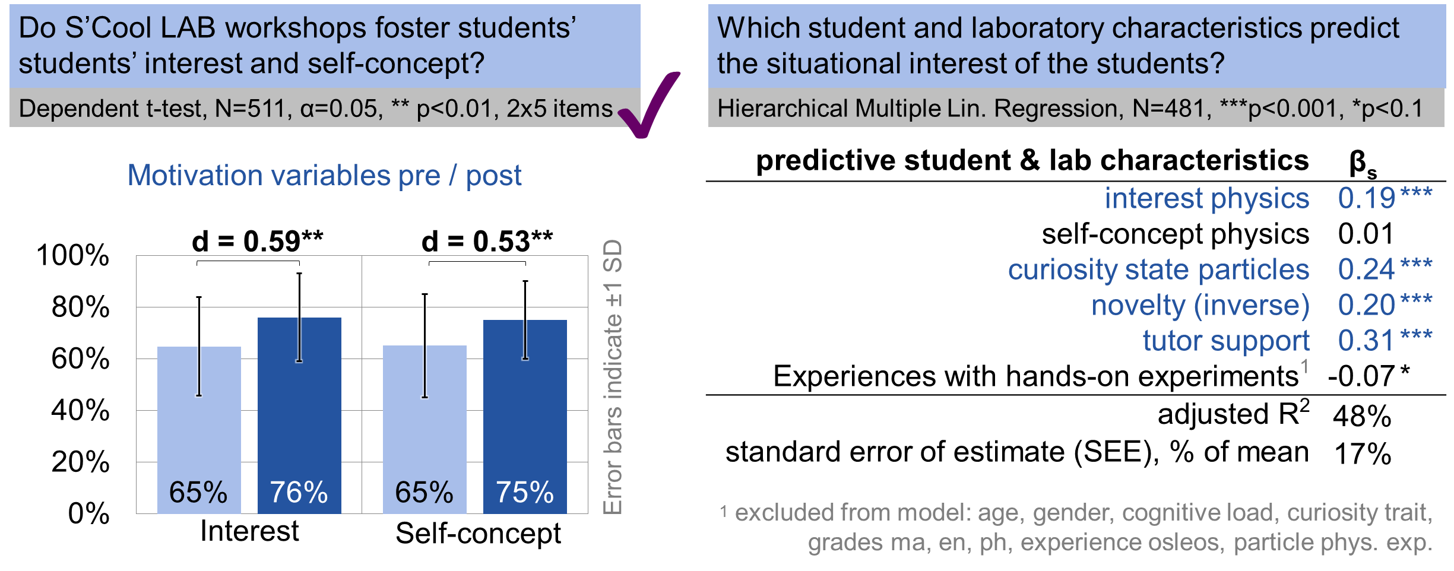
Affective effects of S‘Cool LAB

Slide 7
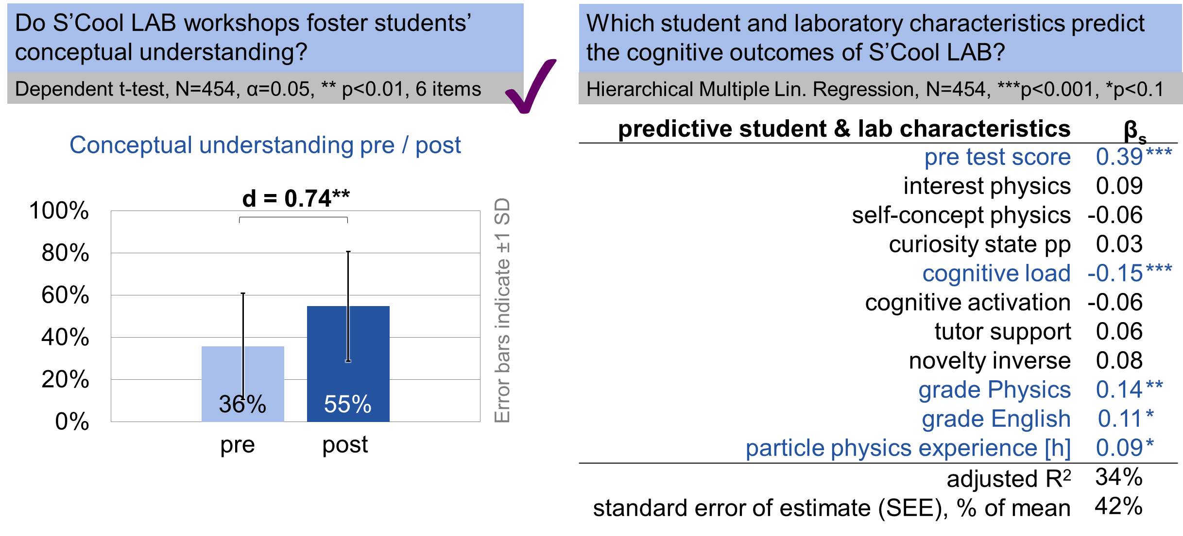
Cognitive effects of S‘Cool LAB

Slide 8
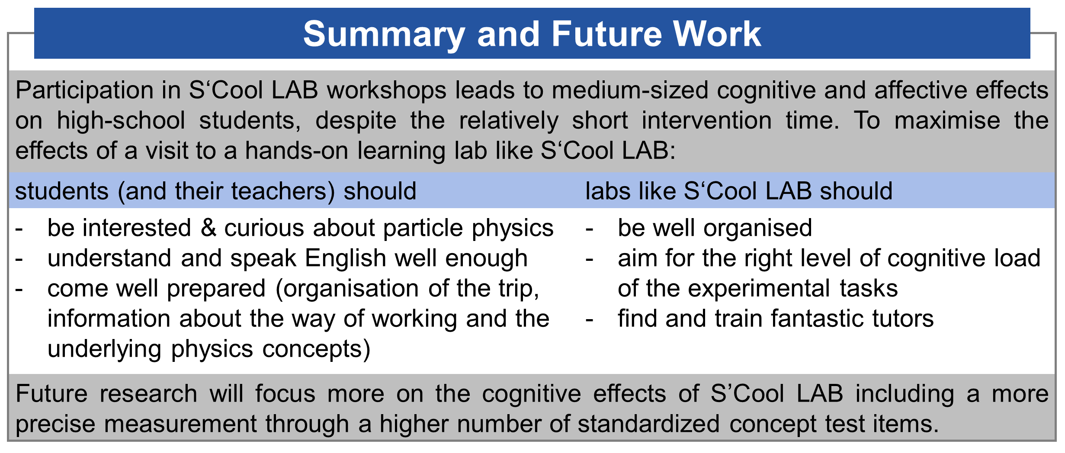

Slide 9

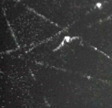
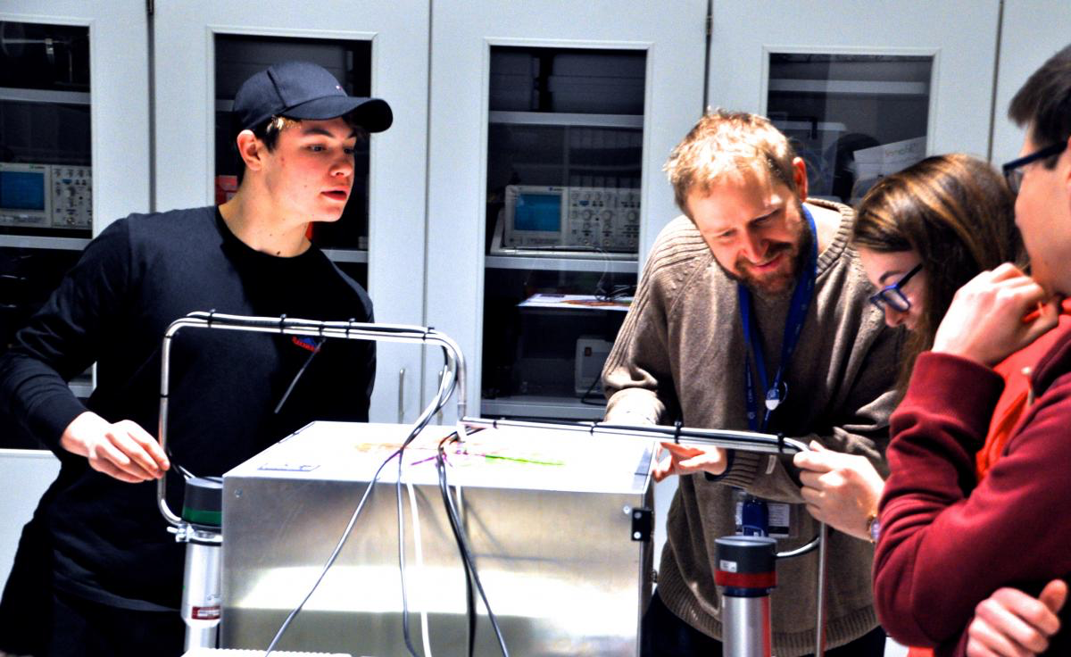




Experiments: high-tech vs. low-cost
In S’Cool LAB: high-tech
electrons beams in magnetic fields
cloud chamber
supercon-ductivity
pixel detector
PET
X-ray
machine

Slide 10
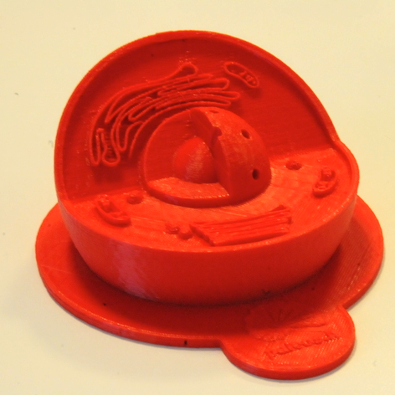
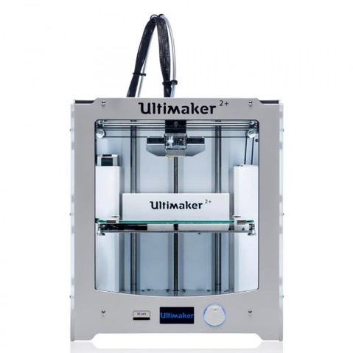
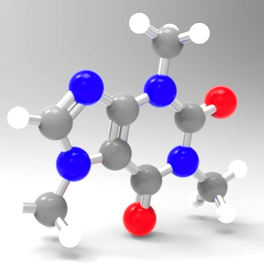
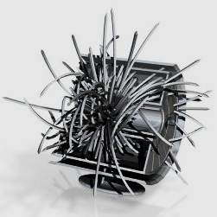
3D printable things & education
model of an animal cell www.thingiverse.com/
thing:689381
model of a caffeine molecule www.thingiverse.com/
thing:876224
More and more 3D printers &
3D printable things available
e.g. www.thingiverse.com/education
model of ALICE detector http://cern.ch/alicematters/
?q=ALICE_3D_models
Notes:
3D printing services
10% education discount https://i.materialise.com

Slide 11


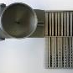

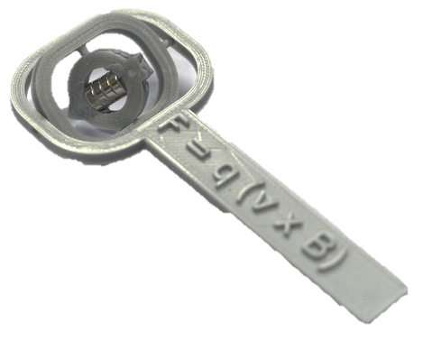
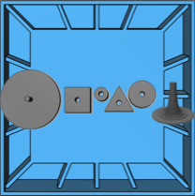
Experiments: high-tech vs. low-cost
In S’Cool LAB: high-tech
For the classroom: low-cost
electron beams in magnetic fields
cloud chamber
ATLAS magnet model
DIY
cloud
chamber
super-
conductivity
pixel detector
Bragg peak model
particle trap
PET
X-ray
machine
3D compass
Rutherford scattering model

Slide 12
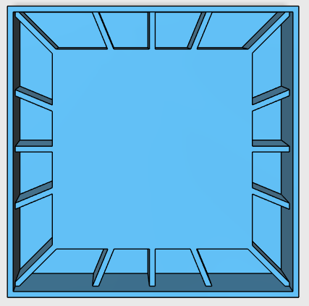
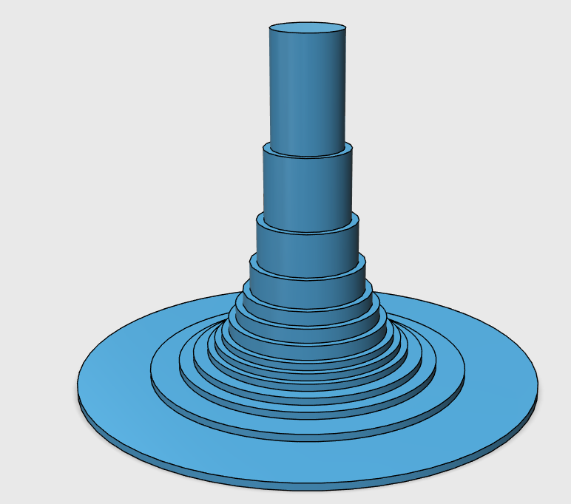
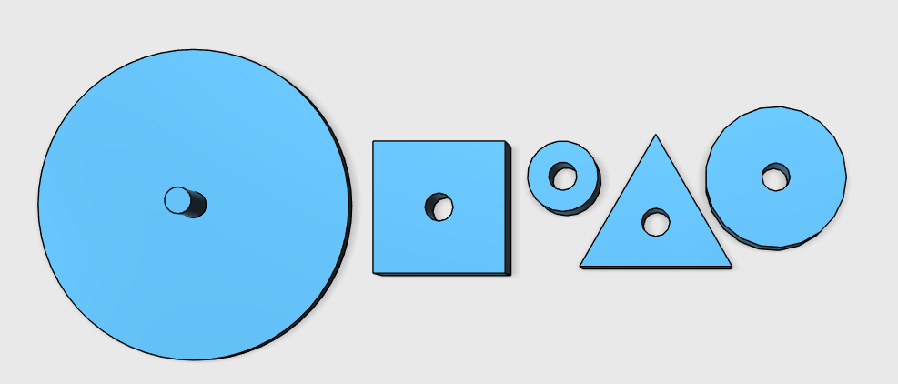
Rutherford scattering model
Outreach tool of University of Göttingen
© Ching-Yen Huang
Notes:
plum-pudding model, it had to be abandoned (1911) on both theoretical and experimental grounds in favour of the Rutherford atomic model, in which the electrons describe orbits about a tiny positive nucleus.
one in 20,000 alpha particles had been deflected 45° or more
Lemmer, B. (2013). Bis (s) ins Innere des Protons: ein Science Slam durch die Welt der Elementarteilchen, der Beschleuniger und Supernerds. Springer-Verlag.
FLINN SCIENTIFIC: Atomic Target Practice: Solving the Structure of the Atom. https://www.flinnsci.com/api/library/Download/00a643b932ac4478a6cad90536a3b466
Perimeter Institute: Scattering Experiment: Rutherford Scattering https://insidetheperimeter.ca/perimeter-classroom-activity-rutherford-scattering-with-marbles/
www.springer.com/cda/content/document/cda_downloaddocument/9783642377136-c1.pdf?SGWID=0-0-45-1415407-p175274474
Chapter 2
Boris Lemmer
Seite 24
Abb. 2.5 Ein Versuch, der das Prinzip des Rutherfordschen Streuversuchs darstellt.
Murmeln rollen über die Rampe gegen Holzfiguren und werden danach weggestreut.
Die Form der Figur entscheidet über die Streurichtung. (Foto: © Ching-Yen Huang)
2.3 Murmelspiel und Rosinenkuchen: das heitere Ratespiel um die Struktur der Atome
Rutherfordschen Streuversuch
Holzfigur unter einem Dach, Schaut man von oben drauf, kann man erst mal nicht sehen, was für eine Figur darunter liegt.
Raten
Ablenkrichtung der Murmeln
Rechteck Die Kugeln, die gegen die Vorderseite des Rechtecks knallen, werden wieder in die Richtung der Rampe zurückreflektiert. Diejenigen, die seitlich vorbeigehen, fliegen einfach weiter.
Dreieck Da die Kugeln alle auf die schrägen Kanten des Dreiecks prallen, erwartet man, dass sie verteilt in der vorderen Hälfte landen.
Kreis Der Kreis ist schön symmetrisch rund und sollte die Murmeln gleich verteilt in alle Richtungen streuen.
Streumuster der Murmeln → Figur darunter
Rutherfords Heliumgeschosse und die verrückte Struktur der echten Atome
Ernest Rutherford nicht Holzfiguren, sondern Atome (nachschauen geht nicht)
Anstelle Murmeln: Kerne von Heliumatomen (gutes Geschoss weil schwer → wenig Ablenkung)
Rosinenkuchenmodell Thomson: Kugeln soillten einfach durchfliegen, manche leicht abgelenkt
Beobachtung_ meisten geradeaus durch, wenige abgelenkt, in alle möglichen Ecken, teilweise auch zurück
Atom = etwas kleines runden und rund herum im Wesentlichen nichts = Rutherforsches Atommodell
https://de.wikipedia.org/wiki/Rutherford-Streuung
Perimeter
Science snacks exploratorium

Slide 13
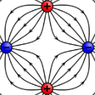

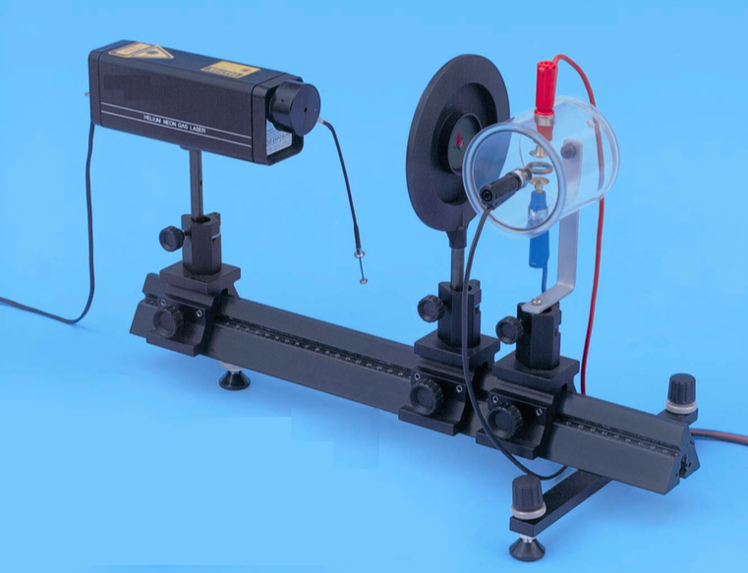
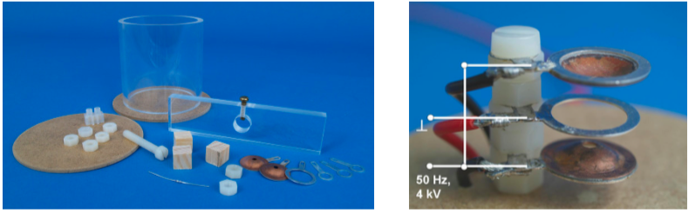
DIY particle trapping
Trap and optical bench
by Leybold ® link
newtonianlabs.com
Coberger, N. (2007). Moderne Modellexperimente als Schülerprojekt - Paulfallen und Teilchenbeschleuniger. Thesis, University Mainz
Prof. Klaus Wendt
Notes:
Newtonian Labs 2013, Newtonian Labs is founded by Dr. Kenneth G. Libbrecht, a professor of physics at Caltech University.
5000EUR for LD trap → 50 EUR
Paul-Falle 558 80 1 862 EUR
He-Ne-Laser, linear polarisiert 8 471 830 1 2250 EUR
Linse in Fassung, f=5 mm 8 460 01 1
Optische Bank mit Normalprofil, 0,5 m 460 335 1 430 EUR
Optikreiter 60/50 8 460 373 3 900 EUR

Slide 14
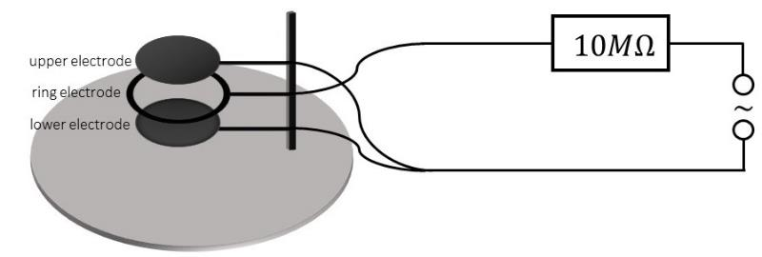
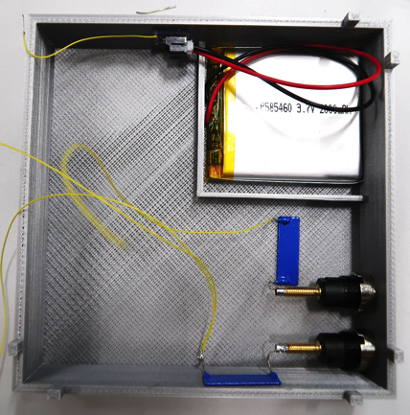
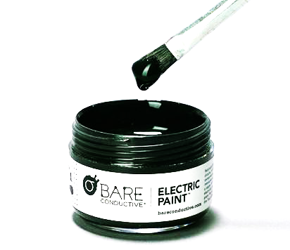
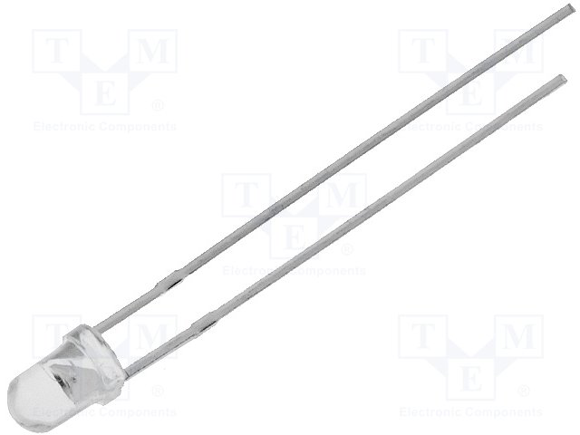
A 3D printable particle trap
2 - 4 kV
bareconductive.com
LL-304PGC2E-G4-1BC
Notes:
Super Bright True Green – high intensity LED Lucky Light LL-304PGC2E-G4-1BC 20 pc 1 Dollar
Conductive paint or Silver conductive paint

Slide 15
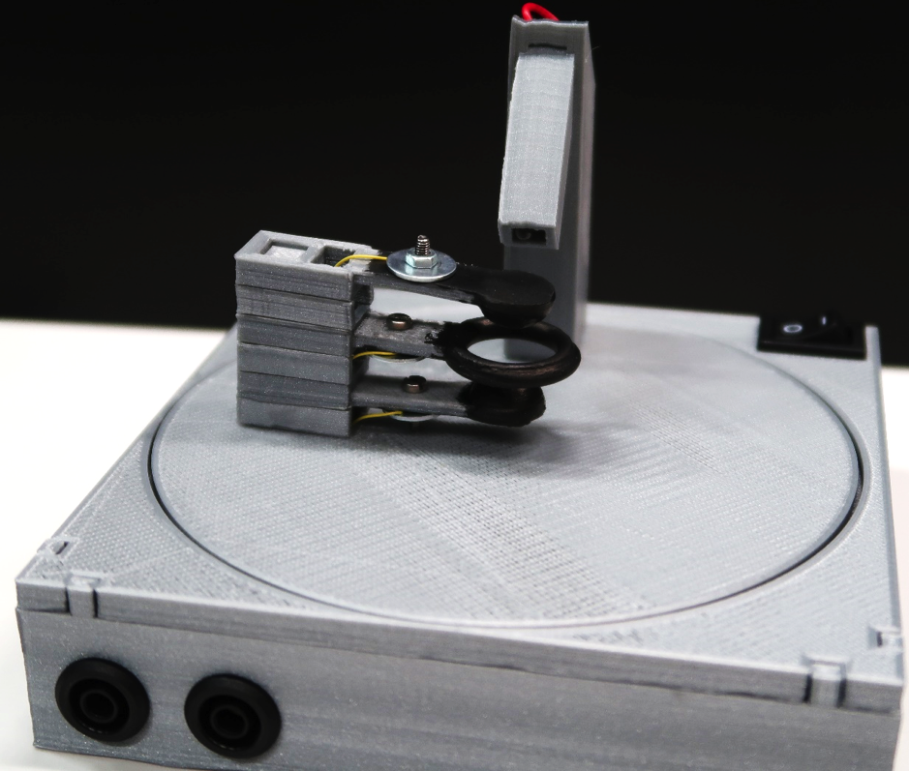
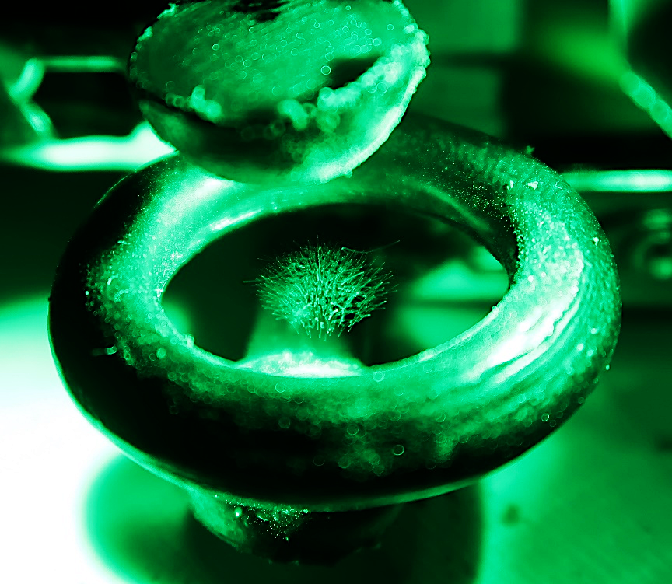
A 3D printable particle trap
Notes:
Add video?

Slide 16

ATLAS – A Toroidal LHC ApparatuS
(Image: ATLAS Experiment/CERN)

Slide 17
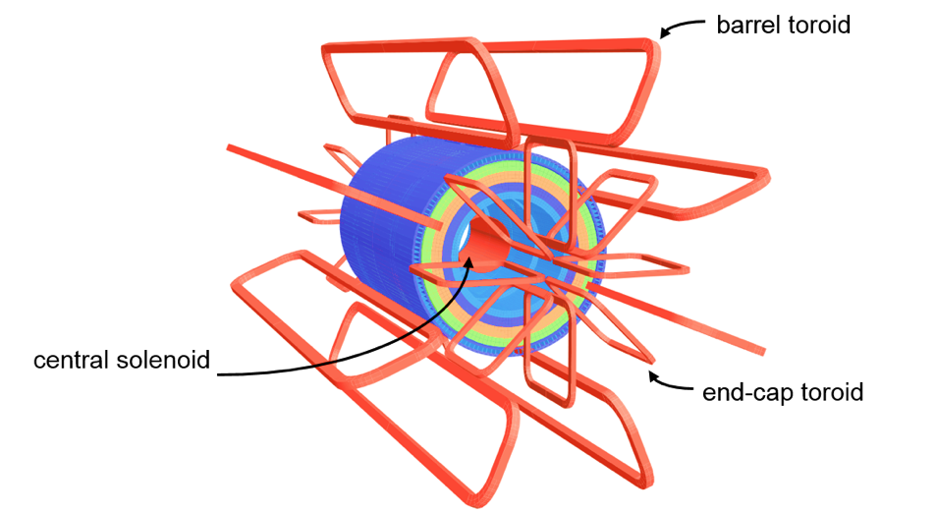
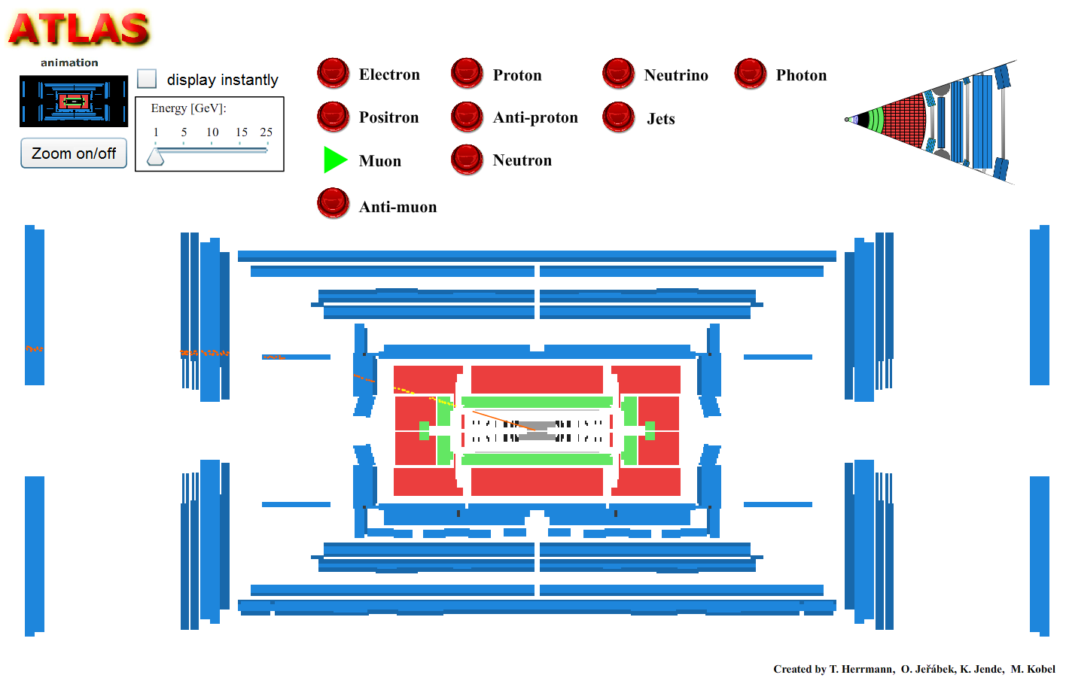
Toroidal magnet system – the T in ATLAS
The ATLAS Collaboration (2008). The ATLAS Experiment at the CERN Large Hadron Collider. Journal of Instrumentation, 3, S08003
http://cdsweb.cern.ch/record/1129811
Hermann, T., Jeřábek, O., Jende, K, & Kobel, M. (2012). Interactive simulation of the ATLAS detector
http://atlas.physicsmasterclasses.org/en/wpath_teilchenid1.htm
Notes:
Lehrer meckern curriculum links, daher lorentz kraft, spulen, magnetfelder

Slide 18
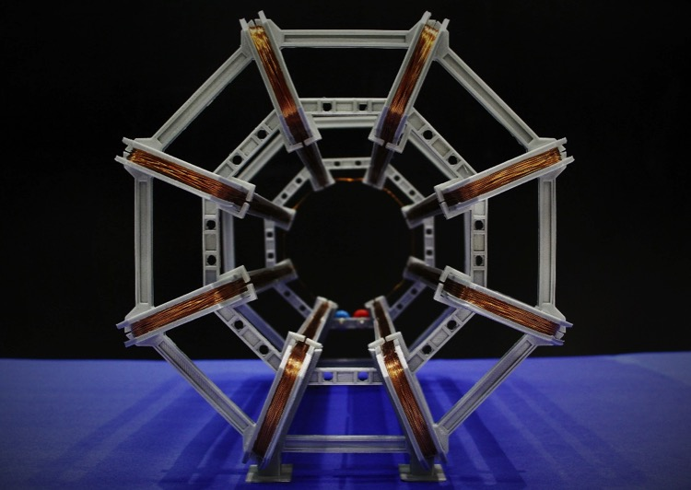
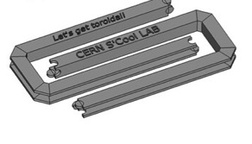
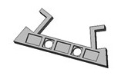
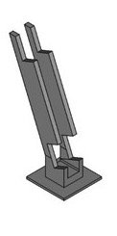
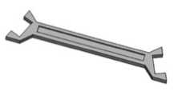
Designing a 3D printable model
FreeCAD 0.16
scaled 1:100
8x
4x
16x
16x
+500 m copper wire
(Image: CERN)
S’Cool LAB www.thingiverse.com/thing:1722230

Slide 19
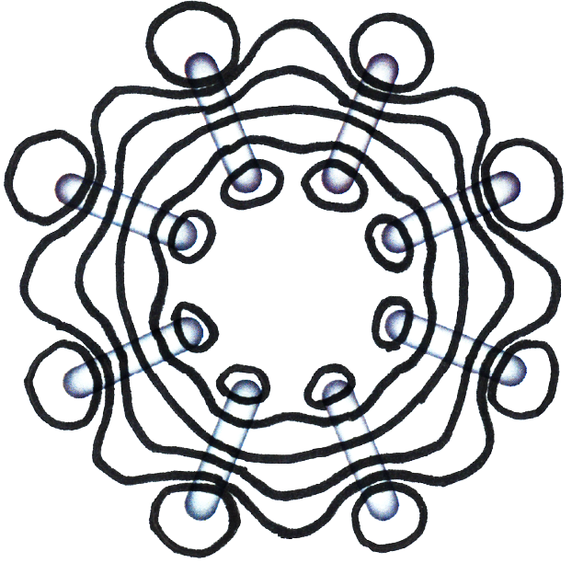
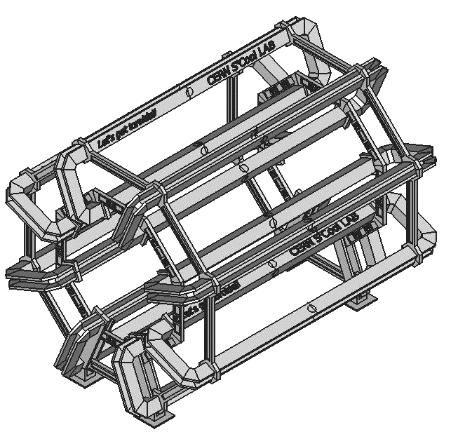
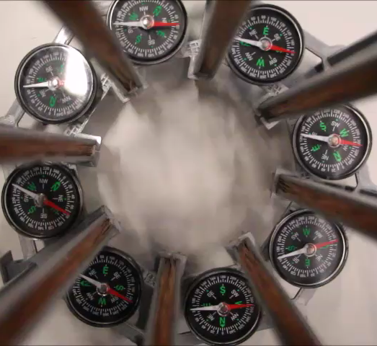
A 3D printable ATLAS magnet model
www.thingiverse.com/
thing:1722286

Slide 20
Comparison between the ATLAS barrel toroid and the functional 3D-printed model
 | Feature | ATLAS toroid¹ | Modell toroid
Dimensions | Inner diameter | 9.4 m | 9.3 cm
 | Outer diameter | 20.1 m | 20.1 cm
 | Length | 25.3 m | 24.7 cm
 | Mass | 830 t | 860 g
Coils | Number of coils | 8 | 8
 | Material | Niobium-Titanium | Enamelled copper wire
 | Operating temperature | 4.5 K | Room temperature
 | Turns per coil | 120 | 80
 | Total length of conductor | 56 km | 500 m
 | Voltage | 16 V | 12 V
 | Nominal current | 20.5 kA | 0.4 A
 | Resistance | 0.16 mΩ | 31 Ω
 | Average magnetic field | 0.5 T | 0.8 mT
¹ The ATLAS Collaboration (2008). The ATLAS Experiment at the CERN Large Hadron Collider. Journal of Instrumentation, 3, S08003 http://cdsweb.cern.ch/record/1129811

Slide 21
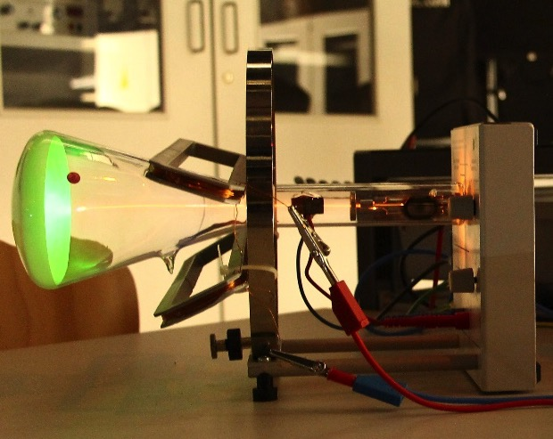
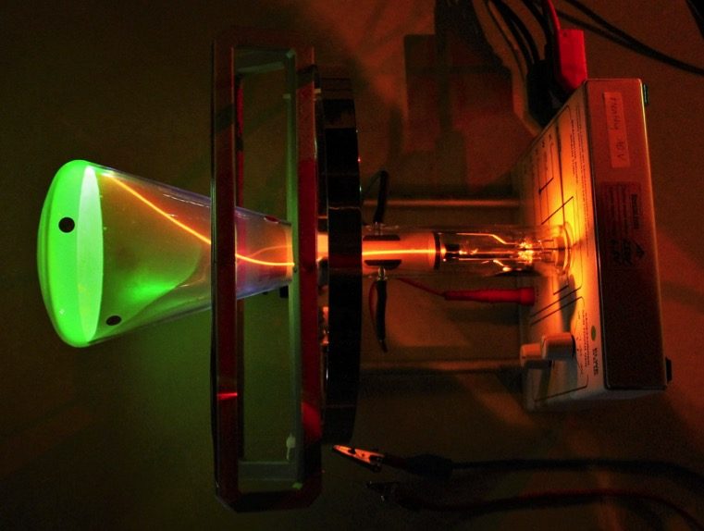
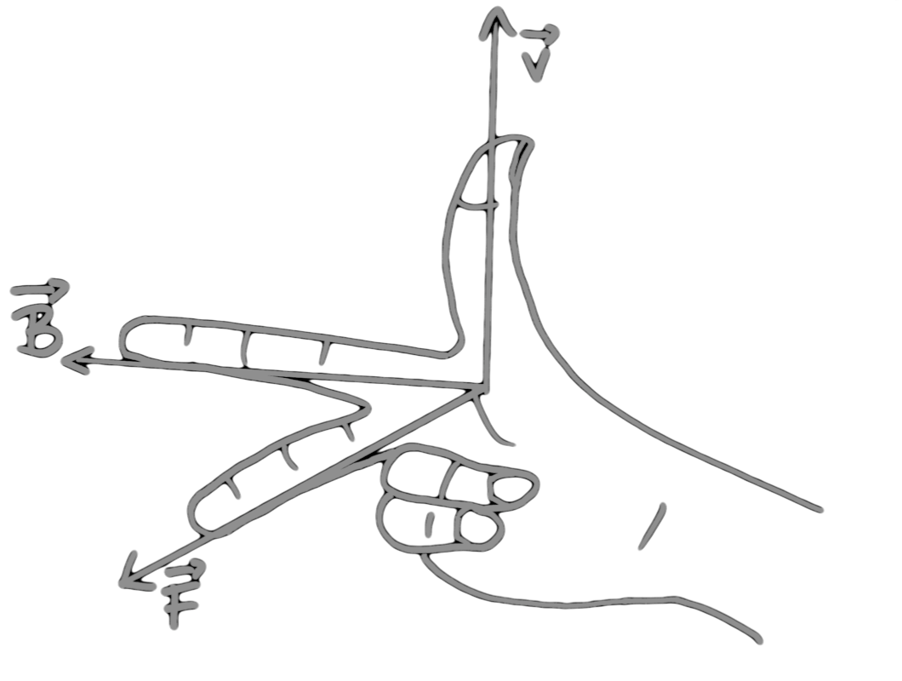
250 eV electron beam & model coils

Slide 22
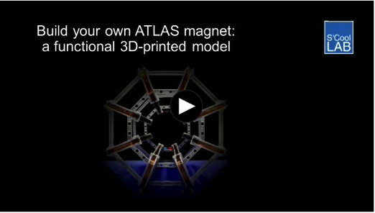
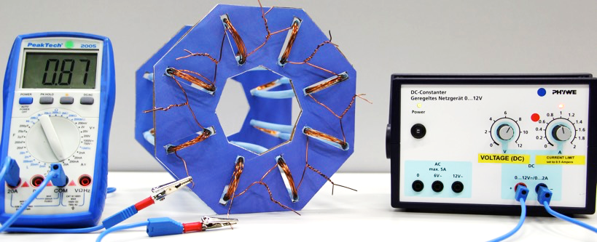
More about the ATLAS magnet model
Video:
https://cds.cern.ch/
record/2255117
Model with straws (German):
https://cds.cern.ch/
record/2244917

Slide 23
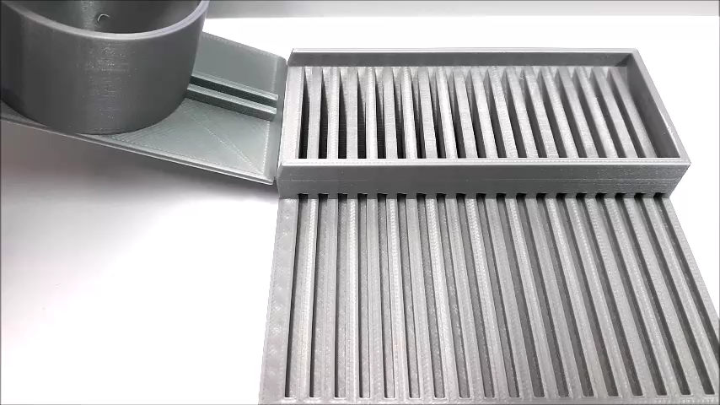
A 3D printable Bragg peak model
Notes:
-dE/dx prop z^2/v^2 * ln
Too bouncy?
Inelastic scattering with electrons
Elastic scattering nucleus
100 steel balls for 5 dollars, CERN 100 for 2 CHF

Slide 24
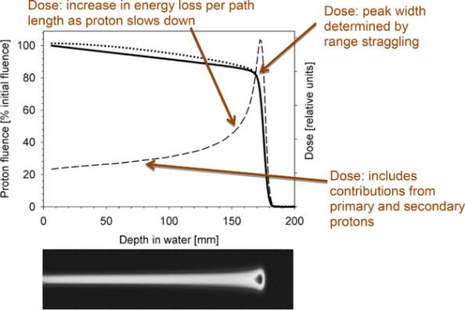
Bragg peak
Paganetti, H. (2017). Proton Beam Therapy https://doi.org/10.1088/978-0-7503-1370-4ch1
Notes:
Mostly electromagnetic interaction – inelastic coulomb scattering with electron
1% of protons per cm : nuclear reaction producing secondary protons
Dotted line: primary and secondary protons
Solid line: only primary protons
A peak occurs because the interaction cross section increases as the charged particle's energy decreases. Energy lost by charged particles is inversely proportional to the square of their velocity, which explains the peak occurring just before the particle comes to a complete stop

Slide 25

Stone skipping
A stone skipping on calm water © Killy Ridols

Slide 26






A 3D printable Bragg peak model
14°
20°
26°
32°
Notes:
Was sehe ich? Verteilung der position des bragg peaks = max dE/dx?
Range in matter – gauss verteilt, landau verteilt?
Range depends on energy
Range = slot when 50% of the marbles are gone
14-5, 20-7, 26-8.5, 32-
10.5
Evans The Atomic Nucleus, (McGraw Hill) page 660 "Identical charged particles, all having the same initial velocity do not all have the same range. The observed ranges of individual particles from any monoenergetic source will show a normal (gaussian) distribution about the mean range. As early as 1912. Darwin correctly identified this distribution as due to statistical fluctuations in the individual collisions between the charged particle and atomic electrons, and named the effect range straggling."
Reference https://www.physicsforums.com/threads/why-straggling-appears.445419/
http://slideplayer.com/slide/11479998/ range straggling
Bragg Kleeman Rule http://holbert.faculty.asu.edu/eee460/IonizationRange.pdf R = a*E^1.8 (protons), R= a*E - b (alpha particles)

Slide 27

A 3D printable Bragg peak model
14°
20°
26°
32°
Notes:
Was sehe ich? Verteilung der position des bragg peaks = max dE/dx?
Range in matter – gauss verteilt, landau verteilt?
Range depends on energy
Range = slot when 50% of the marbles are gone
14-5, 20-7, 26-8.5, 32-
10.5
Evans The Atomic Nucleus, (McGraw Hill) page 660 "Identical charged particles, all having the same initial velocity do not all have the same range. The observed ranges of individual particles from any monoenergetic source will show a normal (gaussian) distribution about the mean range. As early as 1912. Darwin correctly identified this distribution as due to statistical fluctuations in the individual collisions between the charged particle and atomic electrons, and named the effect range straggling."
Reference https://www.physicsforums.com/threads/why-straggling-appears.445419/
http://slideplayer.com/slide/11479998/ range straggling
Bragg Kleeman Rule http://holbert.faculty.asu.edu/eee460/IonizationRange.pdf R = a*E^1.8 (protons), R= a*E - b (alpha particles)

Slide 28

More 3D printable low-cost experiments!
coming soon!

Slide 29

What we’ve learned:
3D-printable experiments very well received
Modern physics topics prominently featured
Committee on International Physics Education
Fruitful discussions with Exploratorium in SF
Being vacuum sealed is fun

Slide 30
Thank you for your attention!
S’Cool LAB publications: cern.ch/s-cool-lab
Jeff's publications: cern.ch/jeff.wiener

Slide 31



Particle physics hands-on
„Real“ particle physics
Functional models
Structural models
Notes:
experiencing particle physics

