Slide 1


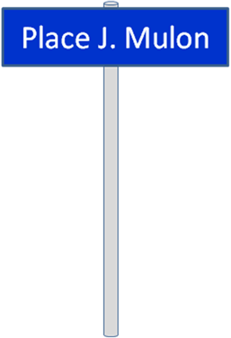
DT Science-Techno Tea
Thé virtuel
DT News (5') Christian Joram
Assembly of a straw prototype for NA62 and the use of CNC machines
(examples from NA62) (20’)
Francisco Perez and Jerome Bendotti
Cooling Problems for Silicon detectors of LHC and SLHC (20’)
Paolo Petagna
Inauguration of ‘Place J. Mulon’
All
8 Oct 2009

Slide 2
  DT personnel matters
  Two new staff members (since 1 Oct. in section DT-PO ):
  - Paola Tropea, engineer
  - Ian Godlewski, engineer
    CMS / ATLAS detector cooling
    New DT cooling activity
  Philippe Fontaine-Vive-Roux (electro-mechanical technician), member of PH-ESE group, supports gas systems team (Vincent Darras, FSU technician left team, now staff in TE-GRG)
  4 fellows (already mentioned in June meeting) arrived (5th will start in 2010)
    DAGUIN, Jerome , Det. Cooling, supervisor P. Petagna
    ZWALINSKI, Lukasz, Det. Cooling, supervisor P. Petagna
    DROZD, Adam, WP6, Quality assurance, supervisor A. Honma
    MOLNAR, Levente, ALICE, supervisor P. Martinengo
    Visitor, (1 month), Santoyo Munoz, David → Design Office
  Appointments of indefinite contracts
    Jerome Noel
    Christophe Bault
    Frederic Merlet
    Sylvain Ravat
    Veronique Wedlake

Slide 3
  DT personnel matters
  Retirements
  José Mulon (30/9)
  Stephane Rangod (31/10)
  Left DT group
  Katharina Kaska, PhD student. End of contract (30/9). Finishing thesis at Univ. Vienna.
  Nominations by Department Leader
  Ferdi Hahn: Technical Coordinator of NA62 experiment.
  Antti Onnela: GLIMOS of CLOUD experiment

