Slide 1
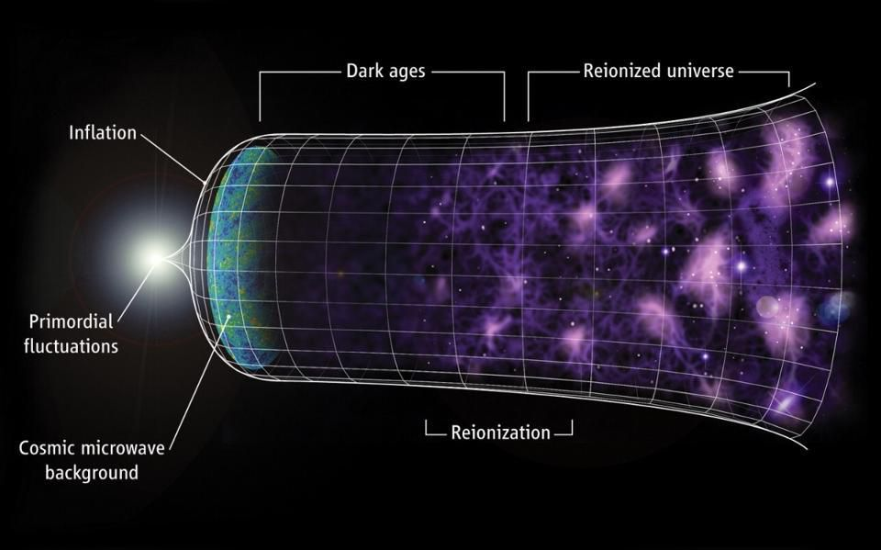
The Future of Cosmology
Prof. George F. Smoot
Hong Kong University of Science and Technology
PCCP Université Sorbonne Paris Cité
University of California at Berkeley
ECL Nazarbyaev University

Slide 2
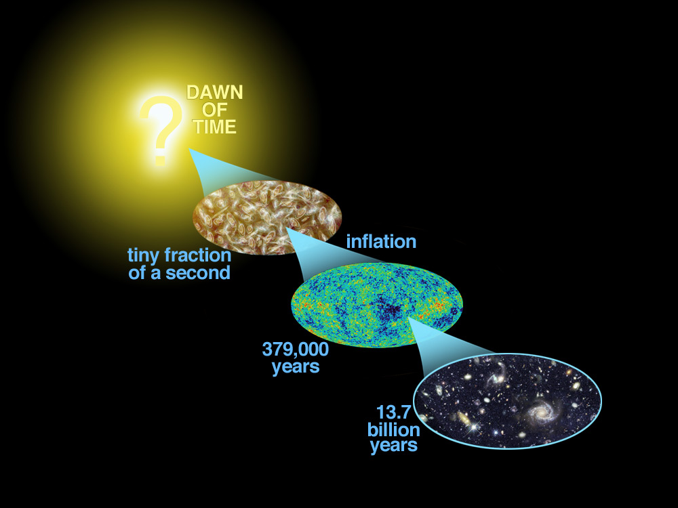

Slide 3
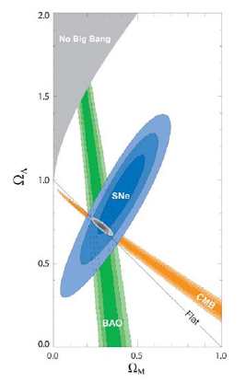
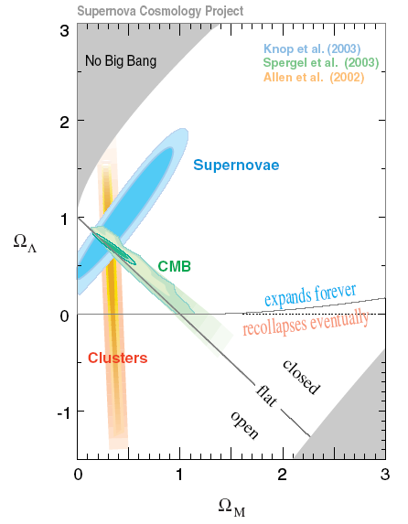
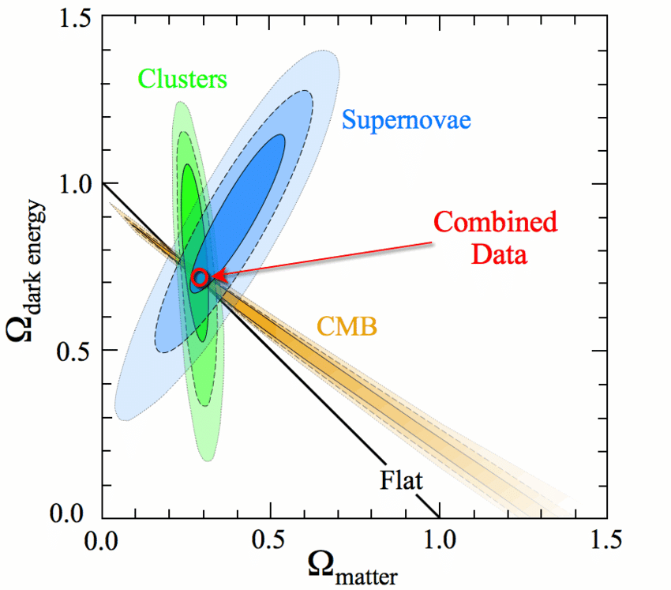
Observational support for the CDM model (http:rpp.lbl.gov)

Slide 4
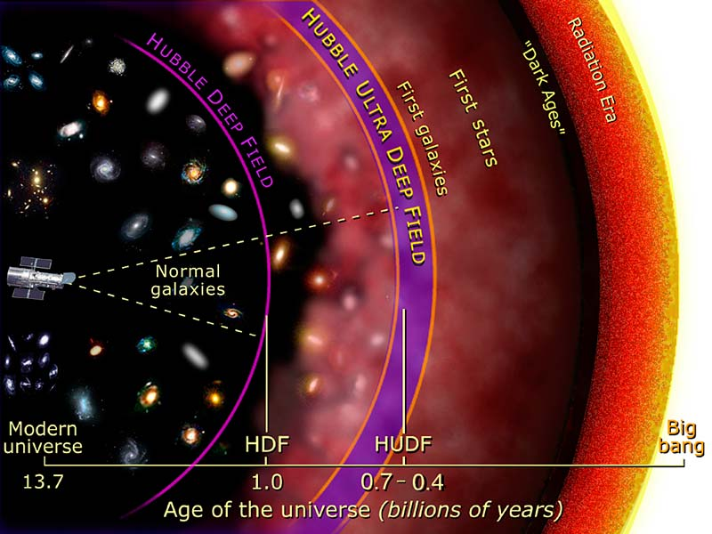

Slide 5
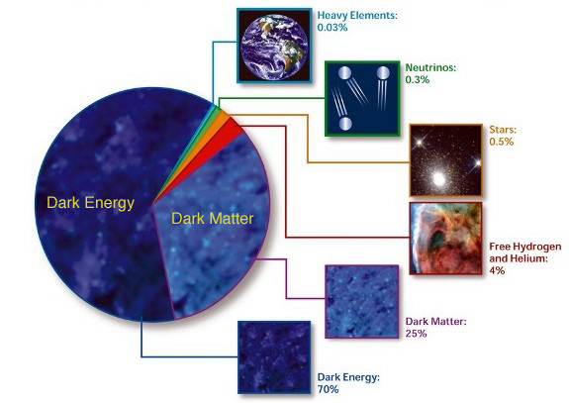
The Energy Budget of the Universe

Slide 6
Standard cosmological model
Cosmological principle (Isotropy and homogeneity at large scales)
Friedmann-Lemaitre-Robertson-Walker metric
Energy-momentum (perfect fluid)
Dynamics (Friedmann equations)

Slide 7
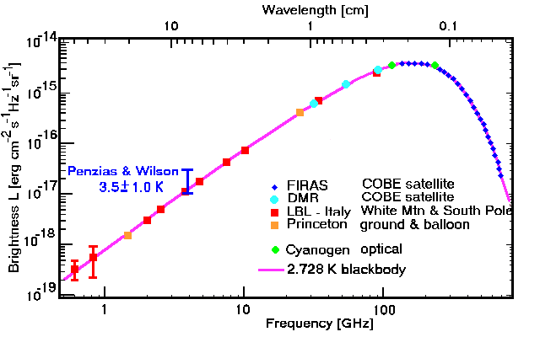
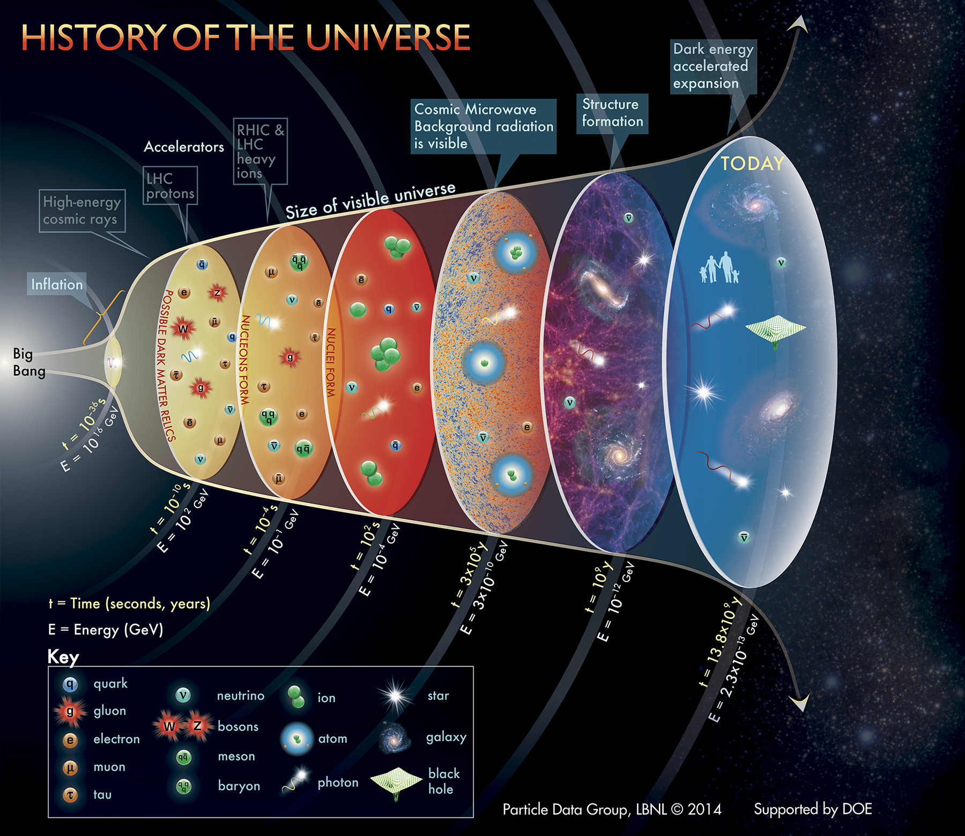
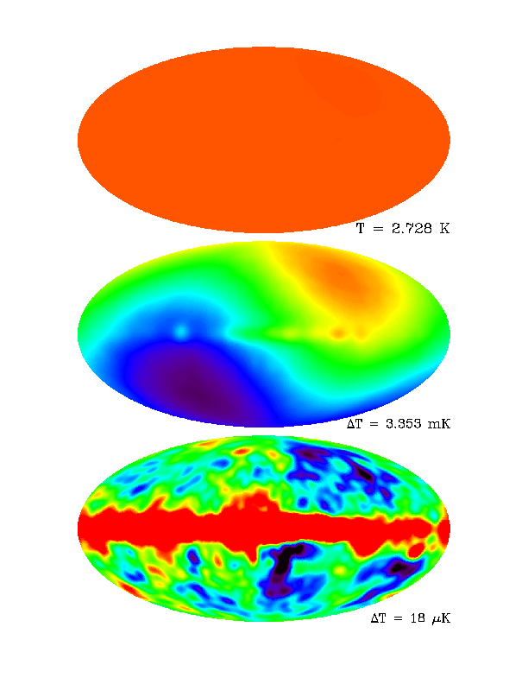

Slide 8
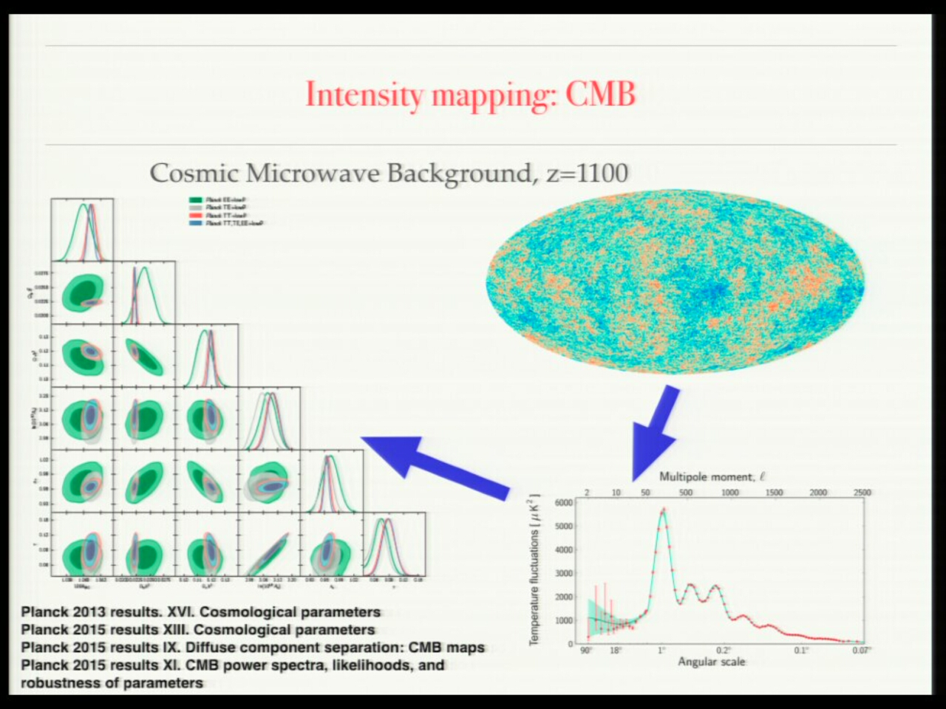
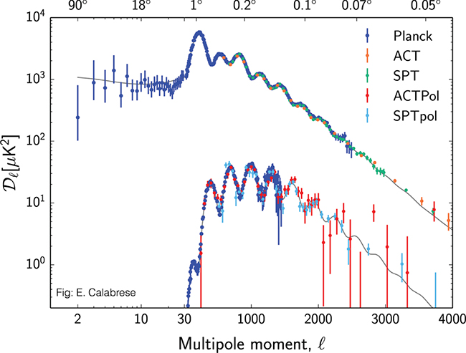

Slide 9
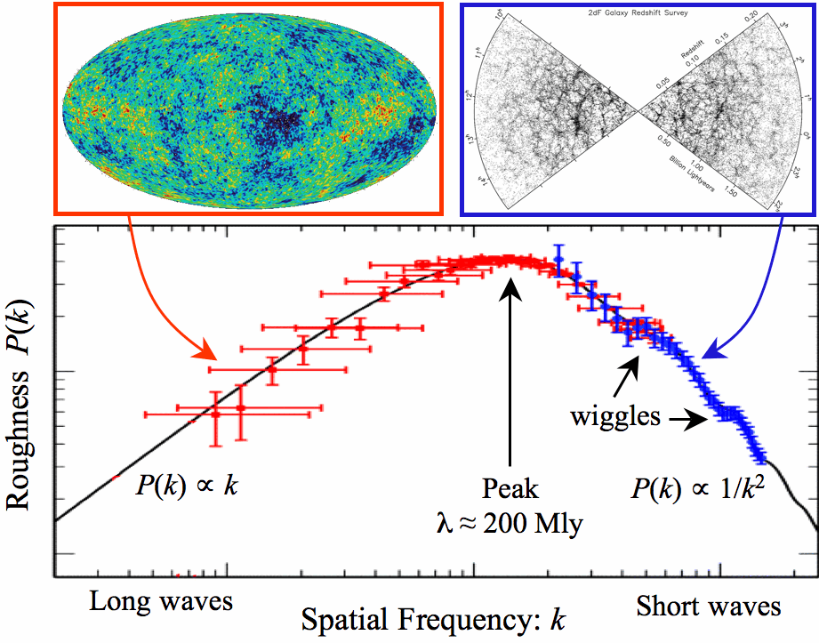
Observations show very good fit to cosmology model
The Sloan Digital Sky Survey - Baryon Oscillation Spectroscopic Survey
has transformed a two-dimensional image of the sky (left panel)
into a three-dimensional map spanning distances of billions of light years,
shown here from two perspectives (middle and right panels).
This map includes 120,000 galaxies over 10% of the survey area.
The brighter regions correspond to the regions of the Universe
with more galaxies and therefore more dark matter.
Notes:
How much is too much? The power spectrum puts strong limits on the amount of hot dark matter that is tolerable. The upper limit is ∑m_{ν} < 0.12 eV. This is an order of magnitude stronger than direct experimental constraints.

Slide 10
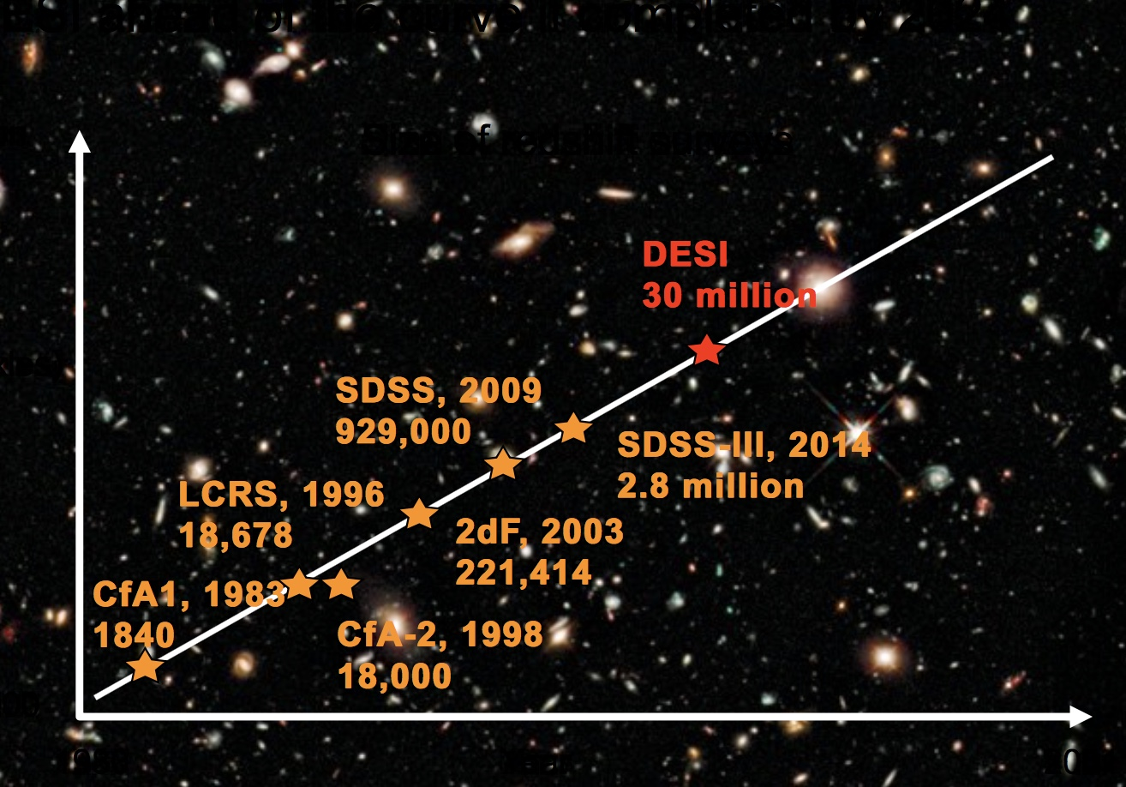

Slide 11
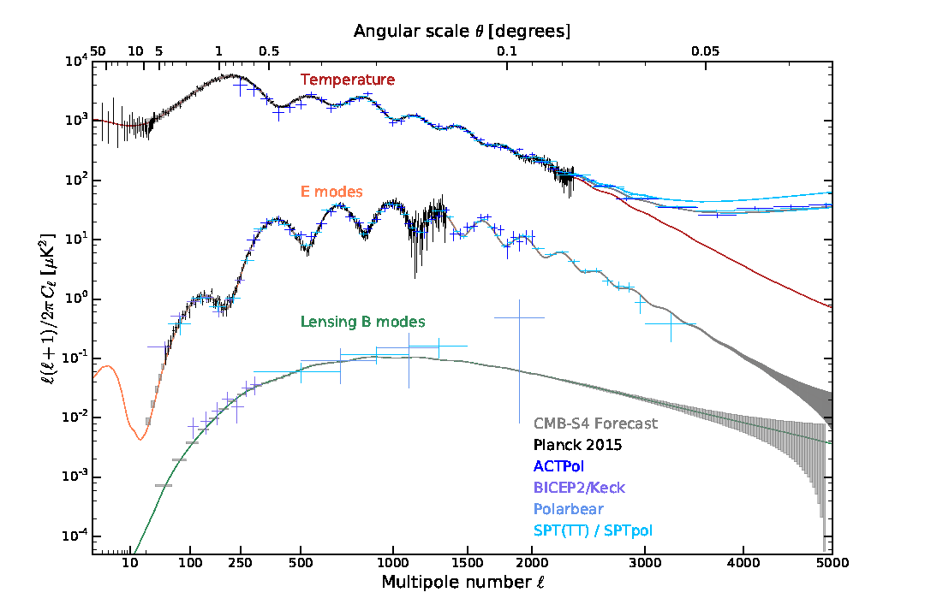
CMB Angular Power Spectra
Theory
Current and Proposed Observations
Scott & Smoot 2015
CMB S4 Science Report

Slide 12
Cosmic Microwave Background (CMB) Radiation
The 'Stage-4' ground-based cosmic microwave background (CMB) experiment, CMB-S4, consisting of dedicated telescopes
equipped with highly sensitive superconducting cameras operating at the South Pole, the high Chilean Atacama plateau,
and possibly northern hemisphere sites, will provide a dramatic leap forward in our understanding of the fundamental nature
of space and time and the evolution of the Universe. CMB-S4 will be designed to cross critical thresholds in testing inflation,
determining the number and masses of the neutrinos, constraining possible new light relic particles,
providing precise constraints on the nature of dark energy, and testing general relativity on large scales.

Slide 13
Cosmic Background Radiation

Slide 14
CMB S4 Update John Carlstrom

Slide 15
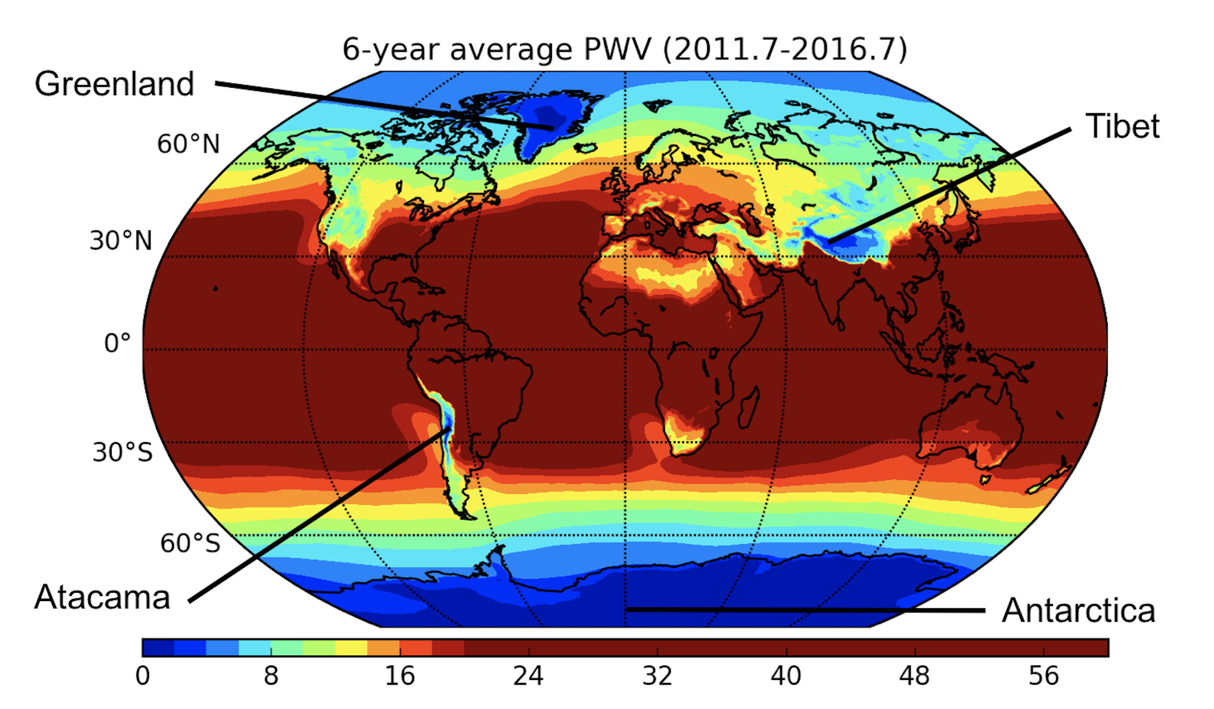
Atmospheric Precipitable Water Vapor

Slide 16
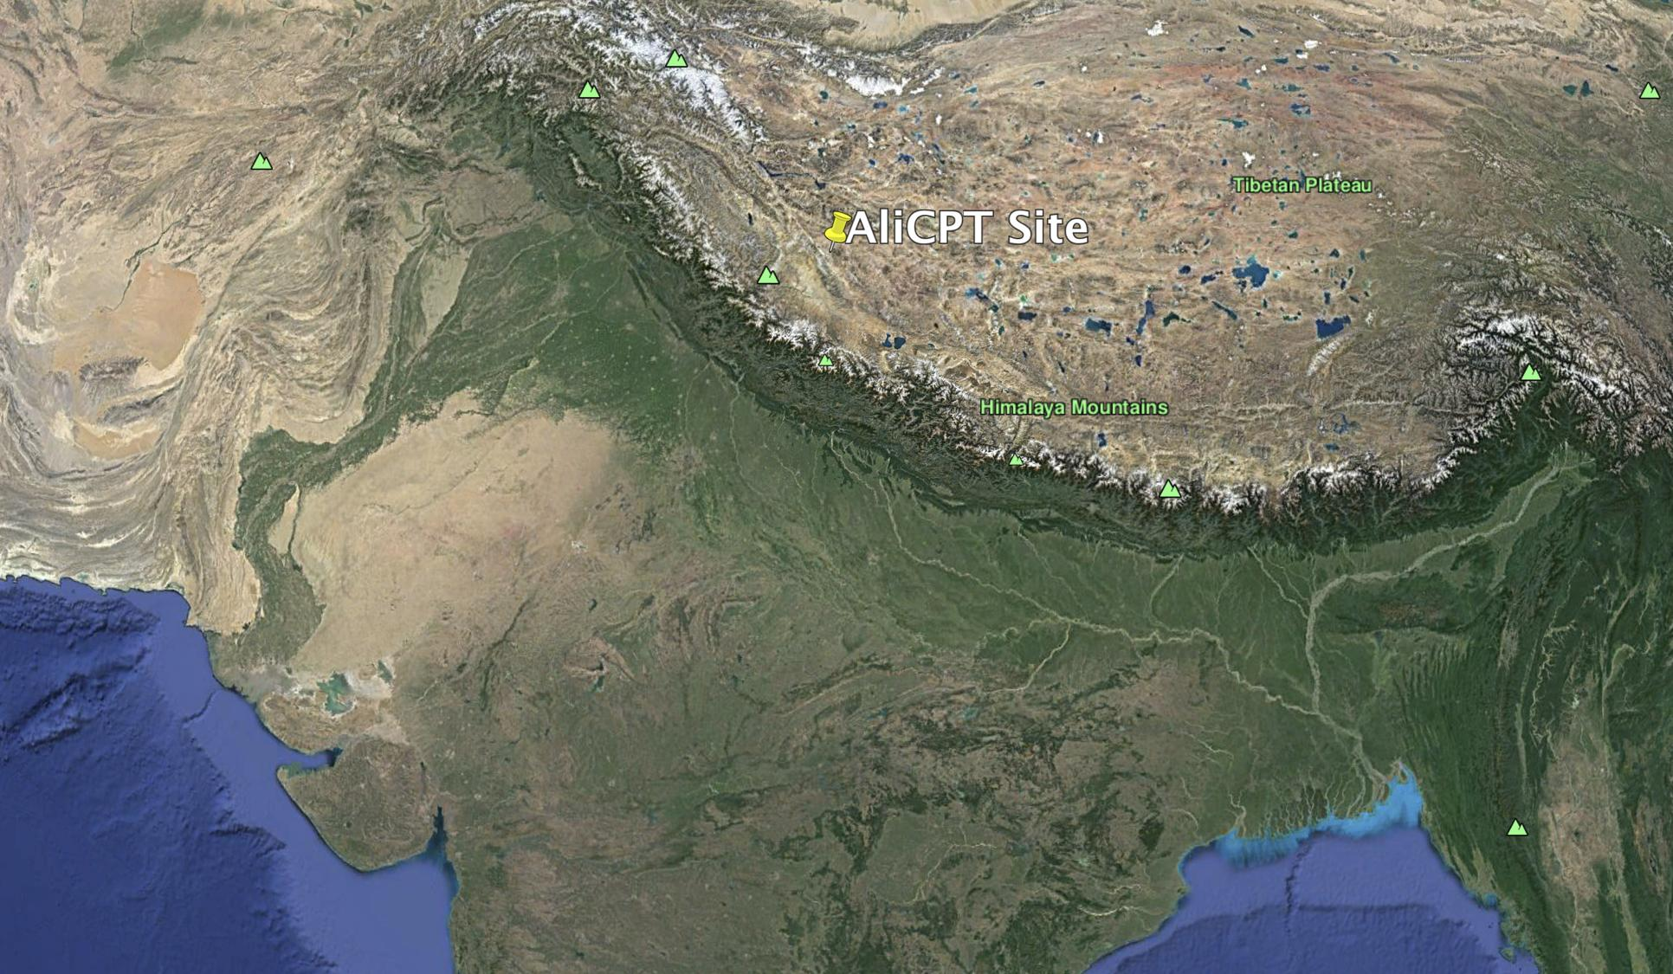

Slide 17
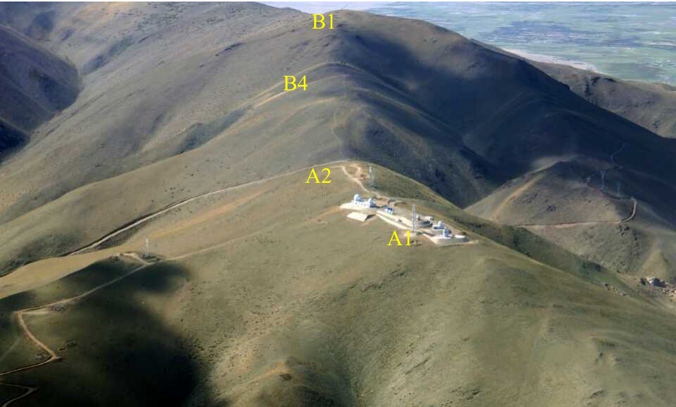
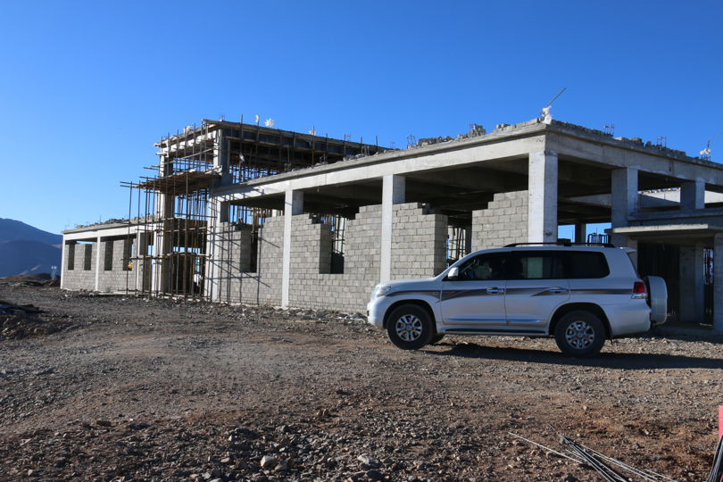
Ali CMB Program Observing Site
Name | Ali CPT-1 | Ali CPT-2
Year | 2019 | 2020-2022
Altitude | 5250 m | 6000 m
#Detectors | 7,000 | >20,000
Frequencies | 95 & 150 GHz | 95 & 150 GHz

Slide 18
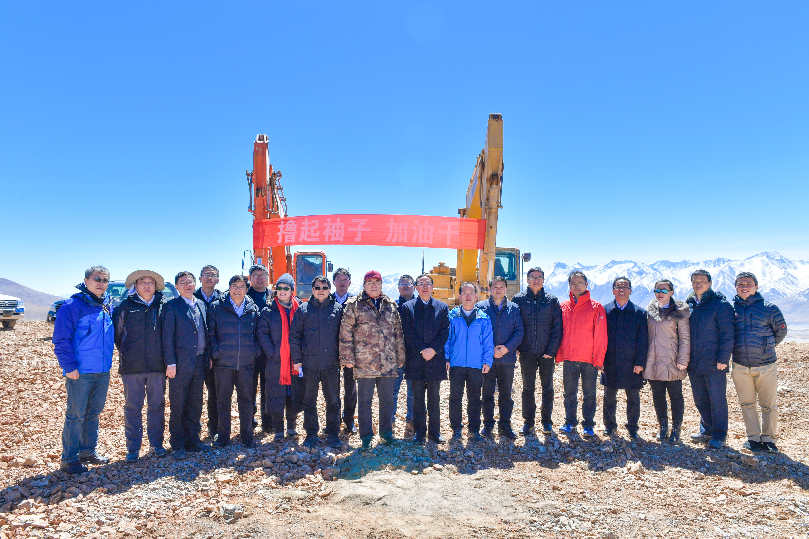

Slide 19
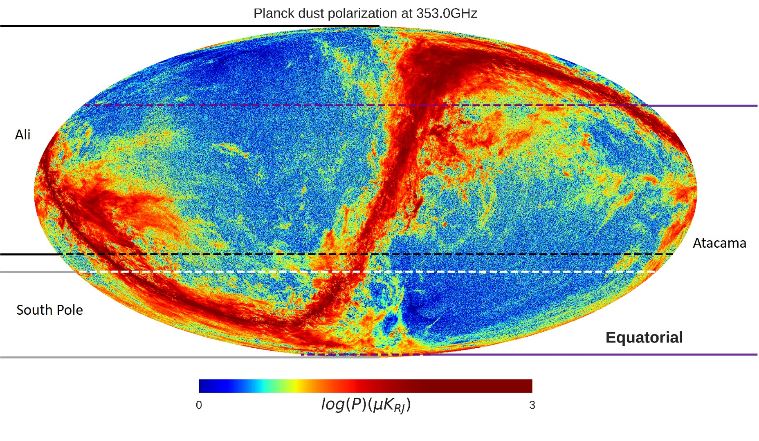
Notes:
Plots of the observable sky for AliCPT together with BICEP (the South Pole) and POLARBEAR (Atacama). Region above the black dashed line is for AliCPT, regions below the white and purple dashed lines are for BICEP and POLARBEAR. The background is the dust polarization brightness temperature from Planck 2015 results. The minimum and maximum are set tobe1.0μKRJ and1.0×103μKRJ

Slide 20
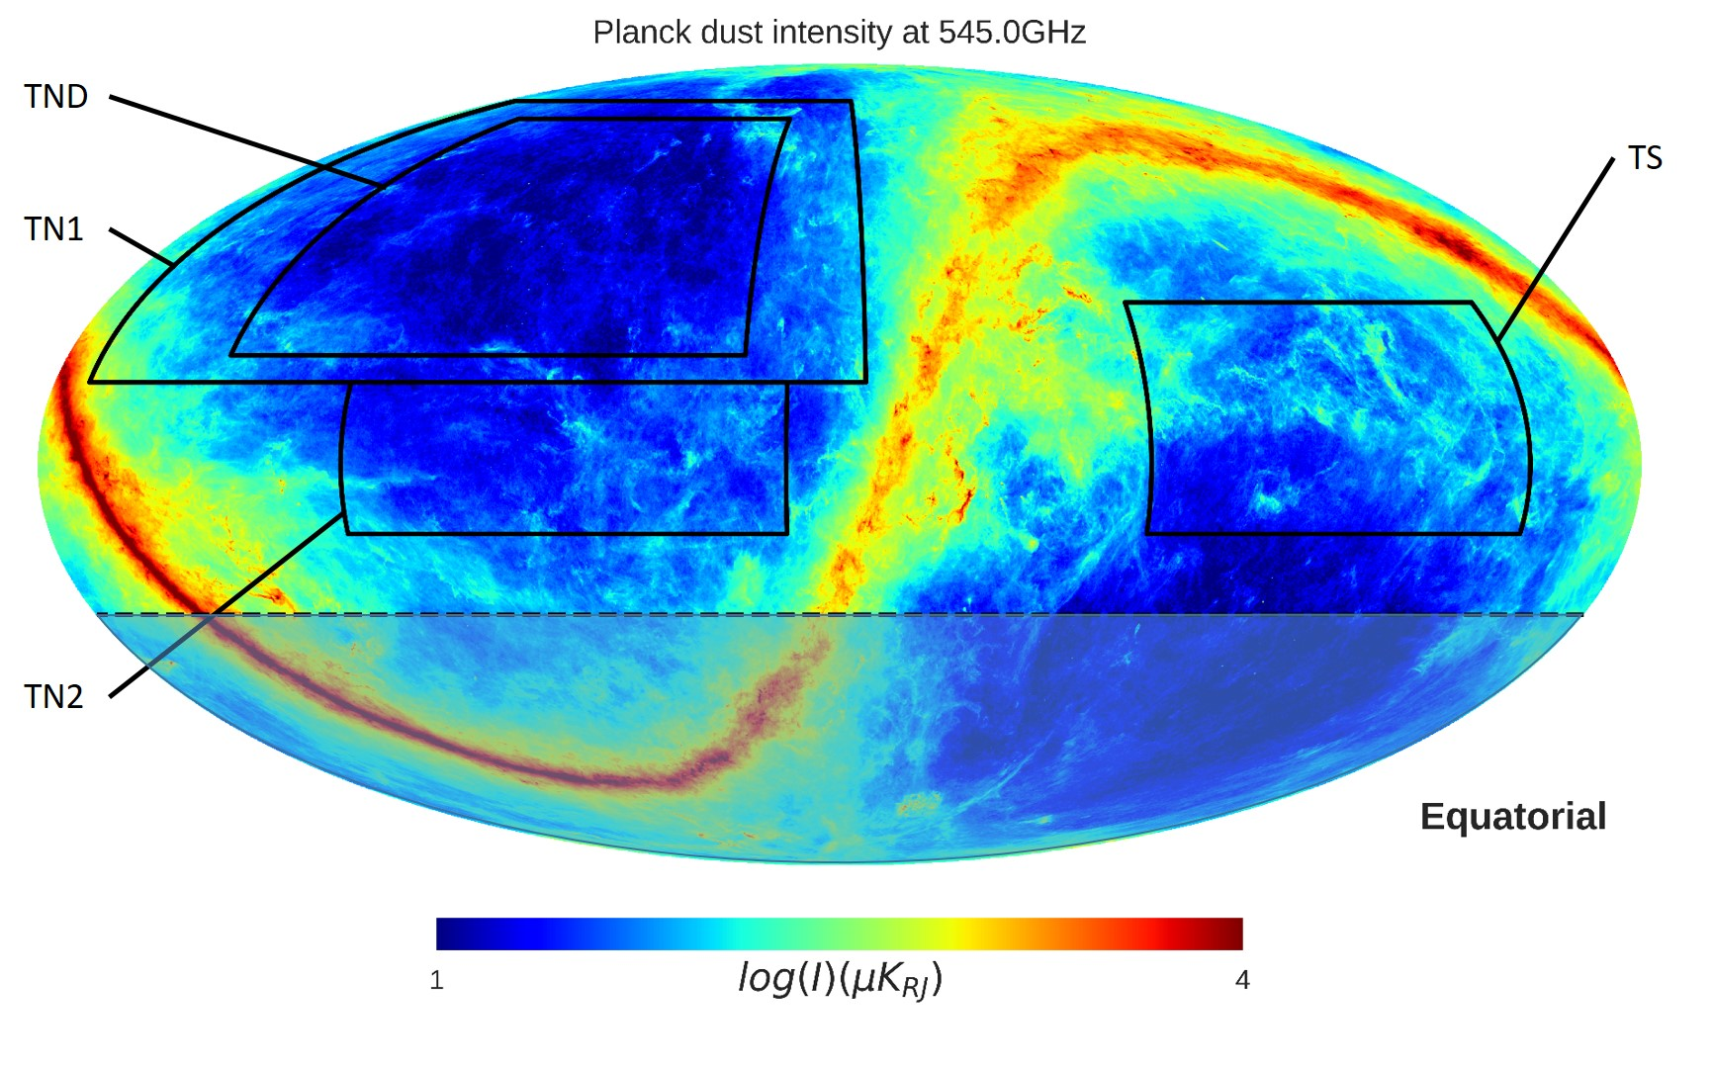
Notes:
Target fields for AliCPT. TN1 and TN2 regions are the target fields in the northern galactic hemisphere, TS is the target field in the southern galactic hemisphere. The smaller TND region with the lowest foreground is for deeper scan. The background is the dust intensity brightness temperature from Planck 2015 results. The minimum and maximum are set to be 10.0μKRJ and 1 × 104μKRJ

Slide 21
The Copernican Time Principle
The current cosmological epoch
has no special significance.
Interesting physics processes will
continue to take place in the future,
despite very decreased energy levels.
Can we get Cosmological Principle in Time?
Will that define the future of cosmology.

Slide 22
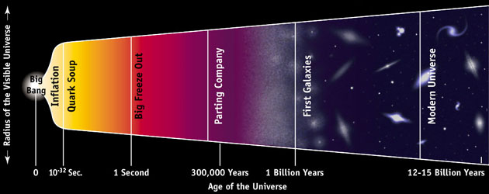
Cosmic Timeline
Five Ages of the Universe
Primordial Era n < 6
Stelliferous Era n = 6 - 14
Degenerate Era n = 14 - 40
Black Hole Era n = 40 - 100
Dark Era n > 100
10^{n} years
Fred Adams 2002

Slide 23
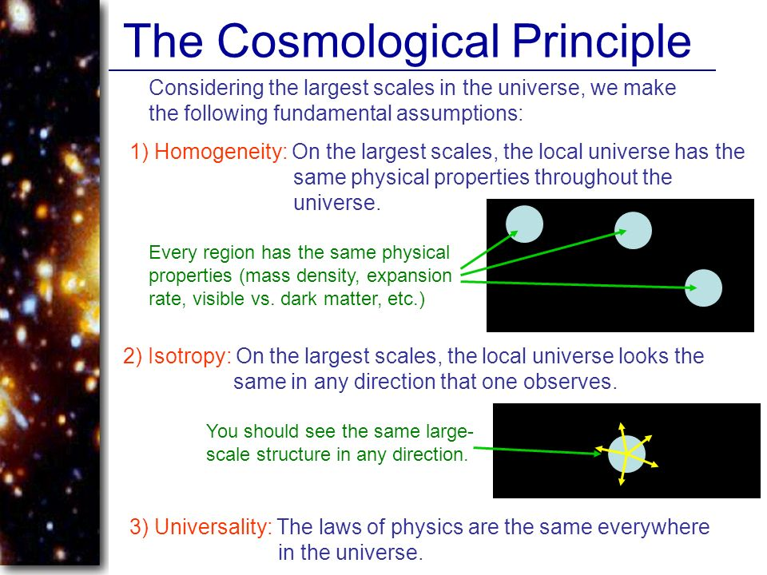

Slide 24
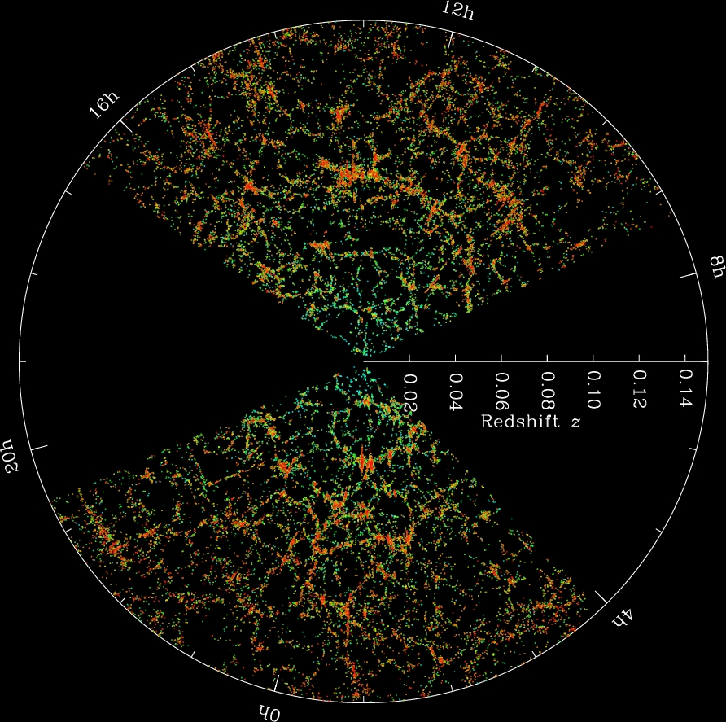
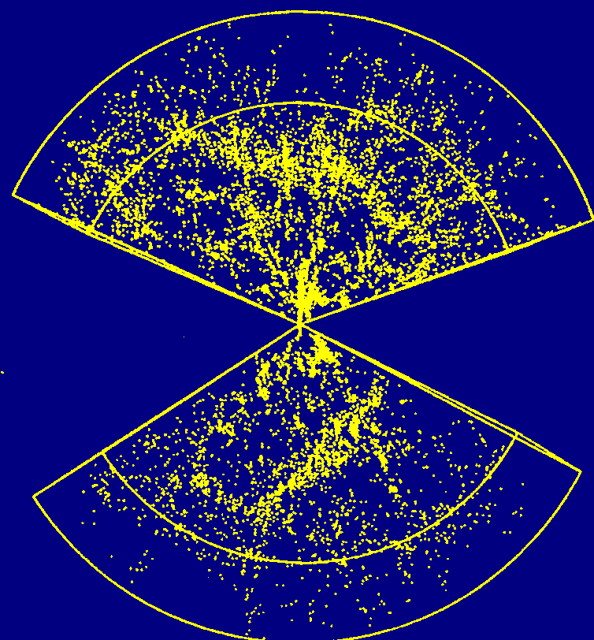
Observed Distribution
of Galaxies
SDSS
Notes:
Slices through the SDSS 3-dimensional map of the distribution of galaxies. Earth is at the center, and each point represents a galaxy, typically containing about 100 billion stars. Galaxies are colored according to the ages of their stars, with the redder, more strongly clustered points showing galaxies that are made of older stars. The outer circle is at a distance of two billion light years. The region between the wedges was not mapped by the SDSS because dust in our own Galaxy obscures the view of the distant universe in these directions. Both slices contain all galaxies within -1.25 and 1.25 degrees declination.
Credit: M. Blanton and the Sloan Digital Sky Survey.

Slide 25
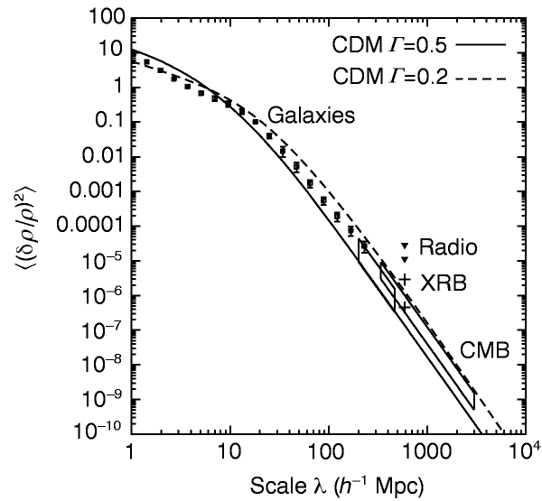
Cosmological Principle Re-Interpeted Currently

Slide 26
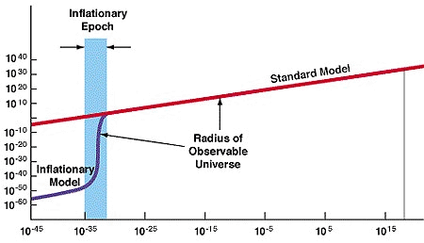
The Inflationary Universe
(Guth)
Time in seconds

Slide 27
Observational Constraints on the Primordial Curvature Power Spectrum -
Emami, Razieh & George F. Smoot. JCAP 1801 (2018) no.01, 007 arXiv:1705.09924 [astro-ph.CO]

Slide 28
Supermassive Black Holes
Rough currrent curvature spectrum
Observational Constraints on the Primordial Curvature Power Spectrum -
Emami, Razieh & George F. Smoot. JCAP 1801 (2018) no.01, 007 arXiv:1705.09924 [astro-ph.CO]

Slide 29
Supermassive Black Holes
Rough currrent curvature spectrum
Earth Size
Observational Constraints on the Primordial Curvature Power Spectrum -
Emami, Razieh & George F. Smoot. JCAP 1801 (2018) no.01, 007 arXiv:1705.09924 [astro-ph.CO]

Slide 30
Supermassive Black Holes
Atoms x 10⁶
Rough currrent curvature spectrum
Earth Size x 10⁴
Nuclei
10³²
10³⁷
Observational Constraints on the Primordial Curvature Power Spectrum -
Emami, Razieh & George F. Smoot. JCAP 1801 (2018) no.01, 007 arXiv:1705.09924 [astro-ph.CO]

Slide 32
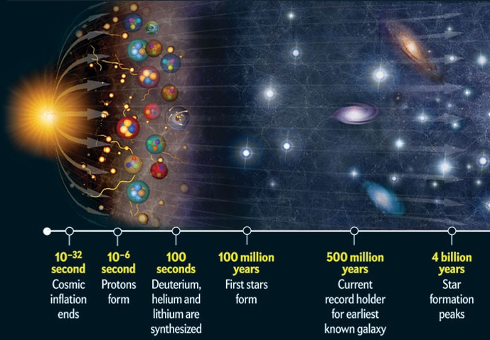

Slide 33
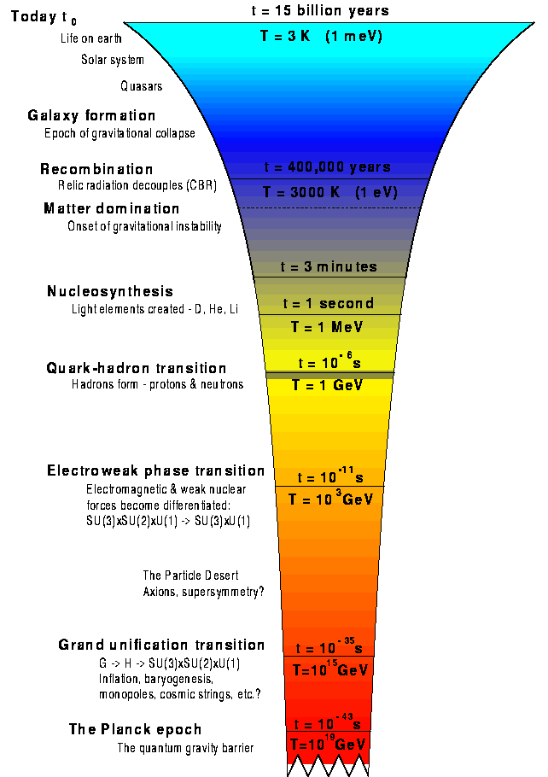
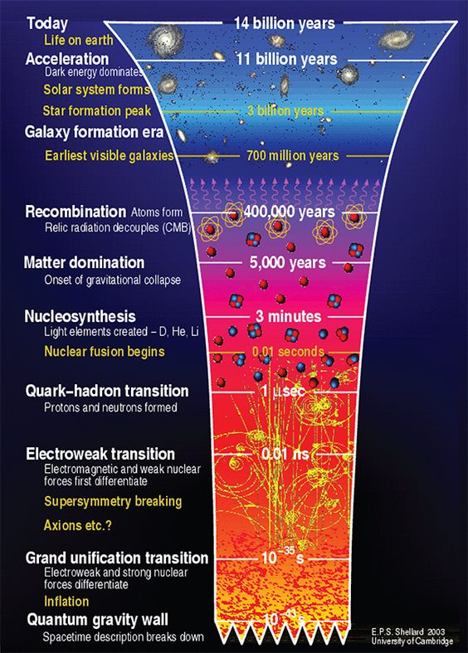

Slide 34
Cosmic Energy/Time
Time | Time (s) | Event
-43 |  | Planck Time | 10^19 GeV | 28
-35 |  | Grand Unification Transition | 10^15 GeV | 24
-33 |  | Inflation |  | 23
-32 |  | End of Inflation |  | 21
-11 |  | Electroweak phase transition | 10^3 GeV | 12
-6 |  | protons form/ quark-gluon phase transition | 1 GeV | 9
2 |  | D, He, Li light element synthesis | 1 MeV | 6
 | 10000 | Matter Domination structure formation begins
12.5 | 400000 years | Recombination, CMB freed | 10eV | 1
15.5 | 10^8 years | First stars
16 | 5*10^8 years | first galaxies
17 | 4*10^9 years | star formation peaks
 | 10 *10^9 years | Dark Energy begins accel | 1 meV | -3
17.5 | 14*10^9 years | Present | 1 meV | -3
 |  | ALP 1 |  | -18
 |  | ALP 2 |  | -22
 |  | ALP 3 |  | -28
Kind of global see-saw mechanism
At any time in the universe there is a “special” time transition nearby on an approximately log scale

Slide 35
Broken Symmetries
Cosmological Principles
Observations
The Copernican Principle:
  We do not occupy a special place in the Universe
The Cosmological Principle:
  The Universe is homogeneous and istotropic (no special place or direction)
The Perfect Cosmological Principle:
  The Universe is homogeneous in space and time, and is isotropic in space.
The Weak Anthropic Principle:
  Life can exist only in the Universe as it is.
The Strong Anthropic Principle:
  The Universe is such as it is, because its purpose is to create life.
Well Earth is pretty special for light years. There is no Planet B.
The Universe is homogeneous only on very large scales and more in the past than now. Seems isotropic on large scales.
Clearly wrong on the homogeneity of time on even largest observed scales.
No clear observations supporting this concept.
Not necessarily well defined statement.

Slide 36
The Einstein-Hilbert action
Variational Principle
Locality & boundary
EH gravitational Lagrangian
Key is variation of the metric
Obtain the full field equations by adding the matter Lagrangian and vary the action
Or a la Bjorken : MacDowell–Mansouri action : Unified Geometric Theory of Gravity and Supergravity

Slide 37
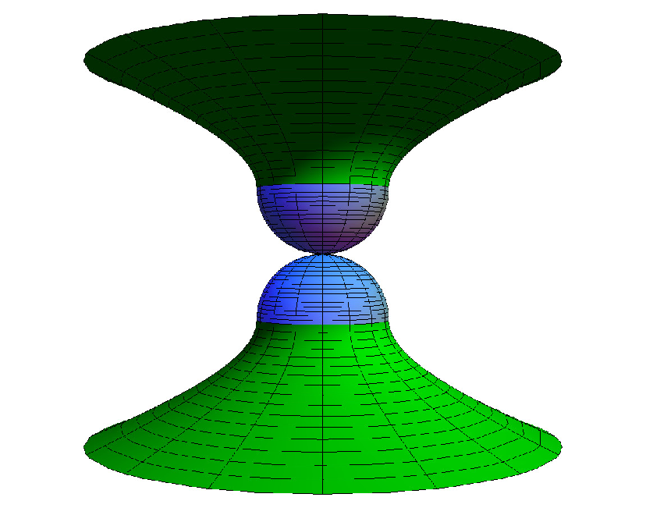
MacDowell-Mansouri action with FRW symmetry imposed
Plotted is a solution to the equations of motion obtained from the MacDowell-Mansouri action with FRW symmetry imposed. The blue regions have Euclidean signature metric and the green Lorentzian. The whole manifold consists of Euclidean pole-less four-sphere hemispheres attached to halves of the de Sitter spacetime and joined via hyper-surface where the spatial triad is vanishing. Apart from the fact that the polynomial field equations allow for analytical extension through the event where the radius of the universe is zero (where the South and North poles join), this constitutes an exact classical realization of the Hartle-Hawking no-boundary proposal. Solutions with a deficit angle at the South Pole also exist and correspond to non-zero values for the contorsion form.

Slide 38
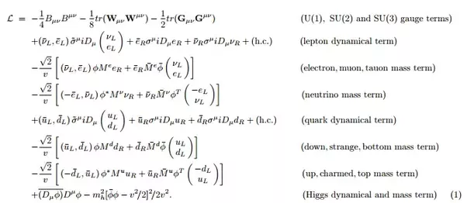
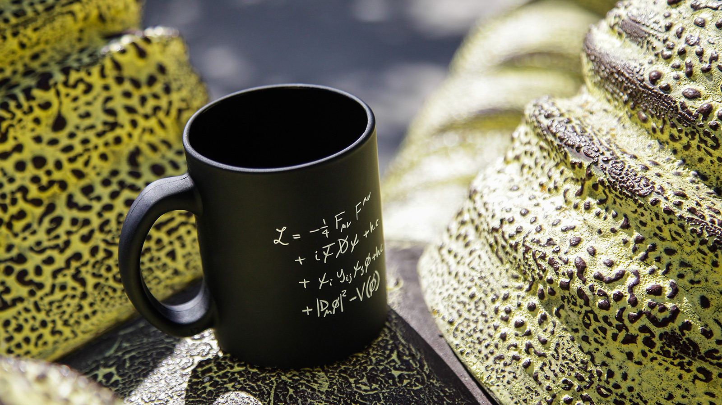
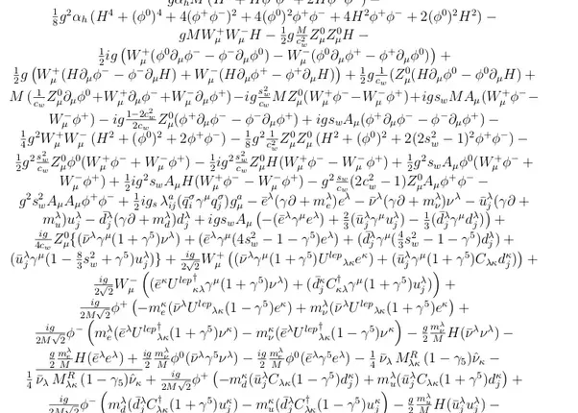
Variation of matter Lagrangian components
To provide the extrememum of the action
Including space time

Slide 39
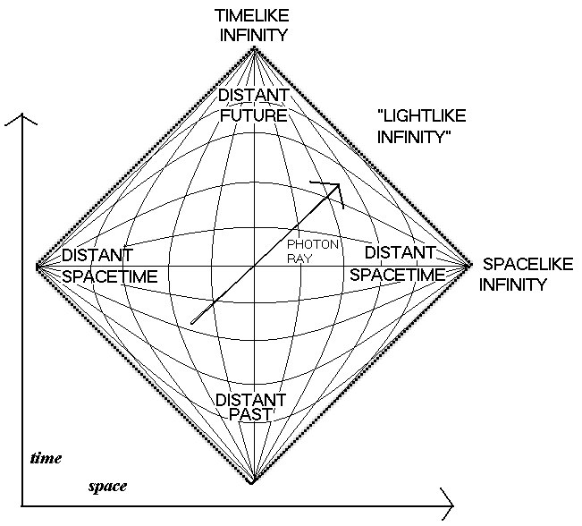
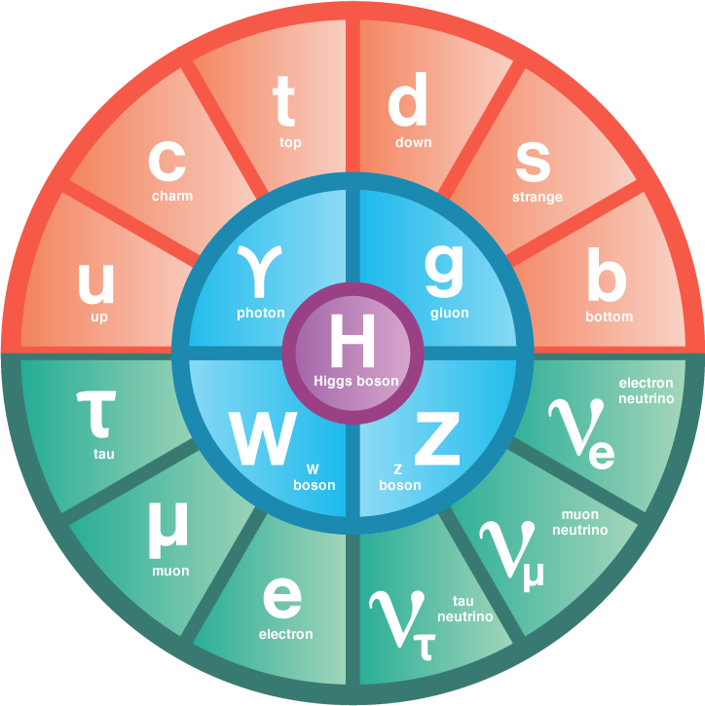
Must Integrate over all space-time should be path integral
All space-time approximately
Actually rounded at corners?

Slide 40
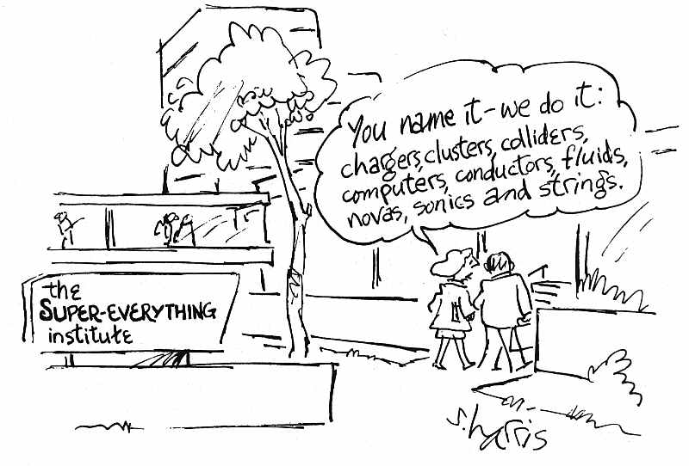
What about Super- symmetry?

Slide 41
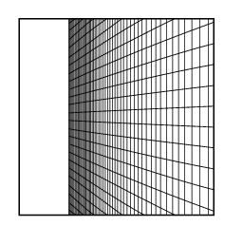
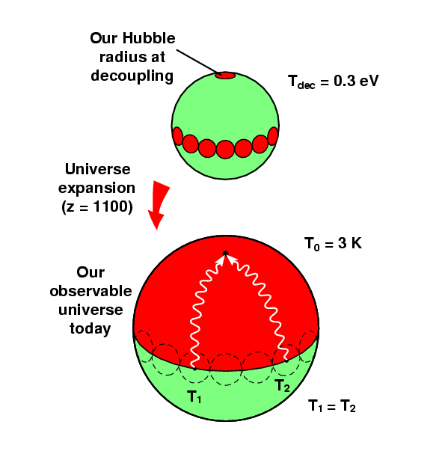
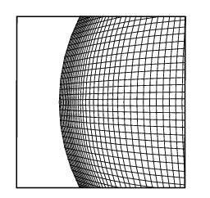
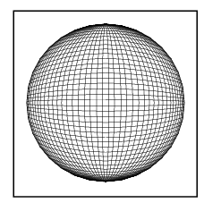
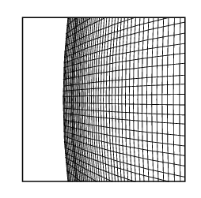
But what else has SUSY ever done for us?
SUSY provides the basis for cosmological theories in which the Universe naturally inflates to its present size, and explain how the microwave background radiation appears isotropic
For example a SUSY version of the Standard Model with extra Higgs singlets has been constructed that explains inflation, large scale structure, the origin of Higgs mass, and the origin of right-handed neutrino mass (Bastero-Gi,SFK, Di Clemente)

Slide 42
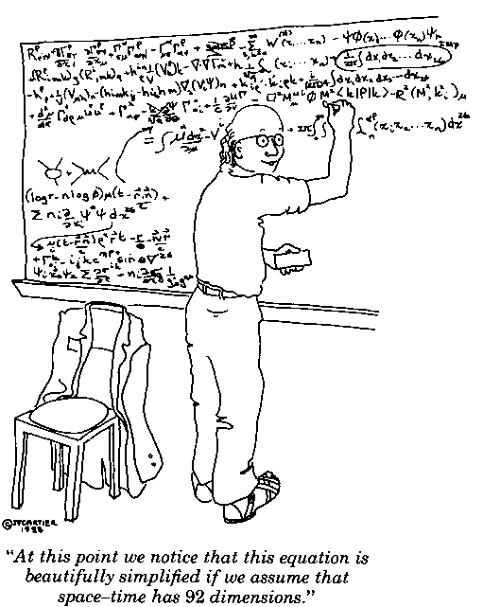
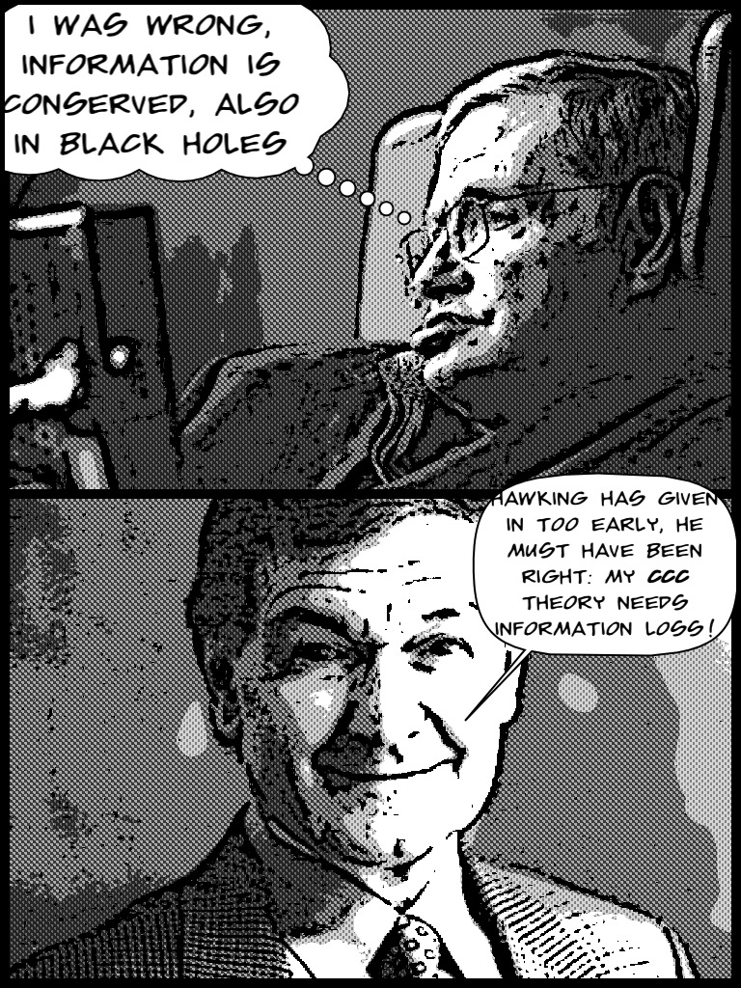

Slide 43
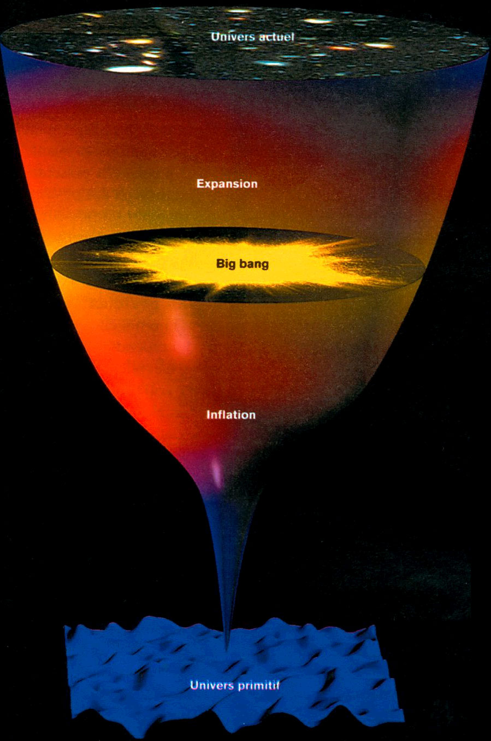
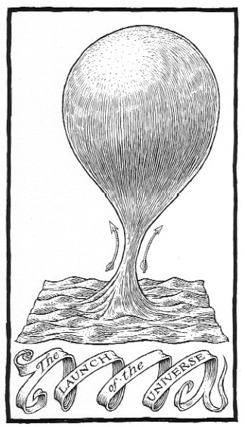

Slide 44
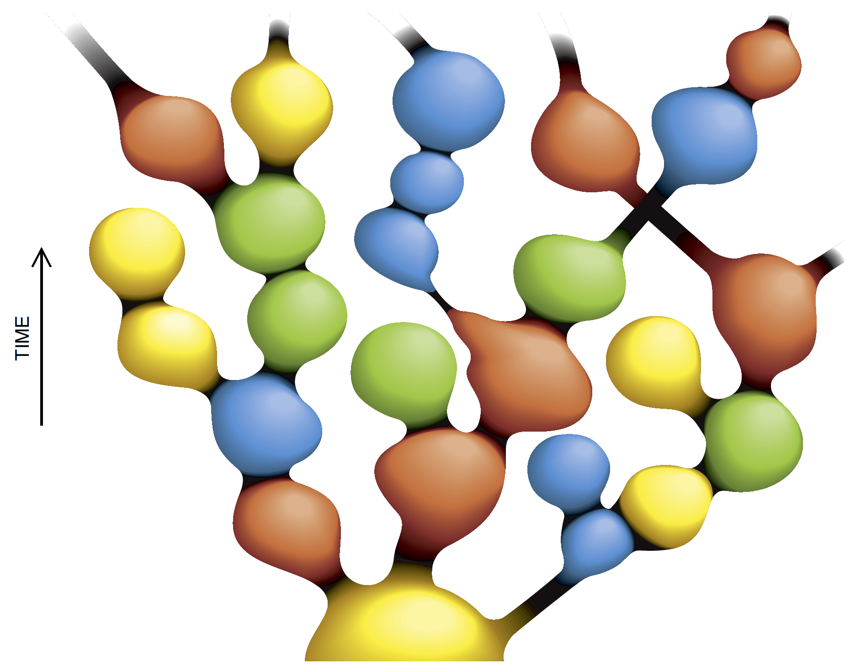
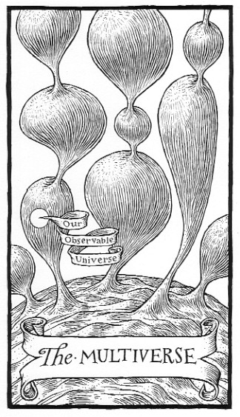
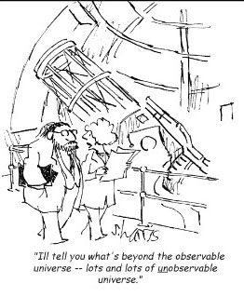
As our own universe
experiences its time-
line, other parts of
the global space-time
(other universes) can
live through their own
lifetimes, as part of
a cosmic archipelago
sometimes called the
MULTIVERSE.
Other words GHOSTS in the theory

Slide 45

Gaia map

Slide 46


