Slide 1



Discovering the Higgs Boson
Jon Butterworth
The Standard Model @ 50
June 2018
Notes:
Experiments.
Would we have found it anyway?
DIS
4l
Roman villa/cms. Traces of the SM will exist as long as there is a civilisation.

Slide 2
Thank you, this is an honour
Will not cover the history of the search, but the discovery – along with a status report of where we are now.
Will be a necessarily brief summary
Plus some counter-historical speculation for fun
Notes:
Not only to be open such a meeting of stars, but also to be representing the work of some many others over so many years.

Slide 3
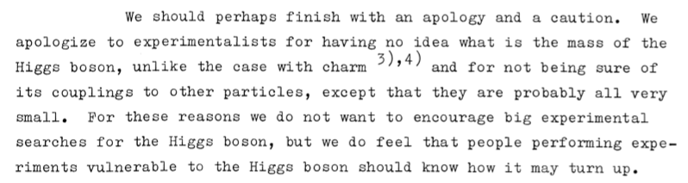
Motivation
J. R. Ellis, M. K. Gaillard and D. V. Nanopoulos, A phenomenological profile of the Higgs boson, Nucl. Phys. B 106 (1976) 292. (See also arxiv:1504.07217)

Slide 4
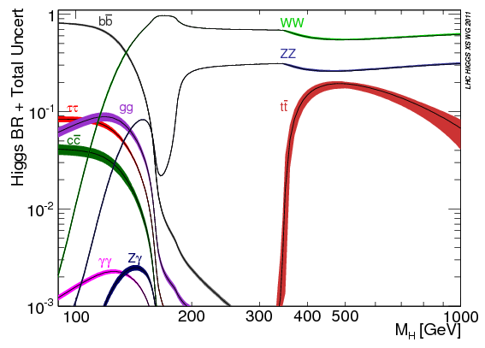
More precisely….
Denner et al, arXiv:1107.5909

Slide 5
More precisely….
Denner et al, arXiv:1107.5909

Slide 6
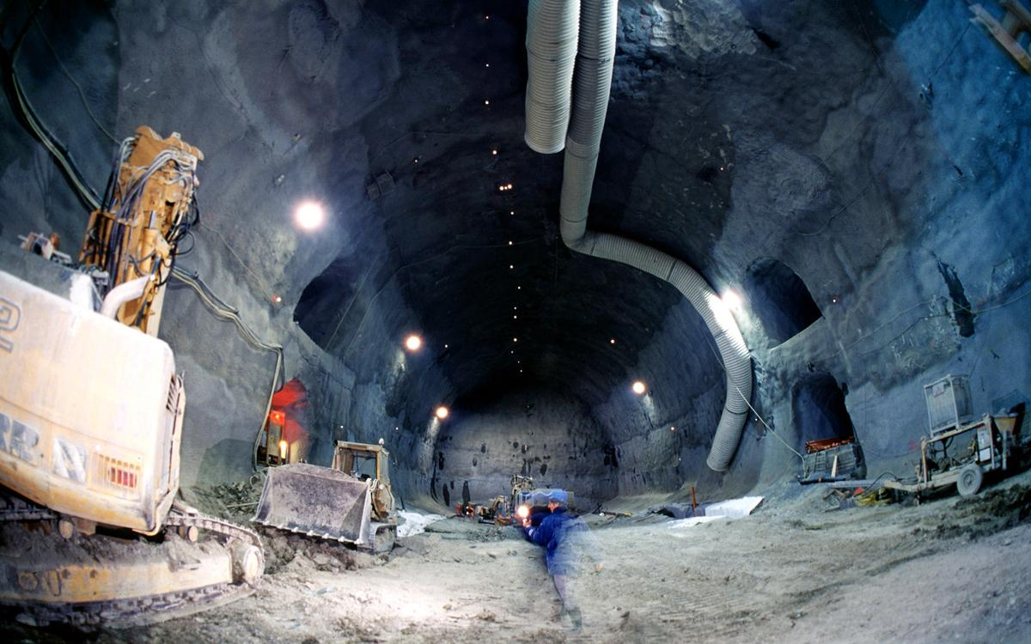
Notes:
ATLAS cavern construction

Slide 7
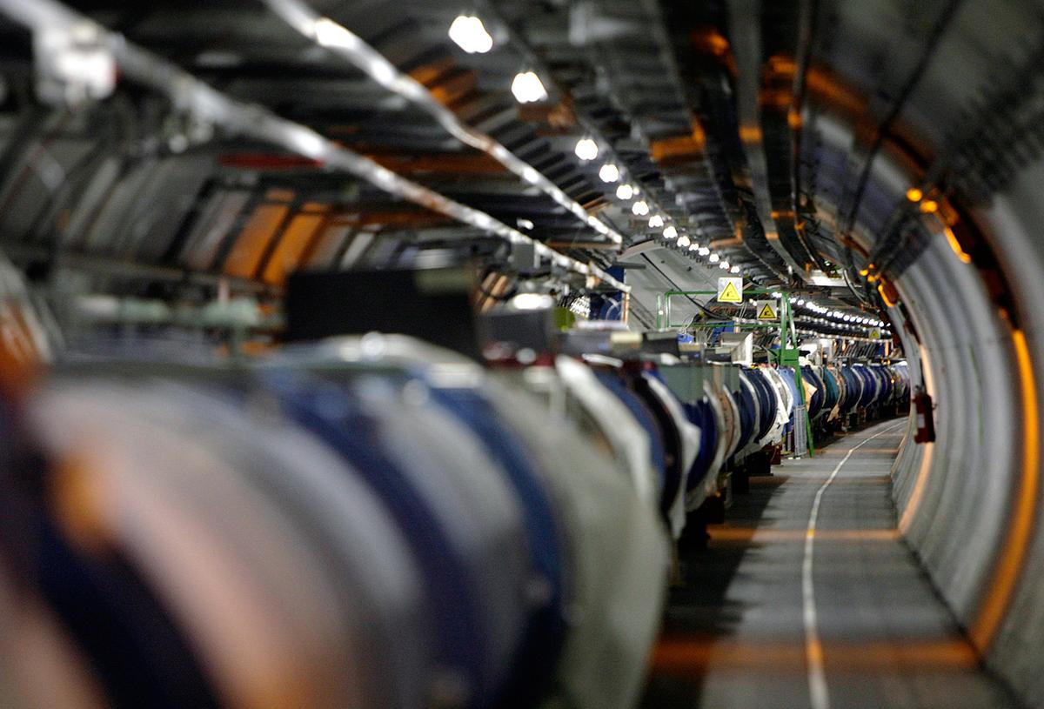
Notes:
This was of course the LEP tunnel… built bigger than needed, but still requiring R&D on a more compact LHC magnet design (Maini, LHCP 2017)

Slide 8
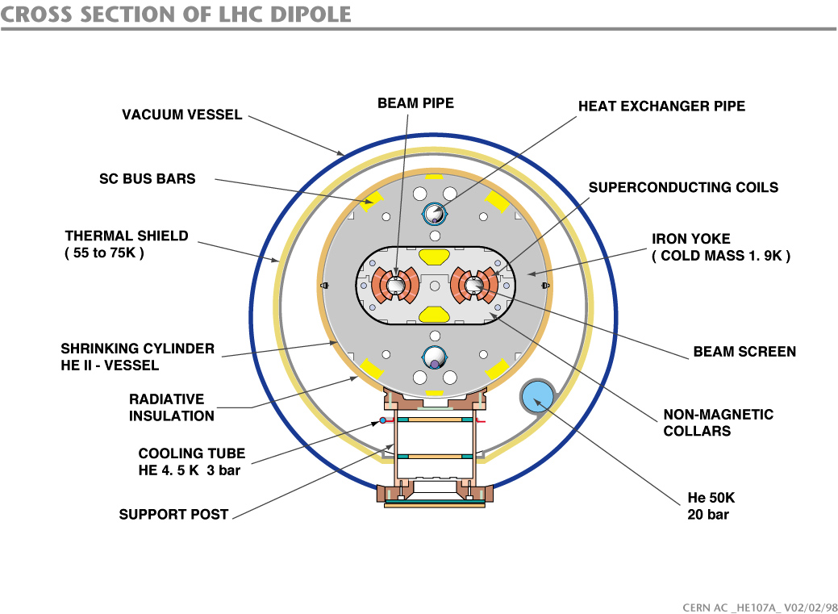
Notes:
This was of course the LEP tunnel… built bigger than needed, but still requiring R&D on a more compact LHC magnet design (Maini, LHCP 2017)

Slide 9
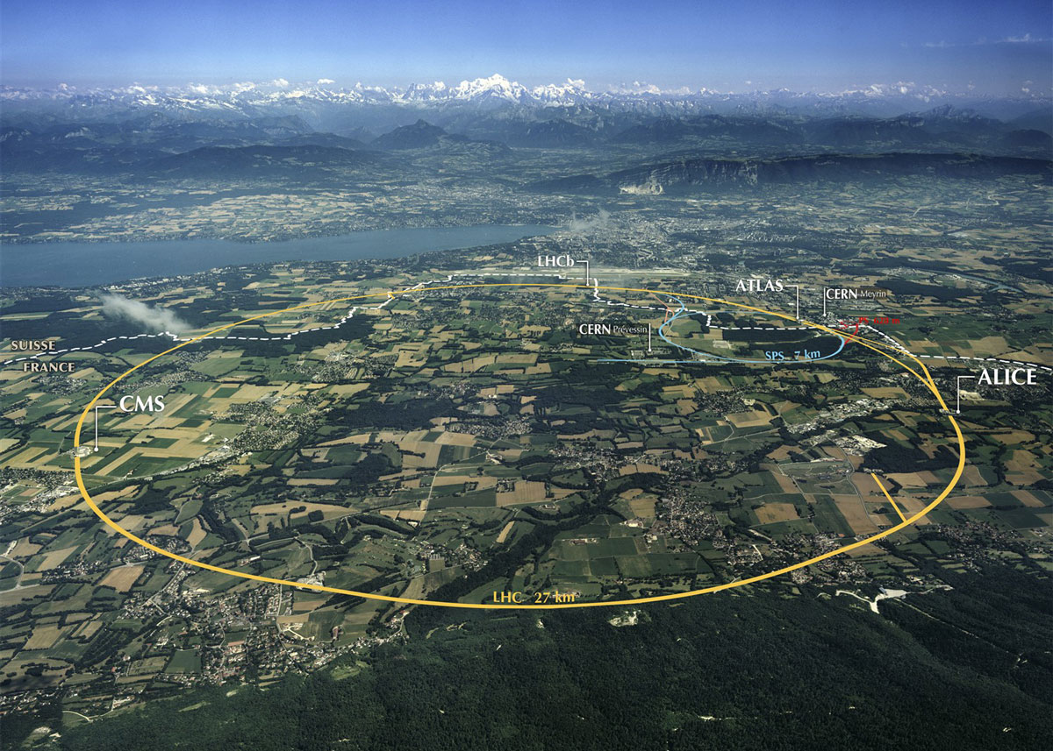

Slide 10
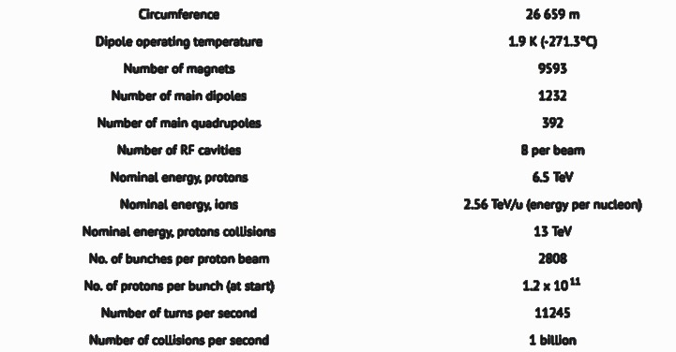

Slide 11
The Detectors

Slide 12
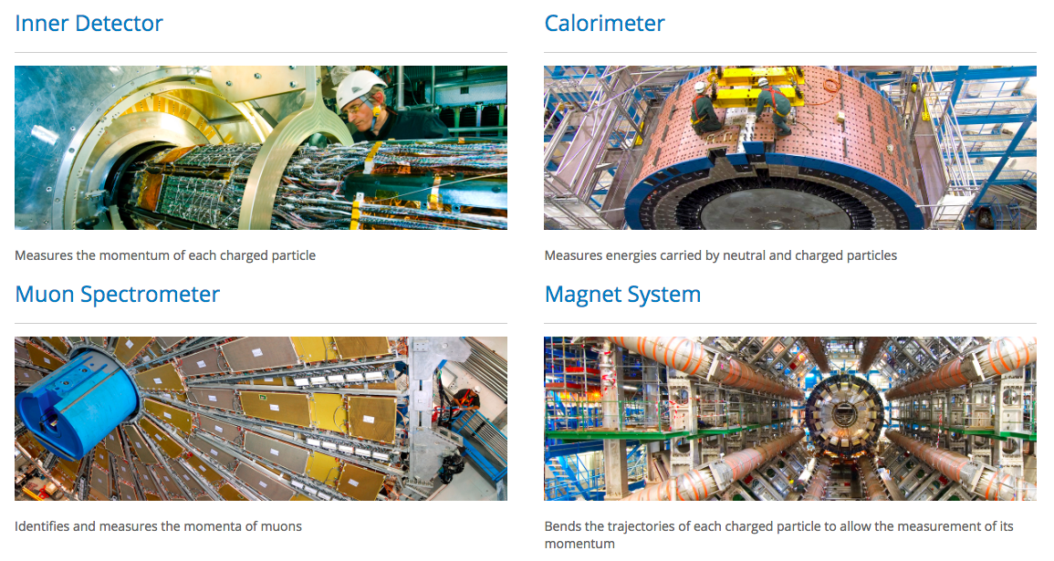

Slide 13
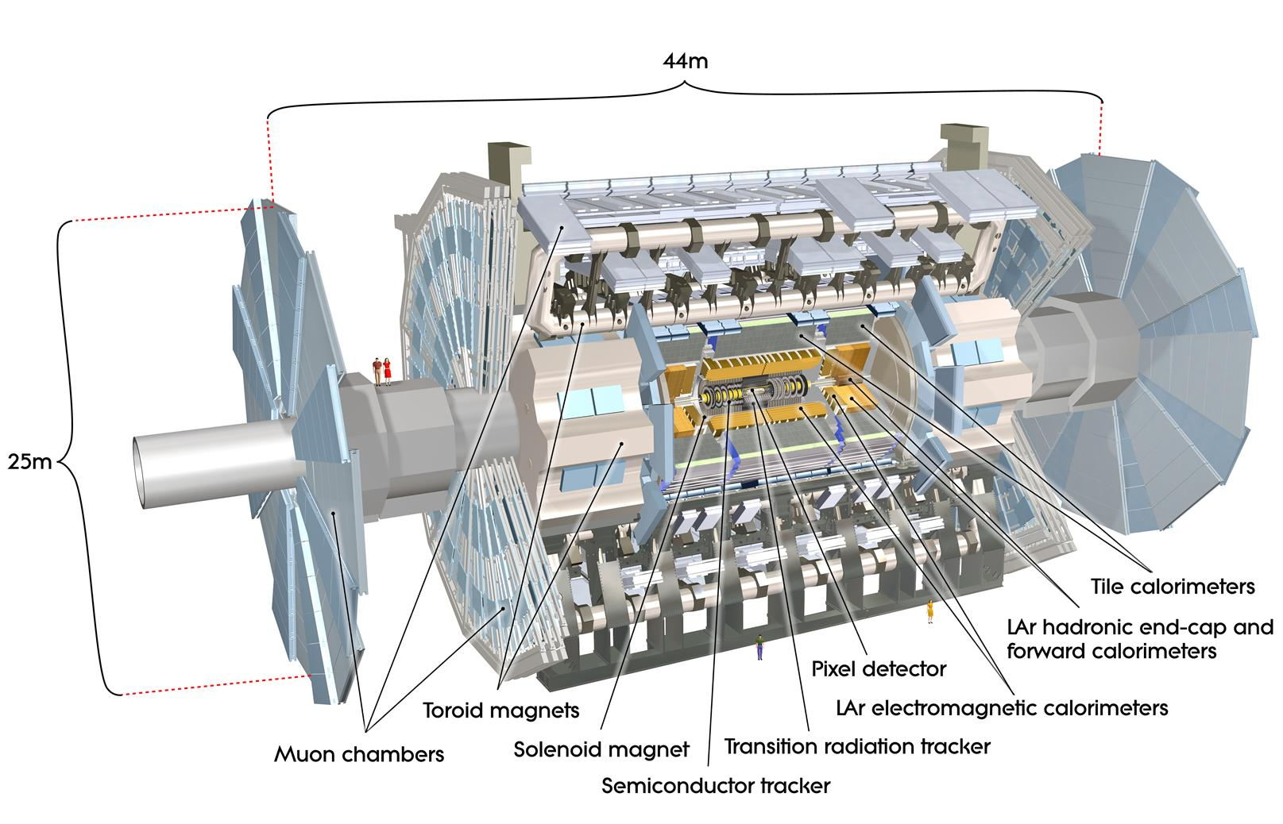

Slide 14
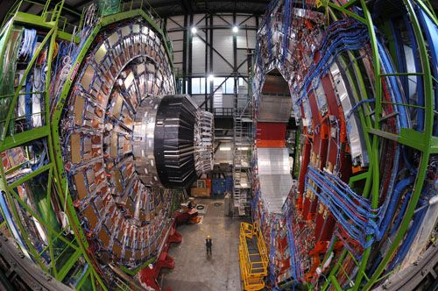

Slide 15
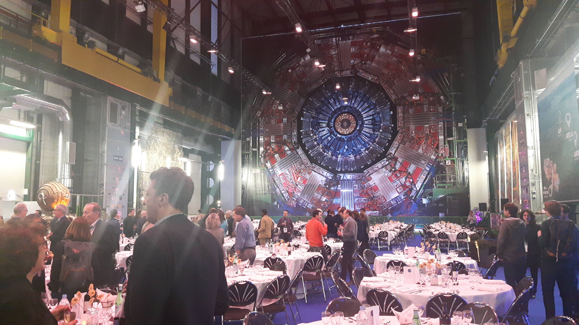

Slide 16
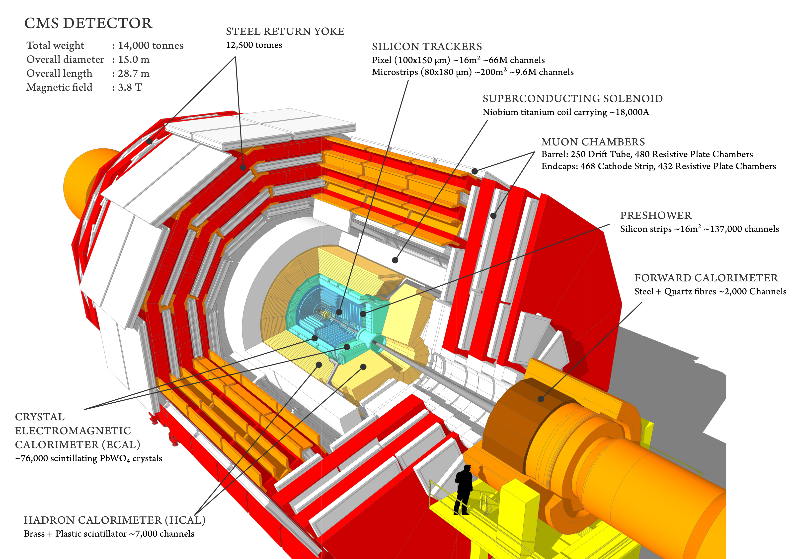

Slide 17
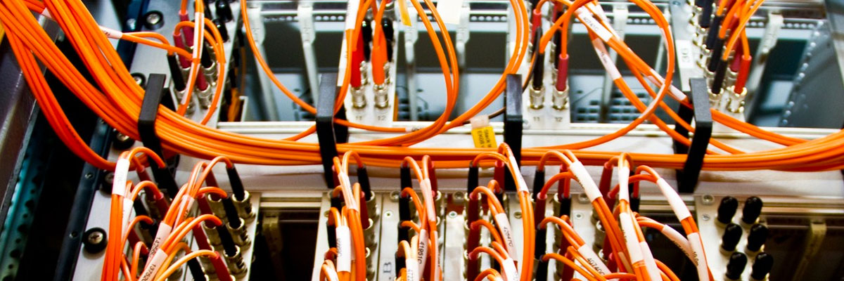
Trigger and Data Acquisition
100 Hz of interesting events, from > 1 billion Hz total
Typical (raw) event size O(1MB)
Fig: W.J. Stirling

Slide 18
Software
Fast and performant reconstruction of objects in the detectors (also used online for selection)
Detailed software models of the detectors
  Example →

Slide 19
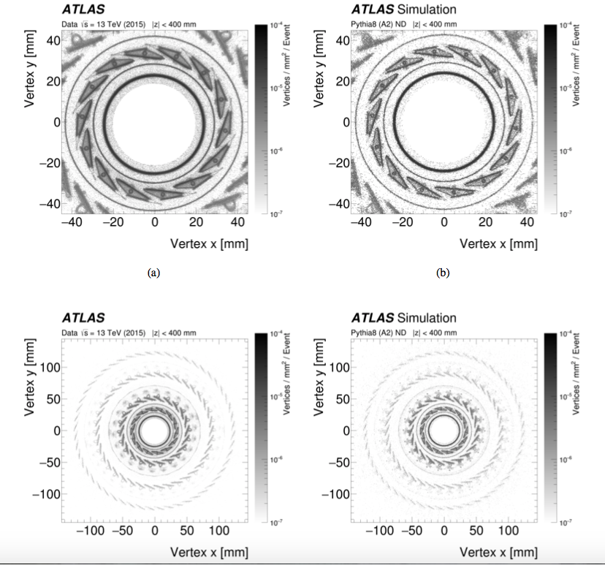
Detailed software models of the detectors
Fast and performant reconstruction of objects in the detectors (also used online for selection)
arXiv:1707.02826 [hep-ex] (in JINST)
Notes:
Reconstructed hadronic interactions. Material in front on calorimeter critical for photon resolution.

Slide 20

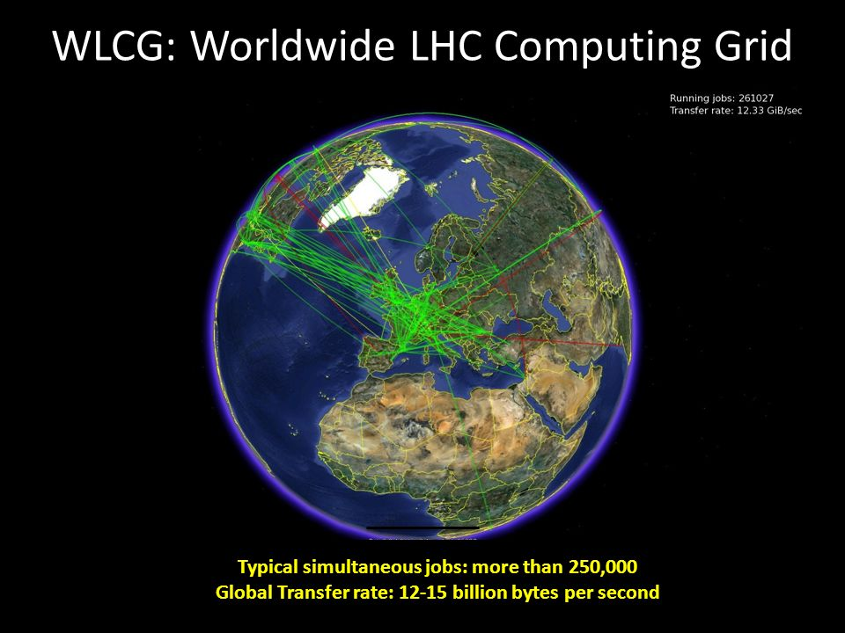
Computing

Slide 21
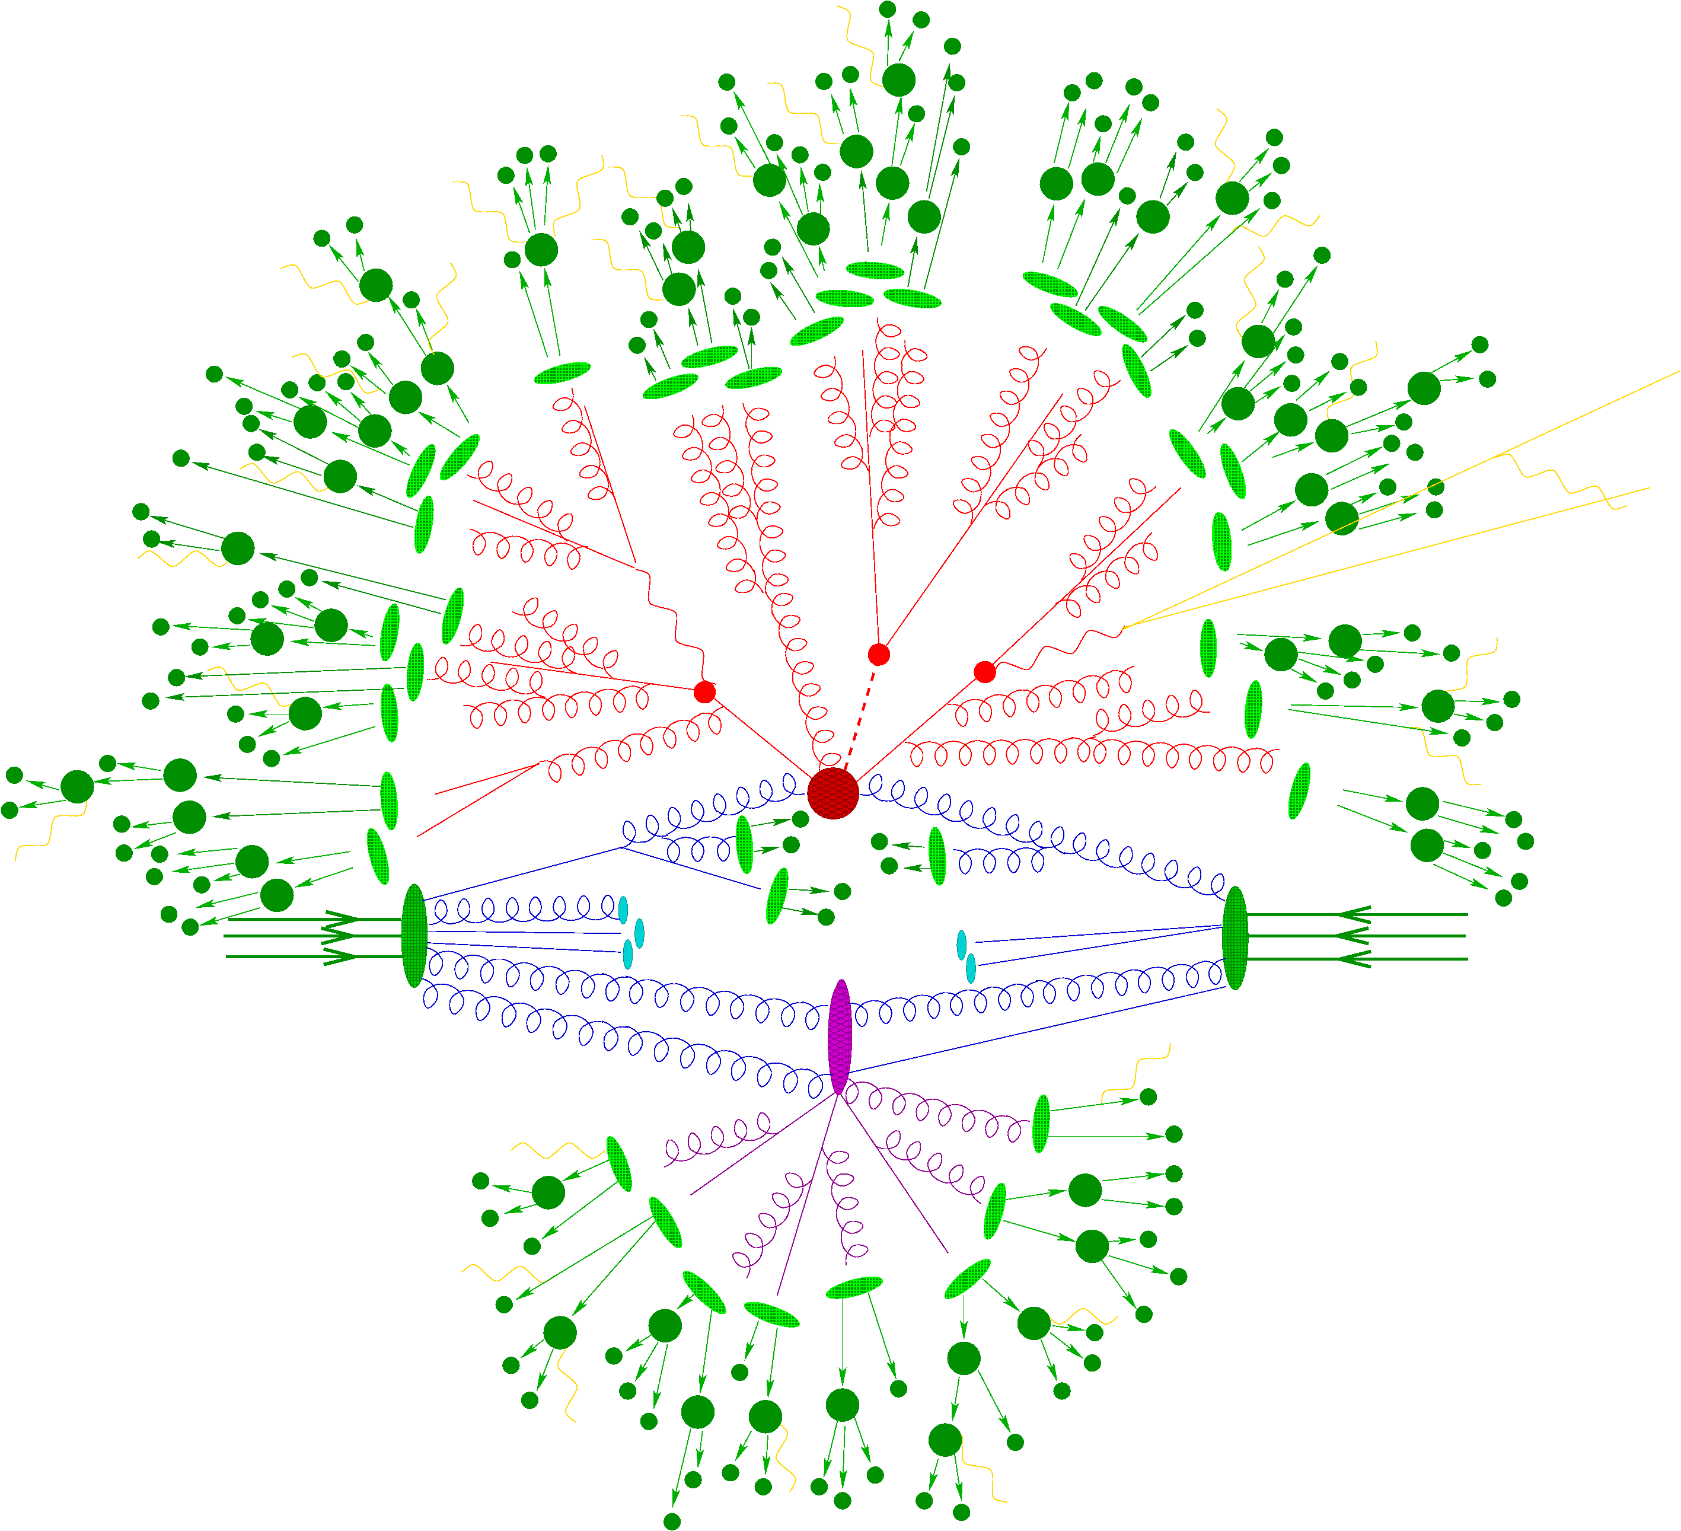
Theory
You’ll hear a lot about theory later
  but, perhaps not about Monte Carlo event generators
Precision theory, exclusive calculations
  fixed order QCD & EW resummation & matching, and interfaced to models of non-perturbative physics
Key tool in LHC modern collider physics
Fig: F.Krauss/Sherpa

Slide 22
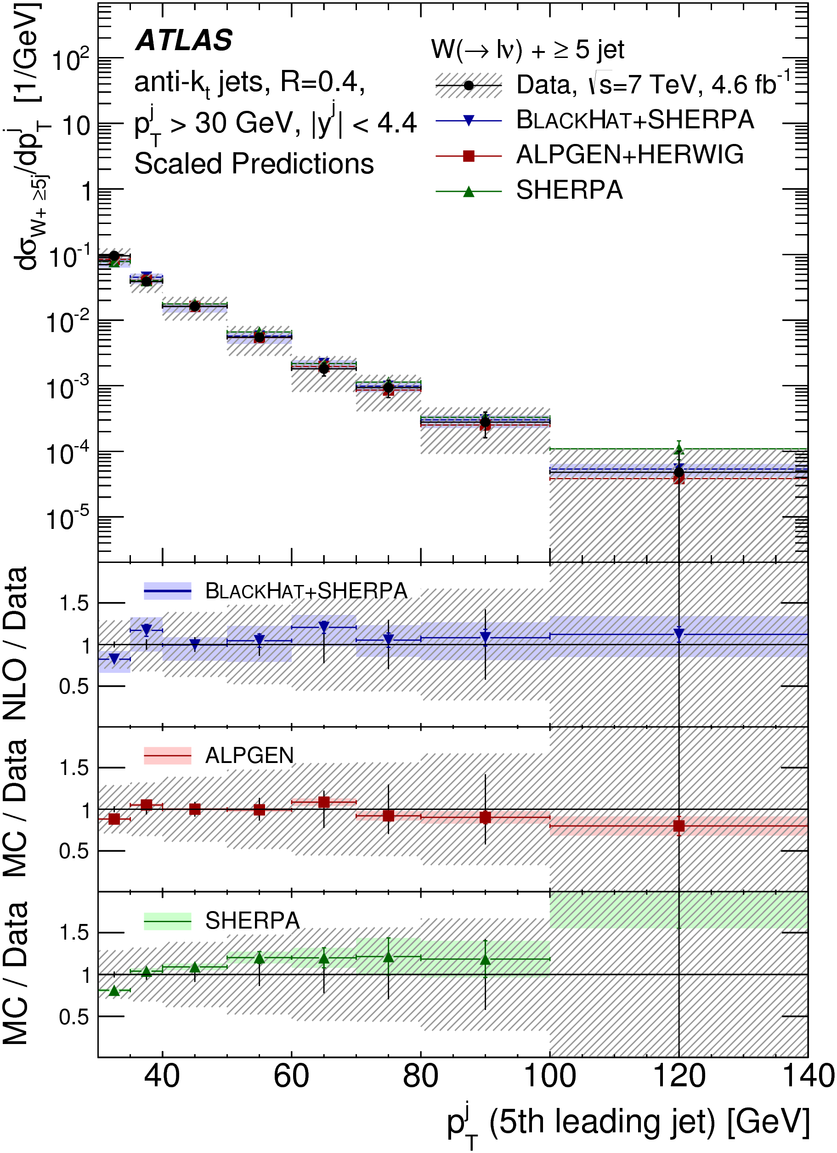
Theory
You’ll hear a lot about theory later
  but, perhaps not about Monte Carlo event generators
Precision theory, exclusive calculations
  fixed order QCD & EW resummation & matching, and interfaced to models of non-perturbative physics
Key tool in LHC modern collider physics
arXiv:1409.8639 [hep-ex] (in EPJC)

Slide 23
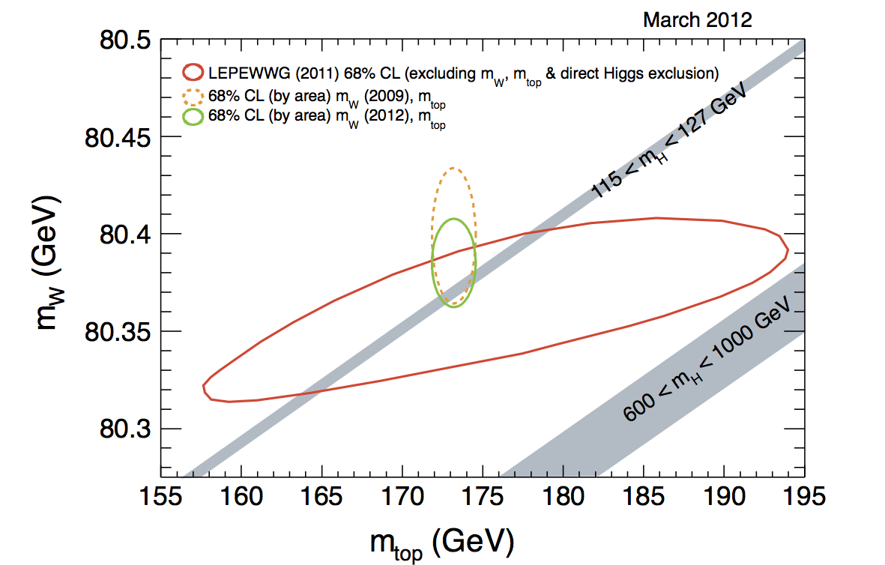
Electroweak symmetry breaking
Tevatron (CDF/D0)

Slide 24


Slide 25
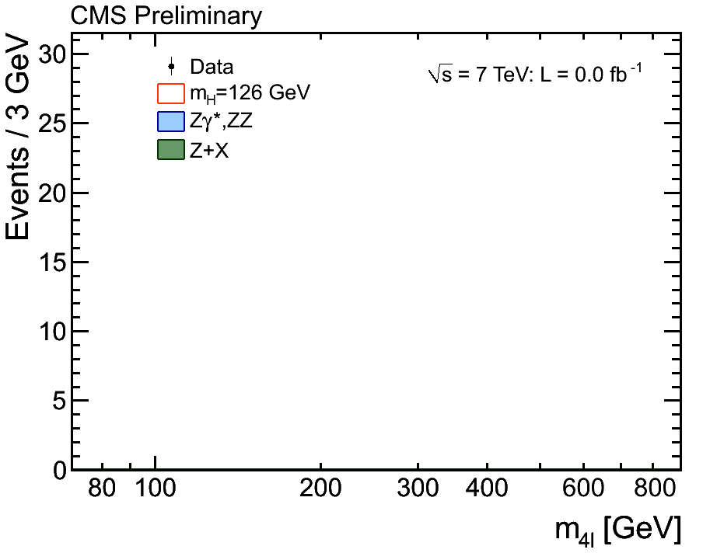

Slide 26
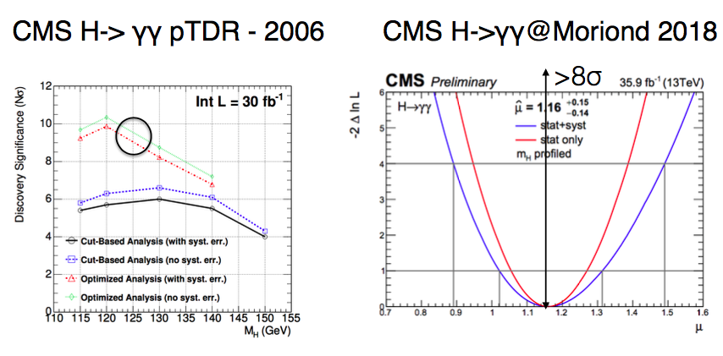
From Nick Wardle, at the “UK input to the European Particle Physics Strategy Update”, IPPP Durham, April 2018
Notes:
What all that work on understanding the detector & the theory buys you.

Slide 27
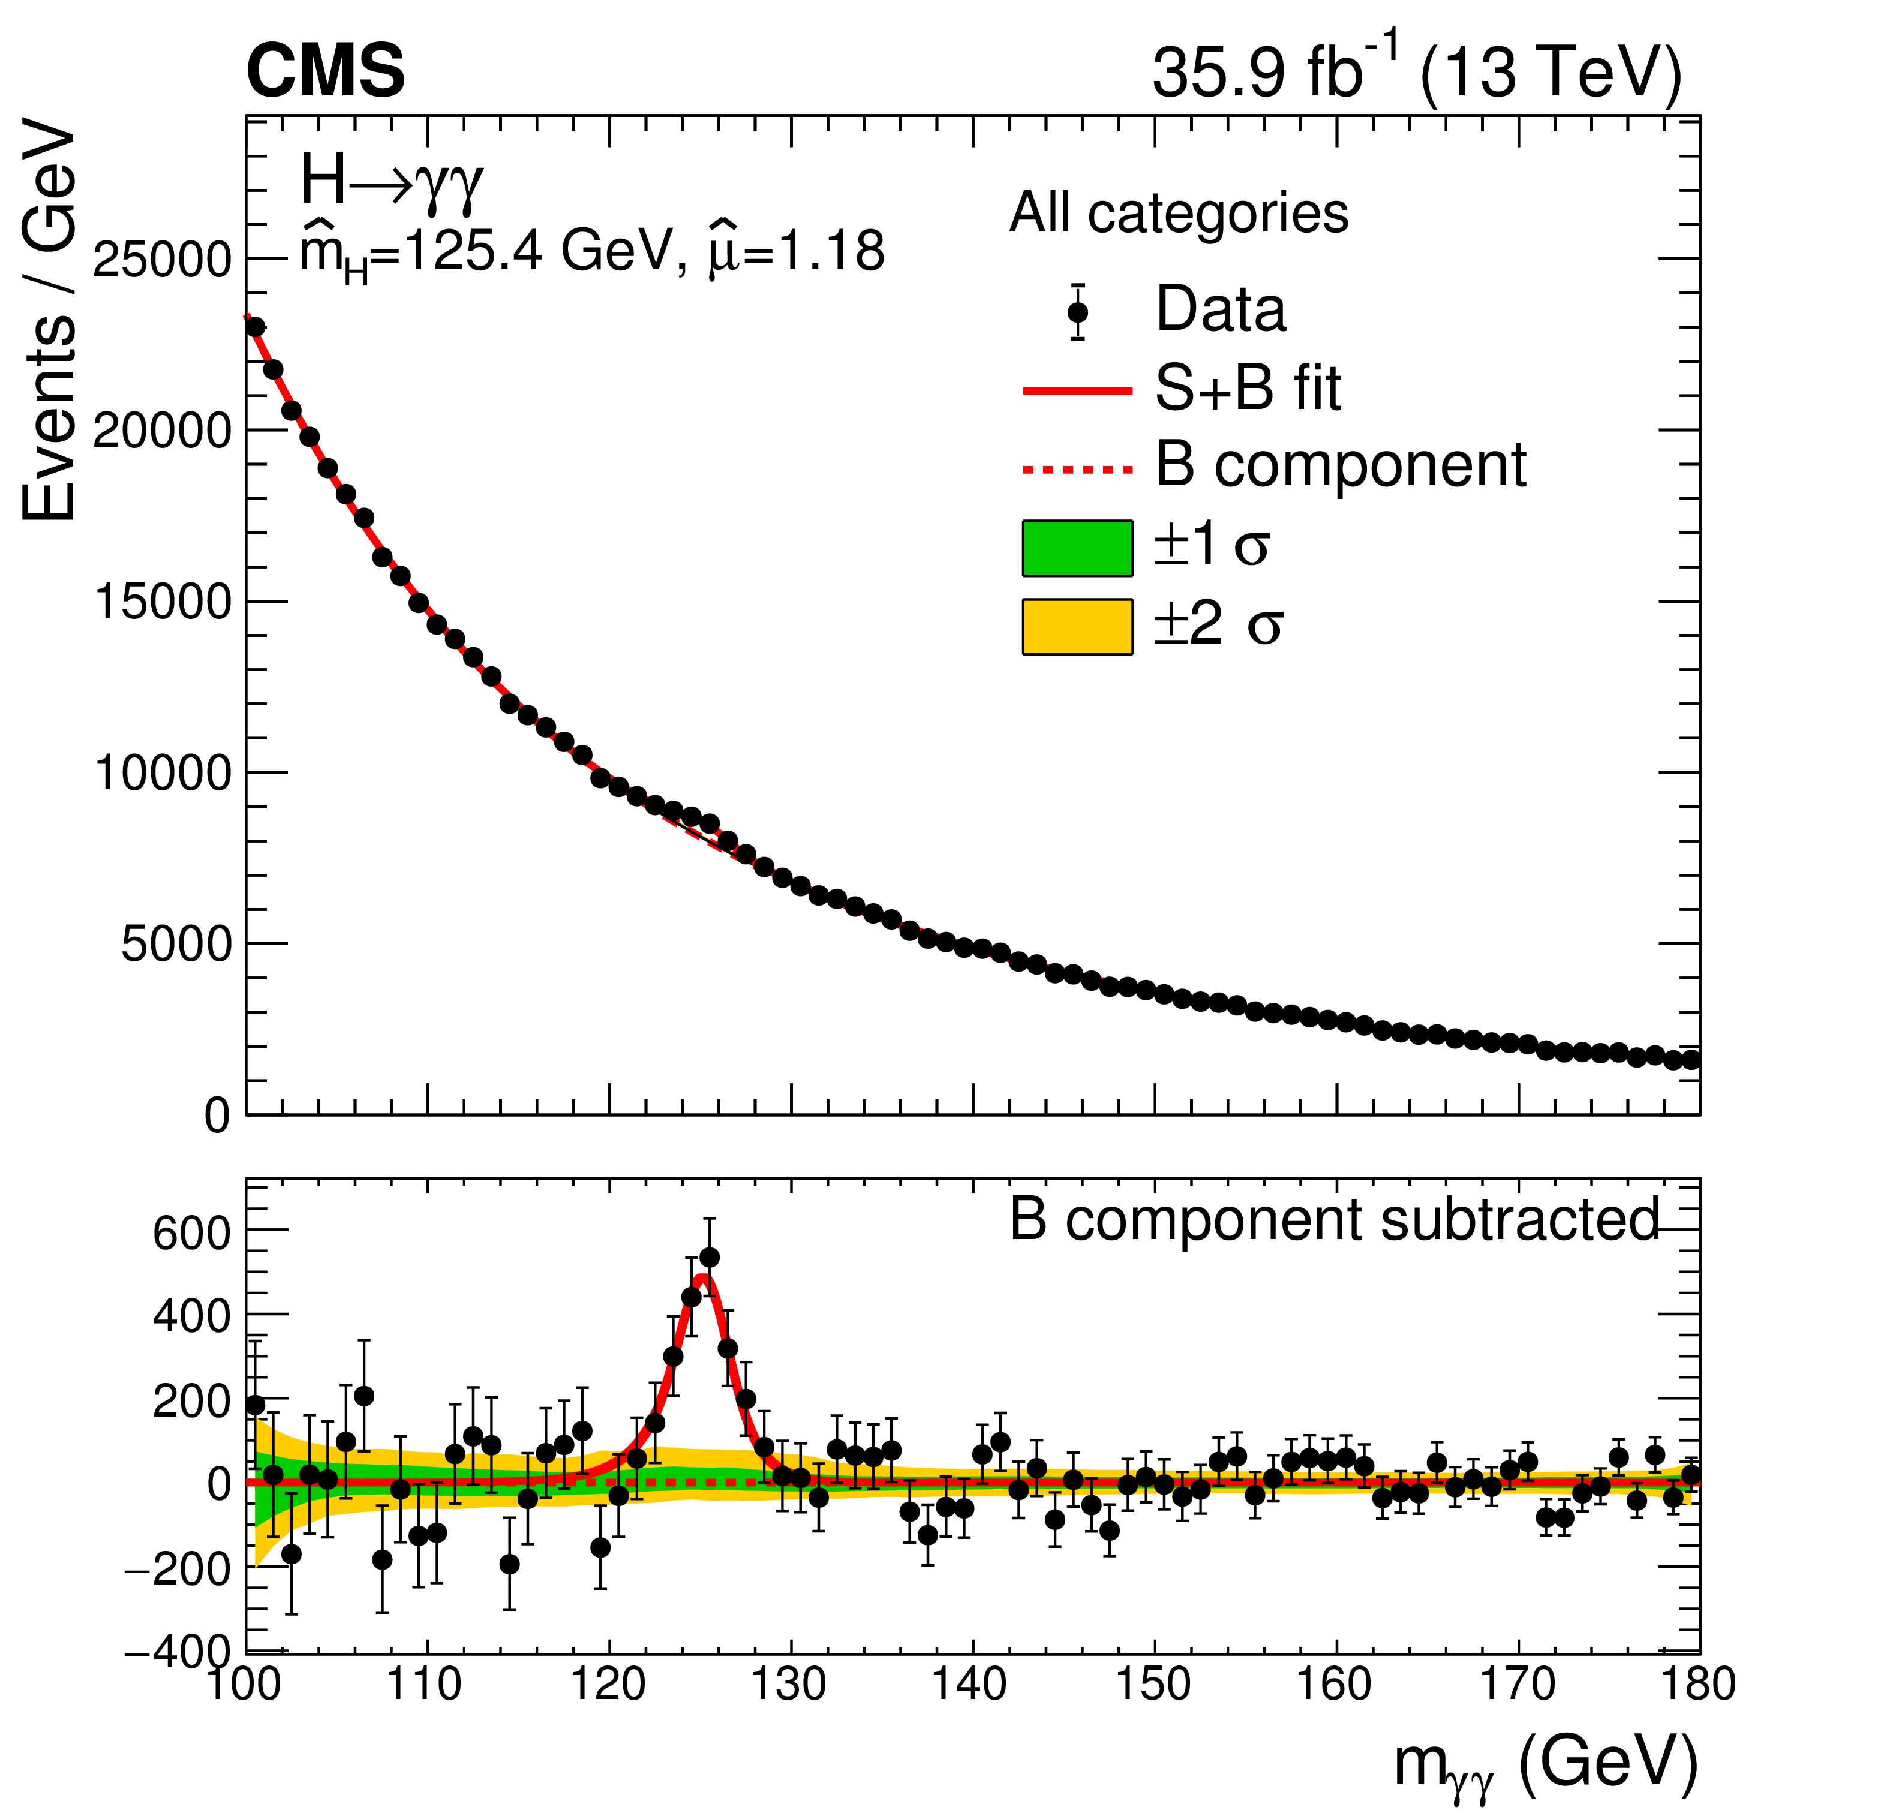
From Nick Wardle, at the “UK input to the European Particle Physics Strategy Update”, IPPP Durham, April 2018
Notes:
What all that work on understanding the detector & the theory buys you.

Slide 28
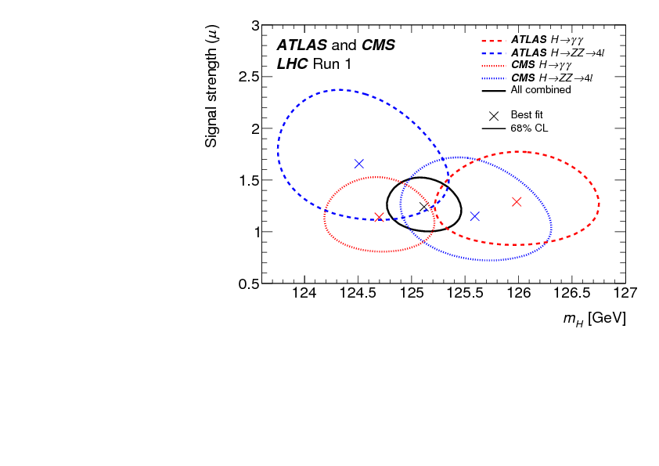
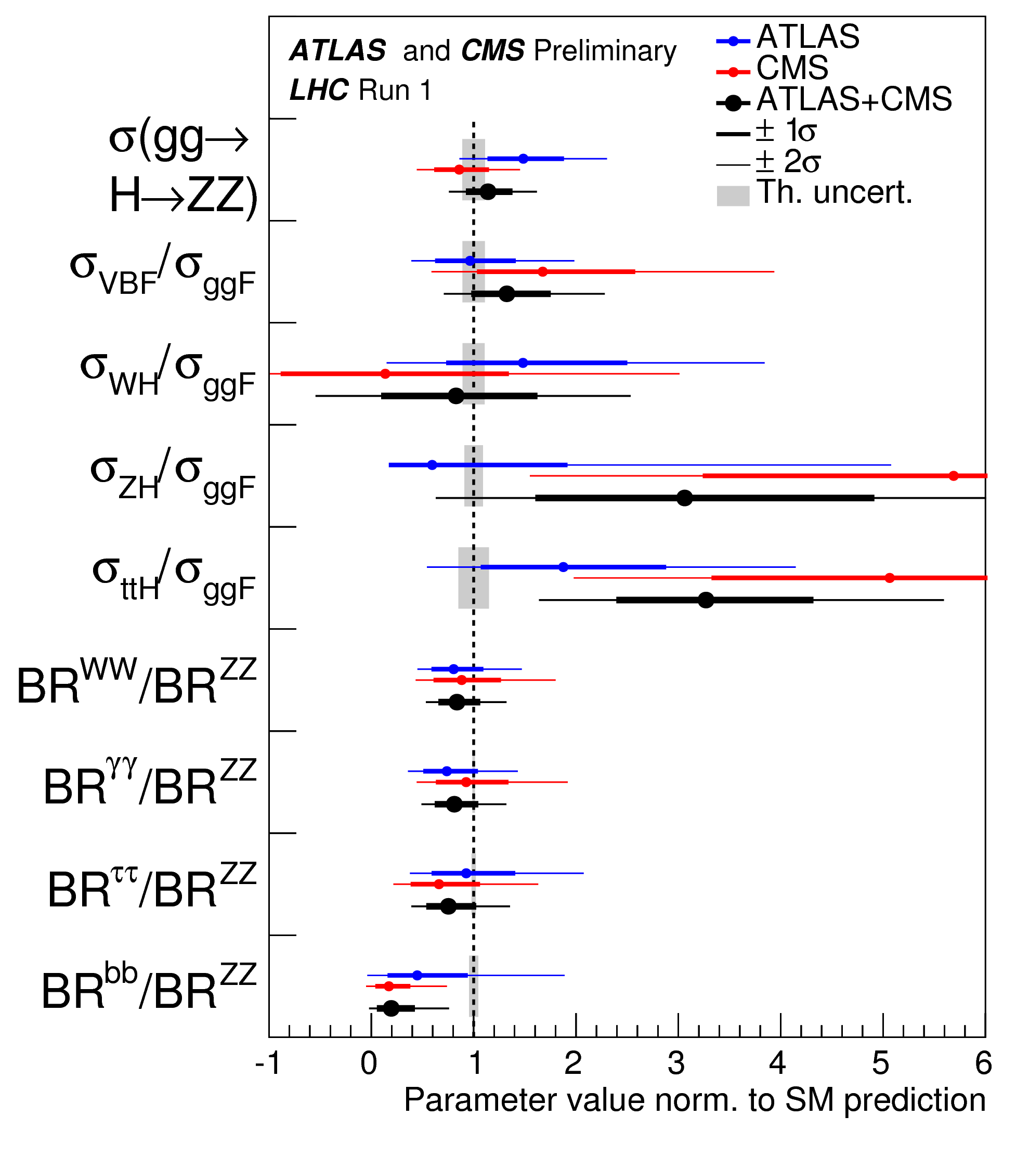
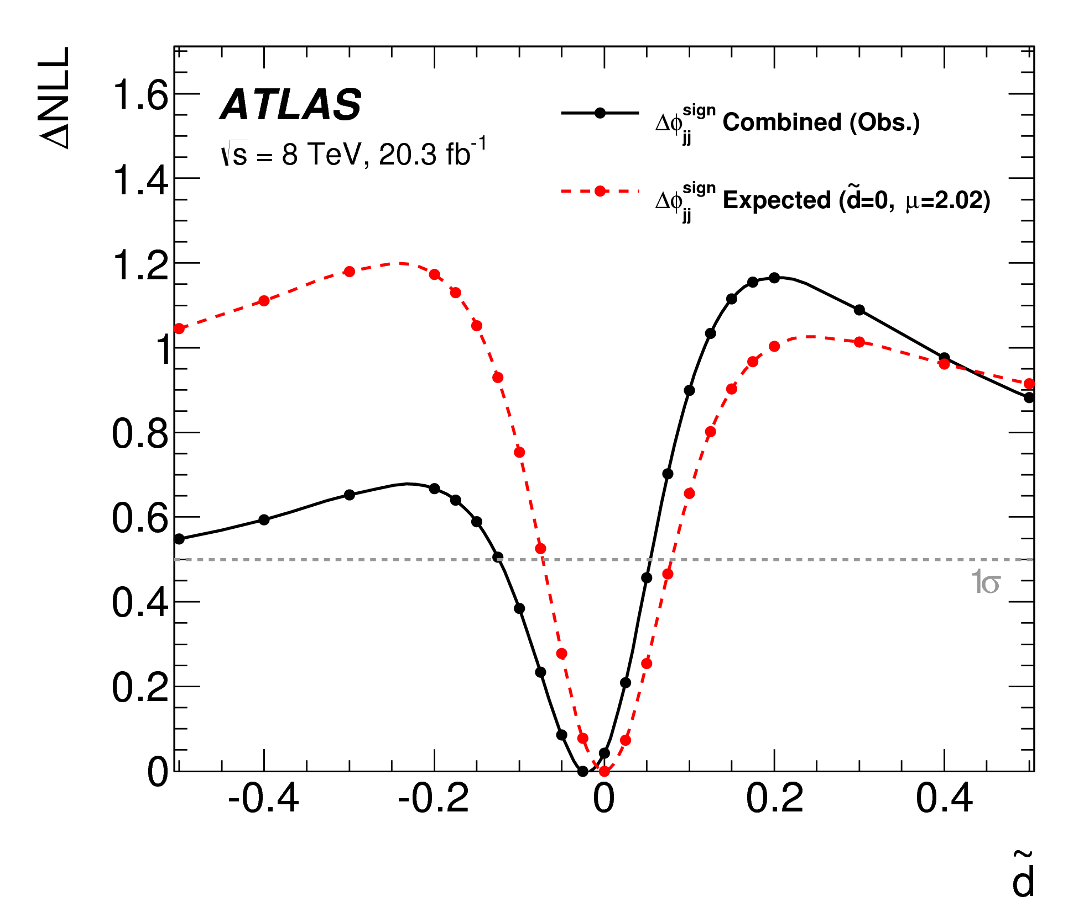
Precision Higgs

Slide 29
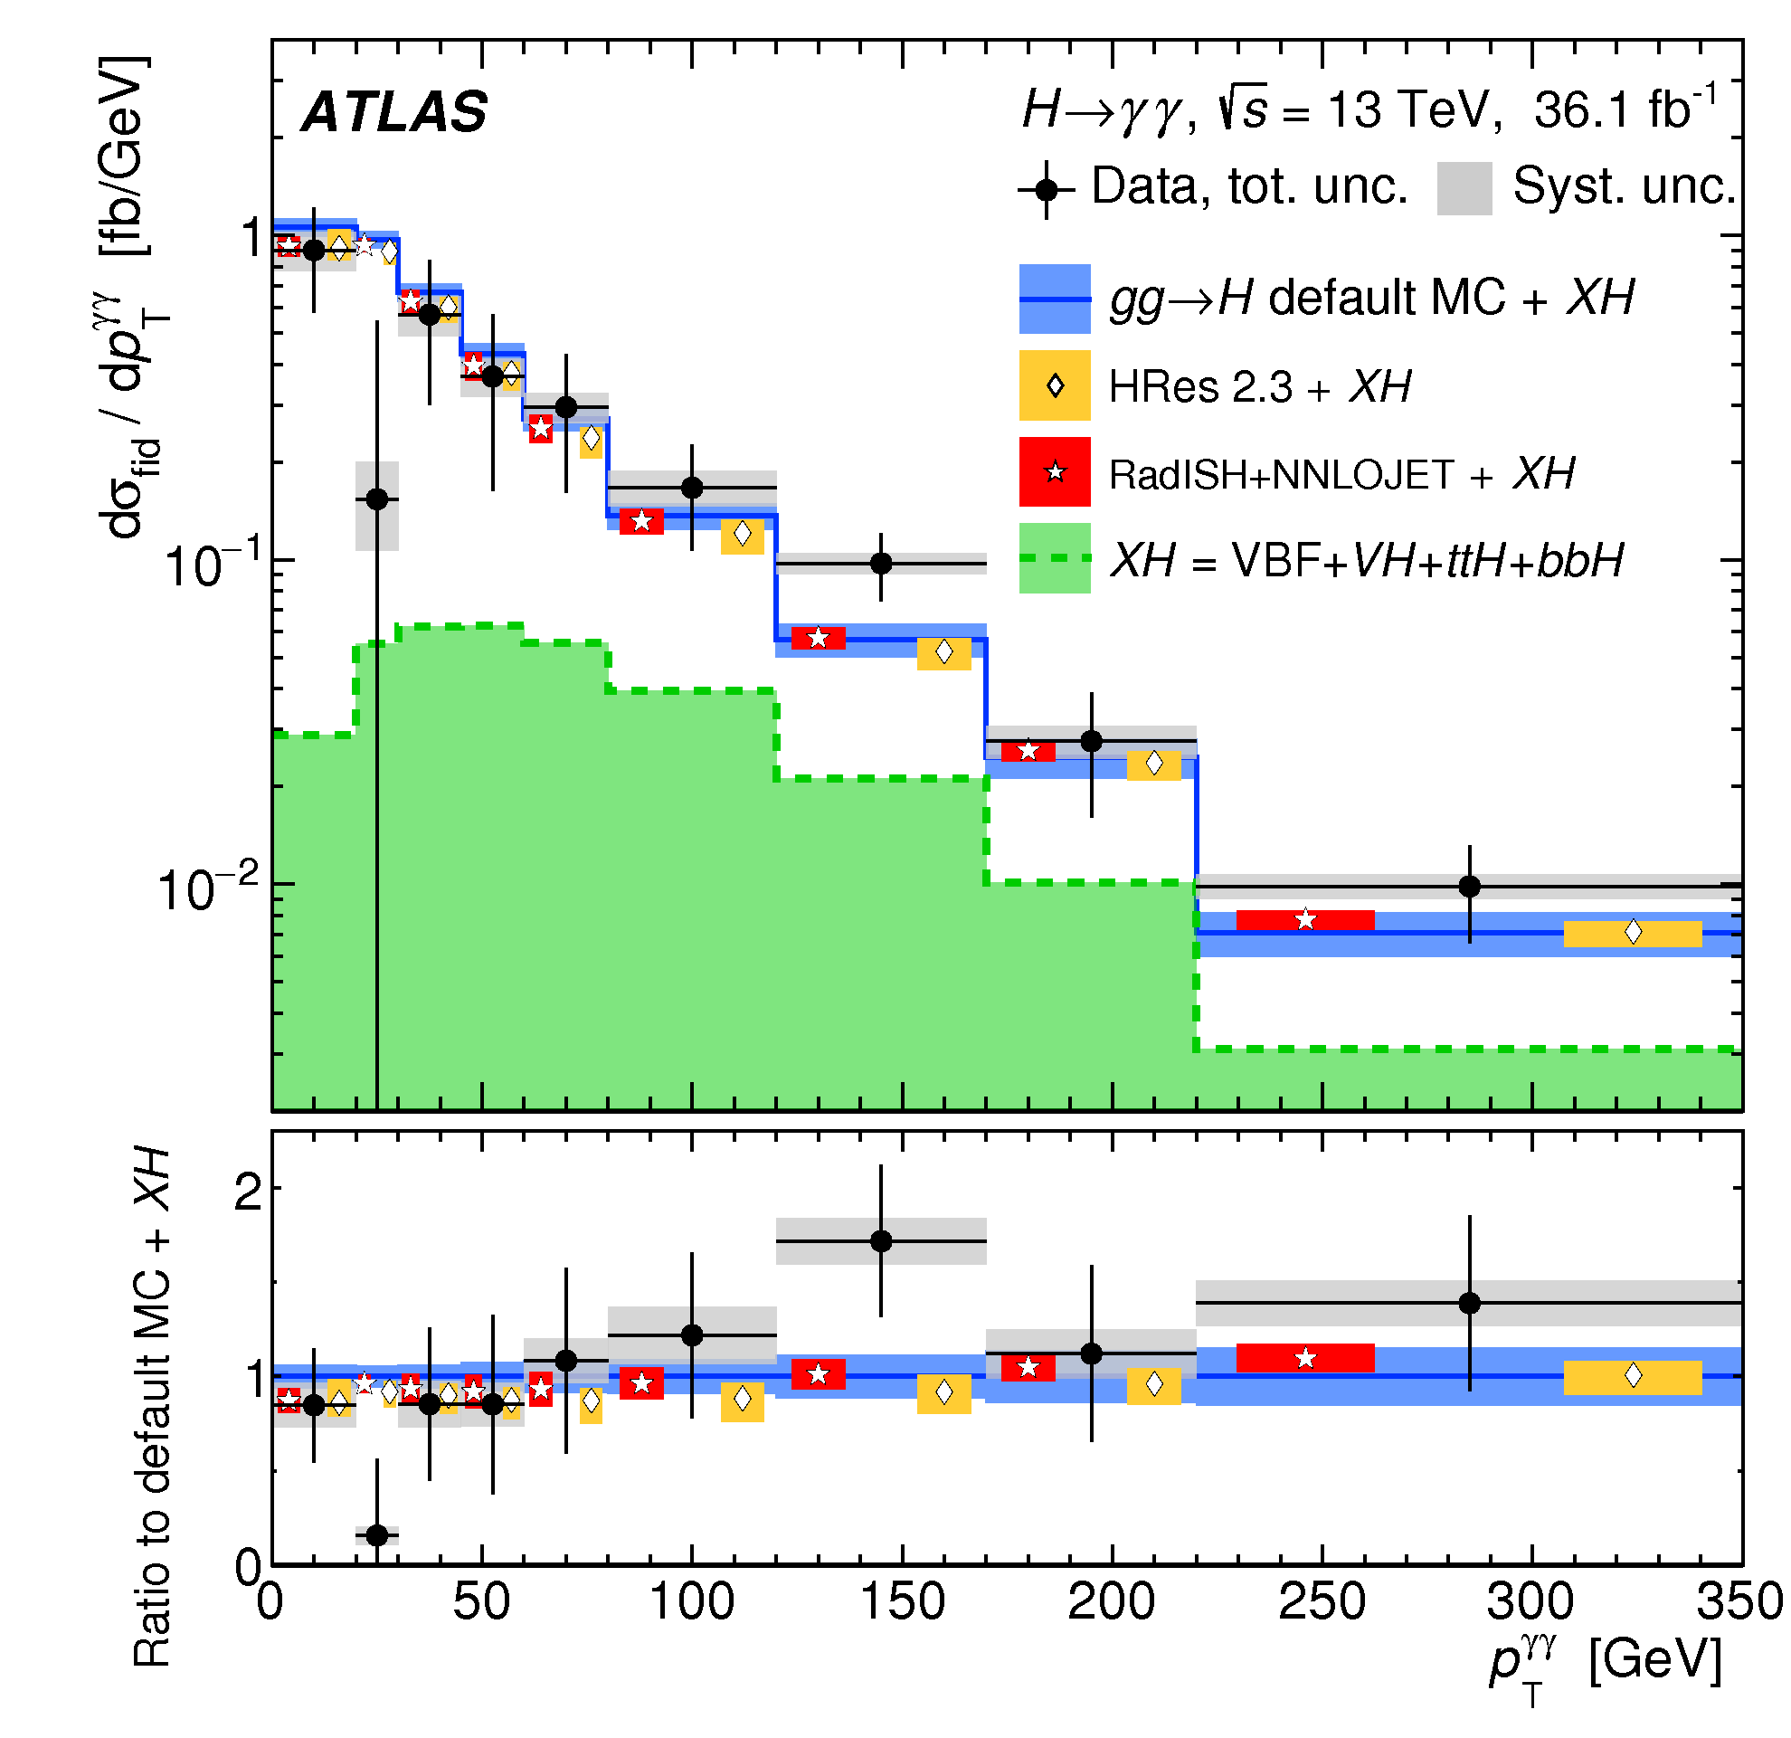
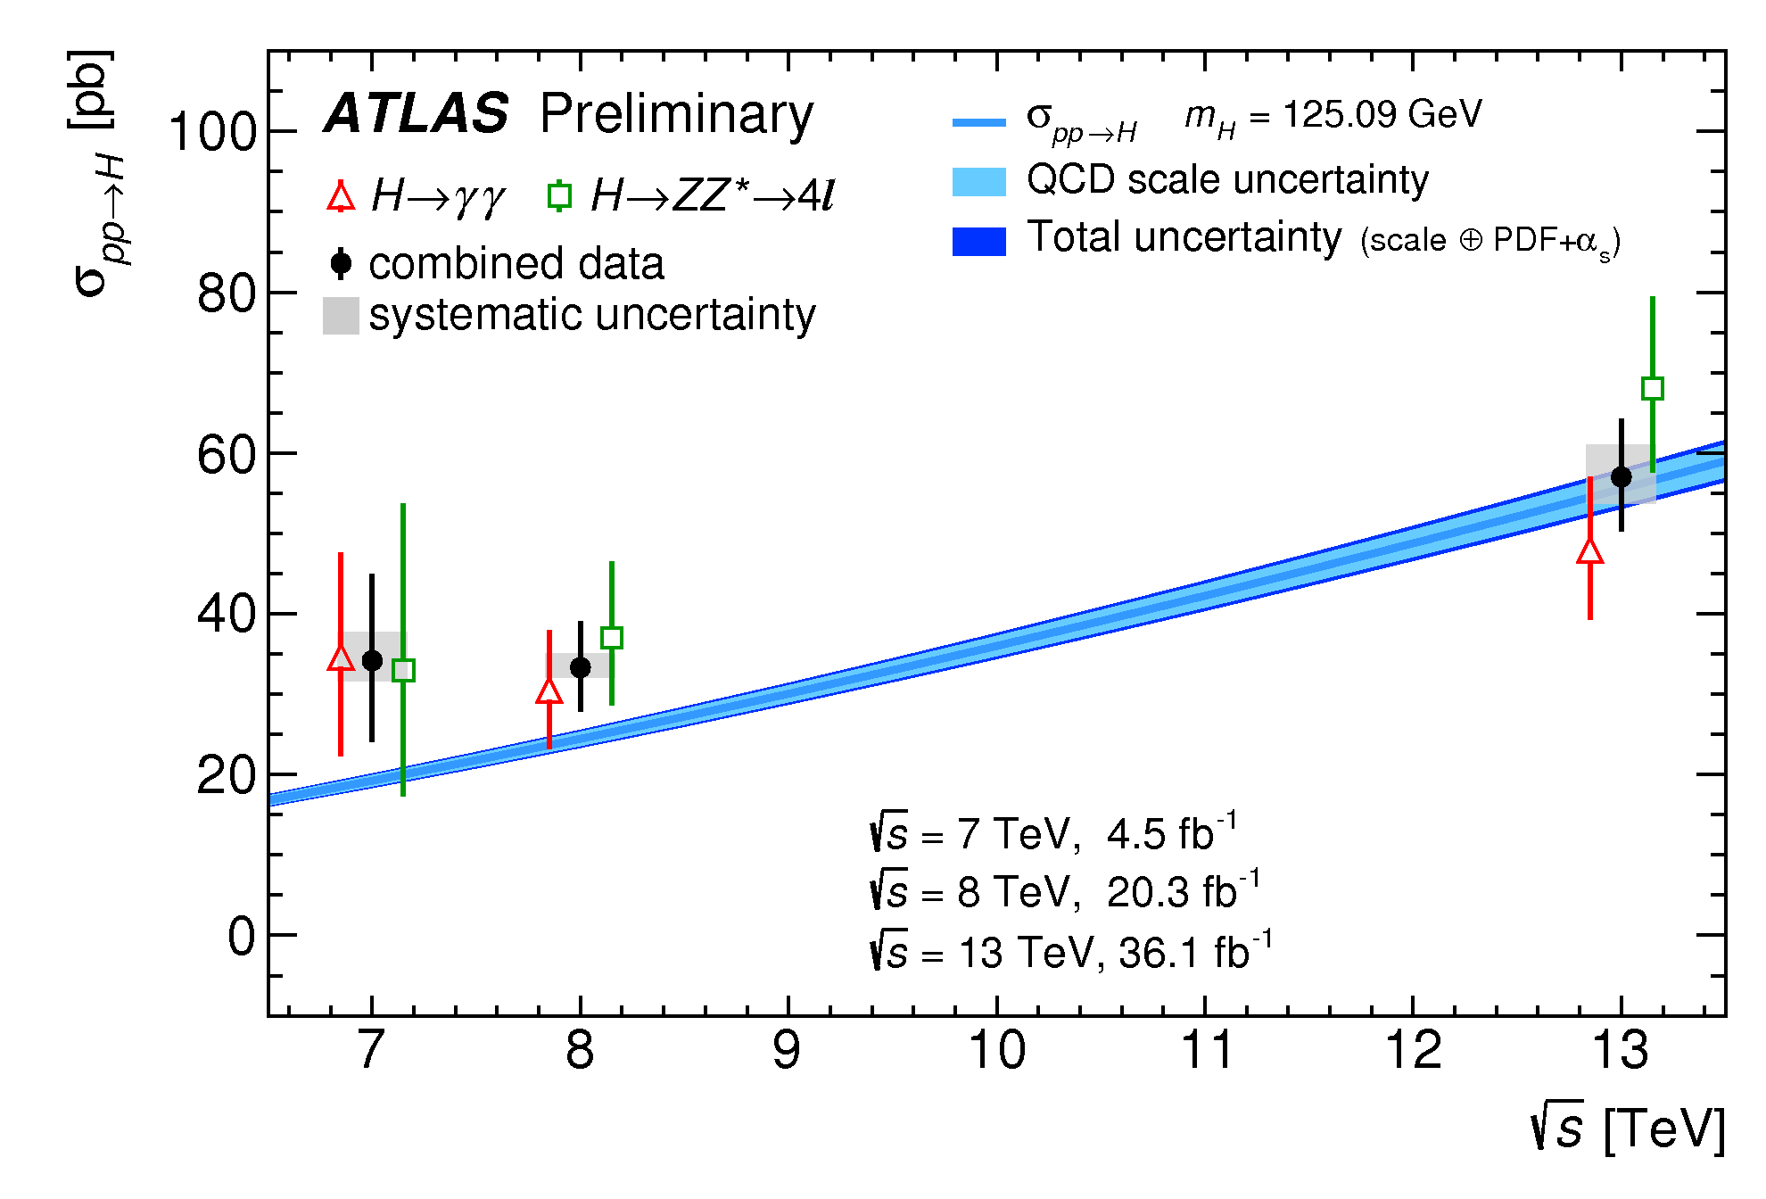
Exploring the production kinematics

Slide 30
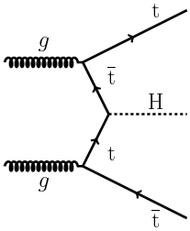
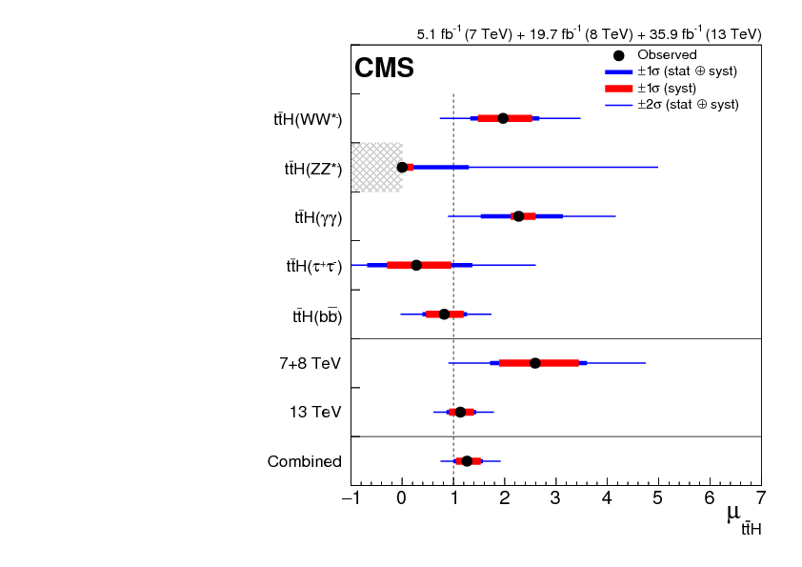
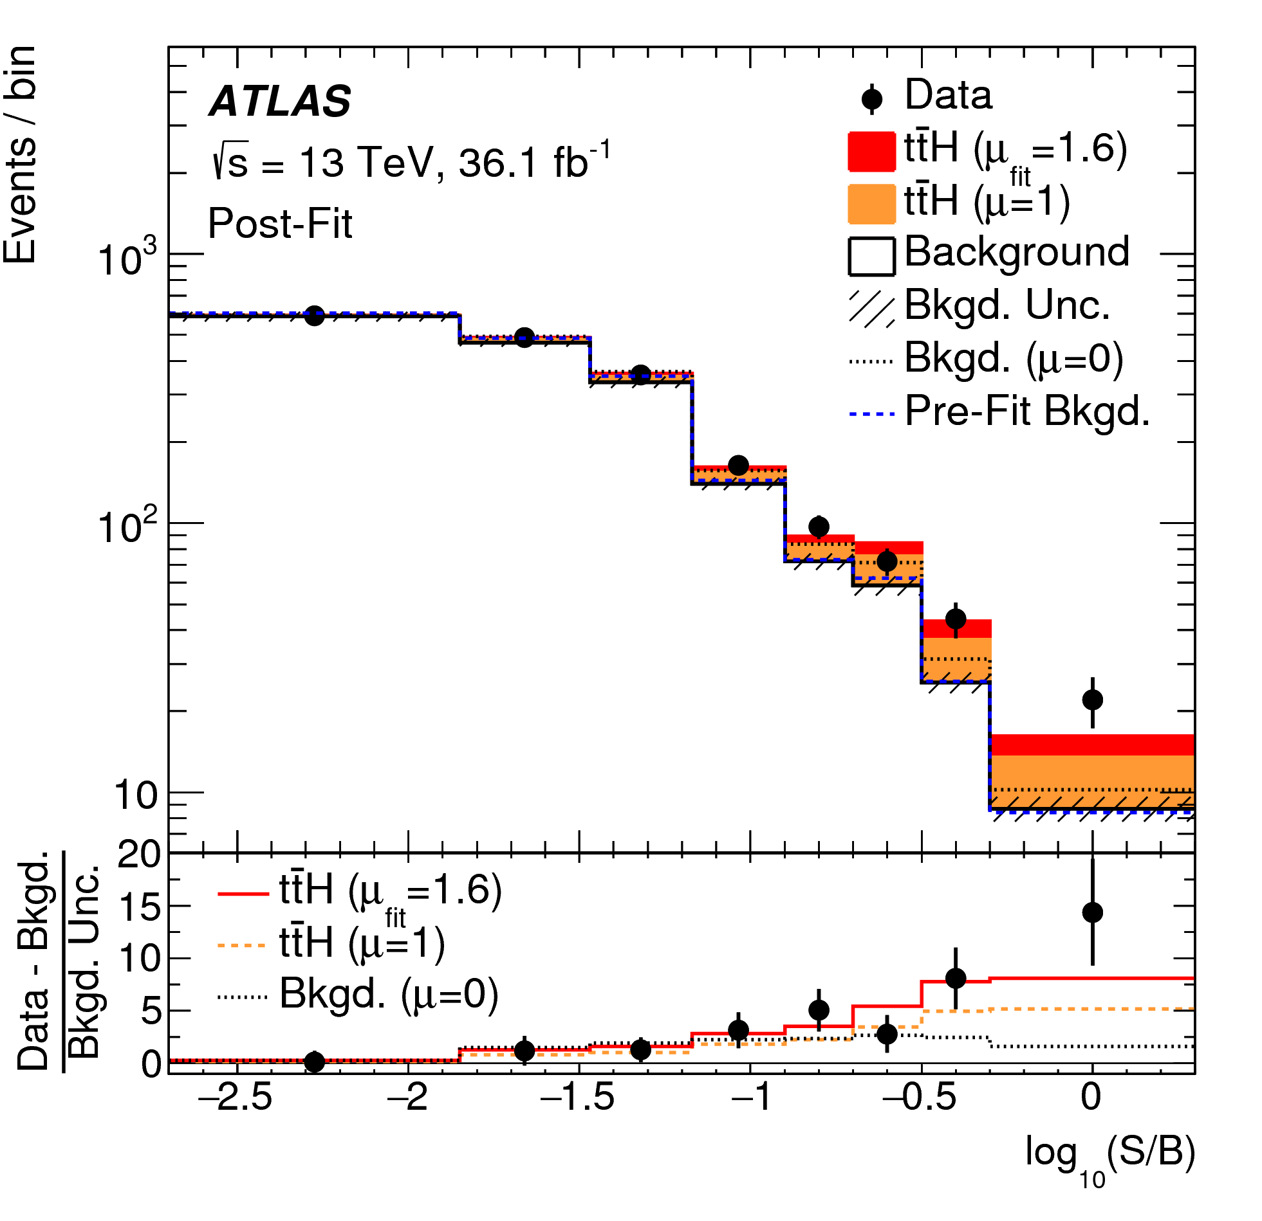
Challenging production modes
arXiv:1712.08891
arXiv:1804.03682
arXiv:1804.02610

Slide 31
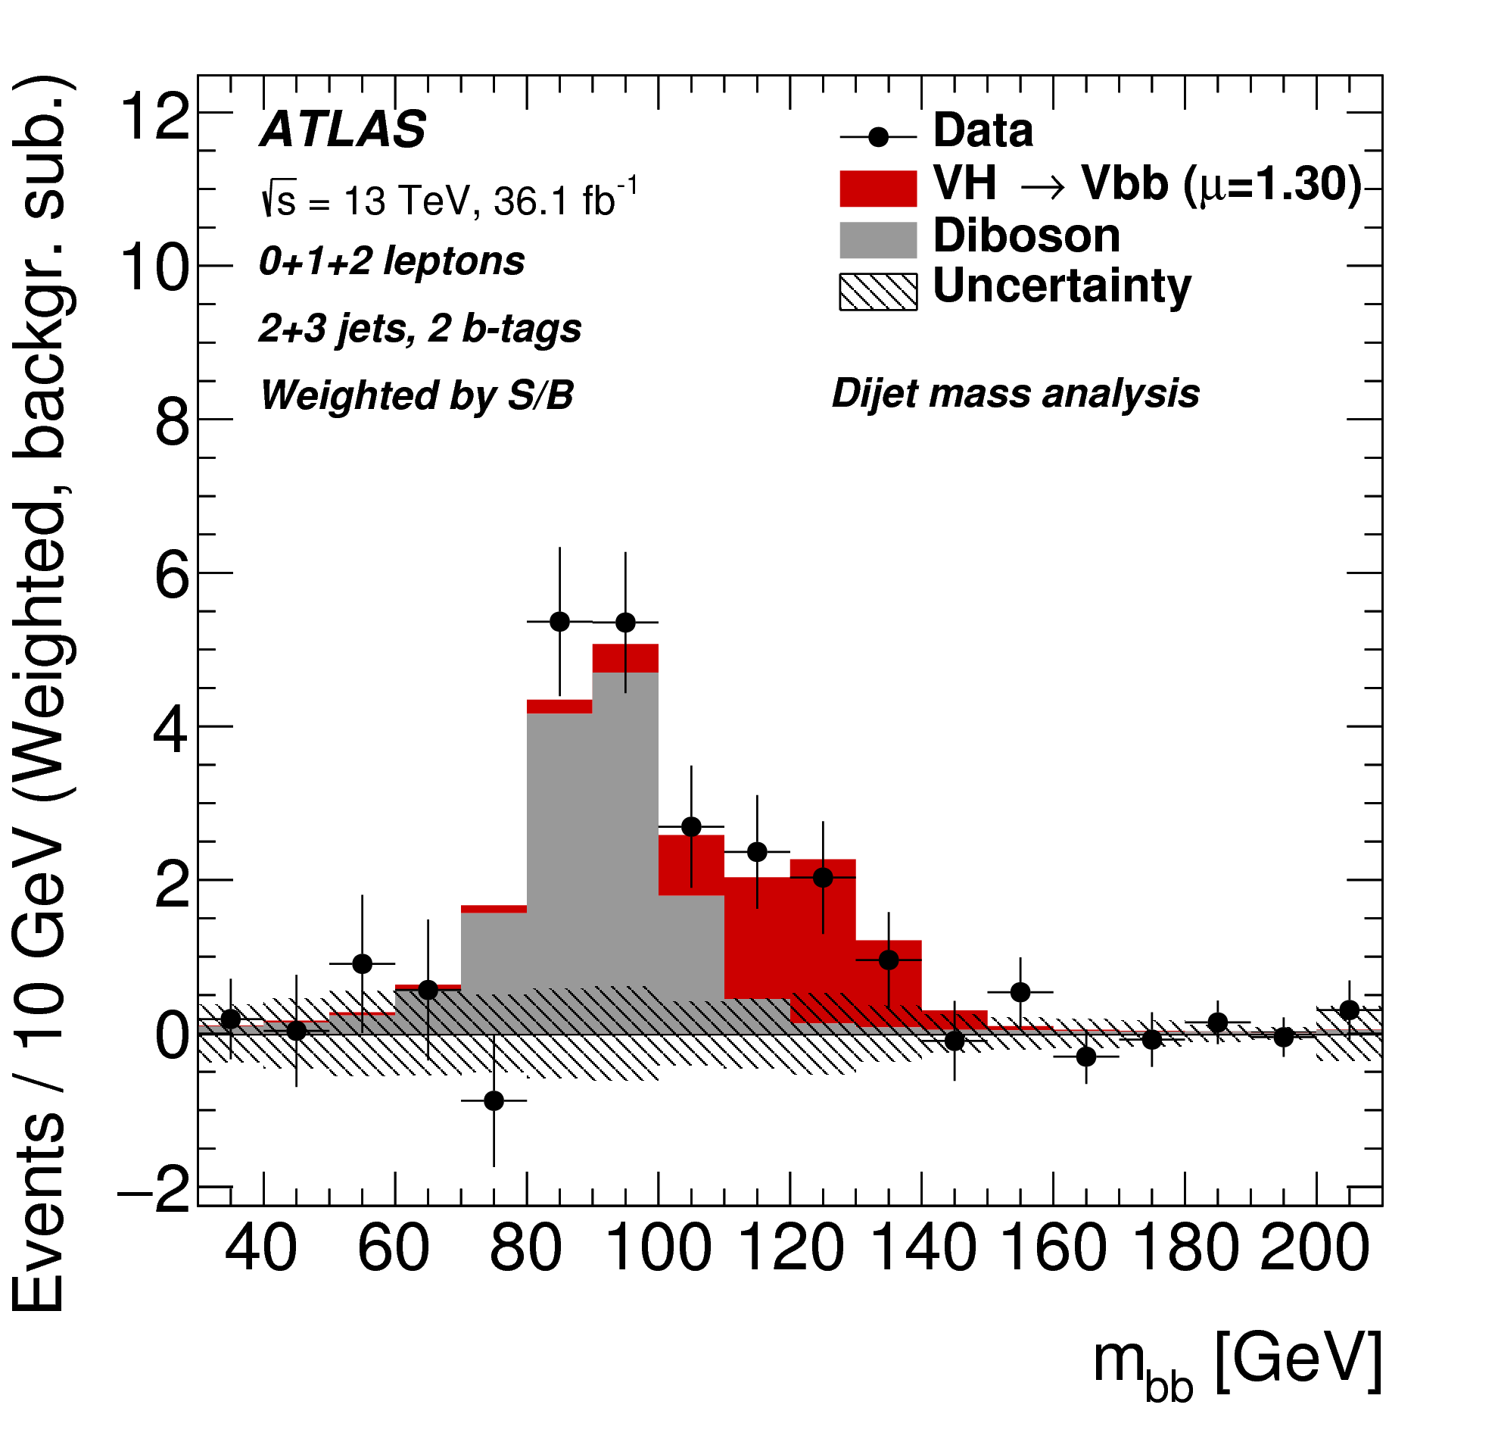
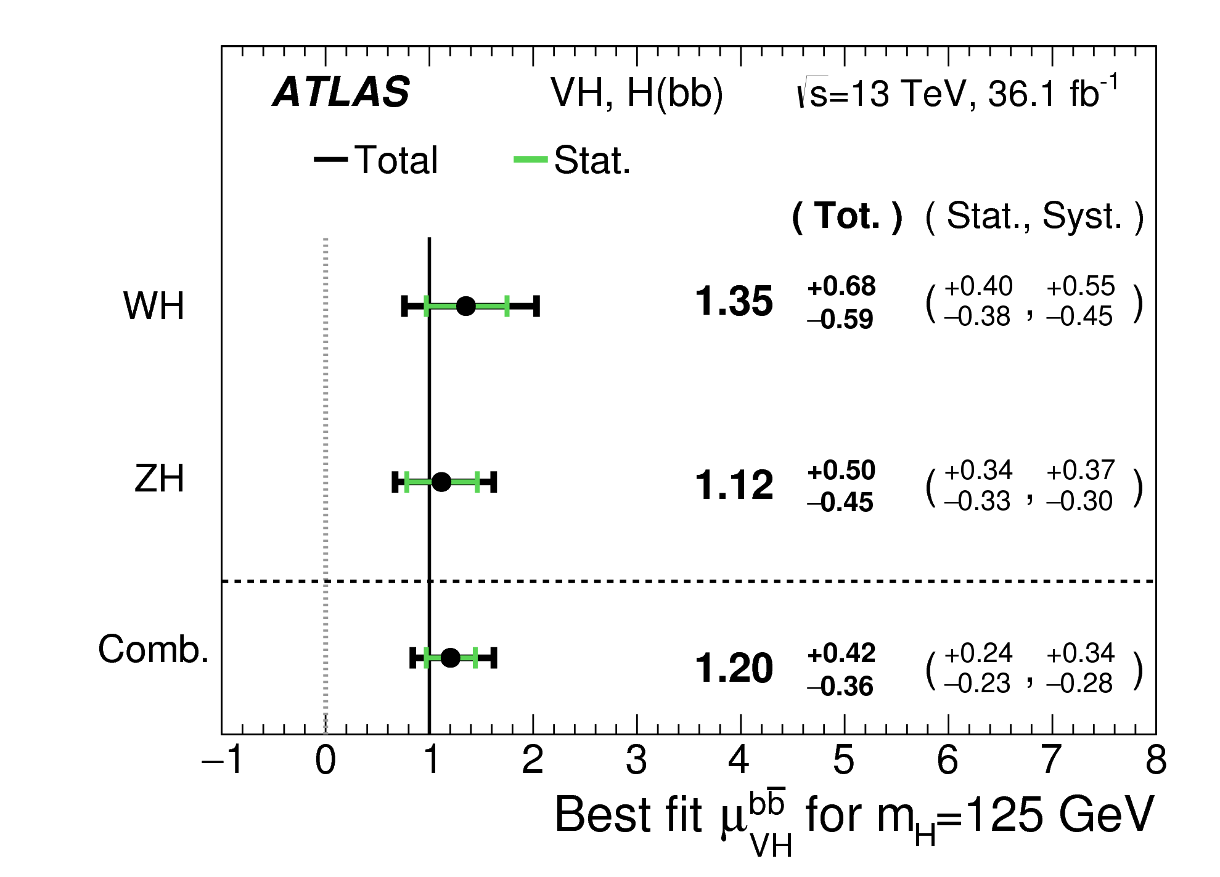
Challenging decay modes
ATLAS: arXiv:1708.03299
CMS: arXiv:1709.07497
Notes:
Also CMS

Slide 32
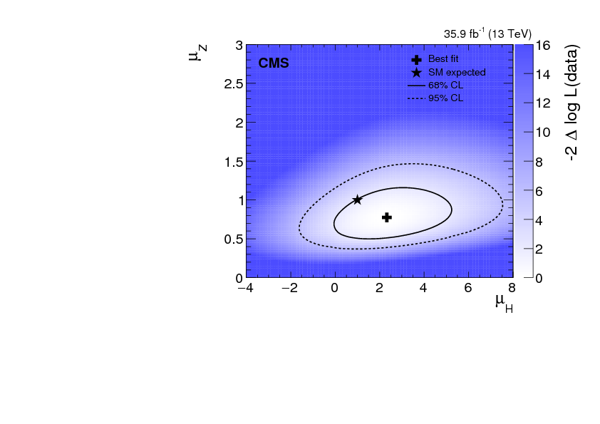
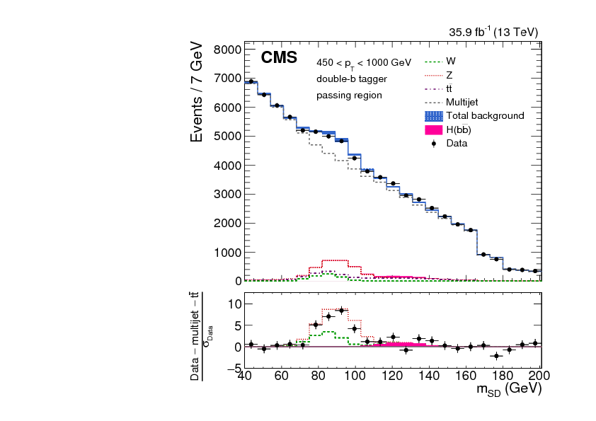
Challenging production & decay modes
arXiv:1709.05543

Slide 33
Alternative history
“Theory-driven experiments are designed and performed in order to investigate well-defined research questions by relying on the well-established theoretical frameworks of the target phenomena. Both the experimental set-up used and procedures carried out in cases of theory-driven experimentation are tailored to investigate specific research questions.”
Korey Karaca, Synthese (2017) 194:333–354
Would we have seen it without the Standard Model/Brout, Englert, Higgs et al, to guide us?

Slide 34
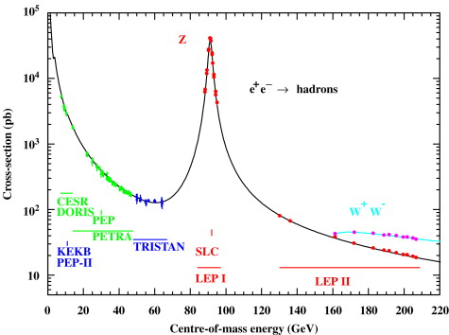
We knew interesting things happen here…

Slide 35
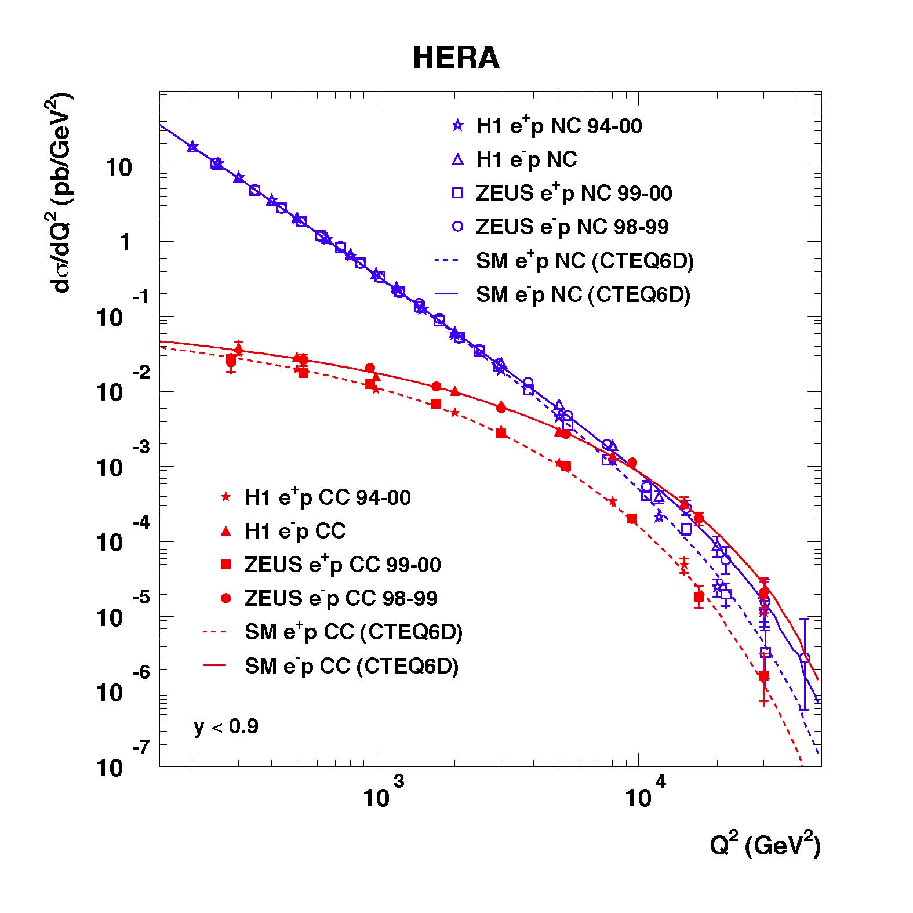
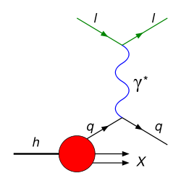
And perhaps even more so here…
Notes:
The weak force (isn’t). Reminder of the short-distance physics.

Slide 36
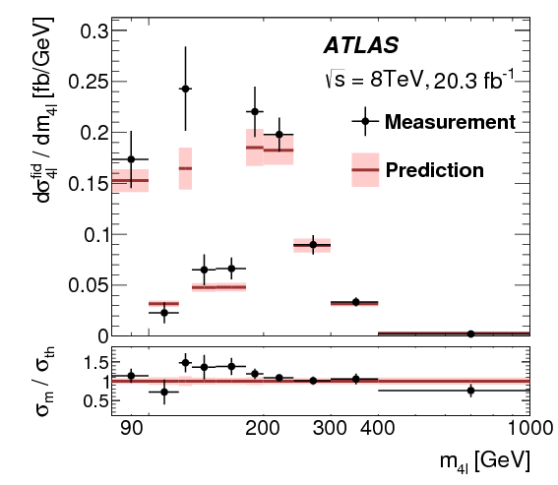
Model-independent, particle-level measurement of differential cross section vs four-lepton invariant mass

Slide 37
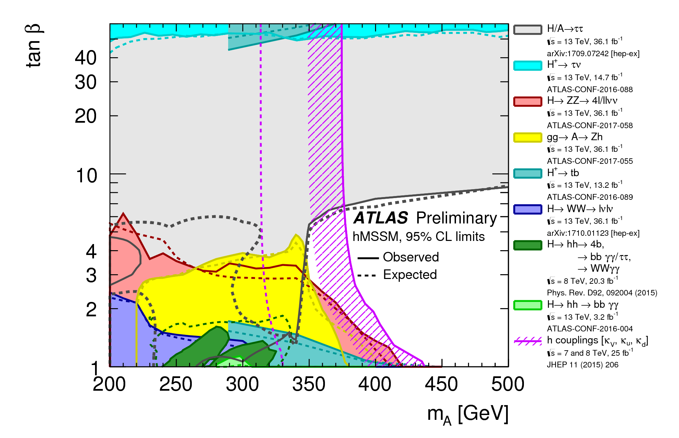
More scalar bosons, BSM…

Slide 38
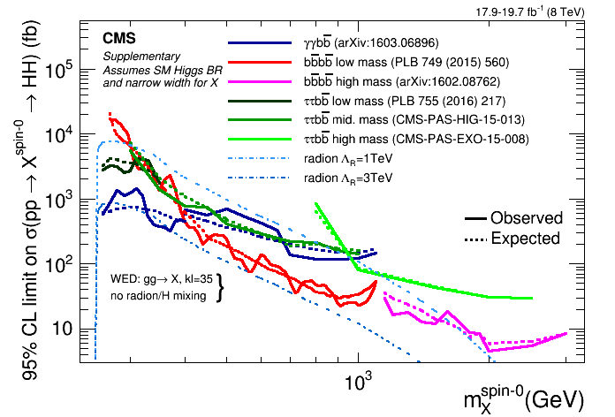
More scalar bosons, BSM…

Slide 39
Conclusions and beyond…
Textbook-like prediction and discovery, after many years of experimental and theoretical work
Final particle of SM
Fantastic success of theory: a qualitatively new phenomenon predicted from basic principles
Higgs mass is a key new physics parameter of the SM

Slide 40
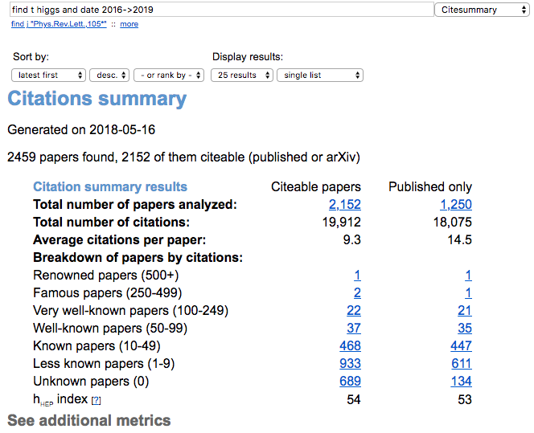
Conclusions and beyond…
Textbook-like prediction and discovery, after many years of experimental and theoretical work
Final particle of SM
Fantastic success of theory: a qualitatively new phenomenon predicted from basic principles
Higgs mass is a key new physics parameter of the SM

Slide 41
Conclusions and beyond…
Into the unknown…
  Well-defined, precise measurements and calculations.
  High multiplicities, high boosts, even for electroweak-scale objects
Even rarer decays
  Zγ, μμ, access to charm via J/ψ, etc
  Off-shell/interference effects to constrain H width
  HH production
  Anomalous couplings, Higgs portal
  …

Slide 42
Conclusions and beyond…
Into the unknown…
  Well-defined, precise measurements and calculations.
  High multiplicities, high boosts, even for electroweak-scale objects
Even rarer decays
  Zγ, μμ, access to charm via J/ψ, etc
  Off-shell/interference effects to constrain H width
  HH production
  Anomalous couplings, Higgs portal
  …
A lot to learn, and many challenges…

