Slide 1
Update on 2018 start-up
J. Wenninger, R. Giachino, M. Albert,
M. Solfaroli, S. Fartoukh

Slide 2
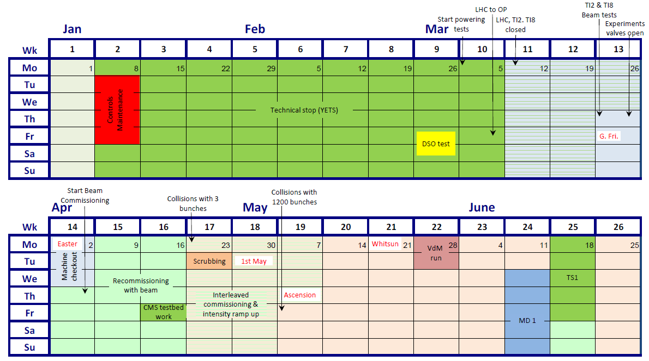
Latest official 2018 start-up schedule
Powering tests should be completed at the beginning of week 13.
Checkout starts week 13, opening of CMS vacuum valves is delayed from Mo 26th March to Thu 29th March.
  No BIS and full LBDS tests possible as long as CMS valves closed.
  TI2/8 test middle of week 13.
First beam postponed by 4 days to second half of week 14.
Powering tests completed
CMS vac valves open
First beam

Slide 3
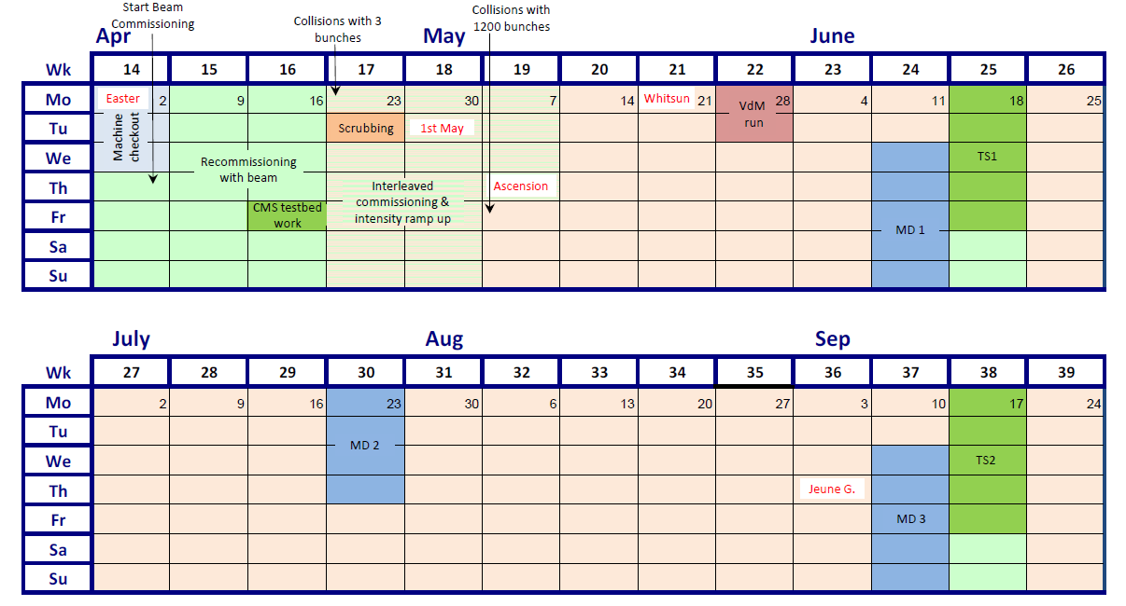

Special runs tentative planning
High beta test at injection is foreseen in weeks 19 or 20 (Mo or Tu).
  1 – 1.5 shifts.
VDM calibration is currently foreseen just after TS1.
  First some low-beta ramp up to ‘warm up’ some detectors (but not too much). This includes a 150 indiv fill for mu scan cross calibration.
High beta at 6.5 TeV (~90 m) for TOTEM follows the VDM in week 39.
  Commissioning of cycle & optics mid-may – mid June.
High β* @
450 GeV
90 m @
6.5 TeV
Intensity ramp up with low b*

Slide 4
Special runs
Low energy high beta run:
  Another test at injection in May with 2017 optics version.
  If not successful → increase energy to 900 GeV + new optics (higher beta*).
  Run will most likely be scheduled after the summer – tbc.
High energy (@6.5 TeV) high beta run:
  90m like optics in IR5, IR1 tbd.
  Optics will start from standard ATS injection, to be developed until end of April.
  Baseline operation with 100 ns beam (~700 bunches, ~1E11 ppb), 50 ns as an option / test (LRBB).
VDM run ~ same recipe as in 2017:
  Reuse the 2016 settings once more.
    This year crossing angles are back in IR1 and IR5 at injection and in the ramp.

Slide 5
Physics and special runs beams
The MSWG requested a presentation on 23rd March of the beams required for LHC operation in 2018.
  At least up to the summer, assuming all goes well.
Beams for physics operation including special runs.
  100 ns and 50 ns: smallest reasonable emittance ~ OK.
Beam type | Intensity [10¹¹ p/b] | Emittance [μm] | Date
Probe | 0.05-0.2 | - | startup
Nominal bunch | 0.8-2 | ~2 | startup
Vdm bunch | 0.8-1 | ~3-3.5 | W24
25 ns standard (4 batches) | 1.15 | 2.5 | W16
25 ns BCMS | 1.1-1.3 | 1.5-1.9 | W15
100 ns standard | 0.8-1.1 | 1-2 | W24
50 ns standard | 0.7-1.1 | 1-2 | W24

Slide 6
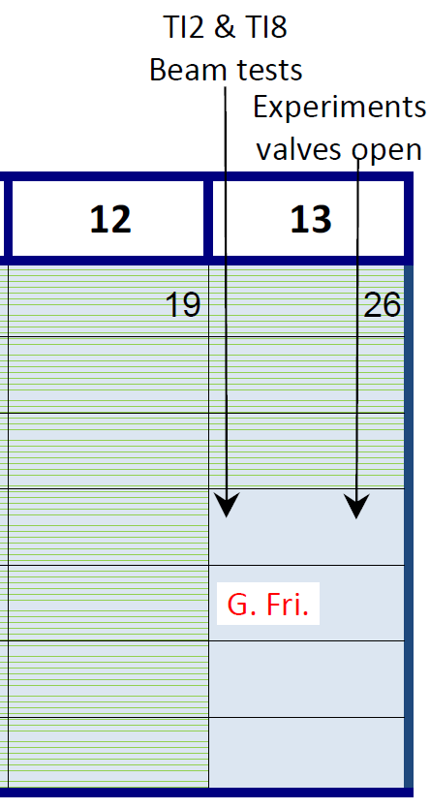
Activities – Weeks 12/13
Week 12:
  Last powering tests,
  Th 22.3: Local BIS loop disconnected (LBDS test), reconnect LBDS to LHC BIS loops.
Week 13:
  Moving from powering tests to global machine checkout.
    Checkout of full 2018 cycle down to β* of 25 cm.
  Mo 26.3 : UPS tests of LBDS.
  Mo 26.3-We 28.3: LBDS BETS tests with sectors 45,56,67,78.
    RP interlocks tests – requires declaring stable beams.
    MKI pulsing (with test key).
    Experiments handshake tests.
    Tests for SMP (energy, beta*).
  Th 29.3: All experiments vacuum valves opened.
    Arm BIS loop and LBDS.
    BIS and LBDS commissioning tests (start of).
  Th 29.3: TI2/TI8 tests to downstream TEDs
    Beam will reach ALICE & LHCb.
    MKI pulsing in nominal conditions.
1
2
2
1
3
4
3
4

Slide 7
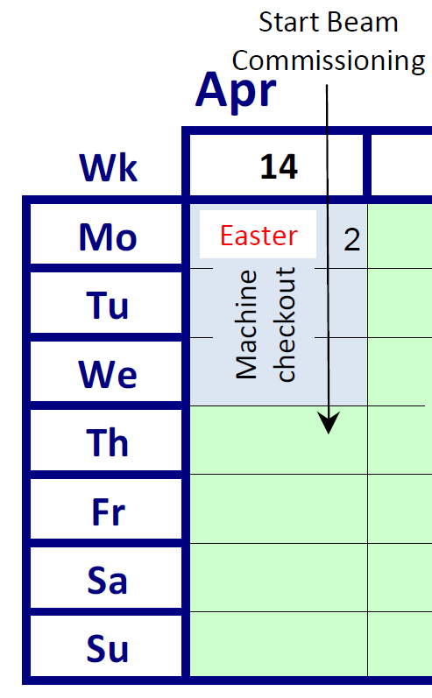
Activities – Week 14
Week 14:
  Mo 2.4: options if we progress well?
  Tu 3.4 - We 4.4: Complete BIS and LBDS commissioning without beam, and missing checkout tests.
    Very likely ½ day of access to fix issues detected during checkout weekend.
    Complete missing checkout tests.
  Th 5.4: Start of beam commissioning.
5
6
5
6

Slide 8
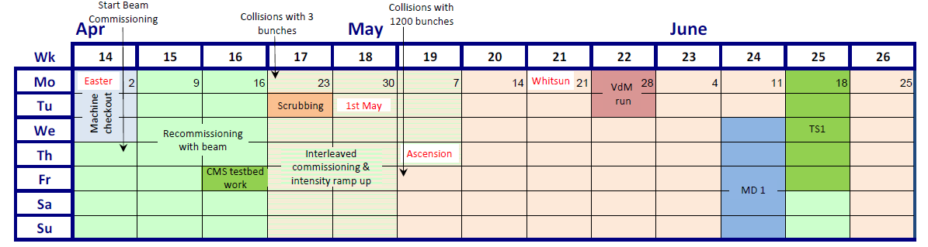
Commissioning activities
Collected commissioning activities, incorporated into a tentative schedule.
With the current input ~2 ½ weeks is a reasonable estimate for the time needed to first stable beams.
Since S12 was not brought to room temperature, the time for scrubbing was reduced to ~ 24 hours based on the experience of the previous years.
1000
2100
600
300
1200
2500

Slide 9
Start-up plan – rough outline
Injection
Circulating probe
RF, ADT, coarse collimators
Circulating nominal
Probe cycle
Orbit bumps
Optics at injection
Collimators
OMC measurements and corrections
Orbit bumps
TL and injection protection
Nominal cycle
Collimators FT
MPS validation
RF, ADT, BI
Collisions
Train injections
MPS validation cycle

Slide 10
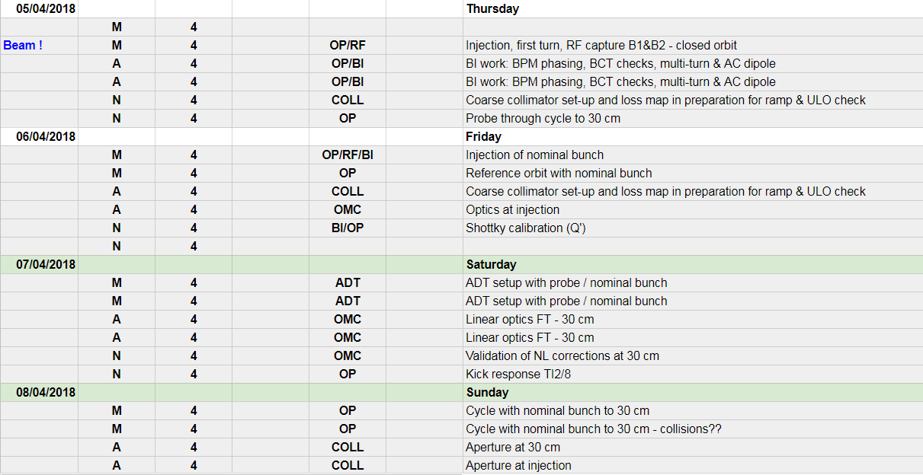
Commissioning plan
Shift-by-shift commissioning plan prepared based on the requests that were received – start on Thu 5th April.
Google spreadsheet to plan & track:
  https://docs.google.com/spreadsheets/d/1nnEb3f15L3NwxJ0RAnh-WkG_eiUUfJ9WGh2yxaT5Kjo/edit?usp=sharing
  Aim to inject nominal bunch on Friday → open sufficient room for variety of activities during first weekend (after Easter).

Slide 11
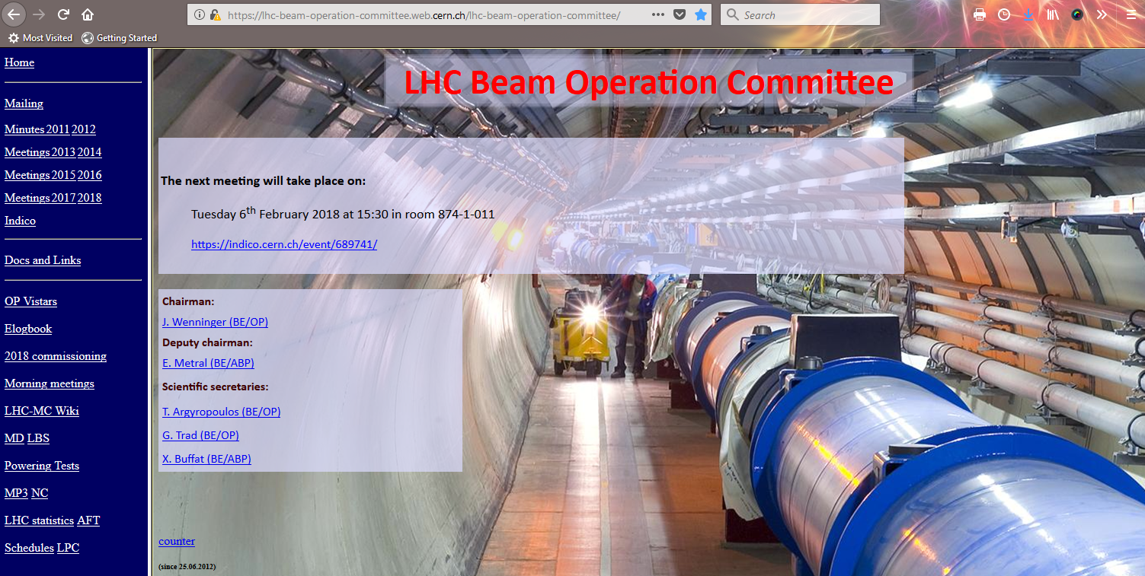
Commissioning plan
The commissioning plan is accessible from the LBOC home page

Slide 12
Update on cycle configuration
New sequence elements have been imported. Optics (re-)import to start soon.
  Wire collimator in IR1 and associated BPMs.
Ramp: faster PPLP ramp.
  The settings established during the 2017 MD will be used for bootstrapping.
  Work starting this week…
Tune change:
  No change wrt 2017, clone for 2018 in place.
Squeeze:
  Merge squeeze segments 1m-40cm and 40cm-30cm,
  Take a short cut to the CTTPS2 version (Q6 @ 200 A) – see next slide,
  Reuse the 2017 settings for bootstrapping as much as possible.
Collisions:
  No change wrt 2017, clone for 2018 in place.
Squeeze for β* levelling:
  New squeeze segment 30cm-27cm-25cm.
    In preparation.
  Must be setup eventually with colliding beams.
  Detailed scenario discussed next week at LBOC.

Slide 13
Squeeze 100-25 cm
The 40cm-30cm squeeze segment will be merged with the 1m-40cm segment to form a single squeeze beam process covering 1m-30cm.
  The end of the squeeze to 30 cm will be rebuild by taking a short cut towards the CTTP2 variant. This should save some ~100 s of squeeze time.
Dedicated β* levelling squeeze beam process 30cm-27cm-25cm.
New optics files were delivered, upload as soon as the 2018 sequence is uploaded.
CTPPS1
Q6 @ 250 A
CTPPS2
Q6 @ 200 A
Q6 @ 300 A
= 2018 squeeze
49 s
52 s
40 cm
= 2017 squeeze
93 s
37 cm
91 s
= existing 2017 optics file
33 cm
61 s
= new 2018 optics file
30 cm
27 cm
25 cm

Slide 14
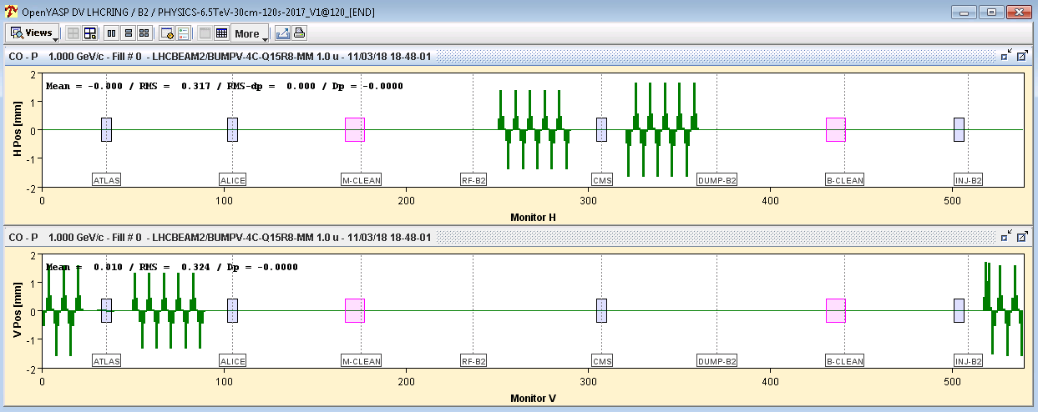
Spurious dispersion
The crossing angle (and to some extend also the separation) bumps generate spurious dispersion that increases as β* is reduced.
For the ATS optics S. Fartoukh provides knobs that compensate the dispersion.
  Not used in 2017.
In order to remove a source of systematic errors on the emittance measurement, G. Trad asked if it would be possible to use the bumps and reduce the spurious dispersion that feeds into the beam sizes @ BSRT.
Since the bumps are not very large (in the arc) and present no technical challenge, we propose to use them in 2018.
  Nominal settings at 30 cm,
  To be defined how we ramp the bumps up.
    In the ramp → nominal settings at FT (6.5 TeV / 1m),
    In the squeeze → nominal setting at 40 cm.
ULO bump
Dispersion knobs for B2 @ 30 cm and 160 μrad
Peak orbit excursion ~ ±1.6 mm
Drawn with +1 mm ULO bump

Slide 15
Bump settings
Bumps values through the cycle.
  The dispersion knobs are ramped up in the first points of the squeeze.
Bump | Injection | FT | 30cm | collisions
Xing IR1 | 170 | 160 | 160 | 160
Xing IR2 | 170 | 200 | 200 | 200
Xing IR5 | 170 | 160 | 160 | 160
Xing IR8 | -170 | -250 | -250 | -250
Sep IR1 | -2 | -0.55 | -0.55 | 0
Sep IR2 | 3.5 | 1.4 | 1.4 | 0
Sep IR5 | 2 | 0.55 | 0.55 | 0
Sep IR8 | -3.5 | -1 | -1 | 0
Dispersion IR1 | 0 | 0 | 160 | 160
Dispersion IR5 | 0 | 0 | 160 | 160
IP shift IR2 | 0 | 0 | 0 | -2
IP shift IR5 | 0 | 0 | 0 | -1.8

Slide 16
Xing angle levelling in LHCb
After considering all aspects with the LPCs we decided to drop the idea of crossing angle changes in IR8 (to replace the bunch length blow up for one of the polarities).
The overhead for setup and validation was not worth ~1% of integrated luminosity gain for ATLAS & CMS.

