Slide 1
Polarised target status
Norihiro DOSHITA

Slide 2
Outline
He3 line of the dilution refrigerator
He4 line of the dilution refrigerator
Target cell
Magnet
Precooling
Man power

Slide 3
He3 line of the DR
Isolation vacuum
- 5 10^-6 mbar
Root pumps running test with dry N2 gas for 24 hours
Leak check
- Pumping line connections
- needle valves and gauges connections
- access tube line
- condensation line
- from He4 line
- root pumps → Leak @ 8th pump back → fixed
- from cooling water
- gas panel
- LN2 trap
New LN2 buffer dewar for LN2 trap

Slide 4
He4 line
Pump system running test
Leak check
- pumping line → leaks → fixed (TE-CRG) : no more spare helicoflex joint
- needle valves and gauges connection
- cavity pumping line → leak → fixed
- around pump
500 L liquid helium dewar (TE-CRG)
- already delivered (15/2)
- transfer line installation (20/2)
Recovery line modification
- recovery line to cold box closed
- connection to balloon line with a check valve
Purging
- 3 times

Slide 5
Target cell
All coils installed
Target cell and target holder connection
- a NMR coil cable damaged
Insertion test at room temperature
Check of the NMR cables
Leak check of the holder

Slide 6
Magnet
New power convertor lack installed (31/1)
Converters commissioning
-- Full current with short cut circuit (12-13/2)
-- MSS signal test on going with the short cut circuit
Flow controllers service
Leak check
-- magnet necks
-- flow controller panel
-- Two big safety valves
Precooling preparation
-- 4 times purging → see next page
-- LN2 line installation
Valve control tests

Slide 7
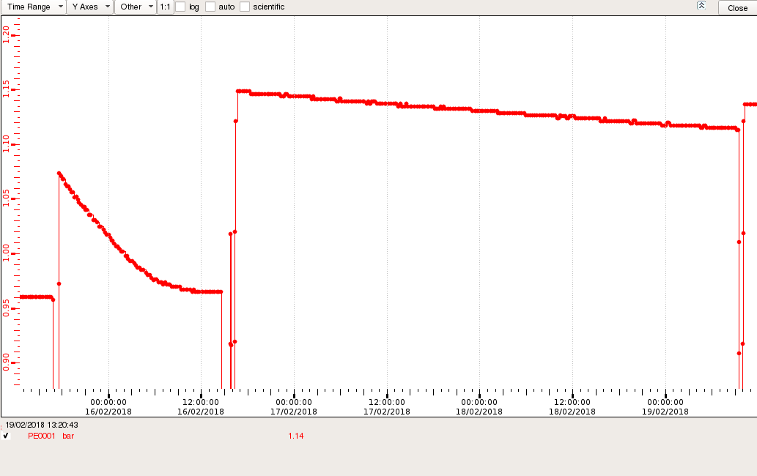
Magnet helium vessel pressure
3rd
4th
1.15 bar
1.10 bar
34 mbar drop for 60 hours
1st purging
2nd
1.00
Thur
Fri
Sat
Sun
Mon

Slide 8
Precooling
Magnet : OK ➔ started at 8:00 in this morning
- purging : done
- Alexey and Fabrice came to check.
- N2 transfer test : done
DR : OK ➔ started at 9:00 in this morning
- purging : done
- 500 L dewar : installed
-- transfer line : installed at 9:00 today
- helium recovery line : OK

Slide 9
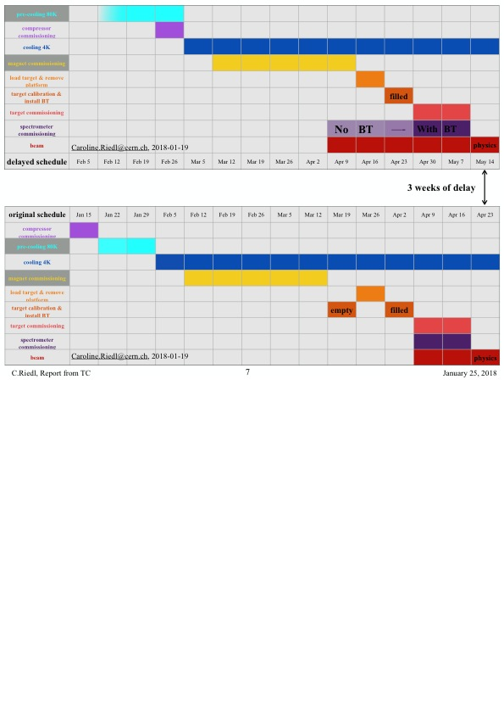
COMPASS Preparation schedule
We are here.

Slide 10
Man power
Accelerating of preparation since last week
Jaakko, Kaori and Nori
-- Permanently at CERN
Michael : back to CERN on Wednesday
Genki : back to CERN on Thursday
Eric : came to CERN on Thursday for 2 weeks
Three tasks progressed in parallel
Yuri will come from April

Slide 11
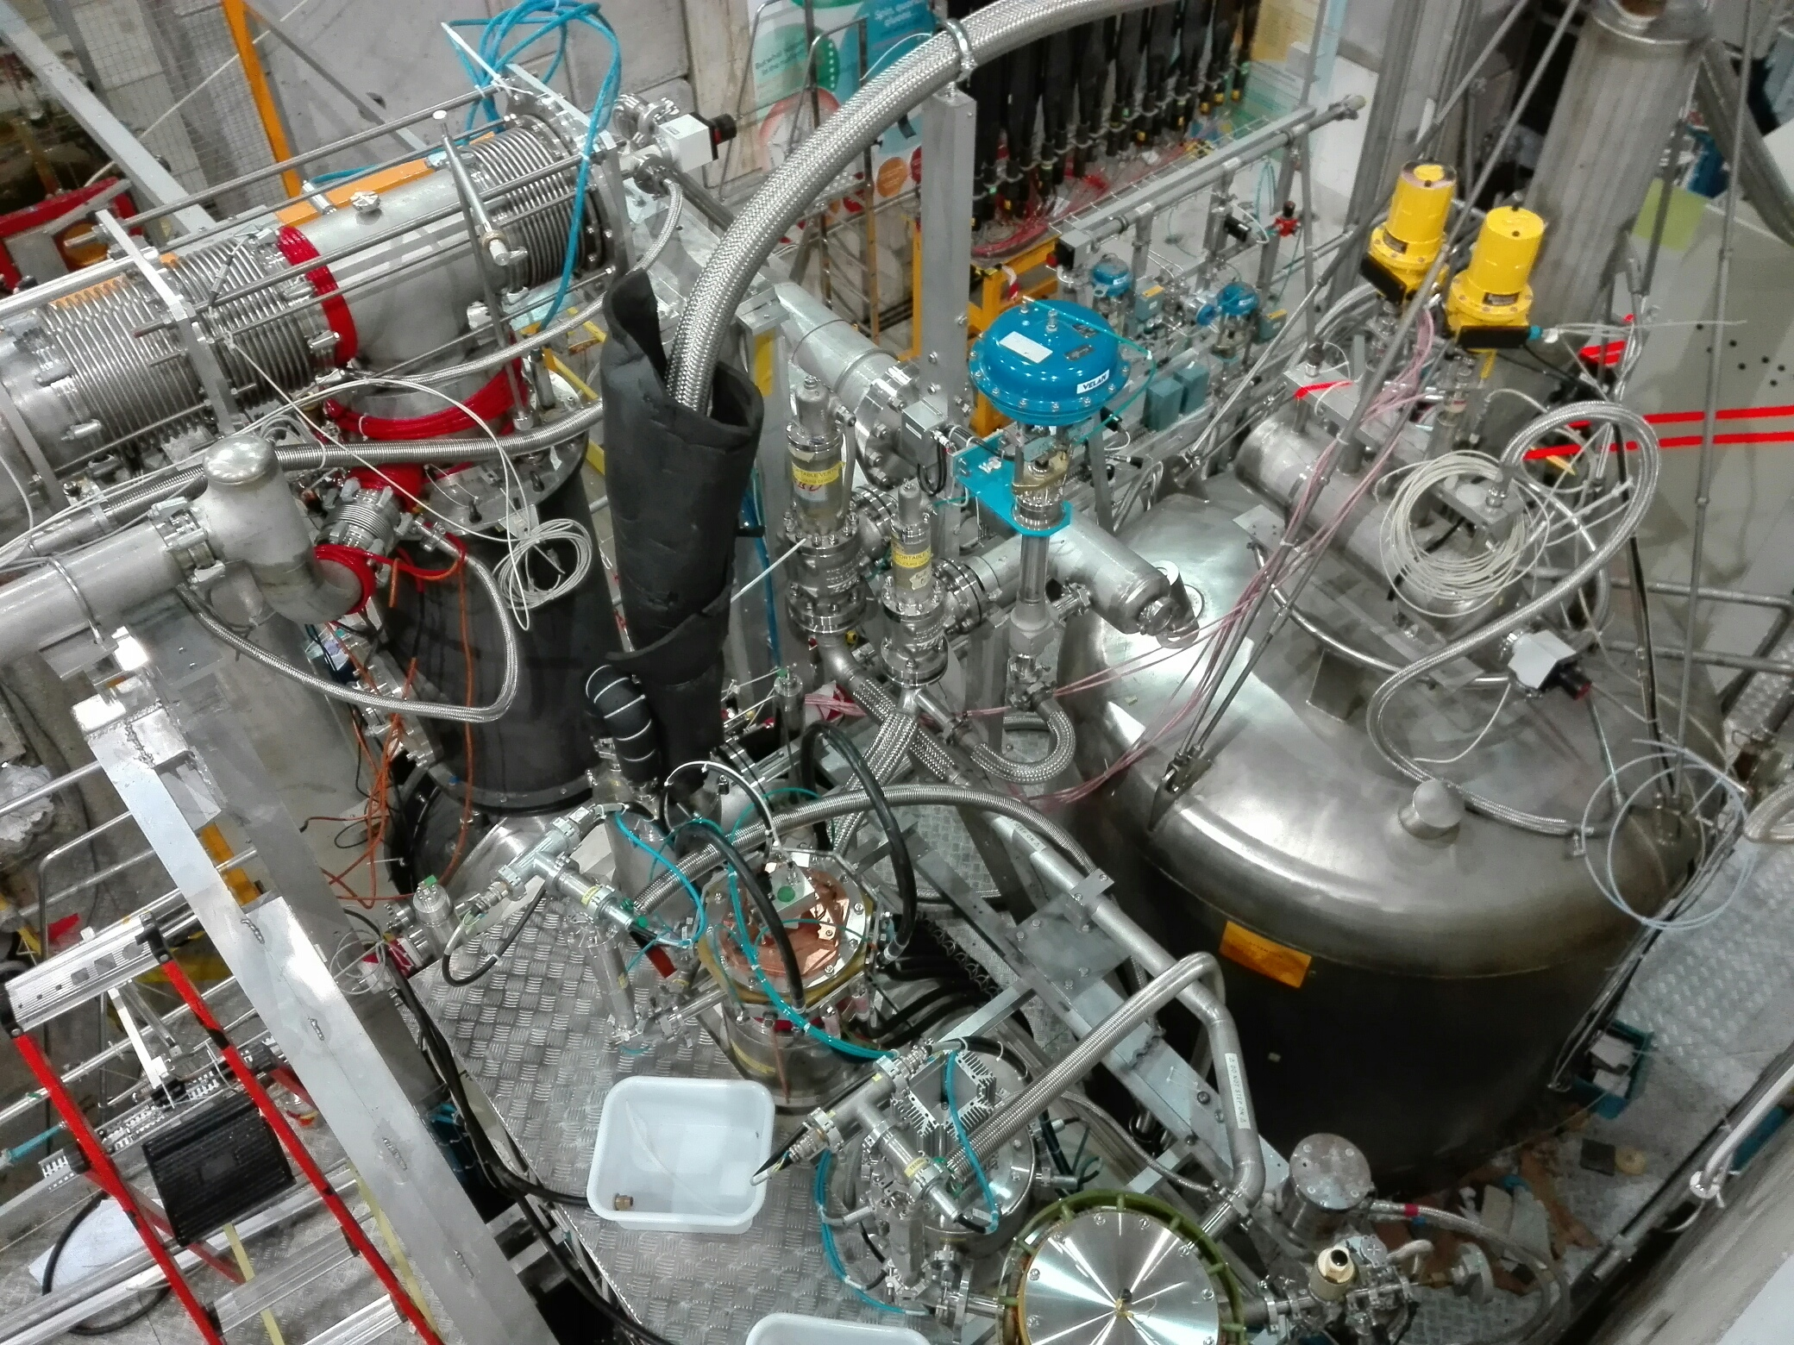
LN2 transfer line
Short cut cable

Slide 12
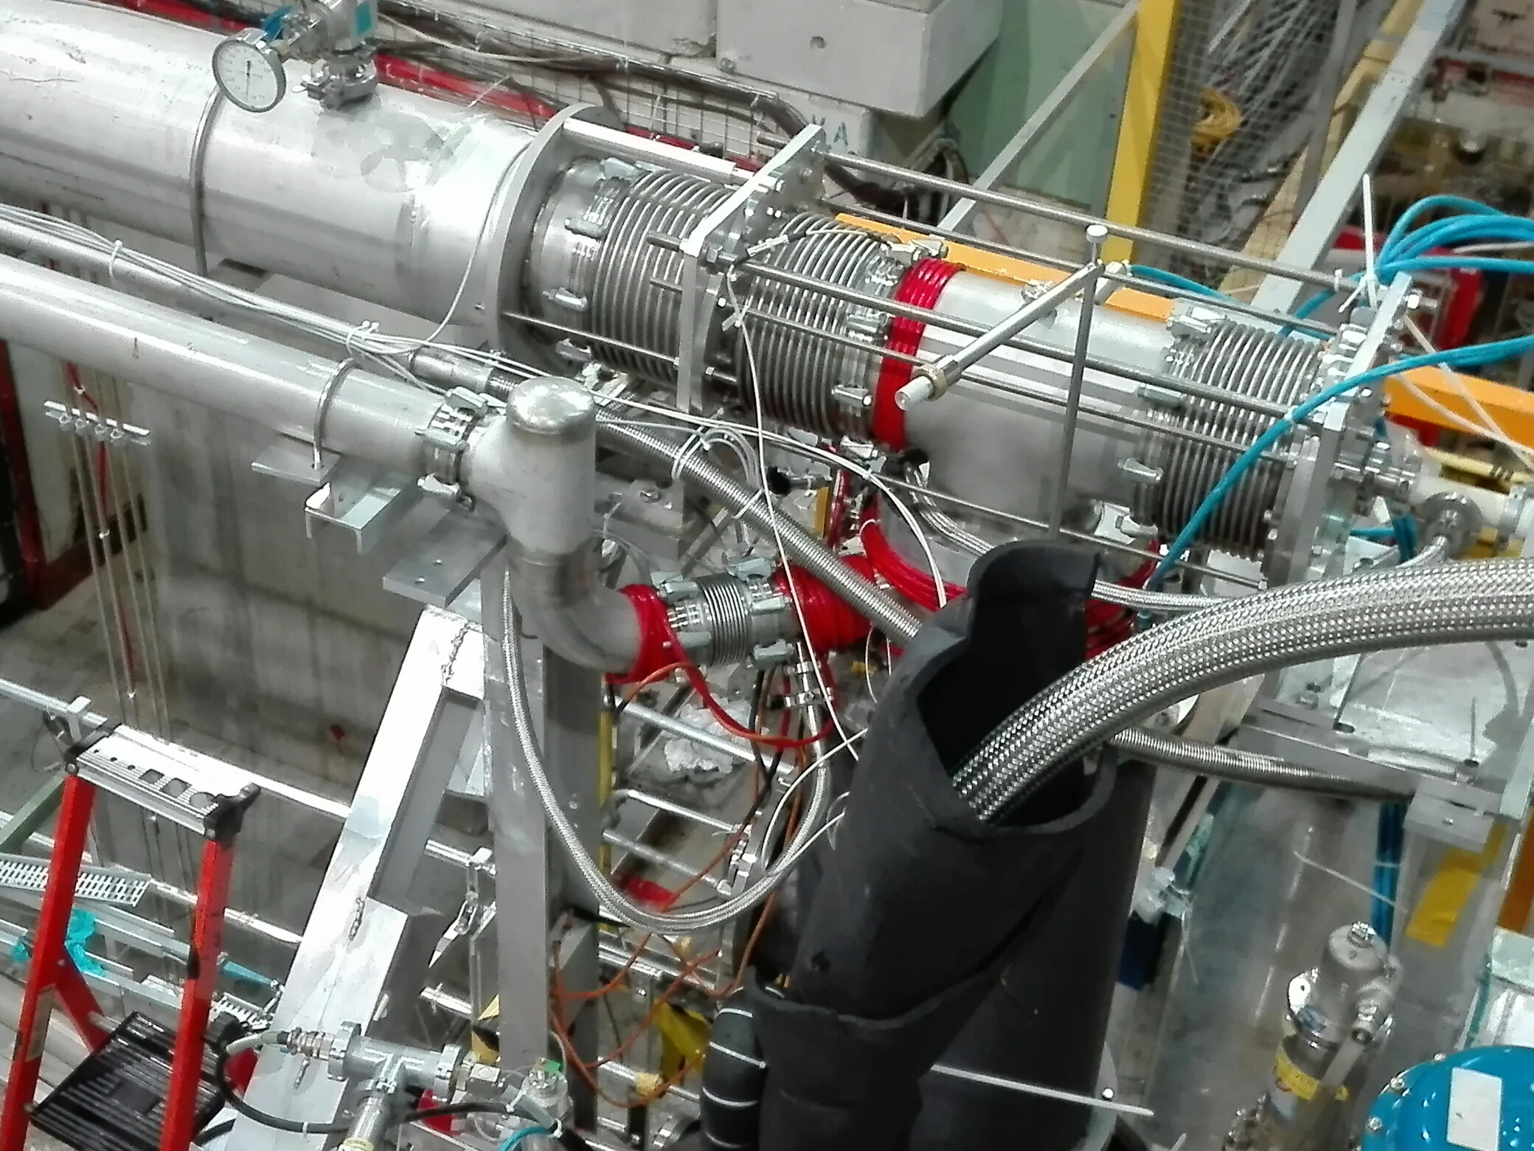
He3 pumping line
He4 pumping line
Helicoflex joint

Slide 13
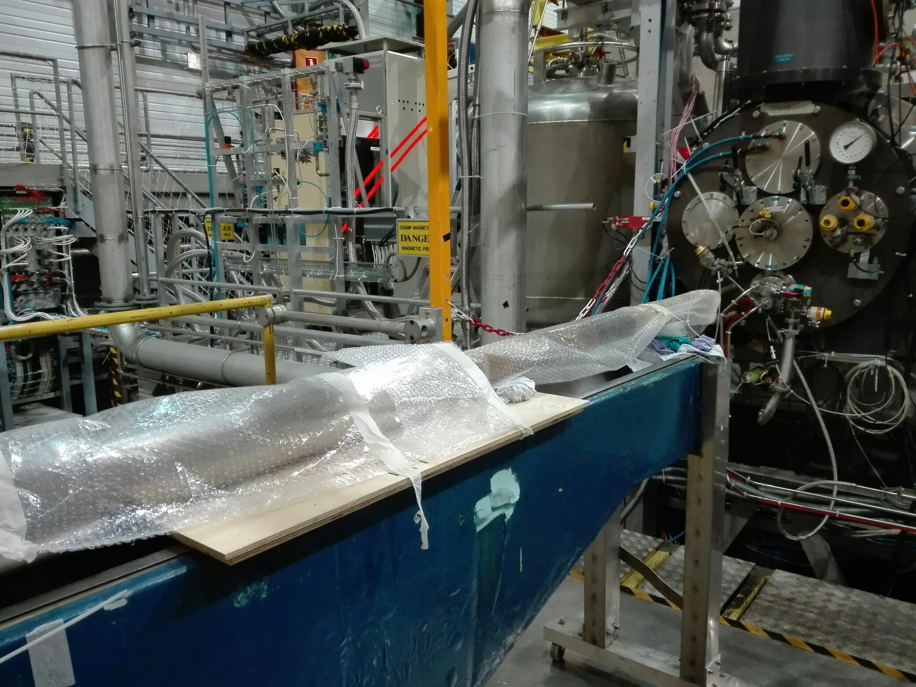
Target insertion place
Target cell and holder

Slide 14
