Slide 1
Cockcroft Update
H. Zhang, A. Salehilashkajani

Slide 2
Content
New setup
  Injector
  Alignment laser system
  Skimmer assemblies
  Setup as a whole
Use residual gas to calibrate the gas jet density

Slide 3
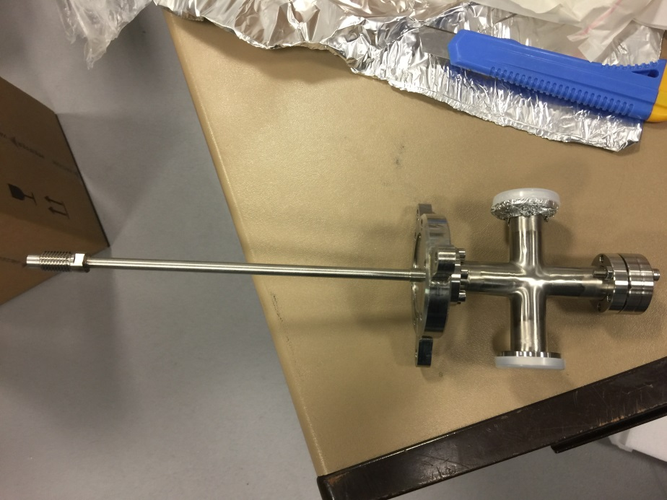
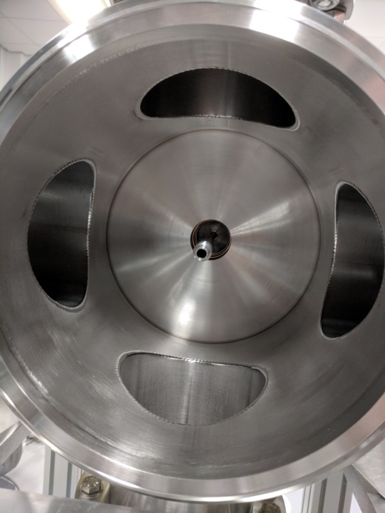
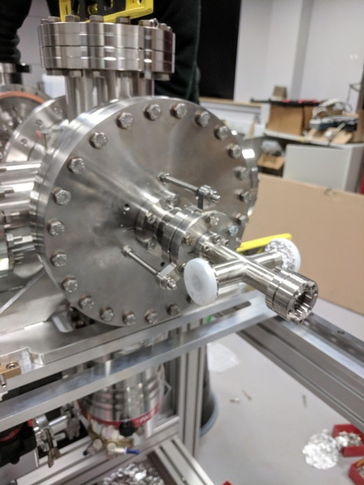
Injector

Slide 4
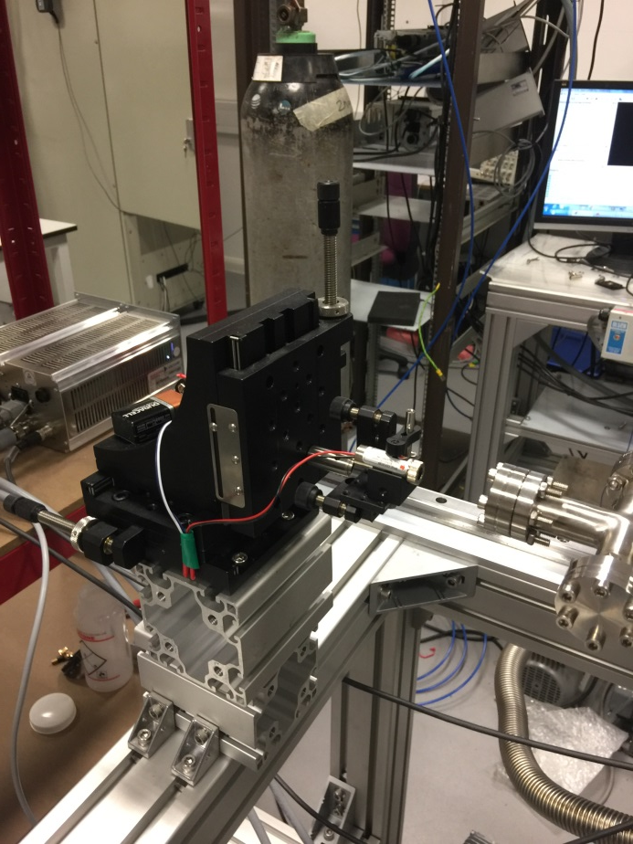
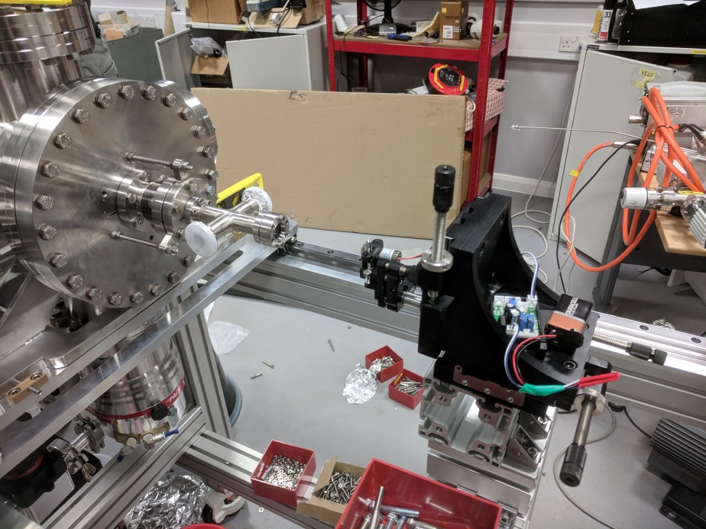
Alignment laser system

Slide 5
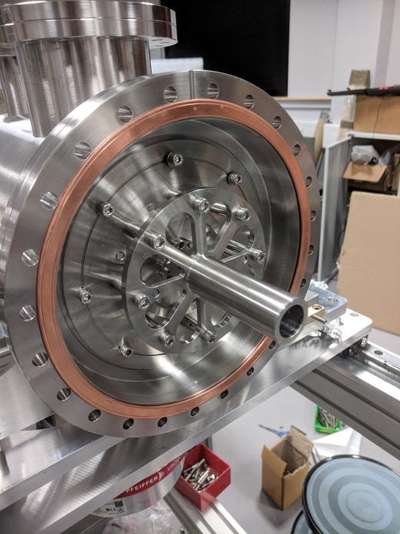
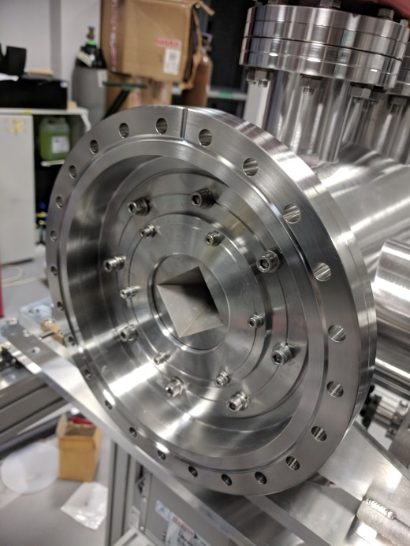
Skimmer assemblies

Slide 6
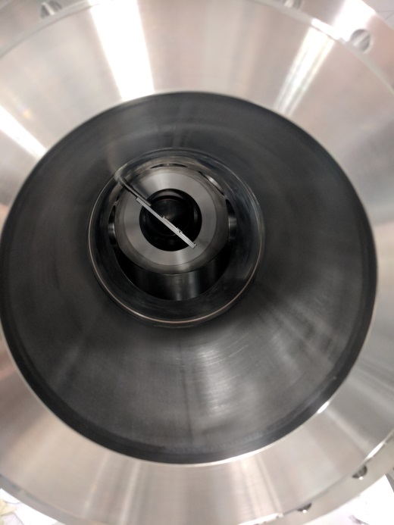
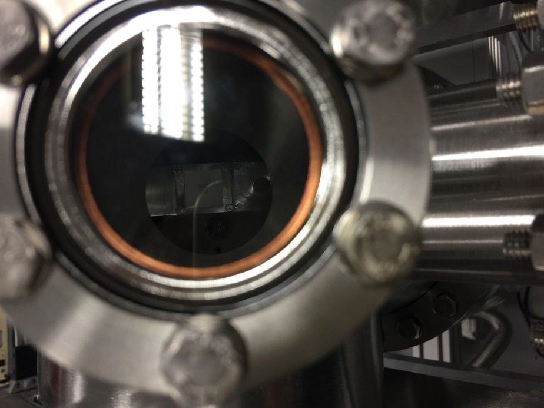
Screen & Target

Slide 7
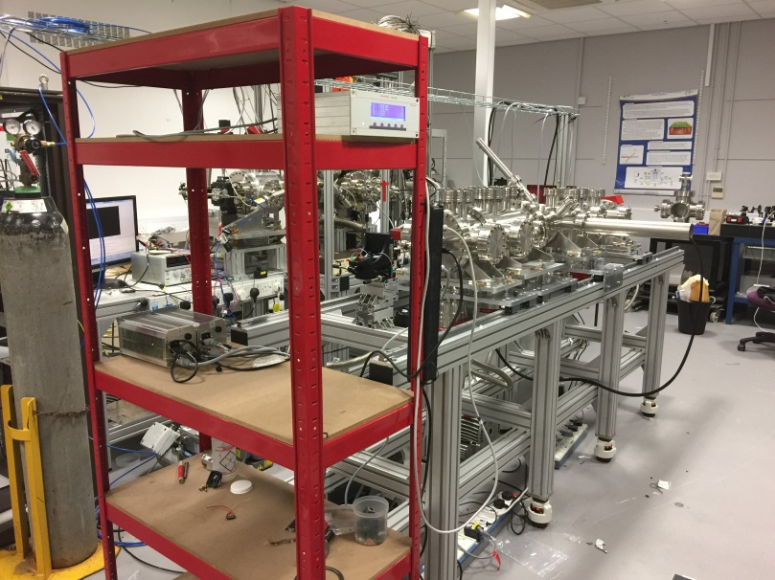
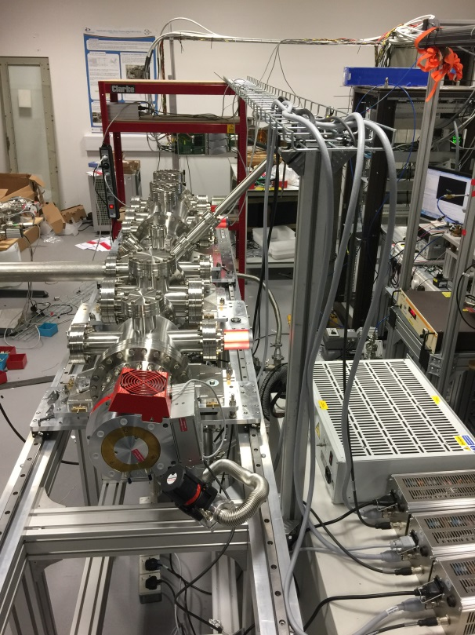
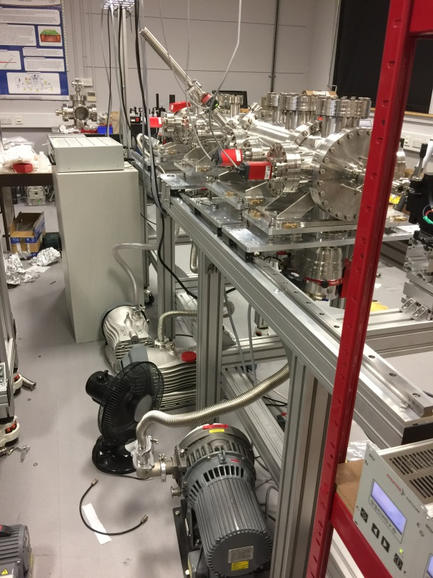
Setup as a whole

Slide 8
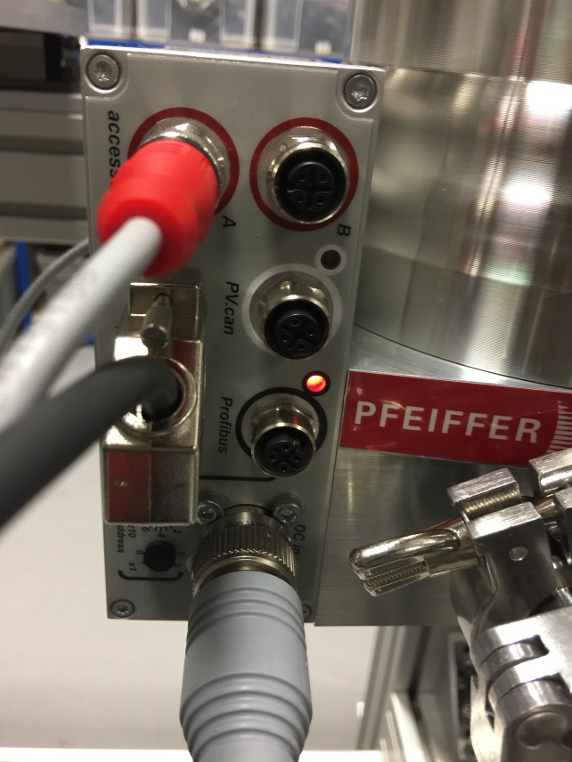
Pump connection issue
The standard cable (4 pins) from DCU is not compatible with the TC (Profibus), remade the cable to connect the TC with remote port this week according to the Pfeiffer Technician, and start to pump yesterday.

Slide 9
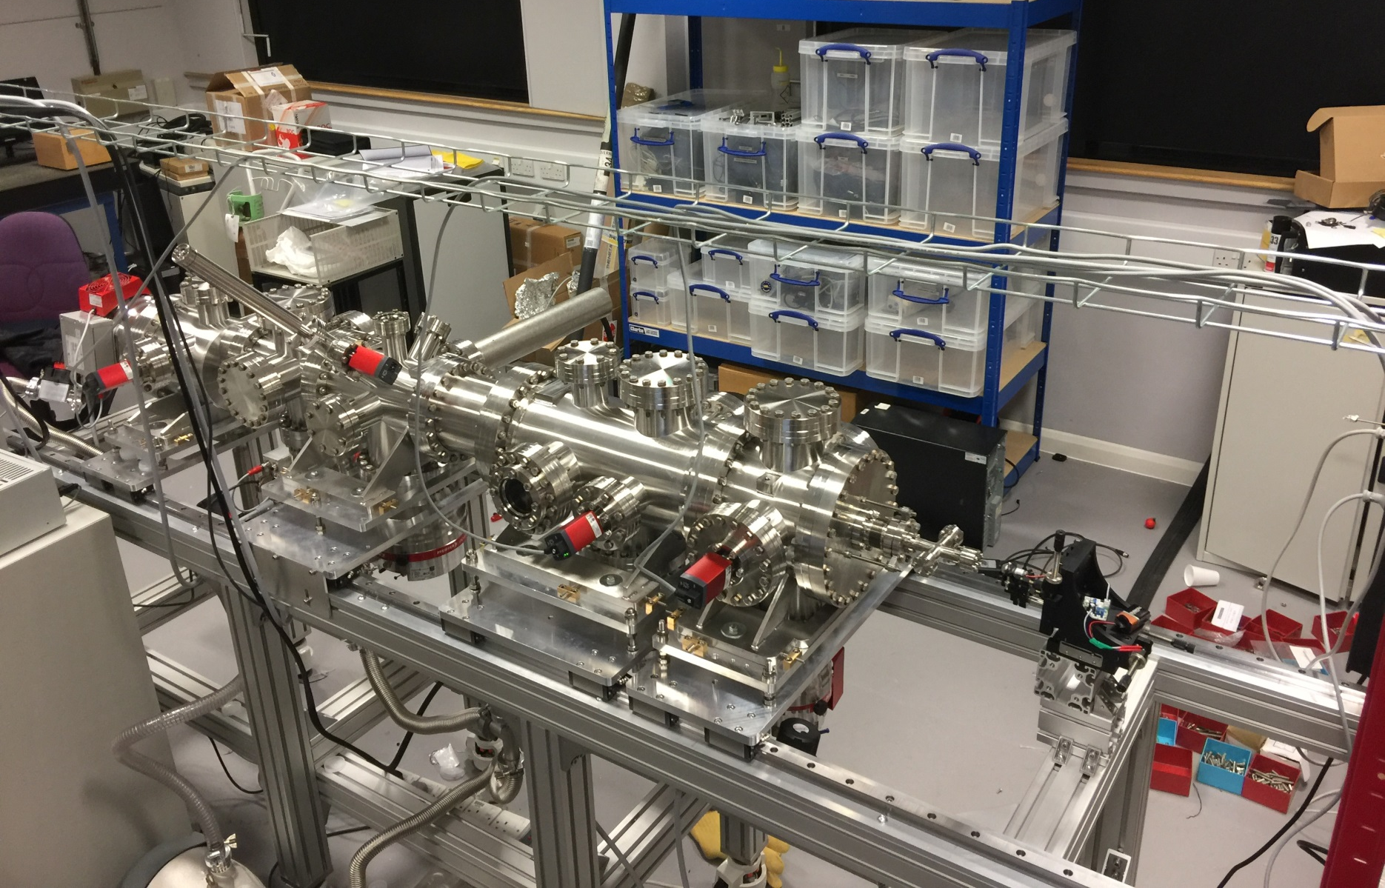
Pumping test
8.4e-7 mbar
2.0e-7 mbar
2.7e-7 mbar
5.4e-8 mbar

Slide 10
Things not ready
Gas line (Will be delivered this week)
Optics holder (under manufacturing)
Alignment mirror & holder (under manufacturing)
LED port for target??
Nozzle??

Slide 11
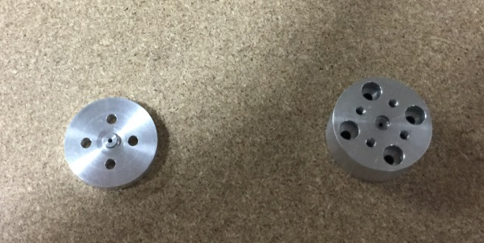
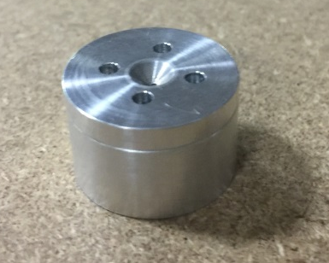
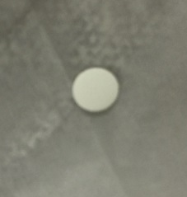
Nozzle suggestion

Slide 12
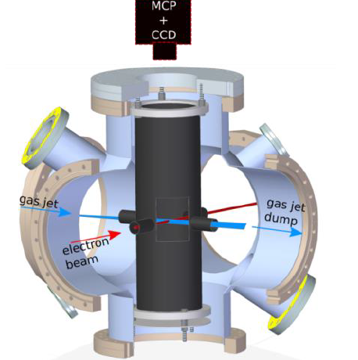

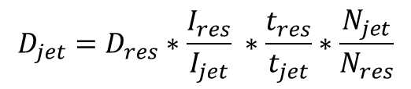

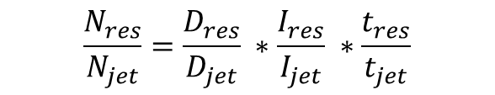
Using residual gas to calibrate the gas jet density
$$N_{phton}∝Density ∗Current ∗t$$
Gauge
Leaking valve
$$\frac{N_{res}}{N_{jet}}=\frac{D_{res}}{D_{jet}} ∗\frac{I_{res}}{I_{jet}} ∗\frac{t_{res}}{t_{jet}}$$
$$P_{Gauge}{= D}_{res} ∗k_{B}∗T$$
$$D_{jet}=D_{res}∗\frac{I_{res}}{I_{jet}} ∗\frac{t_{res}}{t_{jet}}∗\frac{N_{jet}}{N_{res}}$$

Slide 13
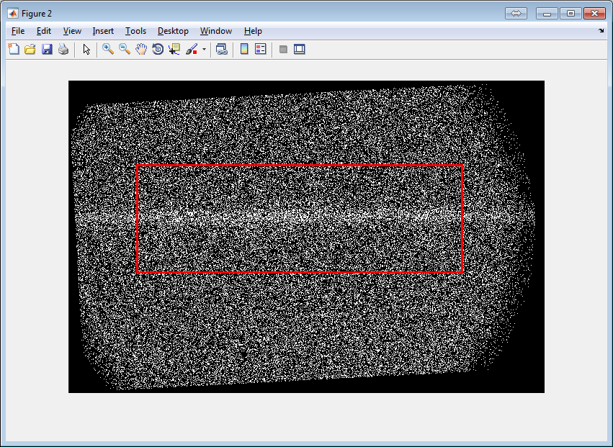
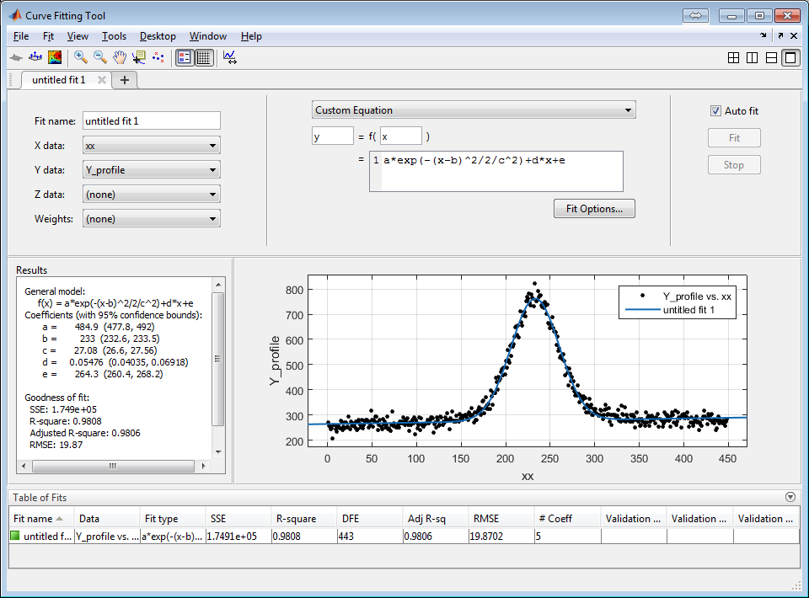

Slide 14
Photon counting VS Gauge measurement using leaking valve
Photon number
Pressure

Slide 15
Next
Continue the density measurement using gas jet
Test with new scintillator and target in the interaction chamber
Install the alignment mirror, align the nozzle and skimmers after nozzle arrives
Checking any leakage of the new system
Bake-out

