Slide 1
Modifications of Schottky spectra for high currents
Oliver Boine-Frankenheim, TU Darmstadt / GSI

Slide 2
Literature (not complete !)
Books:
N. S. Dikansky, D.V. Pestrikov, The Physics of Intense Beams and Storage Rings (1997)
K.Y. Ng, Physics of intensity dependent beam instabilities (2006)
M. Reiser, Theory and Design of Charged Particle Beams (2008)
I. Hofmann, Space Charge Physics for Particle Accelerators (2017)
…
Papers:
S. Cocher, I. Hofmann, Part. Acc. 34 (1990)
D. Möhl, H. Schönauer, Part. Accel. (1974, 1995)
D. Pestrikov, Nucl. Inst. Meth. A (2006, 2007)
M. Blaskiewicz, Phys. Rev. ST-AB (1998, 2001)
A. Burov, V. Lebedev, Phys. Rev. ST-AB (2009)
O. Boine-F., V. Kornilov, S. Paret, Phys. Rev. ST-AB (2000,2010)
…..

Slide 3
Introduction
Two important collective forces in intense beams are:
  Space charge: Direct interaction between the charged beam particles
  Impedances: Interaction with the surrounding wall or with other structures
Both modify the fluctuation spectra of intense (stable) beams.
Space charge:
(in the rest system of the beam)
Wakefields and impedances:
(lab system)
Bunch (rms length: 0.1 m–dc)
Bunch length >> pipe diameter
Image current
Goal:
1) Extract the ‘usual’ parameters from the modified Schottky spectra.
2) Extract quantitative additional information about the intensity effects.

Slide 4
Longitudinal space charge waves (dc beam)
beam pipe
Space charge impedance
coasting beam with current modulation
Cut-off harmonic:
„Cold beam“ dispersion relation:
(slip factor)
Phase velocity:
(cold beam)
Space charge waves exist below the pipe‘s cut-off frequency and transition energy.
Above transition the broadband impedance causes similar effects.

Slide 5
Observation of (unstable) space charge waves
Observed self-bunching in an electron cooled C⁶⁺ beam in the ESR.
Beam instabilities:
‘Keil-Schnell’ criterion:
Boine-F., Hofmann, Rumolo, Phys. Rev. Lett. 1999

Slide 6
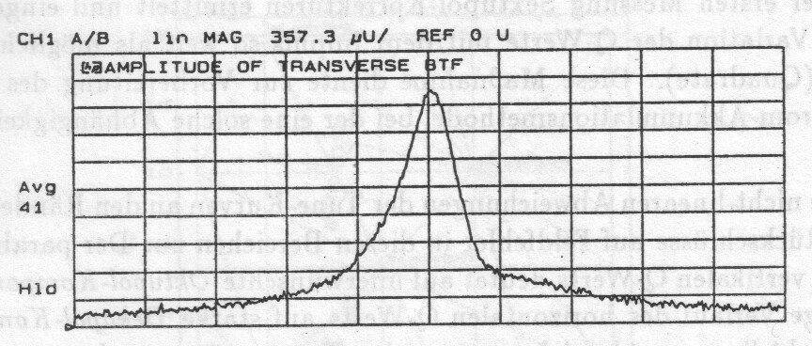
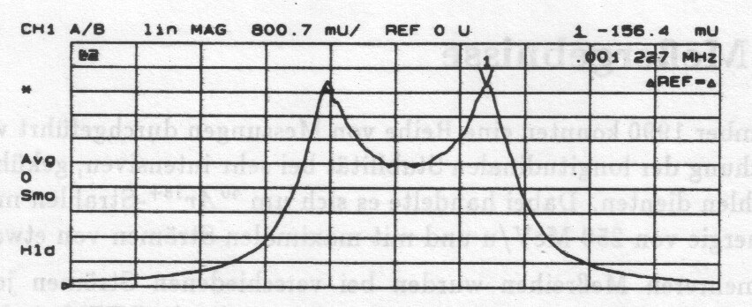
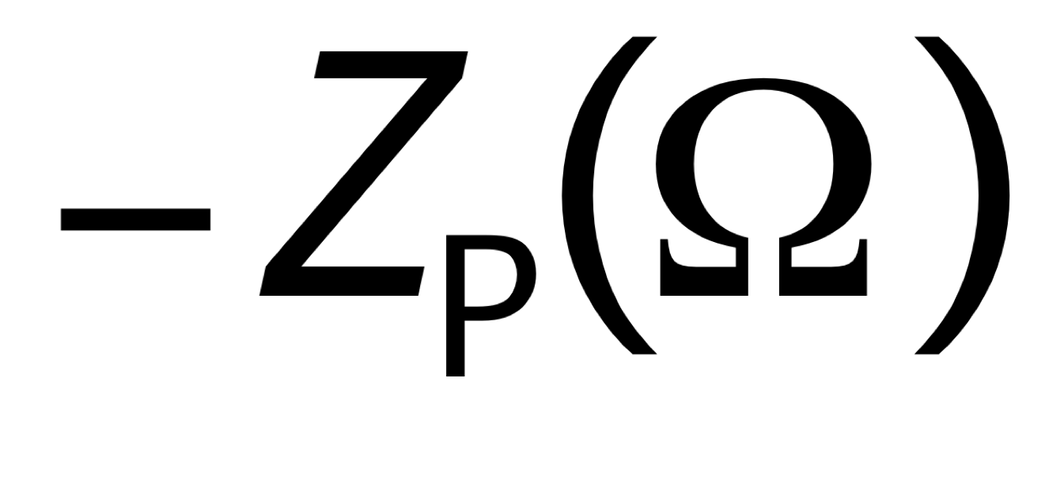
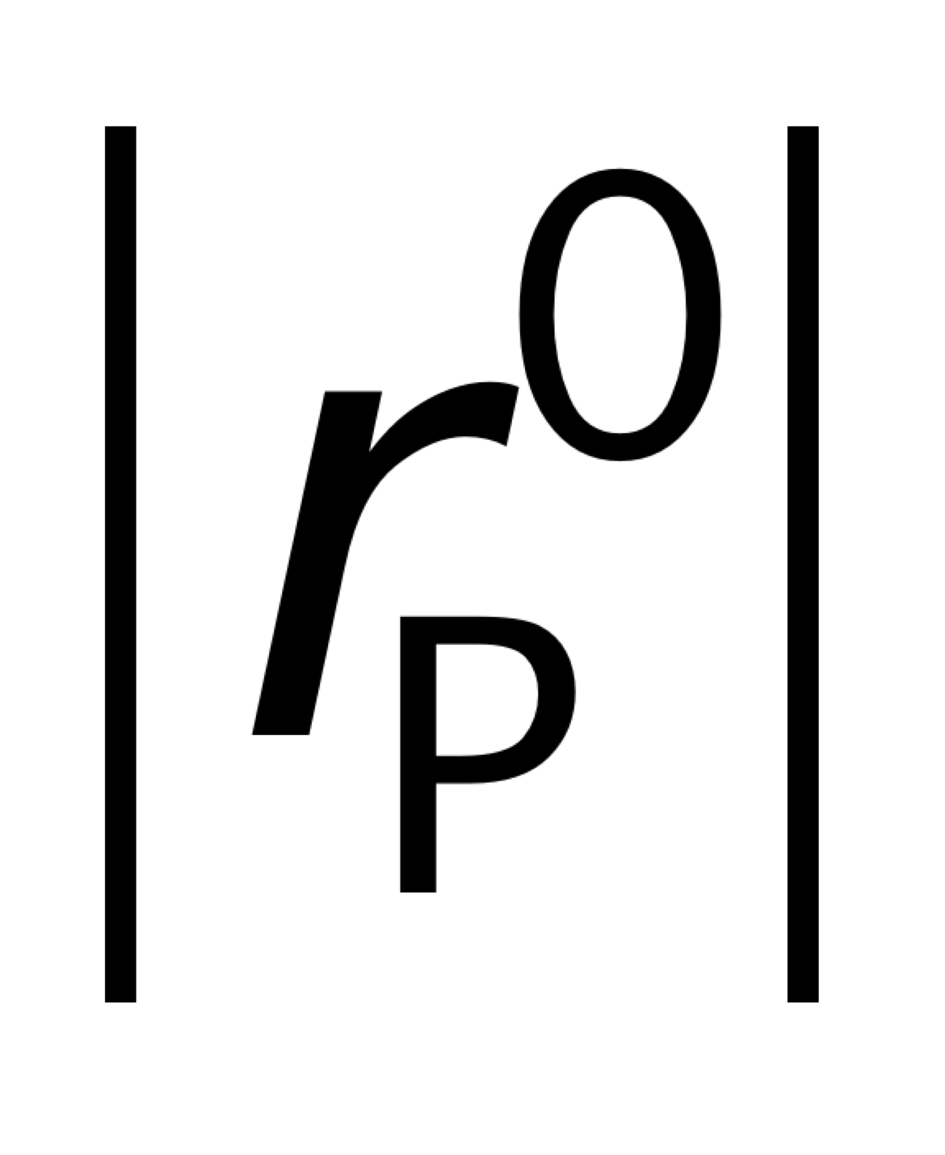
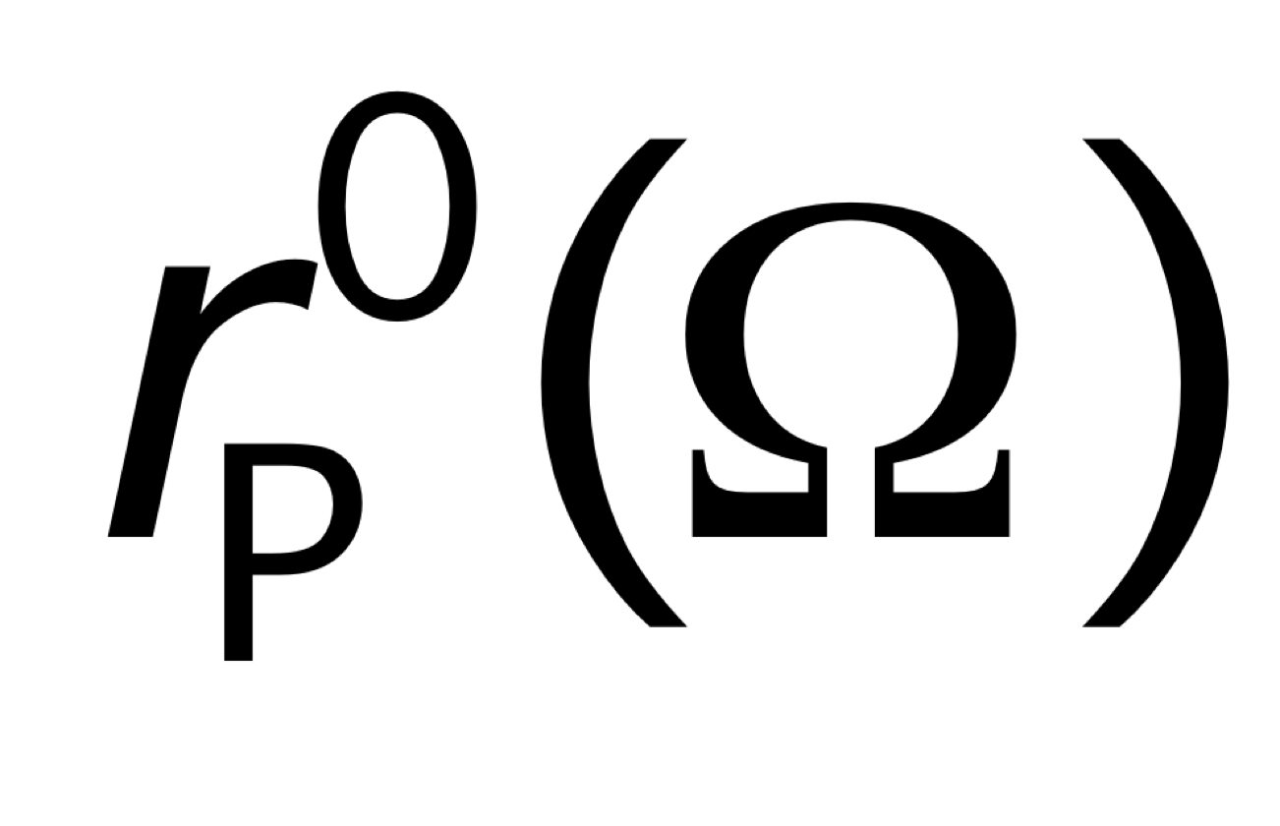

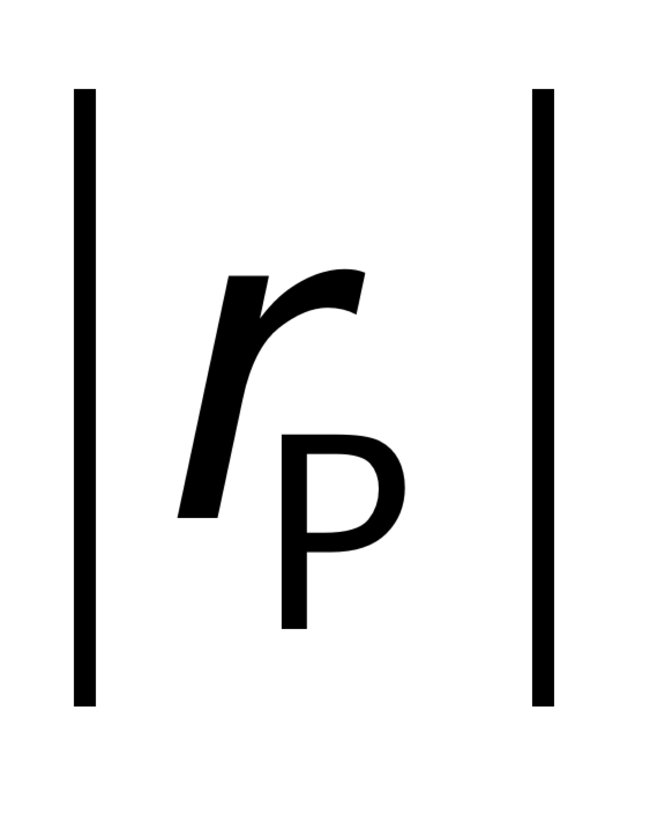
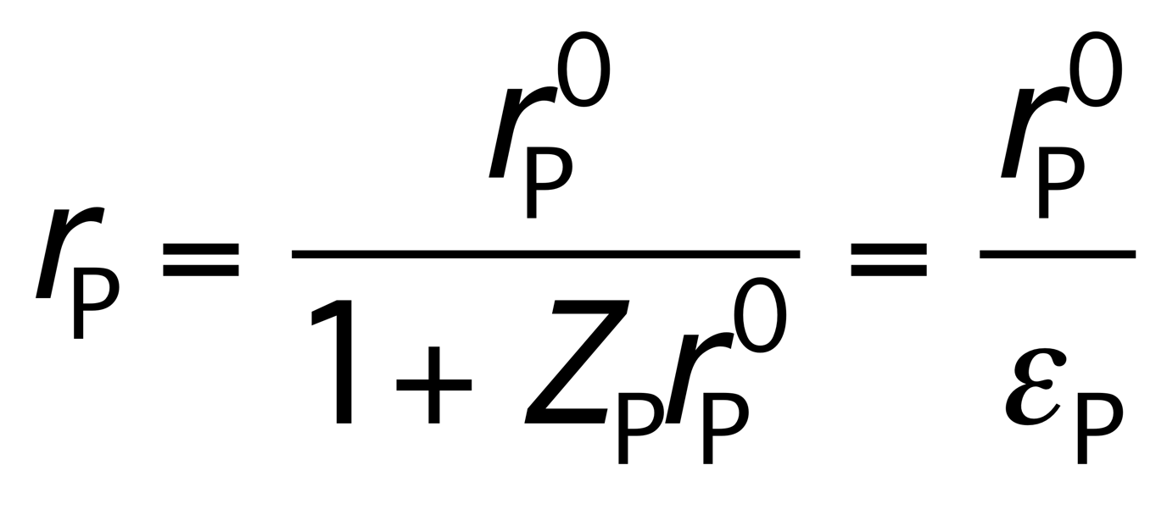
Longitudinal BTF with space charge
U. Schaaf, PhD thesis, Uni. Frankfurt (1991)
( particle frequency distribution)
n=30
Beam transfer function
Beam
excitation
Beam
response
V_{ex}
I_{PU}
(dielectric function)
Space charge waves
‚Dielectric noise signal suppression‘

Slide 7
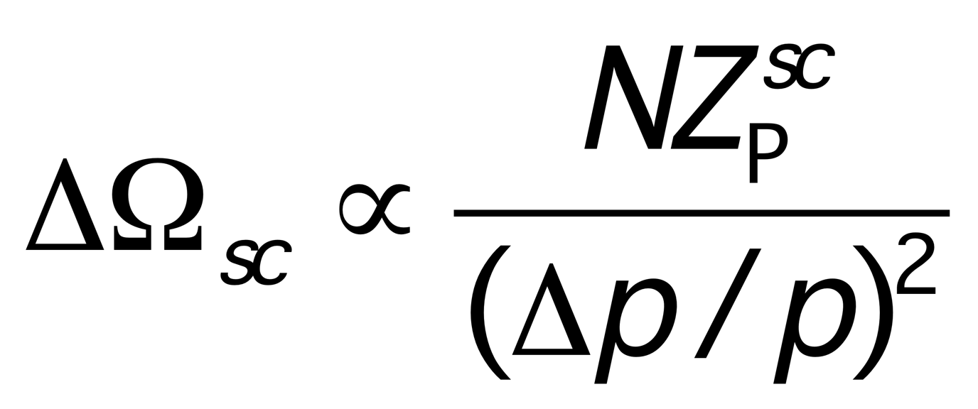
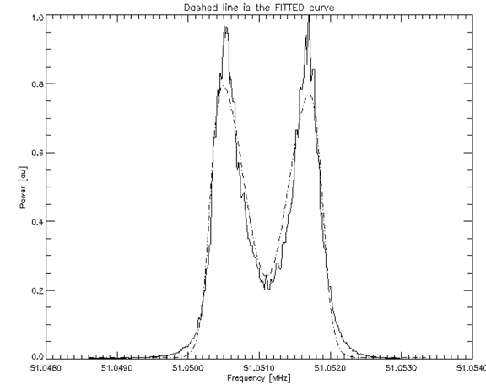
Schottky spectra
Data: U. Schaaf, PhD thesis, Uni. Frankfurt (1991)
Cooled Ar¹⁸⁺
beam in the ESR
with
V. V. Parkhomchuk, D. V. Pestrikov,
Sov. Phys. Tech. Phys. 50, 1411 (1980)
For a Gaussian momentum distribution (dashed line):
frequency
V. Ziemann, Analytic expressions for longitudinal
Schottky signals from beams with Gaussian
momentum distribution, PAC 1997

Slide 8
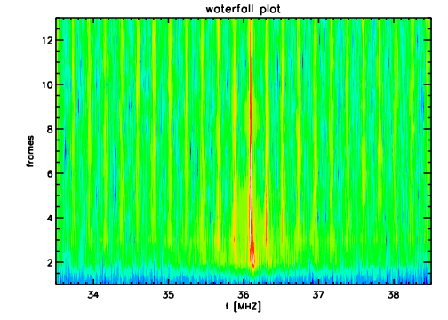
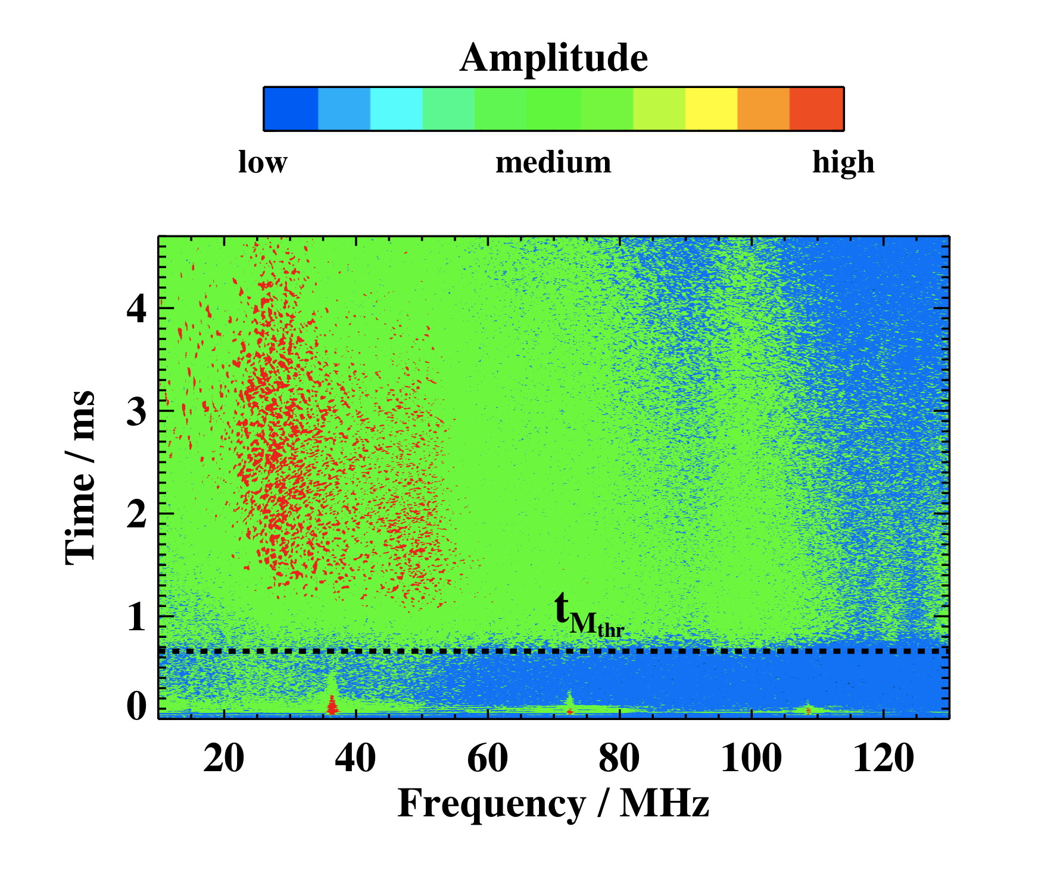
Coherent (‚pseudo‘) Schottky noise
Micro-pulses from UNILAC
36 MHz
≈ 20 turn injection
500 turns
‘phase’ pickup
(≈ 0.1-30 MHz)
turns
SIS-18
36 MHz
FFT
+
no debunching !
+
‚Schottky‘ pickup
(≈ 10-300 MHz)
LeCroy DSO
(0.5 GHz, 64 MB)
injection
frequency
Long-term:
‘turbulent’ beam.
Simulation studies indicate
that the coherent structures result
from the effect of the longitudinal
space charge force.
I. Hofmann, Part. Acc. 1990
S. Appel, O. Boine-F., PRAB 2010
Goal:
„Fast“ interpretation of the specta !

Slide 9

Longitudinal Schottky: Ultra-cold beams
Scaling of the cooling
equilibrium (with IBS)
for weak coupling :
Equilibrium momentum spread as
a function of the number of ions
Challenge: Interpretation of
„Schottky“ spectra
from „strongly“ coupled beams.
Experiment: M. Steck et al., Phys. Rev. Lett. 1996
Theory/Simulations: R. Hasse, Phys. Rev. Lett. 1999, 2001, 2003

Slide 10
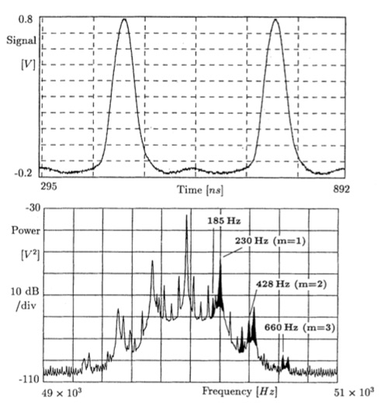
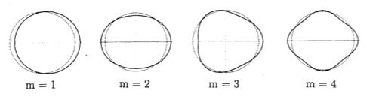
Bunched beam: Longitudinal Schottky
Synchrotron satellites:
ESR Observation (e-cooled bunches)
(synchrotron frequency)
(space charge parameter)
Dipole:
Quadrupole:
Measure space charge parameter:
Hofmann, Kalisch, PRE 1996
Boine-F., Shukla, PRAB 2005

Slide 11
Coasting beam: Transverse space charge
Transverse space charge and image forces:
Oscillation of a beam inside a pipe.
(incoherent:
space charge)
(coherent:
images)
E
Incoherent (space charge) tune shift:
B
Coherent tune shift:
E_{x}
E_{x}
x
x
a
a
b
b
Transverse “space charge” impedance:
Space charge field moves
with the beam center

Slide 12
Coasting beam: Transverse Schottky sidebands
Gaussian momentum distribution:
Dispersion function:
(coherent frequency)
: chromatic tune spread
(betatron oscillations)
(complex error function)
Lower betatron sideband (n-Q)
Normalised tune shifts:
(impedance
parameter)
(space charge
parameter)
Schottky power spectrum:
Möhl, Schönauer (1974), Ng (2005), Boine-F., Kornilov, Paret, PRAB 2008

Slide 13
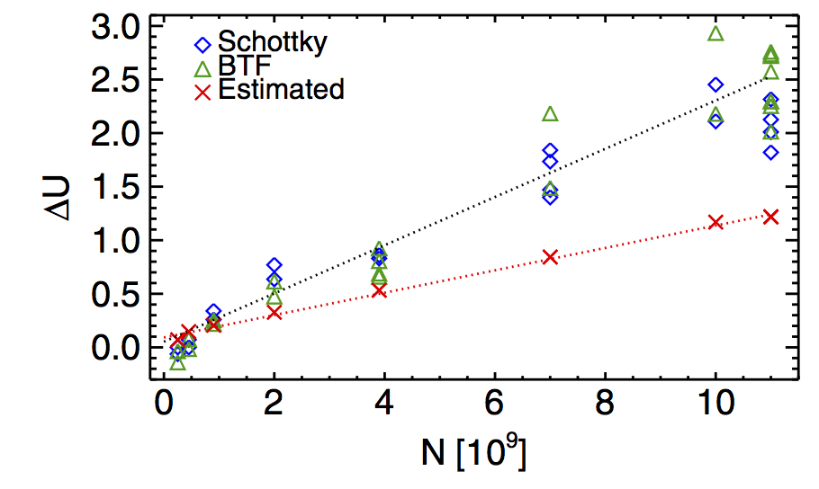
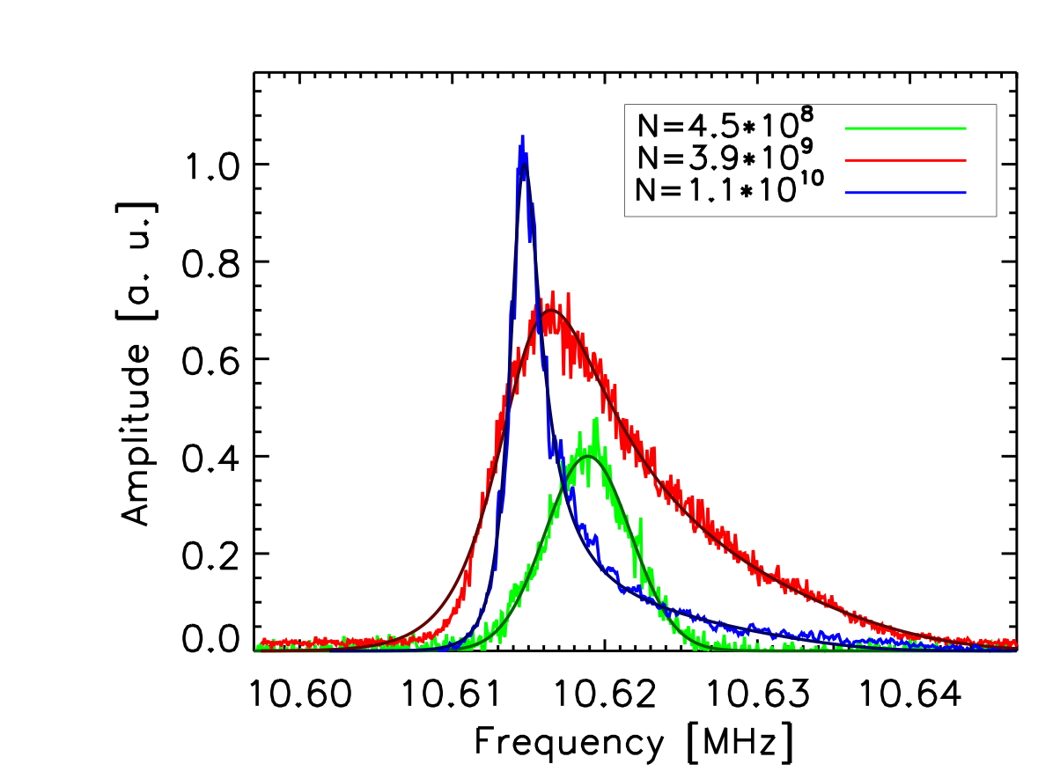
Observations in the GSI SIS
Space charge parameter:
Measurement time: ≈ 100 msecs
Beam parameter:
Ar¹⁸⁺, 11.4 MeV/u
f₀=215 kHz
from RGM profiles
Space charge tune shift from
Schottky/BTF is systematically (factor 2)
larger than the one from RGM profiles.
S. Paret, O. Boine-F., V. Kornilov, T. Weiland , Phys. Rev. ST-AB (2010)

Slide 14
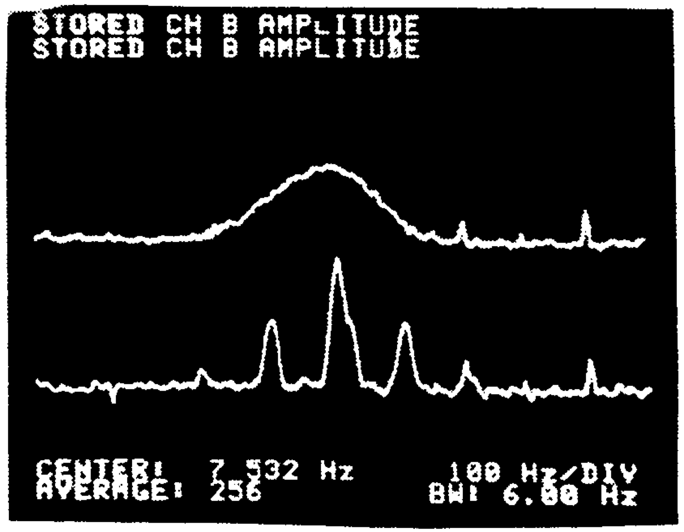
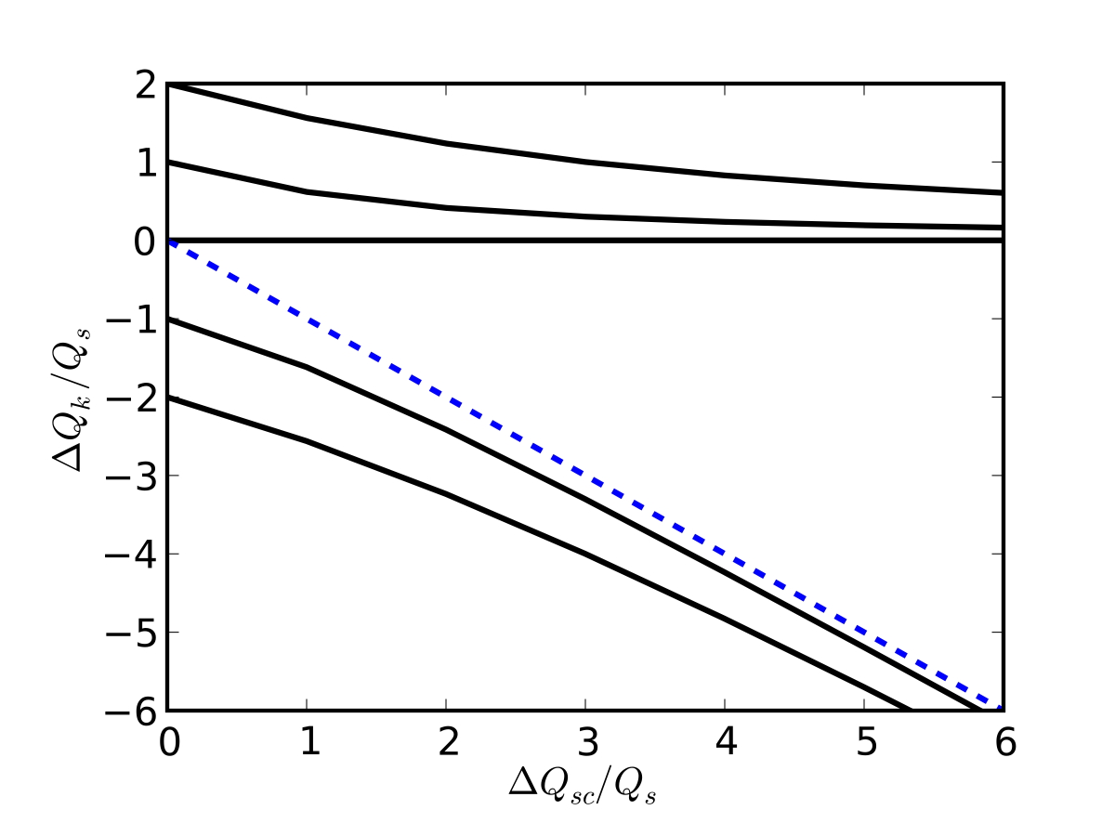
Bunched beams: Transverse tune spectra
Transverse spectra (low intensity)
High intensity: head-tail oscillations
k=1:
coasting
beam
k=0:
bunch
positive k
CERN/SPS measurement (Linnecar, PAC 1981)
Synchrotron satellites (synchrotron tune Q_{s}):
or
negative k
Tune spread in a rf bucket (rms bunch length σ):
strongly damped
Blaskiewicz, Phys. Rev. ST Accel. Beams (1998)
Boine-F., Kornilov, Phys. Rev. ST Accel. Beams (2009),
Burov (2009), Balbekov (2009)
space charge parameter:

Slide 15
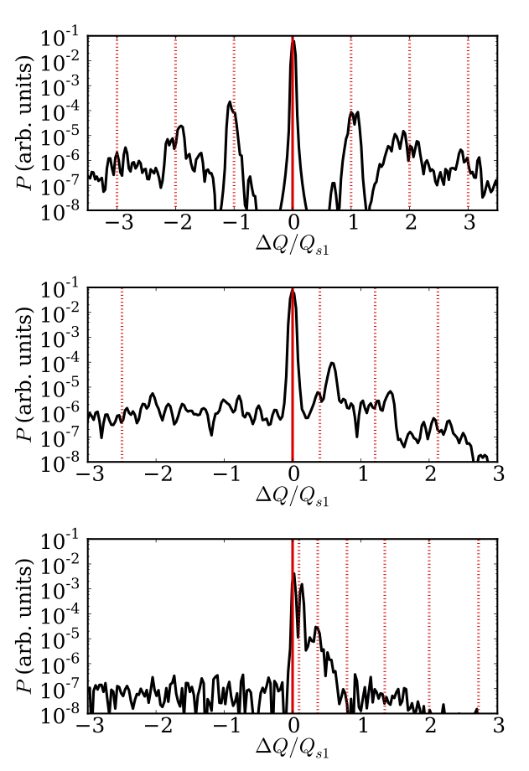
Observation and Simulations
(BTF and Schottky tune spectra)
BTF tune spectra
Intensity
SIS-18/100: q_{sc}=10-20
Head-tail tune shifts
CERN PSB/PS: q_{sc} ≥100
tune spectra:
not so useful
for space charge
measurements
R.Singh, O. Boine-F., O.Chorniy, P. Forck, P. Kowina, et al., Phys. Rev. ST-AB (2013)

Slide 16
Some conclusions
Example cases for the modification of Schottky spectra by intensity effects (space charge and impedances) were given.
There is a distinct difference between „incoherent space charge“ and coherent impedances, especially in the transverse plane.
„Fast“ interpretation of Schottky spectra is important, to possibly adjust settings (intensity parameter) for stable beams or as a „beam quality monitor“ for beams at the threshold.
Schottky spectra simulations: PIC-tracking codes.
To do:
  Longitudinal/transverse spectra in dual rf buckets
  Transverse quadrupolar Schottky spectra (see talk by Adrian)
  Fast estimations (using eg ML).
  ….

