Slide 1

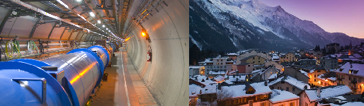
LHC Performance Workshop (Chamonix’18)
Summary
Frédérick Bordry
7th March 2018

Slide 2
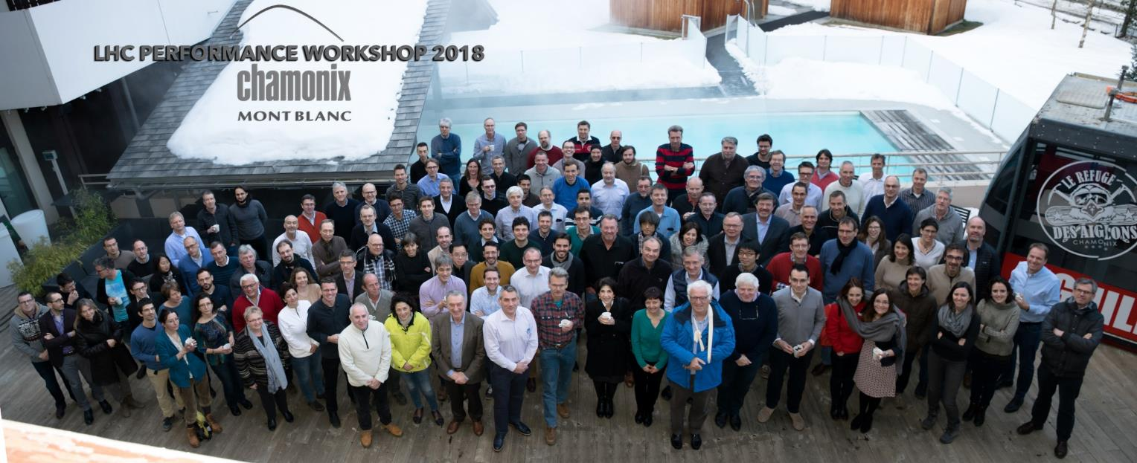
A dense and fruitful workshop after a bumpy and great year 2017,
to prepare:
2018 (the last RUN2 year),
LS2, LIU and HL-LHC projects
29th January to 1st February 2018
252 participants (54 full time)
Un grand cru !

Slide 3
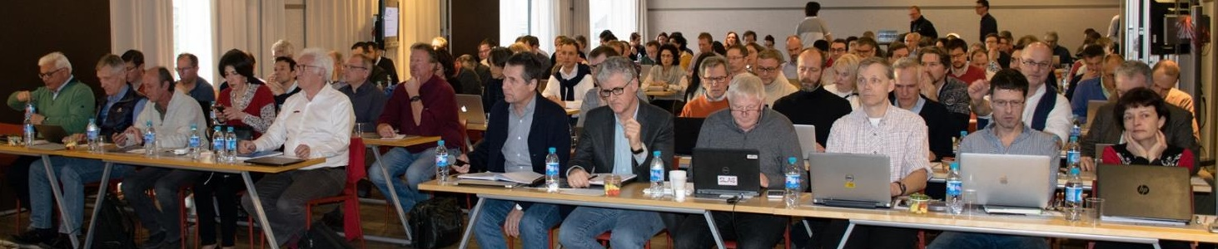
LHC Performance Workshop
(Chamonix 2018)
Session 1: Review of 2017 operation
Chair: Rende Steerenberg
Scientific secretary: Theodoros Argyropoulos
Session 2: Operational scenario for 2018
Chairs: Paul Collier
Scientific Secretary: Laurette Ponce
Sessions 3: LIU
Chairs: Malika Meddahi
Scientific secretary: Giovanni Rumolo
Session 4: HL-LHC developments
Chair: Lucio Rossi
Scientific secretary: Susana Izquierdo Bermudez
Session 5:HL-LHC open issues and options
Chair: Gianluigi Arduini
Scientific Secretary: Dario Pellegrini
Session 6: Infrastructure, test facilities and plans for HL-LHC prior/for LS2
Chair: Oliver Brüning
Scientific Secretary: Michele Modena
Session 7: LS2
Chair: José Miguel Jiménez
Scientific Secretary: Jean-Philippe Tock
Session 8: LHC full energy exploitation
Chair: Oliver Brüning
Scientific Secretary: Chiara Bracco
8 sessions: 53 talks, ∼ 1500 slides !

Slide 4
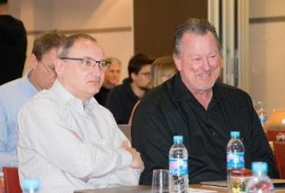



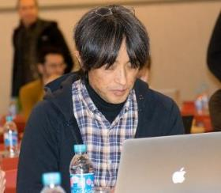
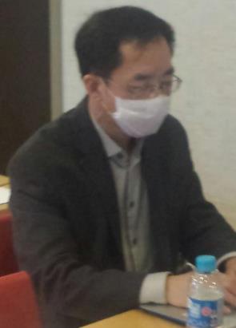
CERN Machine Advisory Committee (CMAC14)
Bai Mei GSI
Gourlay Stephen LBNL
Holtkamp Norbert (chair) SLAC
Koseki Tadashi KEK
Nagaitsev Sergei FNAL
Qing Qin IHEP
Seidel Mike PSI
Vedrine Pierre CEA
Delille Benoit, Zerlauth Markus CERN
(scientific secretaries)
Closed session on Friday 2nd February at CERN
CMAC Close out : Friday 2nd February at 12h45

Slide 5
CMAC14 charge (1/3)
Sessions 1 & 2 - Review of 2017 operation & Operational scenario for 2018
Does the Operational scenario presented for 2018 optimize the potential performance of the LHC?
Is the operation vs. machine development mix a reasonable balance between short term performance and long-term developments? Is anything missing from our 2018 development plans that should be addressed?
From the observations and recommendations of the beam-induced heat-load task force, are there any additional recommendations for activities, installations or measurements that should be prepared for LS2 in order to advance our understanding of the issues?
Session 3 - LIU
What items can be identified as posing the main beam performance risks within the present baseline of the LIU project?
What changes in the baseline should be implemented or further investigated to mitigate the identified risks?

Slide 6
CMAC14 charge (2/3)
Session 4 - HL-LHC developments
Is the main new equipment for the upgrade mature enough and with adequate margin to safely operate with good availability? (Nb3Sn IT Quadrupoles and other new larger bore Nb-Ti magnets, new collimators, SC links, CC and 11T)
Is the cold powering layout, based on MgB2 SC links, technically adequate to the scope and advantageous vs. more classical solutions? (for example solutions based on resistive cables or SC links based on Nb-Ti)
Is the novel ATS optics mature enough to be considered as definitive baseline with minimal risk also in terms of availability and operation flexibility?
Session 5 - HL-LHC open issues and options
Is our approach for preserving the brightness against blow-up and instabilities realistic? Do we have sufficient margin?
Are the back-up scenario and mitigation measures adequate (electron cloud, stability, emittance preservation)?
Is there any suggestion on the machine studies that should be performed to address the potential issues?

Slide 7
CMAC14 charge (3/3)
Session 6 - Infrastructure, Test facilities and plans for HL-LHC prior/for LS2
Are the preparations for the technical test facilities on track for the HL-LHC LS2 installation and commissioning schedule (e.g. Crab Cavities, 11T magnet technology, IT triplet string and superconducting link)?
Do the planned test facilities and test programs address the appropriate technical risks of the new equipment?
Are the plans for in-situ upgrades of existing LHC technical infrastructure on track for the planning of the HL-LHC project (e.g. cryo upgrade in IR4, in-situ coating of vacuum components against e-cloud)?
Session 7 – LS2
Is the objective scope of LS2 clearly defined and communicated?
Are the LS2 plans consolidated in terms of resources, organization, support teams? What is the planned contingency?
Session 8 - LHC full energy exploitation
Does CERN address the relevant questions and plan for the required technical validations / upgrades of the LHC equipment for pushing the beam energy in the LHC beyond the current beam energy of 6.5TeV (first to nominal, then to ultimate beam energy of 7.5TeV and potentially beyond) without jeopardising the machine performance (efficiency) and safety?

Slide 8
2017

Slide 9
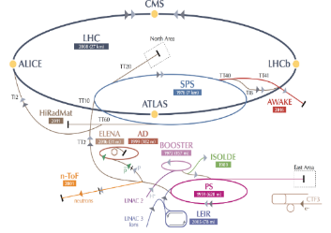
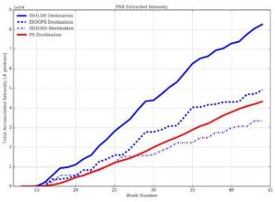

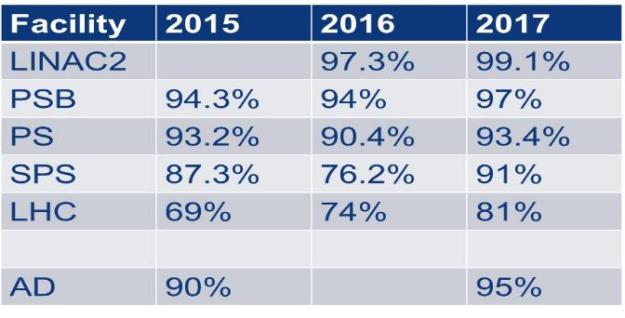
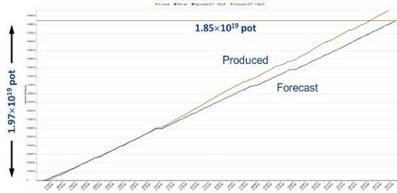


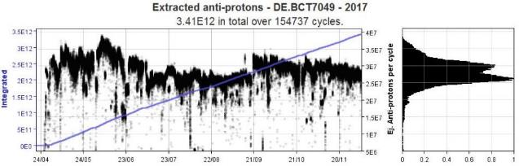
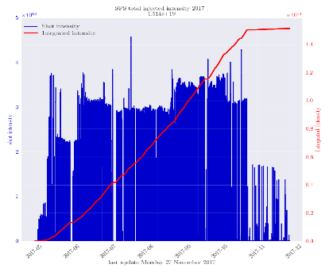
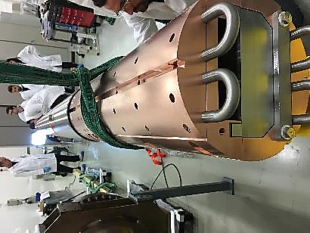
Operations 2017
Thanks to all the teams from infrastructure, all equipment groups to operation for their competence, professionalism, creativity and commitment.
> 8 x10¹⁹ protons have been transported
to both ISOLDE targets
More than 66 % of the protons at CERN were delivered to ISOLDE
More than 60% of the protons in the PS were delivered to nTOF (1.97 10¹⁹ )
  SPS 1.5 10¹⁹ protons
3.0 10¹³ to North Area thanks to new beam dump
Excellent run for AD with a record >5500 hours realised
Beam time shared between 5 experiments (ATRAP, ASACUSA, ALPHA, AEGIS and BASE) and 1 project: ELENA (commissioning with beam)

Slide 10
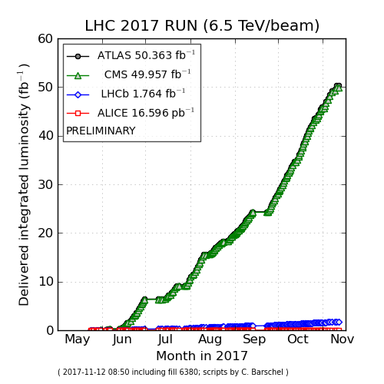
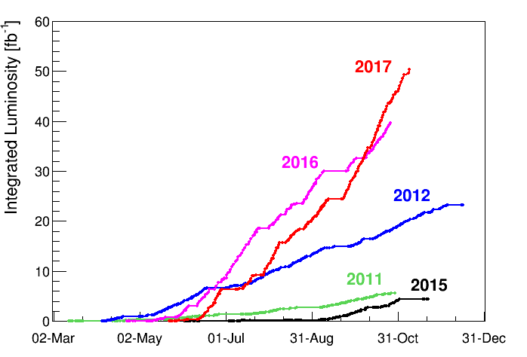
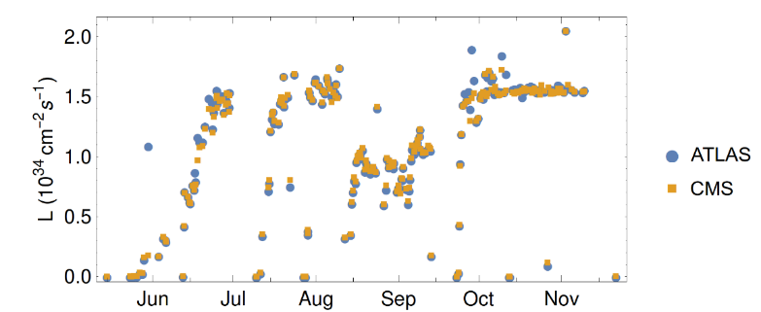
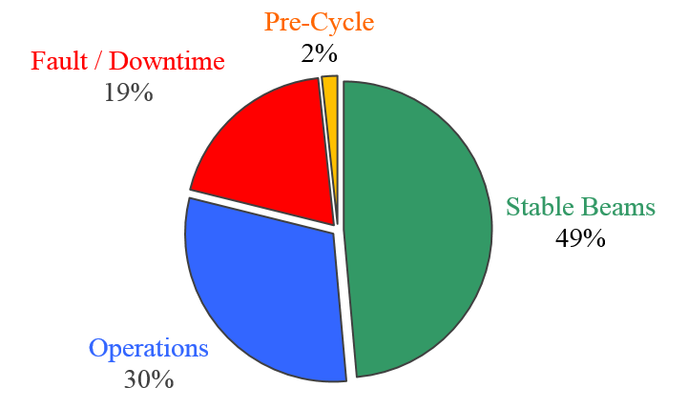
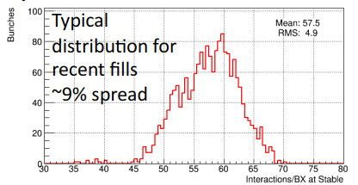
LHC 2017 operation
Thanks to all the teams from infrastructure, all equipment groups to operation for their competence, professionalism, creativity and commitment.
2017 goal:
45 fb⁻¹
Achieved : 50 fb⁻¹
Peak luminosity
2.2 10³⁴ cm⁻² s⁻¹
With luminosity levelling at
1.5 10³⁴ cm⁻² s⁻¹
Lower β* 30 cm
(new ATS optics)
Availability: 81%
BCMS
8b+4e
16L2
dumps
LHC takes <0.03 % of the CERN protons

Slide 11
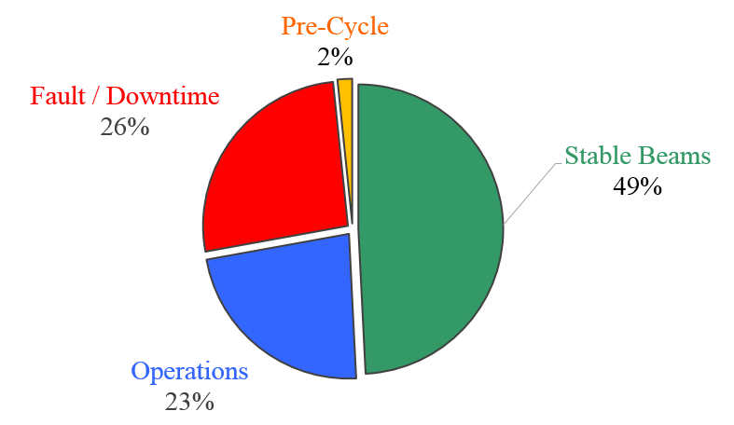
LHC availability (13 TeV) in 2016 and 2017
2016
2017
7% less time in fault
7% more time in operations
16L2
Stable Beams : 55 % reachable but not easy

Slide 12
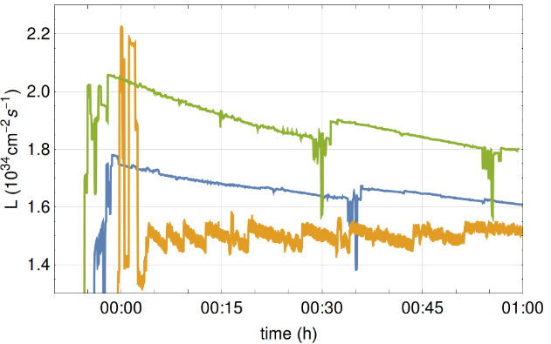
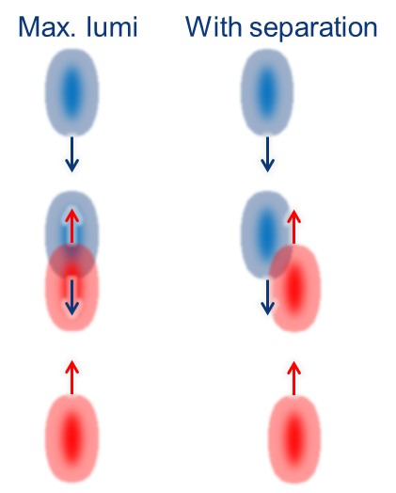
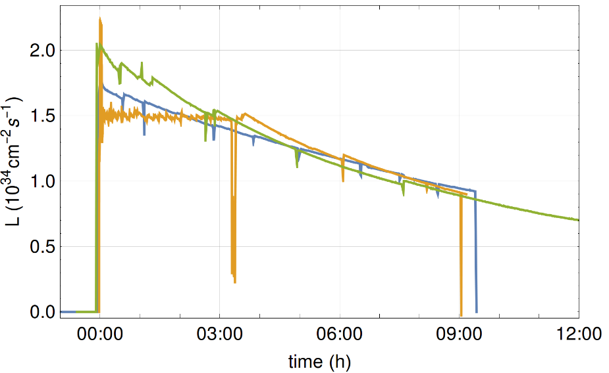
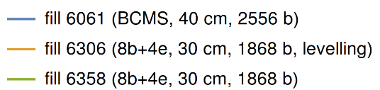
LHC 2017 : separation levelling
- Introduced separation levelling for all experiments (Separation levelling is used since many years for ALICE and LHCb)
- Dynamic orbit bump changes overlap of colliding bunches
- Initial spike before leveling reaching 2.2×10³⁴ cm⁻²s⁻¹

Slide 13
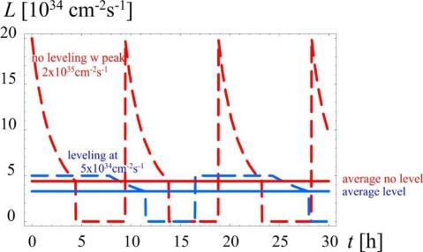
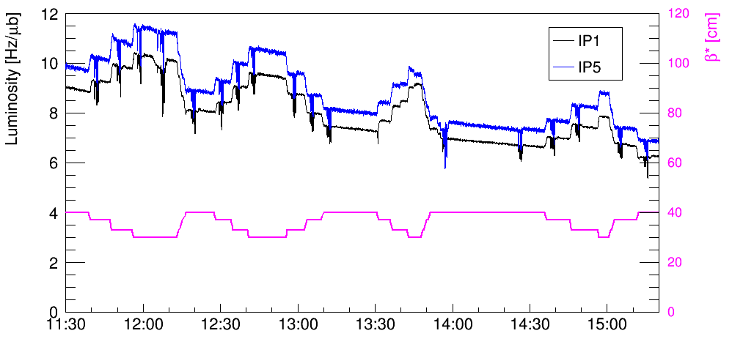
MDs on β* levelling
Levelling luminosity by β* should be
the main levelling technique for HL-LHC
β* levelling in the last LHC MD: a possible tool for 2018 operation
Luminosity evolution during β* levelling, moving back and forth between 30 cm and 40 cm. The beams remained head-on within ~ 2 μm !

Slide 14
LHC “16L2”: Air inlet as “most probable” cause
Event (accidental air inlet with BS at 20 K)
(same pumping group pumping beam 1 and beam 2)
Plug-in module (20 K)
Cold bore (2 K)
Cold bore (2 K)
Beam screen (20 K)
Beam screen (20 K)
Surface covered with N2, O2, Ar
Surface covered with H₂O
Thermal anchor (50 K)
High background limitation due to H₂O from air.
After event, significant amount of N₂, O₂ and Ar all around pumping port and beam screen bellows. However most likely most of those gases stick on the pumping port bellows.
Pumping port valve (293 K)
Courtesy of “16L2” Task Force

Slide 15
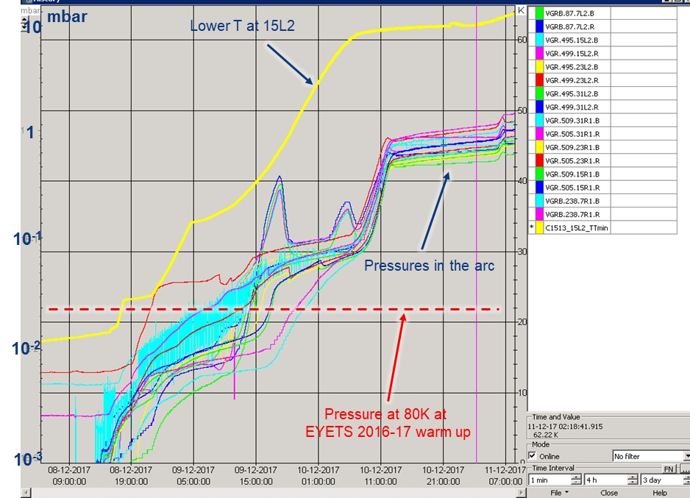

LHC: sector 1-2 warming-up
Estimated quantity of extracted air
Estimated quantity of extracted water vapour

Slide 16
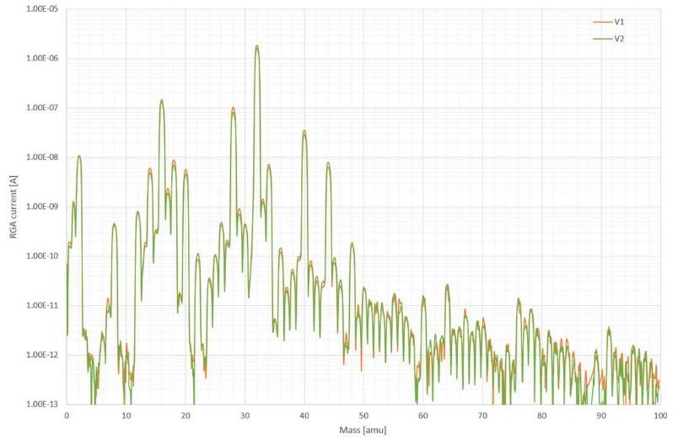
Results from gas analysis in 16L2
Clear signature of
atmospheric gas

Slide 17
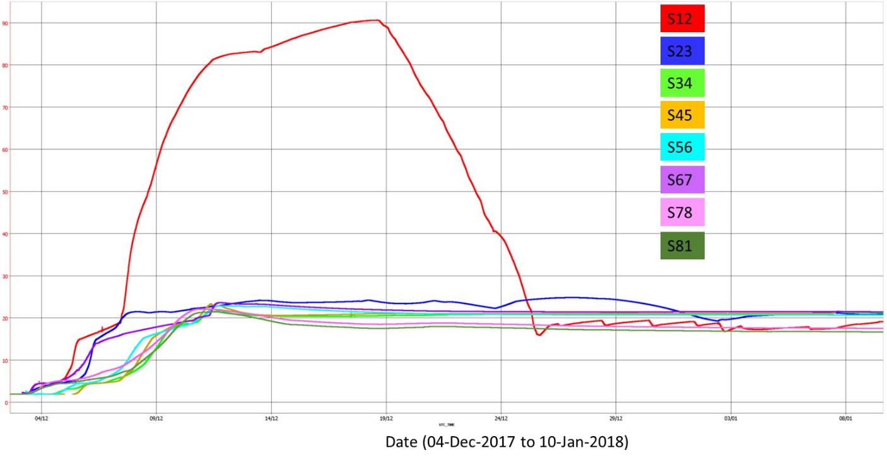
LHC: sector 1-2 warmed up up to 90 K and cooled down

Slide 18
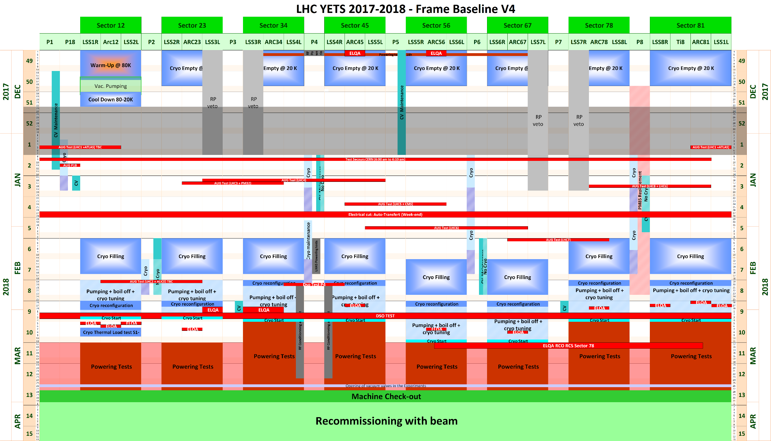
YETS 2017-2018: Baseline V4 (EDMS 1817803)

Slide 19
Main activities during YETS 17/18
Emergency Stop tests (AUG)
Cryogenic maintenance
GGPSO (reference points) extensions for the HL-LHC Project
Collimation activities (crystal, installation of 2nd pair of wire collimators for long-range beam-beam compensator in IR1)
Beam Instrumentation activities (Beam Synchrotron Radiation Telescope, fluorescence measurement test chamber, new Beam Position Monitors…)
Dump activities (new gaskets to fix leaks of 2017, N₂ line for continuous supply)
Injection kicker replacement MKI8D
RF finger exchange
Cabling and re-routing for HL
Solenoid and extra BLMs installation in 31L2
….
Survey and re-alignment campaigns
EXP: AFP maintenance in IR1, BRAN prototype detector replacement, LHCb Forward Shower Counter Stations, CT-PPS Timing Detector installation in cylindrical Roman Pot, Passive detector installation in the IT region under Q1

Slide 20
2018

Slide 21

2018 LHC schedule : Q1 and Q2
Powering tests started on Saturday 3rd March to be completed week 13; LHC back to BE-OP on Friday 9th March
Opening of experiment vacuum valves planned for Friday 30th March ; Beam Back in LHC ~ Thursday 8th April
2100
1200
2500
Cold check out over Easter is difficult and requires availability of specialists: LBDS, BIS, controls, piquet services, …
1 days scrubbing instead of 4 days for S12
Optimised commissioning with beam up to 1200 bunches

Slide 22
2018 LHC schedule : Q3 and Q4
Need for powering tests week 49 confirmed at Chamonix

Slide 23
LHC: Machine Configuration in 2018
BCMS 25 ns
Based on 2017 ATS optics and to minimize recommissioning time
  Initial β* at 30cm, down later to 27 or even 25 cm (collimators settings, commission the squeeze to 25 cm from the start to allow β* levelling test to start asap)
  Use of β* leveling initially at end of fills to make it operational
  “continuous” crossing angle anti-leveling
Parameter | Value
Optics | 2017 ATS
Ramp Cycle | PPLP ramp with squeeze to 1m
Beam type | BCMS (25ns)
Bunch Intensity p/bunch | 1.15-1.3 x 10¹¹
Maximum Bunches per injection | 144
Total Number of Bunches/ring | 2556
Initial/baseline β* /cm | 30
Final β* (by levelling) /cm | 27-25
Initial ½ crossing angles /μrad | 160/200/160/-250

Slide 24
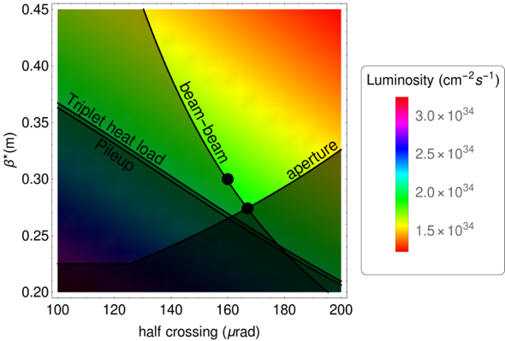
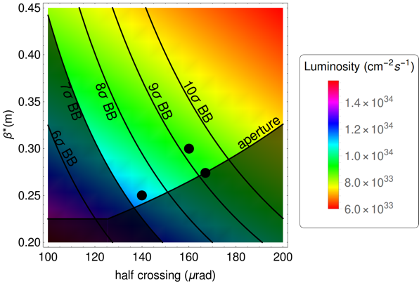
β* levelling – how far can we go?
- Better reach in β* as limits from beam-beam, triplet heat load, and pileup are relaxed at smaller bunch intensities. Limit depends on bunch intensity
- Could reach 25 cm later in fill staying above 7 σ beam-beam separation
Exact path of leveling still to be defined (β* -values and crossing angles)
  BCMS pile-up remains ≤ 60 up to 1.3×10¹¹ ppb.
  β* levelling may become mandatory for peak L above 2.5×10³⁴ cm⁻²s⁻¹ !
Start of fill
Later in fill – lower intensity
Positive IR1 crossing
Positive IR1 crossing
?
R. Bruce

Slide 25
LHC 2018 : Performance reach
With proposed configurations, may reach limit on peak luminosity set by pileup in the experiments (55- 60) and triplet cooling capacity ( ∼2.2 10³⁴ cm⁻² s⁻¹ )
  => leveling needed (toolkit of leveling options)
Assuming realistic estimates of availability of the machine (50-55 % stable beams) and with the present allocated number of days for physics
and reducing the time to reach collisions with >1200 bunches to 36 days
(was 46 days in 2017)
Performance target for 2018 p-p operation:
  ∼ 60 fb⁻¹ for CMS/ATLAS (leveled at pileup 55-60 if PU higher)
  ∼ 2 fb⁻¹ for LHCb leveled at 4.6x10⁺³²

Slide 26
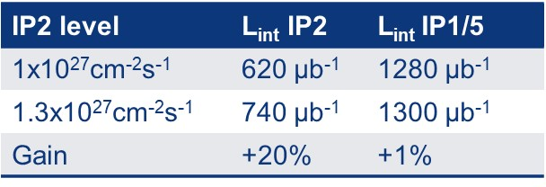
2018 LHC: Pb-Pb run
1 month of Pb-Pb run just before LS2: challenging program
Data taking requested by the 4 experiments:
  distribution of luminosity in high burn-off regime will clearly be an issue
Improved performance from injectors allowing to inject more bunches in LHC (wrt 2015) and 10% more bunch intensity (wrt 2016)
Operational scenario still under discussion to optimize the time: choice of Beta*, leveling options, possible ramp&squeeze...
Values for IP1/5 levelled at 3x10²⁷cm⁻²s⁻¹
Present proposal to run with ATLAS, ALICE and CMS squeezed to 50cm and LHCb squeezed to 1.5m and to use flexible filling scheme and levelling techniques to share the accumulated luminosity:
  Run 2 goal of 1 nb⁻¹ reachable

Slide 27
LHC 2018 : special runs (9 days)
VdM scans early in the year for the 4 experiments: (2 days)
Both ATLAS and CMS may need a second scan if problems during the first one
With injection crossing angle to allow flexibility in filling scheme
Additional fills with special conditions to reduce systematics (pileup effects, effects due to trains, and stability of the calibration over the year)
90 m beta* run at 6.5 TeV with high luminosity:
Requested by TOTEM/CMS for low mass resonance studies (ATLAS will participate)
1 week including set-up ; the aim is to accumulate 8-10 pb⁻¹)
Details of the request being worked out between TOTEM and machine experts
Low energy High Beta run:
Tested in 2017, optics tested but finally cancelled because of background conditions
Data analysed some ideas to improve background but at present no agreement between ATLAS and TOTEM on the energy for the run
Early test for this run in 2018 to give maximum flexibility in scheduling if energy switch needed (test 900 GeV in a very limited of time (1-2 shifts) and 1.8 TeV for a decision)

Slide 28
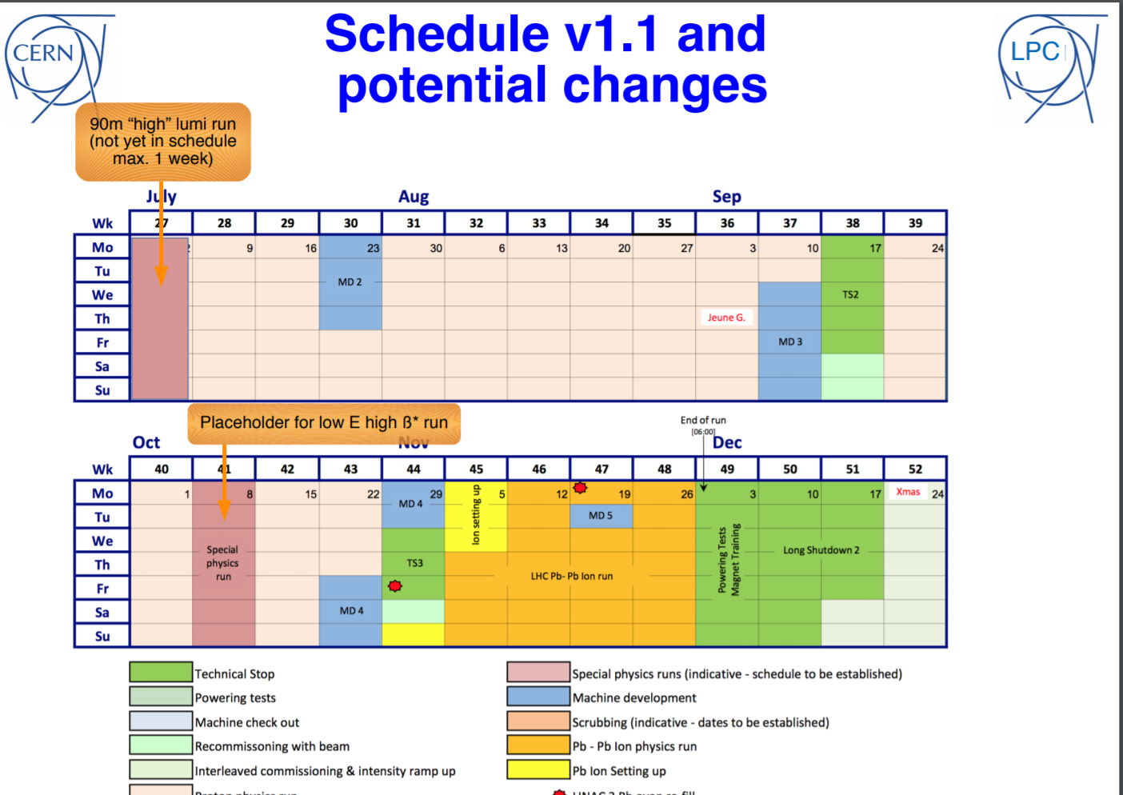
LHC 2018 special runs: potential increase to 16 days !
LPC @ LHCC:
Christoph Schwick, Brian Petersen

Slide 29
2018 LHC: Machine Development scheduling
19 days scheduled during p-p run, in 4 periods + 1 day during Pb-Pb run
- Many studies important for both present understanding of the machine (short term performance) and for post-LS2 and HL-LHC era preparation
- High priorities studies already requested exceeding available time by ~80%
  => more work needed on priority definition
MD time in 2018 will have to be reviewed in the light of machine performance, as done in 2017 (3 to 5 extra days)
- Special MD requests (not included in the 20 days):
  Further development of “round ATS” optics with high intensity for HL-LHC study may be pushed into the high intensity operation in 2018
  Request for several days to make tests for FCC study will be discussed (injection at 225 GeV)
Priority will be given to studies needed for decision making on work to be done in LS2 or for design/construction for HL-LHC

Slide 30
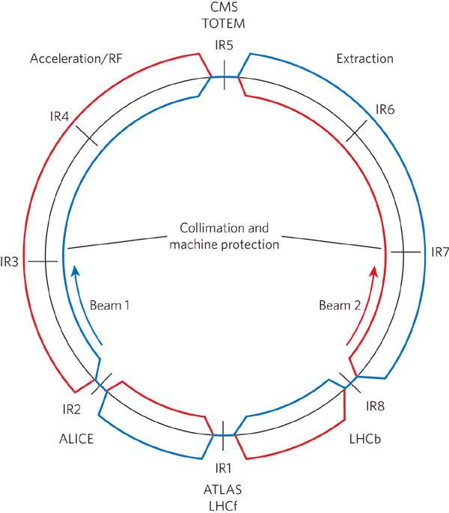
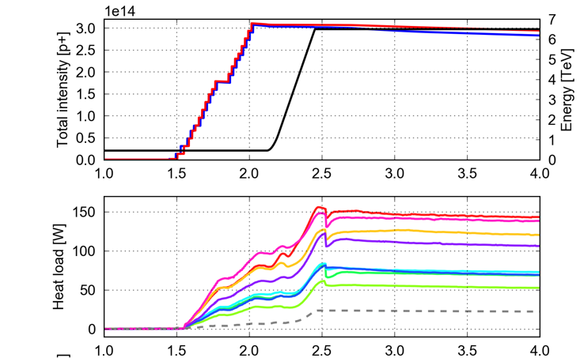
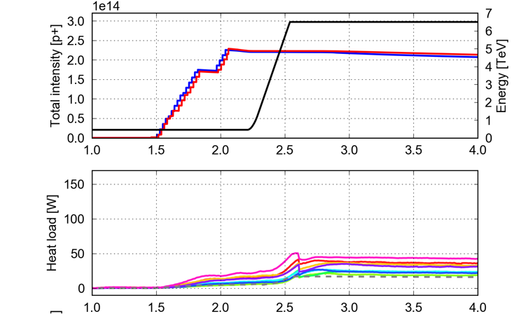
Beam Induced Heat Loads
- Difference in Beam induced heat loads between sectors could be a performance limitation for the machine (especially HL-LHC)
- Task force launched to review information, list possible explanations, propose further investigations and predict medium-term evolution
Difference in heat load between sectors appeared after LS1, is reproducible and only present with 25ns bunch space
Seems to be related to e-cloud even if evidence not yet compelling
25 ns
(2017)
8b+4e
(2017)
Sector 3-2
Sector 2-1
Sector 1-8
Sector 8-7
Higher ???

Slide 31
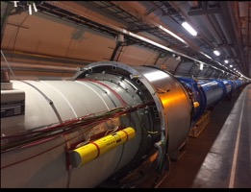
Beam Induced Heat Loads
Additional diagnostics proposed to better assess heat load deposition profile and increase statistics on heat load per magnet
  Upgrade of already instrumented cells and more cells (nb?) to be equipped
  aC coating on stand alone magnet
  Warm-up needed so cannot be done before LS2 but clear definition of what should be installed during LS2 (compatible with the already heavy loaded schedule)
Additional diagnostics for e-cloud measurement in 2018
  - Solenoid (16L2 like) on interconnect with high heat load (31L2)
  - Develop method to observe e-cloud with 2 consecutive BPM

Slide 32
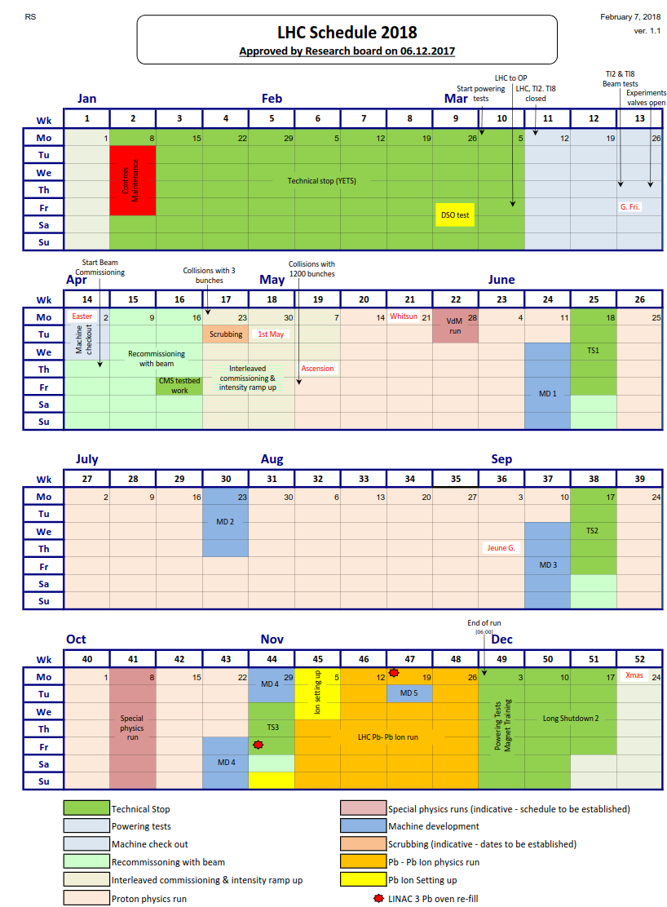
LHC schedule 2018
A production year
to complete Run 2
Goal 60 fb⁻¹ ATLAS/CMS
2 fb-1 for LHCb
with 131 days of p-p physics
55 fb⁻¹ and 1.8 fb⁻¹ if 119 days
BCMS 25ns , 13 TeV
keeping the LHC availability close to 50% (stable beams)
Pb-Pb run : 24 days
4 days setting-up
Special runs: 9 days (16 days ?)
20 days of MD
+ 3-5 days, later during 2018 according integrated luminosity
Week 49: powering tests to 14 TeV
(Main dipole circuit ONE sector training to 14 TeV)

Slide 33
2018 LHC schedule (V1.1)
Phase | Days
Initial Commissioning+ intensity ramp up | 34
Scrubbing | 1
Proton physics 25 ns | 131
Special physics runs | 8 + 1
Machine development | 20
Setting-up fo Pb-Pb ion run | 4
Pb-Pb ion run | 24
Technical stops (3) | 13
Technical stop recovery (3) | 5
Total | 241 days

Slide 34
2019-2020
LS2

Slide 35
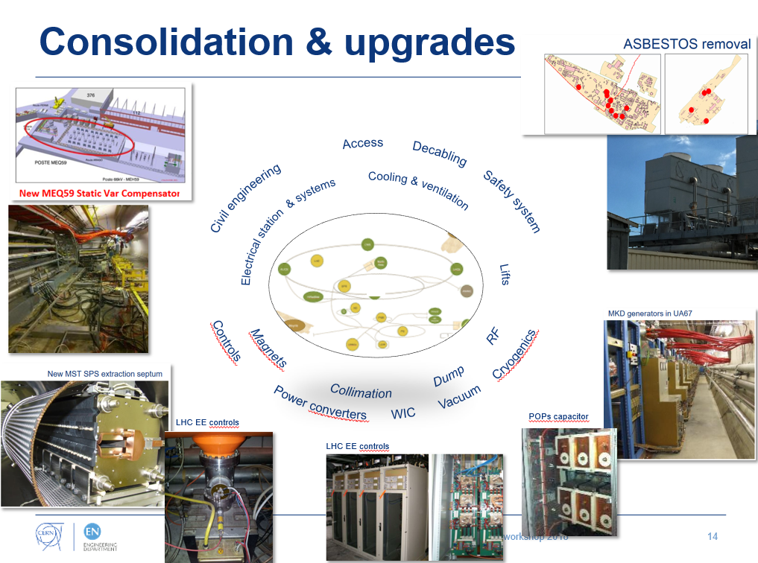
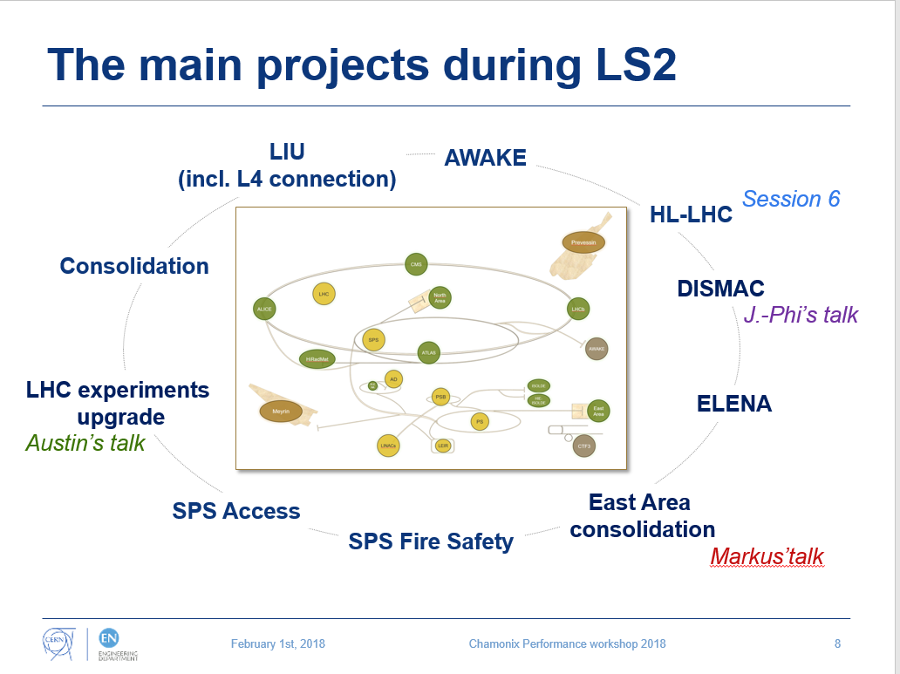
LS2 (2019-2020 period): coordination of multi projects
Space Management
Storage
Base de Chantier
Logistics
Workshops
Offices / Workshops

Slide 36
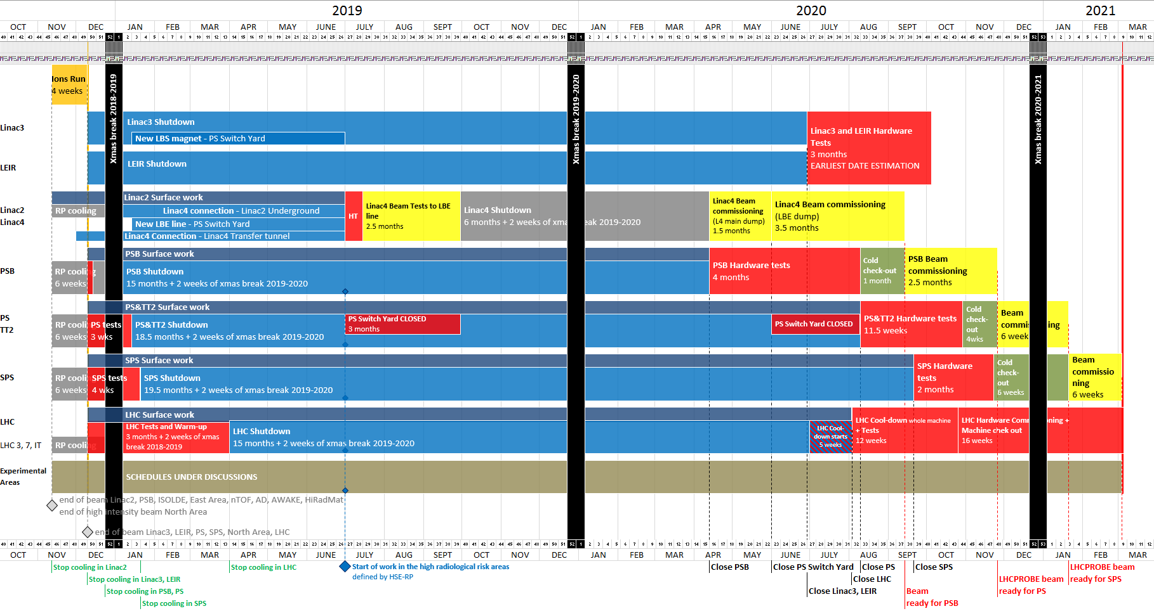
LS2: multi-project coordination challenge
Master schedule of LS2 EDMS ACC-PM-MS-0002 v.1.0
Only 9 months left to LS2 start… access restrictions as of April’2020!

Slide 37
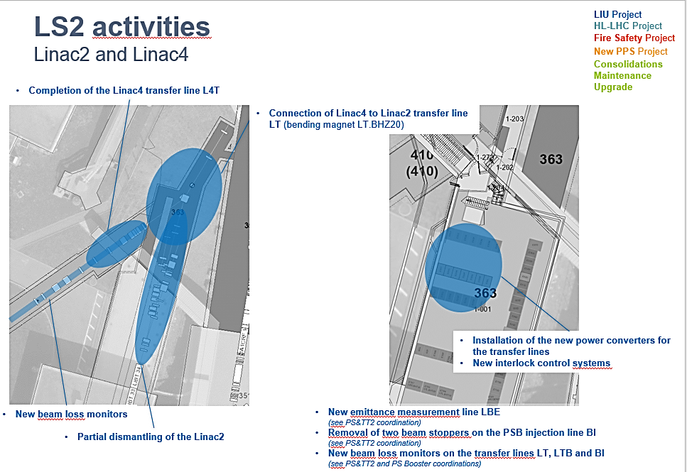
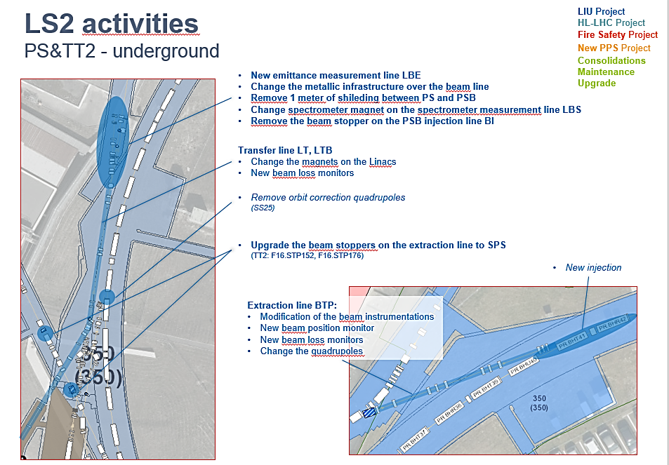
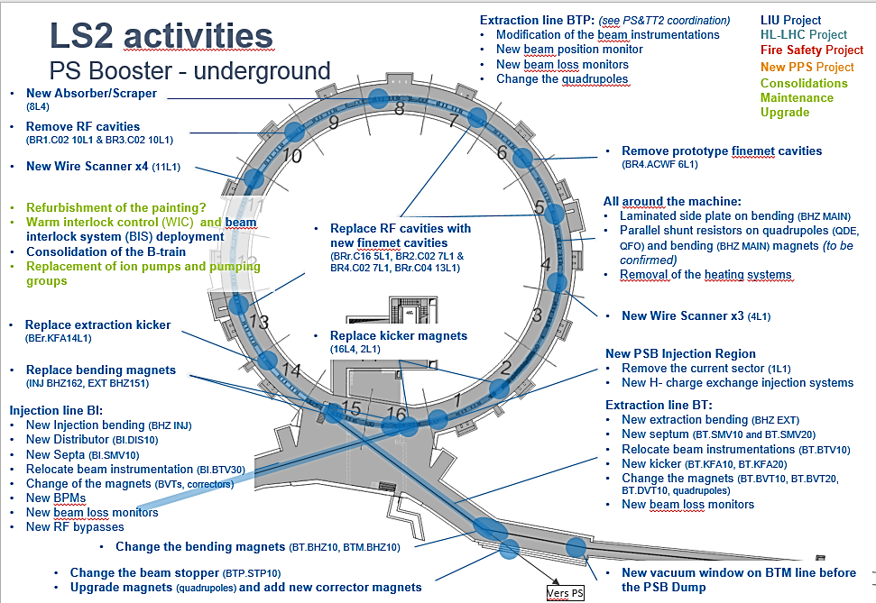
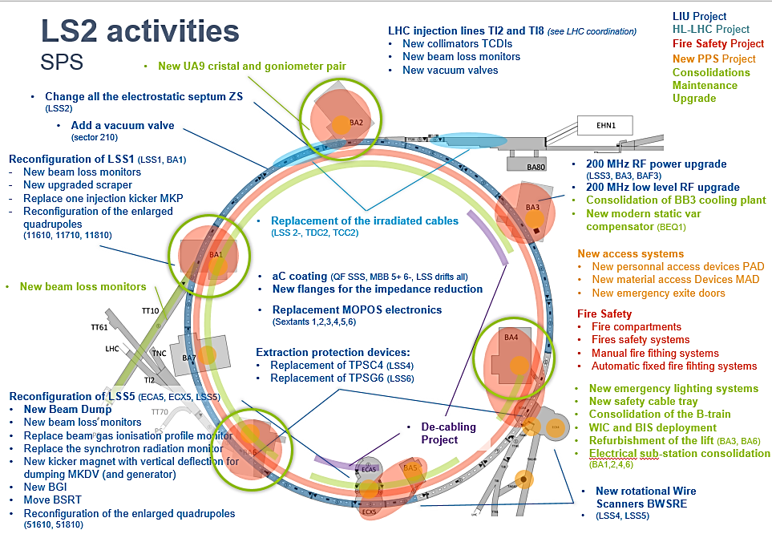
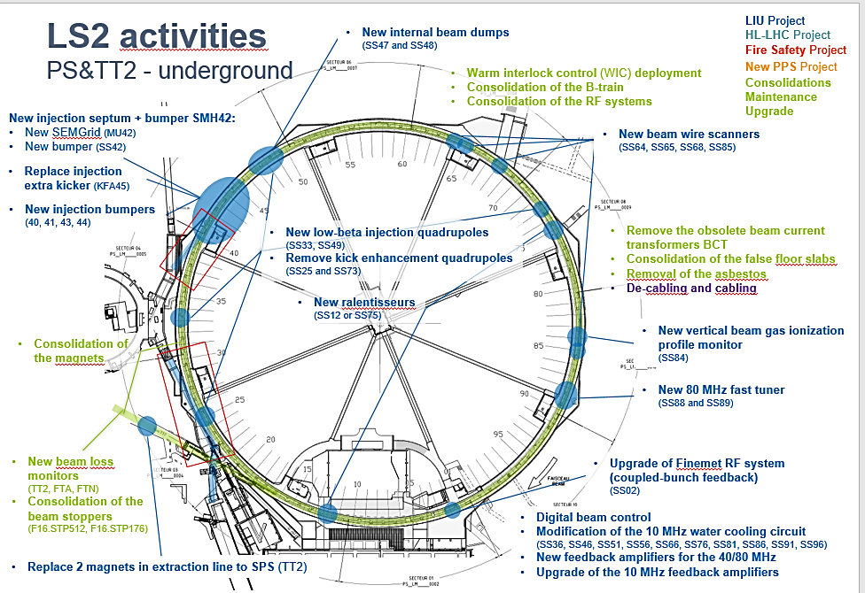
LS2: multi-projects in all the injector machines
Master schedule of LS2 EDMS ACC-PM-MS-0002 v.1.0
Baseline for the Injectors: Equipment readiness vs Coactivity

Slide 38
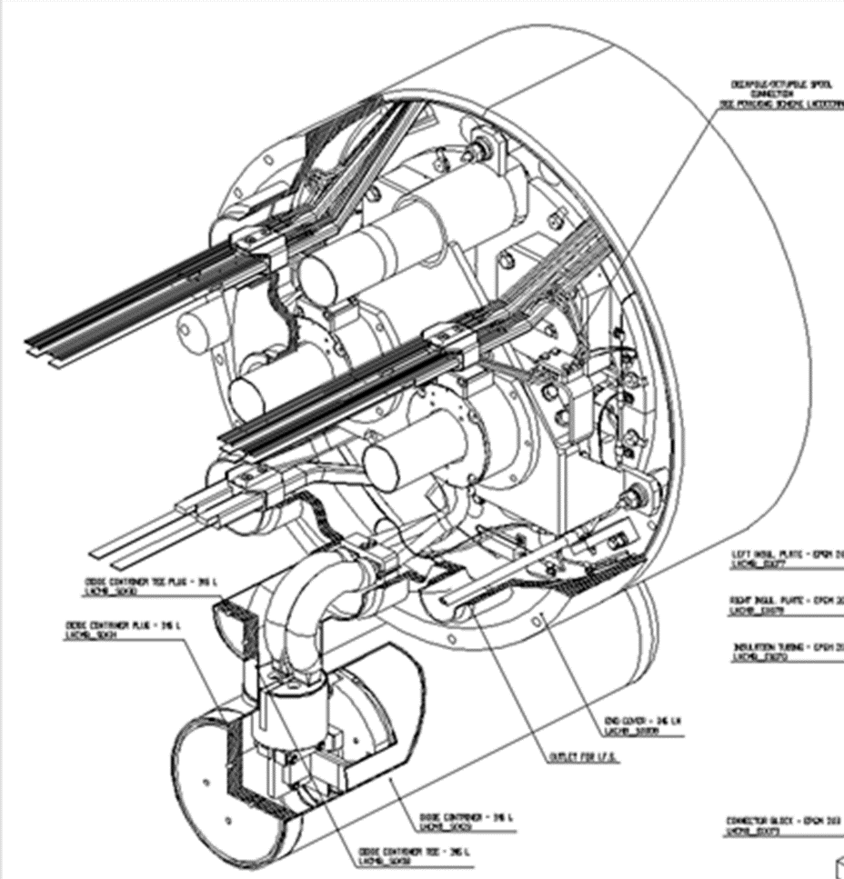
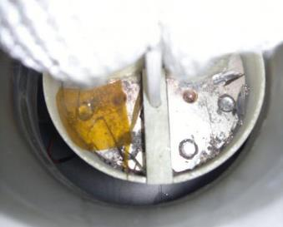
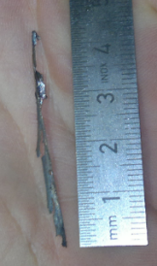
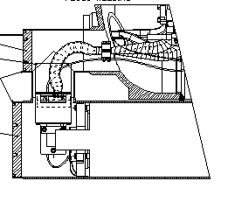
Run 2
Beam energy : Run 2 @ 13 TeV c.m.
NO change of beam energy in 2017 and 2018
Goal is to prepare the LHC to run at 14 TeV during Run 3.
Study how to reinforce the insulation (and to clean) during LS2 the electrical part connecting the dipole bypass diode.
Powering tests before and during LS2 should be defined
After Chamonix’17:
Working group was set up:
How ?, How long ?, How much ?
Work will be done during LS2
(cost in the MTP: 10 MCHF)
DISMAC project
DISMAC: Diodes Insulation and Superconducting MAgnets Consolidation

Slide 39



DISMAC Consolidation Project: 3 main actions
Diode Insulation and Superconducting MAgnets

Slide 40

LS2: LHC activities
Master schedule of LS2 EDMS ACC-PM-MS-0002 v.1.0
Baseline for the LHC: access restrictions as of June 2020!

Slide 41





LS2: LHC experiments
Most of these activities need support from the A&T Sector

Slide 42
LS2: next actions and milestones
LS2 preparation:
  - PLAN is closed, next iteration through LS2 Committees (LS2C)
  - Engineering Change Requests to be issued by Mid-April 2018
  - Integration studies shall be completed by Summer 2018
  - Equipment readiness to be communicated for fine tuning of schedules by end of March 2018
  - Work package analysis to assess equipment and installation risks and feasibility by Q3-2018
  - ALARA committees to be scheduled already for Q2-2018
  - IMPACT tool to coordinate daily activities
  - Safety joint visits (VICs) and compensatory measures to be anticipated
To help the running of LS2
  - Individual system tests & overall Safety coordination are being scrutinized
  - Space Management for Storage, “Base de Chantier” and Logistics: prioritisation phase
Milestones
  Arbitrations by mid-March 2018 (3 months ahead of Schedule)
  LS2 consolidated planning baseline by end of April 2018 (7 months ahead, final in November 2018)
  Priority given to ECR validation, integration, risk mitigation
  and coactivity risk management

Slide 43
Arbitrations decisions based on EL resources: Re-phased
LS2: arbitration
Injectors & associated exp.
  Part of SPS Fire Safety (phasing of the project LS2 and LS3)
  Replacement of irradiated cables LSS2 - (185km), TCC2-TDC2 (100km) & MKP cables in LSS1 (except 2-3 cables TBD)
  Remaining decabling in injectors
  Telecom radiating cable - Priority 2 is AD target, SPS 3&5, Awake – Priority 3 is SPS 4&6&7, TT60-61-70, TCC6
  No cabling in North Area, except M&O activities
  SPS Electrical Network Consolidation – low voltage
LHC
  Telecom radiating cable - Priority 3 is LHC 3 &7
  Turbo pump cabling (7 remaining octants)
Surface
  SM18 test bench evolution - cluster A, D, F & electrical & cabling studies linked to SM18 extension
  Blg 163 upgrade

Slide 44
Arbitrations decisions based on EL resources: Approved
LS2: arbitration
Injectors & associated exp.
  Daily work CPS & SPS: multi-clients ~100km of cables
  New Access system: 75% of cables already pulled
  Telecom radiating cable GSM- P1 is SPS1&2, TT20, TT10 & NA
  Decabling BA3 (LIU:70 km + recurrent decabling is 221km)
  LIU: ~400km of cabling + 86km of decabling in PSB
  SSPA project (SPS 200 Mhz RF)
  ELENA transfer line
  East Area upgrade
  Part of SPS Fire Safety (phasing of the project LS2 and LS3)
  Yearly maintenance DC cables on Injectors (up to 25 interventions)
LHC
  HL-LHC: minimum studies and modification for CE works
  Daily work in LHC (~40km)
  Monitoring of WCC cables & Replacement of WCC hoses - P1,P2,P5
  Turbo pumps cabling (1 octant only)
Surface
  SM18 magnet test bunch evolution – cluster G
All activities in PLAN are approuved (except the re-phased list)

Slide 45
LS2: next steps
PLAN is and will be the LS2 activity reference:
only DIC/Snowtickets linked to PLAN items will be considered!
- Step 1: Review all existing PLAN items and update their status according to recent discussions, both for demands and supports.
Step 2:
Link all created DIC/Snowtickets with the existing PLAN items or suppress them
Contact persons: Samy Chemli (EN-ACE) and/or Jonathan Meignan (EN-ACE)
  - Create the remaining DIC/Snowtickets and link them with the PLAN items.
Deadline is 15th March for the DIC/Snowtickets
Deadline is 22nd March for PLAN QA:
  - PLAN update
  - linking DIC/Snowtickets with PLAN items

Slide 46
2018-2020
LIU

Slide 47

LIU project
Linac4
  Linac4 underwent a Reliability Run (RR) with 160 MeV H⁻ beam
    Average availability of 90.6% and peak current of 23 mA before chopping
    If current remains lower than target, LHC beam (and pre-LS2 high intensity FT beam) will be produced by increased number of injected turns into PSB
    Beam quality and reproducibility to be improved (e.g. pulse shape, position along the pulse)
    Three options identified to increase beam current after the RFQ → Taskforce in place, decision by June 2018
LIU-ions PS injectors
  Linac3 and LEIR already fulfil the HL-LHC requirements
  Activities now focus on reproducibility and reliability
    Advanced machine modelling (optics, impedance, space charge) and added flexibility in production schemes (e.g. 3 bunch production) to provide margin for future operation
  2018 Lead ions operation will be fully exploited with machine tests / simulation benchmarking / operational improvement to prepare for post-LS2 HL-LHC ion beam run
Notes:
Achieved: 23 mA peak in the linac (before chopping) vs. 40 mA peak as defined in LIU secs March 2018.
3 options: source, extraction and LEBT design, RFQ acceptance

Slide 48
LIU project
LIU-PSB
  - Half Sector Test completed in April 2017
    Future PSB injection principle demonstrated and design confirmed
    Discovery of design/fabrication issues and mitigation, preparation of controls and applications, test of instrumentation
  Large longitudinal emittance LHC beams produced with different blow up schemes
  Finemet cavities used operationally in Ring4 throughout 2017
LIU-PS
  Brightness preservation along the PS cycle under close scrutiny → studies underway to confirm that LIU baseline items will allow staying within emittance growth budget
  LHC beam with 2e11 p/b demonstrated at PS extraction → Landau cavity (30 or 40 MHz with 5% tuning range) to reach the 2.6e11 p/b target: simulation and conceptual design study launched. No decision and not during LS2
  3 Xe ion bunches from LEIR compressed to 75 ns at extraction

Slide 49
LIU project
LIU-SPS
  Losses at injection plateau for proton beams expected to be significantly improved with new LLRF and correction of momentum aperture restriction
  Actions to mitigate future intensity limitations well advanced and promising, e.g. deployment of Q22 optics and demonstration of instability damping with wideband feedback system
  Ion beams:
    LIU single bunch parameters demonstrated at SPS extraction
    Scheme with 3 bunches from LEIR compressed to 75 ns in PS estimated to lead to 71% of full LIU performance
Notes:
Horizontal aperture restriction at QD (design flaw of SPS vacuum chamber transitions (QD-LSS) since construction.

Slide 50


LIU project
LIU-SPS
  Power upgrade of 200 MHz RF system on critical path
    - Solid State Power Amplifier baseline plan to be demonstrated in S1-2018
    - Mitigation and back up plan being analysed
Notes:
Horizontal aperture restriction at QD (design flaw of SPS vacuum chamber transitions (QD-LSS) since construction.

Slide 51
LIU project
LIU hardware and beam commissioning strategy after LS2
  LIU Beam Commissioning Working Group in place to start planning the machine restart after LS2
    Procedures and tools for commissioning of new hardware
    Inclusion of beam commissioning in hardware check lists
  Beam commissioning after LS2
    Pre-LS2 proton beams and LIU ion beams to be delivered in 2021
    Gradual ramp up over Run 3 of the LHC beam parameters towards LIU goals
General LIU
  Procurement / delivery / installation / test of remaining hardware to continue
  Important programme of machine development / simulations to further understand limitations and reliably meet beam targets

Slide 52
2018-2026
HL-LHC

Slide 53



HL-LHC project: magnets
11 types of magnets to be built (4 mains and 7 correctors)
  Agreements with US (Q1/Q3), CIEMAT (MCBX) and INFN (High Order Correctors) to make the series magnets.
  The prototype and series production of D1 is under negotiation with Japan.
6 out of the 11 magnets have been built and tested, confirming the validity of the design.
  The rest (5 magnets) will be completed and tested in 2018.
  Reproducibility of performance is a key issue for Nb₃Sn models not yet fully resolved
Options under consideration:
  Re-use of Q4 (baseline) and Q5 (option) as present LHC (also same correctors), needs full remote align.
  Increase high order correctors strength to cope with actual Nb₃Sn field quality

Slide 54



HL-LHC project: Cold Powering System
Innovative robust solution based on MgB₂:
  - Industrial production of MgB₂ wire started (180 km procured, 300 km being delivered).
  - First stage of the industrial cable production started (∼3.1 km of wire successfully cabled).
  - SC Link Test Cryostat under test.
  - DFX and DFH (novel concepts) demonstrators under construction.
  - Intensive studies on-going for the
  development and qualification of the splices.
Key Milestone: Test of a 60 m long demonstrator system by end of 2018 to confirm the viability of whole system.
3 x 7 kA
(3x2)x2 x 2 kA
Φ∼ 75 mm
4 x 18 kA
First industrial cabling of MgB2 cable for HiLumi Sc links
SC links demonstrator test prepration in SM18

Slide 55


HL-LHC project: Cold Powering System options
MgB₂ (Baseline, with novel DFH/X layout)
  Viable and innovative option
  Does not have technical showstopper
  Design and development to be completed by end of 2019.
Nb-Ti variant (but with Hilumi layout for DFH/X)
  Back up solution relaying on well known technologies (proved in DSL for LHC)
  Lower operation margin
  Nb-Ti strand and cable development program needed.
  Requires design studies and R&D: decision needed before end of 2019 for installation in LS3
Copper variant (not viable option at this stage)
  Needs changes of the civil engineering
  Additional power consumption of ~4 MW, and extra cooling and ventilation capacity.
  Maintenance issue due to activation in DFBX area of the LHC tunnel.

Slide 56


HL-LHC project: crab cavities
Crab Cavities in the SPS:
One module with 2 cavities installed,
cryogenics commissioning under progress … so far so good
Tests at SPS will provide info and validation for Crab Cavities installation in LHC: detailed program should be finalised
Upgrade of LLRF electronics still required for HL-LHC (under study)

Slide 57



HL-LHC project: heat deposition and radiation dose vs operation mode and mitigation schemes
Inner Triplet Region (Q1 to D1)
  - Peak dose < 30 MGy after 3 ab⁻¹ (∼ LHC after 300 fb⁻¹)
  - The crossing angle variation along the fill offer a 10% gain for the considered schemes.
Matching Section
  - Despite the weaker TAXN effectiveness, collimators and masks can offer a reasonable protection to the matching section (Peak dose < 10 MGy after 3 ab⁻¹)
  - The use of the present LHC Q5 (option under consideration) can be acceptable despite the increased dose due to its smaller aperture.
Dispersion suppression
  - Losses are expected to respect luminosity scaling, inducing for an ideal aperture profile a max dose of about 15 MGy after 3 ab⁻¹, with sensitivity to imperfections.
DS COILS IN THE
HL-LHC ERA
All elements withstand ultimate integrated luminosity of 4 ab⁻¹

Slide 58

HL-LHC project: collimation
Solid baseline, with important collected results in 2015-2017 which demonstrated the key solutions for LS2.
Key prototype activities were carried out successfully
TCSPM (low impedance prototype)
Impedance measurements with LHC beam confirmed that the baseline Mo coating is adequate, ambitious plan to assess robustness in 2018.
TCLD (Dispersion suppressor collimator)
Prototype completed, design finalized for LS2 production (4 units + 1 spare)
DS collimation in P7 (11 T): very good with protons. Further improvement of ion cleaning maybe be required (2016 re-baselining has reduced the collimators and 11 T).
  More quench test with ions needed in 2018!
  If needed crystal collimation system, very effective for ions, may be implemented (decision by beginning 2019).

Slide 59

HL-LHC project: ATS optics
LHC nominal operation and MD’s
Achromatic Telescopic Squeezing is a vital ingredient for HL-LHC.
  ATS MD’s in Run 1 (2011-12) demonstrated the basics
  ATS MD’s in Run 2 (2016-17-..18) studied a new version of the ATS optics (optimized for machine protection aspects)
Challenge: preserving state-of-the-art optics correction at large telescopic index.
β*= 10 cm
ATS 2018 MD’s:
  Flat optics development with a few trains for LRBB studies
  Round optics with large telescopic index at full intensity for e-cloud studies with tele-optics
  Preparation of the decision making process for the Run III optics: flat vs. round optics.

Slide 60

HL-LHC project: open issues and options
  Review of the baseline scenario after the re-baselining in June 2016.
  Analysis of open issues and mitigation of the corresponding risks
  Required studies and developments
  Options
Recovery of full HL-LHC performance
New baseline scenario after 2016 re-baselining:
  optimization of MKD-TCT phase advance for β* reach in any crossing plane configuration
    smaller protected aperture
    smaller β* (15 cm)
  detailed analysis of orbit corrector budget and crab cavities re-alignment needs
  Combined ramp and squeeze based on LHC experience (reduced cycle time)
  Reduced crossing angle: 500 μrad
Recovered pre-rebaseline performance
with efficiency = 50%
250 fb⁻¹/160 days (nominal) with 5.0 10³⁴ cm⁻² s⁻¹
320 fb⁻¹/160 days (ultimate) with 7.5 10³⁴ cm⁻² s⁻¹

Slide 61



HL-LHC project: open issues (from LHC to HL-LHC)
Difference in heat loads among sectors: identification and suppression of the source is fundamental for HL-LHC
Validation of the scaling of electron cloud with bunch population is vital: tests in 2018 (8b4e) and Run 3 with LIU beams!
Backup plan (8b+4e and hybrid schemes)
to mitigate performance loss
8b4e
25 ns
Collimator impedance reduction (Pt 3 and Pt 7) and a-C coating of all triplets and matching sections (Pt 2 and Pt 8) are key ingredients for digesting LIU beams
LESS (Laser Engineered Surface Structures) not ready yet for LS2
a-C coating of standalone magnet in LS2;
final treatment in LS3
Sources of emittance growth in the LHC need to be understood ➔ critical for HL-LHC ➔ Need to keep a low-noise environment for HL-LHC (power converters, transverse feedback, crab cavities)

Slide 62


HL-LHC project: open issues (from LHC to HL-LHC)
Excellent measurement and correction of linear and non-linear optics achieved but further improvement required for HL-LHC at low β*.
Rely on:
  - new trim circuit for Q1a (included in the baseline)
  - excellent alignment and magnetic measurements accuracy
  - 2018 experience with β* levelling
  - low tune ripple (initial discussion of upgrading of dipoles power converters in Sectors 12/45/56/81 ????)

Slide 63

HL-LHC project: developments and Options
Possible performance improvements:
  - Adaptive crossing angle ➔ reduction of the pile-up density and triplet radiation by ~10%
  - Upgrade of the triplet power converters in IR2/8 (not in the baseline, later consolidation? LS4 or LS4?)
  ➔ reduction of turn-around time ➔ performance improvement ~3%.
First experimental demonstration of BBLR compensation by means of wires as a back-up scenario (option)
  Experimental program continuing in 2018
  HW solutions towards the HL-LHC era to be further investigated together with their impact in terms of performance

Slide 64



HL-LHC project: simplification of the matching section
Global review of the alignment tolerances and realignment capabilities has been performed
Two alternative options identified allowing to reuse the existing Q4 and Q5 LHC cold masses:
  Option A: based on a fully remote alignment system (minor enhancement of the baseline alignment system) ➔ further increase of the available aperture and performance gain
  Option B: based on the baseline alignment system but requiring the installation of additional warm correctors
Baseline
Option A
Option B

Slide 65




HL-LHC project: Remote Alignment
Manual alignment (RADIATIONDOSE!)
Remote alignment system introduced from the beginning of the project to minimize radiation to the personnel
Thorough review of the alignment scenarios/procedures and of the implications on the HW conducted in 2017:
  - Revealed some missing elements in the baseline
  - Solution found will reduce by more than a factor 10 the collective dose
  - Additional costs estimated
Enhancement of the alignment system to allow operation from the CCC with safe beams will reduce the modifications to the matching section (Option A) and will provide additional gain in flexibility and performance.
Baseline
Remote alignment
Fully remote alignment from CCC
Cost/benefit analysis and global optimisation ongoing

Slide 66

HL-LHC project: Hollow Electron Lens
Necessary tool for halo cleaning and control, machine protection already for the intensity ramp up during commissioning in HL-LHC
A few design iterations (inner bore diameter, solenoid field, number and location of gas jet monitors)
Design (including recent modifications) integrated in IR4. Plan to finalize it in 2018.
Schedule compatible with installation in LS3 if launched in 2018 and if overlap with activities in LS2 can be avoided
Integration request : HEL into the HL-LHC baseline at upcoming C&S review

Slide 67
HL-LHC project: Infrastructure, test Facilities
Civil Engineering: Technical specifications and call for tender for Civil Engineering work at IP1 and IP5 completed
→ contract adjudications at March 2018 FC
(in agreement with actual schedule)
String Test preparation and upgrade of SM18 are well underway!
Cryogenic Upgrade: baseline for Pt4 changed from new dedicated cryo-plant to an upgrade of the existing plant;
Pt1 & Pt5 feature new cryo-plants; distribution line design under final revision due to change in the magnet baseline

Slide 68
Beyond 2030…
after LS4
beyond ‘nominal’ energy

Slide 69
Full Energy Exploitation of the LHC
Working group – Chair: Oliver Bruning
Main scope and goals :
Study divided into 3 parts:
Implications for pushing the LHC to 7 TeV (nominal energy) (report by March 2017 – Done)
Implications for pushing the LHC to 7.7 TeV (ultimate energy) (report by June 2018 but better knowledge after LS2)
Implications and feasibility for pushing the LHC beam energy beyond ultimate by replacing some of the LHC magnets with 11T magnets (report by end 2018 on feasibility)

Slide 70
LHC: beyond nominal energy (Ultimate energy)
Push for 7 TeV after LS2 and for 7.5 TeV at the earliest after 1st HL-LHC run ➔ Run5
Equipment readiness for operation at 7.5 TeV:
Analysis for 3 systems that will undergo upgrades for HL-LHC:
Assure that the upgrade plans for the LHC Beam Dump system,
the LHC intercepting devices and the collimation system components either are, or can be made compatible with!!!
the discussed components are compatible for operation at 7.5 TeV after iteration on the upgrade designs that are already underway for LS2 and LS3!

Slide 71



Slide 72
LHC: beyond nominal energy (Ultimate energy)
Reliability Estimate and Performance Reach at 7.5 TeV:
Assume earliest operation at ultimate energy after commissioning
of the HL-LHC hardware ➔ at the earliest during LHC Run5
Assume identical beam parameters and optics as for HL-LHC
no further optimization for direct comparison
Two scenarios: ‘conservative’ (max occurrence of failures) and ‘relaxed’:
between -5% and -27% performance loss wrt estimates for 7 TeV
resulting in between +13% to -24% wrt nominal HL-LHC goal
General Observations:
-VAC and Powering systems are not expected to limit operation!
-Less cryo margins due to increased SR ➔ e-cloud mitigation !
-Have to assure that all new HL-LHC equipment will be compatible
with 7.5TeV operation ➔ new HL-LHC triplet and 11T magnets!

Slide 73
2018
CMAC

Slide 74


CMAC14 messages
The team is to be congratulated for the very good operational performance in 2017, an impressive set of successful MD studies and the fast and effective reaction on mitigating the 16L2 problem.
Our congratulations to your phenomenal progress. It’s a great team that works enthusiastically on the job.
See you in March 2018...

Slide 75
CMAC14 recommendation 1
  In spite of a coordinated effort, an understanding of the uneven heat load in the arcs was not gained. Heat load is the major limitation for HL operation and the resolution of the problem deserves the highest priority. The installation of diagnostics in additional half cells is supported by the committee, as well as the exploration of additional diagnostic concepts, such as RF measurements and other new ideas.
  Coating and instrumentation of the two stand-alone magnets Q6R2 and Q6L8 is encouraged. As proposed by the task force, equipping one of the interconnects (31L2, D3-D4) with a solenoid and studying the impact may gain more insight.
  The committee notes a lack of proposals for studies and potential explanations/mitigations
  Give the highest priority to understanding and mitigating the problem of uneven heat load in the arcs. Continue the task force and extend it by a broader range of experts in electron cloud to generate more ideas for studies and approaches to the problem. Prioritize related MD studies.

Slide 76
CMAC14 recommendations 2
  LIU:
  - Find a solution to execute the SPS 200 MHz power amplifier upgrade in a timely manner.
  - Add the Landau cavity to the baseline for reaching the PS LIU intensity requirement.
  HL-LHC:
  Understand the detraining behaviour, based on an extensive analysis of the coil parameters and loading scheme.
  Further evaluate the Nb-Ti link option being careful not to jeopardize the necessary progress on the baseline technology choice. This should include a clear assessment of risks, cost and schedule for both possible solutions.
  Pursue the implementation of the hollow electron lens in HL-LHC further and integrate the electron lens into baseline of HL-LHC.

Slide 77
CMAC14 recommendations 3
  HL-LHC:
  - Start the collaring of the first of series 11 T magnet by industry only after the test results of the new double aperture model in order to give sufficient feedback in case of problems.
  Define a specific set of measurements for crab-cavities in the SPS and link these measurements to the HL-LHC requirements
  Expand the LHC availability study for higher energy exploitation to include a model for new subsystems (crab cavities, hollow e-lens, sc-links, etc)

Slide 78
Thanks
&
Conclusion

Slide 79

Thanks for the inputs to session chairs and scientific secretaries
Thanks to CMAC and scientific secretaries
A big thanks to all the speakers together with all persons involved to prepare the presentations and thanks to all participants for the open and live discussions.
Many thanks to Julia
for the administrative and
practical organisation

Slide 80

Next
3rd LIU/HL-LHC Cost & Schedule review
26th March – 28th March 2018
Chamonix’19
To be defined but around September 2019
Chamonix’20
To be defined but around September 2020

Slide 81

2017 marks the 90th birthday of the invention of the first RF linear accelerator which was built in Aachen, Germany.
Save
the date
Seminar:
Rolf Wideröe - Life and Work
Thursday 29th March 2018
at 16h30
(Council Chamber or Main Auditorium)
Norbert Holtkamp
SLAC Deputy Director

Slide 82

2018:
a production year
to complete Run 2
- Look forward to the post-LS2 LIU era and how to exploit the potential
- Look forward to HL-LHC without compromising present performance
Thanks for your attention

