Slide 1
Luminosity at W with Higher Synchrotron Tune
Dmitry Shatilov
BINP, Novosibirsk
Thanks to: K. Oide
69th FCC-ee Optics Design Meeting
CERN, 16 February 2018

Slide 2
Introduction
Very large synchrotron tune ν_{s} = 0.075 was recently demanded in order to obtain resonant depolarization at W (80 GeV).
The previous demand was about ν_{s} = 0.05. To achieve this, we increased the momentum compaction factor (similarly as it was done at Z), and RF voltage (to 750 MV).
In order to achieve ν_{s} = 0.075, we need to double U_{RF}.
Here we discuss the consequences…

Slide 3
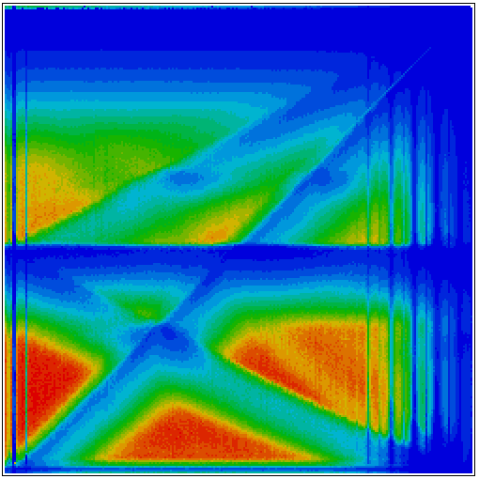
Choice of the Working Point, ν_{s} = 0.0375
Luminosity versus betatron tunes at Z, ν_{s} = 0.0125 (weak-strong, without coherent instabilities and flip-flop). This is typical picture for crab waist collision. At W it will be very similar, but… synchrotron tune is 3 times larger!
2ν_{x} – 2ν_{s} = 1
2ν_{x} – 4ν_{s} = 1
1.0
With ν_{s} = 0.05, we stood between (2ν_{x} – 4ν_{s} = 1) and (2ν_{x} – 6ν_{s} = 1). With ν_{s} = 0.075, this “window” is located too far on right, outside of good area.
So, we have to stay in vicinity of low order synchro-betatron resonances. This enhances the coherent X-Z instability and 3D flip-flop.
ν_{y}
ν_{x} + 2ν_{y} = n
0.5
0.5
ν_{x}
1.0
(0.554, 0.59)

Slide 4
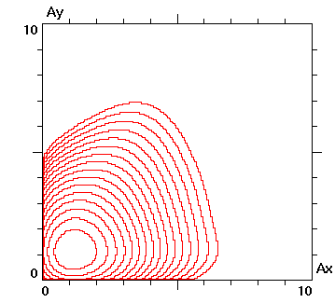
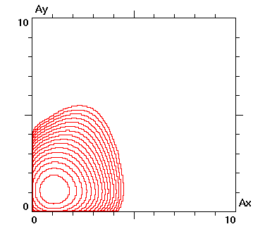
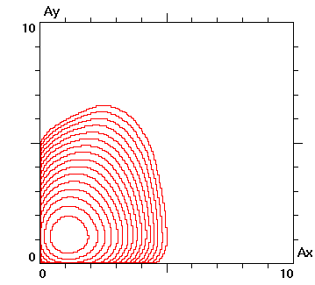
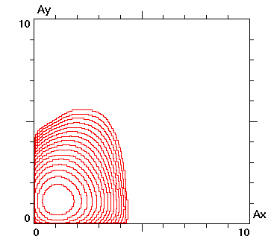
We need to decrease β_{x}!
I = I₀ – 3% I = I₀ + 3%
β_{x} = 20 cm
N_{p} = 1.0⋅10¹¹
Limited by 3D flip-flop !
β_{x} = 15 cm
N_{p} = 1.2⋅10¹¹

Slide 5
Decrease of β_{x}
ξ_{x} decreases, since it is proportional to β_{x}.
Threshold of coherent instability and flip-flop raises.
σ_{x} decreases, and this makes beamstrahlung stronger. So, with the same bunch population, σ_{E} increases – this affects lifetime; σ_{z} also increases => luminosity drops.
Another negative consequence: momentum acceptance drops.
With β_{x} = 20 cm we are limited by flip-flop, with β_{x} = 15 cm we are limited by beamstrahlung lifetime. What is better?
15 cm!

Slide 6
Parameters at W, Different Options
beam energy [GeV] | 80
arc cell optics | 60 / 60
momentum compaction [10⁻⁵] | 1.48
horizontal emittance [nm] | 0.84
vertical emittance [pm] | 1.7
longitudinal damping time [ms] | 77
SR energy loss / turn [MeV] | 340
beam current [mA] | 147
horizontal beta* [cm] | 20 |  | 15
vertical beta* [mm] | 1 |  | 1 | 0.8
length of interaction area [mm] | 0.85 |  | 0.74
tunes, half-ring (x, y, s) | (0.562, 0.60, 0.0253) | (0.554, 0.59, 0.0375) | (0.554, 0.59, 0.0375)
total RF voltage [GV] | 0.75 | 1.5 | 1.5
RF acceptance [%] | 3.5 | 6.4 | 6.4
energy acceptance [%] | 1.3 |  | 1.2 | 1.1
energy spread (SR / BS) [%] | 0.066 / 0.165 | 0.066 / 0.130 | 0.066 / 0.150 | 0.066 / 0.144
bunch length (SR / BS) [mm] | 3.0 / 7.5 | 2.0 / 4.0 | 2.0 / 4.6 | 2.0 / 4.4
Piwinski angle (SR / BS) | 3.5 / 8.7 | 2.3 / 4.6 | 2.7 / 6.15 | 2.7 / 5.9
Crab sextupoles [%] | 92 | 80 | 86
bunch intensity [10¹¹] | 2.3 | 1.0 | 1.2 | 1.1
number of bunches / beam | 1300 | 3000 | 2500 | 2730
luminosity [10³⁴ cm⁻²s⁻¹] | 34 | 27 | 30 | 30
beam-beam parameter (x / y) | 0.010 / 0.141 | 0.015 / 0.114 | 0.011 / 0.119 | 0.011 / 0.102
allowable asymmetry [%] | ±3
required lifetime by BS [min] | 16 | 15 | 15 | 15
actual lifetime (w) by BS [min] | 24 | > 200 | 27 | 21

Slide 7
Summary
Large synchrotron tune at 80 GeV can be achieved with the help of β_{x} decrease to 15 cm.
Luminosity drops by ∼12%, and it is limited by the energy acceptance (as usual).
Decrease of β_{y} below 1 mm does not help, since it reduces the energy acceptance.
Important for all energies: we need very small asymmetry not only in the population of colliding bunches, but also in the beam sizes (e.g. emittances and betatron coupling).

