Slide 1

Preparation of the ECR regarding the modification of the HL-LHC base line for a-C coating
V. Baglin, P. Chiggiato on behalf of WP12
40th HL-LHC TCC, CERN, 22nd February 2018

Slide 2
Present base line for a-C coating
During Long Shutdown 2:
  In-situ coating of
    D1Q3Q2Q1L2 + D1Q3Q2Q1R2
    D1Q3Q2Q1L8 + D1Q3Q2Q1R8
Between LS2 and LS3:
  Ex-situ coating of
    D2L1 + D1CPQ3Q2Q1L1 + D1CPQ3Q2Q1R1 + D2R1
    D2L5 + D1CPQ3Q2Q1L5 + D1CPQ3Q2Q1R5 + D2R5

Slide 3
Proposed new base line for a-C coating
During Long Shutdown 2:
  In-situ coating of
    Q6R2 + Q5R2
    Q6L8 + Q5L8
Between LS2 and LS3:
  Ex-situ coating of
    D2L1 + D1CPQ3Q2Q1L1 + D1CPQ3Q2Q1R1 + D2R1
    D2L5 + D1CPQ3Q2Q1L5 + D1CPQ3Q2Q1R5 + D2R5
    Dipole, quadrupole and CP’s electron shields located behind pumping slots
    Interconnections of Triplets region in LSS1 & 5 (5 x 4)
During Long Shutdown 3:
  In-situ coating of
    D1Q3Q2Q1L2 + D1Q3Q2Q1R2 + D2Q4R2
    Q4D2L8 + D1Q3Q2Q1L8 + D1Q3Q2Q1R8
  Ex-situ coating of
    Q5L1 + Q4L1 + Q4R1 + Q5R1
    Q5L5 + Q4L5 + Q4R5 + Q5R5

Slide 4
Thank you for your attention

Slide 5
Spares slides

Slide 6
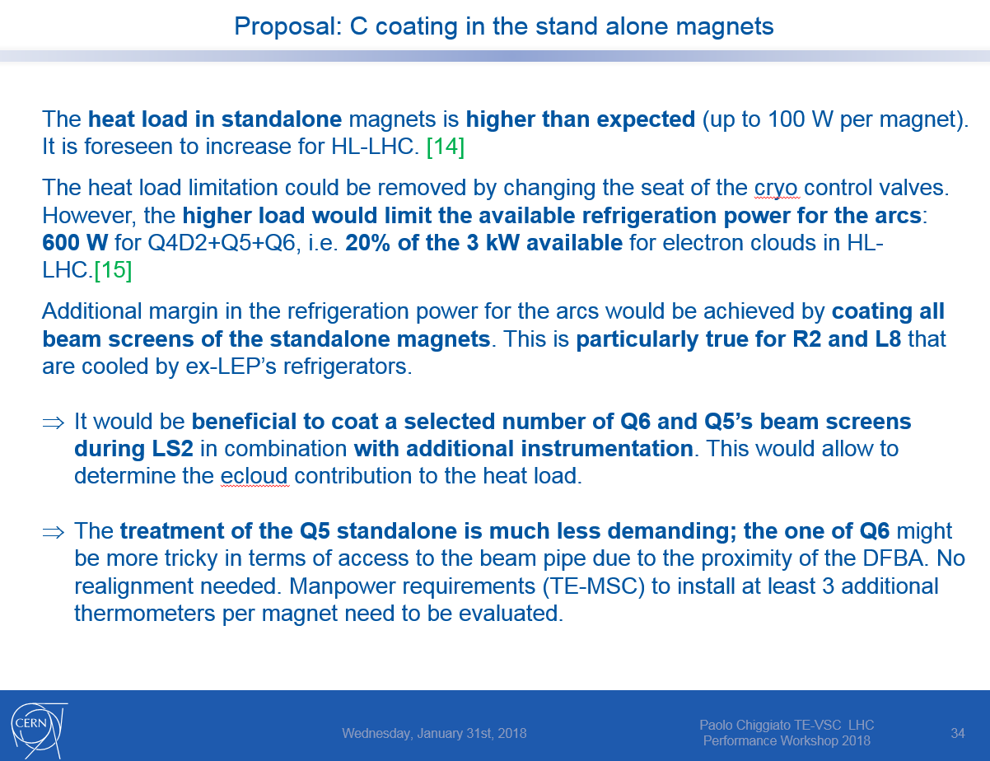
Chamonix 2018

Slide 7
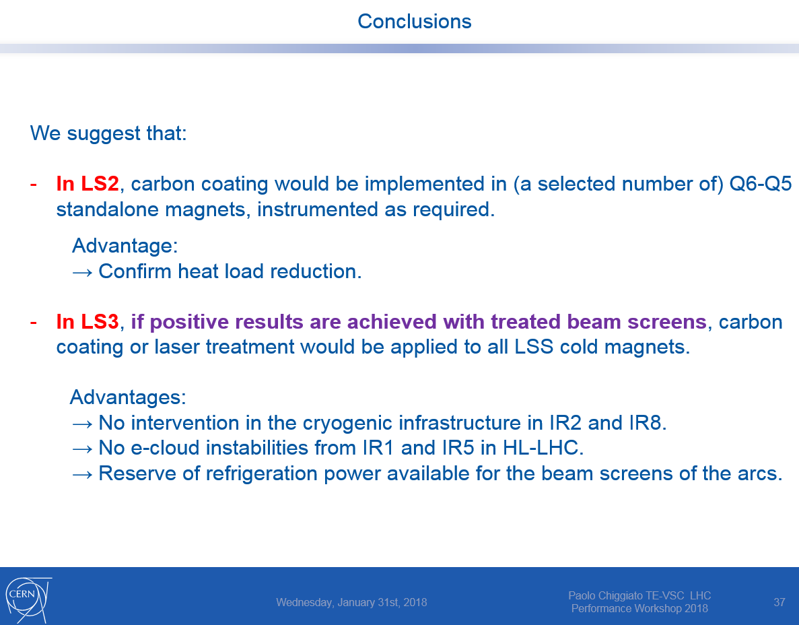
Chamonix 2018

