Slide 1
Helium Release from SC Link to UR
Thomas Otto, PSO
Nora Grada, PSSO
Contributions from:
A. Ballarino, K. Brodzinski, S. Claudet, A. Devred, V. Parma, P. Retz, R. v. Weelderen
HL-LHC TCC, 22. 2. 2018

Slide 2
Cold Powering layout (schematic)
Power Converter
Current Leads
DFH
DSH
Q1
Q2
Q3
D1
DFX

Slide 3
Failure Modes leading to Helium evaporation
MCI 3: Short / Arc
Power Converter
Current Leads
DFH
MCI 3: Short / Arc
DSH (SC Link)
MCI 4:
Loss of Insulation vacuum
MCI 1: Short / Arc
MCI 1:
Quench
MCI 1
Rupture
Q1
Q2
Q3
D1
MCI 2:
Short / Arc
Heater failure
DFX

Slide 4
SC Link Options
Different sources give different values for Helium content in SC Link – I use conservative values
Free volume of SC link approx. 1 m³
SC link with MgB₂ cable
  25 kg Helium gas at p=1.3 bar and T =4.5 – 15 K
  Active shield (V ≈ 1.5 m³, T ≈ 40 K): +2 kg Helium
  Passive shield (MLI only) optional
  DFX two-phase cryostat
SC Link with Nb-Ti cable
  140 kg supercritical Helium at p = 3-4 bar and T = 4.5 K
  Active shield as for MgB₂ link: +2 kg
  DFX’ one phase cryostat

Slide 5
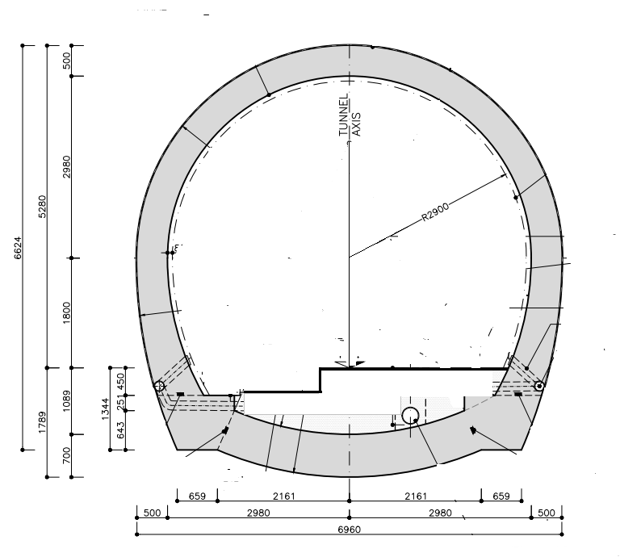
UR Gallery – Accessible during Operation
Volume of the gallery (300 m long)
V_{free} ≈ 6000 m³ (25 % occupancy)
Ventilation:
mixing by Air handling units
Fresh air in UR : 10000 m³/h
(1 exchange every 40 minutes)
Smoke extraction system:
18000 m³/h, can be directed in one particular sector
R=2900 mm

Slide 6
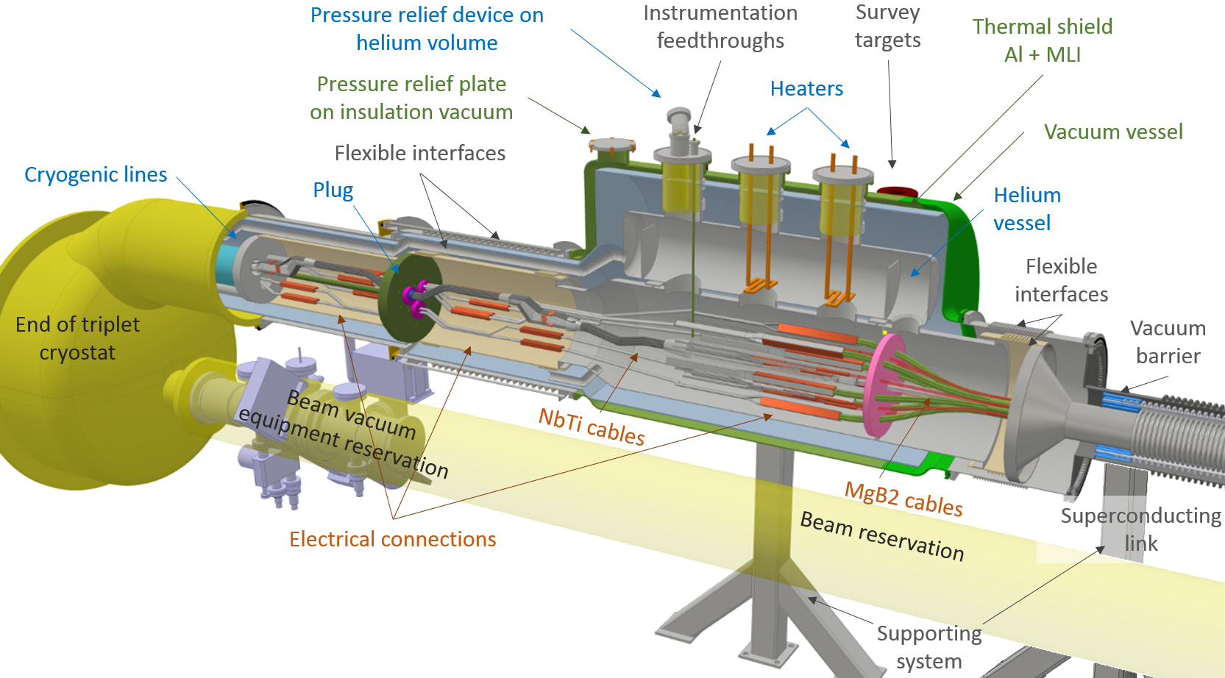
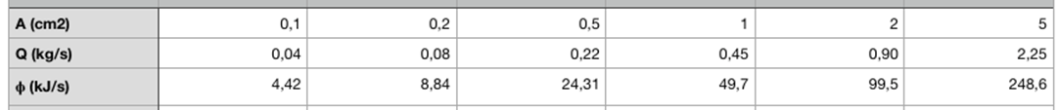
MCI 1: Quench or Short in IT
< 200 kg,
17 bar, 20 K
Helium (p = 17 bar / T = 20 K) passes though ruptured plug
Mass- and Heat Flow depends on rupture size:
Full evacuation by DFX Safety Device to LHC Tunnel

Slide 7
MCI 2: Overheating or Short in DFX
Helium evaporation in DFX
MgB₂ may quench – resistive heating leads to full loss of Helium in SC Link => MCI 4a / 4b

Slide 8
MCI 3: Internal short or arc
Consequence: rupture of cryostat to insulation vacuum
  Size of the hole determines flow to insulation vacuum and release mass flow to tunnel
  Bottom line: the full contents of the cryostat (and active shield) will be released, as in the LIV event.
  From the point of view of Helium release, similar to MCI 4a/4b, only the dynamics may change

Slide 9
MCI 4: Loss of Insulation Vacuum in SC Link
Cryostat surface 25 m², 10 layer MLI
Heat load from LIV (0.6 W cm⁻²): 150 kW
Initial Mass Flow through SC Link Safety Device*:
  MCI 4a: MgB₂ SC link: 2 kg s⁻¹
  MCI 4b: Nb-Ti SC link: 4.5 Kg s⁻¹
  * Estimated with CERN Kryolize Software

Slide 10
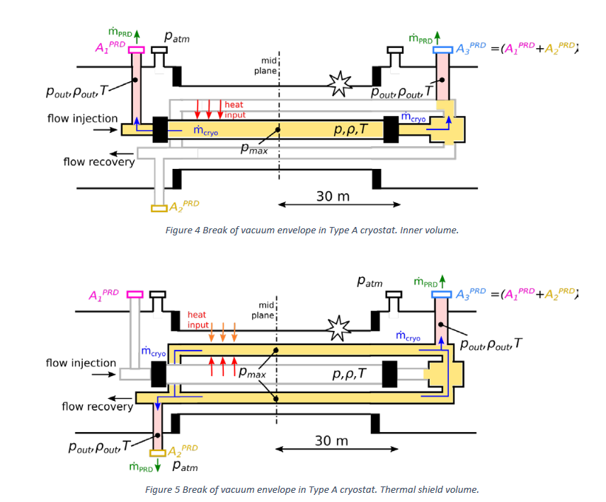
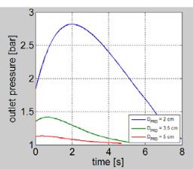
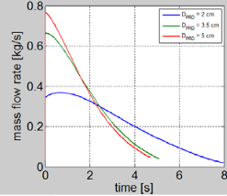
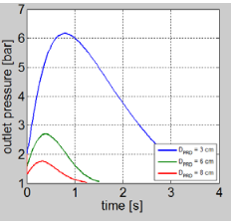
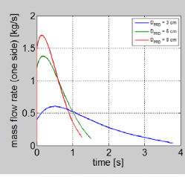
MCI 4a: Time evolution after LIV
“Sizing of pressure relief devices for 60 m semi-flexible cryostats”*
Illustrated option is MgB₂ link with active shield
    * S. Giannelli, TE-MSC-SCD, EDMS 1722630

Slide 11
Helium Behaviour after release
Well-mixed He-air zone
MgB₂ link: c(O₂) = 20.5 %
Nb-Ti link: c(O₂) = 18.2 %
Ventilation
Turbulent Zone
He - Air mixture
Extension of the turbulent zone ?
Time until “”homogeneous” mixture
These variables depend on the mass flow, the total amount released and the dimension of the tunnel. Two known cases:
Experimental and simulated He spill tests in LHC,
125 kg at at 0.1, 0.25 and 1.0 Kg s⁻¹
Simulated release from SPS CC, 15 kg in very short time

Slide 12
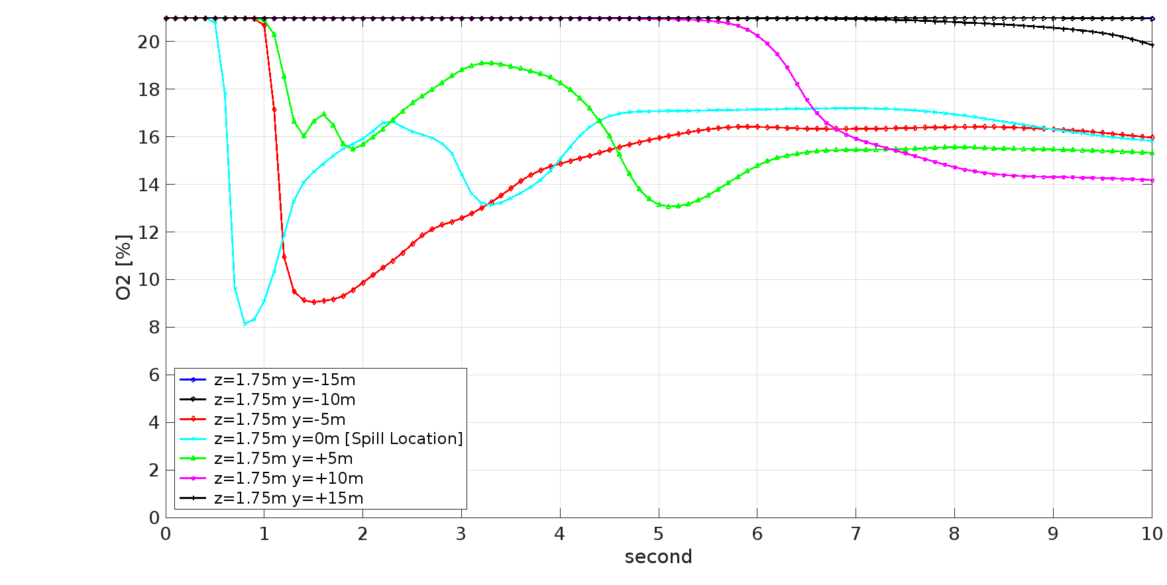
MCI 4a – Comparison with SPS CC Test
Small Helium Mass (15 kg vs. 27 kg)
Rapid release, quickly ceasing
Oxygen conc. (%)
Turbulent phase – low O₂ concentration at spill location +/- 5, for 5 sec.
Numerical calculation: R. van Weelderen, F. Aabid, TE-CRG

Slide 13
MCI 4b: LIV in Nb-Ti cryostat
Reminder:
  140 kg He in cryostat, +2 kg in active shield
  4.5 kg s⁻¹ initial flow, total release within 1 minute (?)
  800 m³ Helium gas at NTP
  At the release location, a turbulent mixing zone with c(O₂) << 18 % and low temperature will persist for the release location
  Size of turbulent zone ?
  Helium will warm up be mixed by AHU
  Time until mixing
  After turbulence has ceased, c(O₂) close to alarm value of ODH detection

Slide 14
Conclusion
MCI 1: IT Quench and ruptured cryogenic plug
  DFX safety device shall be sized to release all helium in underground
MCI 2: heater fault or short in DFX
  Quench of MgB₂ cable, full evaporation => MCI 4a / 4b
MCI 3: internal short or arc in SC link
  Full evaporation => MCI 4a / 4b
MCI 4: Loss of insulation vacuum in SC Link
  4a, MgB₂ link: release of up to 25 kg of He in UR:
  Similar to SPS CC test, short and limited turbulent zone
  4b, Nb-Ti link: release of 140 kg He in UR:
  Size and duration of the turbulent zone: need to evaluate helium behaviour after release

Slide 15
Homework
WP 6a:
  Terminate design of SC Link
  Define Helium content and its thermodynamic state in cryostat (and shield)
  Dimension safety devices to protect SC Link, DFX and DFH from overpressure
  Determine proper dynamics of Helium outflow
PSO
  Model helium behaviour (mixing, purging) after release with consideration of the ventilation
  Decide on ventilation options in case of He release:
  use smoke extraction, stop AHUs to allow stratification …
PSO with WP 9:
  Analyse cryoplant and QXL

