Slide 1


Applications of Synchrotron Light Sources
Professor Zehra Sayers
Vice President, Sabanci University, Turkey
Chair, SESAME Scientific Advisory Committee

Slide 2
Outline
Synchrotron radiation (SR) & Beamlines
Applications of SR
General
Life Sciences
Art and Archaeology
Special Features of SR facilities
Social and Scientific Environment
Learning Environment
Building up Infrastructures
International

Slide 3

Synchrotron Light Sources:
Getting Brighter
SR makes a difference:
Brilliance
Intensity
Time structure
X-rays to infrared
MAX IV
ESRF
Notes:
4th generation SR sources more than 1000 billion times brighter than the sun

Slide 4
Getting the Light Out of a Synchrotron: Beamlines (I)
http://www.synchrotron-soleil.fr

Slide 5
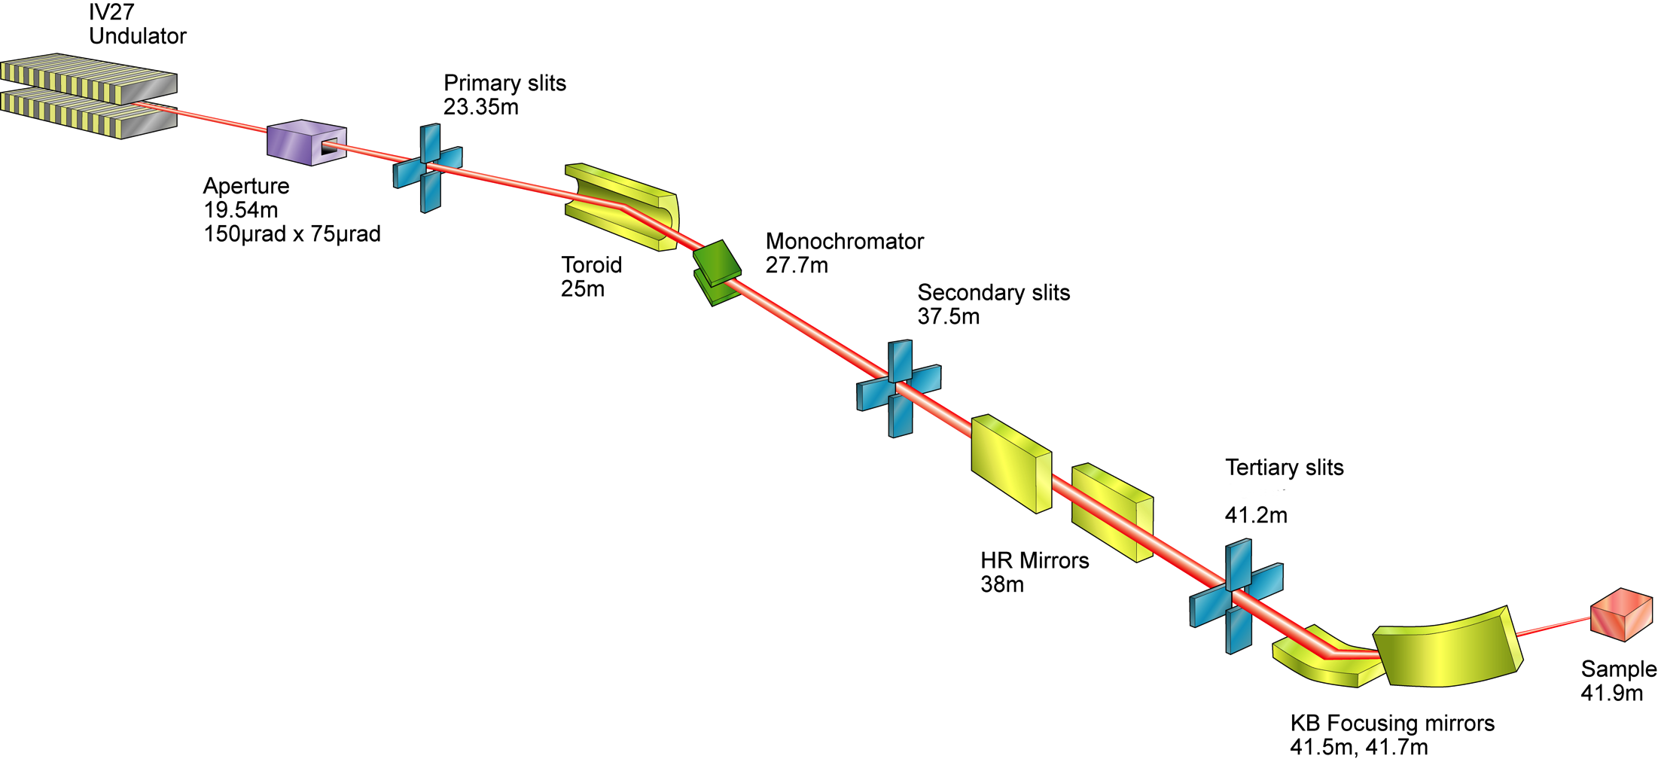
Getting the light out of a synchrotron: Beamlines (II)
Spectral range from
microwave to X-rays
http://www.diamond.ac.uk

Slide 6
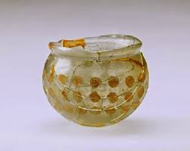
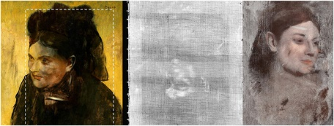
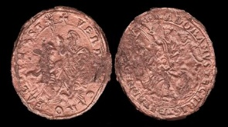
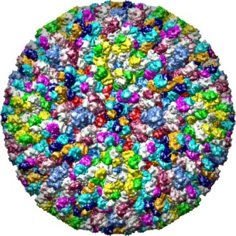
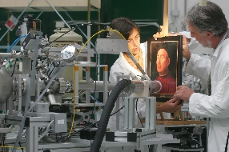
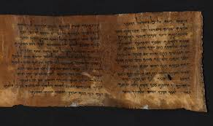
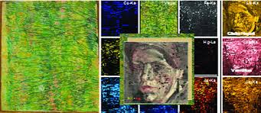

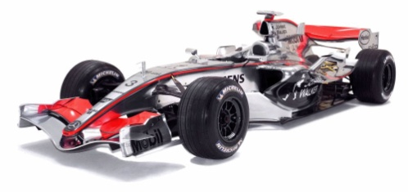
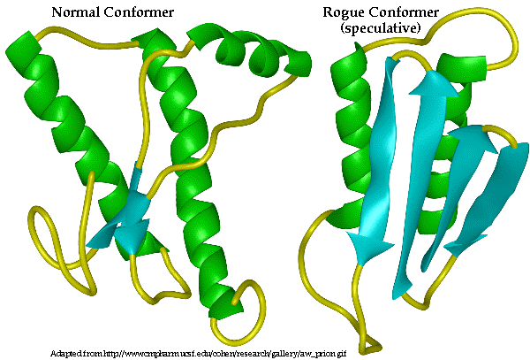
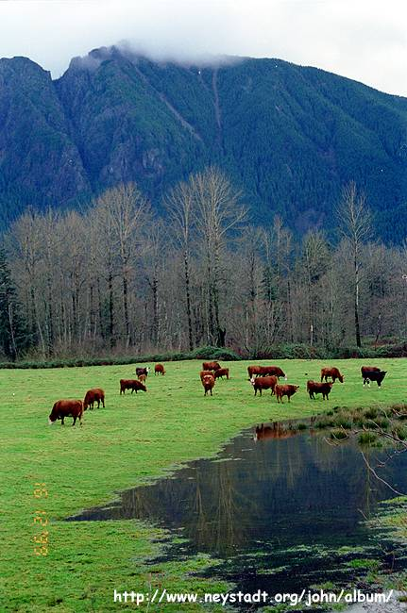
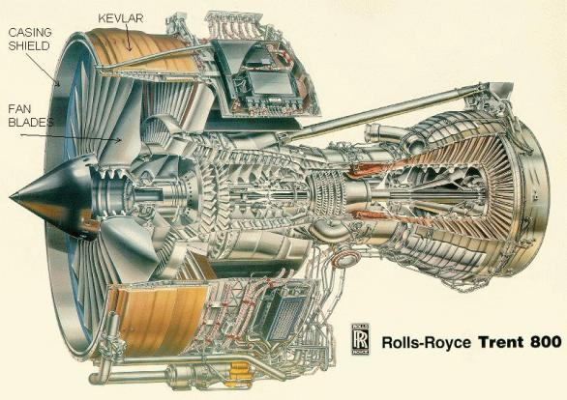
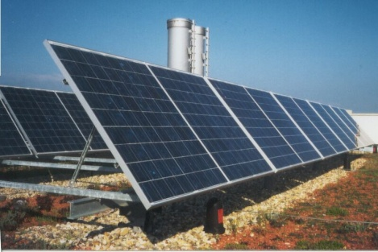
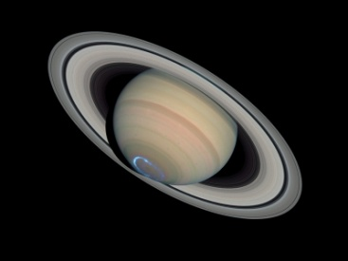
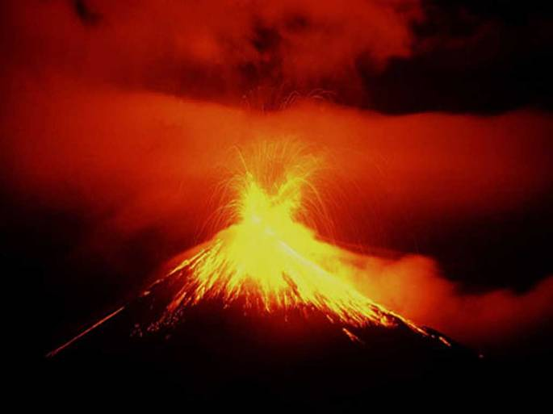
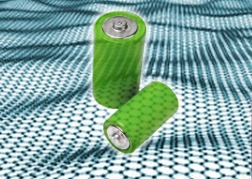
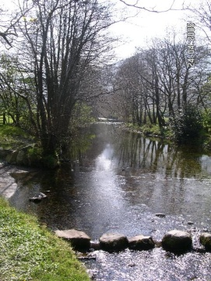
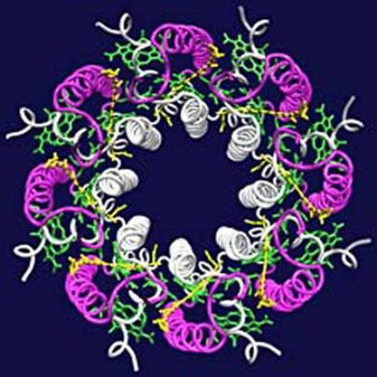
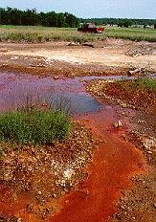
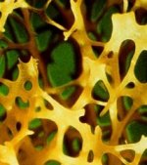
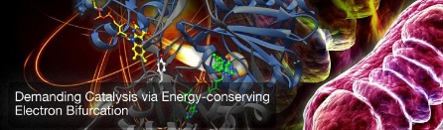
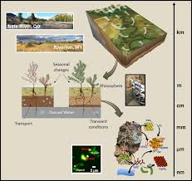
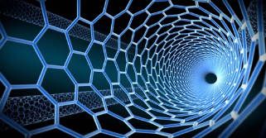
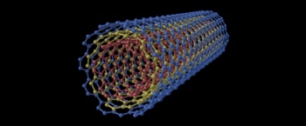
Using Synchrotron Radiation (SR)
Archaeology
Arts
Medicine
Engineering
SR: wide community
Energy
Physics
Environment
Chemistry&Materials

Slide 7
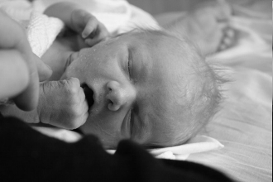
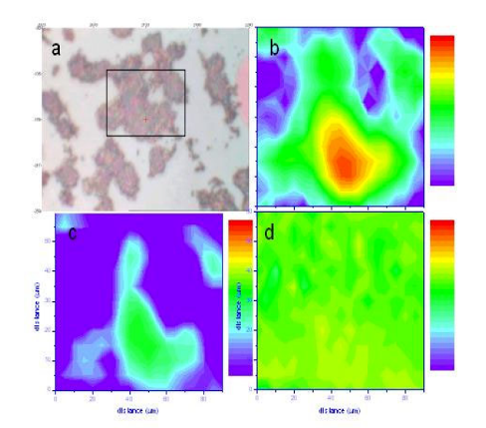
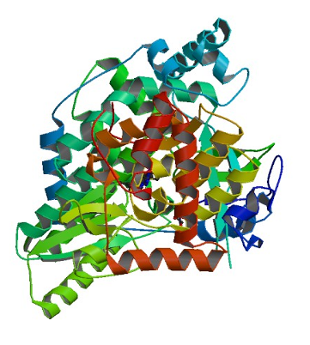
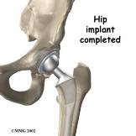
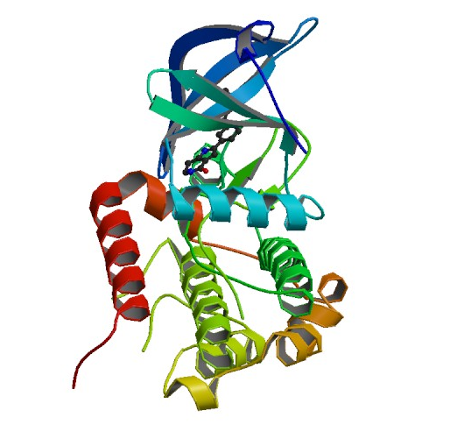
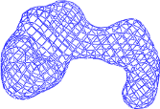

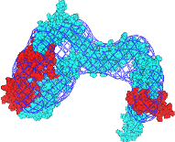
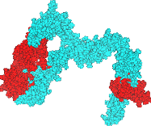

Using SR in Life Sciences
Biofilms
Biological processes
SR: complementary
techniques
Medical coatings
Wang et al, Bioorg. Med. Chem. Lett., 19, 4480-4483, (2009)
Protein structure
Protein shape
Cheng et al, Protein Science, 19, 168-173, (2010)
F1-ATPase:
Energy generation

Slide 8
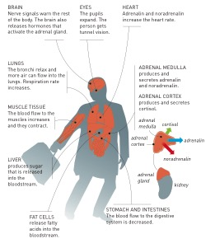
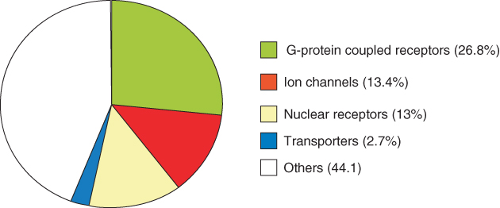
Complex Problems:
G-Protein Coupled Receptors (GPCRs)
GPCRs control sensory systems, muscles, hormones, cell growth…
DOI: http://dx.doi.org/10.1016/j.cell.2017.11.033
Drug Targets
nobelprize.org
Dickenson et al.,Molecular pharmacology (2013)

Slide 9
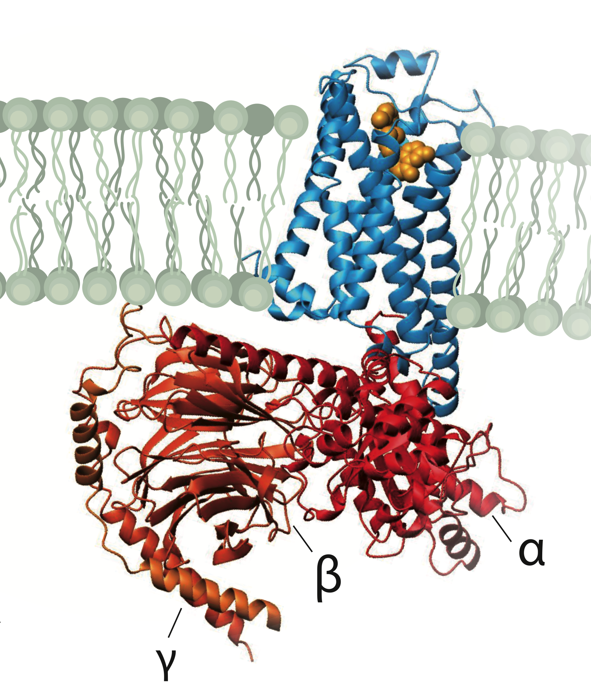
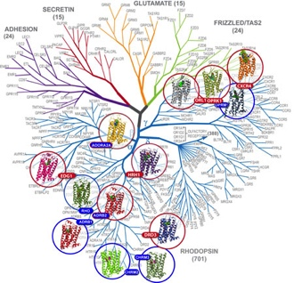
Protein Structure: GPCR Structures
Nobel prize in chemistry 2012: R. Lefkowitz and B. Kobilka
Protein structure analyses help to understand the function and malfunction.
gpcr.usc.edu
nobelprize.org
SR: Systematical
Faster
Good resolution

Slide 10
Imaging Cells*
<100 nm resolution functional imaging of cells
Syncrotron based X-ray microscopy: Structural and functional imaging
Easy sample preparation
Energy resolution
Deep penetration of X-rays
Circumvention of diffraction limit
*Imaging is possible in a range from sub nm to cms (or more)

Slide 11
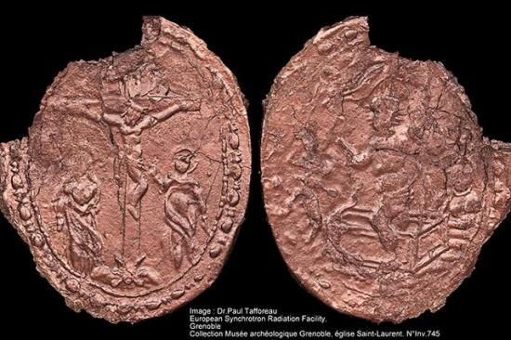
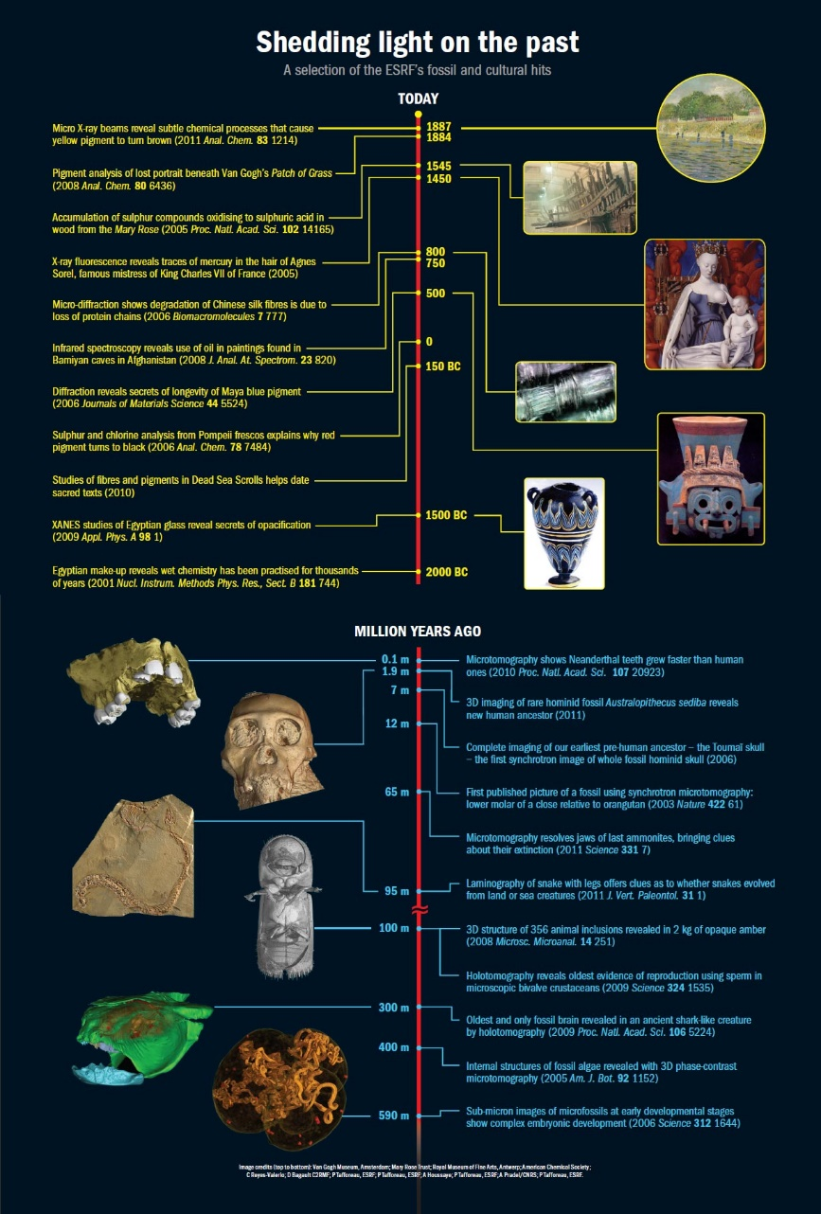
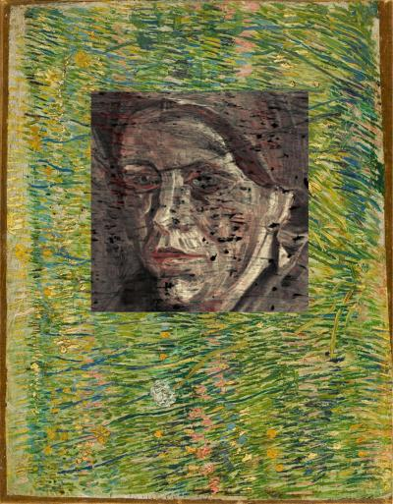
Arts and Archaeology
X-ray microtomography [ESRF]
Noninvasive tools
Chemical mapping
Fluorescence
Infrared
Imaging
khm.uıo.no
X-ray fluorescence microscopy [DESY]

Slide 12
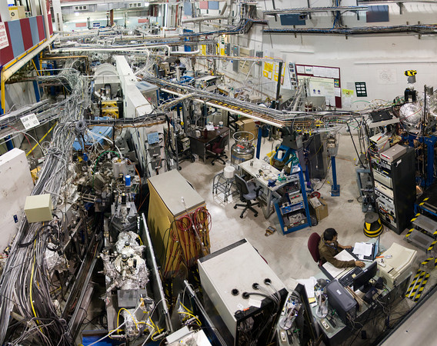
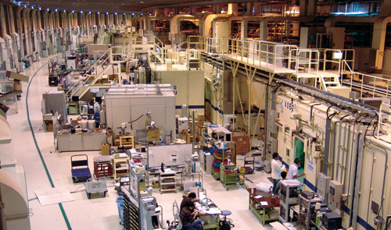
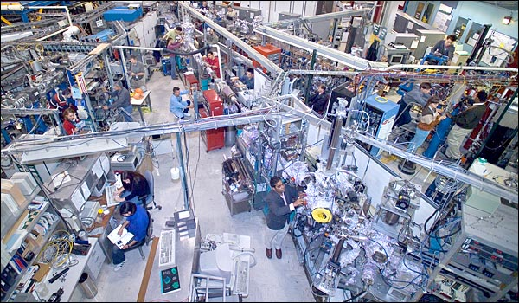
Experimental Halls of SR Facilities
Special ‘social environment’:
Science and curiosity driven
Multi-/Inter-/Cross-disciplinary
24 hour operation→Young scientists

Slide 13
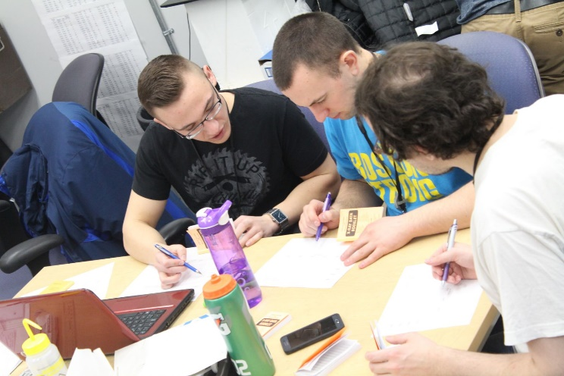
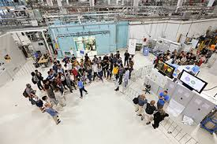
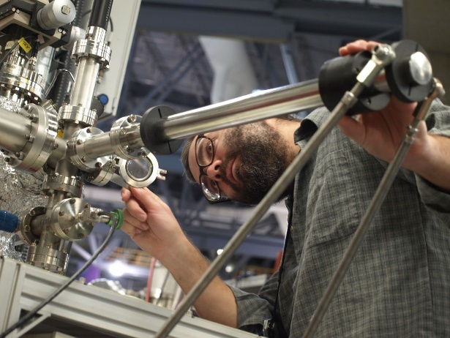
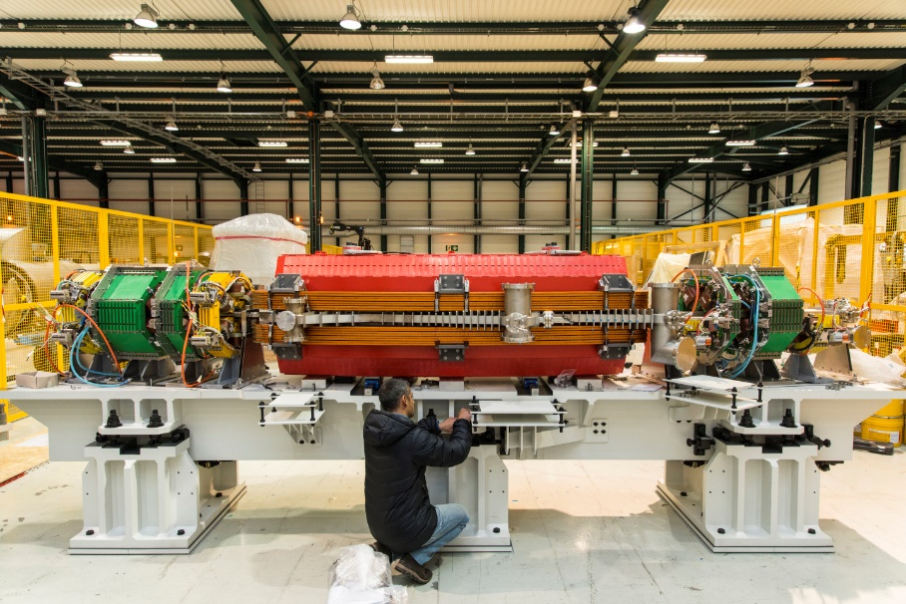
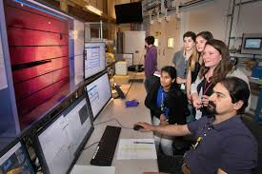
Strong Learning Environment
Know-how transfer for young people:
Academic
Technical

Slide 14
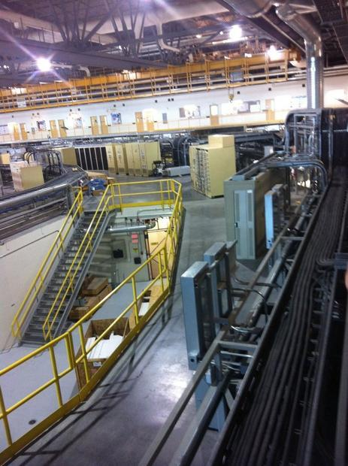
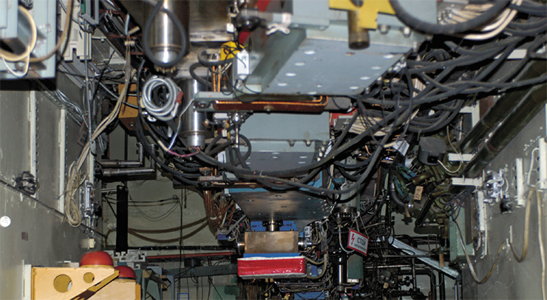
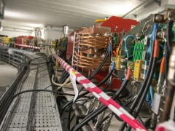
Capacity Building & Technology Transfer
@SR Facilities
Opportunities to develop local expertise:
From cable trays to cooling
From vacuum pumps to electronics
From magnets to optical instruments

Slide 15

Fostering International Collaboration
Financial necessity
Complementary know-how and expertise..
Outcome: Win-Win

Slide 16
Thank you

