Slide 1
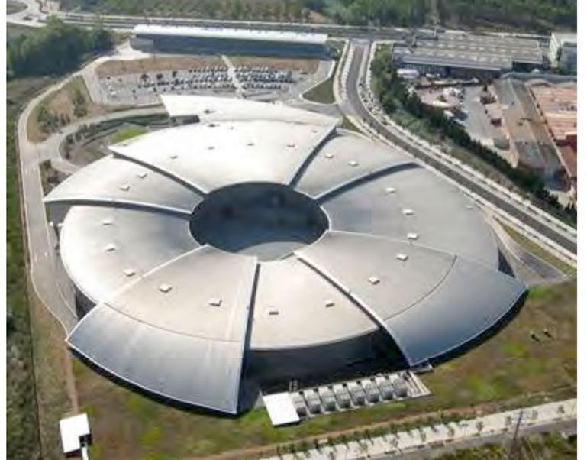
FORUM on New Intern. Research Fac. in South-East-Europe
4th Generation Synchrotron Light Source (SRL) for SEE
Light SD. Einfeldª , R. Bartolini^{b}, A.Nadji^{c} , C. Quitmann^{d}, T. Rayment^{e} . and P.F. Tavares^{d}
ª European Synchrotron Radiation Facility (ESRF), Grenoble, France, ^{b} Diamond, Oxfordshire, OX 11 0DE, United Kingdom
^{c} Synchrotron Soleil, 91190 Saint-Aubin, France, ^{d} MAX IV Laboratory, 22594 Lund, Sweden, ^{e} University Birmingham, United Kingdom

Slide 2
Members of the SRL Committee
All of us have a full engagement at our home institutes and hence we are working since Summer 2017 in our free time on this project. It is not possible to figure out in this short time a final version of the project. What we can do is only looking for general solutions. The final design has to be made by the design team and it takes roughly 1 to 2 years.

Slide 3
FORUM on New Intern. Research Fac. in South-East-Europe
Outline
> Introduction
> Requirements
> Brilliance
> Proposed Lattice
> Machine Components
> Building
> Education & Training
> Site
> Costs

Slide 4
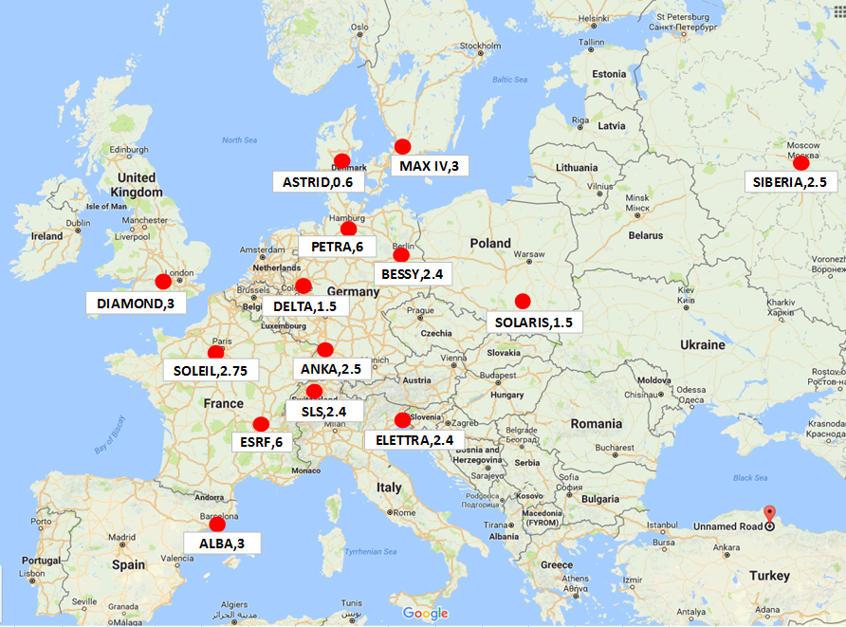
Distribution of Light Sources in Europe
There is something missing in the SEE-Area

Slide 5
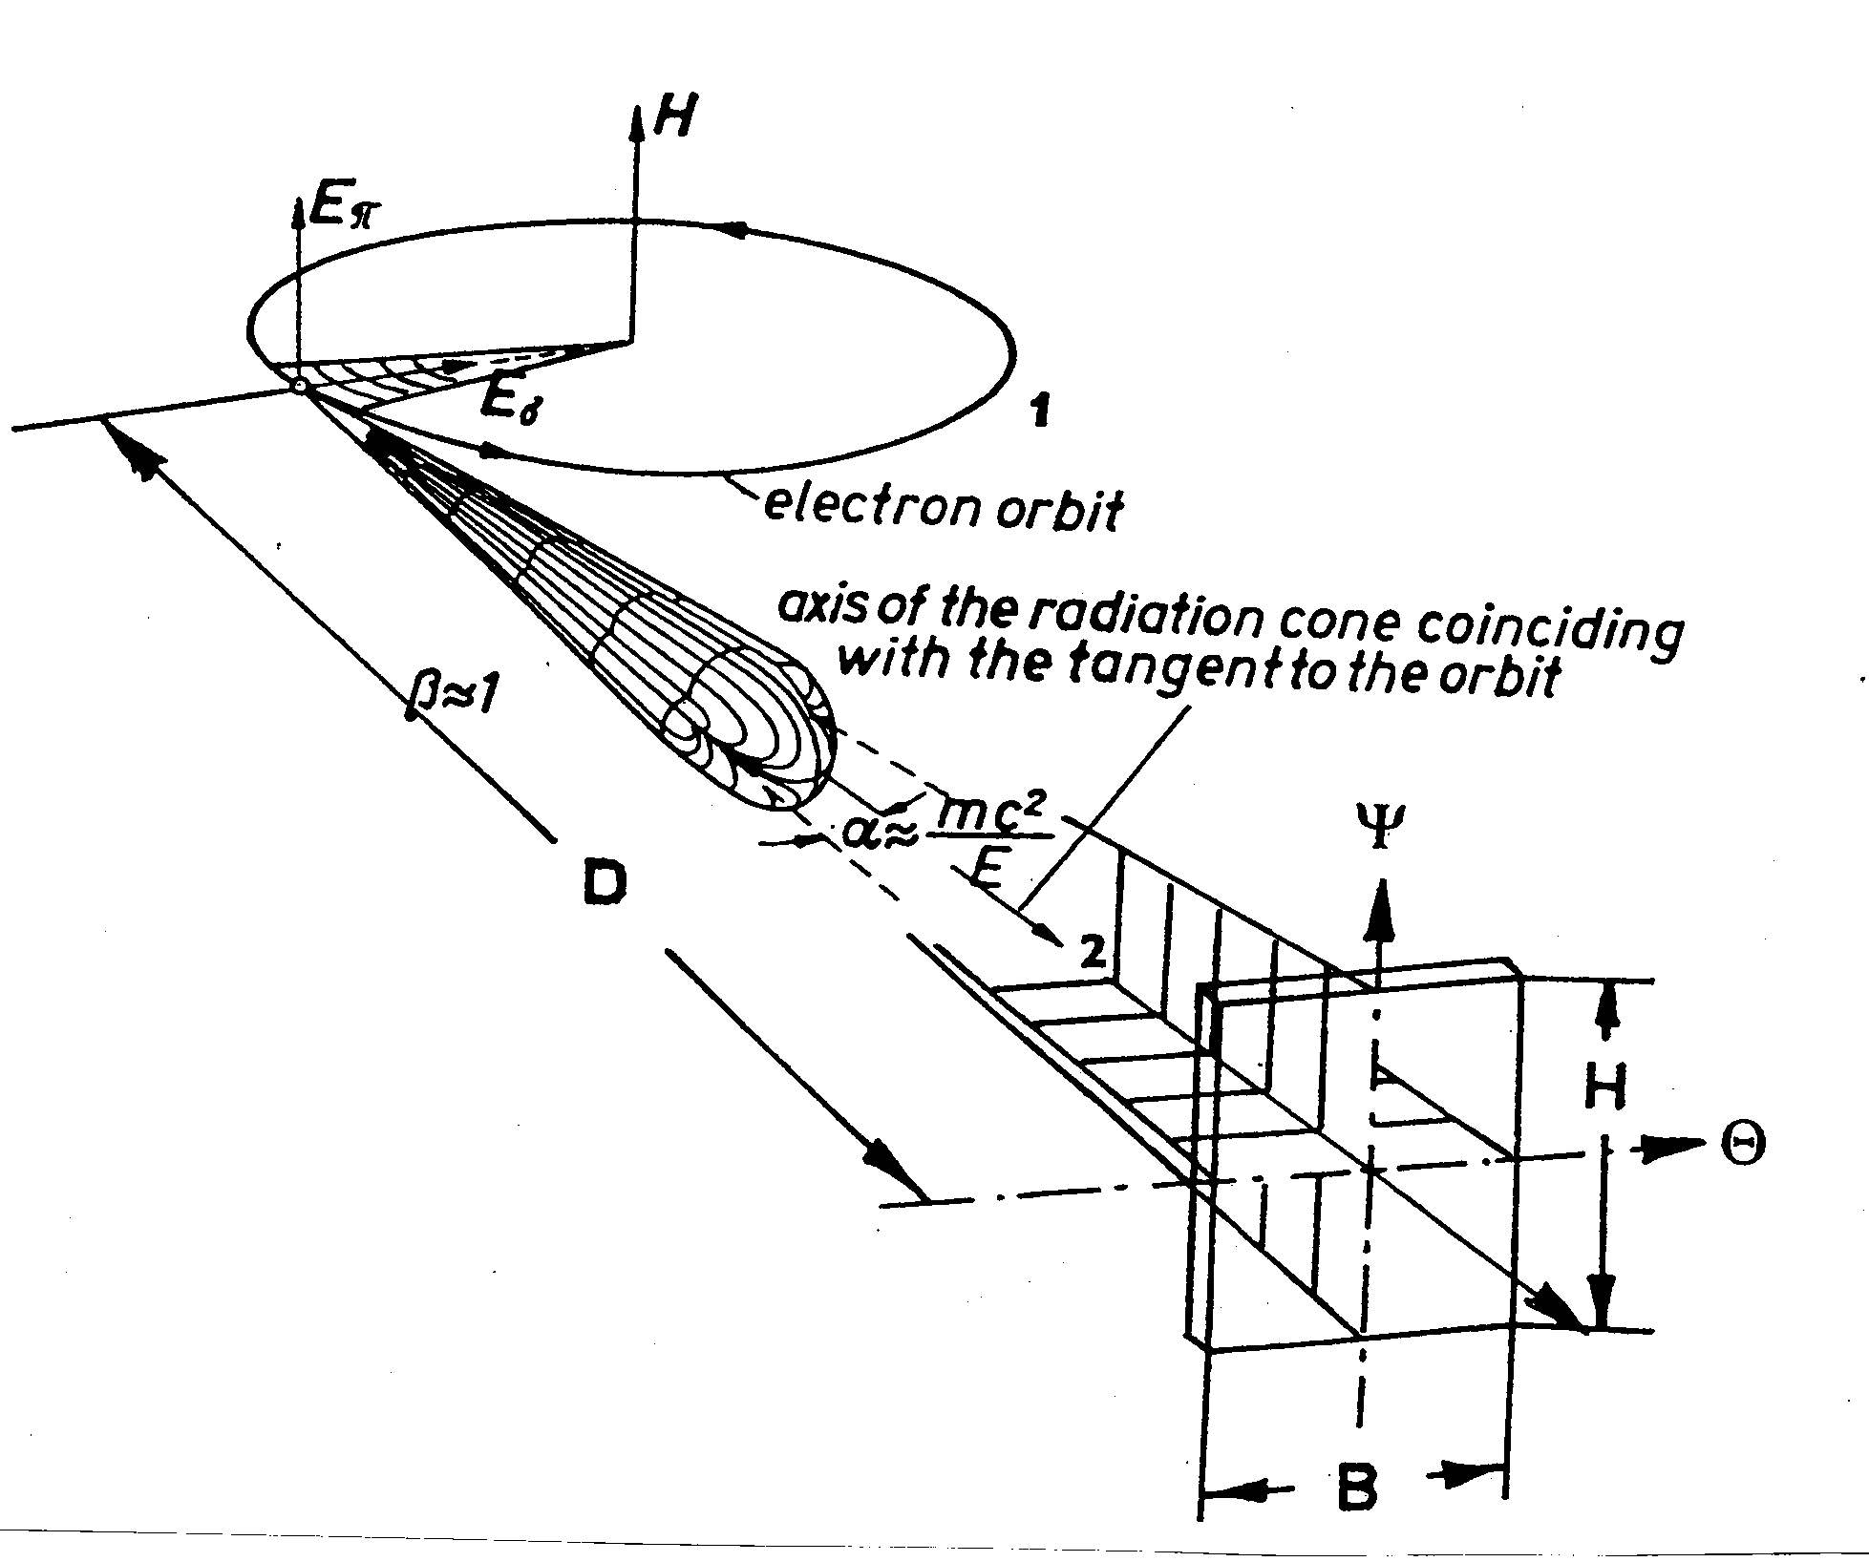
Characterization of Synchrotron Radiation
The Radiation from a Bending Magnet
For the characterization of the synchrotron radiation we have the following definitions:
As
Flux = Photons / ( s • BW) Flux density = Flux / A_{s} , [ Photons / (s • mm² • BW)] Brilliance = Flux / ( A_{s} • ΔΦ •∇ψ) , [ Photons / ( s • mm² • mrad² • BW )]
Φ
ψ
Soft X-Rays
Hard X-Rays

Slide 6
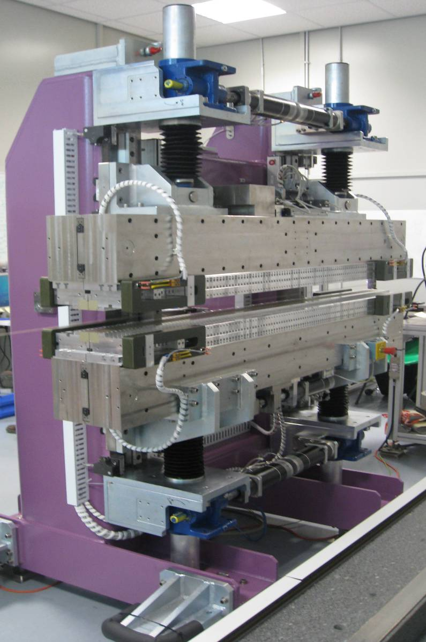
Insertion Devices as Light Sources
g
λ_{Und}
Soft X-Rays
Hard X-Rays

Slide 7
Performance of a Synchrotron Radiation Light Source
The performance of a synchrotron light source is given and determined by: the emitted photon spectrum ⇒ electron energy (γ_{photon} ≈ E²) the brilliance of the emitted radiation ⇒ emittance (ε) and current (I) (Br ≈ I / ε^{1.5}) emittance (ε) is given by E²*φ³ The coherence (fc) of the emitted light ⇒ is given by the emittance  the overall length of the straight sections ⇒ circumference of the machine the stability of the beam ⇒ current, the rf-, vacuum-, feedback -system, etc

Slide 8
Requirements for the Design of the SEE-SRL
ESSENTIAL REQUIREMENTS
1.) The energy should be between 2.5 to 3 GeV in order to reach with “in-vacuum” undulators
photon energies of 20 to 30 keV.
2.) The circumference has to be around 350 m.
3.) The lattice should be optimized for a high photon flux and brilliance
4.) The natural emittance has to be in the range of smaller as 200 pmrad.
5.) 12 to 16 straights should be available.
6.) The design current should be 400 to 500 mA.
7.) The booster synchrotron should be in the same tunnel as the storage ring.
⇒ Overall it should be a 4th Generation Light Source
⇒ Most important is the emittance of the storage ring

Slide 9
Requirements for the Design of the SEE-SRL
DESIREABLE REQUIREMENTS
8) Permanent magnets should be used.
9.) A commercial 100 MHz system should be used.
10.) For the vacuum system NEG coating should be used.
11.) The pre accelerator should be a Linac with an energy of at least 100 MeV.
12.) The “topping up” injection mode must be possible in order to have a constant
head load on the optical components of the beam lines.
13.) The lifetime should be large enough (› 8 hours) to reduce the radiation level in
the experimental hall.
14.) The energy acceptance has to be at least 4 % ( life time requirement )
15.) Feedback systems have to be introduced to get sub-micron-stability of the
stored electron beam.

Slide 10
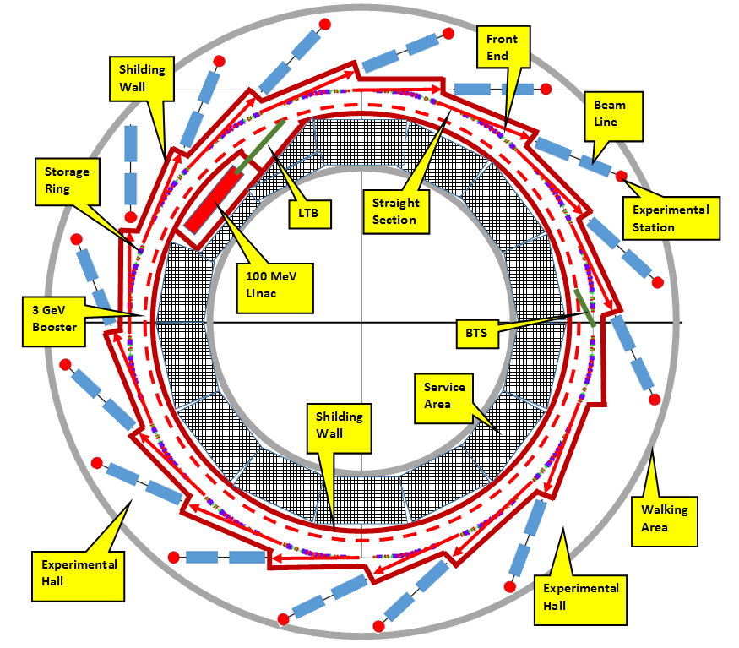
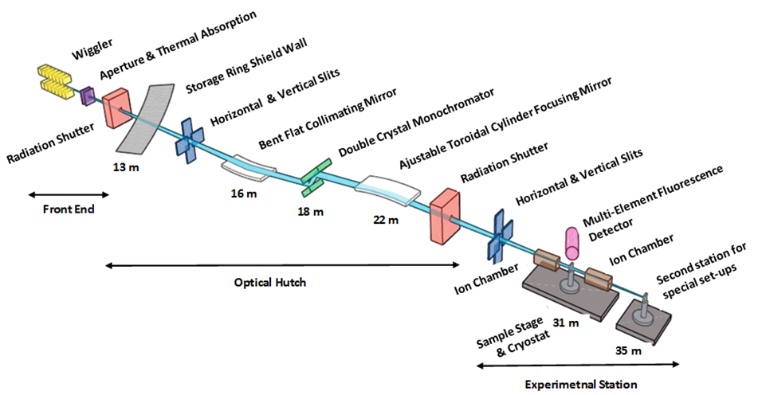
General Layout of a Synchrotron Light Source

Slide 11
Machine Functions of the 7MBA-Lattice (MAX IV)
Steps: 1.) looking for existing lattices, 2.) Matching the lattices to a circumference of roughly 350 m, 3.) Beam dynamics calculations, 4.) Brilliance calculations and 5.) Final lattice selection.

Slide 12
Towards low Emittance of a SRL
To achieve low emittance the following points should be considered:
• The number of magnets has to be large, which means multi-bend achromat
cells (MBA) with 5 or more bending magnets.
• The outer bending magnets must be shorter by roughly a factor 2
• The bending magnets should be combined-function construction with vertical
focusing to increase maximize J_{x.} Combined-function bending magnets also
have the advantage of leading to a compact machine design.
• Damping wigglers can be installed to increase radiative energy loss per turn
and therefore decrease the emittance.
• Longitudinal gradient bending magnets have the potential to further decrease
emittance
• Anti-bends also reduces the emittance
Steps: 1.) looking for existing lattices, 2.) Matching the lattices to a circumference of roughly 350 m, 3.) Beam dynamics calculations, 4.) Brilliance calculations and 5.) Final lattice selection.

Slide 13
Proposed Lattice Layout for the SEE-SRL
∆ϕ(x)=3π & ∆ϕ(y)=π

Slide 14
Survey of low emittance lattices for light sources
According to R.Bartolini and A.Nadji
Circumference (m)

Slide 15
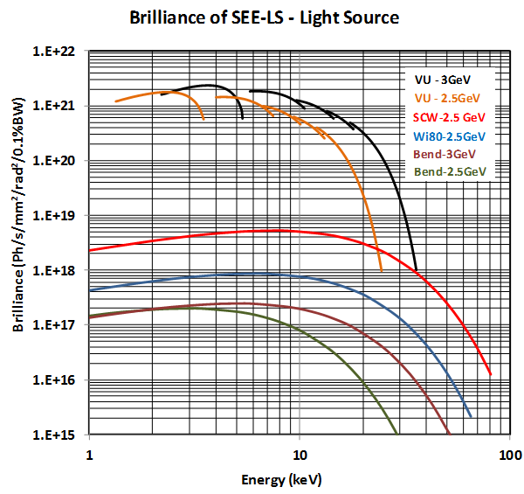
Brilliance for a 2.5 and 3 GeV Light-Source
Soft X-Rays
Hard X-Rays

Slide 16
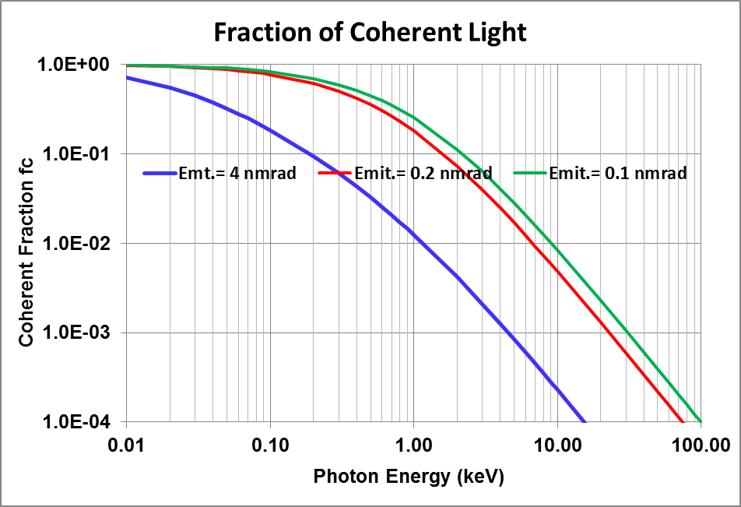
Coherence of Light-Sources

Slide 17
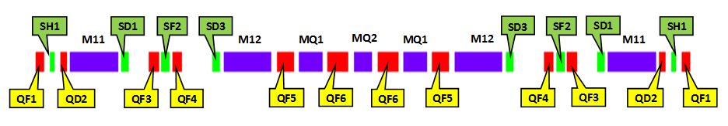
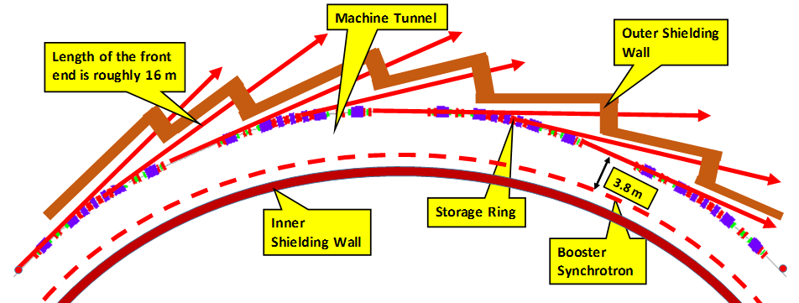
Arrangement of Magnets within an Achromat

Slide 18
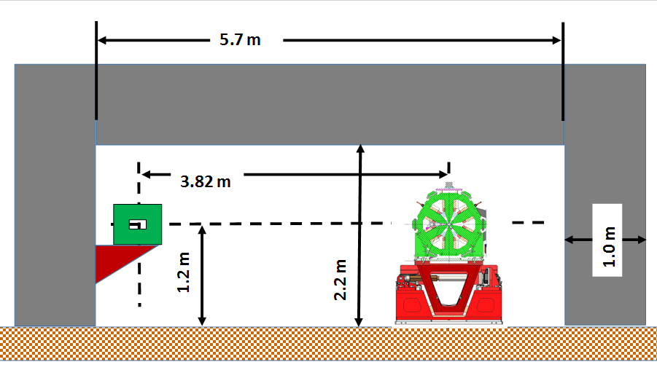
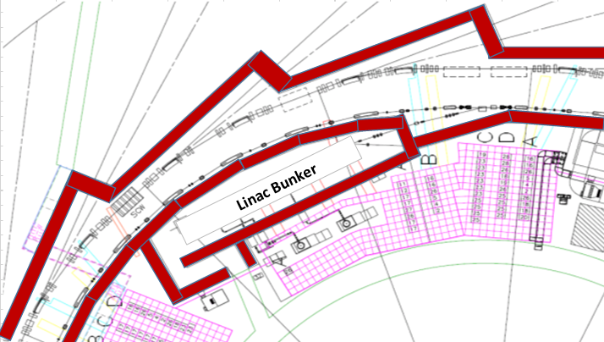
Space of the Machine-Tunnel

Slide 19
Space Requirements for the Machine
The idea is to build a 3 GeV machine, run it at the beginning with 2.5 GeV in order to save money for the RF-System and make later an upgrade to 3 GeV.

Slide 20
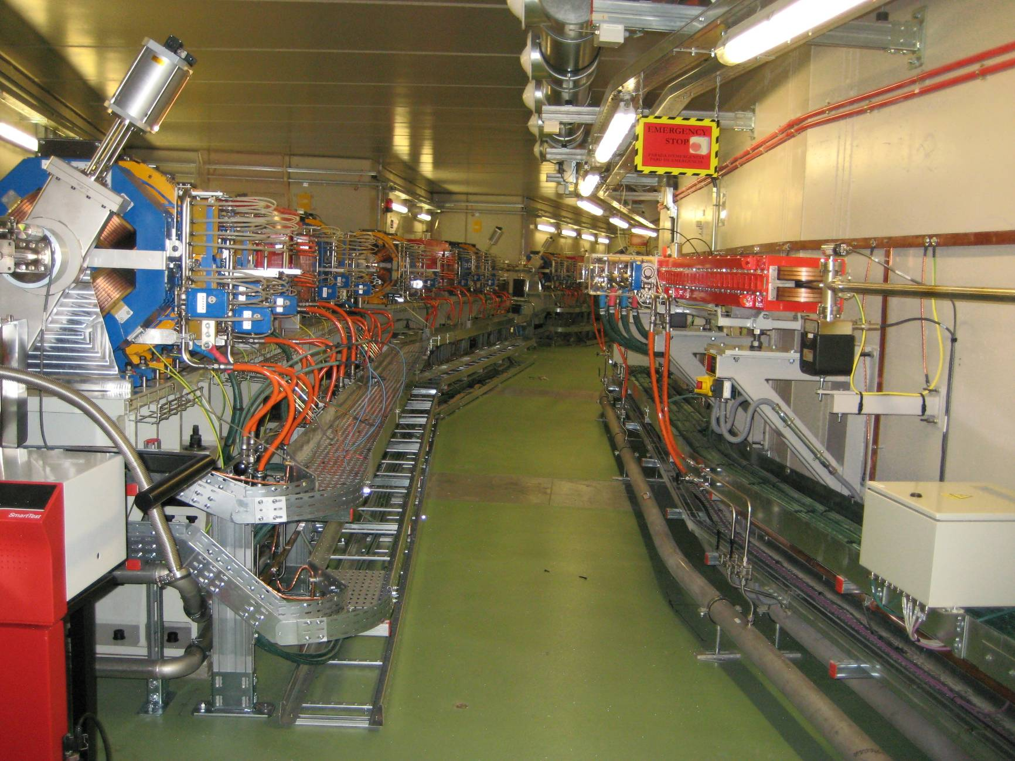
Space within the Machine-Tunnel (ALBA)
Storage Ring
Booster Synchrotron
Walking Area

Slide 21
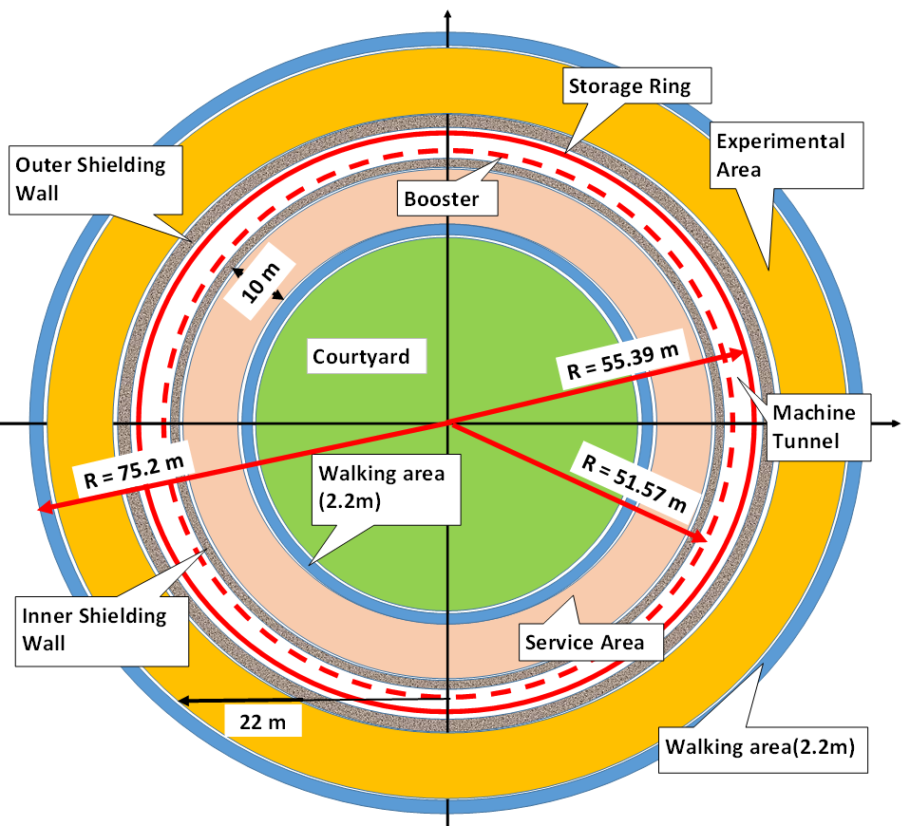
Overall Size of the SEE-SRL Main Building

Slide 22
Components of the Accelerator Complex
Vacuum
Chambers
Flanges
Pumps
Bellows
Contr.-Syst.
Injector
Diagnostic
Magnets
Pow.-Suppl.
Injection
Cooling
Vacuum
RF-System
Injection
Septum
Kickers
Timing
Cooling
Magnets
RF.-System
Pow.-Suppl.
Absorbers
Magnets
Dipoles
Quadrupoles
Sextupoles
Correctors
RF-System
Cavities
Electronics
Klystron
Waveg.-Syst.
Injector
Pre-Accel.
Booster
Transf.-Line
Pow.-Sup.
Magnets
Klystron
Pumps
Diagnostic
Current
Position
Work.-Point
Ins.-Div.
Conv.-Undul.
In-Vac.-Und.
SC-Wigglers
Special-Und.
Front-End
Vacuum
Absorbers
Diagnostics
AC-Div.
Comp-Div.
Eng-Div.
1m
10 m

Slide 23
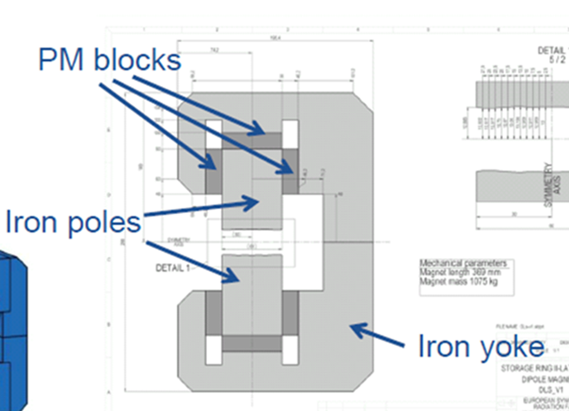
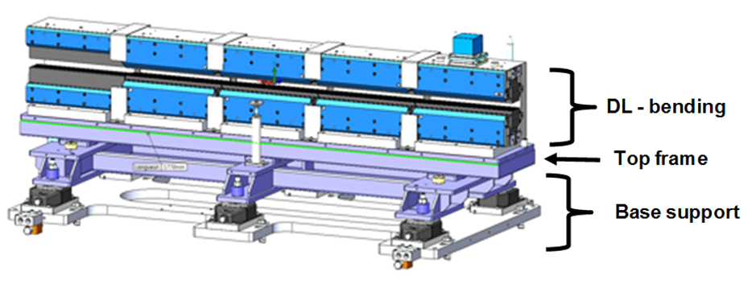
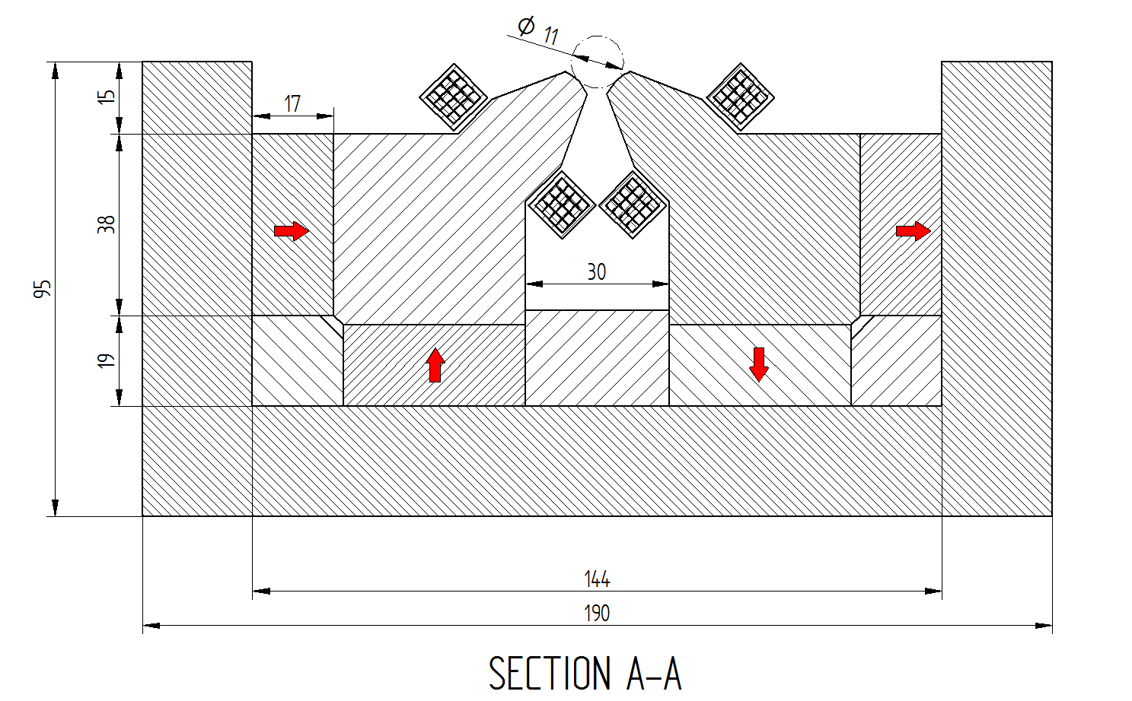
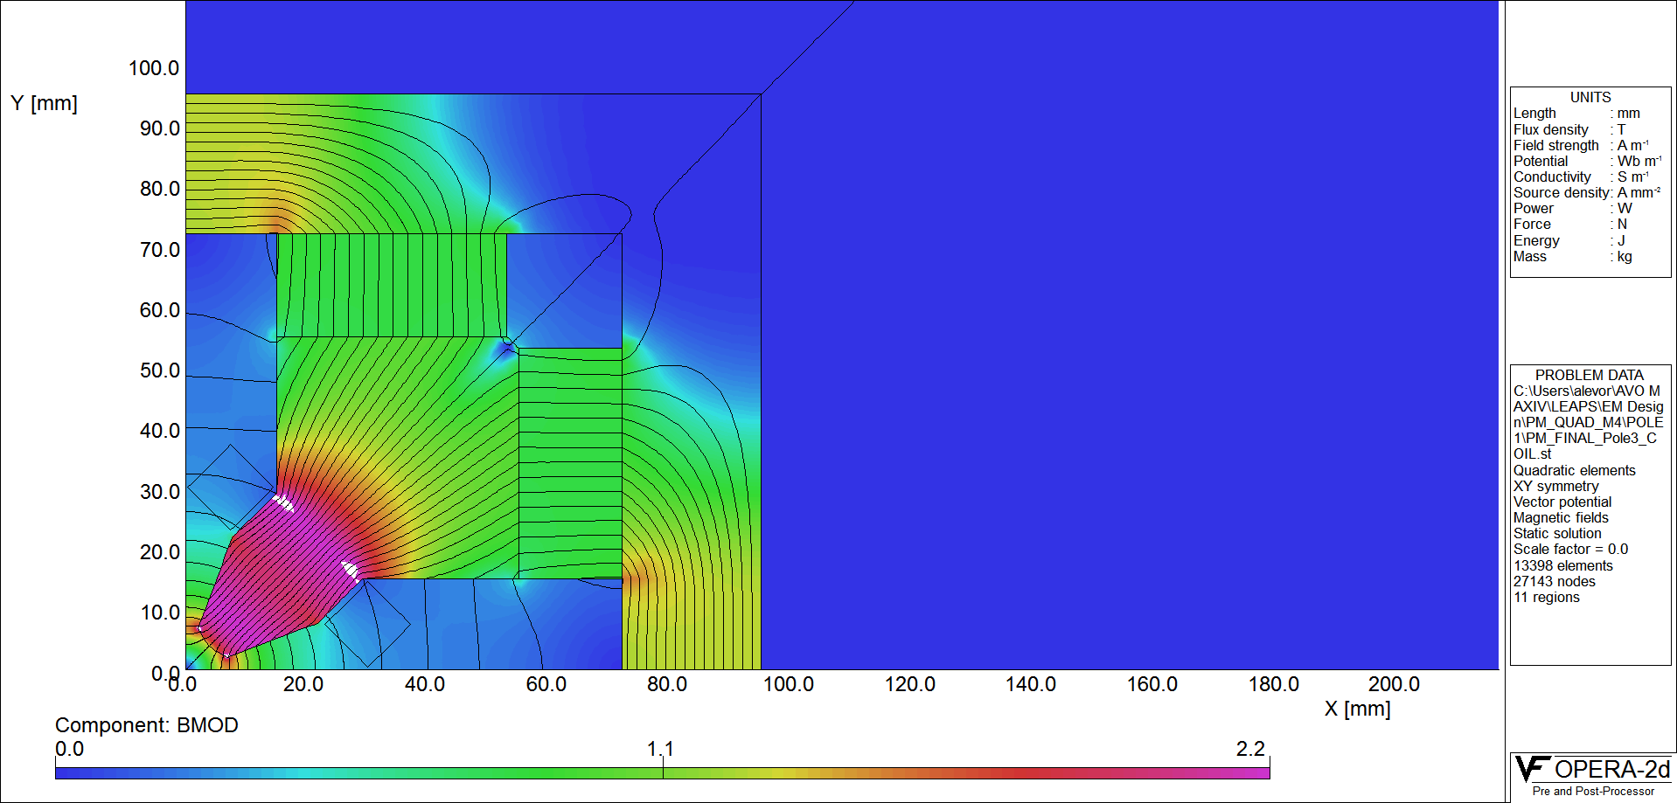
Permanent Magnets proposed for SEE-SRL (ESRF & MAX IV)

Slide 24
Girder-System proposed for the SEE-SRL (like ESRF-EBS)

Slide 25
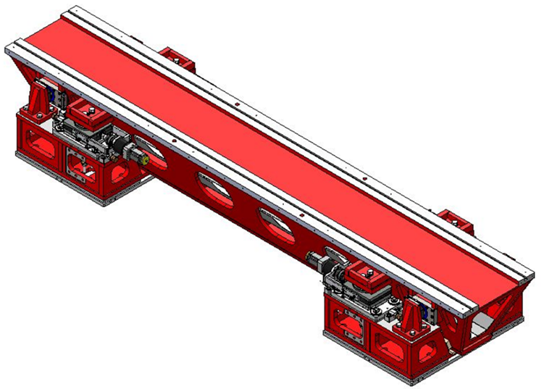
Girder-System proposed for the SEE-SRL (like ESRF-EBS)

Slide 26
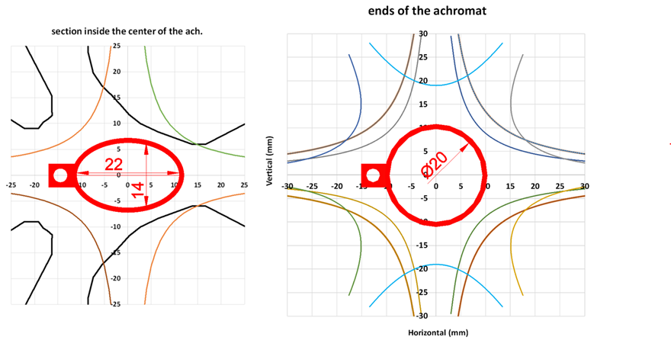
NEG coated Vacuum System (like MAX IV)
Thanks to Eshraq Al-Damour (MAX IV)

Slide 27
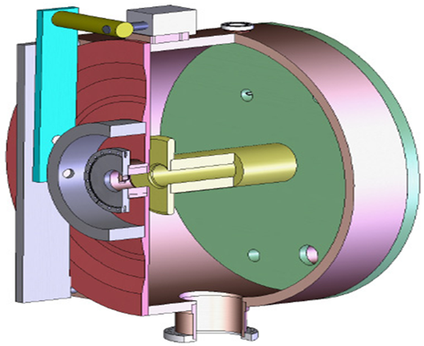
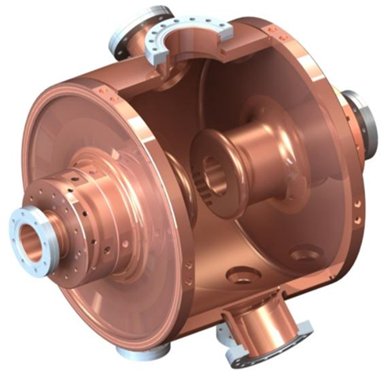
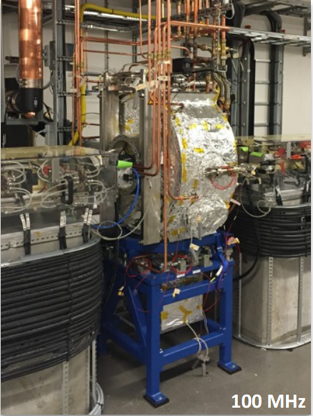
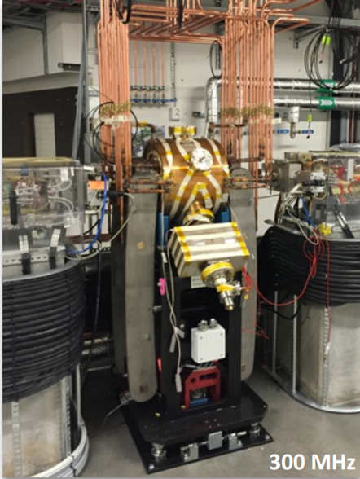
Layout of the 100 MHz Cavity (like MAX IV)
100 MHz Cavity
300 MHz Cavity
Thanks to Ake Andersson (MAX IV)

Slide 28
4th Generation Synchrotron Light Source (SRL) for SEE
This facility will take the best from all the other ones and building on their experiences.
Hence it will be a top-class facility but with reduced risk

Slide 29
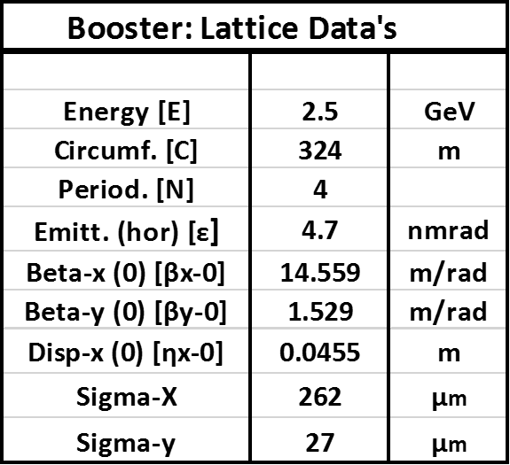
Layout of Booster Synchrotron
Booster lattice: 12 unit cells + 2 matching cells in an achromat
Unit cell

Slide 30
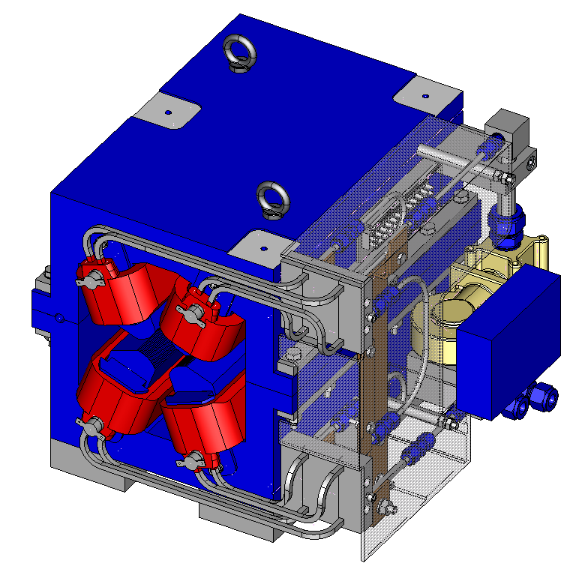
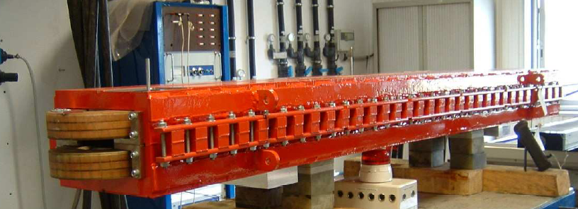
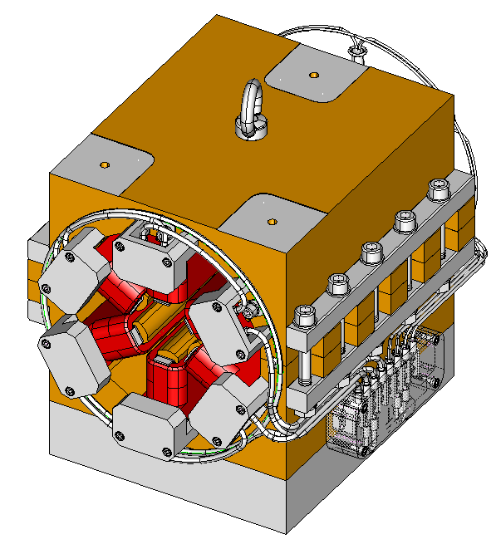
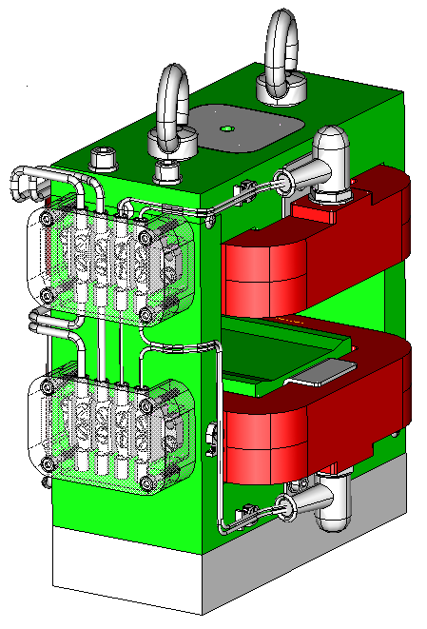
Booster Synchrotron Magnets
Magnets for Booster Synchrotron
Bending Magnet + Quadrupole & Sextupole -Component
Quadrupole + Sextupole-Component
Sextupole
Corrector

Slide 31
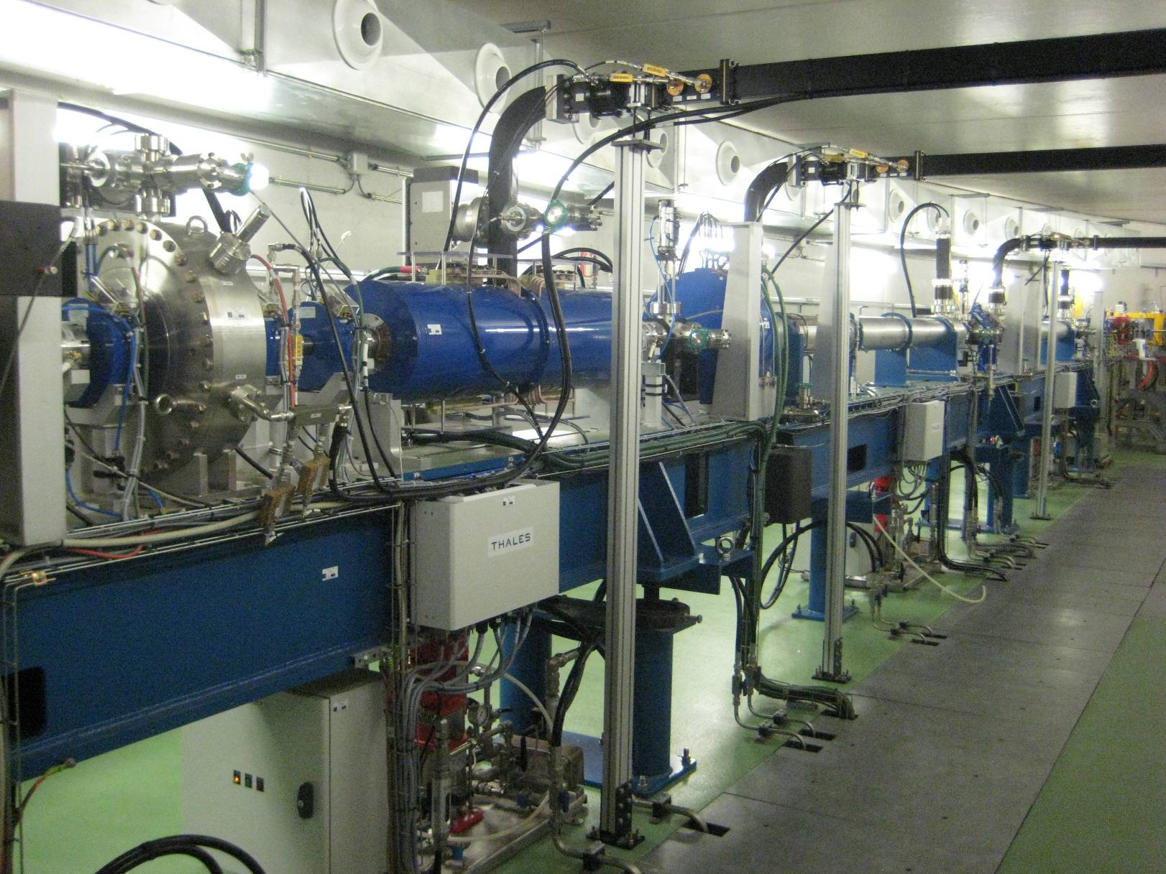
100 MeV Pre-Injector at ALBA
LINAC in the Tunnel
1st Acc.-Str.
Buncher
2nd Acc.-Str.
Pre-buncher
Glaser Lens
E-Gun

Slide 32
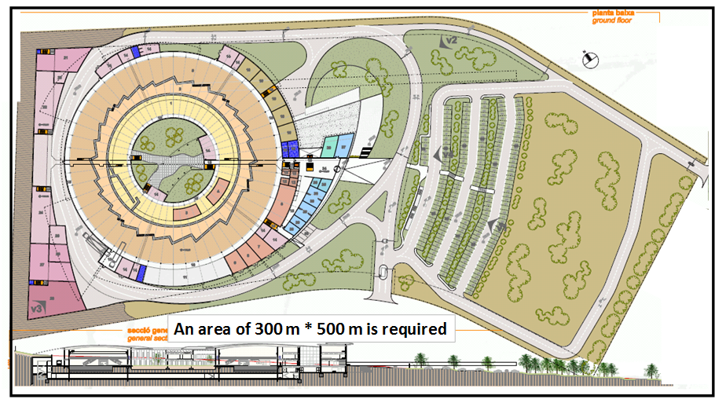
Size of the Site
500 m
150 m
300 m

Slide 33
Site Requirements
The overall size of the site should be about 300 mx500 m.
In view of possible future upgrades, considering the lifetime of the facility of 30 years, a possible
extension of the site by about 50% would be an advantage.
The site should be very stable and no vibrations (by nearby traffic) should disturb the stability of the
building and the beam.
A good connection to the electric power grid should exist.
Easy access would be important including easy road access and a not too distant airport.
A guest house would be convenient or at least hotel accommodation should be available in the vicinity.

Slide 34
Education and Training
The training of scientists, engineers and technicians must be considered as a priority from the beginning.
An international training committee with experts in the accelerator field might be established in order to help organizing efficiently the formation and training.
At the beginning, the most urgent need would be the training of the experts who would help to design and construct the accelerator complex composed of a linac, a booster and a storage ring.
The scheme applied in the case of the SESAME project was rather successful and should be used for SEE-SRL too.
During their training, the selected candidates can also deepen their knowledge by participating in the well-known accelerator schools like CAS (Cern Accelerator School).

Slide 35
Estimated Time Schedule
 | Year 1 | Year 2 | Year 3 | Year 4 | Year 5 | Year 6
Design
Prototype
Series
Installation Linac
Installation Booster
Installation Storage Ring
Commissioning

Slide 36
Investment Costs
Investment cost for initial set up (not including additional laboratories)
Item | Investment cost in M€
Linac, booster, storage ring, front end beams, controls | 87.5
First 3 beamlines (average € 6 million/beam) | 15. 0
Buildings and shielding | 45.0
Laboratory staff during the construction | 11.7
Total | 159.2
Investments for possible upgrades (in M€)
Energy increase from 2.5 to 3 GeV | 8
Additional beam lines 10 (average € 5 million/beam) | 50
Total | 58

Slide 37
Yearly Operating Cost
Yearly operating cost.
Item |  | M€
Maintenance and consumables |  | 3
Laboratory staff | 60 to 70 staff | 3
Energy | 3.0 MW (western prices) | 2 to 3
Total |  | 8 to 9

Slide 38
Acknowledgment
Thales Linac - Layout
E. Al-Dmour, MAX IV, Vacuum System
A. Andersson, MAX IV, RF-System
R. Bartolini, DIAMOND, General
P. Campany, CELLS, Brilliance Calculations
D. Fernandez, CELLS, Control System
H. Gassem, DIAMOND, Beam Dynamics
P. Kuske, Helmholtz-Zentrum, Injection
S. Liuzzo, ESRF, Beam Dynamics
A. Nadji, SOLEIL, General
F. Perez, CELLS, Diagnostics
C. Quitmann, MAX IV, General
P. F. Tavares, MAX IV, General

Slide 39
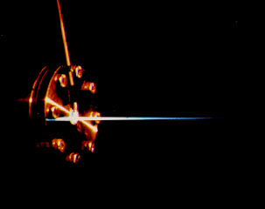
Lets hope that the SEE-SRL will shine soon

Slide 40

4th Generation Synchrotron Light Source for SEE
THANK YOU
VERY MUCH

