Slide 1
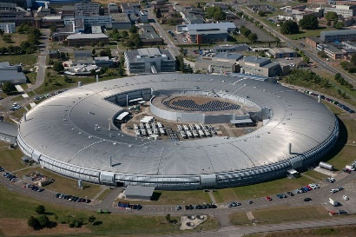


Synchrotron light: a bright future for SEE scientists and society
Professor Trevor Rayment
University of Birmingham, UK

Slide 2
Synopsis
Output from typical beamlines
Collaborations…
Supporting sustainable energy
Cleaning up
Summary

Slide 3
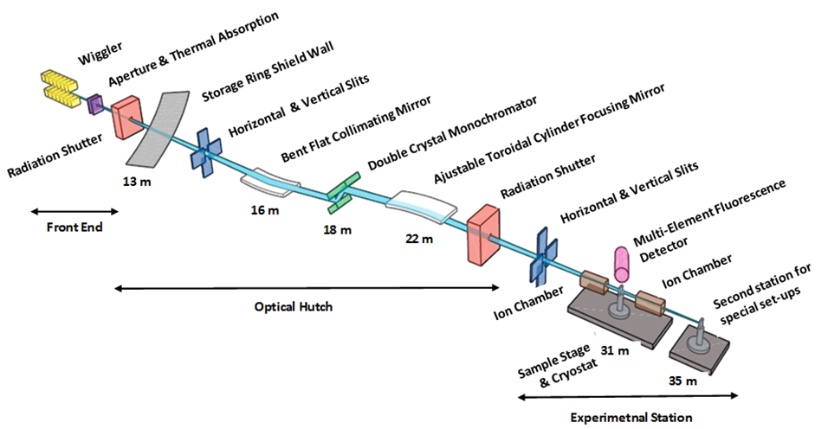
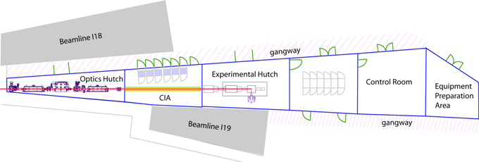
Typical Beamline layouts for spectroscopy
Schematic
(ALS)
Floor plan
(Diamond)

Slide 4
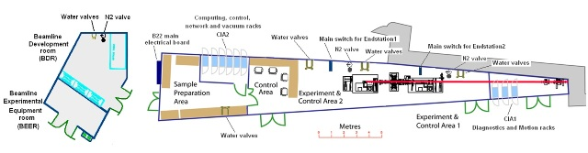
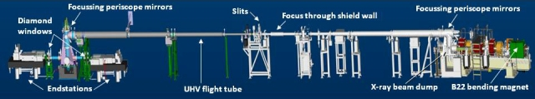
Typical Beamline layouts for infra red spectroscopy

Slide 5
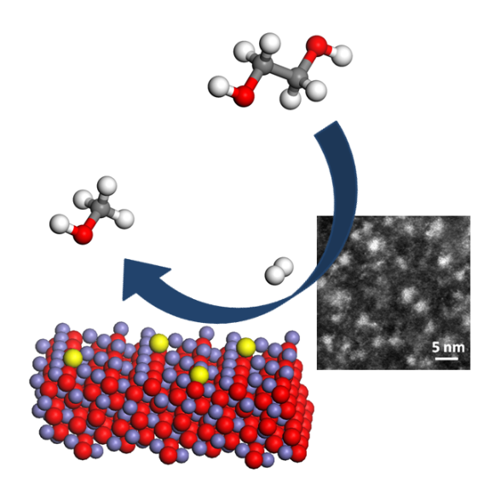
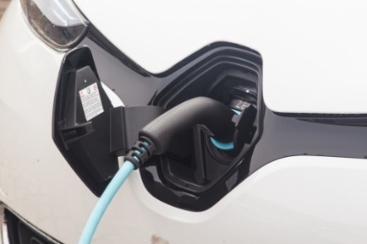
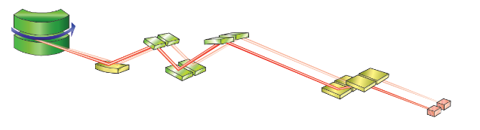
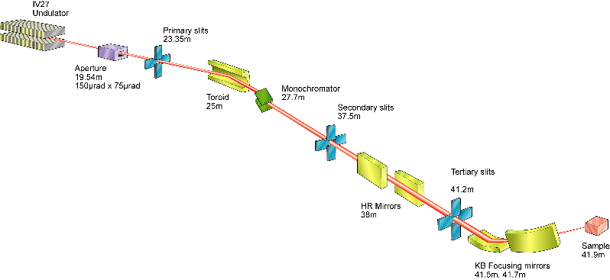

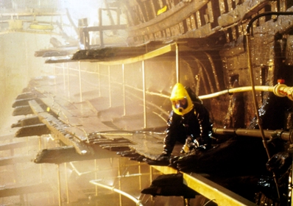
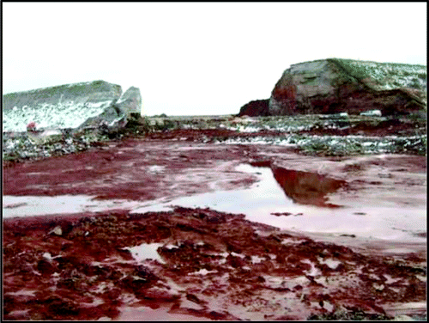

Beamlines are versatile…
Catalysts for biofuels
Li-batteries:
next generation
Minerals in food
Health
Conservation of heritage
Environment

Slide 6
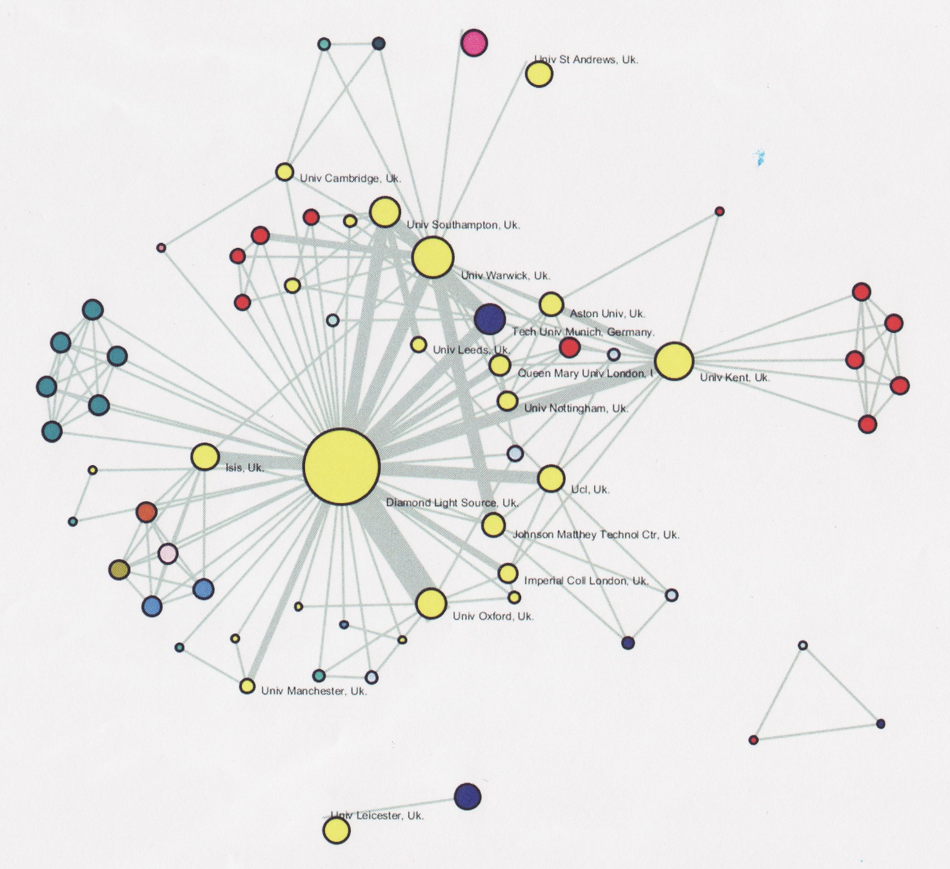
Encouraging collaboration…
Light Sources attract users
Light Sources nurture
collaborations

Slide 7
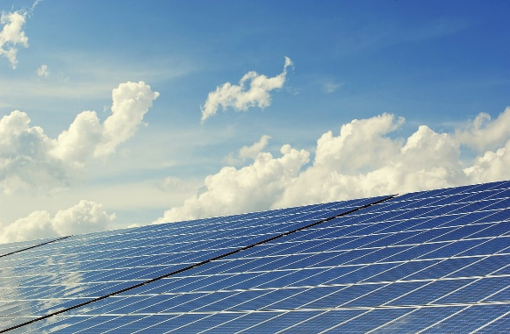
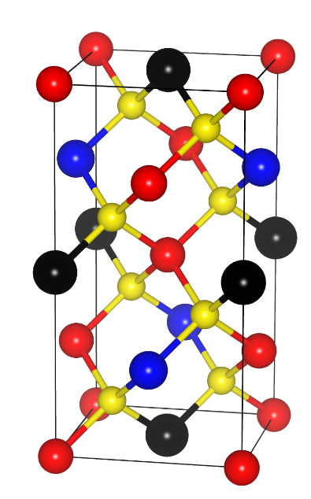
Applications of SR in Sustainable Energy I
Solar photovoltaics supply ca 2% of global supply.
  -increasing this demands better, low-cost materials
Synchrotrons play a vital role in materials discovery.
Cu₂ZnSnS₄ (CZTS) is a highly promising material
  currently a low PV efficiency, possibly due to crystal defects
X-ray studies at Diamond in combination with neutron studies at ISIS show evidence for presence of mixed phases and structural disorder.
A key step forward in fabricating better photovoltaic devices
Key Strategic factor for SEE − collaborations essential

Slide 8
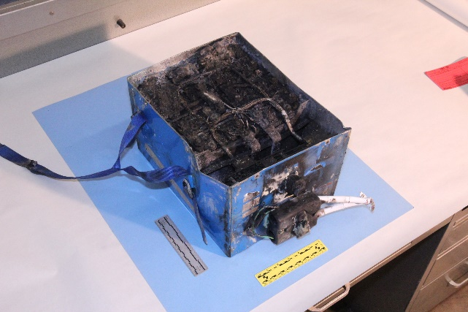
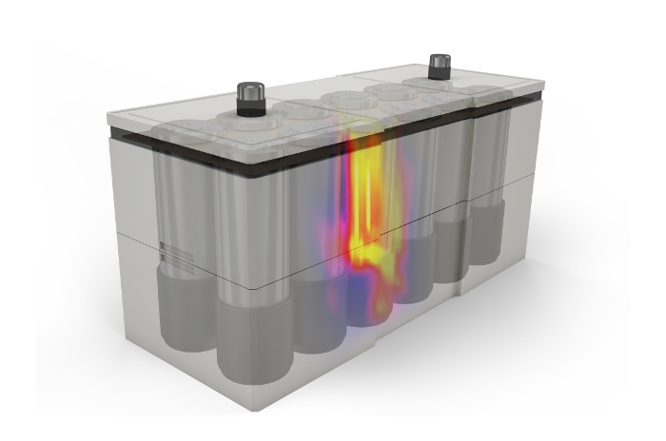
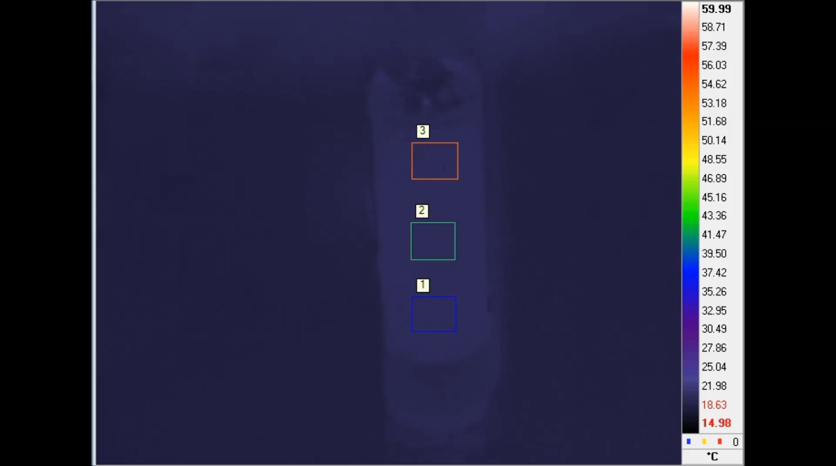
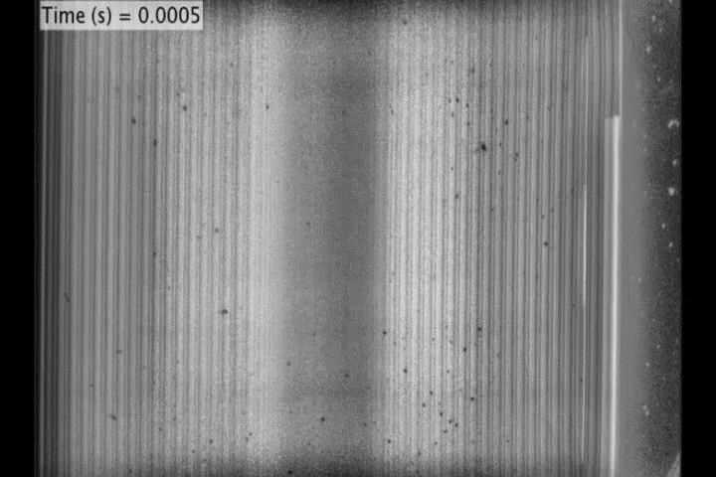
Applications of SR in Sustainable Energy II
Why do batteries sometime fail?
Work by scientists from UCL, Warwick with NASA, at ESRF and Diamond have imaged the thermal runaway during battery failure
2013 Japan Airlines Boeing 787 Dreamliner
Thermal imaging
High speed X-ray imaging (I12)
DOI:10.1039/C7EE00385D

Slide 9
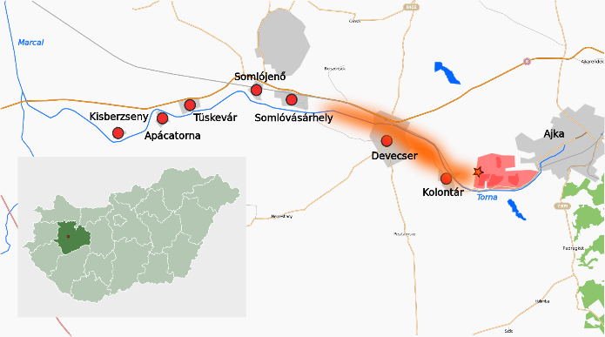
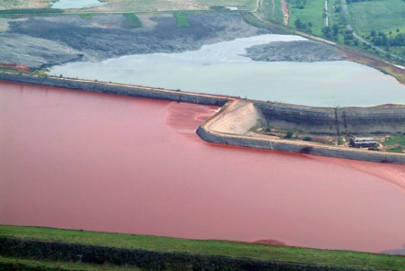
Cleaning up… our environment I
In 2010, a dam at an aluminium plant in Ajka, Hungary, burst spilling 1,000,000 m³ toxic red mud into the environment.
…waste containing
  arsenic, chromium and vanadium
A large scale clean needed!
Questions – What is safest action?
Need to understand the waste

Slide 10
Cleaning up… our environment II
Arsenic, chromium and vanadium are all toxic metals
X-ray spectroscopy can determine the speciation of these elements in the mud.
Results: in the red mud …
Arsenic and Chromium are ‘fixed’
Vanadium is ‘more soluble’
Vanadium is (surprisingly) the greater environmental hazard
Better to remove rather than bury the mud.
Ian Burke et al, Leeds UK, doi:10.1021/es3003475
Notes:
Ask how the presence of SEE-LS would have been able to contribute to the clean up…

Slide 11
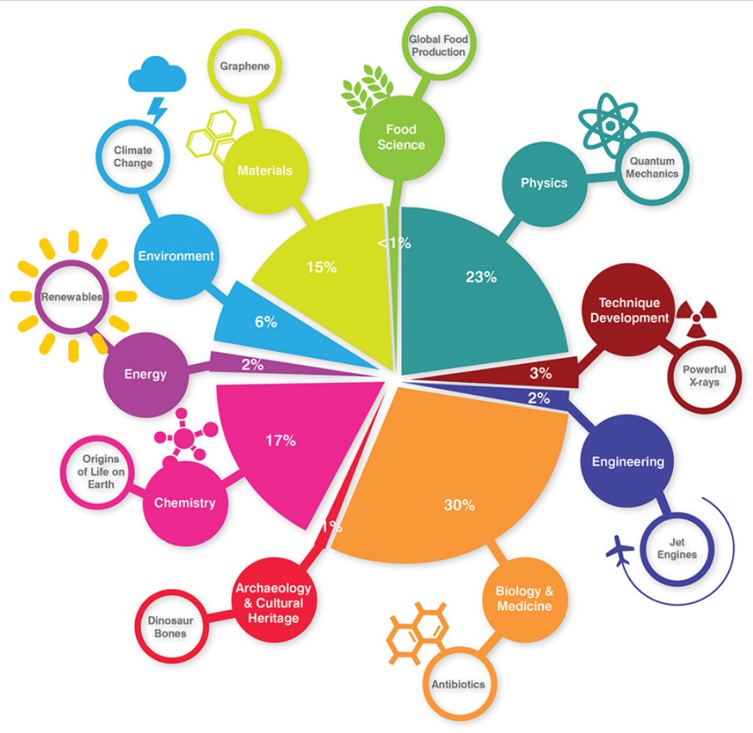
How the UK Diamond Synchrotron is used…
…but today’s question is −
http://www.diamond.ac.uk/Public/Multimedia/Infographics/Science-Area.html

Slide 12
…how would SEE use a synchrotron light source?
?
… it is your choice but,
    whatever you choose…
    the future for science in SEE is bright with a light source.

Slide 13
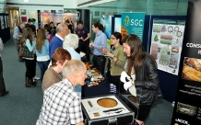
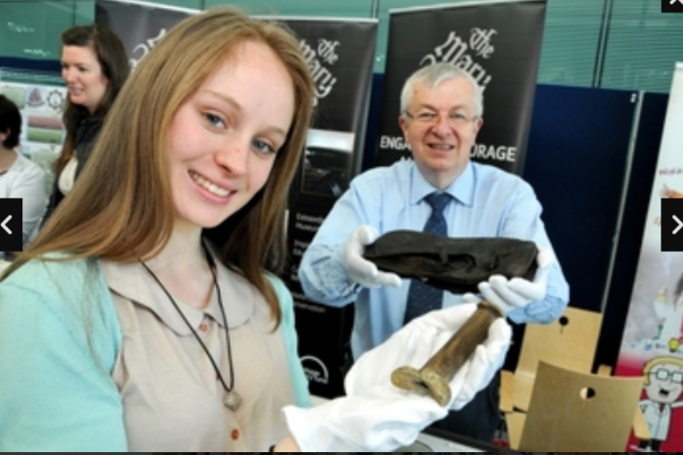
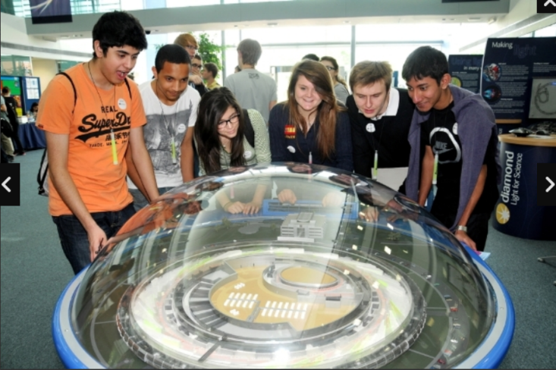
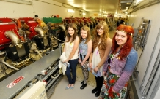
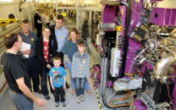
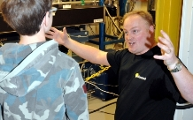
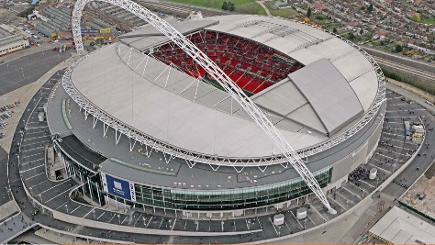
Thank you!
?

