Slide 1
Advancement in studies of hybrid nanostructures by using synchrotron radiation
Dušan Božanić
Vinča Institute of Nuclear Sciences, University of Belgrade, Serbia
Previously: DESIRS Beamline, Synchrotron SOLEIL, France

Slide 2
overview
Synchrotron radiation spectroscopy
Different domains of the EM spectrum
Tunable energy source => discrimination of sample features in the absorption stage
High intensity of EM radiation => possibility of performing experiments on diluted samples, small volumes or in short time intervals
Non-invasive techniques
Synchrotron facilities
Open access to external users
Active development & improvement of measurement techniques and sample environments
A hub of top experts in the field
Efficient transfer of knowledge
How would Serbian nanocommunity benefit from a regional synchrotron facility?
Presentation of the community and estimation of its capacity
Description of some of processes and phenomena that could be investigated by synchrotron radiation spectroscopy
Example of performed synchrotron radiation experiments on hybrid nanostructures designed for biomedical applications

Slide 3

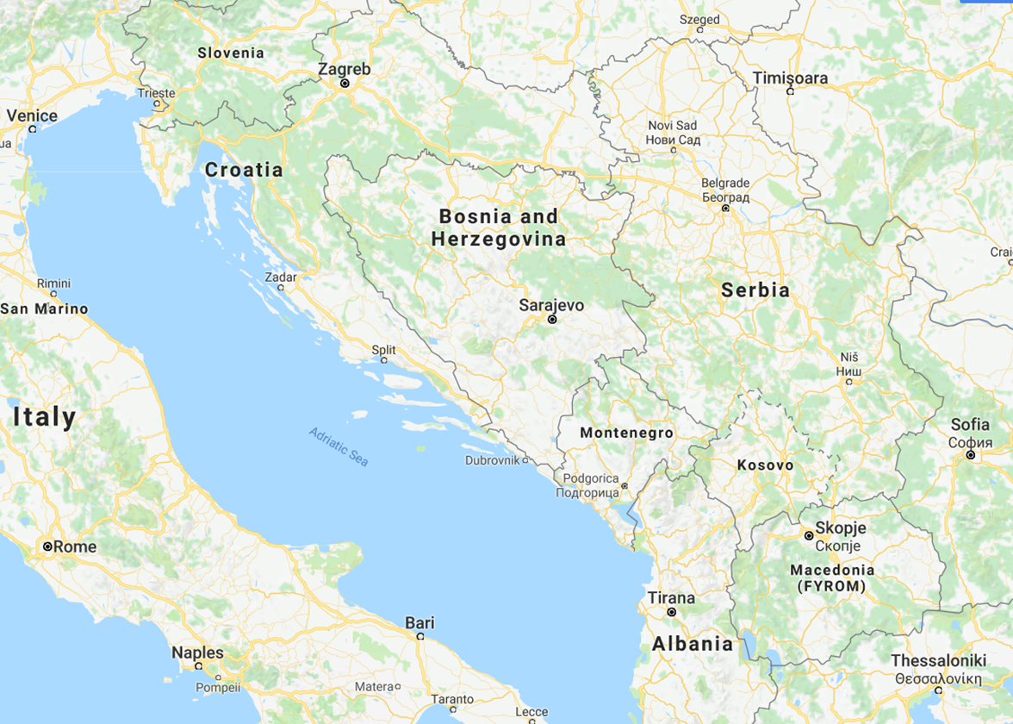
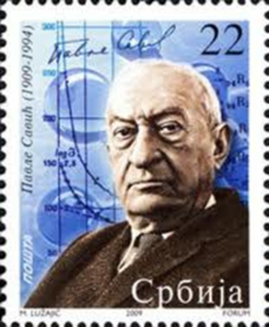
VINčA Institute of nuclear sciences
Vinča Institute
Founded in 1948 by Pavle Savić (discovery of the existence of La in U upon neutron irradiation)
14 km SE from Belgrade
~750 employees/250 PhDs
12 research departments

Slide 4
Nanocommunity in VINčA Institute
The activities in Vinča
Multidisciplinary research: physics/chemistry/biology
40+% of experimental scientists deals with nanoscience/nanotechnology
Vinča Institute of Nuclear/Nano Sciences
Research topics/objectives
NEW MATERIALS
Polymer nanocomposites
Optical nanomaterials
Antibiofouling materials
Radiation Chemistry and Physics Lab.
60 employees/52 scientists
Almost exclusively nanoscience
1.2 article/per/year; x4 national avg.
~50% young researchers (<35 years)
Group leaders:
CLEAN ENERGY
Photovoltaic cells
Nanocatalysts
Fuel cells
HEALTH & ENVIRONMENT
Antimicrobial agents
Photodynamic therapy
Biosensors & imaging probes
5696 cit
h=39
4090 cit
h=30
3024 cit
h=29
1852 cit
h=22

Slide 5
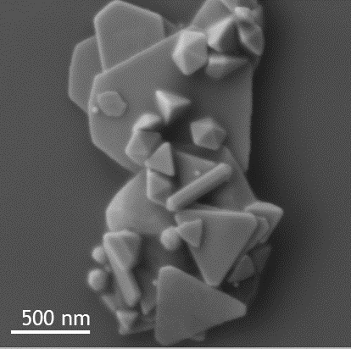
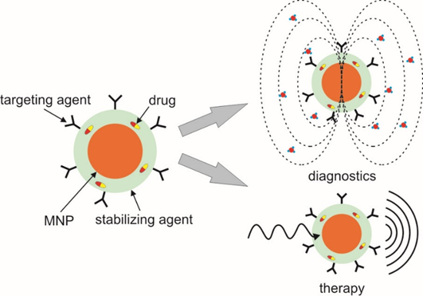
Hybrid nanostructures in biomedical diagnostics and therapy
What is a nanoparticle?
a crystal of an inorganic compound with at least one dimension in the nanometer range, which is an integral unit in terms of transport and properties and exhibits a property that is different than the bulk crystal as a consequence of its size
Hybrid nanostructures?
Nanoparticles composed of two or more structurally different parts
Biomedical applications of hybrid nanostructures
  Diagnostics: targeting, bioimaging, detection and quantification of molecules
  Prevention: antimicrobial activity
  Therapy: photodynamic, photothermal, drug delivery

Slide 6
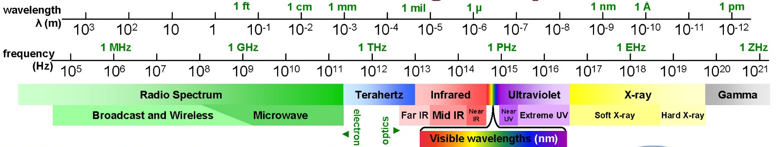
Spectroscopy of hybrid nanostructures
interaction of NPs and
surrounding molecules
size distribution by light scattering
optical bandgap in
semiconductor NPs
superconductor NPs
crystal structure
defects/dopants
Band structure of NPs
e- transitions within NPs:
fluorescence/absorption
NP to vacuum e- transitions:
photoemission

Slide 7
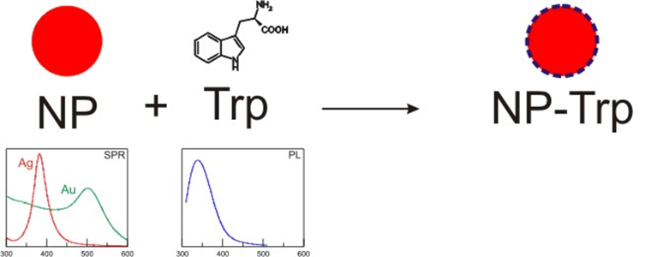
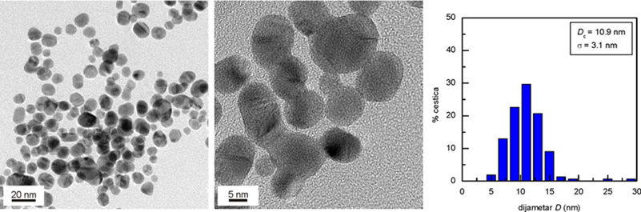
Gold-Tryptophan hybrid nanostructures
Tryptophan (Trp)
Essential amino acid
Photoluminescent - responsible for optical properties of proteins
Facilitates internalization into cells
The lowest IP of all essential amino acids
Gold-tryptophan (AuTrp) nanoparticles

Slide 8
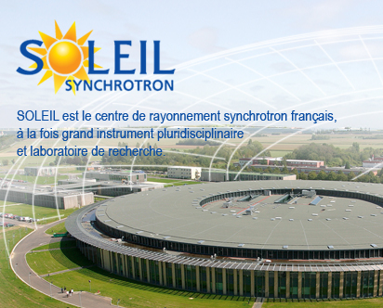
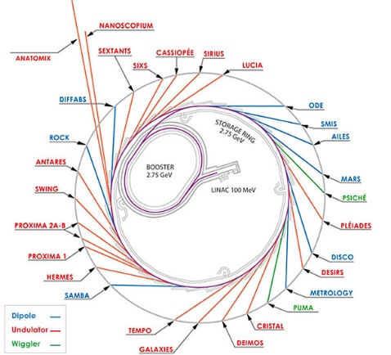
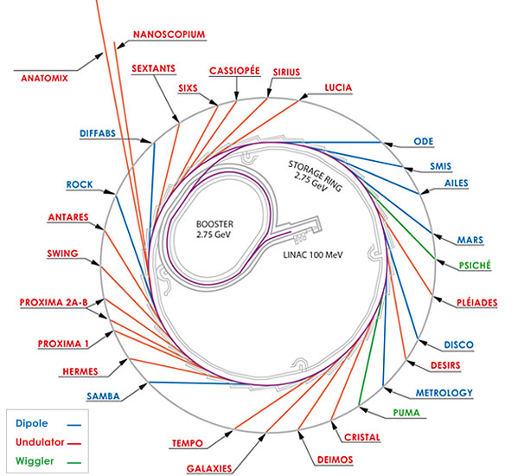
Gold-Tryptophan hybrid nanostructures
Stepping-up with synchrotron radiation spectroscopy of AuTrp NPs
Projects:
-20120810: Localization of functionalized noble metal nanoparticles in microorganisms by synchrotron fluorescence UV imaging DISCO
-20131218: Deep UV spectral imaging of microorganism and liver cancer cells incubated with functionalized noble metal nanoparticles DISCO
-20131037: Gas phase study on state-selected VUV ionization of biomolecules attached to noble metal nanoparticles DESIRS
-20141244: VUV state-selected photoionization and fragmentation behavior of amino acids attached to noble metal nanoparticles studied in the gas phase DESIRS
-20161124: Photoelectron circular dichroism study of amino acid functionalized gold nanostructures DESIRS

Slide 9
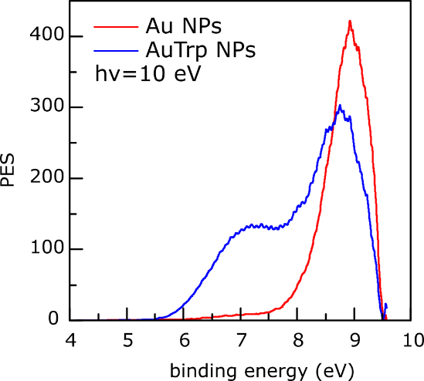
Photoemission spectroscopy of gas-phase nanoparticles
VUV gas-phase photoemission
‘spraying’ of nanoparticles into the ionization chamber
high photon flux=> sufficient photoelectron signal on a diluted target
Band information for the NPs w/o the influence of the substrate!
signal+background
background
difference
DESIRS

Slide 10
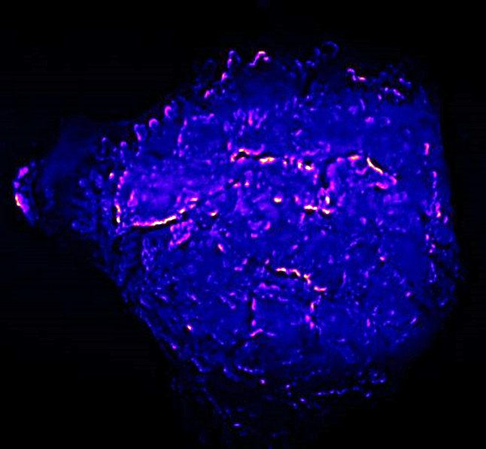
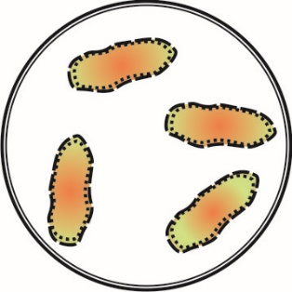
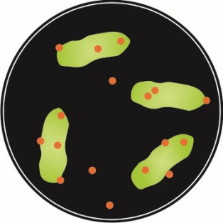
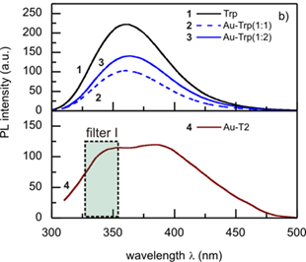
Localization of nanoparticles within live cells
DUV fluorescence spectroscopy
Spatial resolution ~λ/2
By using SR one can shift excitation to DUV range
Trp luminescent in DUV => localization of AuTrp in live cells within ~150 nm
fluorescence
SR
Localization of AuTrp nanoparticles within a cluster of Huh7-wt cancer cells
DISCO

Slide 11
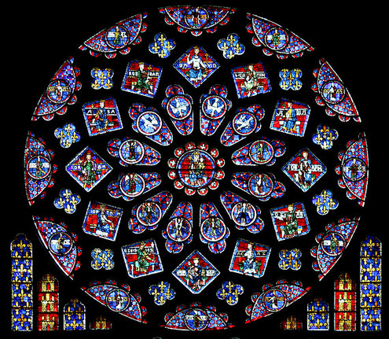
Thank You for your attention
North Rose Window at Notre Dame Cathedral, Chartres, France, year 1235

