Slide 1

Perspectives of ESOF2020TRIESTE
S.Fantoni, FIT, Trieste
Forum on New International Research Facilities for South East Europe
ICTP, January 25, 2018, Trieste, Italy

Slide 2
ESOF – EuroScience Open Forum
The largest interdisciplinary science meeting in Europe focused on scientific research and innovation.
It offers a unique biennial platform for interaction and debate for scientists, young researchers, business people, policy makers, science communicators and general public.
Created in 2004, it brings together over 4000 participants from all over the World; more than 40 % are students and young researchers.
The 9th edition will be in Trieste in 2020!

Slide 3


Freedom for science,
science for freedom
The mind behaves like a parachute:
It works only if is opened up

Slide 4
THE ANNOUNCEMENT
EuroScience and the ESOF Supervisory Board
are proud to announce that the EuroScience Open Forum 2020
will be hosted from 4-10 July 2020
in TRIESTE
Trieste has seen the development of important International and
National research institutes for
research, technology transfer and the dissemination of science
As a Central European city, Trieste will work to make ESOF2020 an example of strengthening links with Central and Eastern European scientists, businesses, politicians and citizens.

Slide 5
WHERE

Slide 6
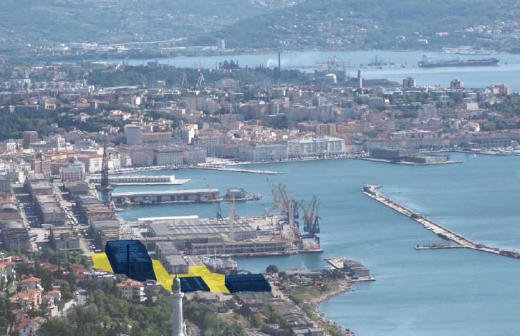

Slide 7
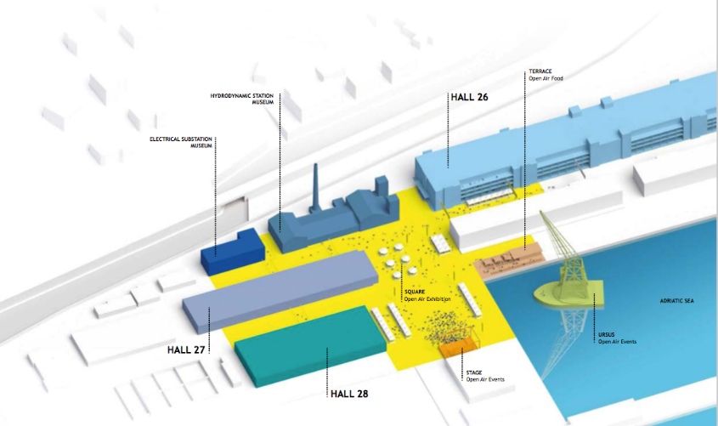

Slide 8
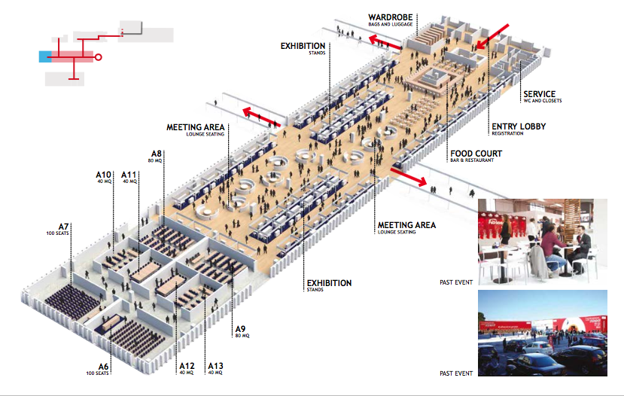

Slide 9
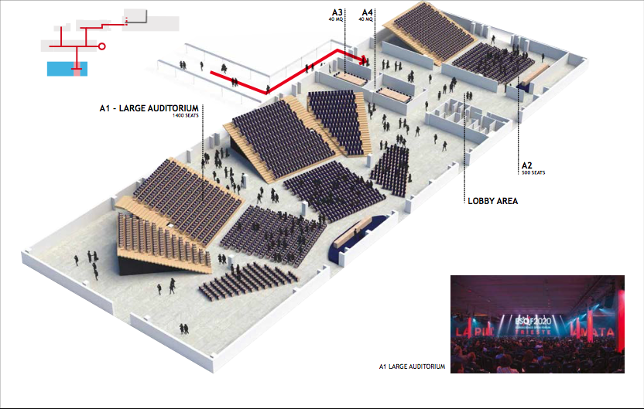

Slide 10
ESOF 2020 FOCUS AREA
Trieste + North Adriatic:
natural crossroads
N-S and E-W
500 km

Slide 11
ESOF 2020 MAIN GOAL
Establish a permanent and efficient network in the enlarged Central and European Area to reinforce positive interactions and transfer among Research Institutions, Industry, Policy and Society
500 km

Slide 12

186 Letters of endorsement
CECHIA
1
2
AUSTRIA
3
HUNGARY
6
ROMANIA
ITALIA
SLOVENIA
CROATIA
164
SERBIA
BOSNIA –
HERZEGOVINA
BULGARIA
MONTENEGRO
GEORGIA
UCRAINIA
ALBANIA

Slide 13
WHAT
a mix of bottom-up proposals and keynote speeches, with plenary sessions, workshops, roundtables and debates

Slide 14

SCIENCE TO SCIENCE
SUSTAINABLE DEVELOPMENTS
No poverty
Zero hunger
Good health&well-being
Quality education
Gender equality
Clean water&sanitation
Affordable and clean energy
Decent work&economic growth
Industry innovation&infrastructure
Reduced inequalities
Sustainable cities&communities
Responsible consumption&production
Climate action
Life below water
Life on land
Peace, justice and strong institutions
Perternship for the goals

Slide 15


SCIENCE TO BUSINESS

Slide 16

SCIENCE COMMUNICATION

Slide 17

SCIENCE TO POLICY
Cooperation amongst stakeholders, government, scientists, industry and the public at large, to ensure future benefit of whole society

Slide 18

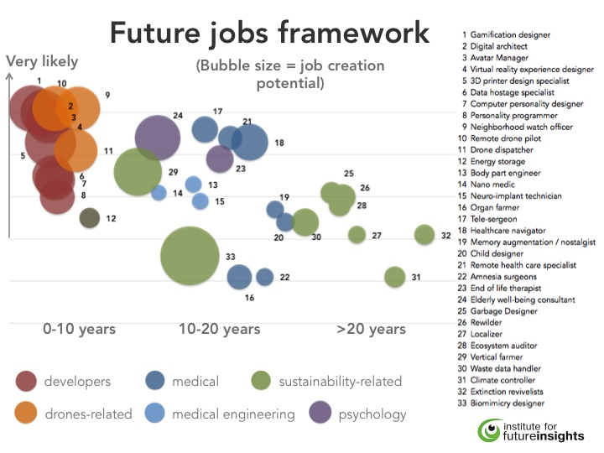
CAREER PROGRAM
young scientists future careers
future “new jobs” opportunities

Slide 19
Towards ESOF 2020
Nomination ESOF European committees:
  International Steering Committee (ISC) (done)
  International Programm Committee (IPC)
  International Media&Marketing committee (IMMC)
Nomination Local Program Committee (LPC) (done)
Commissioning the construction of the structures in
Porto Vecchio (done)
Building up of the ESOF2020 organizing team (almost done)

Slide 20
PROESOF and ESOF program
 | 2017 | 2018 | 2019 | 2020 | 4-10 Jul. 2020
PROESOF Events |  | X | X | X
ESOF Events |  |  |  |  | X
Science in the city |  |  |  |  | X
ESOF: call for proposals > January 2019 (IPC)
PROESOF: calls of ideas > March 2018 (LPC)

Slide 21
Trieste Encounters on Science and Innovation (TESI)
Agorà to invite/meet contributors from the enlarged Central European area
Lab of ideas to stimulate innovative proposals for 50-100 events
Operative tool to build up proposal and projects for PROESOF events and Science in the City program:
  For the early PROESOF phase 2018-2019
  For preparation/submission of proposals to the regular call ESOF 2020 (in 2019)
  For “Science in the City” events, during the 2020 ESOF week

Slide 22
TESI Headquarters

Slide 23
TESI Call for IDEAS
An Open Call for ideas will be posted on the FIT website by mid Feb. 2018
The format and guidelines will image the ESOF format/evaluation Criteria
Three options available: PROESOF, ESOF and Science in the City events
Periodic evaluations will be carried out by LPC
Accepted proposals will be supported for development by TESI team

Slide 24
TESI - First stakeholders international meeting
Relevant organizations active in the Public Engagement of Science in Central-East European countries
Representatives of Universities and Research Institutes of the same countries
Representatives of policy makers for research, high education and industry
Preliminary dates: mid-March 2018
PARTICIPANTS

Slide 25
TESI – First stakeholders international meeting
Goals
To stimulate interest for ESOF Trieste 2020
To disseminate information for the TESI open call for proposals for PRO-ESOF activities and draft proposals for ESOF 2020
To strenghten and promote the links between organizations for the design of PRO-ESOF and ESOF activities and events

Slide 26
TESI – First stakeholders international meeting
Example of contacted organizations
Science Netzwerk – Austrian network for the Public Engagement in Science and Technology
Centre for the Promotion of Science – Serbian government organization for the promotion and the popularization of science
Hisa Eksperimentov – Lubiana science centre
Techmania – Pilsen science centre
Countries involved (to be completed): Austria, Croatia, Czech Republic, Hungary, Montenegro, Poland, Serbia, Slovakia, Slovenia +JRC

Slide 27
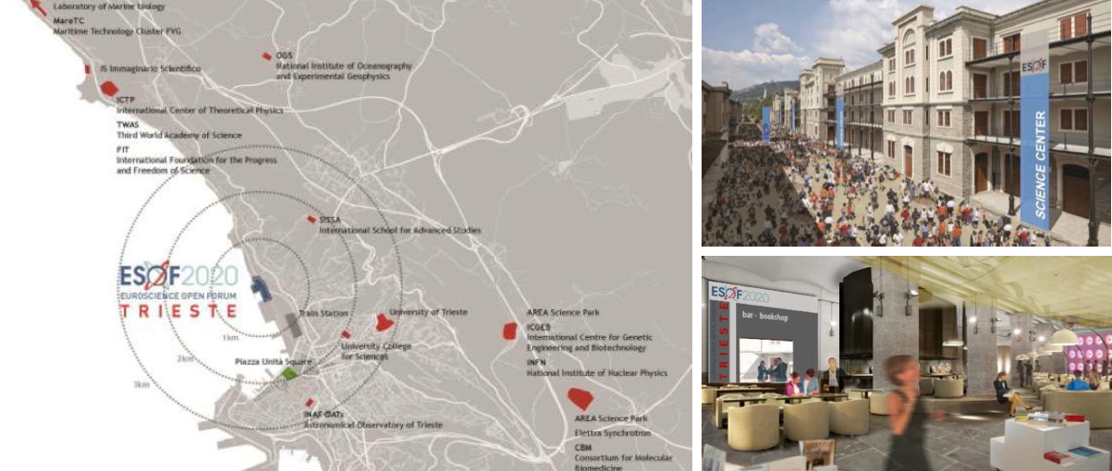
Thank you for your attention

