Slide 1










Training opportunities for young students and early stage researchers at FAIR/GSI
Pradeep Ghosh
Program Coordinator – International Students
Facility for Antiproton and Ion Research in Europe GmbH
Finland
France
Germany
India
Poland
Romania
Russia
Slovenia
Sweden
UK

Slide 2
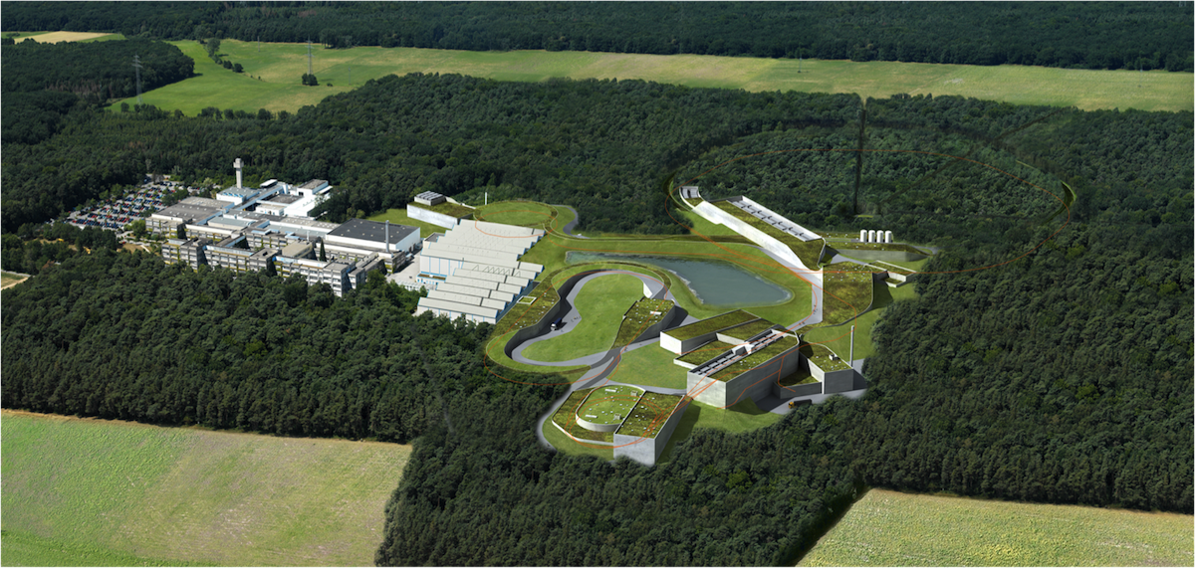


The FAIR Project
Finland
France
Germany
India
Poland
Romania
Russia
Slovenia
Sweden
UK

Slide 3
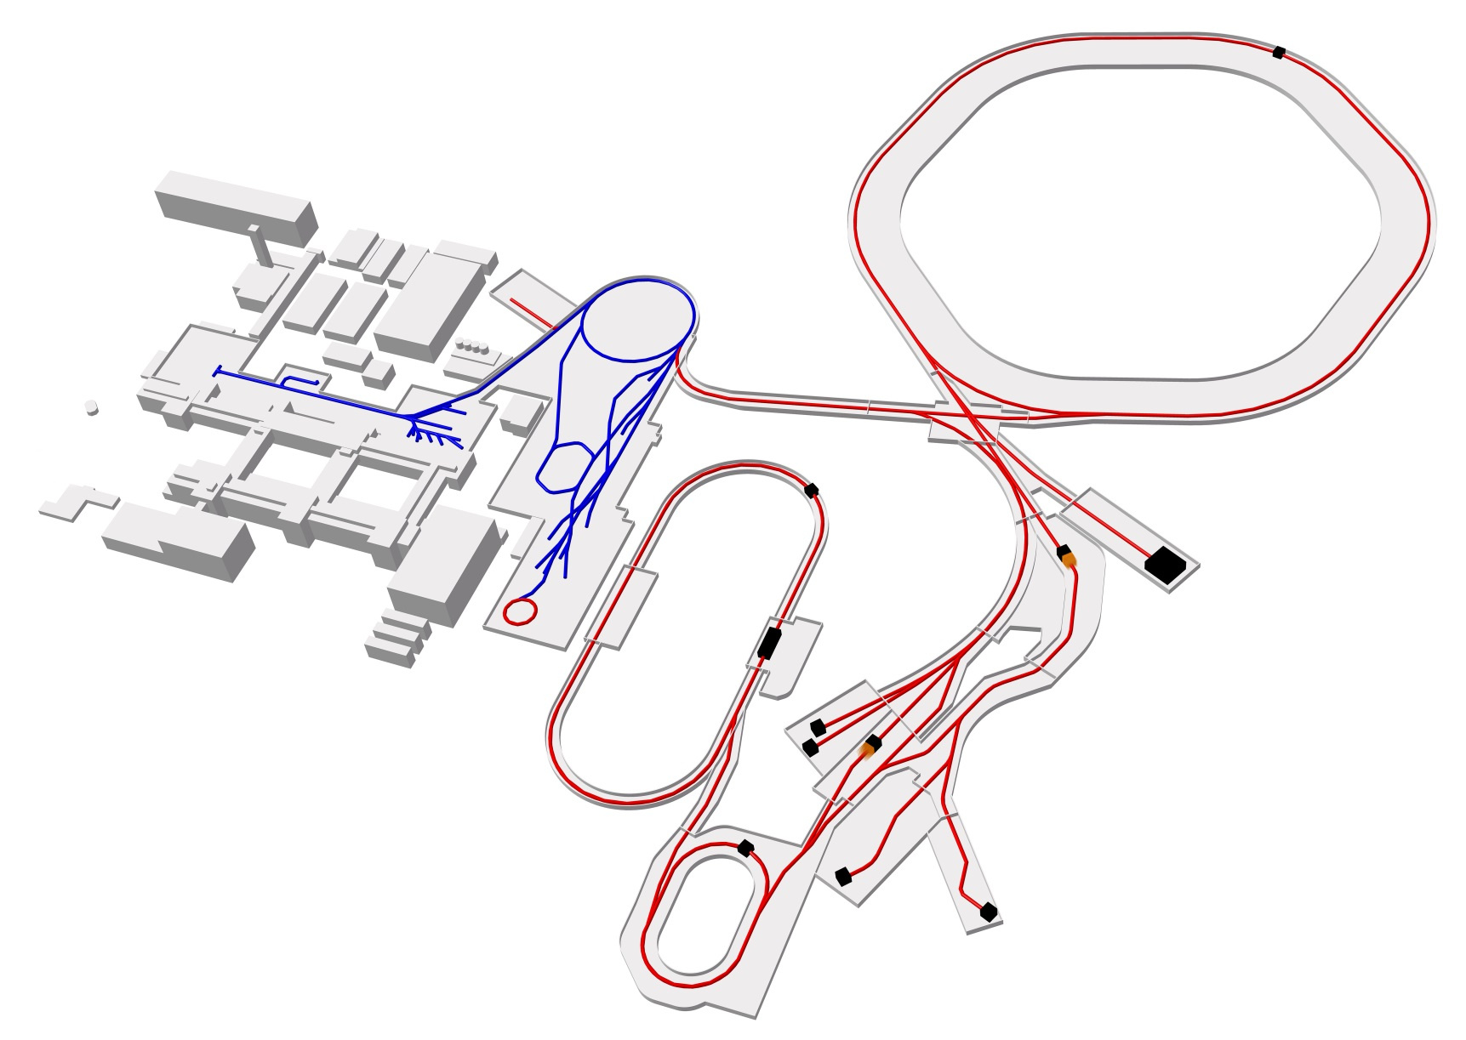
Facility for Antiproton and Ion Research
– new international research laboratory under construction
to explore the nature and evolution of matter
in the Universe
Ring
accelerator
Ring accelerator SIS100
Linear
accelerator
Production of new atomic nuclei
Antiproton
ring
Production of antiprotons
100 meters
“Gain factors” rel. to GSI
100 – 10.000 x intensity
10 x energy
antiproton beams
= > major discovery potential
Existing facility
Planned facility
Experiments
Collector
ring

Slide 4
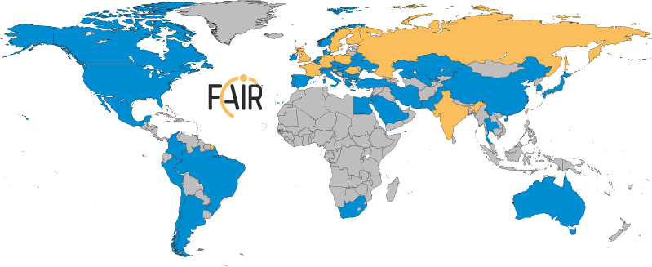
FAIR – International Cooperation
Shareholder
Collaborations
Realization and operation in international cooperation
Ten international partners own the company
More than 53 countries participate in the experiments
Participation of 3.000 scientists from all continents

Slide 5
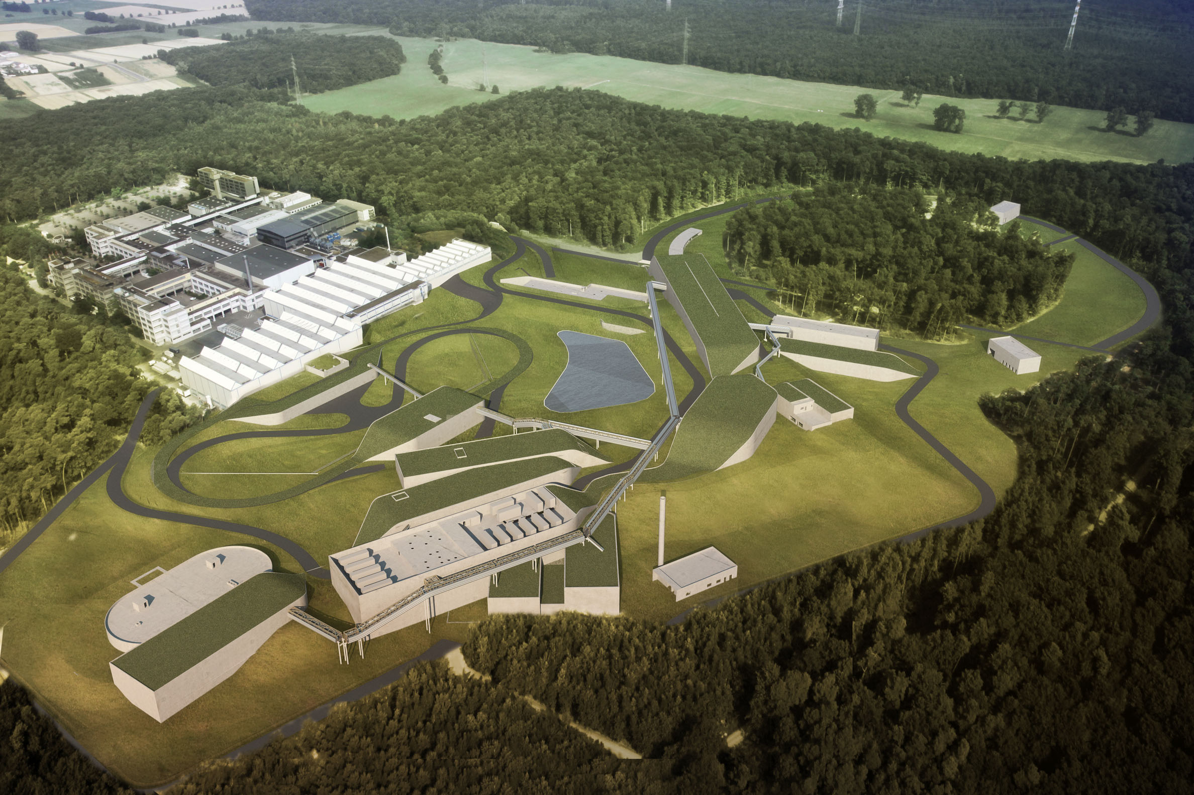



3 words to describe FAIR
World – Class – Science
Forefront – Technologies
Talent – Factory

Slide 6
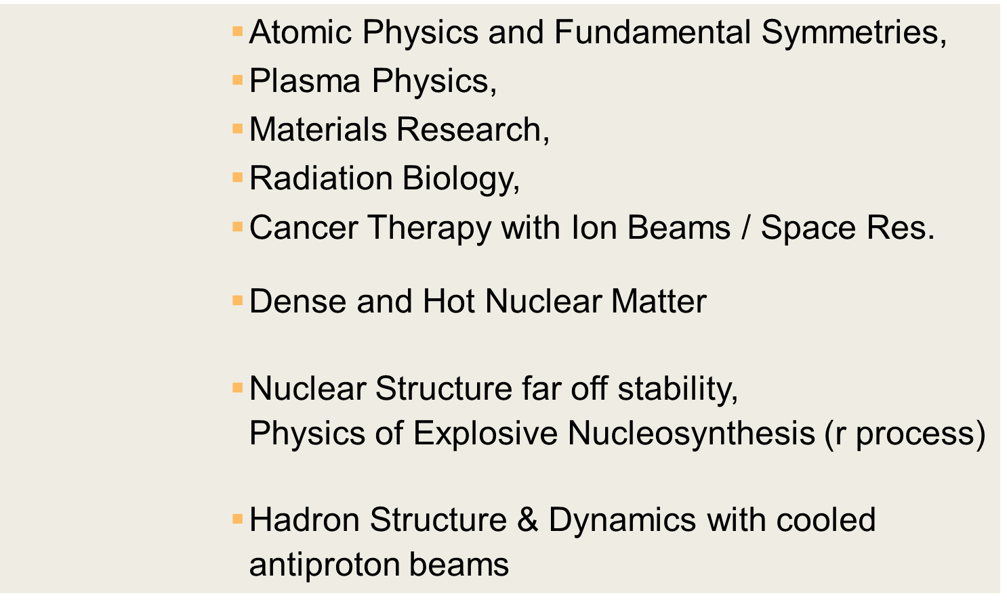
Four scientific collaborations at FAIR
APPA
CBM
NUSTAR
PANDA

Slide 7
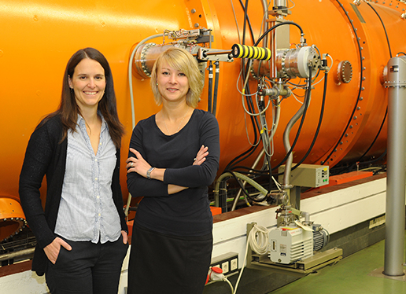
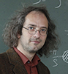
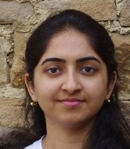
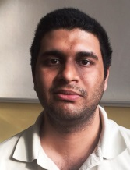
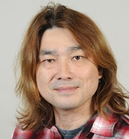
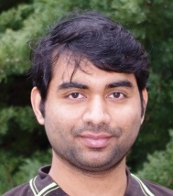
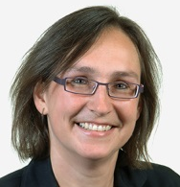
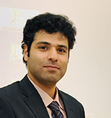
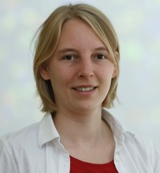
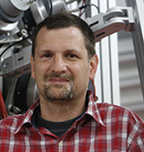
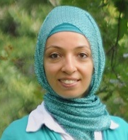
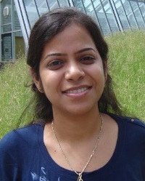
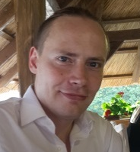
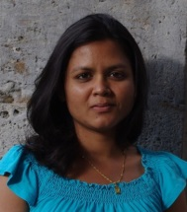
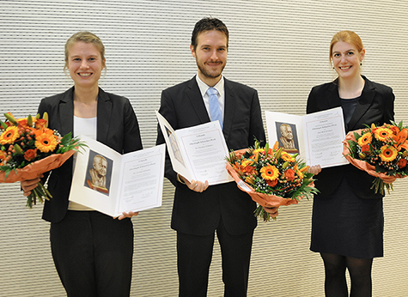
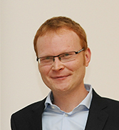
A Talent Factory
A unique capability to attract and create talent and know-how.
Training and education of the next generation of scientists, engineers and computing experts from all over the world:
  Graduate Schools with currently more than 300 doctoral students from all over the world
  International Postdoc Programs
  Multiple training programs for students
  Bilateral Agreements with several countries for training and education of young scientists and engineers

Slide 8
Existing Talent Management Program
Programs
Intl. Summer Student Program
Intl. PhD Program – Graduate School HGS-HIRe
GET_INvolved Program
Visiting Scientists

Slide 9
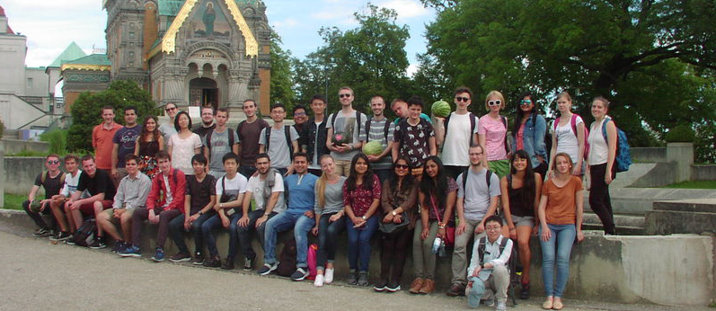
GSI International Summer Student Program
Open Call: Every year notified in Nov.
How many: around 35 -40 talented students
Eligibility: Bachelors and Master Students
Application via webpage: www.gsi.de / www.fair-center.eu
Program: 8 Weeks (Jul. – Sept.)
Financial Support: for all students
2018 Deadline: 15. Feb 2018

Slide 10
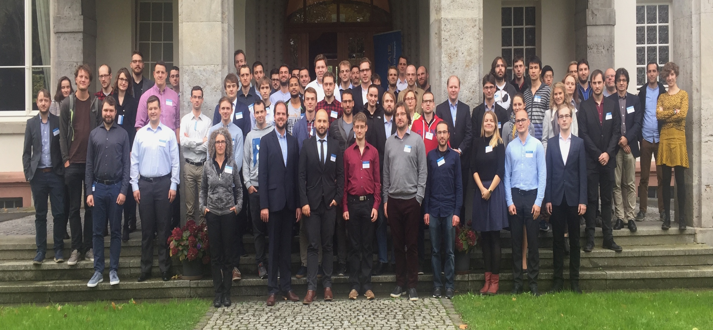
HGS-HIRe PhD Student Program
HGS-HIRe : Helmholtz Graduate School for Heavy Ion Research
More than 300 students in the program. There are 5 Universities around FAIR/GSI participating in this graduate school program.
It is a structured PhD program, with scholarships for 3 years research projects from all research department and support for travel.
Application all round the year via website: : www.gsi.de / www.fair-center.eu
Selection on merit and upon availability for projects.

Slide 11
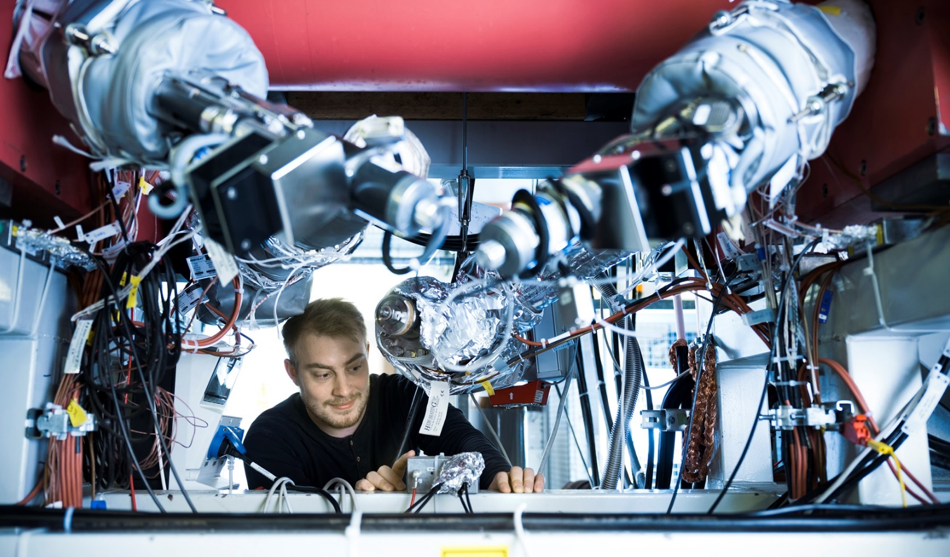
GET_INvolved Program

Slide 12
GET_INvolved Program
What is GET_INvolved?
An umbrella program offering a unique opportunity to GET young students and early stage researchers INvolved in excellent world-class scientific facility allowing them access to perform first-hand research experience at GSI and FAIR.

Slide 13
GET_INvolved Program
What is intended?
Opportunity to aspiring students with first-hand training
Synergies to foster existing collaboration between Uni. And GSI/FAIR
Building capacities for research groups and providing skillful training

Slide 14
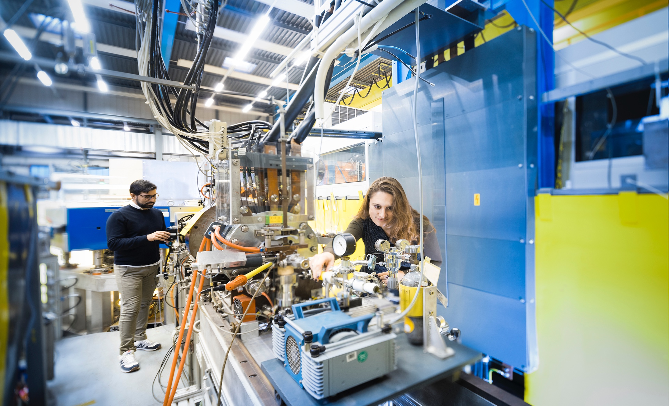
GET_INvolved Program
What is possible?
Internships
Traineeships
Doctoral Research experience
Post Doctoral Research experience
Each participant will be offered to work on a dedicated sci./tech. project

Slide 15
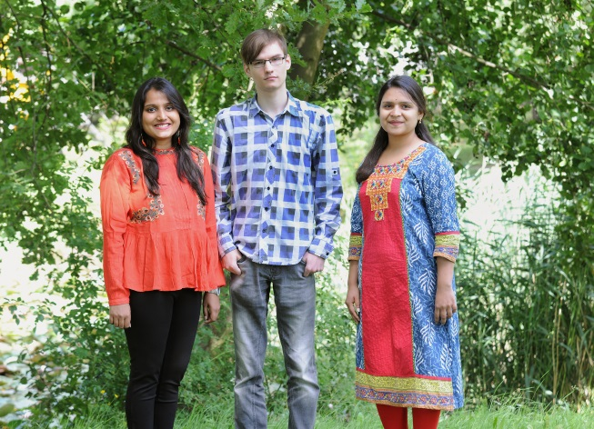
Opportunities in GET_Involved
Multi cultural environment
Project oriented research
Acquiring Hard/Soft skills
Access to lectures
Reporting & documentation
Integrated to Project WP

Slide 16
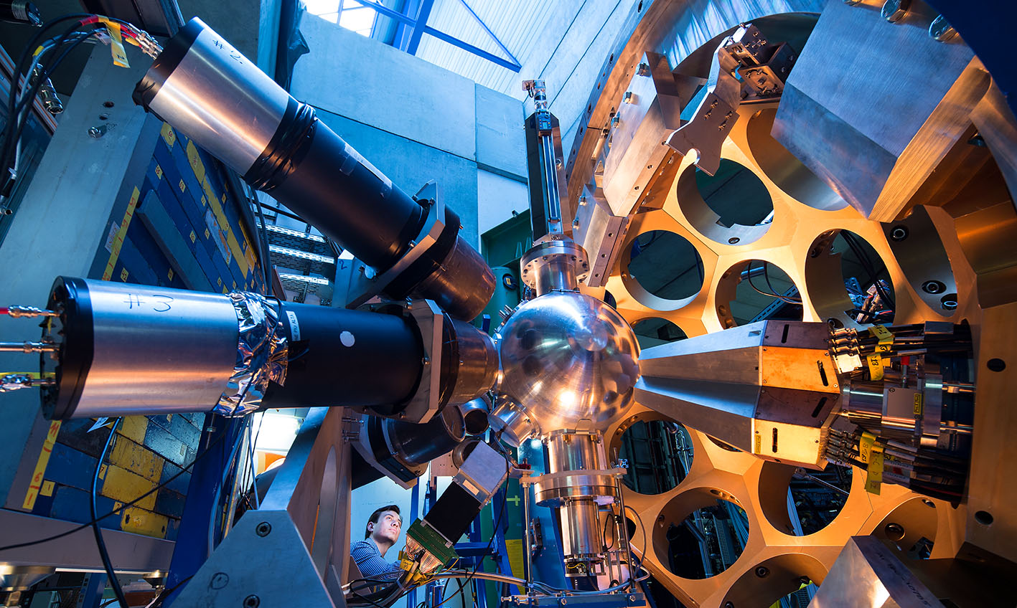
Training Projects available!
The projects are available from nuclear physics, accelerator physics, control systems, electronics, computing, NANO science, biophysics, instrumentation and so on.
Based on request a customized training on one or more projects can be designed with the framework of the FAIR Project.

Slide 17
GET_INvolved Program
Who can (and How can you) participate?
Individuals/students
Potential partners

Slide 18
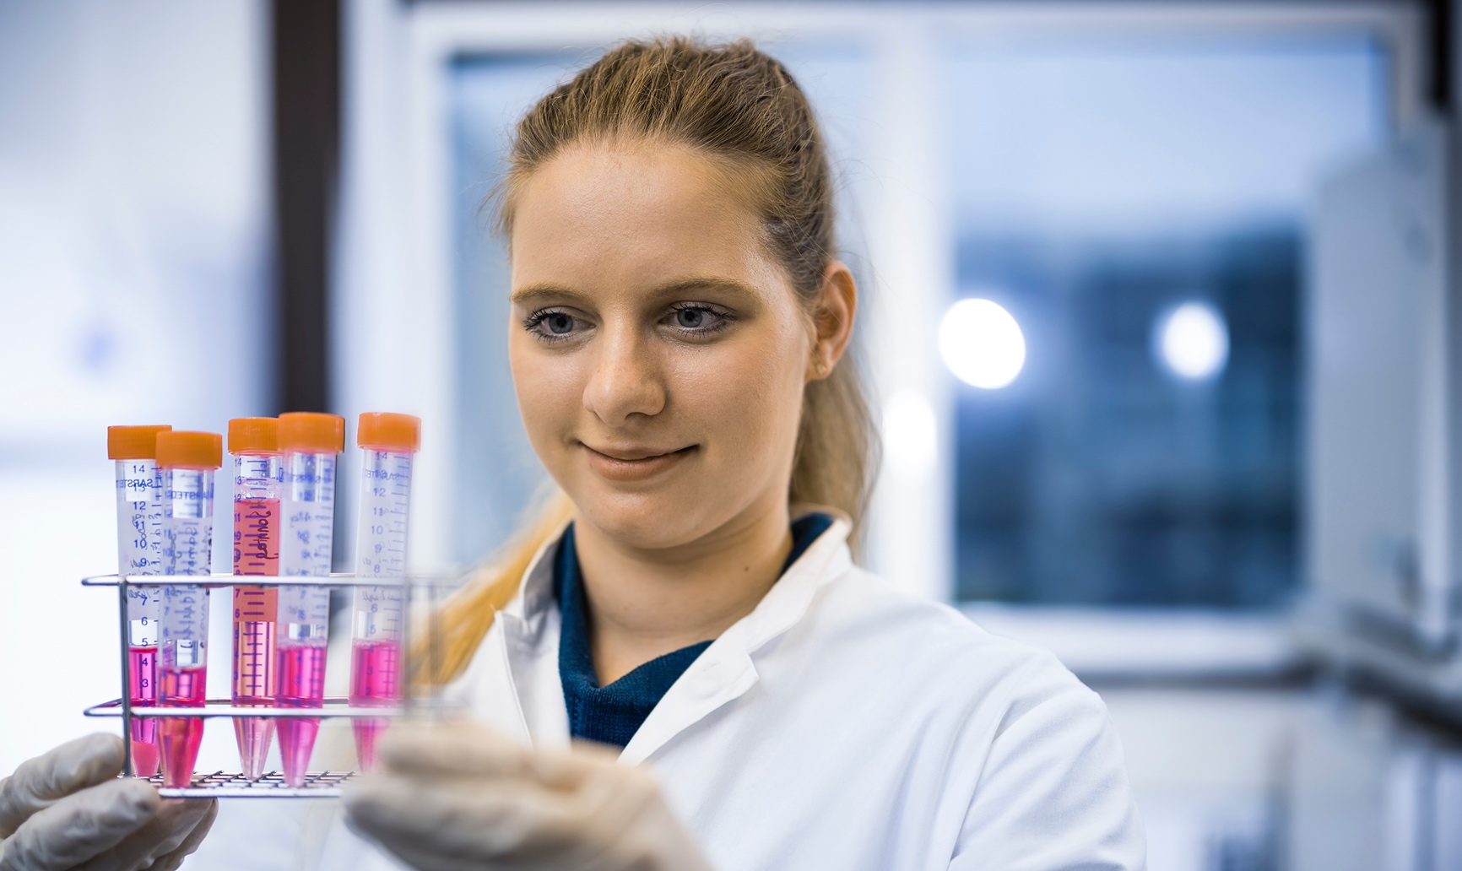
GET_INvolved Program
Interested
Individuals or students
Send your request via email to Program coordinator
Students with or without funding will be processed to evaluate possibilities.
Selected students will be awarded a sci. tech project

Slide 19

GET_INvolved Program
Interested
Potential partners for dedicated training program
Send your request via email to Program coordinator
Indicate your existing (or intended) fields of cooperation with us.
Fulfilling all criterions, you will be contact for negotiation

Slide 20
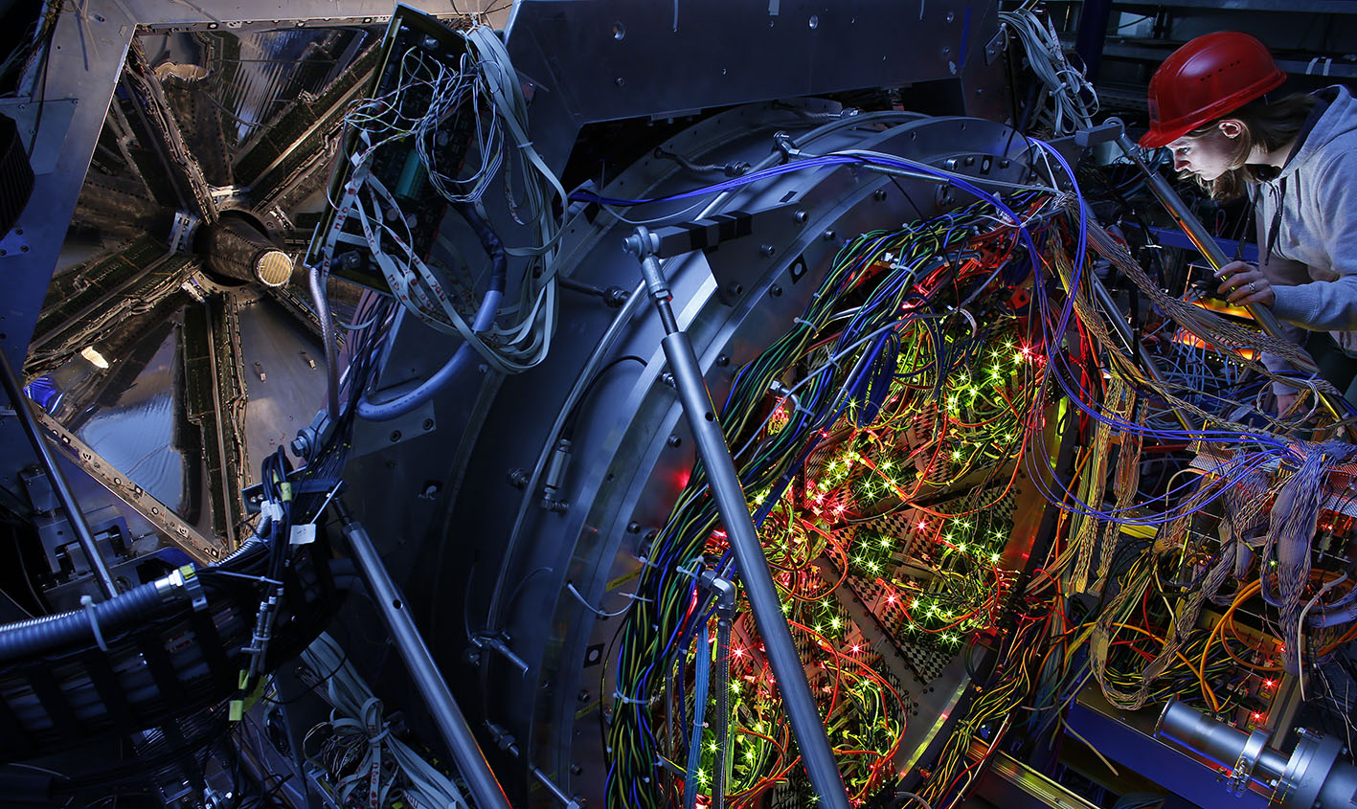
Status of GET_INvolved Program
Individual Students
India
Romania
Turkey
Individual applications from students are in process from..
Iran, Pakistan, South Africa, Japan South Korea …
China
Poland

Slide 21
Status of GET_Involved Program
Dedicated Internship and Training Program
Azerbaijan
China
Mexico
Negotiations are ongoing with.. India, Poland, South Africa, Brazil, UK, Sweden, Finland, Russia ..
Thailand
Romania
20

Slide 22

Contact us – Join the journey!
Web:
www.gsi.de/get_involved
www.fair-center.eu
email:
international@gsi.de
international@fair-center.eu

Slide 23
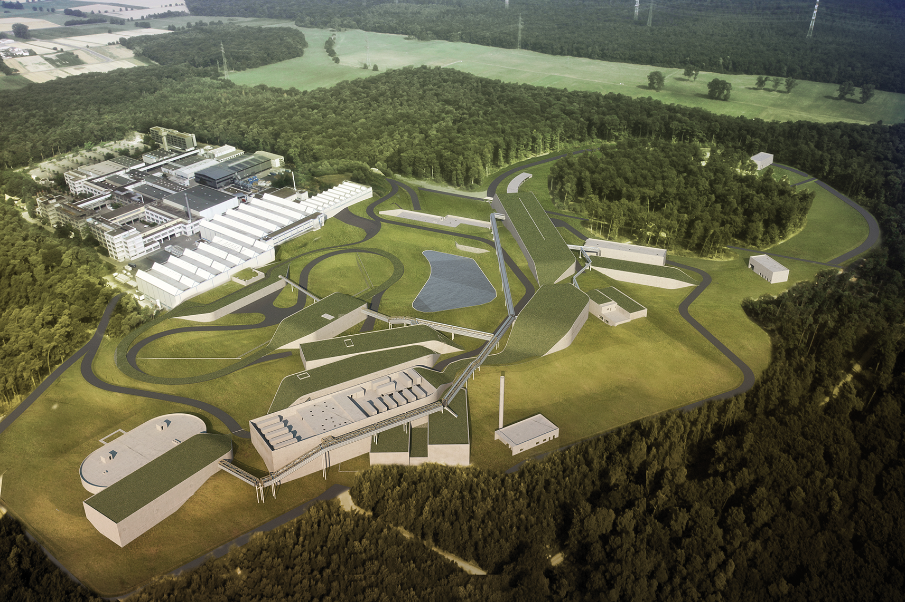
FAIR: A reality in 2025 – GET_INvolved NOW!
Thank You!

Slide 24
backup

Slide 25
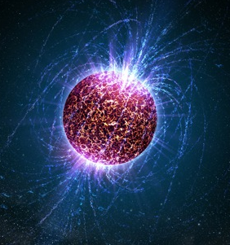
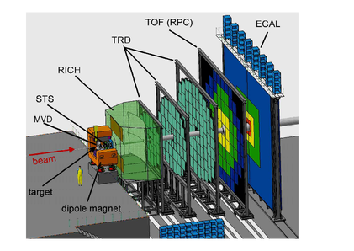
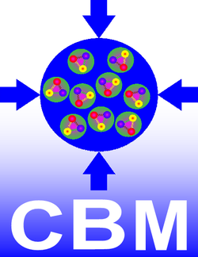
Example CBM Science:
Nuclear Matter at Extreme Density and Pressure
Neutron Stars
- the most compact
objects in the universe
FAIR CBM:
QCD matter at neutron star densities
nuclear matter equation of state
search for QCD phase transition, exotic phases
onset of Chiral symmetry restoration
hypernuclei, strange matter
CBM:
India has a leading role since the conception and design, and now large components are under construction in India.
CBM Detector

Slide 26
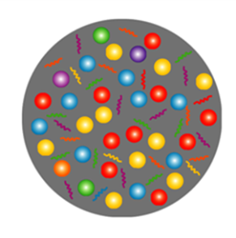
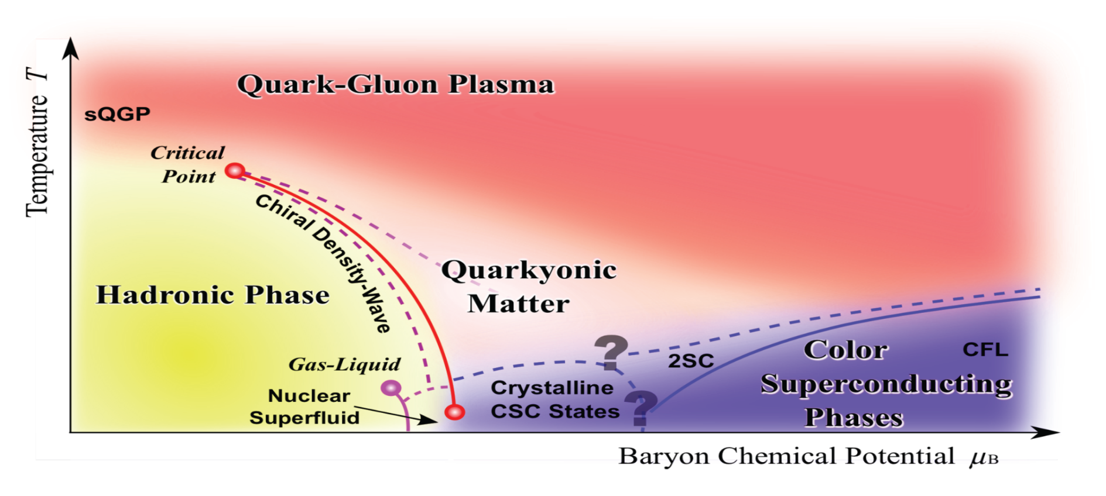
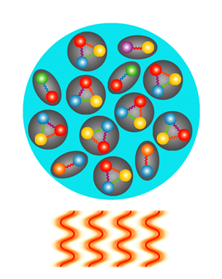
Exploring the phase diagram of „nuclear“ matter
Courtesy of K. Fukushima & T. Hatsuda
At very high temperature:
➢ N of baryons ≈ N of antibaryons
Situation similar to early universe
➢ L-QCD finds crossover transition between
hadronic matter and Quark-Gluon Plasma
➢ Experiments: ALICE, ATLAS, CMS at LHC
STAR, PHENIX at RHIC

Slide 27

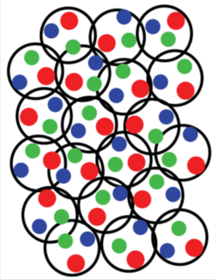
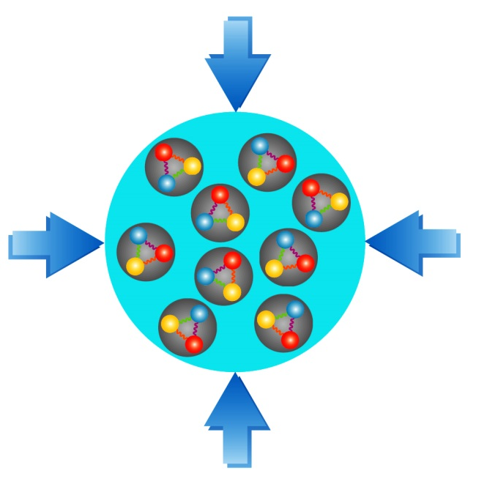
Exploring the phase diagram of „nuclear“ matter
Courtesy of K. Fukushima & T. Hatsuda
At high baryon density:
➢ N of baryons >> N of antibaryons
Densities like in neutron star cores
➢ L-QCD not (yet) applicable
Models predict first order phase transition
with mixed or exotic phases
Experiments: BES at RHIC, NA61 at CERN SPS,
CBM at FAIR, NICA at JINR, J-PARC

Slide 28
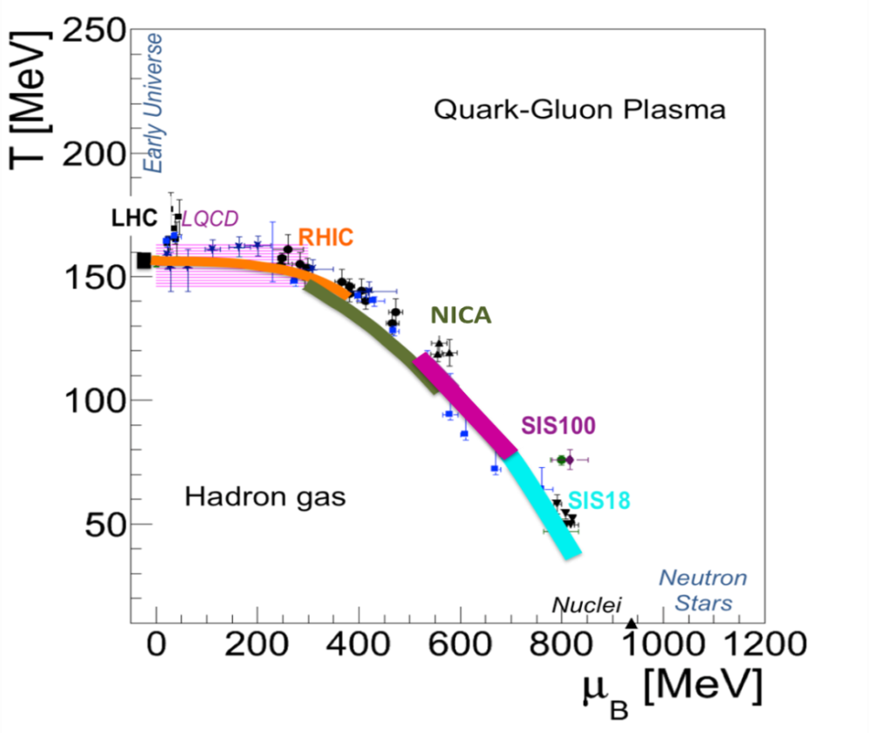
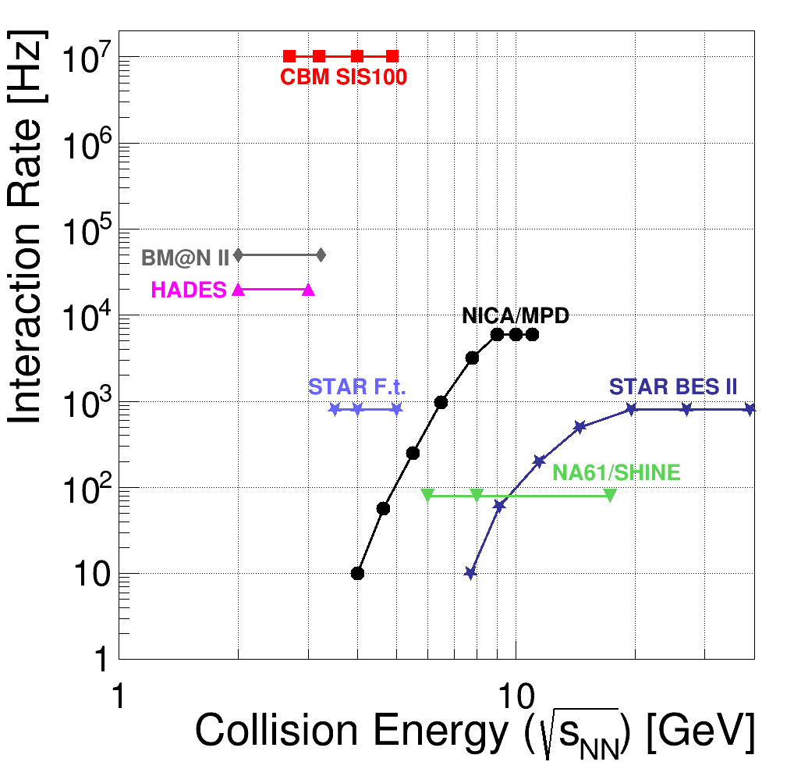
CBM:Exploring QCD matter at neutron star core densities (> 5 ρ₀)
nuclear matter equation of state
search for phase transition,
phase coexistence, exotic phases
onset of Chiral symmetry restoration
hypernuclei, strange matter
New physics insights by “pushing” interactions rates up to 10 MHz
optimized for precision measurements of rare probes (hyperons, hypernuclei, dileptons, charm)

Slide 29
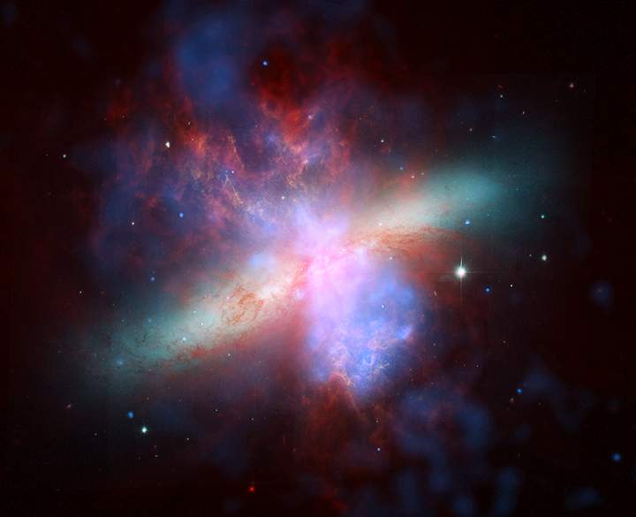
Example NUSTAR Science:
Synthesis of the chemical elements
Unique particle accelerator facility
Where and how were the heavy elements made in the universe?

Slide 30
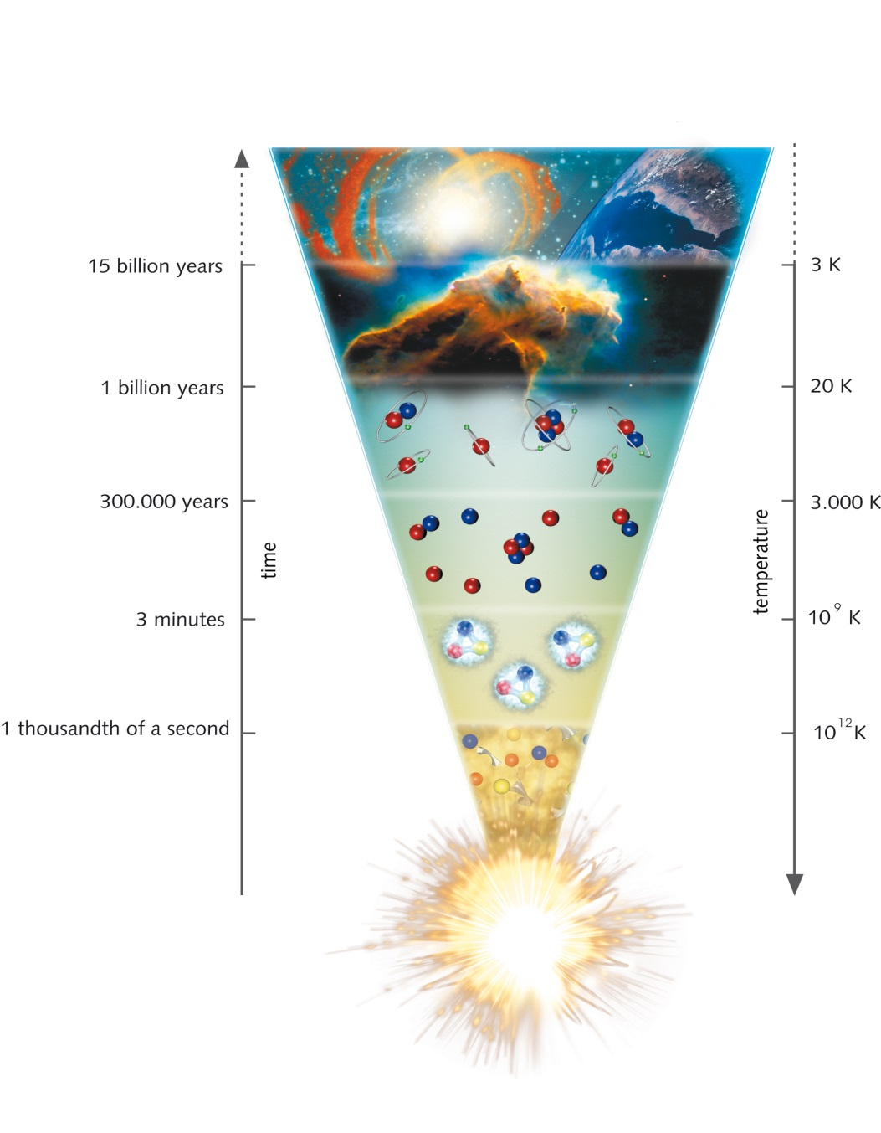
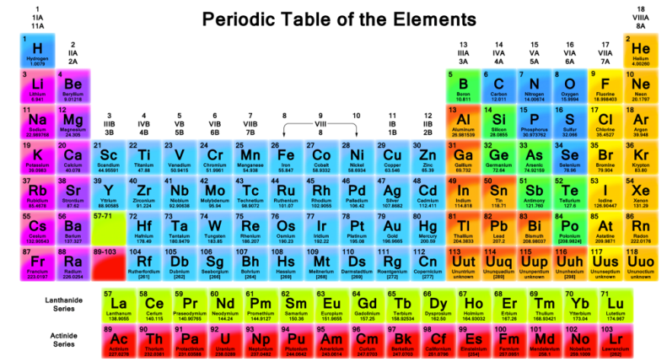

Example NUSTAR Science:
Synthesis of the chemical elements
Unique particle accelerator facility
Where and how were the heavy elements made in the universe?

Slide 31

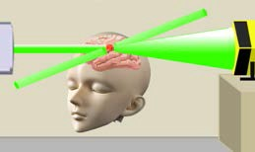
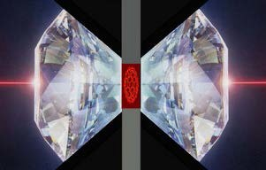
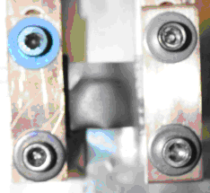
Example APPA Science:
Biophysics and Materials Research at FAIR
Biophysics
Materials Research
Space radiation biophysics
Biological effects of very high energetic ions
Shielding measures: new materials
Particle therapy: “theranostics”
(use of high energetic proton beams for simultaneous diagnostics and therapy)
Ion-matter interaction at highest energies and highest charge states
Materials behavior under extreme conditions (high flux irradiations)
Irradiations under multiple extremes (high pressure, temperature, dose)
Radiation hardness of accelerator and spacecraft components

Slide 32
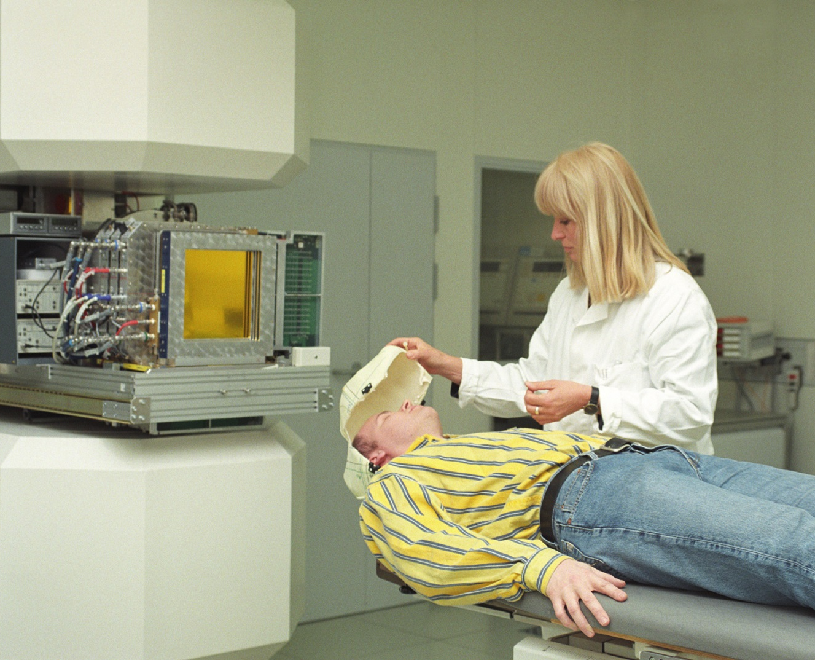
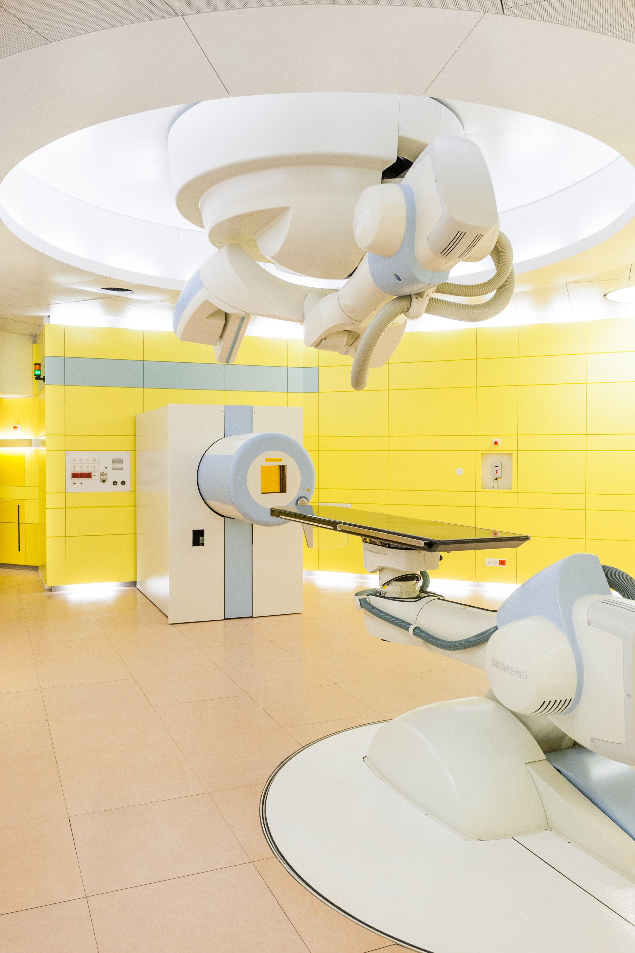
Health and medical therapy
Breakthroughs in medical research

Slide 33
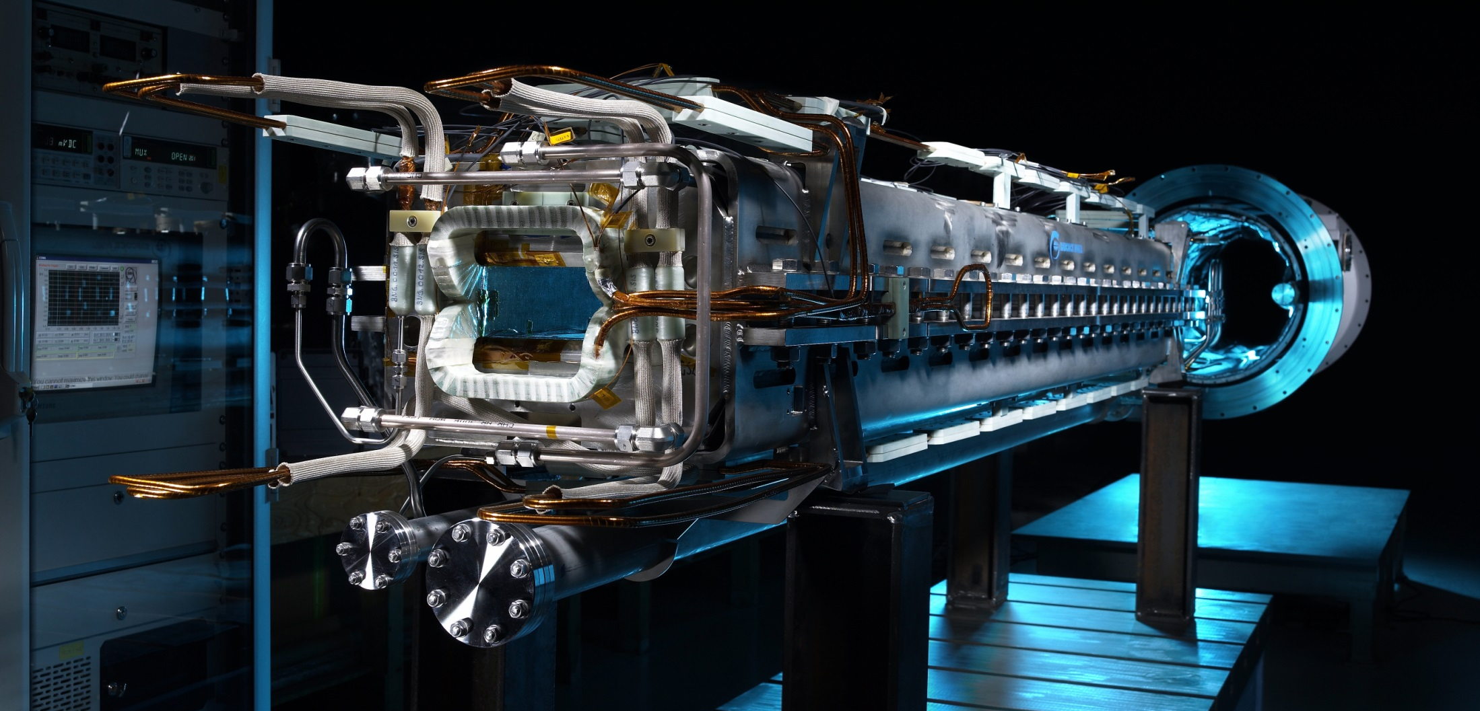
Forefront Technologies
Applications in accelerator science, detector instrumentation, materials research, radiation biology, therapy

Slide 34
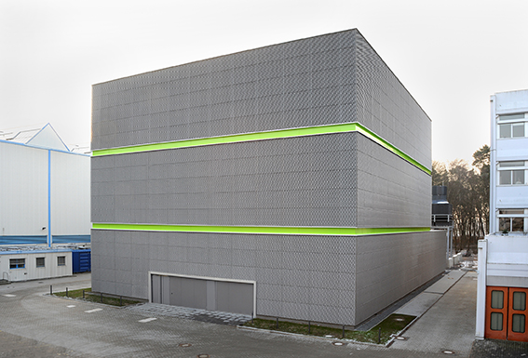

Forefront Technologies
Technological advancements in high-performance & scientific computing, Big Data, Green IT

Slide 35














APPA: Sophisticated & Versatile Instrumentation
Observables: Photons, electrons, positrons, ions
Targets
4D Position-sensitive solid-state detectors
High-resolution spectrometers
Particle detectors
Particle spectrometers
High pressure cell
Traps
X-ray optics, channel-cut crystals
Laser systems

Slide 36






CBM detector and DAQ prototypes
TRD
MUCH
TOF
DAQ
Diamond
The strong Indian collaboration is evident in this group photo

Slide 37







NUSTAR: Novel detectors developed for FAIR
Backward-angle neutron detector for tensor-force
experiments
Ion Catcher → LEB-MATS/LASPEC
O-TPC: discovered β-delayed
3p-emission of ³¹Ar
GADAST prototype measurements at S2
Full integrated S2 fiber tracker
Simulations for a
pion detector
integrated at S2

Slide 38






NUSTAR R3B Tracking Detectors
LOS
PSP
GLAD
200 μm square fiber for FIB4a 200/500 μm round fiber FIB4b/5
T
FIB (3x)
TOFD
PAS
PASTOF
    10 x 10 cm²
Z separation | σ_{E} < 1%
A separation | σ_{t} < 10ps
Rate | 1 MHz
Proton Arm Spectrometer
Z separation | σ_{E} < 0.5%
Position x y | σ_{x} < 100μm
Rate | 0.1 MHz/strip
Z separation | σ_{E} < 1%
A separation | σ_{t} < 38ps
Rate | 1 MHz/strip
Notes:
Before target LOS (plastic) + Silicon + Fiber detectors
After target (Between CALIFA and GLAD) 1 Silicon or 1 LOS (Plastic)
Heavy Fragment arm: 2 plane Fiber detectors→ Fiber 4 (41x24 cm², 200 μm) and Fiber 5 (80x80 cm², 500 μm) + TOF wall (120x80 cm², 5 mm plastic paddles)
Proton Arm Spectrometer : Strawtubes (210x100 cm²) + TOF wall (1 cm plastic paddles)

Slide 39







PANDA: Straw Tube Tracker
Detector Layout
4600 straws in 21-27 layers,
of which 8 layers skewed at ~3°
Tube made of 27 µm thin Al-mylar, Ø=1cm
R_{in}= 150 mm, R_{out}= 420 mm, l=1500 mm
Self-supporting straw double layers
at ~1 bar overpressure (Ar/CO₂)
Readout with ASIC+TDC or FADC
Material Budget
Max. 26 layers,
0.05 % X/X₀ per layer
Total 1.3% X/X₀
Project Status
3000 Straws produced
Readout prototypes and beam tests
Ageing tests: up to 1.2 C/cm²

Slide 40


CRYRING@ESR in new Cave
Commissioning is ongoing ...
View from local injector to the ring

Slide 41
Initiative – International Student
The GET_INvolved program has already started welcoming first Student.
First three Student have successfully accomplished a dedicated internship and training experience from our new program.
  02 Student from Indian University
  01 student from Polish University
As an outlook we are in preparation to welcome the following:
  02 Turkish PhD students
  11 Chinese Postdoctoral researchers
  02 Azerbaijan students
  02 Thai students
Resources for this GET_INvolved program are sought from within existing and new mobility programs worldwide and not within in FAIR funding.

