Slide 1
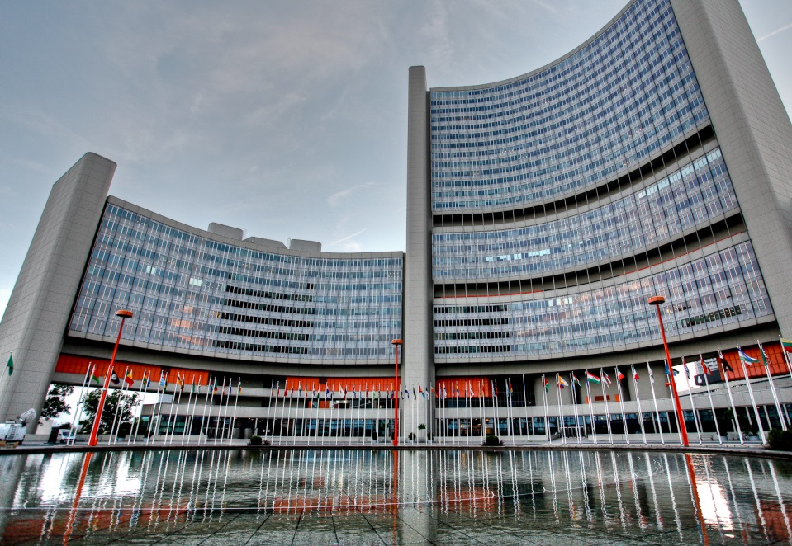

IAEA Ministerial Conference on
Nuclear Science and Technology: Addressing Current and Emerging Development Challenges
Dates
28-30 November 2018
Venue
Vienna International Centre
(M building, corridors and rotunda)
Notes:
Good Morning Excellences, dear colleagues!
Thank you co-chairs for giving us the opportunity to elaborate on the Announcement which was shared with all Member States in November of the last year.
As per the Agency practice, the Conference announcements are issue about one year ahead of the Conference. The Conference Announcement aims at providing date and venue of the major international event and general information that will lead to discussion among the relevant stakeholders for developing the Conference programme.
As requested by Member States through the GC resolutions in 2015, 2016 and 2017, this Ministerial Conference will focus on nuclear science and technology and their delivery to Member States through the Agency’s technical cooperation programme, while highlighting their future contribution to sustainable development.

Slide 2

Conference Objective
To enable the participants to engage in high-level
dialogue for promoting integration of nuclear
science and technology in their national strategy
for achieving sustainable development, as well as to recognize high impact innovations in peaceful applications of nuclear techniques in addressing current and emerging development challenges and the role of the Agency in facilitating the deployment of the techniques in the Member States.
2
Notes:
The proposed title and the objective of the Conference attempt to capture the intent of the GC resolutions.
Since this is a ministerial level conference, it will have a high-level dialogue where ministers are expected to discuss the integration of nuclear science and technology for sustainable development at national level. The Conference will be an occasion to recognize high impact innovations that can be used by Member States to address current and emerging development challenges. The Conference will discuss the role of the Agency in facilitating the transfer of peaceful applications of nuclear science and technology to Member States through various mechanisms in a comprehensive manner. These mechanisms include inter alia the IAEA technical cooperation programme, the Coordinated Research Activities, training activities undertaken through the IAEA Collaborating Centre scheme, on line education tools and others. As you are aware, the deployment of such techniques encompasses the building of human resource capacity, infrastructure and adequate policies and legislation.
In this regard, let me reiterate that this is an Agency Conference and participation of all relevant Departments and support of all Member States is crucial for making this a successful Conference.
In addition, we have contacted relevant International Organizations for cooperation. To date confirmations have been received from FAO, UNEP and UNIDO.

Slide 3




Structure
Scientific and Technical Programme:
High-level panel discussions (29-30 Nov.):
Prominent scientists; Government, academia and relevant private sector representatives
Ministerial Segment:
Plenary session (28 Nov.)
National statements
Ministers of Science, Industry, Health, Environment, Agriculture, Water, Education, Planning…
Exhibitions
Expected Outcome
Recognition of the role of nuclear techniques and their contribution in addressing current and emerging development challenges
3
Notes:
The conference envisages to include a Ministerial Segment to provide an opportunity for ministers to deliver brief national statements, as well as Scientific and Technical Programme comprising high level panel discussions.
While preparing the announcement we had the following aspects in our consideration:
a/ In our view the participation of Ministers would require the Conference to deliberate global challenges that are of relevance to all Member States in a holistic manner and hence needs to be comprehensive and overarching.
b/ The duration and nature of the Conference does not allow elaborated sessions on the line of sectoral approach such as Food and Agriculture, Human Health, Environment, Industrial Applications, etc. As we frequently organize conferences/symposia on this basis, we thought of proposing approach of themes which will allow these subjects to be dealt in an integrated manner to address high level issues.
Those aspects led to proposing the following three themes under which various panel discussions could be set up:
Improving quality of life is the main goal of countries for achieving socio-economic development. Nevertheless the needs and priorities might differ among Member States, resulting in emphasis placed on different areas for which nuclear techniques have an added value (health, environment, food, agriculture, water, industrial development).
The effects of climate change impact our daily life across the globe through phenomena such as changing environment, fluctuating crop production, disease outbreaks, extreme temperature fluctuations. Nuclear techniques can offer unique solutions to monitor, mitigate and adapt to some of those challenges.
While peaceful applications of nuclear science and technology may have a salient role in many areas, their sustainable deployment requires robust education, certification, nuclear legislation, infrastructure and research and development in place.
These topics provide us with a broad framework within which the Conference programme could be developed.

Slide 4

Participation and Registration
Request for participation should be done through
the national competent authority (or through one of
the organizations invited to participate) and addressed
to Official.Mail@iaea.org
Registration through the platform InTouch+ is encouraged (https://intouchplus.iaea.org)
Participation is intended from representatives of relevant Ministries, academia, relevant private sector
The working languages of the conference will be all the official IAEA languages, interpretation will be provided for the Ministerial Segment and the plenary sessions of the Scientific and Technical Programme
4
Notes:
Request for participation should be done through the national competent authority or through one of the organizations invited to participate and addressed
to Official.Mail@iaea.org
Registration through the platform InTouch+ is encouraged ((https://intouchplus.iaea.org)
Participation is intended from representatives of relevant Ministries, academia, relevant private sector
The working languages of the conference will be all the official IAEA languages, interpretation will be provided for the Ministerial Segment and the plenary sessions of the Scientific and Technical Programme

Slide 5
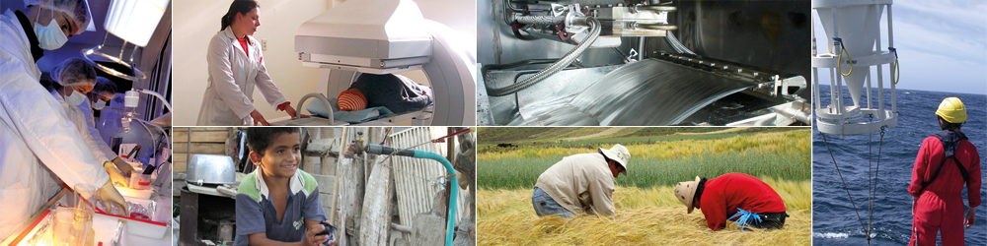
Thank you
5
Notes:
This is in a nutshell, our best proposal for your consideration. We look forward to listen to your views and stand ready to provide answers to any questions that you may have.

