Slide 1
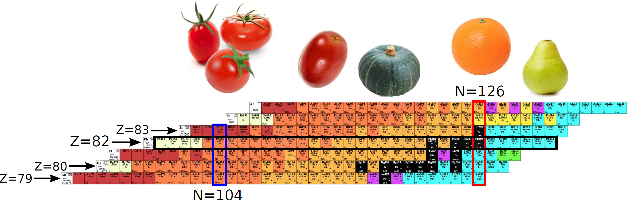
Shape studies in the lead region: in-source laser spectroscopy of astatine nuclei and decay studies in ¹⁷⁸Au.
James Cubiss – University of York
On behalf of the RILIS–Windmill–ISOLTRAP collaboration

Slide 2
Collaborators
University of York, United Kingdom
A. N. Andreyev, J. G. Cubiss, R. D. Harding, C. Raison, M. Al Monthery
RILIS, CRIS and ISOLDE, Geneva, Switzerland
S. Rothe, B. A. Marsh, A. M. Sjodin, V. N. Fedosseev, M. D. Seliverstov, N. Imai,
K. Lynch, T. Day Goodacre
Institut für Physik, Johannes Gutenberg-Universität Mainz, Mainz, Germany
S. Raeder, K. D. A. Wendt
Instituut voor Kern- en Stralingsfysica, K.U. Leuven, Leuven, Belgium
S. Sels, L. Ghys, C. Van Beveren, E. Rapisarda, D. Pauwels, D. Radulov,
Yu. Kudryavtsev, M. Huyse, P. Van Duppen, K. Rezynkina, L. Gaffney, T. E. Cocolios,
G. J. Farooq-Smith
Comenius University, Bratislava, Slovakia
S. Antalic, B. Andel
PNPI, Gatchina, Russian Federation
A. E. Barzakh, D. V. Fedorov, P. Molkanov
University of Manchester, UK
J. Billowes, M. Bissel
MR-TOF@ISOLTRAP team:
S. Kreim, V. Manea, F. Wienholtz +...
University of Liverpool
G. O‘Neill

Slide 3
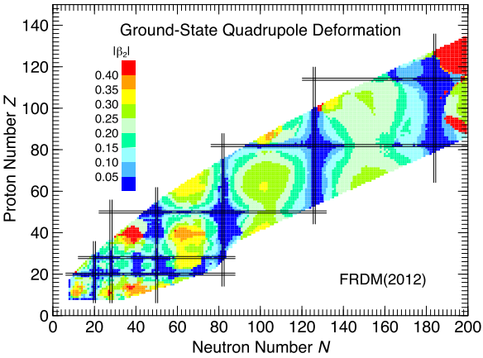
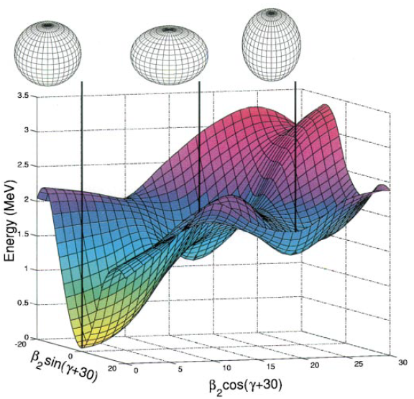

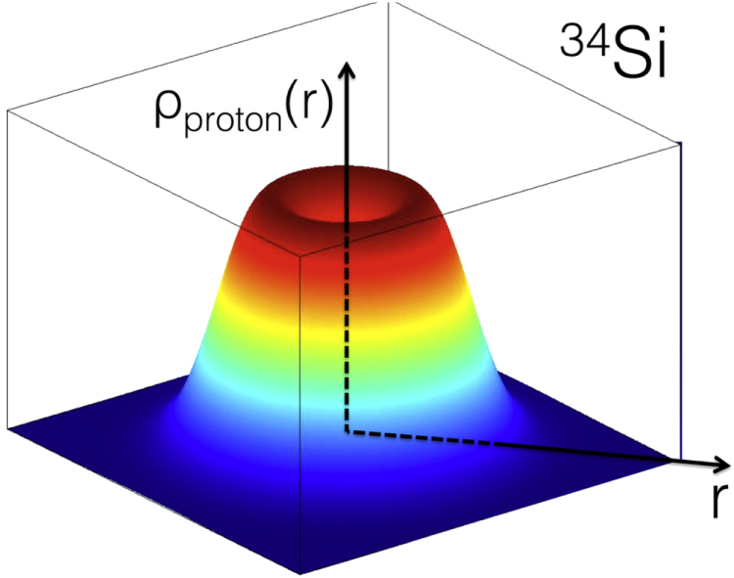
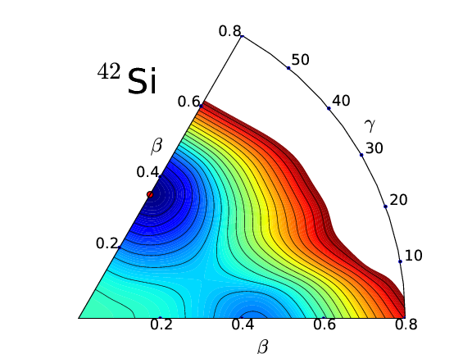
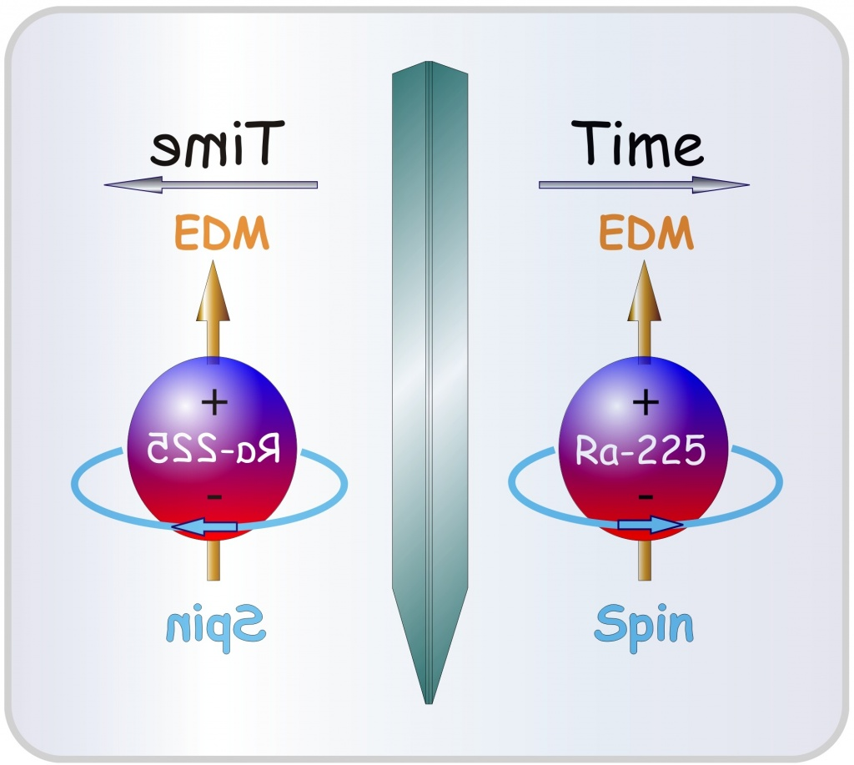
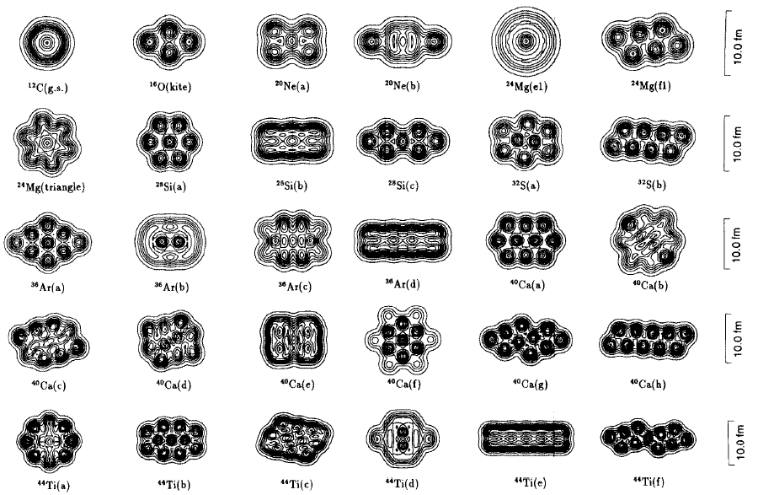
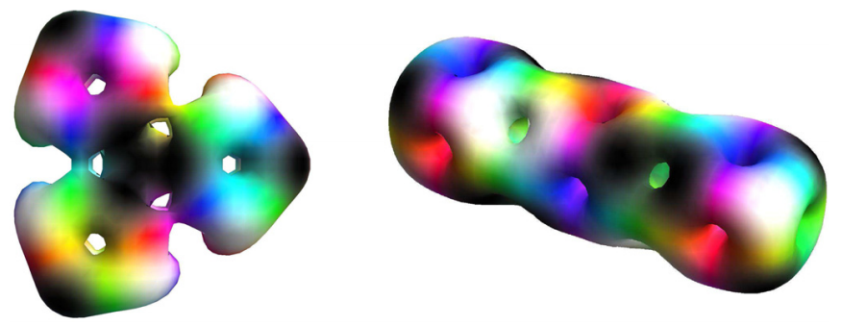
Why study nuclear shapes?
One of the characteristic properties.
Gives an insight into the governing forces
They are strange!
Not just of interest to nuclear physics
- BSM studies
- Astrophysics

Slide 4
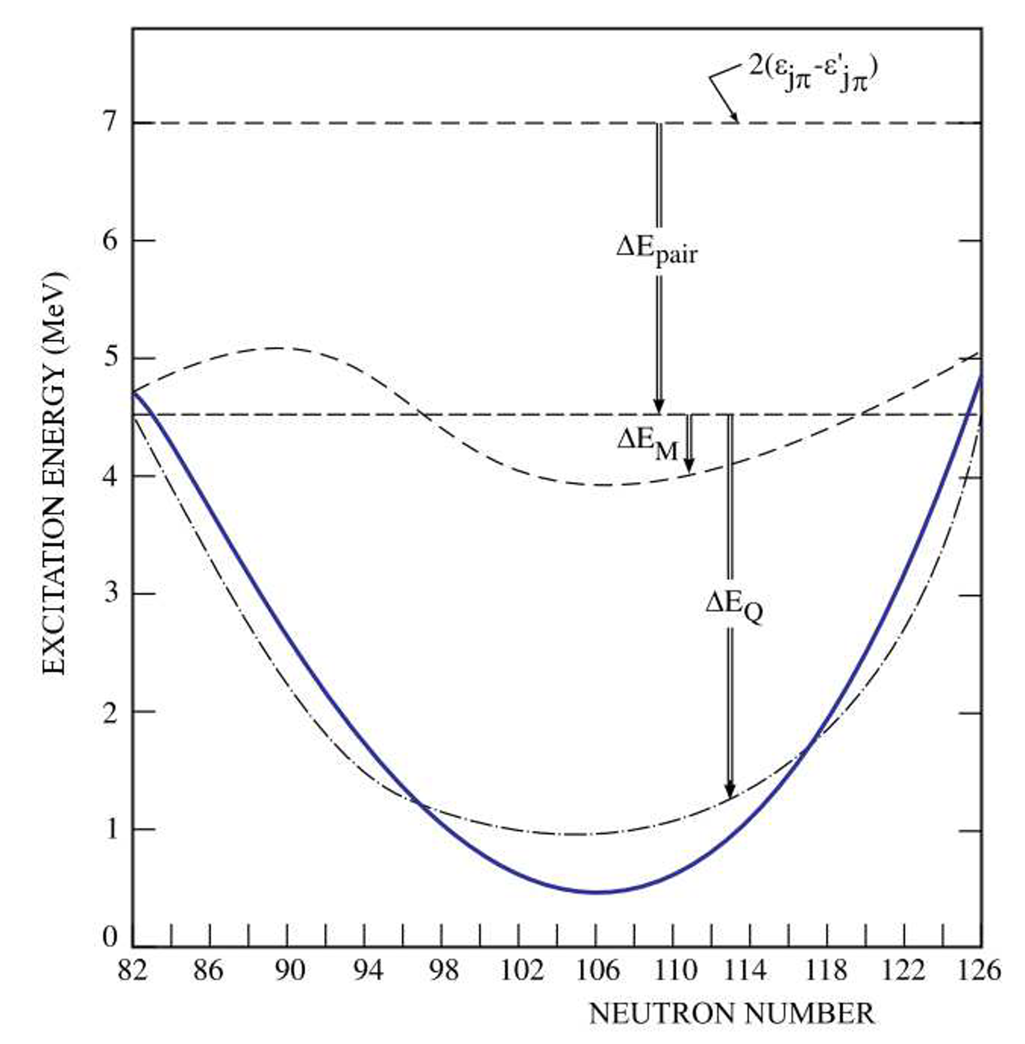
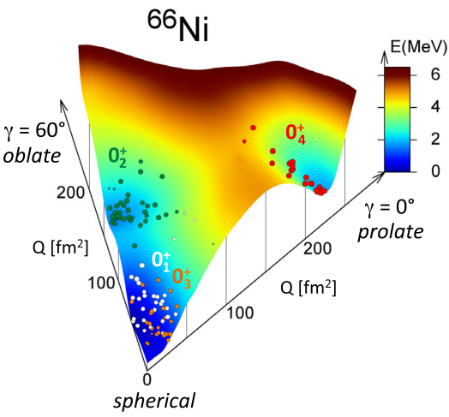
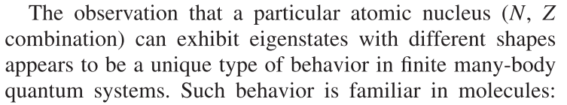
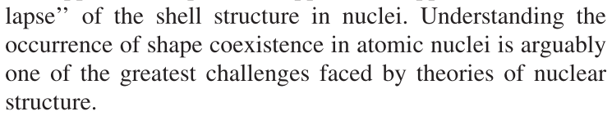
Shape coexistence
S. Leoni, PRL 118, 162502, 2017
A. N. Andreyev, Nature, 2000
………....……...………..……
…
K. Heyde and J. L. Wood, Rev. Mod. Phy., 83(4):1467–1521, 2011.

Slide 5
In-source laser spectroscopy of astatine, the rarest naturally occurring NUCLEI on Earth!

Slide 6
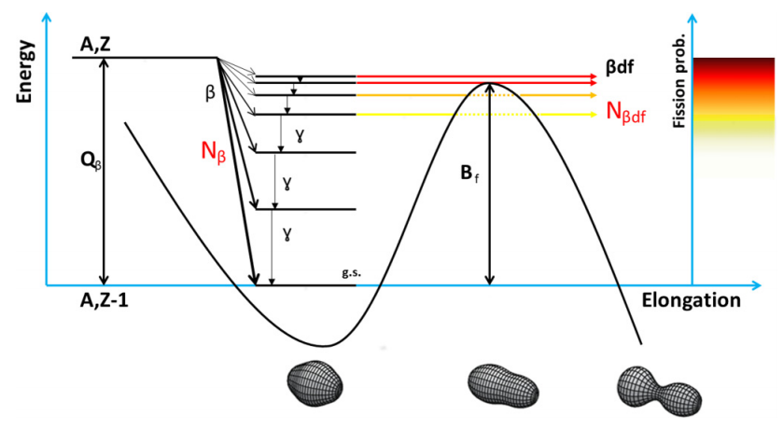
Since the initial LOI on laser-ionised At beams…
Nature comms. paper on IP
S. Rothe, Nat. Comms., 2013
A number of β-delayed fission and
α-decay studies made (^{194,196}At):
L. Ghys, PRC 90, 041301, 2014
L. Ghys, PRC 91, 044314, 2015
V. L. Truesdale, PRC 94, 034308, 2016
Large systematic study, with laser spec.
(presented here, paper submitted)
Made possible beams for:
- Mass measurements of astatine nuclei, ISOLTRAP
- Octupole studies in radon nuclei, fast timing of β-delayed γ transitions
Interest in running beams with negative ions.

Slide 7
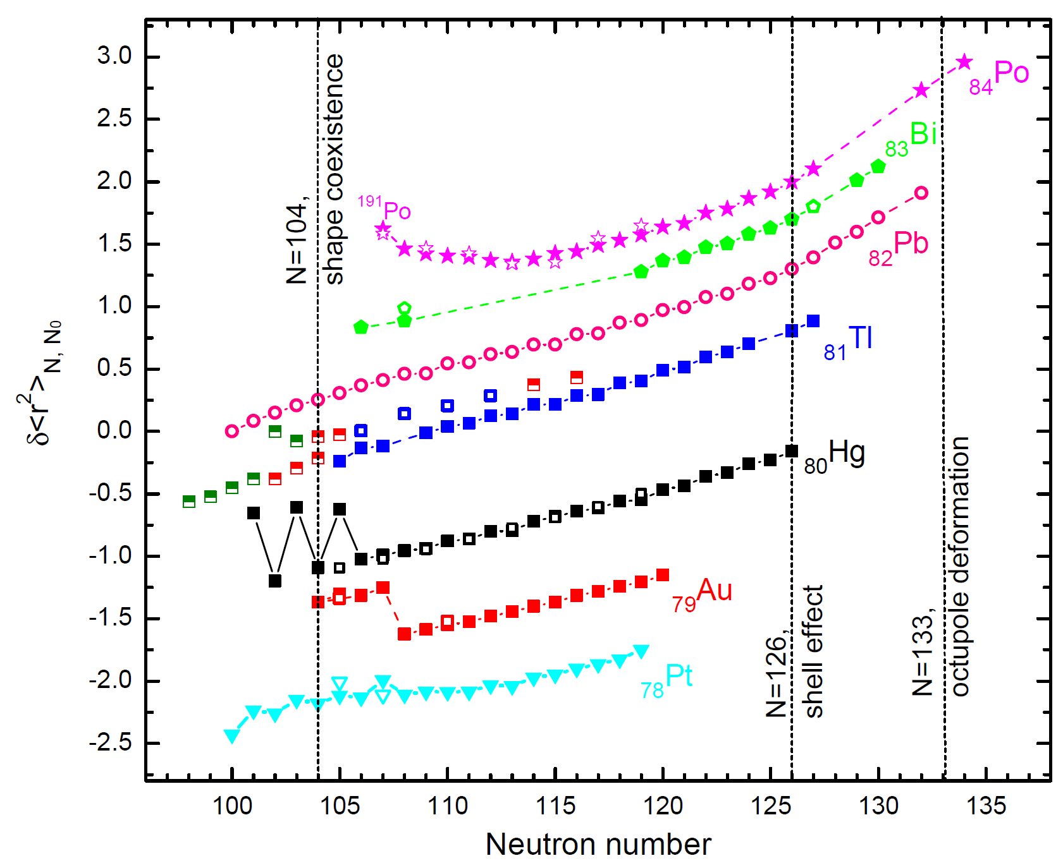

Charge radii in Pb region, measured as of 2011
What about astatines?
Po ISOLDE,PRL106, 052503 (2011)
T. Cocolios et al.,
Pb ISOLDE, PRL98, 112502 (2007) H. De Witte et al.
2011: Tl isotopes:
IS511 ISOLDE and IRIS(Gatchina)

Slide 8
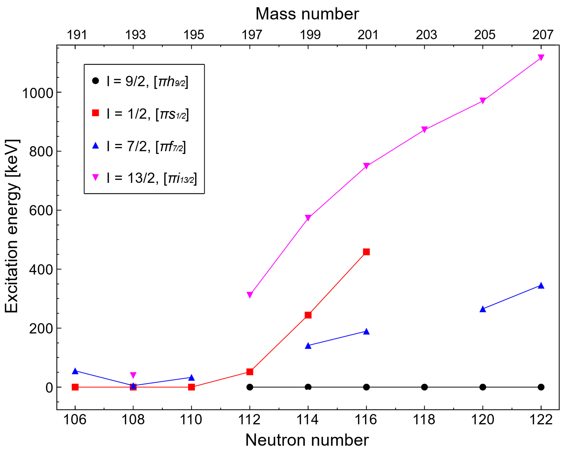
At isotopes
IS534 ran beam for 7 days in 2014.
Measured the isotope shifts and hyperfine structures of 21 isotopes of astatine, ¹⁹⁴⁻²¹¹At and ²¹⁷⁻²¹⁹At.
Present results for ¹⁹⁵⁻²¹¹At.
Used the in-source method in order to access most exotic cases.
Large collaborative effort between Windmill, RILIS and ISOLTRAP groups
H. Kettunen, Eur. Phys. J. A, 16(4):457–467, 2003.
H. Kettunen, Eur. Phys. J. A, 17(4):537–558, 2003.
A. N. Andreyev, PRC, 73(2):024317, 2006.
A. N. Andreyev, PRC, 79(6):064320, 2009.
K. Auranen, PRC, 90(2):024310, 2014.
V. L. Truesdale, PRC, 94(3):034308, 2016.
N=126
Astatine, Z=85
Z=82

Slide 9
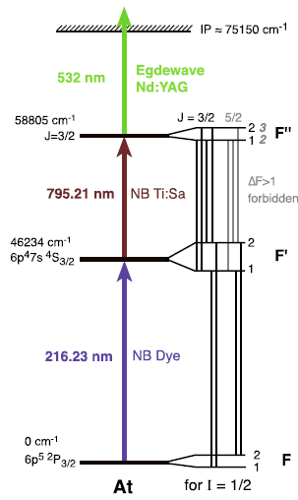

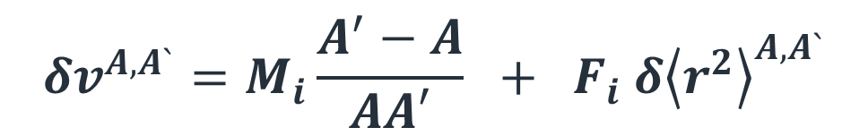

Laser spectroscopy – the basics
$$F_{atom}=I_{nuclear}+J_{electron}$$
$$δv^{A,A`}=M_{i}\frac{A^{′}−A}{AA′} + F_{i} δ{\left\langle r^{2}\right\rangle }^{A,A`}$$
$$∆F=0,±1$$
Mass shift
Field shift
Let’s consider, e.g. even-even Pb (Z=82) isotopes:
I_{nuclear} = 0, therefore F_{atom} = J_{electron}.
F’_{ex}=J’=1
δν^{100,102}
ν₁
ν₂
ν₃
F_{gs}=J=0
¹⁸²Pb(N=100)
¹⁸⁴Pb(N=102)
¹⁸⁶Pb(N=104)
_{Iions}
δν^{100,102} = ν₁ - ν₂ , Isotope Shift (IS) is proportional to the charge radius!
ν₁
ν₂
ν₃
Q_{s} → shape, μ → orbital

Slide 10
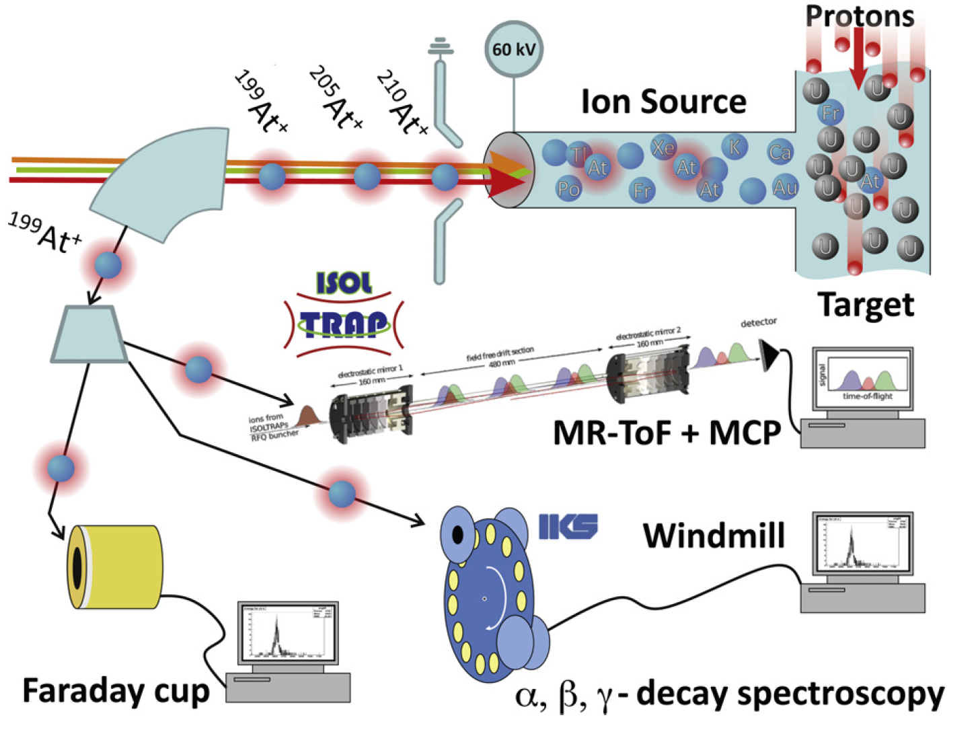
In-source laser spec. - our tools
RILIS
+ High sensitivity and
efficiency! Can deal
with rates of 0.001
ions/sec!
+ Simple setups.
+ Quasi-background free.
- Broadening of spectra,
hot ion source.
(Collinear <50 MHz,
In-source >800 MHz)

Slide 11
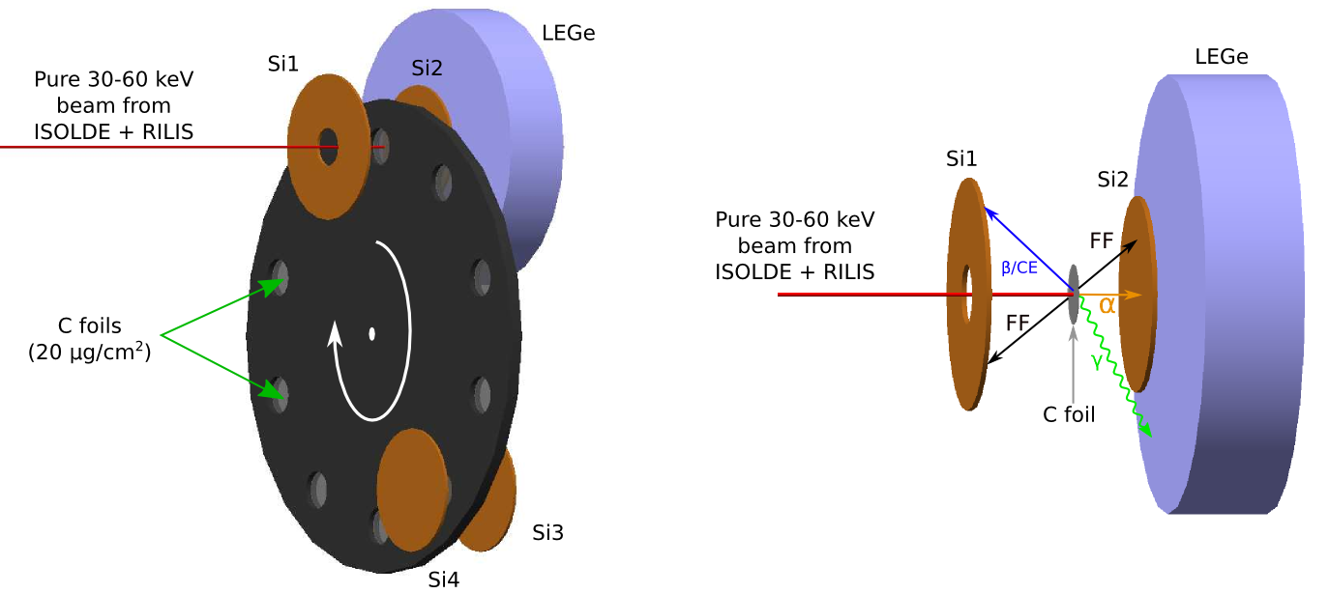
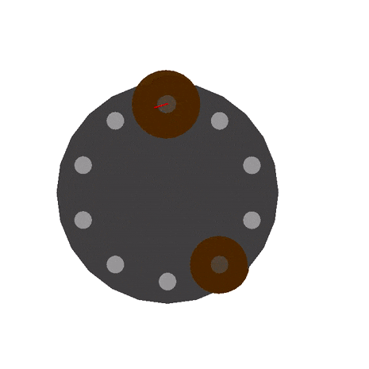
Windmill system
Setup: Si detectors both sides of the C-foil
Simple setup & DAQ: 2 Surface barrier detectors (1
of them – annular) and 2 PIPS detectors.
34% geometrical efficiency at implantation site.
Alpha-gamma coincidences
Digital electronics

Slide 12
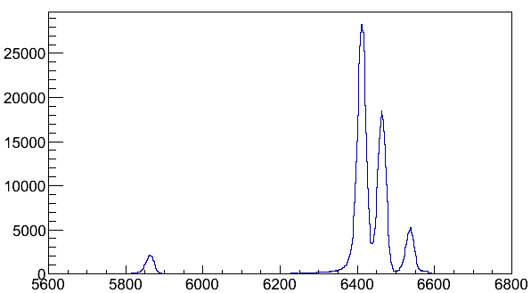
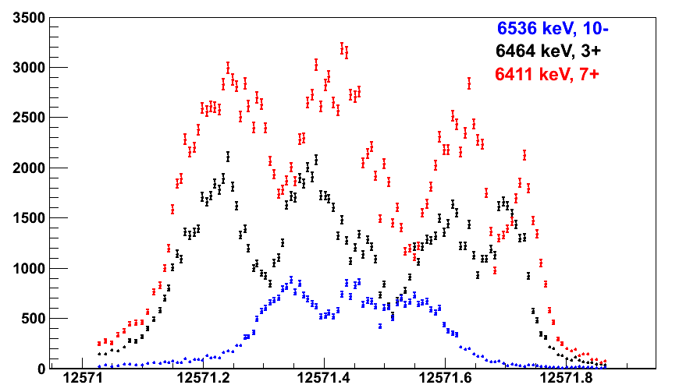
Windmill data
200At
6411 keV, 7+
T_{½} = 47 s
6464 keV, 3+
T_{½} = 43 s
3 distinguishable peaks from 3 isomers of 200At.
Gate on alpha energies to see HFS.
6536 keV, 10-
T_{½} = 3.5 s
200Po
200At
No shift in CoG, three isomers have same deformation!
N_{α}

Slide 13
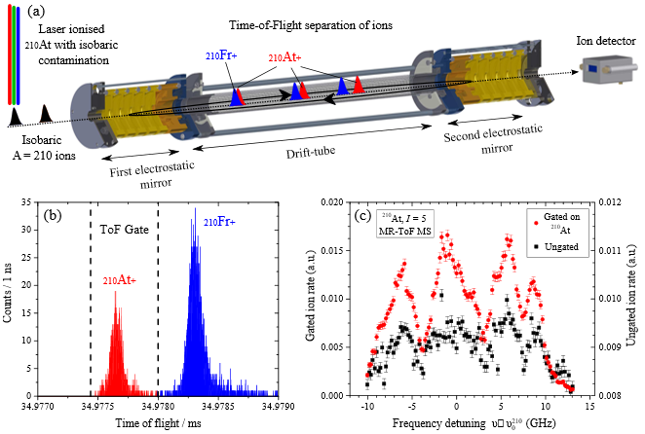
MR-ToF approach

Slide 14
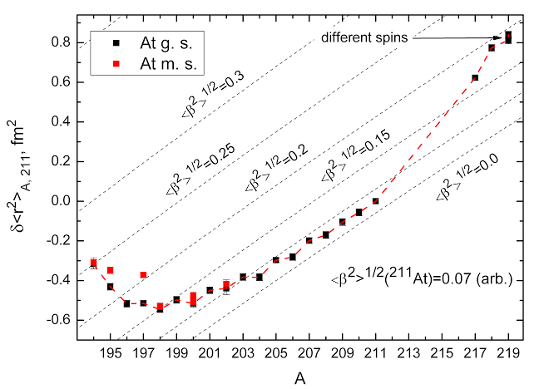
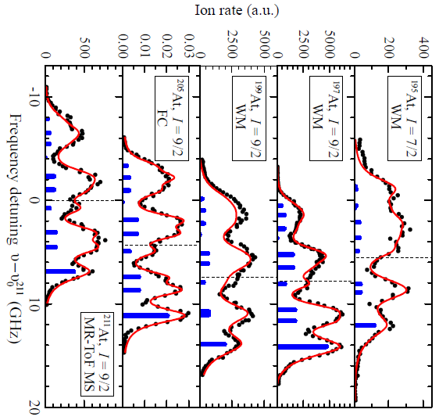
HFS & charge radii
Possible octupole deformation?
N = 126
Onset of deformation
Spherical region

Slide 15
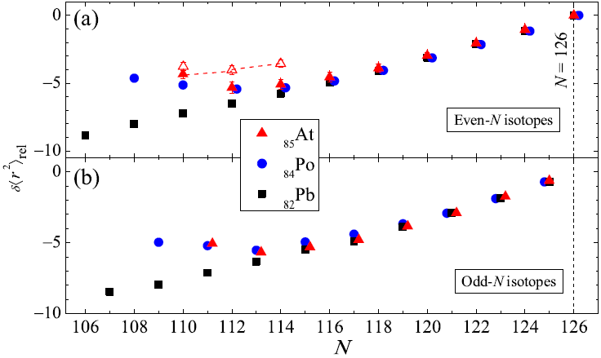
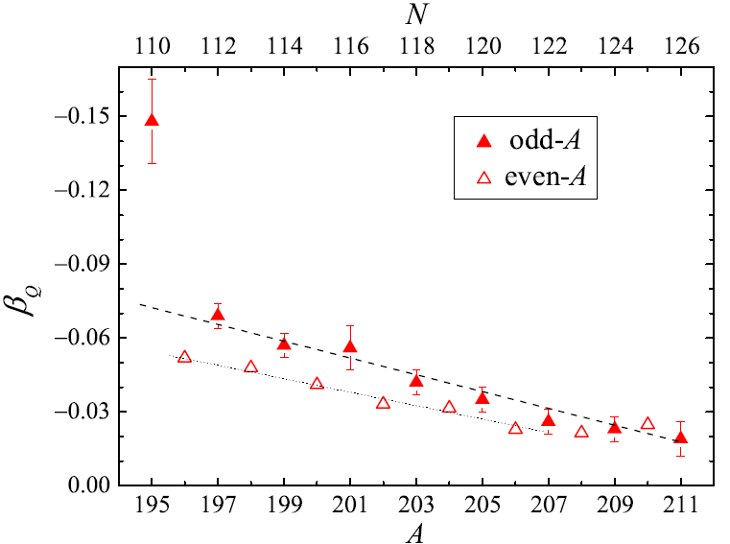
Onset of deformation
Astatines are seen to follow trend of lead and polonium isotopes, for N>115
Astatines and poloniums then depart from spherical trend
Astatines mimic poloniums until N=110,
Online analysis shows ¹⁹⁴At has even bigger jump!

Slide 16
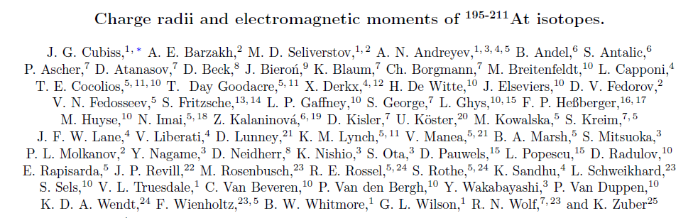
Paper submitted
67 Co-authors, 25 institutions

Slide 17
Thank you for listening

Slide 18
Backup slides

Slide 19
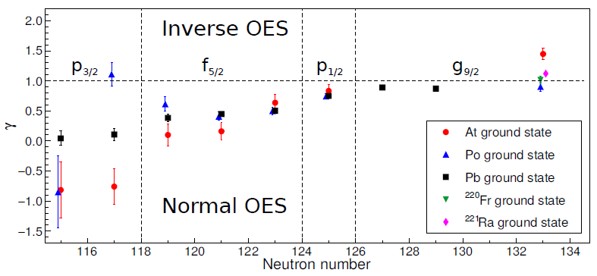
On Octupole collectivity
OES caused by scattering of particles into orbitals
Usually even-N nuclei have larger radius than odd-N neighbours, as no blocking
Inversion of staggering observed in regions where octupole collectivity expected.

Slide 20
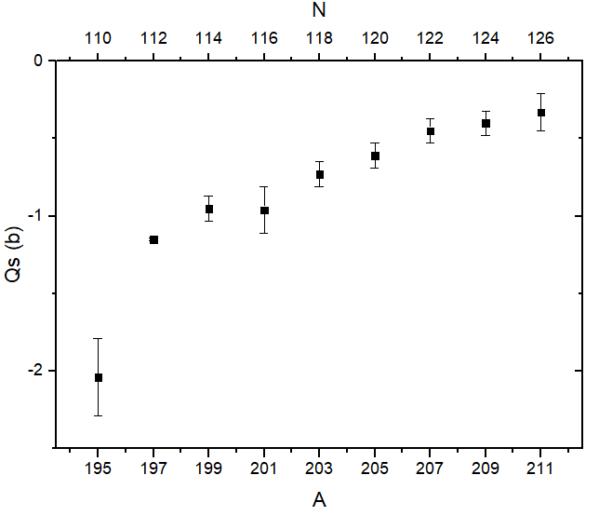
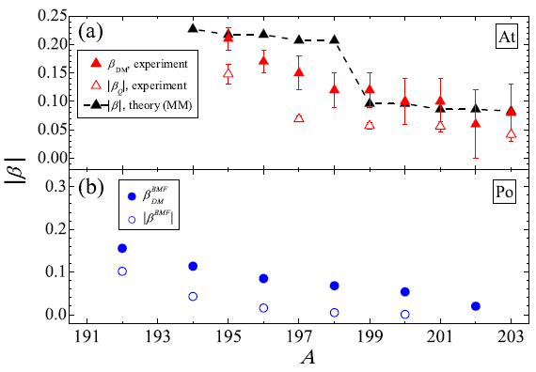
Quadrupole moments
Q moments for even-N astatines show gradual increase in oblate deformation.
Sudden jump for ¹⁹⁵At.
This is in contrast to β₂ values from charge radii, and theory.

Slide 21
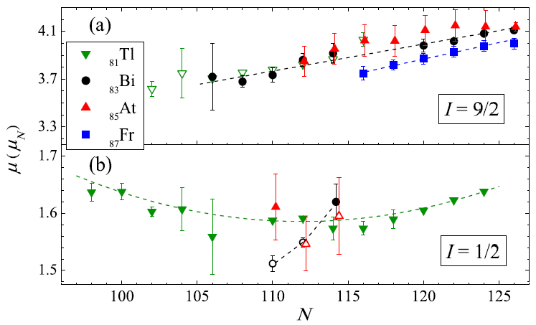
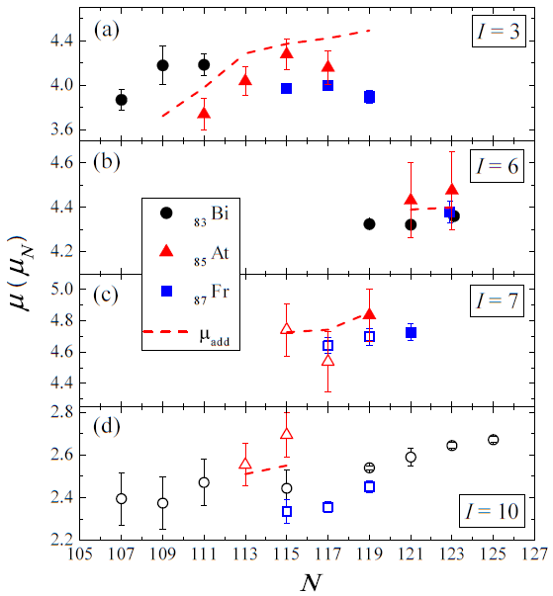
Magnetic dipole moments
πh_{9/2}
πs_{1/2}⁻¹
πh_{9/2} x νp_{3/2}
πh_{9/2} x νf_{5/2}
Good agreement with states of
same spin in other chains.
Even-N:
- I=9/2 consistent with πh_{9/2}
- I=1/2 consistent with πs_{1/2}
- I=7/2 (¹⁹⁵At) consistent with π[f_{7/2}/h_{9/2}]
Odd-N, all protons in πh_{9/2}
New ²⁰⁶At spin assignment based μ
πh_{9/2} x νf_{5/2}
πh_{9/2} x νi_{13/2}

