Slide 1
Injection Studies
C. Bracco, V. Forte

Slide 2
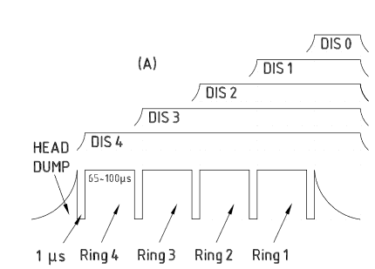
Injection studies assumptions
For all beams fully matched optics (beta, alpha, dispersion etc.)
High intensity beams: longitudinal and transverse painting, no optics imperfections or steering errors (only wished offsets in V plane to reach target emittances)
LHC beams: baseline with no longitudinal or transverse painting, effect of imperfections (optics and steering) taken into account for standard HL-LHC beams.
  Transverse offset along the pulse ≤ 1 mm ➔ precise tailoring of final emittance
Always considered flat current pulses (need to evaluate impact on achievable intensity if “large” variations along the pulse)
  Flatness over 400 us or 600 us ➔ integrated intensity per ring (ISOLDE)
  Flatness along pulse ➔ balanced intensity/ring (both for LHC and ISOLDE beams)
  ±2% flatness determined assuming that this is the wished uniformity intensity between the different rings (both for LHC and ISOLDE beams)

Slide 3
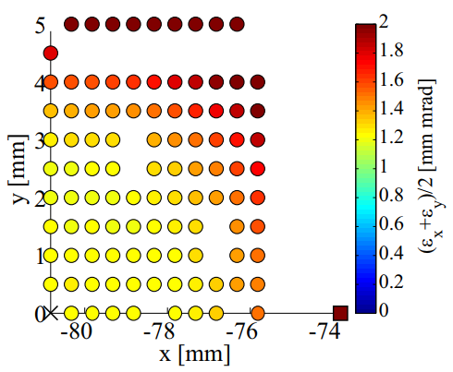
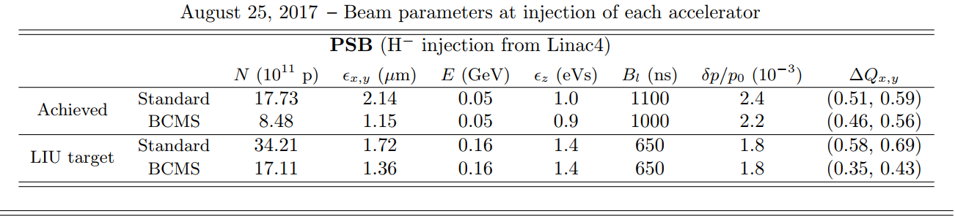
Simulations already performed for LHC beams
V. Forte simulations
  from realistic L4 trains of μ-bunches, NO longitudinal painting, fixed chopping factor at 61% (after optimization), including multi-turn and transverse/longitudinal space charge at PSB injection
  “pencil beam” with injection offset at 3.40e12 ppb, 40 mA before chopping (23 turns).
    Emittance sensitivity simulations with space charge after 10 ms from injection suggest max 3 mm of injection offset to reach 1.2 um
Studies assuming 23mA current before chopping (40 turns for standard HL-LHC beams) with imperfections (optics, steering, BSW fringe fields, etc.) for HL-LHC standard and BCMS beams (from injection to extraction) to be performed.
~3 mm
~3 mm

Slide 4
Achievable intensities with 25 mA* at PSB
User | Description | Intensity per ring | # turns (65% Chopping Factor) | # turns with 5 % losses in the PSB | Painting
LHC BCMS | BCMS | 1.70E12 | 11 | 12 | No
LHC25 Standard | 25 ns LHC single batch | 3.40E12 | 22 | 23 | No
LHCPILOT | LHC pilot | 5.00E9 | 1 | 1 | No
SFTPRO | SPS fixed target | 6.00E12 | 38 | 40 | Yes
AD | AD target | 4.00E12 | 26 | 27 | Yes
TOF | nTOF | 9.00E12 | 58 | 60 | Yes
EASTA/B/C | PS East area | 4.50E11 | 3 | 3 | No
NORMGPS | ISOLDE GPS | 1.00E13 | 64 | 67 | Yes
NORMHRS | ISOLDE HRS | 1.60E13 | 102 | 108 | Yes
STAGISO | ISOLDE special targets | 3.50E12 | 22 | 24 | Yes
* after 65% chopping factor

Slide 5
Achievable intensities with 15 mA* at PSB
User | Description | Intensity per ring | # turns | # turns with 5 % losses in the PSB | Painting
LHC BCMS | BCMS | 1.70E12 | 18 | 19 | No
LHC25 Standard | 25 ns LHC single batch | 3.40E12 | 36 | 38 | No
LHCPILOT | LHC pilot | 5.00E9 | 1 | 1 | No
SFTPRO | SPS fixed target | 6.00E12 | 64 | 67 | Yes
AD | AD target | 4.00E12 | 43 | 45 | Yes
TOF | nTOF | 9.00E12 | 96 | 101 | Yes
EASTA/B/C | PS East area | 4.50E11 | 5 | 5 | No
NORMGPS | ISOLDE GPS | 1.00E13 | 107 | 112 | Yes
NORMHRS | ISOLDE HRS | 1.60E13 | 171** | 179** | Yes
STAGISO | ISOLDE special targets | 3.50E12 | 37 | 39 | Yes
Possible new study: agree on 1 realistic pulse shape (length and flatness) with optics and steering errors ➔ evaluate impact on integrated intensity and balance between rings
* after 65% chopping factor
** DIS limit = 150 us so maximum intensity 1.34E13 ppr

Slide 7
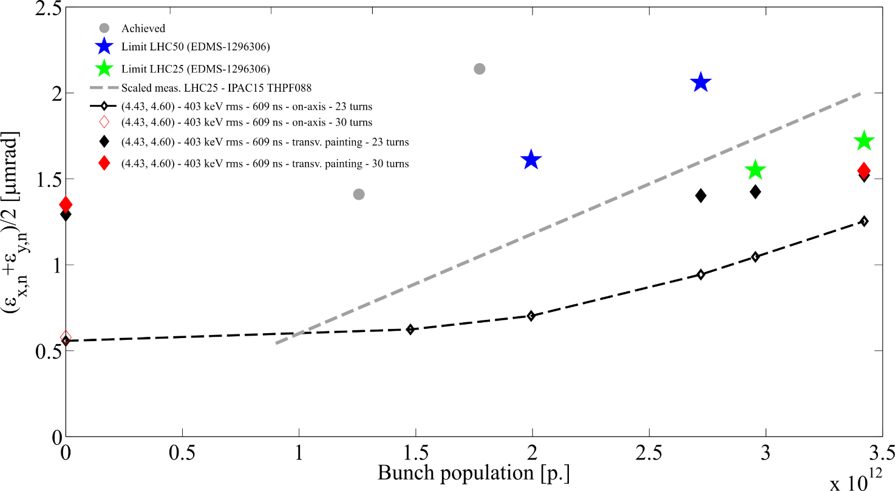
Simulations including space charge (PSB injection process)
V. Forte simulations
  from realistic L4 trains of μ-bunches, NO longitudinal painting, fixed chopping factor at 61% (after optimization), including multi-turn and transverse/longitudinal space charge at PSB injection
  with and without painting functions
  Ph.D. thesis (40 mA before chopping) plus more data points (30 mA before chopping) after A. Lombardi request (presented at LIU/HL-LHC Joint Meeting in 2015)
    ~10% emittance increase at 3.4e12 p → still fine for LHC25 Standard LIU target emittance (ε_{x,y,n}= 1.7 um)
    23 mA before chopping (~40 turns should be fully simulated with optics mismatch and steering errors)

