Slide 1

What do we need for the collaring of the 11T dipole series collared coils?
F. Savary on behalf of WP11
Friday afternoon meeting – CERN 180/1-N51 – 2018-02-16

Slide 2
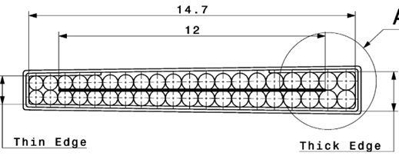
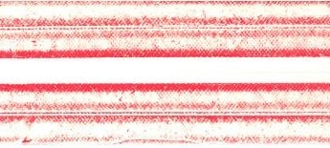
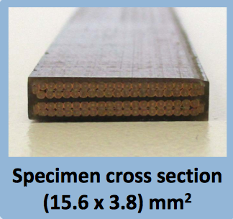
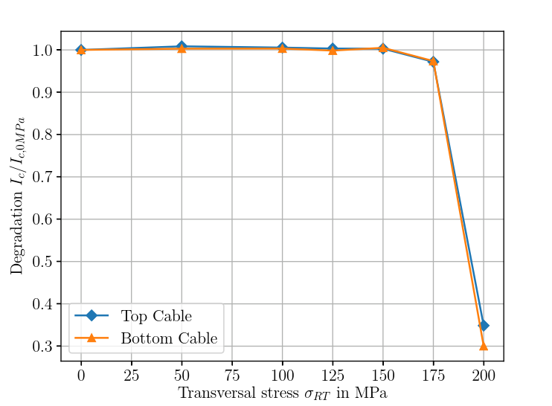
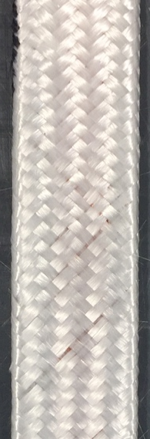
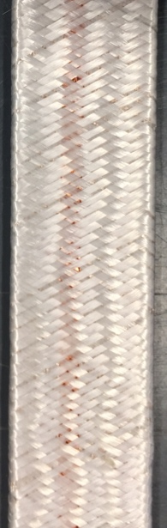
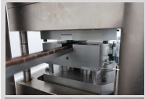

Allowable stress on cable
Irreversible degradation on final cable with final insulation scheme
3 types of samples
  No MICA
  MICA 25 mm wide
  MICA 31 mm wide
Role of MICA, as stress concentrator
Optimization of Fiber Glass braiding para-meters to reduce thickness of insulation
6.9 mm
0.9 mm
$$σallowable$$
Local
Till end 2017
New insulation scheme
Parameter | All coils till end 2017 | New models & Series production
Cable width, mm | 14.7 | 14.7
Cable thickness, mm | 1.25 | 1.25
Mica width, mm | 25 | 31
Gap, mm | 6.9 | 0.9
Gap/cable width, % | 50 | 6
Gap/cable thickness, -- | 5.5 | 0.7
Insulation thickness @ 5 MPa | 135 | 100
Test sample made of conductor RRP 144/169, NO Mica
Courtesy P. Ebermann, J. Fleiter, F. Wolf

Slide 3
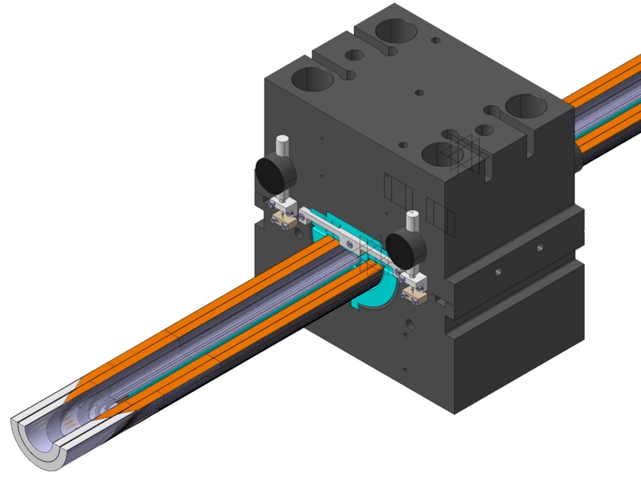
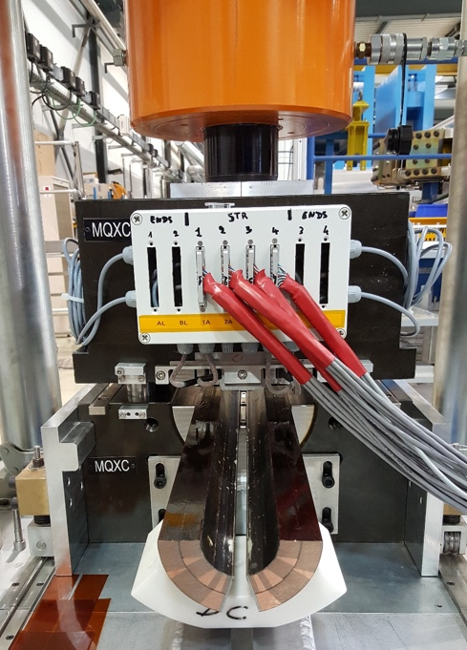
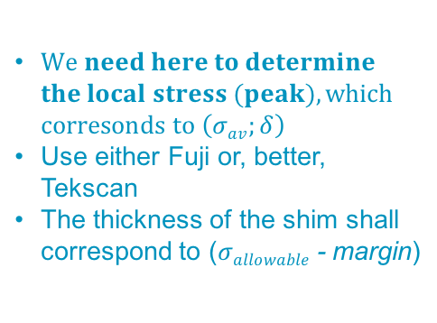

E-modulus measurements on full coil X-section
$$\left(σav;δ\right)$$
$We need here to determine$
$the local stress (peak), which$
$corresonds to \left(σav;δ\right)$
Use either Fuji or, better, Tekscan
The thickness of the shim shall correspond to ($σallowable$- margin)
Courtesy J.L. Rudeiros Fernandez, S. Ferradas

Slide 4
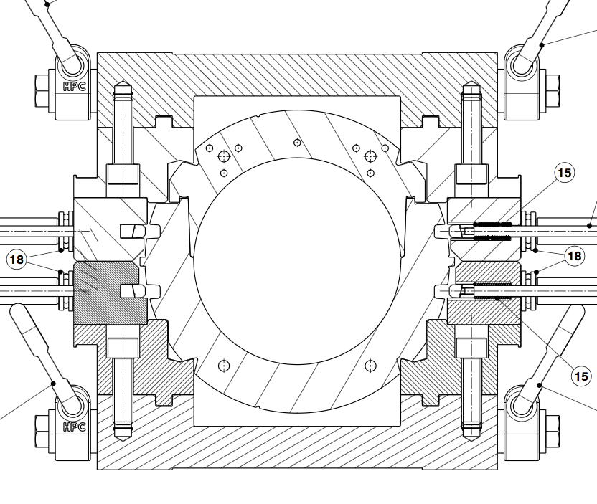
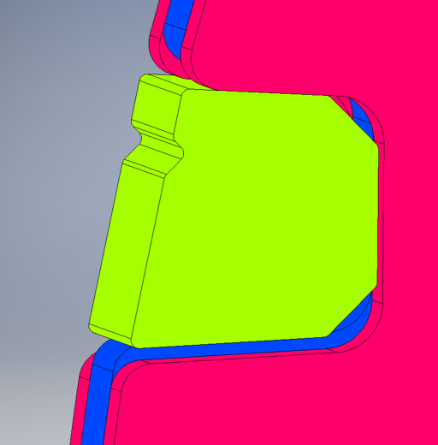
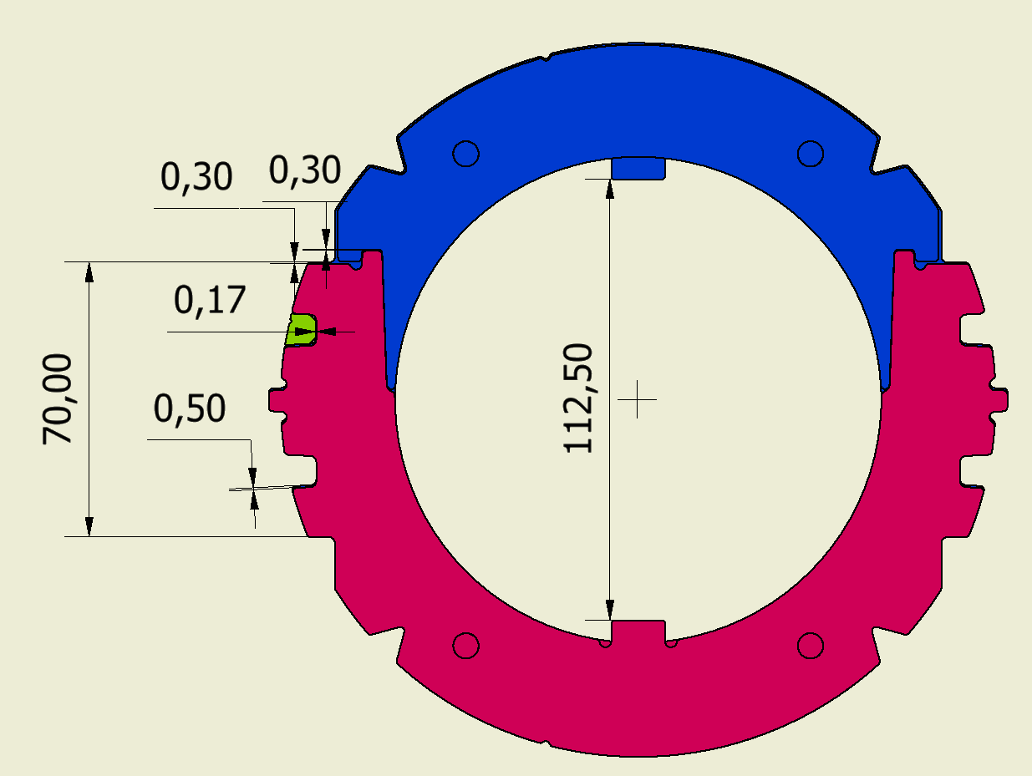
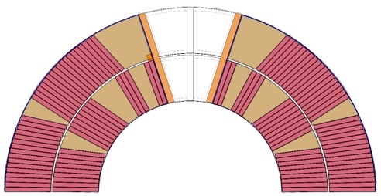
Collaring
Stopper height, or collaring tooling shim, and F_{COLLARING}
such that:
  Keys can be inserted successfully at minimum collaring force
  Coil stress at full collaring force < allowable stress
  (w.r.t. irreversible degradation)
  Spring back as small as possible
F_{COLLARING} = F_{COILS} + F_{TOOLING}
F_{COLLARING}
F_{COILS}
F_{TOOLING}
Stopper height
How do we use the E-modulus measurements to control the collaring process?
Collaring tooling
shim

Slide 5
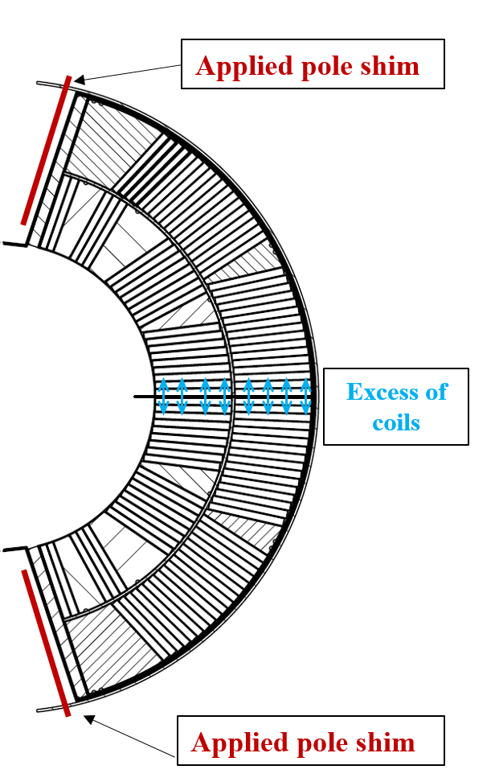
Shimming of magnet models
The pre-stress depends on the sum of the azimuthal oversize of the coils with the thickness of the pole shims (… and also on the mechanical properties of the coil)
Excessive stress!
Stress ok
But ?
Revised collaring procedure
11 T coil branch
(DP101)
Average inner layer azimuthal stresses @ 12 T
Midplane turn | -147 MPa
Pole turn | -29 MPa
Midplane turn | -127 MPa
Pole turn | -7 MPa
Courtesy C. Löffler, E. Nilsson
Notes:
Comment on corresponding average pre stress
Add SP101 and SP106

Slide 6
Collaring mock-up
Determine Excess, i.e. shim, such that local stress at mid-plane stays below allowable for the largest coil, first in the E-modulus press, and then in the collaring mock-up
Check that, for the smallest coil, stress level is still reasonable (not too low), first in the E-modulus press, and then in the collaring mock-up
h
H
 | Step 1 | Step 2 | Step 3 | Step 4
 | No coil No load Keys inserted | Coil No load No key | Coil Collaring load Keys inserted | Coil Collared Keys inserted
Coil height | H | H + Excess | H | H + Spring back
Key slot height | h | h + Excess | h | ≈ h
Key to slot Gap | G | G - Excess | G | ≈ G

Slide 7
In production
Shimming plan based on collaring mock-up made of coil segments cut from coil 118, not anymore on FEM analysis
Variations of E-modulus acceptable, if margin on allowable stress is sufficient (or can be made sufficient)
Variations of coil size at rest (no compression) can be compensated by changing the thickness of the shim determined by E-modulus measurements and mock-up tests
Collaring process controlled in displacement (not in load / pressure, and there is no mechanical instrumentation), and collaring cavity shall be closed

Slide 8
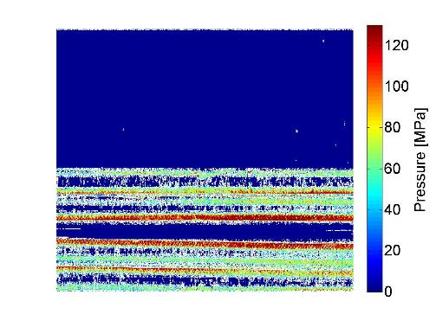
Locations of limitations – Hint 1
Mid-plane
Model | Limit @ 1.9 K [kA] / Location | I/I_{SS} [%] | Limit @ 4.5 K [kA] / Location | I/I_{SS} [%]
SP101 | 11.9 / 107 / O1-O2 (head) | 82 | 11.2 / 107 / O2-O3 (transition) | 86
SP102 | >12.8 | >88 | 11.7 / 106 / layer jump | 90
SP103 | >12.8 | >90 | 11.7 / 111 / layer jump | 92
DP101 | 13.2 / mid-plane | 94 | - | -
SP104 | 12.3 / mid-plane | 85 | 11.4 / mid-plane | 87
SP105 | 12.4 / mid-plane | 84 | 11.3 / mid-plane | 84
DP102 | 11.4 / mid-plane | 80 | 10.4 / mid-plane | 77
SP106 | 12.6 / 1 location (straight part, close to lead end, in turns close to pole) | 85 | 11.4 / 4 different locations | 84
Collaring tests with Fuji paper in the mid-plane have revealed peak stresses along the edges of the cable, not predicted by FEA
Mica tape
OL
IL
IL
OL
120 MPa stress gradient on the mid-plane in MBHSP105b
Courtesy G. Willering, S. Izquierdo Bermudez

Slide 9
V-I Curves in aperture 1 of MBHDP102 – Hint 2
Accurate superconducting to normal transition with a low n-value in 4 out of 8 midplane segments (2 in Ap. 1 and 2 in Ap. 2)
Coil 112
20 µV at 13000 A
No hysteresis between ramp up and ramp down
Scales with temperature from 1.9 K to 4.3 K
Reaches 1 hour stable 18 µV before/without quench
20 µV at 11400 A
Coil 109
No decay on current plateau
All this suggests possible (homogeneous) degradation of strands
Courtesy G. Willering

Slide 10
Task Force on 11T Dipole Magnet
Optimized collaring process
2
Role of Mica in insulation & Fiber Glass braiding on insulation thickness
3
E-modulus on ten-stacks, and on coils
1
Irreversible degradation
Allowable stress
4
Collaring mock-ups and instrumentation
5
QA, harmonization of fabrication and QC procedures between long & short coils
6
Fabrication of 2 magnet models with final conductor & insulation scheme, including cold tests
Scheduling
Links with series production, in particular the collaring operation

Slide 11
Task Force on 11T Dipole Magnet – Task 4
Collaring procedure
Stopper height, or collaring tooling shim, and F_{COLLARING}
such that:
  Keys can be inserted successfully at minimum collaring force
  Coil stress at full collaring force < allowable stress
  (w.r.t. irreversible degradation)
  Spring back as small as possible
F_{COLLARING} = F_{COILS} + F_{TOOLING}
F_{COLLARING}
F_{COILS}
F_{TOOLING}
Stopper height
SP Model | Collaring tooling shim | Stopper height | Key clearance
 | 0 μm | 69.7 mm | +300 μm
 | 100 μm | 69.8 mm | +200 μm
 | 200 μm | 69.9 mm | +100 μm
 | 300 μm | 70.0 mm | 0
101,102,103 | 400 μm | 70.1 mm | -100 μm
104,105,106 | 150 μm | 69.85 mm | +150 μm
Collaring tooling
shim

Slide 12
Training performance @ 1.9K
MBHSM101 not shown, as it cannot be directly compared
I_{ULT.} = 12.80 kA
I_{ULT.} = 12.80 kA
I_{NOM.} = 11.85 kA
I_{NOM.} = 11.85 kA
Very good results on two single aperture models, SP102 & SP103, and first two-in-one DP101
Limitations for the other models SP101, SP104, SP105, SP106, and second two-in-one DP102
Action: understand the reason(s) for the limitations, and consolidate the manufacturing procedures, in particular the collaring operation, in order to guarantee sufficient operation margin
Courtesy G. Willering

